Slide 1
Hybrid Cloud and Cluster Computing Paradigms for Scalable Data Intensive Applications
April 15, 2011 University of Alabama
Judy Qiu
xqiu@indiana.edu
http://salsahpc.indiana.edu
School of Informatics and Computing
Indiana University
Notes:
SALSA is
Service Aggregated Linked Sequential Activities

Slide 2
Challenges for CS Research
Science faces a data deluge. How to manage and analyze information?
Recommend CSTB foster tools for data capture, data curation, data analysis
―Jim Gray’s
Talk to Computer Science and Telecommunication Board (CSTB), Jan 11, 2007
There’re several challenges to realizing the vision on data intensive systems and building generic tools (Workflow, Databases, Algorithms, Visualization ).
Cluster-management software
Distributed-execution engine
Language constructs
Parallel compilers
Program Development tools
. . .

Slide 3
Important Trends
  In all fields of science and throughout life (e.g. web!)
  Impacts preservation, access/use, programming model
    new commercially supported data center model building on compute grids
Data Deluge
Cloud Technologies
Multicore/
Parallel Computing
eScience
  Implies parallel computing important again
    Performance from extra cores – not extra clock speed
  A spectrum of eScience or eResearch applications (biology, chemistry, physics social science and
  humanities …)
  Data Analysis
  Machine learning

Slide 4
Data Explosion and Challenges
Data Deluge
Cloud Technologies
Multicore/
Parallel Computing
eScience

Slide 5
Data We’re Looking at
  Public Health Data (IU Medical School & IUPUI Polis Center)
  (65535 Patient/GIS records / over 100 dimensions)
  Biology DNA sequence alignments (IU Medical School & CGB)
  (1 billion Sequences / at least 300 to 400 base pair each)
  NIH PubChem (Cheminformatics)
  (60 million chemical compounds/166 fingerprints each)
  Particle physics LHC (Caltech)
  (1 Terabyte data placed in IU Data Capacitor)
High volume and high dimension require new efficient computing approaches!

Slide 6
Data Explosion and Challenges
Data is too big and gets bigger to fit into memory
For “All pairs” problem O(N²),
PubChem data points 100,000 => 480 GB of main memory
(Tempest Cluster of 768 cores has 1.536TB)
We need to use distributed memory and new algorithms to solve the problem
Communication overhead is large as main operations include matrix multiplication (O(N²)), moving data between nodes and within one node adds extra overheads
We use hybrid mode of MPI between nodes and concurrent threading internal to node on multicore clusters
Concurrent threading has side effects (for shared memory model like CCR and OpenMP) that impact performance
sub-block size to fit data into cache
cache line padding to avoid false sharing

Slide 7
Cloud Services and MapReduce
Data Deluge
Cloud Technologies
Multicore/
Parallel Computing
eScience

Slide 8
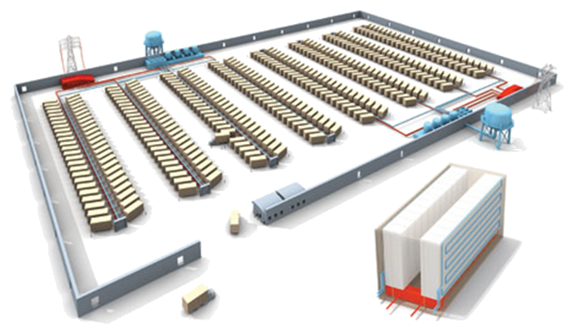
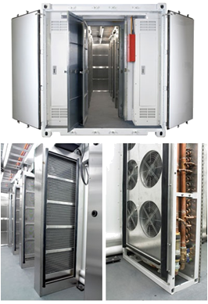
Clouds as Cost Effective Data Centers
Builds giant data centers with 100,000’s of computers; ~ 200-1000 to a shipping container with Internet access
“Microsoft will cram between 150 and 220 shipping containers filled with data center gear into a new 500,000 square foot Chicago facility. This move marks the most significant, public use of the shipping container systems popularized by the likes of Sun Microsystems and Rackable Systems to date.”
―News Release from Web

Slide 9
Clouds hide Complexity
Cyberinfrastructure
Is “Research as a Service”
SaaS: Software as a Service
(e.g. Clustering is a service)
PaaS: Platform as a Service
IaaS plus core software capabilities on which you build SaaS
(e.g. Azure is a PaaS; MapReduce is a Platform)
IaaS (HaaS): Infrasturcture as a Service
(get computer time with a credit card and with a Web interface like EC2)

Slide 10

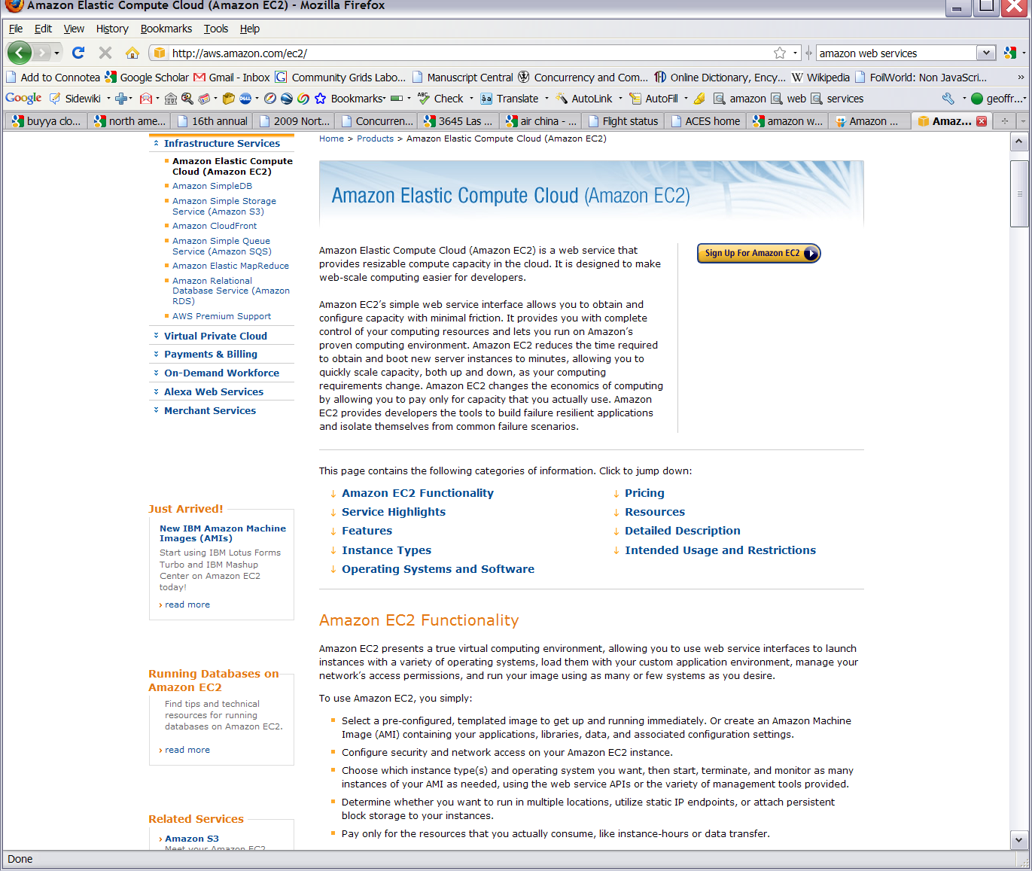









Commercial Cloud
+ Academic Cloud
Software

Slide 11
MapReduce
A parallel Runtime coming from Information Retrieval
Data Partitions
Map(Key, Value)
A hash function maps the results of the map tasks to r reduce tasks
Reduce(Key, List<Value>)
Reduce Outputs
Implementations support:
  Splitting of data
  Passing the output of map functions to reduce functions
  Sorting the inputs to the reduce function based on the intermediate keys
  Quality of services

Slide 12


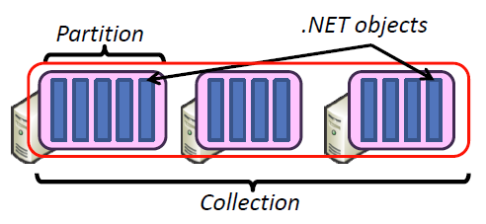
Hadoop & DryadLINQ
Apache Hadoop
Microsoft DryadLINQ
Master Node
Data/Compute Nodes
Standard LINQ operations
Job
Tracker
M
M
M
M
DryadLINQ operations
R
R
R
R
DryadLINQ Compiler
Name
Node
HDFS
Data
blocks
Directed Acyclic Graph (DAG) based execution flows
1
2
Vertex :
execution task
2
3
3
4
Edge :
communication path
Dryad Execution Engine
Apache Implementation of Google’s MapReduce
Hadoop Distributed File System (HDFS) manage data
Map/Reduce tasks are scheduled based on data locality in HDFS (replicated data blocks)
Dryad process the DAG executing vertices on compute clusters
LINQ provides a query interface for structured data
Provide Hash, Range, and Round-Robin partition patterns
  Job creation; Resource management; Fault tolerance& re-execution of failed taskes/vertices

Slide 13

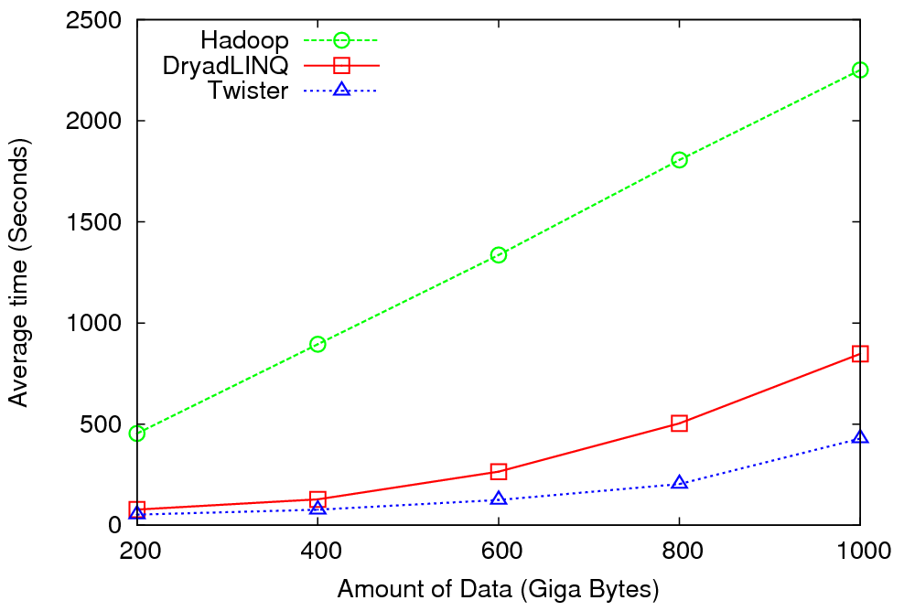
High Energy Physics Data Analysis
An application analyzing data from Large Hadron Collider (1TB but 100 Petabytes eventually)
Input to a map task: <key, value>
key = Some Id value = HEP file Name
Output of a map task: <key, value>
key = random # (0<= num<= max reduce tasks)
value = Histogram as binary data
Input to a reduce task: <key, List<value>>
key = random # (0<= num<= max reduce tasks)
value = List of histogram as binary data
Output from a reduce task: value
value = Histogram file
Combine outputs from reduce tasks to form the final histogram

Slide 14

Reduce Phase of Particle Physics
“Find the Higgs” using Dryad
Higgs in Monte Carlo
Combine Histograms produced by separate Root “Maps” (of event data to partial histograms) into a single Histogram delivered to Client
This is an example using MapReduce to do distributed histogramming.

Slide 15


Applications using Dryad & DryadLINQ
CAP3 - Expressed Sequence Tag assembly to re-construct full-length mRNA
Input files (FASTA)
DryadLINQ
CAP3
CAP3
CAP3
Output files
Perform using DryadLINQ and Apache Hadoop implementations
Single “Select” operation in DryadLINQ
“Map only” operation in Hadoop
X. Huang, A. Madan, “CAP3: A DNA Sequence Assembly Program,” Genome Research, vol. 9, no. 9, pp. 868-877, 1999.

Slide 16
Architecture of EC2 and Azure Cloud for Cap3
HDFS
Input Data Set
Data File
exe
exe
Map()
Map()
Executable
Optional
Reduce
Phase
Reduce
HDFS
Results

Slide 17
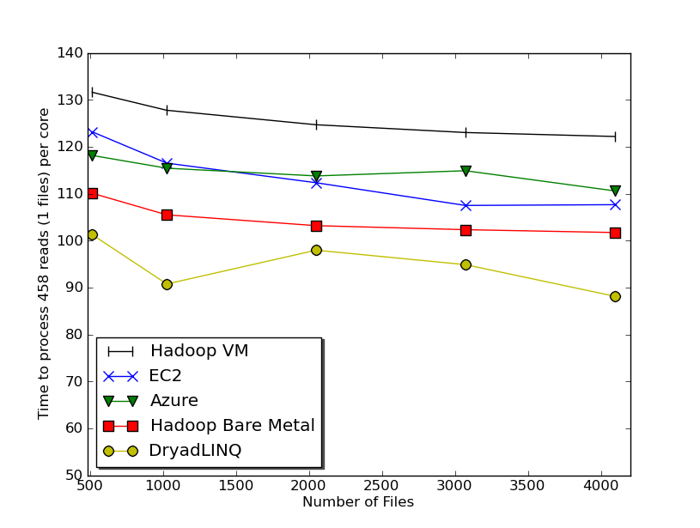

Usability and Performance of Different Cloud Approaches
Cap3 Performance
Cap3 Efficiency
Ease of Use – Dryad/Hadoop are easier than EC2/Azure as higher level models
Lines of code including file copy
  Azure : ~300 Hadoop: ~400 Dyrad: ~450 EC2 : ~700
Efficiency = absolute sequential run time / (number of cores * parallel run time)
Hadoop, DryadLINQ - 32 nodes (256 cores IDataPlex)
EC2 - 16 High CPU extra large instances (128 cores)
Azure- 128 small instances (128 cores)

Slide 18
Data Intensive Applications
Data Deluge
Cloud Technologies
Multicore
eScience

Slide 19
Some Life Sciences Applications
EST (Expressed Sequence Tag) sequence assembly program using DNA sequence assembly program software CAP3.
Metagenomics and Alu repetition alignment using Smith Waterman dissimilarity computations followed by MPI applications for Clustering and MDS (Multi Dimensional Scaling) for dimension reduction before visualization
Mapping the 60 million entries in PubChem into two or three dimensions to aid selection of related chemicals with convenient Google Earth like Browser. This uses either hierarchical MDS (which cannot be applied directly as O(N²)) or GTM (Generative Topographic Mapping).
Correlating Childhood obesity with environmental factors by combining medical records with Geographical Information data with over 100 attributes using correlation computation, MDS and genetic algorithms for choosing optimal environmental factors.

Slide 20



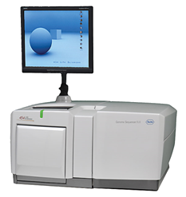
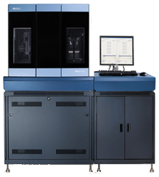
DNA Sequencing Pipeline
MapReduce
Pairwise
clustering
Sequence
alignment
Dissimilarity
Matrix
N(N-1)/2 values
Visualization
Plotviz
FASTA File
N Sequences
Blocking
block
Pairings
MPI
MDS
Read Alignment
This chart illustrate our research of a pipeline mode to provide services on demand (Software as a Service SaaS)
User submit their jobs to the pipeline. The components are services and so is the whole pipeline.
Illumina/Solexa Roche/454 Life Sciences Applied Biosystems/SOLiD
Internet
Modern Commerical Gene Sequences

Slide 21
Alu and Metagenomics Workflow
“All pairs” problem
Data is a collection of N sequences. Need to calcuate N² dissimilarities (distances) between sequnces (all pairs).
  These cannot be thought of as vectors because there are missing characters
  “Multiple Sequence Alignment” (creating vectors of characters) doesn’t seem to work if N larger than O(100), where 100’s of characters long.
Step 1: Can calculate N² dissimilarities (distances) between sequences
Step 2: Find families by clustering (using much better methods than Kmeans). As no vectors, use vector free O(N²) methods
Step 3: Map to 3D for visualization using Multidimensional Scaling (MDS) – also O(N²)
Results:
N = 50,000 runs in 10 hours (the complete pipeline above) on 768 cores
Discussions:
Need to address millions of sequences …..
Currently using a mix of MapReduce and MPI
Twister will do all steps as MDS, Clustering just need MPI Broadcast/Reduce

Slide 22


Biology MDS and Clustering Results
Alu Families
This visualizes results of Alu repeats from Chimpanzee and Human Genomes. Young families (green, yellow) are seen as tight clusters. This is projection of MDS dimension reduction to 3D of 35399 repeats – each with about 400 base pairs
Metagenomics
This visualizes results of dimension reduction to 3D of 30000 gene sequences from an environmental sample. The many different genes are classified by clustering algorithm and visualized by MDS dimension reduction

Slide 23

All-Pairs Using DryadLINQ
125 million distances
4 hours & 46 minutes
Calculate Pairwise Distances (Smith Waterman Gotoh)
Calculate pairwise distances for a collection of genes (used for clustering, MDS)
Fine grained tasks in MPI
Coarse grained tasks in DryadLINQ
Performed on 768 cores (Tempest Cluster)
Moretti, C., Bui, H., Hollingsworth, K., Rich, B., Flynn, P., & Thain, D. (2009). All-Pairs: An Abstraction for Data Intensive Computing on Campus Grids. IEEE Transactions on Parallel and Distributed Systems , 21, 21-36.

Slide 24
Hadoop/Dryad Comparison
Inhomogeneous Data I
Inhomogeneity of data does not have a significant effect when the sequence lengths are randomly distributed
Dryad with Windows HPCS compared to Hadoop with Linux RHEL on Idataplex (32 nodes)

Slide 25
Hadoop/Dryad Comparison
Inhomogeneous Data II
This shows the natural load balancing of Hadoop MR dynamic task assignment using a global pipe line in contrast to the DryadLinq static assignment
Dryad with Windows HPCS compared to Hadoop with Linux RHEL on Idataplex (32 nodes)

Slide 26
Hadoop VM Performance Degradation
Perf. Degradation = (T_{vm} – T_{baremetal})/T_{baremetal}
15.3% Degradation at largest data set size

Slide 27
Parallel Computing and Software
Data Deluge
Cloud Technologies
Parallel Computing
eScience

Slide 28
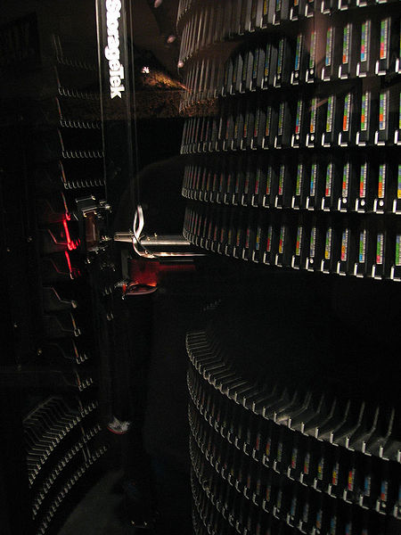
Motivation
Data Deluge
MapReduce
Classic Parallel Runtimes (MPI)
Data Centered, QoS
Efficient and Proven techniques
Experiencing in many domains
Expand the Applicability of MapReduce to more classes of Applications
Iterative MapReduce
Map-Only
MapReduce
More Extensions
iterations
Input
Input
Input
map
map
map
Pij
reduce
reduce
Output

Slide 29


Twister
(Iterative MapReduce)
Pub/Sub Broker Network
Map Worker
M
Streaming based communication
Intermediate results are directly transferred from the map tasks to the reduce tasks – eliminates local files
Cacheable map/reduce tasks
  Static data remains in memory
Combine phase to combine reductions
User Program is the composer of MapReduce computations
Extends the MapReduce model to iterative computations
Worker Nodes
R
Reduce Worker
D
D
MR
Driver
User
Program
M
M
M
M
D
MRDeamon
R
R
R
R
Data Read/Write
Communication
Data Split
File System
Iterate
Static
data
Configure()
User Program
Map(Key, Value)
δ flow
Reduce (Key, List<Value>)
Combine (Key, List<Value>)
Different synchronization and intercommunication mechanisms used by the parallel runtimes
Close()

Slide 30
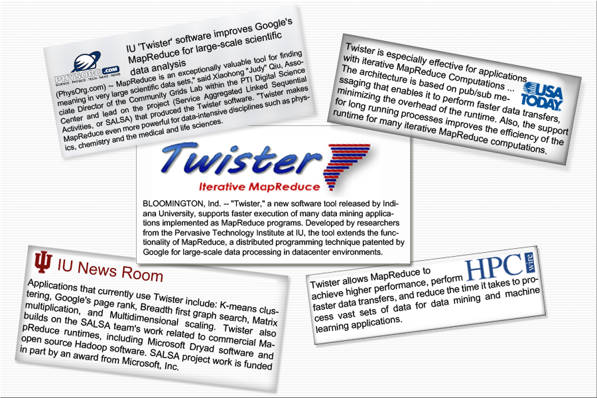
Twister New Release

Slide 31


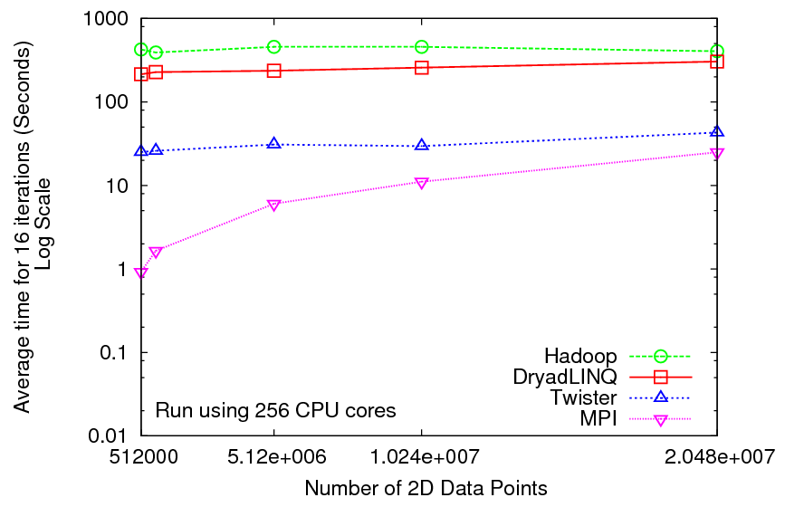
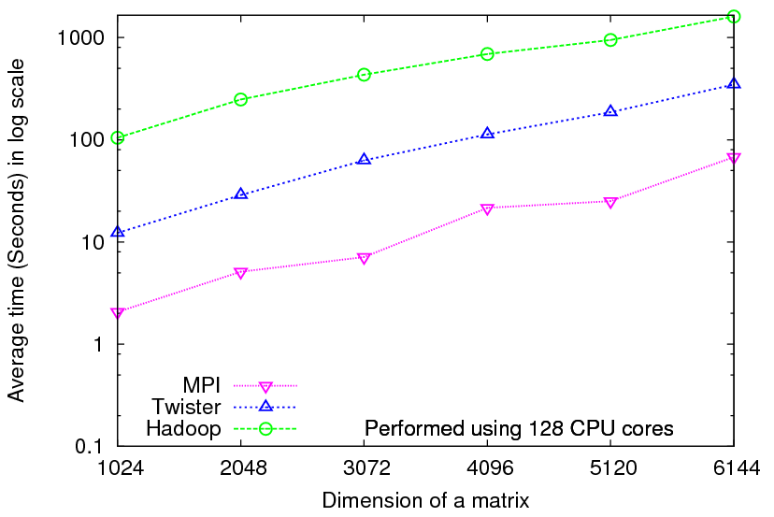
Iterative Computations
K-means
Matrix Multiplication
Performance of K-Means
Parallel Overhead Matrix Multiplication

Slide 32
Next Generation Sequencing Pipeline on Cloud
MapReduce
Pairwise
clustering
FASTA File
N Sequences
block
Pairings
Pairwise
Distance
Calculation
Dissimilarity
Matrix
N(N-1)/2 values
Clustering
Visualization
Plotviz
Blast
Visualization
Plotviz
MPI
1
2
3
MDS
4
5
4
Users submit their jobs to the pipeline and the results will be shown in a visualization tool.
This chart illustrate a hybrid model with MapReduce and MPI. Twister will be an unified solution for the pipeline mode.
The components are services and so is the whole pipeline.
We could research on which stages of pipeline services are suitable for private or commercial Clouds.

Slide 33

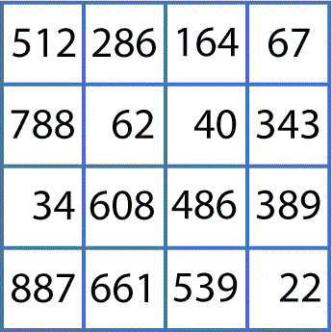
Scale-up Sequence Clustering Model with Twister
Gene Sequences (N = 1 Million)
Pairwise Alignment & Distance Calculation
O(N²)
Select Reference
Reference Sequence Set (M = 100K)
Distance Matrix
Reference Coordinates
N - M Sequence Set (900K)
Interpolative MDS with Pairwise Distance Calculation
x, y, z
Multi-Dimensional Scaling (MDS)
O(N²)
O(N²)
N - M Coordinates
x, y, z
Visualization
3D Plot

Slide 34
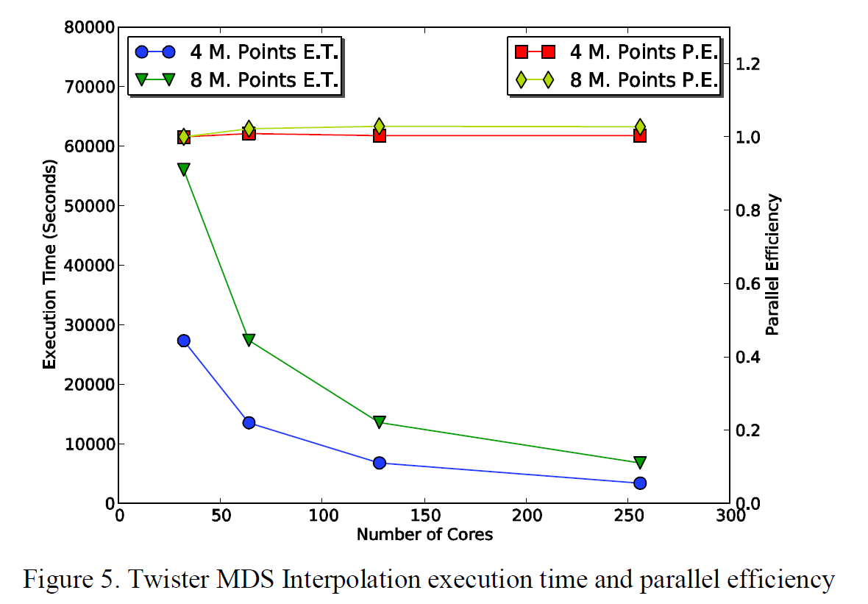
Twister MDS Interpolation Performance Test

Slide 35
Parallel Computing and Algorithms
Data Deluge
Cloud Technologies
Parallel Computing
eScience

Slide 36
Parallel Data Analysis Algorithms on Multicore
Developing a suite of parallel data-analysis capabilities
  Clustering with deterministic annealing (DA)
  Dimension Reduction for visualization and analysis (MDS, GTM)
  Matrix algebra as needed
    Matrix Multiplication
    Equation Solving
    Eigenvector/value Calculation

Slide 37
High Performance
Dimension Reduction and Visualization
Need is pervasive
  Large and high dimensional data are everywhere: biology, physics, Internet, …
  Visualization can help data analysis
Visualization of large datasets with high performance
  Map high-dimensional data into low dimensions (2D or 3D).
  Need Parallel programming for processing large data sets
  Developing high performance dimension reduction algorithms:
    MDS(Multi-dimensional Scaling), used earlier in DNA sequencing application
    GTM(Generative Topographic Mapping)
    DA-MDS(Deterministic Annealing MDS)
    DA-GTM(Deterministic Annealing GTM)
  Interactive visualization tool PlotViz
We are supporting drug discovery by browsing 60 million compounds in PubChem database with 166 features each

Slide 38
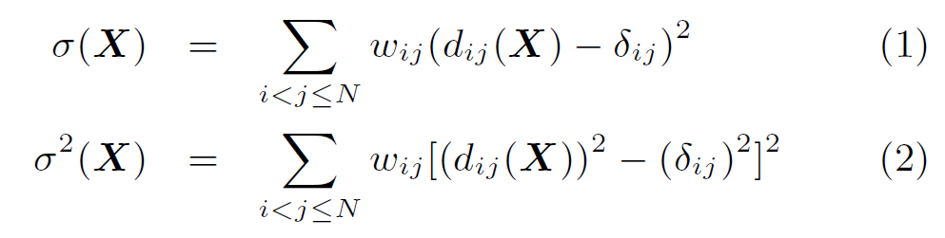

Dimension Reduction Algorithms
Multidimensional Scaling (MDS) [1]
  Given the proximity information among points.
  Optimization problem to find mapping in target dimension of the given data based on pairwise proximity information while minimize the objective function.
  Objective functions: STRESS (1) or SSTRESS (2)
  Only needs pairwise distances δ_{ij} between original points (typically not Euclidean)
  d_{ij}(X) is Euclidean distance between mapped (3D) points
Generative Topographic Mapping
(GTM) [2]
  Find optimal K-representations for the given data (in 3D), known as
  K-cluster problem (NP-hard)
  Original algorithm use EM method for optimization
  Deterministic Annealing algorithm can be used for finding a global solution
  Objective functions is to maximize log-likelihood:
[1] I. Borg and P. J. Groenen. Modern Multidimensional Scaling: Theory and Applications. Springer, New York, NY, U.S.A., 2005.
[2] C. Bishop, M. Svens´en, and C. Williams. GTM: The generative topographic mapping. Neural computation, 10(1):215–234, 1998.

Slide 39
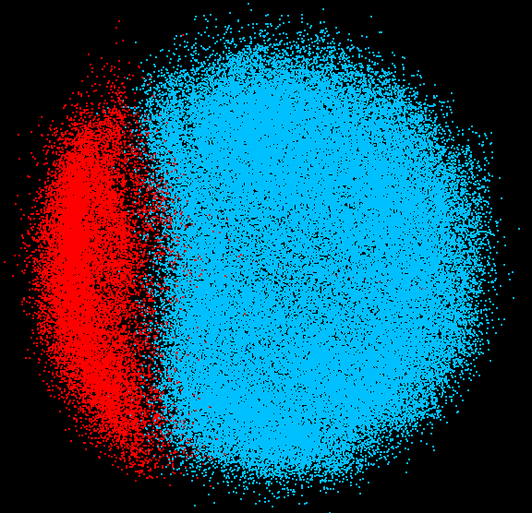
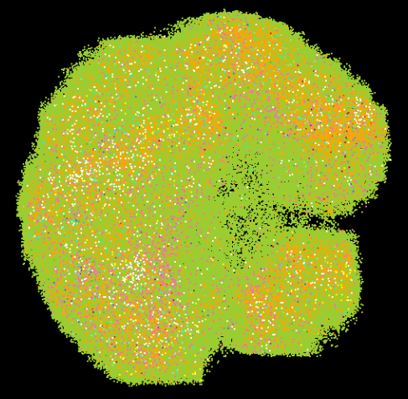
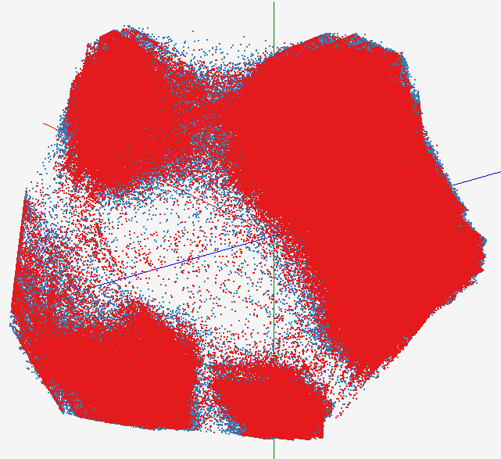
High Performance Data Visualization..
First time using Deterministic Annealing for parallel MDS and GTM algorithms to visualize large and high-dimensional data
Processed 0.1 million PubChem data having 166 dimensions
Parallel interpolation can process 60 million PubChem points
GTM with interpolation for
2M PubChem data
2M PubChem data is plotted in 3D with GTM interpolation approach. Blue points are 100k sampled data and red points are 2M interpolated points.
MDS for 100k PubChem data
100k PubChem data having 166 dimensions are visualized in 3D space. Colors represent 2 clusters separated by their structural proximity.
GTM for 930k genes and diseases
Genes (green color) and diseases (others) are plotted in 3D space, aiming at finding cause-and-effect relationships.
PubChem project, http://pubchem.ncbi.nlm.nih.gov/

Slide 40
Interpolation Method
MDS and GTM are highly memory and time consuming process for large dataset such as millions of data points
MDS requires O(N²) and GTM does O(KN) (N is the number of data points and K is the number of latent variables)
Training only for sampled data and interpolating for out-of-sample set can improve performance
Interpolation is a pleasingly parallel application
n
in-sample
Training
Trained data
N-n
out-of-sample
Interpolated
MDS/GTM map
Interpolation
Total N data

Slide 41
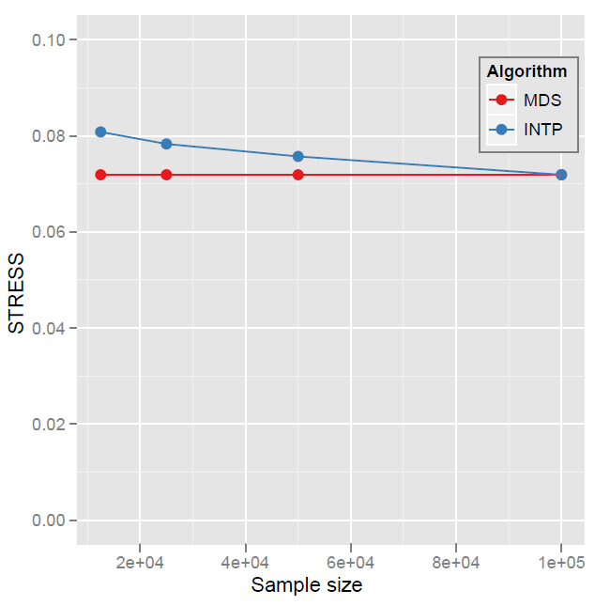
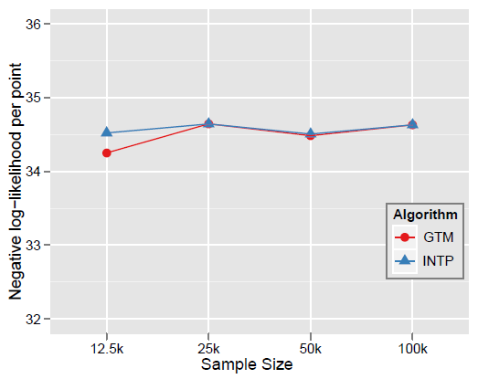

Quality Comparison
(Original vs. Interpolation)
MDS
GTM
Quality comparison between Interpolated result upto 100k based on the sample data (12.5k, 25k, and 50k) and original MDS result w/ 100k.
STRESS:
w_{ij} = 1 / ∑δ_{ij}²
Interpolation result (blue) is getting close to the original (read) result as sample size is increasing.
12.5K 25K 50K 100K Run on 16 nodes of Tempest
Note that we gain performance of over a factor of 100 for this data size. It would be more for larger data set.
Notes:
.

Slide 42
Convergence is Happening
Multicore
Clouds
Data intensive application with basic activities:
capture, curation, preservation, and analysis (visualization)
Data Intensive
Paradigms
Cloud infrastructure and runtime
Parallel threading and processes

Slide 43
Science Cloud (Dynamic Virtual Cluster) Architecture
Smith Waterman Dissimilarities, CAP-3 Gene Assembly, PhyloD Using DryadLINQ, High Energy Physics, Clustering, Multidimensional Scaling, Generative Topological Mapping
Applications
Services and Workflow
Runtimes
Apache Hadoop / Twister/ MPI
Microsoft DryadLINQ / MPI
Linux Bare-system
Linux Virtual Machines
Windows Server 2008 HPC
Bare-system
Windows Server 2008 HPC
Infrastructure software
Xen Virtualization
Xen Virtualization
XCAT Infrastructure
Hardware
iDataplex Bare-metal Nodes
Dynamic Virtual Cluster provisioning via XCAT
Supports both stateful and stateless OS images

Slide 44
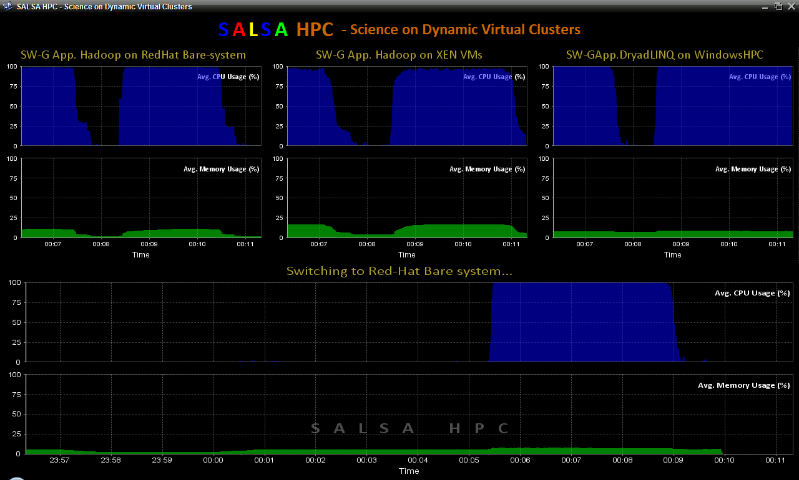
Dynamic Virtual Clusters
Dynamic Cluster Architecture
Monitoring & Control Infrastructure
Monitoring Infrastructure
Monitoring Interface
Pub/Sub Broker Network
SW-G Using Hadoop
SW-G Using Hadoop
SW-G Using DryadLINQ
Linux
Bare-system
Linux on Xen
Windows Server 2008 Bare-system
Virtual/Physical Clusters
Summarizer
XCAT Infrastructure
XCAT Infrastructure
Switcher
iDataplex Bare-metal Nodes
(32 nodes)
iDataplex Bare-metal Nodes
Switchable clusters on the same hardware (~5 minutes between different OS such as Linux+Xen to Windows+HPCS)
Support for virtual clusters
SW-G : Smith Waterman Gotoh Dissimilarity Computation as an pleasingly parallel problem suitable for MapReduce style applications

Slide 45
SALSA HPC Dynamic Virtual Clusters Demo
At top, these 3 clusters are switching applications on fixed environment. Takes ~30 Seconds.
At bottom, this cluster is switching between Environments – Linux; Linux +Xen; Windows + HPCS. Takes about ~7 minutes.
It demonstrates the concept of Science on Clouds using a FutureGrid cluster.

Slide 46
Summary of Initial Results
Cloud technologies (Dryad/Hadoop/Azure/EC2) promising for Biology computations
Dynamic Virtual Clusters allow one to switch between different modes
Overhead of VM’s on Hadoop (15%) acceptable
MapReduce and MPI are SPMD programming model
Twister extends Mapreduce to allows iterative problems (classic linear algebra/datamining) to use MapReduce model efficiently
  K-Means Clustering
  Matrix Multiplication
  Breadth First Search &Pagerank
Intend to implement dataming in the Cloud (Data Analysis Service in the Cloud) and look Twister as a “universal solution”
  Multi Dimensional Scaling (MDS) in various forms
  General Topographical Mapping (GTM)
  Vector and Pairwise Deterministic annealing clustering

Slide 47
Future Work
The support for handling large data sets, the concept of moving computation to data, and the better quality of services provided by cloud technologies, make data analysis feasible on an unprecedented scale for assisting new scientific discovery.
Combine "computational thinking“ with the “fourth paradigm” (Jim Gray on data intensive computing)
Research from advance in Computer Science and Applications (scientific discovery)

Slide 48


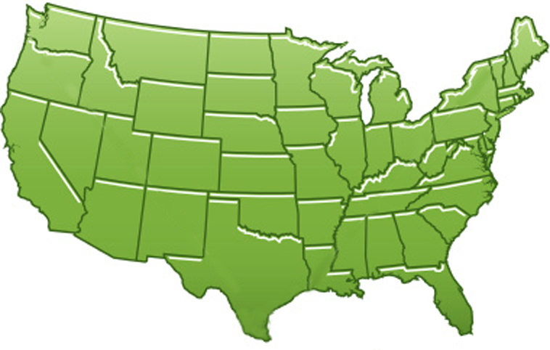















300+ Students learning about Twister & Hadoop
MapReduce technologies, supported by FutureGrid.
July 26-30, 2010 NCSA Summer School Workshop
http://salsahpc.indiana.edu/tutorial
Washington
University
University of
Minnesota
Michigan
State
Johns
Hopkins
Univ.Illinois
at Chicago
Iowa
Penn
State
IBM Almaden
Research Center
Notre
Dame
University of
California at
Los Angeles
Indiana
University
San Diego
Supercomputer
Center
University of
Texas at El Paso
University of
Arkansas
University
of Florida

Slide 49
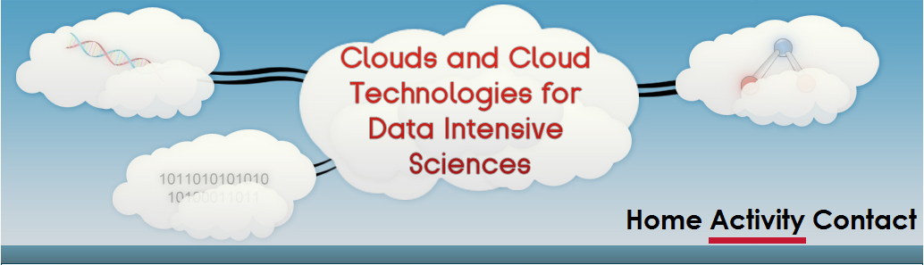
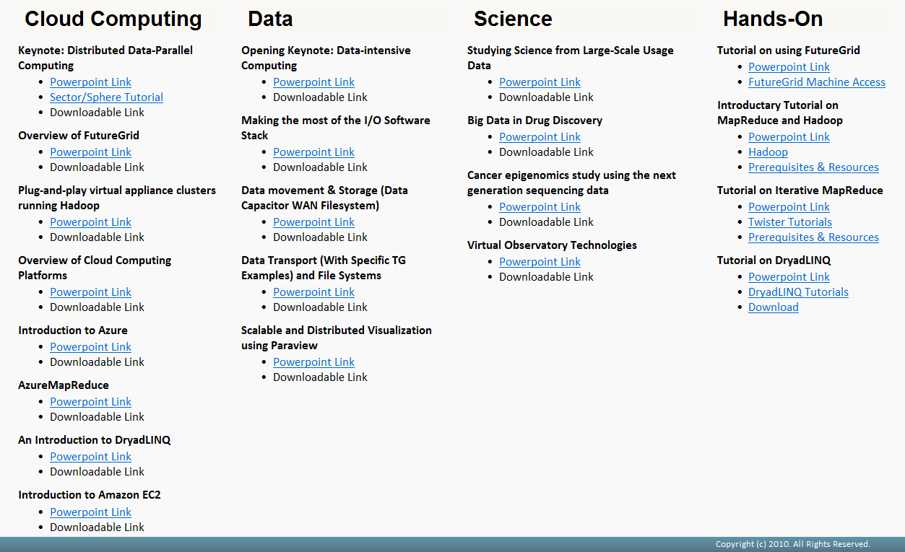

Slide 50
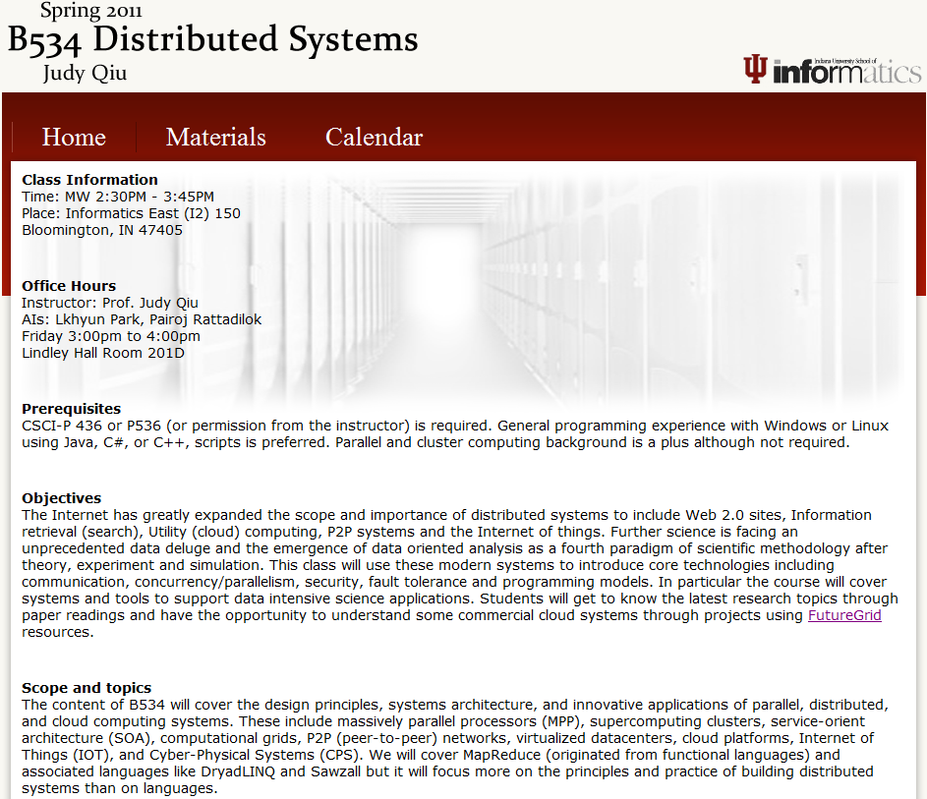

http://salsahpc.indiana.edu/b534/
http://salsahpc.indiana.edu/b649/

Slide 51

A New Book from Morgan Kaufmann Publishers, an imprint of Elsevier, Inc.,
Burlington, MA 01803, USA. (Outline updated August 26, 2010)
Distributed Systems and Cloud Computing
Kai Hwang, Geoffrey Fox, Jack Dongarra

Slide 52
Cloud Technologies and Their Applications
SaaS
Applications/Workflow
Data Mining Services in the Cloud
Smith Waterman Dissimilarities, PhyloD Using DryadLINQ, Clustering, Multidimensional Scaling, Generative Topological Mapping, etc
Higher Level Languages
Apache PigLatin/Microsoft DryadLINQ/Google Sawzall
Cloud Platform
Apache Hadoop / Twister
Microsoft Dryad / Twister
Nimbus, Eucalyptus, OpenStack, OpenNebula
Cloud
Infrastructure
Linux Virtual Machines
Linux Virtual Machines
Windows Virtual Machines
Windows Virtual Machines
Hypervisor/
Virtualization
Xen, KVM
Hardware
Bare-metal Nodes

Slide 53

Yuan Luo, Zhenhua Guo, Yiming Sun, Beth Plale, Judy Qiu, Wilfred Li,
A Hierarchical Framework for Cross-Domain MapReduce,
accepted to the 2nd International Emerging Computational Methods for the Life Sciences Workshop (ECMLS 2011) of ACM High Performance Distributed Computing (HPDC) Conference.

Slide 54

Andrew J. Younge, Robert Henschel, James T. Brown, Gregor von Laszewski, Judy Qiu, Geoffrey C. Fox,
Analysis of Virtualization Technologies for High
Performance Computing Environments,
accepted to the 4th International Conference on Cloud Computing (IEEE CLOUD 2011).

Slide 55
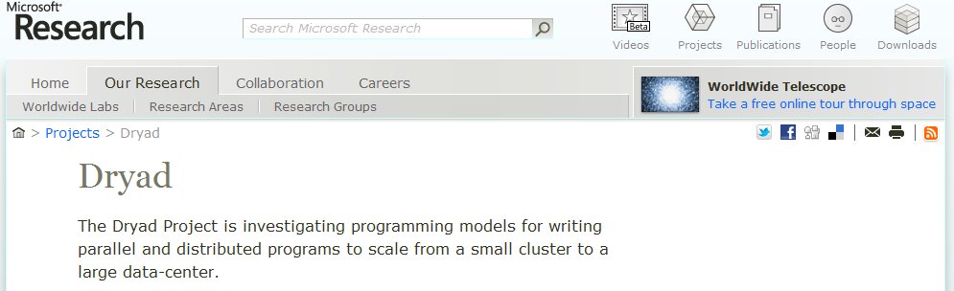
DRYADLINQ CTP EVALUATION
SALSA Group, Pervasive Technology Institute, Indiana University
http://salsahpc.indiana.edu/
Hui Li, Yuduo Zhou, Yuang Ruan, Judy Qiu
Ratul Bhawal, Swapnil Joshi, Pradnya Kakodkar
CTP: Community Technology Preview

Slide 56
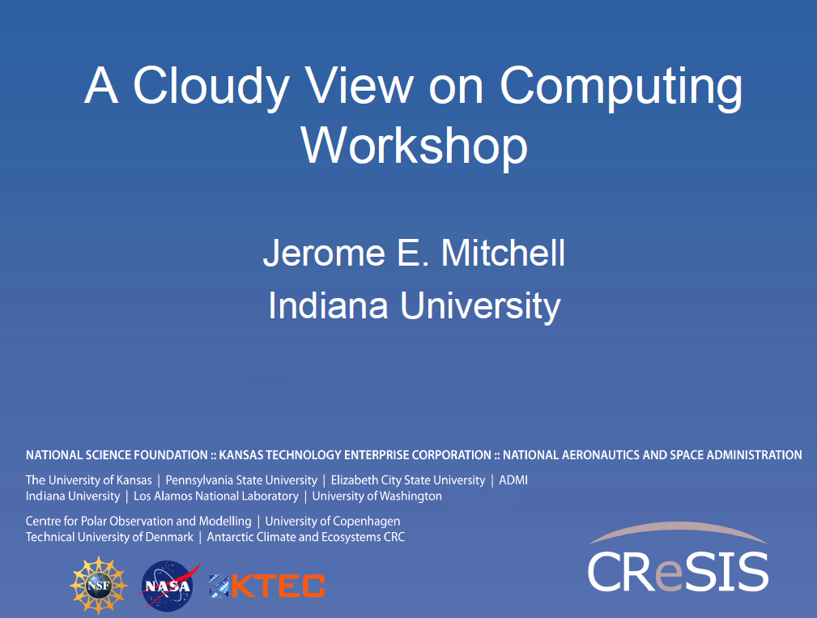
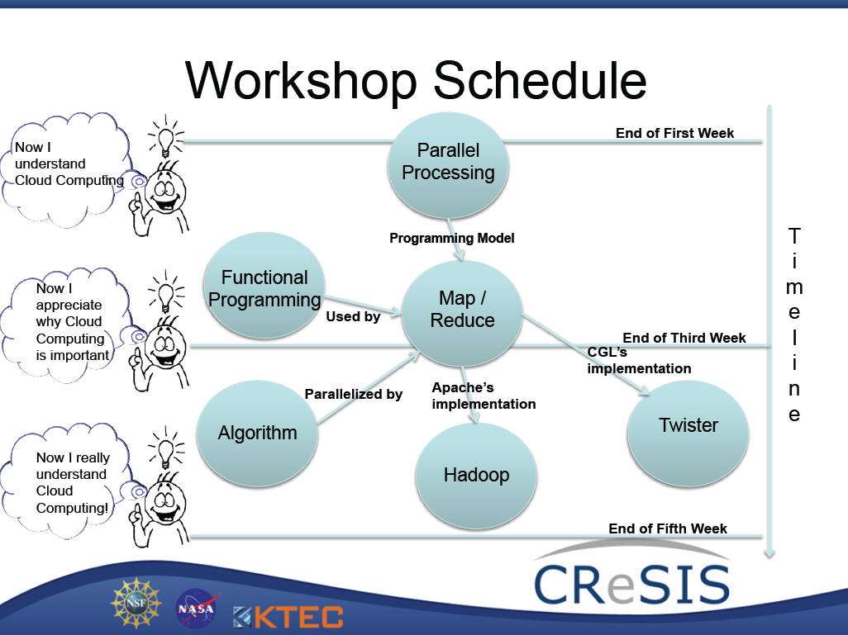
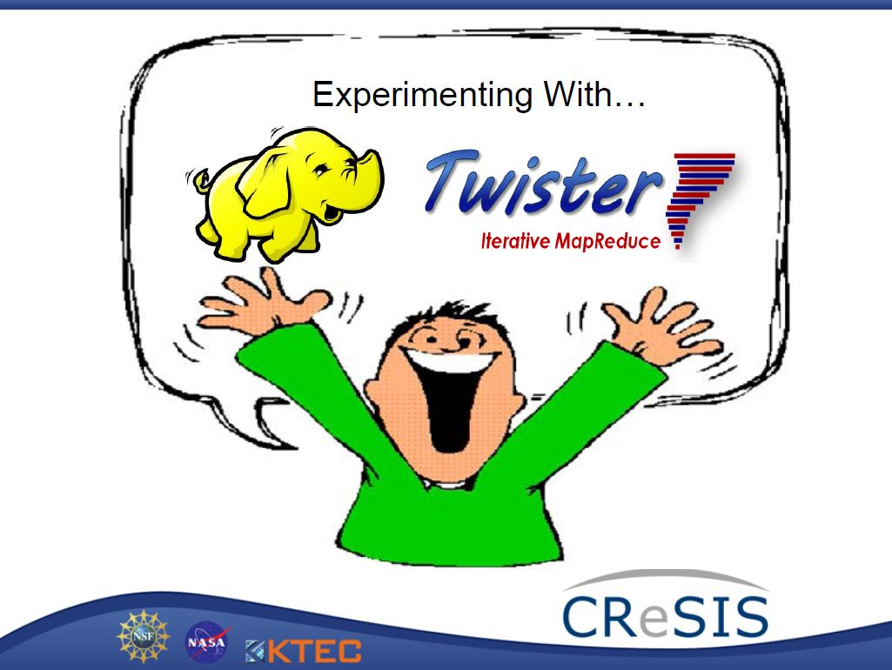
Elizabeth City State University (ECSU), June 7 - July 5 2011

Slide 57

FutureGrid: a Grid Testbed
IU Cray operational, IU IBM (iDataPlex) completed stability test May 6
UCSD IBM operational, UF IBM stability test completes ~ May 12
Network, NID and PU HTC system operational
UC IBM stability test completes ~ May 27; TACC Dell awaiting delivery of components
Private
Public
NID: Network Impairment Device
FG Network

Slide 58
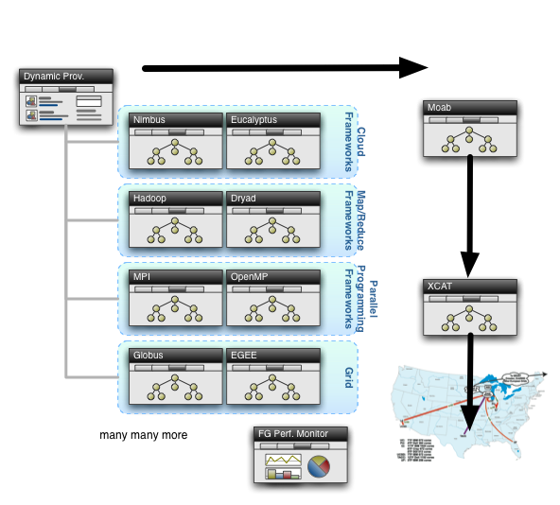
Rain in FutureGrid

Slide 59



Slide 60





Acknowledgements
SALSA HPC Group
Indiana University
http://salsahpc.indiana.edu

Slide 61
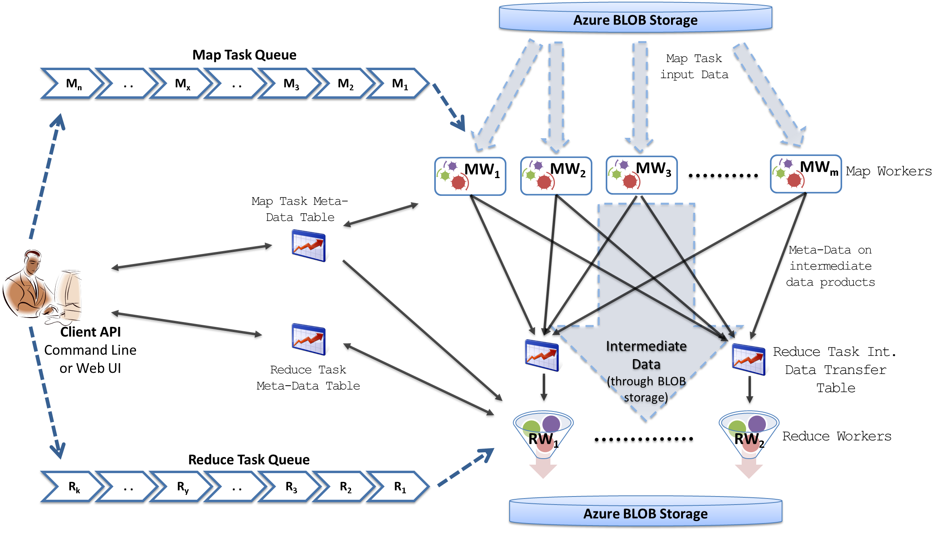
MapReduceRoles for Azure
Notes:
We use Azure Queues for scheduling, Tables to store meta-data and monitoring data, Blobs for input/output/intermediate data storage.

Slide 62
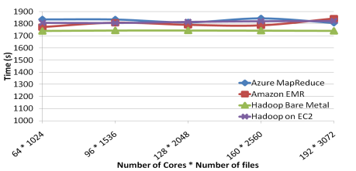
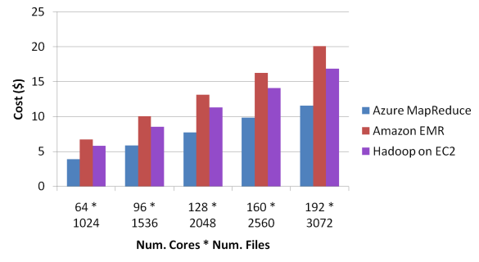
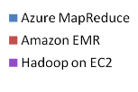
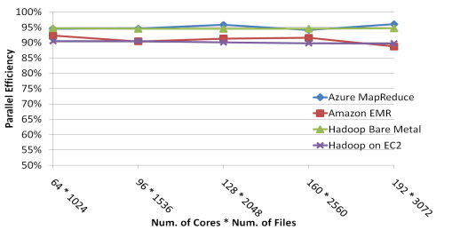
Sequence Assembly Performance

