Slide 1

Portable Parallel Programming on Cloud and HPC: Scientific Applications of Twister4Azure
Thilina Gunarathne (tgunarat@indiana.edu)
Bingjing Zhang, Tak-Lon Wu, Judy Qiu
School of Informatics and Computing
Indiana University, Bloomington.

Slide 2







Clouds for scientific computations
No upfront cost
Zero maintenance
Horizontal scalability
Compute, storage and other services
Loose service guarantees
Not trivial to utilize effectively ☹
Notes:
The utility computing model introduced by cloud computing combined with the rich set of cloud infrastructure services offers a very viable environment for the scientists to process massive amounts of data. Absence of upfront infrastructure spending and zero maintenance cost coupled with the ability to horizontally scale makes scientists very happy.
However, clouds offer unique reliability and sustained performance challenges for large scale parallel computations due to the
virtualization,
multi-tenancy,
non-dedicated commodity connectivity and etc..
Also the cloud services offer unique loose services guarantees such as eventual consistency.
This makes it necessary to have specialized distributed parallel computing frameworks build specifically for cloud characteristics to harness the power of clouds both easily and effectively.

Slide 3
Scalable Parallel Computing on Clouds
Programming Models
Scalability
Performance
Fault Tolerance
Monitoring
Notes:
My research focuses on creating scalable parallel programming frameworks specifically designed for cloud environments to support efficient, reliable and user friendly execution of data intensive iterative computations.
The goals of my work are designing suitable programming models,
achieving good scalability and good performance,
providing framework managed fault tolerance ensuring eventual completion of the computations and
having good monitoring tools to perform scalable parallel computing on clouds.

Slide 4
Pleasingly Parallel Frameworks
HDFS
Input Data Set
Cap3 Sequence Assembly
Data File
exe
exe
Map()
Map()
Executable
Optional
Reduce
Phase
Reduce
HDFS
Results
Classic Cloud Frameworks
Map Reduce
Notes:
Out first step was to build a pleasingly computing framework for cloud environments to process embarrassingly parallel applications. This would be similar to a simple job submission framework.
We implemented several applications including sequence assembly, Blast sequence search and couple of dimensional scaling interpolation algorithms . We were able to achieve comparable performance. This motivated us to go a step further and extend our work to MapReduce type applications..

Slide 5





Map Reduce
Programming Model
Moving Computation to Data
Scalable
Fault Tolerance
  Simple programming model
  Excellent fault tolerance
  Moving computations to data
  Works very well for data intensive pleasingly parallel applications
  Ideal for data intensive applications
Notes:
MapReduce provides a easy to use programming model together with very good fault tolerance and scalability for large scale applications. MapReduce model is proving to be Ideal for data intensive pleasingly parallel applications in commodity hardware and in clouds.
In our current research, we improve and extend MapReduce programming model to support richer applications patterns efficiently.

Slide 6
MRRoles4Azure
First MapReduce framework for Azure Cloud
Use highly-available and scalable Azure cloud services
Hides the complexity of cloud & cloud services
Co-exist with eventual consistency & high latency of cloud services
Decentralized control
  avoids single point of failure
Azure Cloud Services
Highly-available and scalable
Decentralized
Avoids Single Point of Failure
Utilize eventually-consistent , high-latency cloud services effectively
Minimal maintenance and management overhead
Dynamically scale up/down
Global queue based dynamic scheduling
MapReduce
First pure MapReduce for Azure
Typical MapReduce fault tolerance
Notes:
We started by creating a decentralized MapReduce framework for Azure cloud utilizing the highly-available and scalable, Azure infrastructure services as the building blocks.
MRRoles4Azure hides the complexity of cloud services from the users and
is designed to co-exist with the eventual consistent nature of cloud services.
The decentralized architecture avoid the single point of failure and bottleneck, while global queue based dynamic scheduling achieves better load balancing.
We selected Azure platform, as at that time there weren’t any distributed data processing frameworks available for Azure. We performed the first public release of MRRoles4Azure in the 4th quarter of 2010 as the first pure MapReduce framework for Azure.

Slide 7
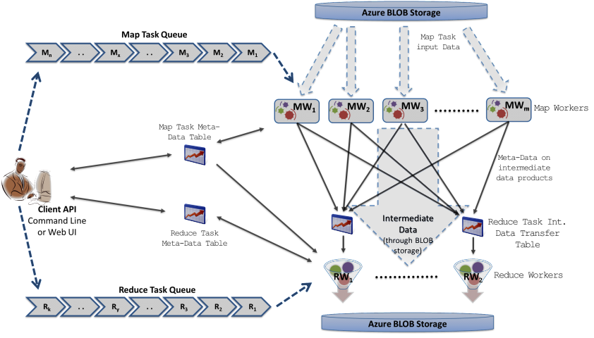
MRRoles4Azure
Azure Queues for scheduling, Tables to store meta-data and monitoring data, Blobs for input/output/intermediate data storage.
Notes:
Ability to dynamically scale up/down
Easy testing and deployment
Combiner step
Web based monitoring console

Slide 8
MRRoles4Azure
Global Barrier
Notes:
One major challenge we encountered is in implementing the global barrier before the reduce task processing. It became a challenge due to the eventual consistency nature of cloud services. We got through it by using special data structures to keep track of the number of reduce data products each map task generated for each reduce task

Slide 9
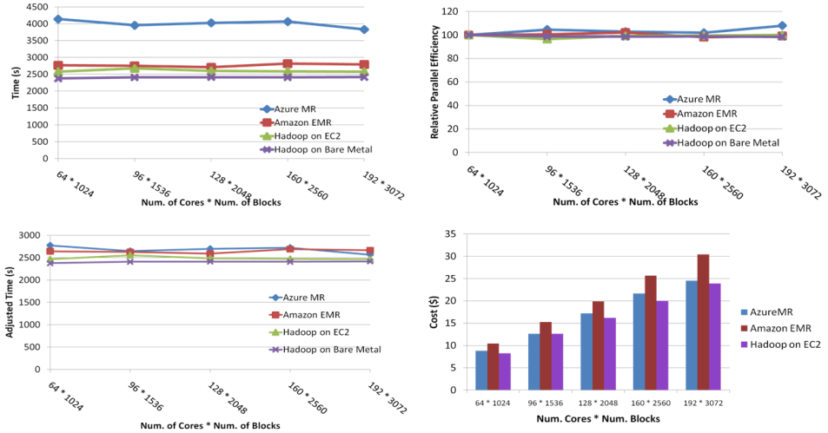
SWG Sequence Alignment
Performance comparable to Hadoop, EMR
Costs less than EMR
Smith-Waterman-GOTOH to calculate all-pairs dissimilarity
Notes:
~123 million sequence alignments, for under 30$ with zero up front hardware cost,
Add call-outs

Slide 10
Data Intensive Iterative Applications
Growing class of applications
  Clustering, data mining, machine learning & dimension reduction applications
  Driven by data deluge & emerging computation fields
  Lots of scientific applications
k ← 0;
MAX ← maximum iterations
δ^{[0]} ← initial delta value
while ( k< MAX_ITER || f(δ^{[k]}, δ^{[k-1]}) )
foreach datum in data
β[datum] ← process (datum, δ^{[k]})
end foreach
δ^{[k+1]} ← combine(β[])
k ← k+1
end while

Slide 11
Data Intensive Iterative Applications
Compute
Communication
Reduce/ barrier
Smaller Loop-Variant Data
Broadcast
New Iteration
Larger Loop-Invariant Data
Notes:
Iterative computations are at the core of the vast majority of data intensive scientific computations.
need to process massive amounts of data and the emergence of data intensive computational fields, such as bioinformatics, chemical informatics and web mining.
Most of these applications consists of iterative computation and communication steps where single iterations can easily be specified as MapReduce computations.
Large input data sizes which are loop-invariant and can be reused across iterations.
Loop-variant results.. Orders of magnitude smaller…

Slide 12
Challenges
Decentralized architecture
Task granularity
Huge number of tasks
Cloud services
Fault tolerance

Slide 13
Twister4Azure – Iterative MapReduce Overview
Decentralized iterative MR architecture for clouds
Extends the MR programming model
Multi-level data caching
  Cache aware hybrid scheduling
Multiple MR applications per job
Collective communications *new*
Outperforms Hadoop in local cluster by 2 to 4 times
Sustain features of MRRoles4Azure
  Cloud services, dynamic scheduling, load balancing, fault tolerance, monitoring, local testing/debugging

Slide 14
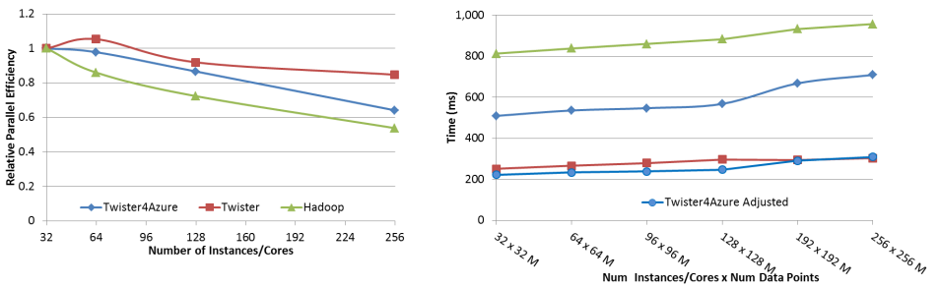
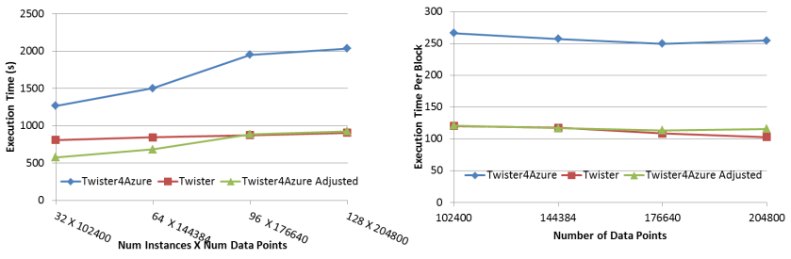
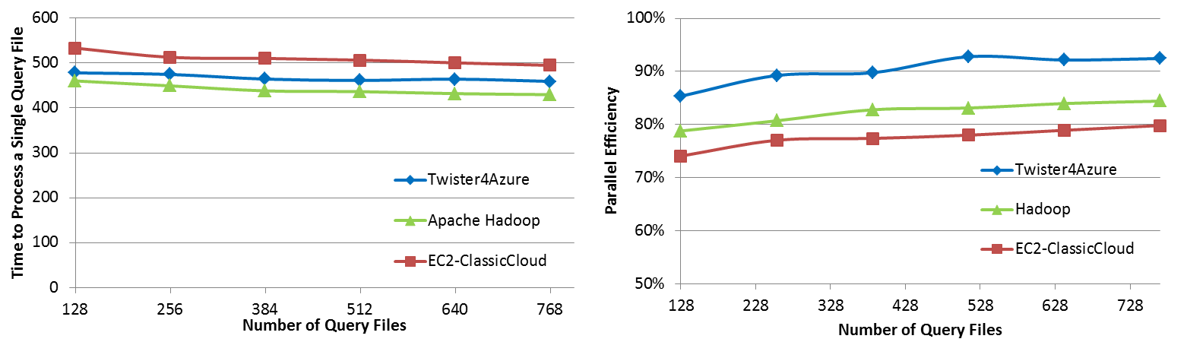
Twister4Azure – Performance Preview
KMeans Clustering
BLAST sequence search
Multi-Dimensional Scaling

Slide 15

http://salsahpc.indiana.edu/twister4azure
Iterative MapReduce for Azure Cloud
Notes:
additional merge step to the programming model, which would be the point where the computations decide whether to go for a new iteration or not.
Extensions to support broadcast data as an additional input to Map & reduce functions.
support in-memory caching of static loop-invariant data between iterations. We achieved this by having cacheable input formats, requiring no changes to the map reduce programming model.
The tasks of iterative computations are much finer grained and the intermediate data are relatively smaller than typical map reduce computations. We added support for hydrid transfer of intermediate data.
First iterative MR on Azure.. Released in early May 2011.

Slide 16
http://salsahpc.indiana.edu/twister4azure
Iterative MapReduce for Azure Cloud
Merge step
Extension to the MapReduce programming model
  Map -> Combine -> Shuffle -> Sort -> Reduce -> Merge
Receives Reduce outputs and the broadcast data
Notes:
additional merge step to the programming model, which would be the point where the computations decide whether to go for a new iteration or not.
Extensions to support broadcast data as an additional input to Map & reduce functions.
Serve as the “loop-test” in the decentralized architecture
Number of iterations
Comparison of result from previous iteration and current iteration
Possible to make the output of merge the broadcast data of the next iteration
support in-memory caching of static loop-invariant data between iterations. We achieved this by having cacheable input formats, requiring no changes to the map reduce programming model.
The tasks of iterative computations are much finer grained and the intermediate data are relatively smaller than typical map reduce computations. We added support for hydrid transfer of intermediate data.
First iterative MR on Azure.. Released in early May 2011.

Slide 17
http://salsahpc.indiana.edu/twister4azure
Extensions to support broadcast data
Iterative MapReduce for Azure Cloud
Merge step
Loop variant data – Comparatively smaller
  Map(Key, Value, List of KeyValue-Pairs(broadcast data) ,…)
Can be specified even for non-iterative MR jobs
Notes:
additional merge step to the programming model, which would be the point where the computations decide whether to go for a new iteration or not.
Extensions to support broadcast data as an additional input to Map & reduce functions.
Serve as the “loop-test” in the decentralized architecture
Number of iterations
Comparison of result from previous iteration and current iteration
Possible to make the output of merge the broadcast data of the next iteration
support in-memory caching of static loop-invariant data between iterations. We achieved this by having cacheable input formats, requiring no changes to the map reduce programming model.
The tasks of iterative computations are much finer grained and the intermediate data are relatively smaller than typical map reduce computations. We added support for hydrid transfer of intermediate data.
First iterative MR on Azure.. Released in early May 2011.

Slide 18
http://salsahpc.indiana.edu/twister4azure
Extensions to support broadcast data
Iterative MapReduce for Azure Cloud
Merge step
In-Memory/Disk caching of static data
Loop invariant data (static data) – traditional MR key-value pair
  Cached between iterations
Avoids the data download, loading and parsing cost
Notes:
Loop invariant data (static data) – traditional MR key-value pairs
Comparatively larger sized data
Cached between iterations
Avoids the data download, loading and parsing cost between iterations
support in-memory caching of static loop-invariant data between iterations. We achieved this by having cacheable input formats, requiring no changes to the map reduce programming model.
The tasks of iterative computations are much finer grained and the intermediate data are relatively smaller than typical map reduce computations. We added support for hydrid transfer of intermediate data.
First iterative MR on Azure.. Released in early May 2011.

Slide 19
http://salsahpc.indiana.edu/twister4azure
Extensions to support broadcast data
Iterative MapReduce for Azure Cloud
Hybrid intermediate data transfer
Merge step
In-Memory/Disk caching of static data
Tasks are finer grained and the intermediate data are relatively smaller than traditional map reduce computations
Table or Blob storage based transport based on data size
Notes:
Loop invariant data (static data) – traditional MR key-value pairs
Comparatively larger sized data
Cached between iterations
Avoids the data download, loading and parsing cost between iterations
support in-memory caching of static loop-invariant data between iterations. We achieved this by having cacheable input formats, requiring no changes to the map reduce programming model.
The tasks of iterative computations are much finer grained and the intermediate data are relatively smaller than typical map reduce computations. We added support for hydrid transfer of intermediate data.
First iterative MR on Azure.. Released in early May 2011.

Slide 20
Cache Aware Scheduling
Map tasks need to be scheduled with cache awareness
  Map task which process data ‘X’ needs to be scheduled to the worker with ‘X’ in the Cache
Nobody has global view of the data products cached in workers
  Decentralized architecture
  Impossible to do cache aware assigning of tasks to workers
Solution: workers pick tasks based on the data they have in the cache
  Job Bulletin Board : advertise the new iterations

Slide 21
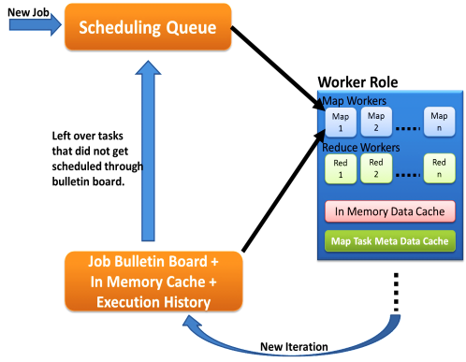
Hybrid Task Scheduling
First iteration through queues
Left over tasks
Data in cache + Task meta data history
New iteration in Job Bulleting Board
Notes:
No master with global knowledge of cached data products. Rather than pushing the workers pick tasks.
Multiple MapReduce applications within an iteration supporting much richer application patterns

Slide 22
Multiple Applications per Deployment
Ability to deploy multiple Map Reduce applications in a single deployment
Capability to chain different MR applications in a single job, within a single iteration.
  Ability to pipeline
Support for many application invocations in a workflow without redeployment

Slide 23
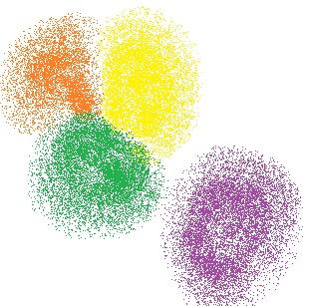
KMeans Clustering
Partition a given data set into disjoint clusters
Each iteration
  Cluster assignment step
  Centroid update step
Notes:
http://www.aishack.in/2010/07/k-means-clustering/

Slide 24
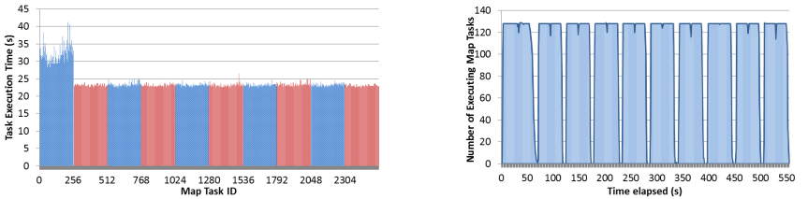




Performance – Kmeans Clustering
Overhead between iterations
First iteration performs the initial data fetch
Task Execution Time Histogram
Number of Executing Map Task Histogram
Scales better than Hadoop on bare metal
Strong Scaling with 128M Data Points
Weak Scaling
Performance with/without
data caching
Speedup gained using data cache
Scaling speedup
Increasing number of iterations
Notes:
Right(c): Twister4Azure executing Map Task histogram for 128 million data points in 128 Azure small instances
Figure 5. KMeansClustering Scalability. Left(a): Relative parallel efficiency of strong scaling using 128 million data points.
Center(b): Weak scaling. Workload per core is kept constant (ideal is a straight horizontal line).

Slide 25
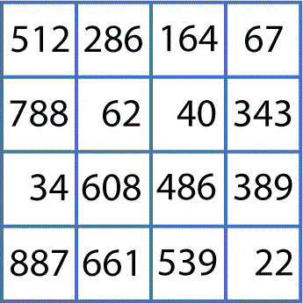
Applications
Bioinformatics pipeline
O(NxN)
Clustering
O(NxN)
Cluster Indices
Pairwise Alignment & Distance Calculation
Gene Sequences
Visualization
3D Plot
O(NxN)
Coordinates
Distance Matrix
Multi-Dimensional Scaling
http://salsahpc.indiana.edu/

Slide 26
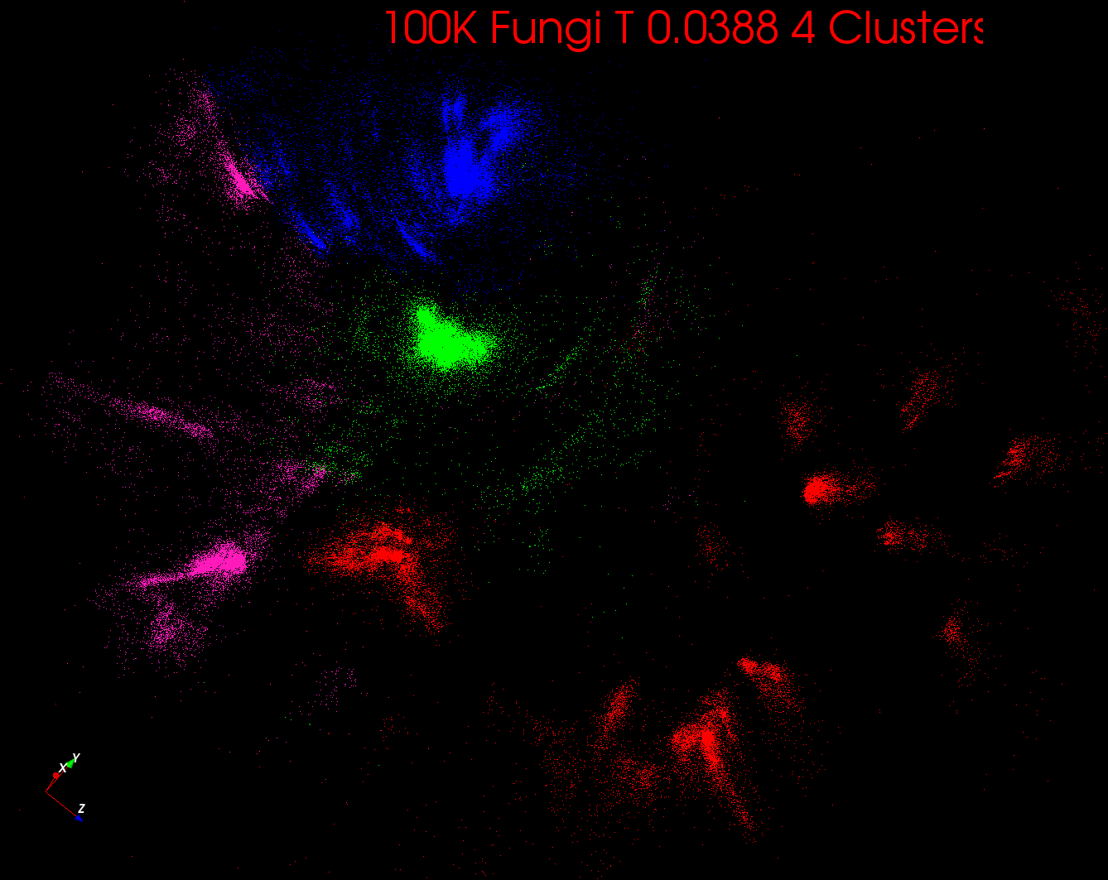
Metagenomics Result
http://salsahpc.indiana.edu/

Slide 27
Multi-Dimensional-Scaling
Many iterations
Memory & Data intensive
3 Map Reduce jobs per iteration
X_{k} = invV * B(X_{(k-1)}) * X_{(k-1)}
2 matrix vector multiplications termed BC and X
BC: Calculate BX
X: Calculate invV (BX)
Calculate Stress
Map
Reduce
Merge
Map
Reduce
Merge
Map
Reduce
Merge
New Iteration

Slide 28
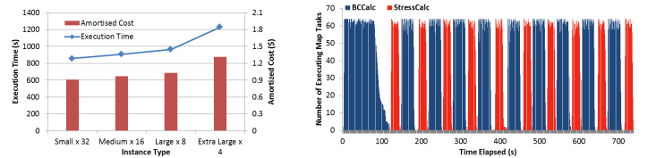
Performance – Multi Dimensional Scaling
Performance adjusted for sequential performance difference
First iteration performs the initial data fetch
Weak Scaling
Data Size Scaling
Azure Instance Type Study
Number of Executing Map Task Histogram
Task Execution Time Histogram
Performance with/without
data caching
Speedup gained using data cache
Scaling speedup
Increasing number of iterations
Notes:
Weak scaling where workload per core is ~constant. Ideal is a straight horizontal line. Center : Data size scaling with 128 Azure small instances/cores, 20 iterations.
Instance type study using 76800 data points, 32 instances, 20 iterations. Right: Twister4Azure executing Map Task histogram for 144384 x144384 distance matrix in 64 Azure small instances, 10 iterations

Slide 29

BLAST sequence search
BLAST Sequence Search
BLAST
Scales better than Hadoop & EC2-Classic Cloud

Slide 30
Current Research
Collective communication primitives
  All-Gather-Reduce
  Sum-Reduce (aca MPI Allreduce)
Exploring additional data communication and broadcasting mechanisms
  Fault tolerance
Twister4Cloud
  Twister4Azure architecture implementations for other cloud infrastructures

Slide 31
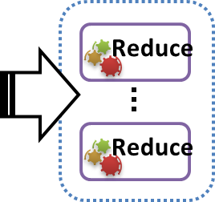
Collective Communications
App X
App Y
Map1 δ
Map2 δ
…..
Map N δ
Map₁
Map₁
Map₂
Map₂
Map_{N}
Map_{N}
Notes:
All-Gather-Reduce
Sum-Reduce

Slide 32
Pipelining

Slide 33
Conclusions
Twister4Azure
  Address the challenges of scalability and fault tolerance unique to utilizing the cloud interfaces
  Support multi-level caching of loop-invariant data across iterations as well as caching of any reused data
  Novel hybrid cache-aware scheduling mechanism
One of the first large-scale study of Azure performance for non-trivial scientific applications.
Twister4Azure in VM’s outperforms Apache Hadoop in local cluster by a factor of 2 to 4
Twister4Azure exhibits performance comparable to Java HPC Twister running on a local cluster.

Slide 34
Acknowledgements
Prof. Geoffrey C Fox for his many insights and feedbacks
Present and past members of SALSA group – Indiana University.
Seung-Hee Bae for many discussions on MDS
National Institutes of Health grant 5 RC2 HG005806-02.
Microsoft Azure Grant

Slide 35
Questions?
Thank You!
http://salsahpc.indiana.edu/twister4azure

