Slide 1
What is High Performance Computing?
Union College Albany Workshop on
“High Performance Computing at Liberal Arts Colleges”
April 7 2009
Geoffrey Fox
Computer Science, Informatics, Physics
Chair Informatics Department
Director Community Grids Laboratory and Digital Science Center
Indiana University Bloomington IN 47404
gcf@indiana.edu
http://www.infomall.org

Slide 2
What is High Performance Computing?
The meaning of this was clear 20 years ago when we were planning/starting the HPCC (High Performance Computing and Communication) Initiative
It meant parallel computing and HPCC lasted for 10 years
NSF started funding of Supercomputer (a pretty well defined concept) centers and we debated vector versus “massively parallel systems”. Data did not exist …..
For a variety of technical and political reasons the supercomputer centers evolved into a “National Cyberinfrastructure” and NSF established the Office of Cyberinfrastructure
NSF introduces concept of “Computational Thinking”
New academic curricula developed termed Computational Science, Scientific Computing, Informatics or revamped Interdisciplinary Computer Science……

Slide 3
Some critical Concepts as list
e-Research and Computational Thinking
Data Deluge
New roles for (digital) libraries
Virtual Organizations
Interdisciplinary Collaboration
Web 2.0
Portals or Gateways
Cyberinfrastructure or e-Infrastructure
Services
Parallel Computing
Multicore
Clusters and Supercomputers
Grids
Virtualization
Clouds
Impact on Education as well as Research

Slide 4
Some critical Concepts as text I
Computational thinking is set up as e-Research and often characterized by a Data Deluge from sensors, instruments, simulation results and the Internet. Curating and managing this data involves digital library technology and possible new roles for libraries. Interdisciplinary Collaboration across continents and fields implies virtual organizations that are built using Web 2.0 technology. VO’s link people, computers and data.
Portals or Gateways provide access to computational and data set up as Cyberinfrastructure or e-Infrastructure made up of multiple Services
Intense computation on individual problems involves Parallel Computing linking computers with high performance networks that are packaged as Clusters and/or Supercomputers. Performance improvements now come from Multicore architectures implying parallel computing important for commodity applications and machines.

Slide 5
Some critical Concepts as text II
Cyberinfrastructure also involves distributed systems supporting data and people that are naturally distributed as well as pleasingly parallel computations. Grids were initial technology approach but these failed to get commercial support and in many cases being replaced by Clouds.
Clouds are highly cost-effective user friendly approaches to large (~100,000 node) data centers originally pioneered by Web 2.0 applications. They tend to use Virtualization technology and offer new MapReduce approach
These developments have implications for Education as well as Research but there is less agreement and success with education as with research. This reflects differences between different fields (e.g. roles of courses and lab work) and problem in teaching rich curricula and still graduating students expeditiously

Slide 6
e-moreorlessanything
‘e-Science is about global collaboration in key areas of science, and the next generation of infrastructure that will enable it.’ from inventor of term John Taylor Director General of Research Councils UK, Office of Science and Technology
e-Science is about developing tools and technologies that allow scientists to do ‘faster, better or different’ research
Similarly e-Business captures the emerging view of corporations as dynamic virtual organizations linking employees, customers and stakeholders across the world.
This generalizes to e-moreorlessanything including e-DigitalLibrary, e-SocialScience, e-HavingFun and e-Education
A deluge of data of unprecedented and inevitable size must be managed and understood.
People (virtual organizations), computers, data (including sensors and instruments) must be linked via hardware and software networks
6
Notes:
6

Slide 7
What is Cyberinfrastructure
Cyberinfrastructure is (from NSF) infrastructure that supports distributed research and learning (e-Science, e-Research, e-Education)
  Links data, people, computers
Exploits Internet technology (Web2.0 and Clouds) adding (via Grid technology) management, security, supercomputers etc.
It has two aspects: parallel – low latency (microseconds) between nodes and distributed – highish latency (milliseconds) between nodes
Parallel needed to get high performance on individual large simulations, data analysis etc.; must decompose problem
Distributed aspect integrates already distinct components – especially natural for data (as in biology databases etc.)
7
Notes:
7

Slide 8
Gartner 2008 Technology Hype Curve
Clouds, Microblogs and Green IT appear
Basic Web Services, Wikis and SOA
becoming mainstream

Slide 9
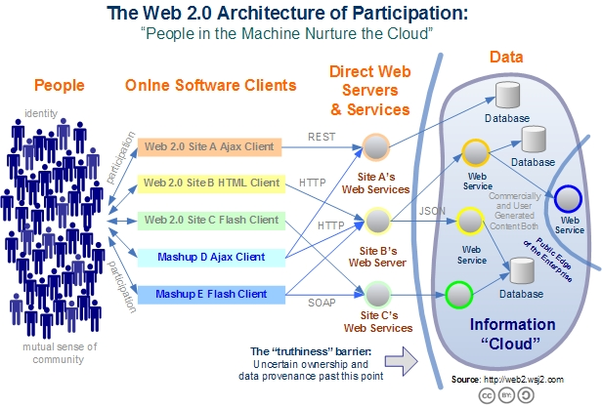
Web 2.0 Systems illustrate Cyberinfrastructure
Captures the incredible development of interactive Web sites enabling people to create and collaborate

Slide 10
Relevance of Web 2.0
Web 2.0 can help e-Research in many ways
Its tools (web sites) can enhance scientific collaboration, i.e. effectively support virtual organizations, in different ways from grids
The popularity of Web 2.0 can provide high quality technologies and software that (due to large commercial investment) can be very useful in e-Research and preferable to complex Grid or Web Service solutions
The usability and participatory nature of Web 2.0 can bring science and its informatics to a broader audience
Cyberinfrastructure is research analogue of major commercial initiatives e.g. to important job opportunities for students!
Web 2.0 is major commercial use of computers and “Google/Amazon” farms spurred cloud computing
  Same computer answering your Google query can do bioinformatics
  Can be accessed from a web page with a credit card i.e. as a Service

Slide 11
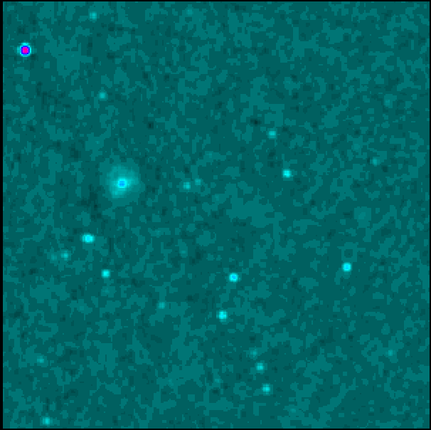
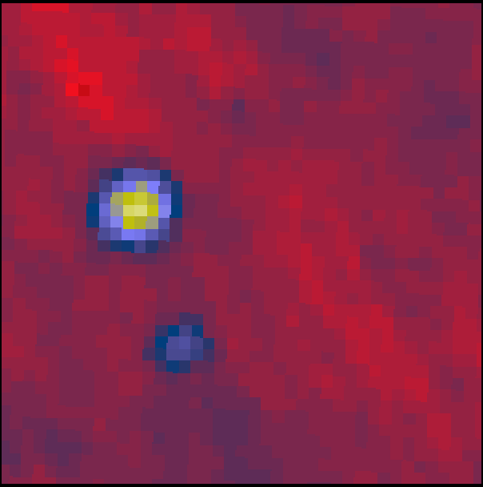
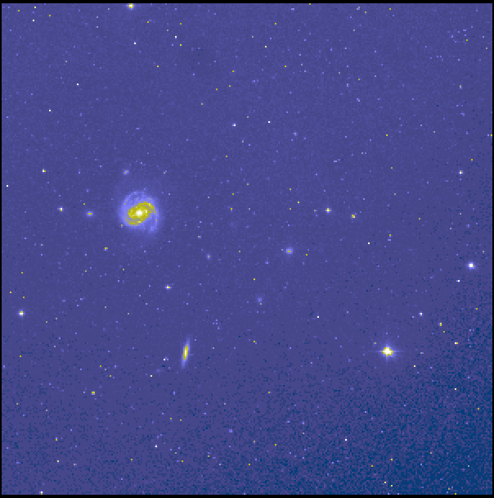
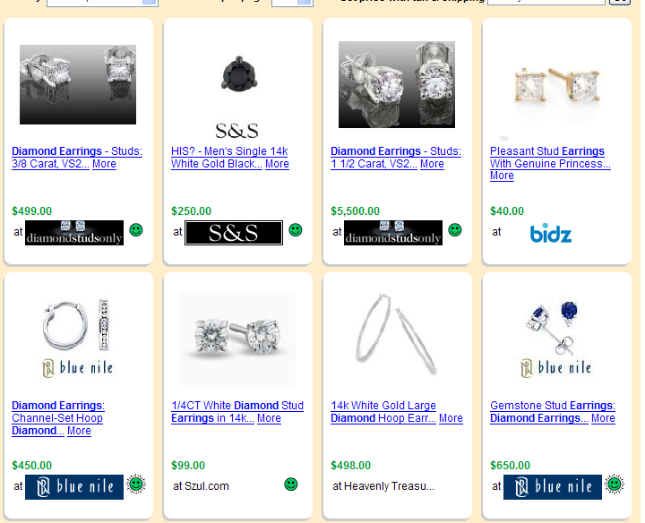
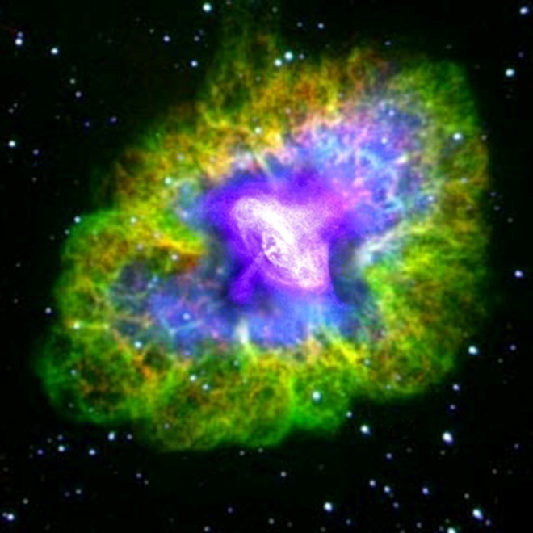
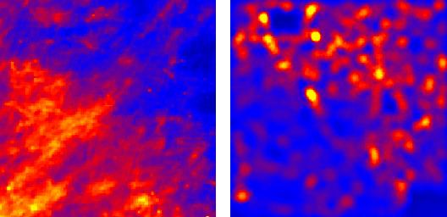
Virtual Observatory in Astronomy uses
Cyberinfrastructure to Integrate Experiments
Radio
Far-Infrared
Visible
Comparison Shopping is Internet analogy to Integrated Astronomy using similar technology
Dust Map
Visible + X-ray
Galaxy Density Map

Slide 12
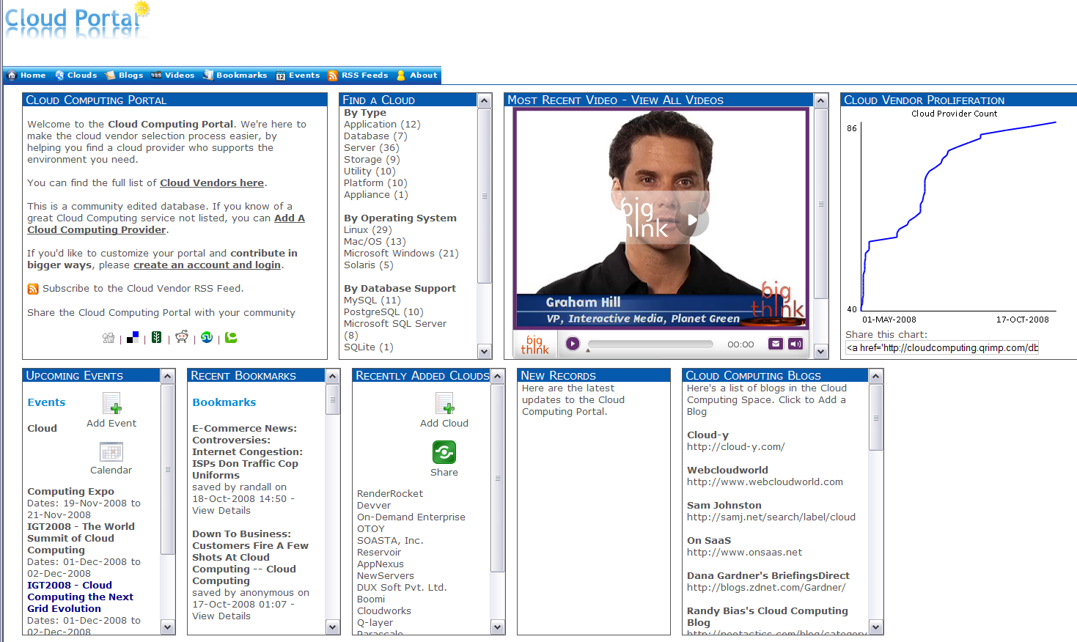
Cloud Computing Resources from Amazon, IBM, Google, Microsoft ……
Computing as a Service from a web page with a credit card

Slide 13


Clouds as Cost Effective Data Centers
Exploit the Internet by allowing one to build giant data centers with 100,000’s of computers; ~ 200-1000 to a shipping container
“Microsoft will cram between 150 and 220 shipping containers filled with data center gear into a new 500,000 square foot Chicago facility. This move marks the most significant, public use of the shipping container systems popularized by the likes of Sun Microsystems and Rackable Systems to date.”

Slide 14

Clouds hide Complexity
Build portals around all computing capability
SaaS: Software as a Service
IaaS: Infrastructure as a Service or HaaS: Hardware as a Service
PaaS: Platform as a Service delivers SaaS on IaaS
Cyberinfrastructure is “Research as a Service”
2 Google warehouses of computers on the banks of the Columbia River, in The Dalles, Oregon
Such centers use 20MW-200MW
(Future) each
150 watts per core
Save money from large size, positioning with cheap power and access with Internet

Slide 15
Clouds v Grids Philosophy
Clouds are (by definition) commercially supported approach to large scale computing
  So we should expect Clouds to replace Compute Grids
  Current Grid technology involves “non-commercial” software solutions which are hard to evolve/sustain
Informational Retrieval is major data intensive commercial application so we can expect technologies from this field (Dryad, Hadoop) to be relevant for related scientific (File/Data parallel) applications
  Technologies still immature but can be expected to rapidly become mainstream

Slide 16
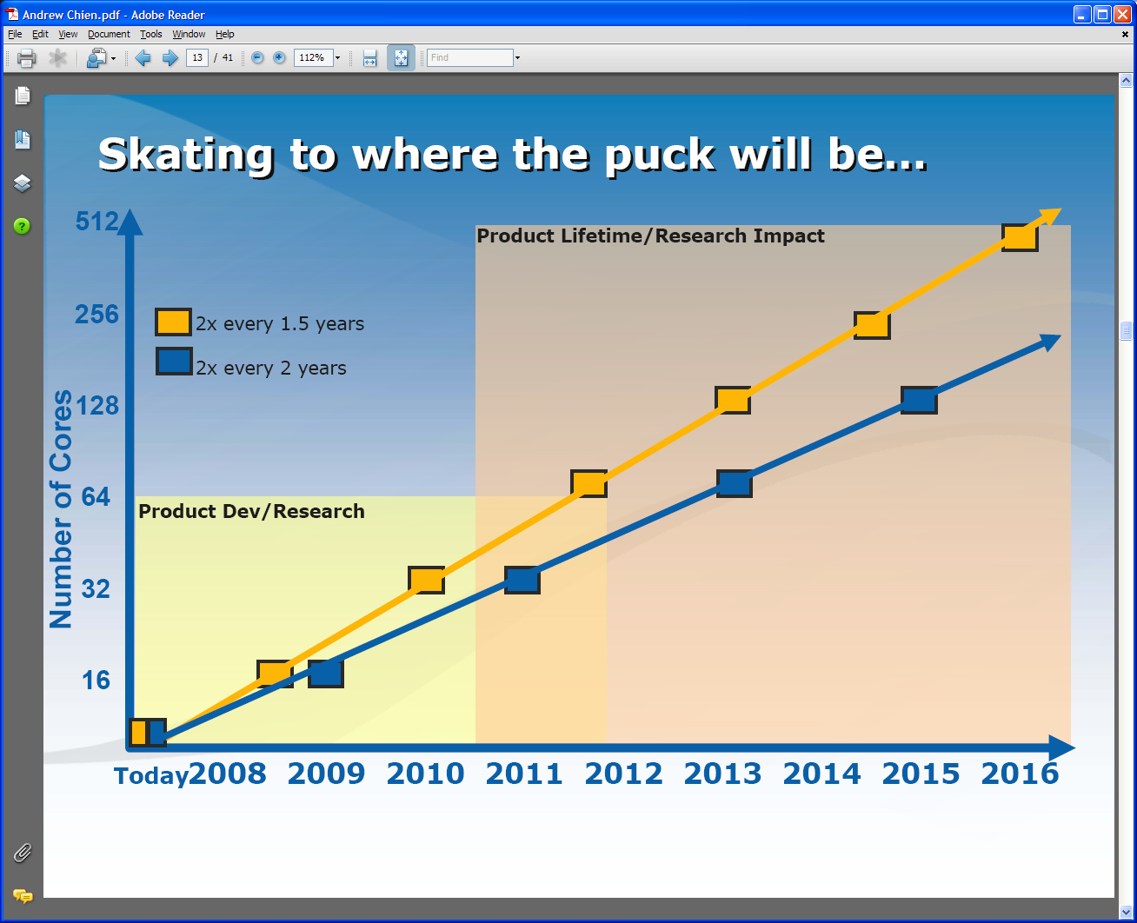
Intel’s Projection
Technology might support:
2010: 16—64 cores 200GF—1 TF
2013: 64—256 cores 500GF– 4 TF
2016: 256--1024 cores 2 TF– 20 TF

Slide 17
Too much Computing?
Historically both grids and parallel computing have tried to increase computing capabilities by
  Optimizing performance of codes at cost of re-usability
  Exploiting all possible CPU’s such as Graphics co-processors and “idle cycles” (across administrative domains)
  Linking central computers together such as NSF/DoE/DoD supercomputer networks without clear user requirements
Next Crisis in technology area will be the opposite problem – commodity chips will be 32-128way parallel in 5 years time and we currently have no idea how to use them on commodity systems – especially on clients
  Only 2 releases of standard software (e.g. Office) in this time span so need solutions that can be implemented in next 3-5 years
Intel RMS analysis: Gaming and Generalized decision support (data mining) are ways of using these cycles

Slide 18
Intel’s Application Stack

Slide 19
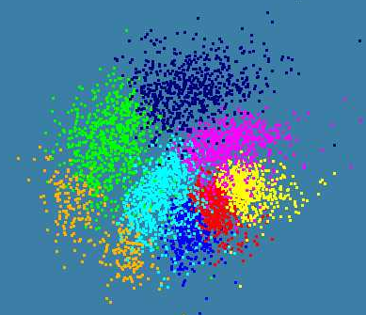
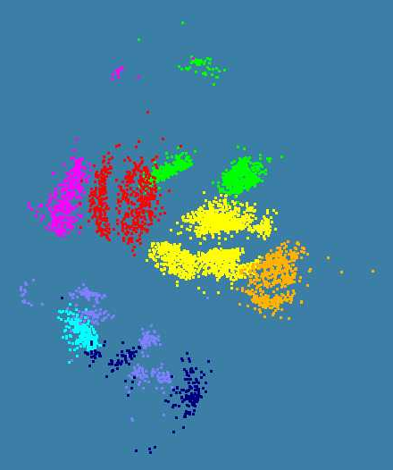
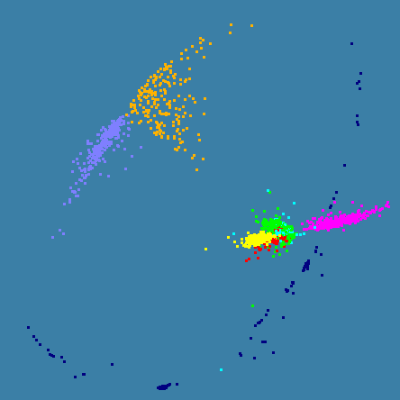
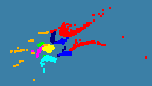
Parallel Clustering and
Parallel Multidimensional Scaling MDS
Applied to ~5000 dimensional gene sequences and ~20 dimensional patient record data
Very good parallel speedup
4500 Points : Pairwise Aligned
3000 Points : Clustal MSA
Kimura2 Distance
4000 Points : Patient Record
Data on Obesity and Environment
4500 Points : Clustal MSA

Slide 20
Comparison of MPI and Threads on Parallel Pairwise Clustering
Parallel Overhead
≈ 1-efficiency
= (PT(P)/T(1)-1)
On P processors
= (1/efficiency)-1
24-way
Speedup = 24/(1+f)
16-way
2-way
4-way
8-way
1-way
Speedup 28
4 Intel Six Core Xeon E7450 2.4GHz 48GB Memory 12M L2 Cache
3 Dataset sizes

Slide 21
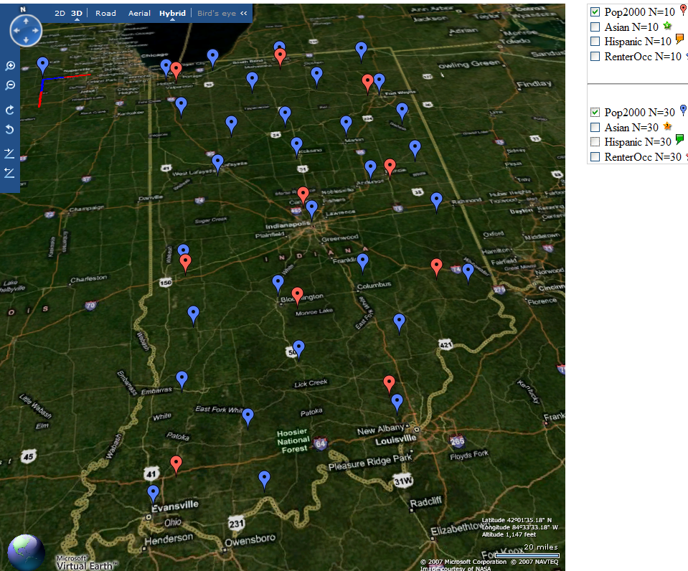
Deterministic Annealing Clustering of Indiana Census Data
Decrease temperature (distance scale) to discover more clusters
Distance Scale
Temperature^{0.5}
Red is coarse resolution with 10 clusters
Blue is finer resolution with 30 clusters
Clusters find cities in Indiana
Distance Scale is √Temperature

Slide 22

What is the TeraGrid in early 2008?
An instrument (cyberinfrastructure) that delivers high-end IT resources - storage, computation, visualization, and data/service hosting - almost all of which are UNIX-based under the covers; some hidden by Web interfaces
  A data storage and management facility: over 20 Petabytes of storage (disk and tape), over 100 scientific data collections
  A computational facility - over 750 TFLOPS in parallel computing systems and growing
  (Sometimes) an intuitive way to do very complex tasks, via Science Gateways, or get data via data services
A service: help desk and consulting, Advanced Support for TeraGrid Applications (ASTA), education and training events and resources
The largest individual cyberinfrastructure facility funded by the NSF, which supports the national science and engineering research community
Something you can use without financial cost - allocated via peer review (and without double jeopardy)
©Trustees of Indiana University. May be reused so long as IU and TeraGrid logos remain, and any modifications to original are noted. Courtesy Craig A. Stewart, IU

Slide 23
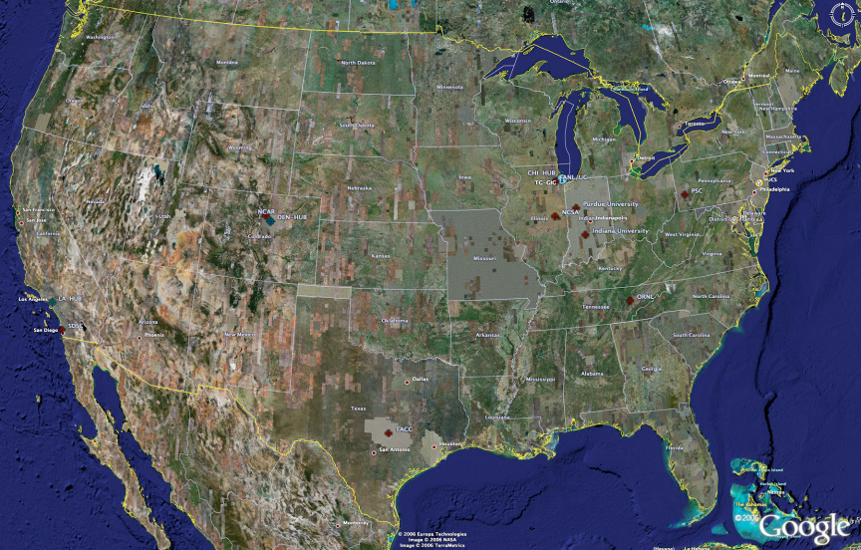
TeraGrid High Performance Computing Systems 2007-8
UC/ANL
PSC
PU
NCAR
NCSA
IU
2008
(~1PF)
ORNL
Tennessee
SDSC
(504TF)
LONI/LSU
TACC
Computational Resources
(size approximate - not to scale)
Slide Courtesy Tommy Minyard, TACC

Slide 24
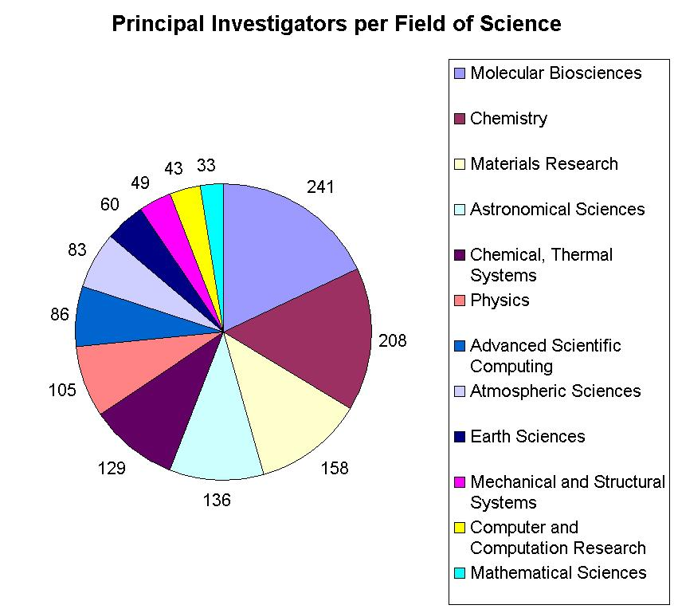
Resources for many disciplines!
> 40,000 processors in aggregate
Resource availability grew during 2008 at unprecedented rates

Slide 25

Large Hadron Collider CERN, Geneva: 2008 Start
pp √s =14 TeV L=10³⁴ cm⁻² s⁻¹
27 km Tunnel in Switzerland & France
CMS
TOTEM
pp, general
purpose; HI
5000+ Physicists
250+ Institutes
60+ Countries
Atlas
ALICE : HI
LHCb: B-physics
Higgs, SUSY, Extra Dimensions, CP Violation, QG Plasma, … the Unexpected
Challenges: Analyze petabytes of complex data cooperatively
Harness global computing, data & network resources

Slide 26
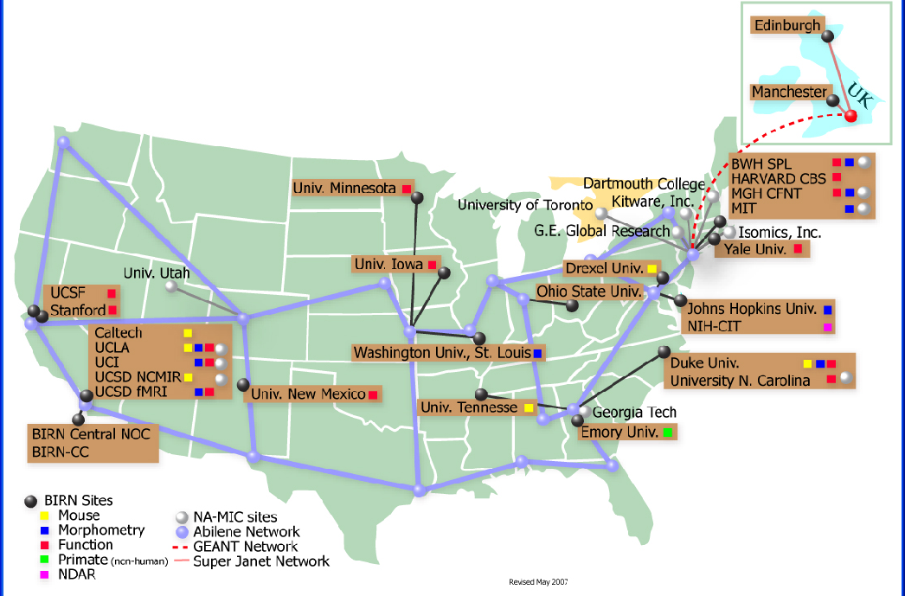
BIRN Bioinformatics Research Network

Slide 27
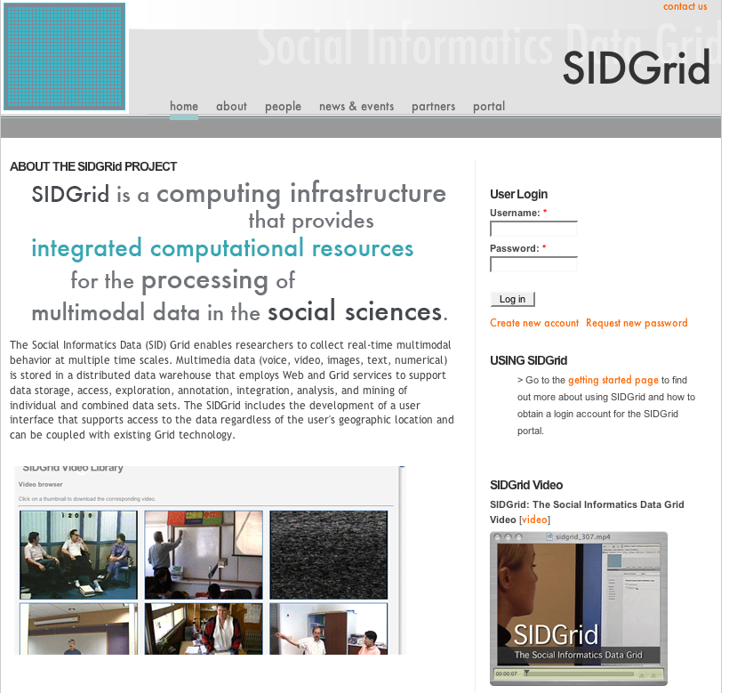
U. Chicago SIDGrid (sidgrid.ci.uchicago.edu)

Slide 28
Data Intensive Research?
Research is advanced by observation i.e. analyzing data from
      Gene Sequencers
      Accelerators
      Telescopes
      Environmental Sensors
      Web Crawlers
      Ethnographic Interviews
This data is “filtered”, “analyzed” (term used in science), “data-mined” (term used in Computer Science) to produce conclusions
The analysis is guided by hypotheses
One can also make models to test hypotheses
These models can be constrained by data from observations – termed data assimilation
  Weather forecasting and Climate prediction are of this type

Slide 29
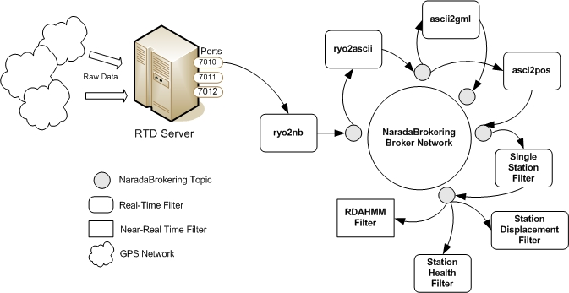
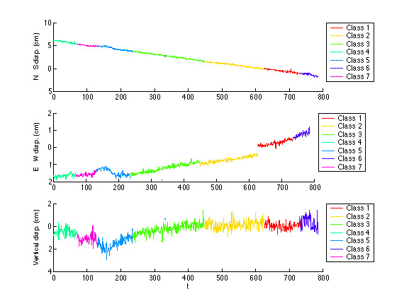
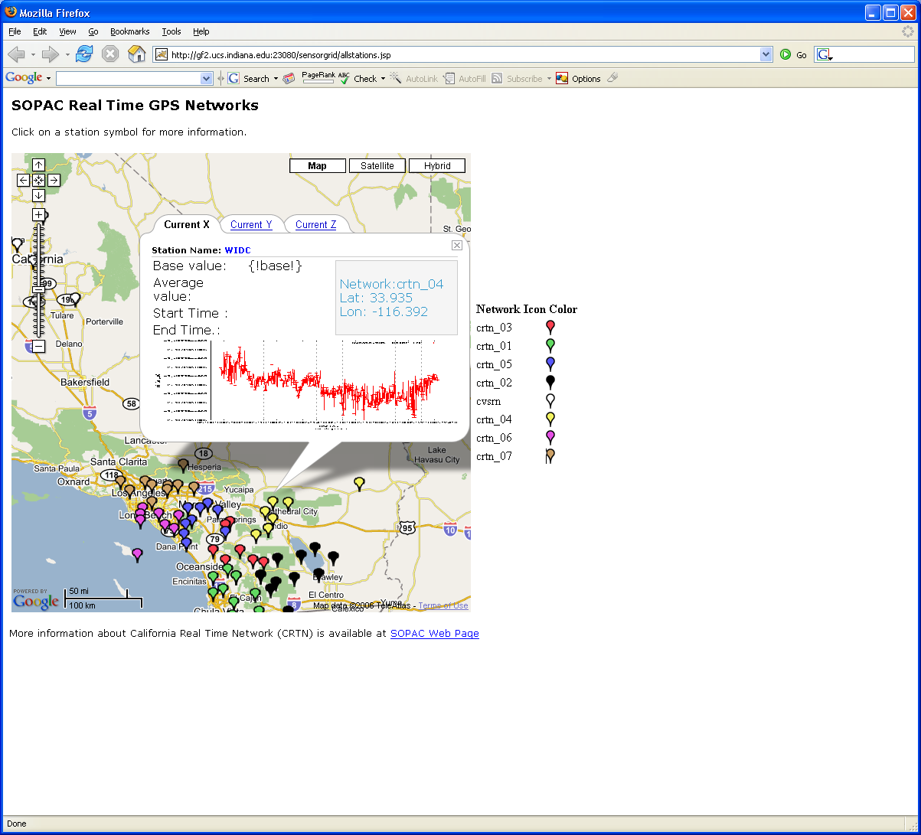
Grid Workflow Datamining in Earth Science
Work with Scripps Institute
Grid services controlled by workflow process real time data from ~70 GPS Sensors in Southern California
NASA GPS
Earthquake
Streaming Data
Support
Archival
Transformations
Data Checking
Hidden Markov
Datamining (JPL)
Real Time
Display (GIS)
29
Notes:
29

Slide 30
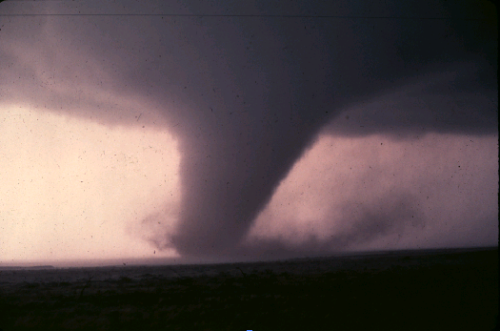
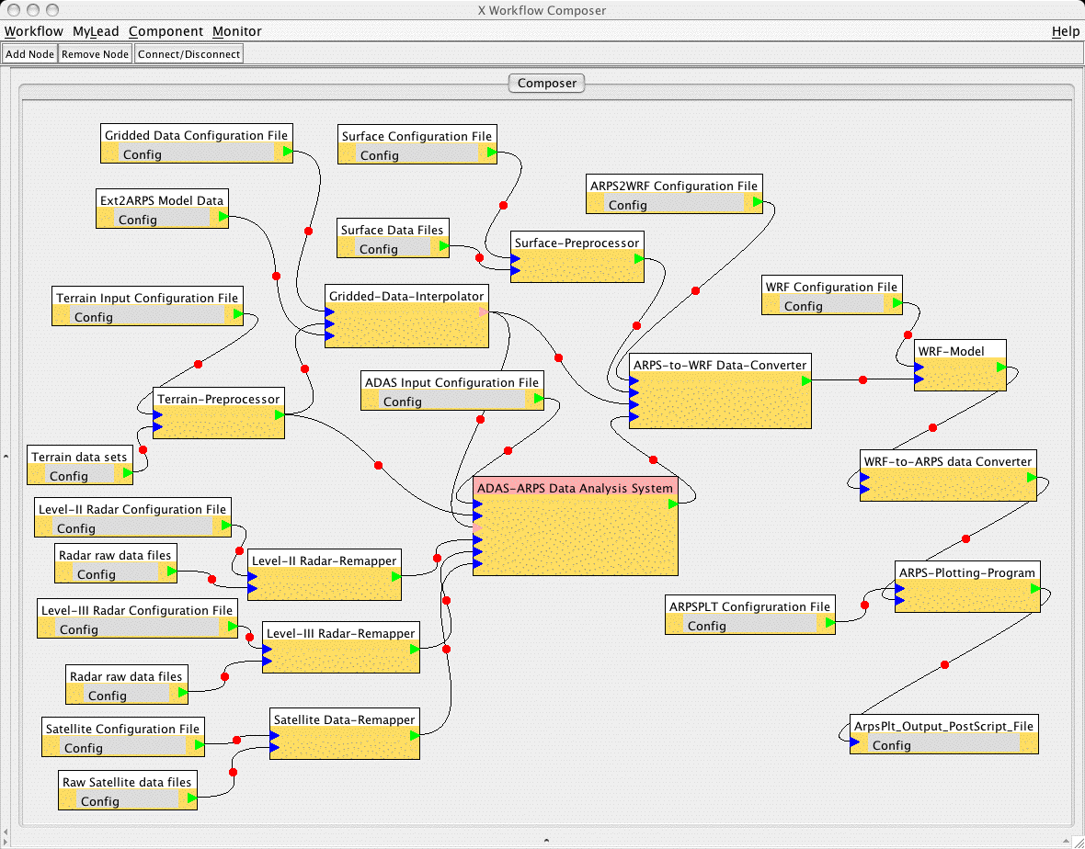
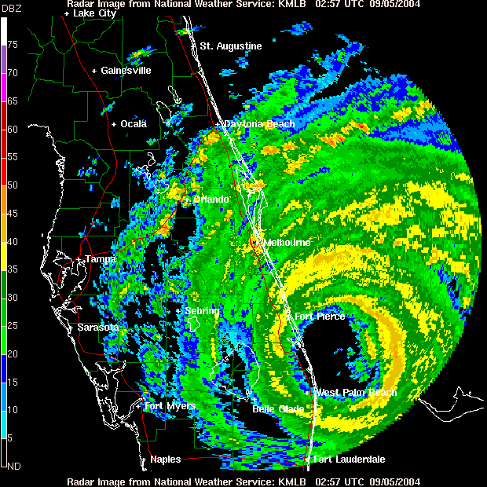
Grid Workflow Data Assimilation in Earth Science
Grid services triggered by abnormal events and controlled by workflow process real time data from radar and high resolution simulations for tornado forecasts
Typical graphical interface to service composition

Slide 31
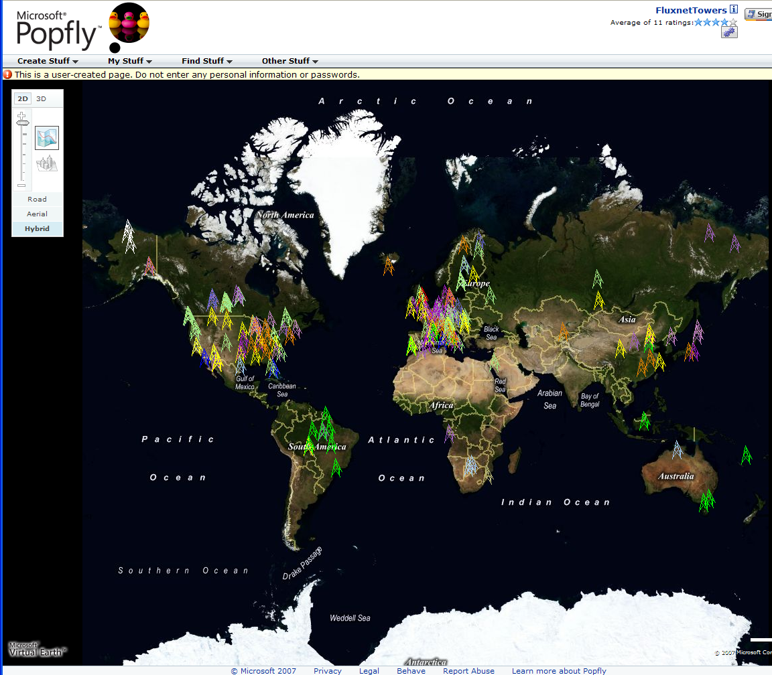
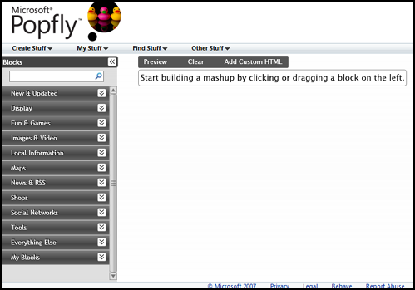
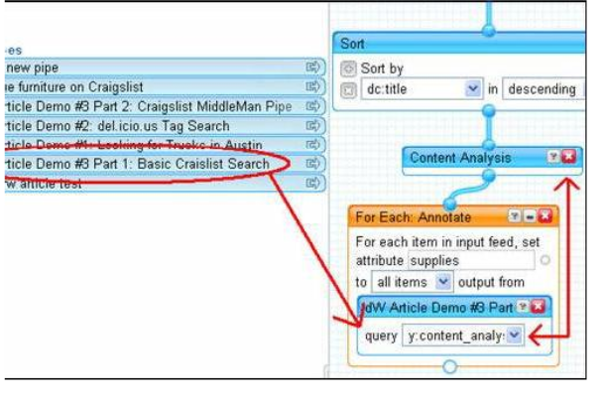
Major Companies entering mashup area
Web 2.0 Mashups (same as workflow in Grids) are likely to drive composition (programming) tools for Grids, Clouds and web
Recently we see Mashup tools like Yahoo Pipes and Microsoft Popfly which have familiar graphical interfaces
Currently only simple examples but tools could become powerful
Yahoo Pipes

Slide 32
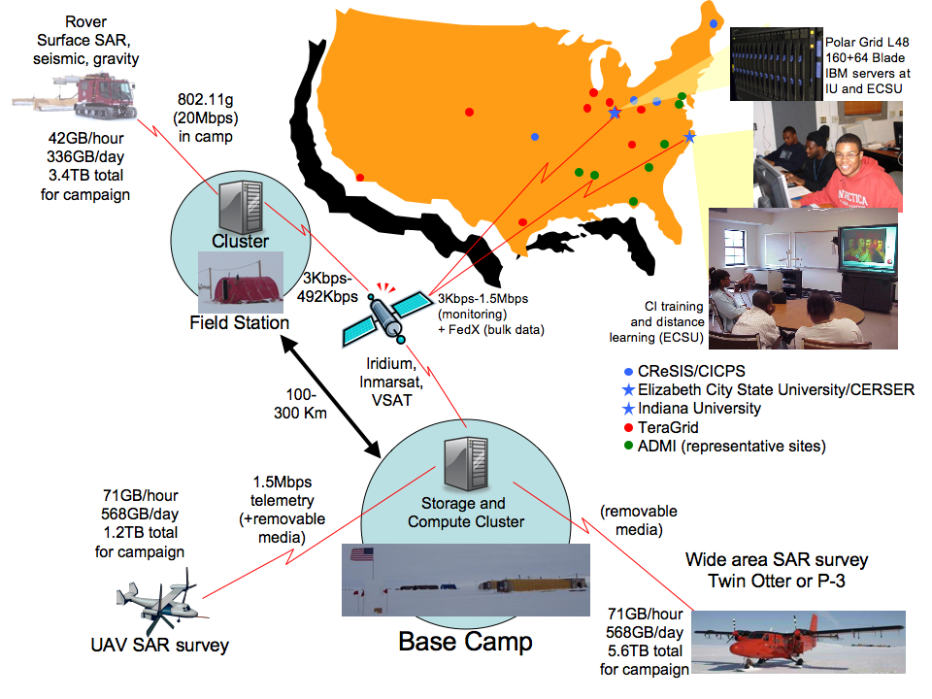

Slide 33
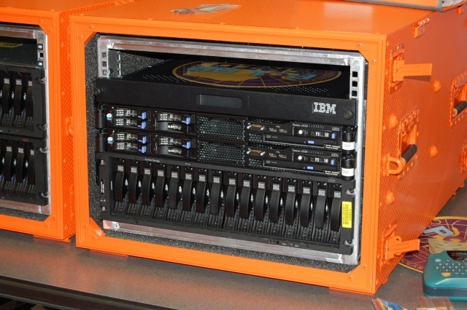
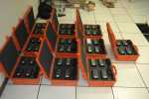
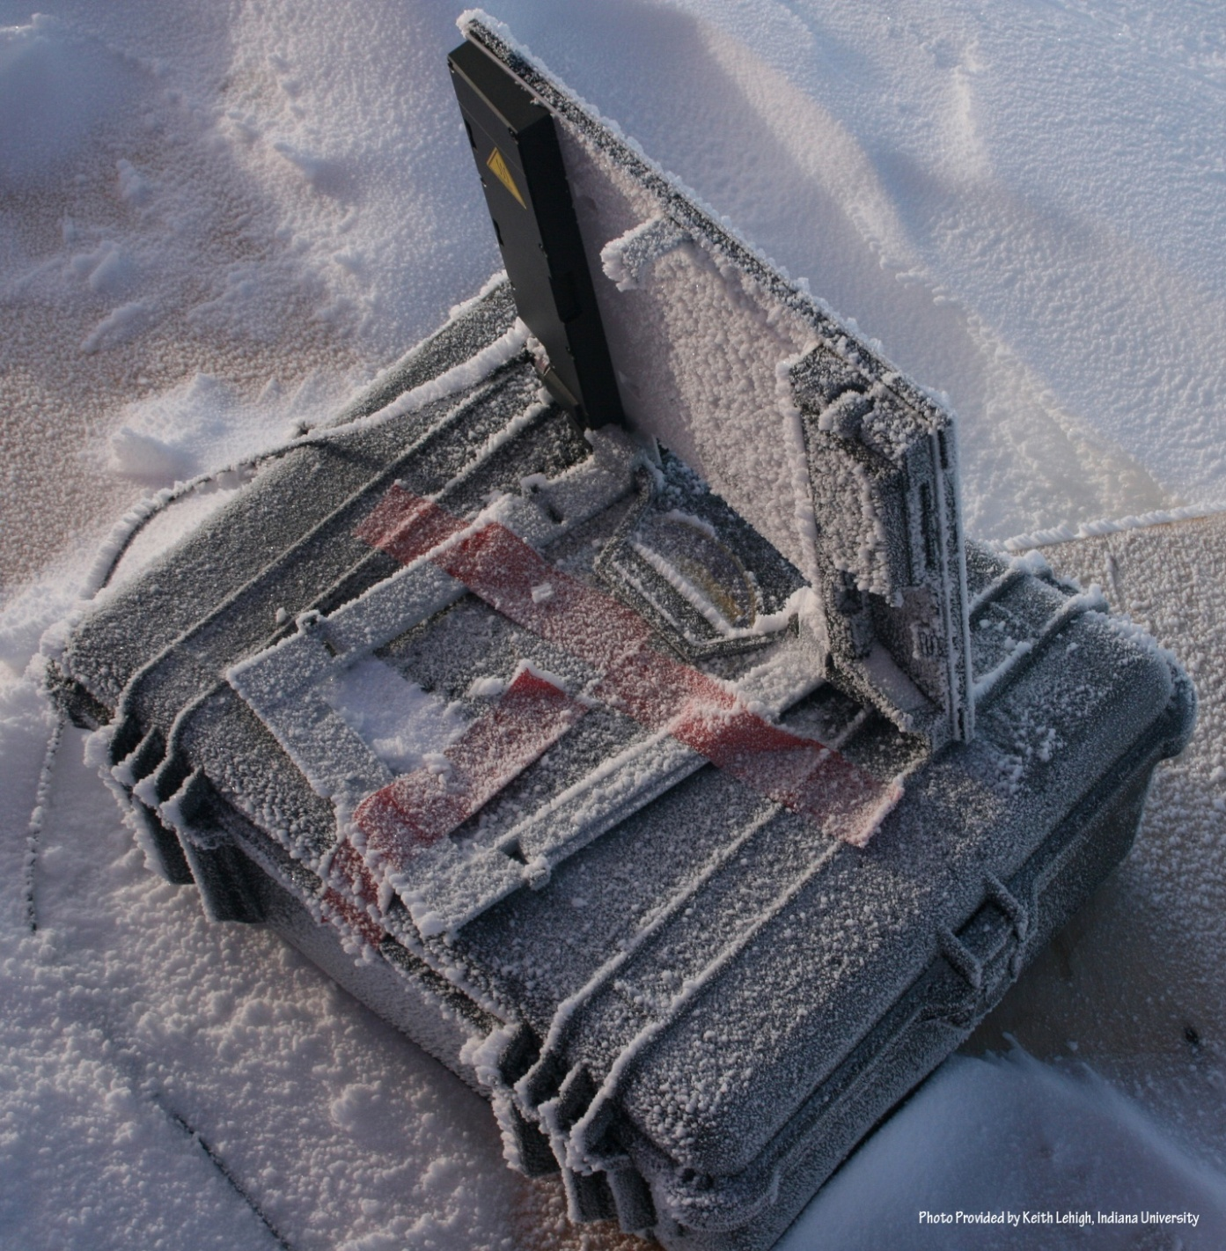
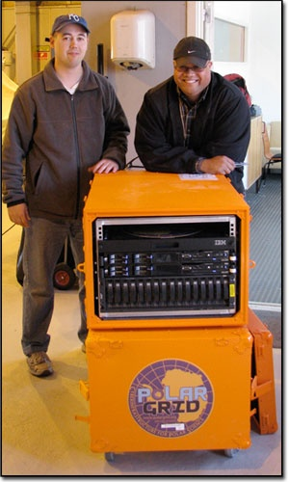
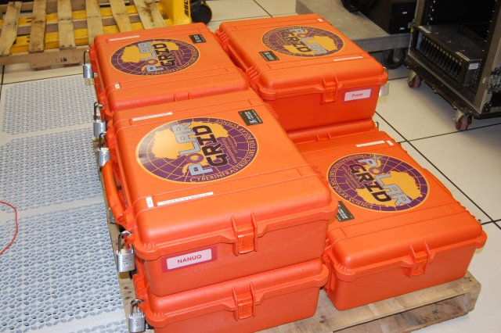
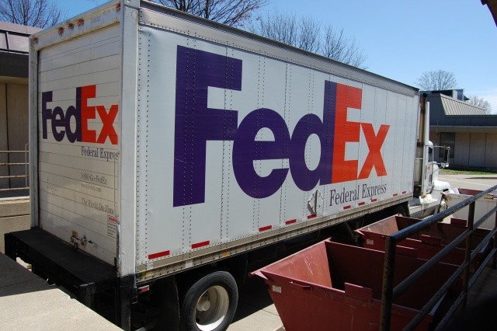
Polar Grid goes to Greenland

Slide 34
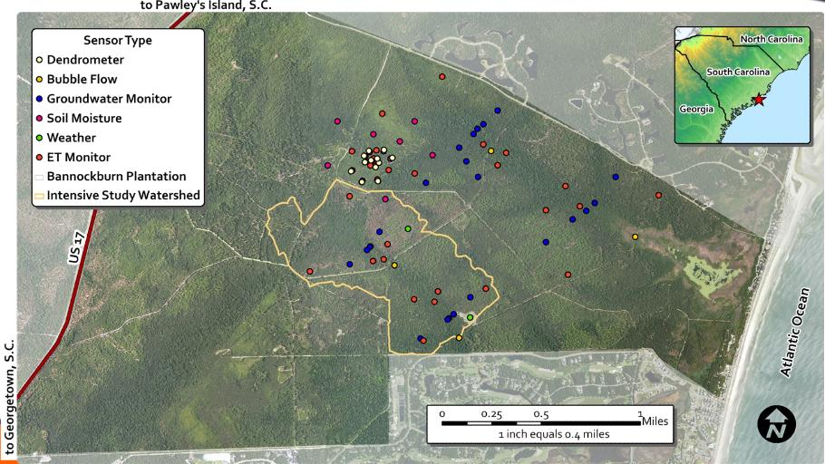
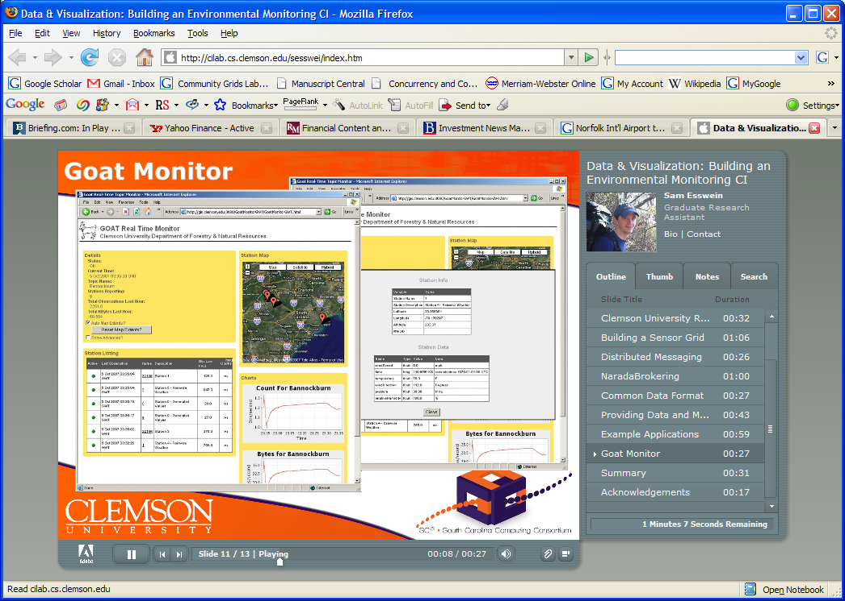
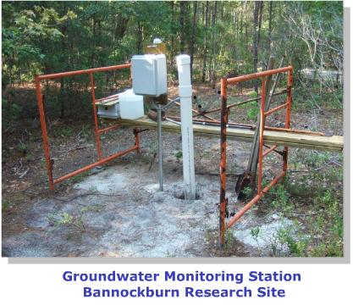
Environmental Monitoring Cyberinfrastructure at Clemson

Slide 35
Sensor Grids Can be Fun
Note sensors are any time dependent source of information and a fixed source of information is just a broken sensor
  SAR Satellites
  Environmental Monitors
  Nokia N800 pocket computers
  RFID tags and readers
  GPS Sensors
  Lego Robots
  RSS Feeds
  Audio/video: web-cams
  Presentation of teacher in distance education
  Text chats of students
  Cell phones

Slide 36

The Sensors on the Fun Grid
Laptop for PowerPoint
2 Robots used
Lego Robot GPS Nokia N800 RFID Tag RFID Reader

Slide 38
The People in Cyberinfrastructure
Web 2.0 can enhance scientific collaboration, i.e. effectively support virtual organizations, in different ways from grids
I expect more resources like MyExperiment from UK, SciVee from SDSC and Connotea from Nature that offer Flickr, YouTube, Facebook, Second Life type capabilities optimized for science
The usability and participatory nature of Web 2.0 can bring science and its informatics to a broader audience
In particular distance collaborative aspects of such Cyberinfrastructure can level playing field; you do not have to be at Harvard etc. to succeed
  e.g. ECSU in CReSIS NSF Science and Technology Center
  Navajo Tech can access TeraGrid Science Gateways

Slide 39
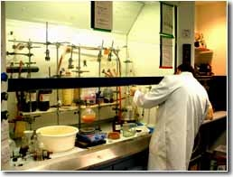
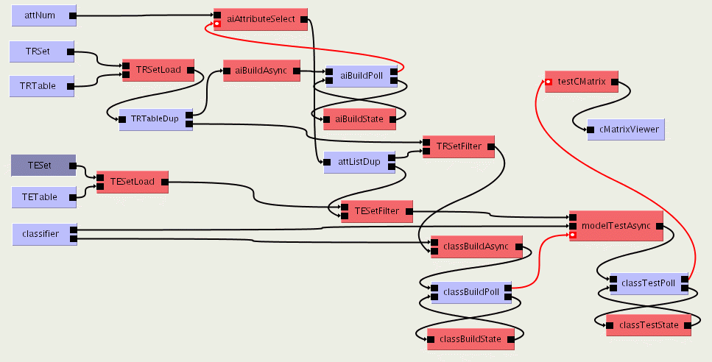

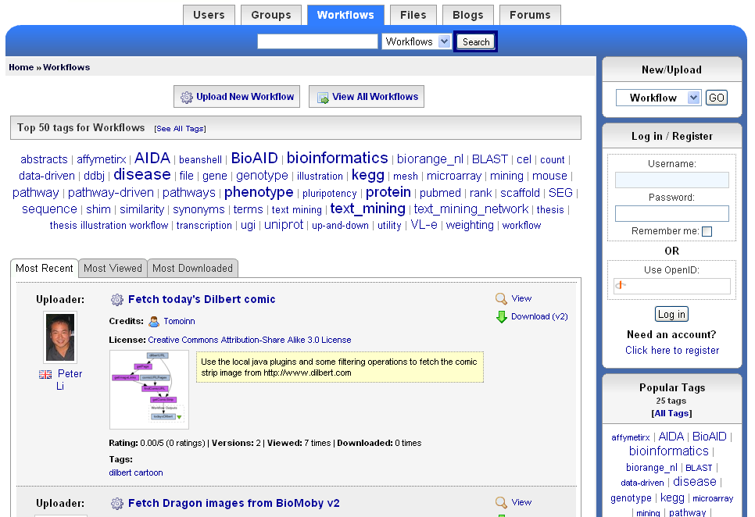
The social process of science 2.0
Virtual Learning Environment
Role of Libraries
and Publishers?
Undergraduate Students
Digital Libraries
scientists
Graduate Students
Reprints
Peer-Reviewed Journal & Conference Papers
experimentation
Technical Reports
Preprints & Metadata
Local
Web
Repositories
Certified Experimental Results & Analyses
Data, Metadata Provenance Workflows
Ontologies

Slide 40
