Slide 1
Supporting Cloud Computing with the Virtual Block Store System
Xiaoming Gao, gao4@indiana.edu
Mike Lowe, jomlowe@iupui.edu
Yu Ma, yuma@indiana.edu
Marlon Pierce, mpierce@cs.indiana.edu

Slide 2
Outline
Motivation
Typical use cases
Web service architecture
Workflows
Consistency
Support for other volume servers and VMMs
Integration with Nimbus
Preliminary performance tests
Future work

Slide 3
Motivation
Needs for data storage support Cloud computing environment
Make scientific data collections available to clouds
Cloud-related data storage services
- distributed file systems: Amazon S3, Hadoop, etc.
- block storage systems: instance storage in Amazon EC2, Amazon Elastic Block Store (EBS), Eucalyptus’ EBS implementation based on ATA over Ethernet (AoE)
- EBS vs. instance storage: off-instance, persistent, extendable
- problems with EBS: proprietary, deeply coupled with EC2

Slide 4
Motivation
VBS – similar interface to EBS
- create-volume <size> <snapshot id> <comment>
- delete-volume <volume id>
- describe-volumes [<volume id>, <volume id>, …]
- create-snapshot <volume id> <comment>
- delete-snapshot <snapshot id>
- describe-snapshots [<snapshot id>, <snapshot id>, …]
- attach-volume <volume id> <VMM Hostname> <VM Id> <VM Device>
- detach-volume <volume id>
More flexibility
- works directly with Virtual Machine Manager (VMM)
- supports various VMMs (Xen, KVM, etc.)
- convenient integration with various cloud computing systems

Slide 5
Typical use cases
Extendable volume storages:
VBS
LV1
Dom U Instance 1
Dom U Instance 2
Attachment
LV2
….
….
Attachment
Xen hypervisor
LV: Logical Volume
Persistent and extendable storage

Slide 6
Typical use cases
Data reuse based on snapshots:
VBS
LV1
Snapshot s
/lost+found
/etc
/usr
…
Attachment
Dom U Instance 1
Dom U Instance 2
….
LV2
Attachment
….
Xen hypervisor
Create a snapshot with basic file system and software installation
2. Create new volumes based on the snapshot, and attach them to different VM instances
3. Load different data sets in different VMs, and get different processing results

Slide 7
Web services architecture
Volume Server
(LVM)
Virtual Machine Manager (Xen Dom 0)
VBD
VM instance (
Xen Dom U)
iSCSI
Volume Delegate
VMM Delegate
Create Volume,
Export Volume,
Create Snapshot, etc.
Import Volume,
Attach Device,
Detach Device, etc.
VBS Web Service
LVM: Logical Volume Manager
iSCSI: internet SCSI protocol
VBD: Virtual Block Device
VBS Client

Slide 8
Workflow – attach volume
VBS Client
VBS Web Service
Volume Delegate
VMM Delegate
Attach_volume
Export_target
Volume ID, VMM hostname,
VM ID
“ietadm new”
Target Information
Do_attach
“iscsiadm --mode discovery”
“iscsiadm --login”
“xm block-attach”
Success/Failure
Update metadata
Success/Failure

Slide 9
Consistency
Metadata level consistency
- HSQLDB: volumes table, snapshots table, attachments table;
System level consistency
- Roll-back in case of failures in multi-step operations

Slide 10
Support other Volume Servers and VMMs
Build new Volume Delegate & VMM Delegate Service
Command line extraction:
Original source code:
String program = "xm";
String[] args = {"block-attach", vmId, "phy:"+vmmDev, vmDev, "w"};
UtilSet.antExecute(program, args, …);
Property file:
blockAttachCmd=xm block-attach <domUId> phy:<dom0Dev> <domUDev> w
blockDetachCmd=xm block-detach <domUId> <domUDev>
New source code:
String cmdLine = prop.getProperty(“blockAttachCmd”).replace("<vmId>", vmId);
…
String program = UtilSet.getProgFromCmdLine(cmdLine); String[] args = UtilSet.getArgsFromCmdLine(cmdLine);
UtilSet.antExecute(program, args, …);

Slide 11
Integration with Nimbus
Volume Server
Xen Dom 0
VBD
Xen Dom U
iSCSI
Volume Delegate
Xen Delegate
Create Volume,
Export Volume,
Create Snapshot,Etc.
Import Volume,
Attach Device,
Detach Device,Etc.
Nimbus Workspace Service
VBS Web Service
Query for Xen Dom0 Host and DomUId with <Nimbus Instance Id>
VBS_Nimbus Web Service
Attch-volume <volId>
<Nimbus Instance Id> <device>
VBS Client

Slide 12
Preliminary performance tests
Single volume/VM test bed
Disk types tested:
- VBS-LVM: a 5GB VBS volume on the volume server;
- AoE-LVM: a 5GB logical volume on the volume server, attached to the VM via AoE
- Local-LVM: a 5GB logical volume on the VMM node
- Local-Image: disk image of the VM
Testing tool:
- Bonnie++ 1.03e
 | CPU | Memory | disk
Volume server | 4*Xeon 2.8G | 512M | 4 * Seagate 147G 10K RPM SCSI (paired in RAID1)
VMM | 2 * Opteron 2.52G | 1.5G | 1 Fujitsu 73G 10K RPM SCSI
VM | 1 Operon 2.52G | 256M | 4G disk image file (3.6G available)
- Network connection: 1Gb Ethernet

Slide 13
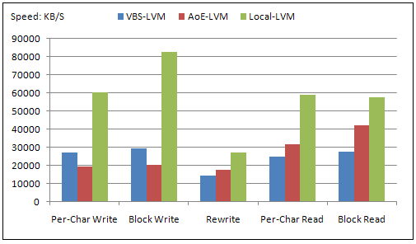
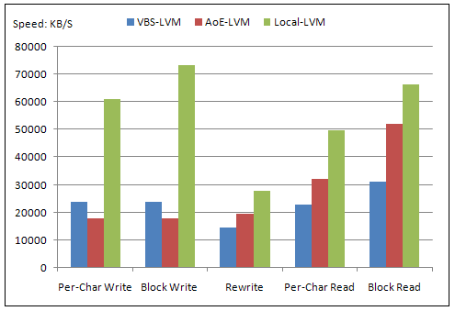
Preliminary performance tests
File size: 512 MB
File size: 1 GB

Slide 14
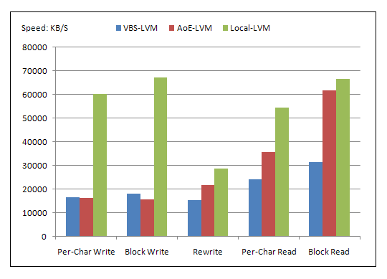
Preliminary performance tests
File size: 1.5 GB
Local-LVM constantly faster than VBS-LVM
- no network overhead, faster hard disk (83MB/s vs. 65MB/s)
VBS-LVM comparable to AoE-LVM
- iSCSI better optimized for write, AoE-LVM benefits more from cache on VMM

Slide 15
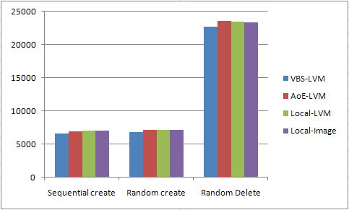
Preliminary performance tests
File creation and deletion

Slide 16
Future Work
1. More functions:
- user management
- read-only volume sharing
2. Security:
- Web services security
- iSCSI security
3. Availability and scalability:
- multiple volume servers
- volume duplication and synchronization

Slide 17
Acknowledgements
Thank Prof. Fox for his review and comments
Thank Joe Rinkovsky for his help with the Eucalyptus test bed
Thank Jun Wang for his help with the testing results
Thank Jan-Philip Gehrcke, Kate Keahey and the Nimbus group in Univ. of Chicago for their help with the integration with Nimbus

Slide 18
Questions?

