Slide 1
Supporting Queries and Analyses of Large-Scale Social Media Data with Customizable and Scalable Indexing Techniques over NoSQL databases
Xiaoming Gao, Judy Qiu
Indiana University
CCGrid 2014

Slide 2
Outline
Motivation and research challenges
Customizable and scalable indexing framework over NoSQL databases
Analysis Stack based on YARN
Preliminary results and future work

Slide 3
Motivation – characteristics of social media data analysis
Big Data for social media data analysis:
- Large size: TBs/PBs of historical data
- High speed: 10s of millions of streaming social updates per day
- Fine-grained data records, mostly write-once-read-many
Analysis workflows contain multiple stages and analysis algorithms
- Analyses focus on data subsets about specific social events/activities
- Need integrated support for queries and analysis algorithms

Slide 4
Scalable data platform – two possible approaches *
NoSQL Databases
Advantages
- highly scalable
- highly fault tolerant
- inexpensive
- easy to setup and use
- flexible schema
- integration with parallel processing frameworks
Disadvantages (weak functionalities)
- SQL
- indices
- query optimization
- transactions
Parallel DBMS
Advantages (strong functionalities)
- SQL
- indices
- query optimization
- transactions
Disadvantages
- difficult to scale
- expensive
- not suitable for frequent fault
- hard to setup and use
*: Comparison slide from Kyu-Younge Whang’s talk at DAFSAA 2011.

Slide 5
Indexing on SQL and current NoSQL databases
Single-dimensional indices
Multidimensional indices
Sorted (B+ tree)
Unsorted (Hash)
Inverted index
(Lucene)
R tree
(PostGIS)
K-d tree
(SciDB)
Quad tree
Single-field
Composite
Single-field
Composite
Single-field
HBase
Cassandra
Yes
Yes
Riak
Yes
Yes
MongoDB
Yes
Yes
Yes
Yes
Yes
Varied level of indexing support among different NoSQL databases.
Lack of customizability in supported index structures.

Slide 6
Indexing on current NoSQL databases
Lack of customizability – an example query
- get-tweets-with-text(occupy*, [2011-10-01, 2011-10-31])
- user-post-count(occupy*, [2011-10-01, 2011-10-31])
Query execution plan using traditional Lucene indices:
Text index
get_tweets_with_text(occupy*, time_window)
Time index
occupyIN:
1234
2346
… (tweet id)
occupyWS
…
2011-10-01:
7890
3345
… (tweet id)
2011-10-02:
…
Text index
Time index
IDs of tweets for occupy*
IDs of tweets for time window
results
10³ ~ 10⁴ per day
~10⁸ per day
Problem:
Complexity of query evaluation = O(max(|textIndex|, |timeIndex|))
Term frequencies and ranking are unnecessary

Slide 7
Indexing on current NoSQL databases
Suitable index structures:
occupyIN
2011-10-01|1234
Index on multiple (text and non-text) columns
Included columns
Index on computed columns
Customizability is necessary!
userID: 333
occupyWS
2011-10-02|3417
2011-10-03|4532
userID: 444
userID: 555
…
Research challenges:
- How to support a rich set of customizable index structures?
- How to achieve general applicability on most NoSQL databases?
- How to achieve scalable index storage and efficient indexing speed?

Slide 8
How to support a rich set of customizable index structures?
Abstract index structure
- A sorted list of index keys
- Each key associated with multiple entries sorted by unique entry IDs
- Each entry contains multiple additional fields
- Key, entry ID, and entry fields are customizable through a configuration file
key1
Entry ID
Entry ID
Entry ID
Field1
Field2
Field1
Field2
Field1
Field2
key2
Entry ID
Entry ID
Field1
Field2
Field1
Field2
key3
Entry ID
Entry ID
Entry ID
Entry ID
Field1
Field2
Field1
Field2
Field1
Field2
Field1
Field2
key4
Entry ID
Entry ID
Entry ID
Field1
Field2
Field1
Field2
Field1
Field2
…

Slide 9
Customizable and scalable indexing framework
Customizability through index configuration file
<index-config>
<source-recordset>tweets</source-recordset>
<index-name>textIndex</index-name>
<index-key sourcetype=“full-text”>{source-record}.text</index-key>
<index-entry-id>{source-record}.id</index-entry-id>
<index-entry-field>{source-record}.created_at</index-entry-field>
</index-config>
<index-config>
<source-recordset>users</source-recordset>
<index-name>snameIndex</index-name>
<indexer-class>iu.pti.hbaseapp.truthy.UserSnameIndexer</indexer-class>
</index-config>

Slide 10
Demonstration of Customizability
Sorted single filed and composite indices
2012-09-24
339330
Uid 735
2012-09-24|339330
2012-09-25
453278
Uid 852
2012-09-24|443319
2012-06-03|453278
…
…
Inverted index for text data
- store frequency/position for ranking
Composite index on both text and non-text fields
- not supported by any current NoSQL databases
american
339330
doc id
doc id
occupyIN
339330
tweet id
tweet id
1
frequency
frequency
2012-09-24
time
time
outrage
339330
doc id
occupyWS
339330
tweet id
1
frequency
2012-09-24
time
…
…

Slide 11
Demonstration of Customizability
Multikey index similar to what is supported by MongoDB
Original data record
Zip Index
{
"id":123456,
“name":“Shawn Williams!",
“zips":[
10036,
34301
],
...
}
10036
123456
34301
123456
Entry ID
…
Join index
Get-tweets-by-user-desc(ccgrid*, [2014-05-01, 2014-05-28])
User-description-tweet Index
catalog
123456
Uid 565
2014-04-02
ccgrid2014
228765
Tweet ID
Uid 676
2014-05-02
Uid
time
…
Simulating K-d tree and Quad-tree are also possible with necessary extensions

Slide 12
How to achieve general applicability and scalability?
Requirements for scalable index storage and efficient indexing speed
NoSQL databases: scalable storage and efficient random access for their data model
Mapping abstract index structure to underlying data model
General applicability and inherited scalability
Client application
Abstract data model and index structure
Mapping to table ops
Mapping to column family ops
Mapping to document ops
HBase
Cassandra
MongoDB
…

Slide 13
Implementation on HBase - IndexedHBase
Text Index Table
Text Index
entries
ameircan
339330
Entry ID
Entry ID
2012-09-24
Field2
Field1
Field2
Field1
Field2
american
339330
Entry ID
Entry ID
2012-09-24
Filed2
Field1
Filed2
Field1
Filed2
outrage
339330
Entry ID
2012-09-24
Field2
Field1
Field2
339330
Entry ID
outrage
2012-09-24
Filed2
Field1
Filed2
Efficient online updates of individual index entries
Efficient range scans following the order of <rowkey, column name, timestamp>
Reliable and scalable index storage on HDFS
Region split and dynamic load balancing – scalable index read/write speed

Slide 14
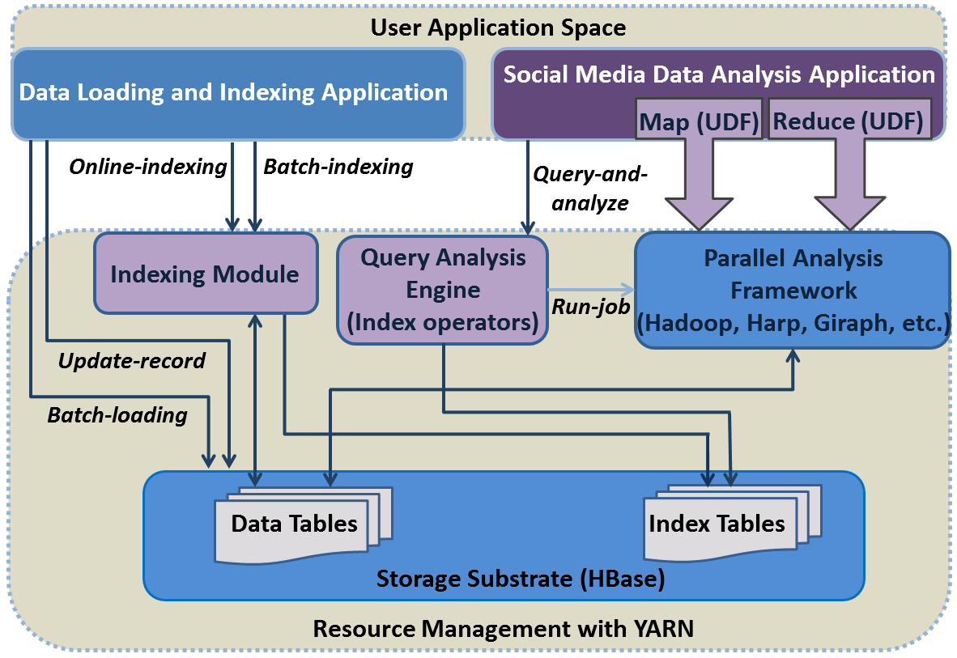
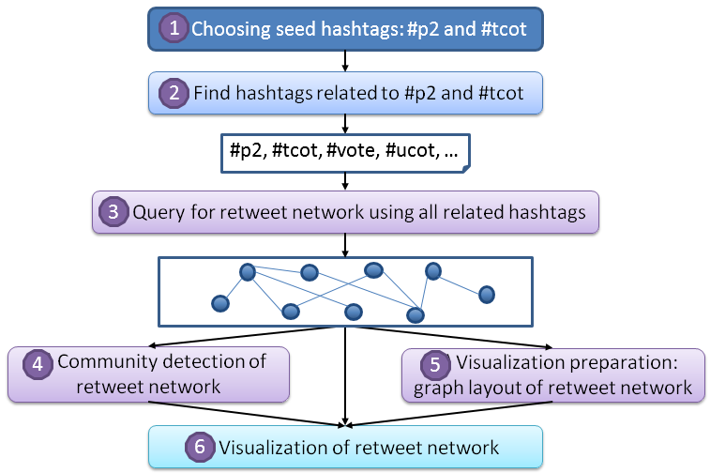
Integrate queries and analysis - analysis stack based on YARN
Query strategies and analysis tasks as basic building blocks for workflows
Customized index structures accessible from both queries and analysis algorithms

Slide 15
Performance tests – real applications from Truthy
Analyze and visualize the diffusion of information on Twitter
Tweets data collected through Twitter’s streaming API
Large data size: 10+ TB of historical data in .json.gz files
High speed: 50+ million tweets per day, 10s of GB compressed
“Memes” to represent discussion topics and social events, identified by hashtags, URLs, etc.
Notes:
Give an example of the real data. Summarize the data, queries, and analysis together.

Slide 16
Performance tests – real applications from Truthy
{
"text":"Americans Should be Outraged that Romney Pays Only 0.2% in Payroll Taxes http://t.co/a9I1O4F9 via @politicususa #p2 #p2b #topprog #ctl",
"created_at":“Mon Sep 24 00:00:21 +0000 2012",
"id":339330,
"entities":{
"user_mentions":[{
"screen_name":"politicususa",
"id_str":"92049",
}],
"hashtags":[“#p2”, “#p2b”, “#topprog”, “#ctl”],
"urls":[{
"url":"http:\/\/t.co\/a9I1O4F9",
"expanded_url":null
}]
},
"user":{
"created_at":"Sat Jan 22 18:39:46 +0000 2011",
"friends_count":63,
"id_str":“73562",
...
},
"retweeted_status":{
"text":“Americans Should... ",
"created_at":“Sun Sep 23 21:40:10 +0000 2012",
"id_str":"259227",
...
},
...
}
Basic range queries:
get-tweets-with-user(userID, time-window)
get-retweets(tweetID, time-window)
Text queries with time constraint:
get-tweets-with-meme(memes, time-window)
get-tweets-with-text(keywords, time-window)
Advanced queries:
timestamp-count(memes, time-window)
user-post-count(memes, time-window)
meme-post-count(memes, time-window)
meme-cooccur-count(memes, time-window)
get-retweet-edges(memes, time-window)
get-mention-edges(memes, time-window)

Slide 17
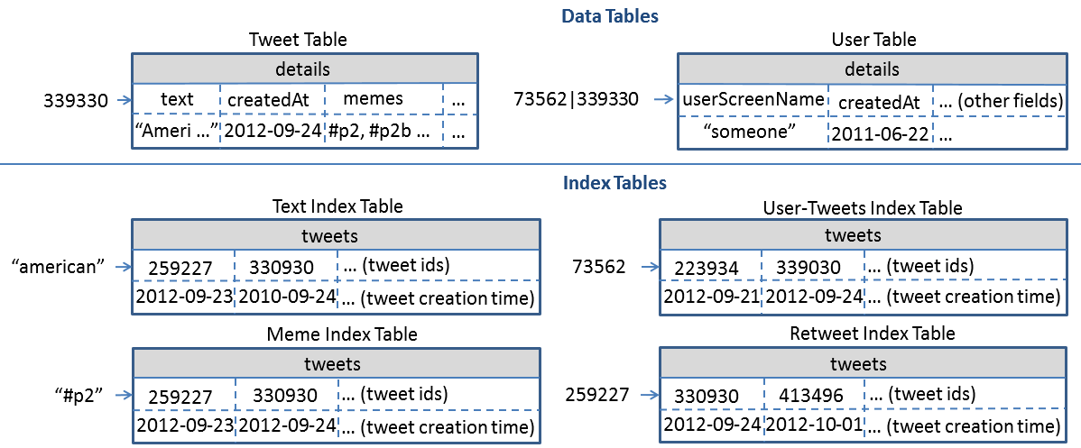
Tables designed for Truthy

Slide 18
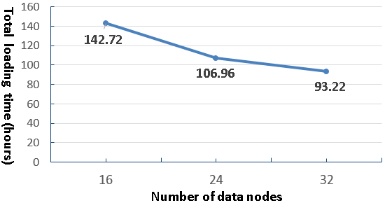
Scalable historical data loading and indexing
Measure total loading time for two month’s data with different cluster size on Alamo
- Total data size: 719 GB compressed, ~1.3 billion tweets
- Online indexing when loading each tweet

Slide 19
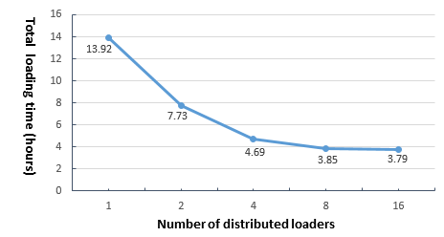
Scalable indexing of streaming data
Test potential data rate faster than current stream
Split 2013-07-03.json.gz into fragments distributed across all nodes
HBase cluster size: 8
Average loading and indexing speed observed on one loader: 2ms per tweet

Slide 20
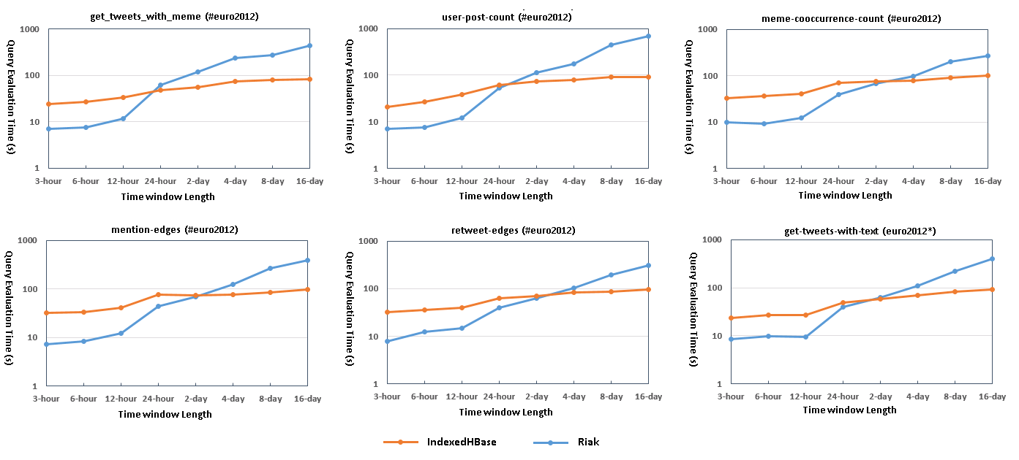
Query evaluation performance comparison
Riak: implementation using original text indices and MapReduce on Riak
IndexedHBase more efficient at queries with large intermediate data and result sizes
Most queries involve time windows of weeks or months

Slide 21
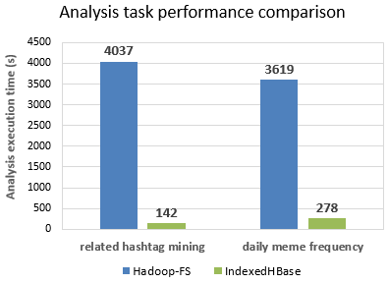
Performance comparison against raw-data-scan solutions
#mitt2012
#p2
#vote
#obama
…
2012 presidential election
Related hashtag mining: #p2, [2012-09-24, 2012-11-06]; Daily meme frequency: 2012-06
Hadoop-FS: Hadoop MapReduce with raw File Scan
IndexedHBase: analysis algorithms relying on index data
Value of indexing for analysis algorithms beyond basic queries
Notes:
Wrong sentence:

Slide 22
Summary and future work
Two challenges in big social data analysis
- Targeted analysis of data subsets
- Workflows involving various processing frameworks
Integrated support for query and analysis is a big trend
- Deeper integration through usage of indices
Next step:
- Explore value of indices in streaming analysis algorithms

Slide 23
Thanks!

Slide 24
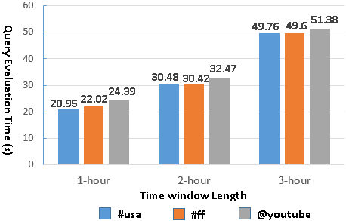
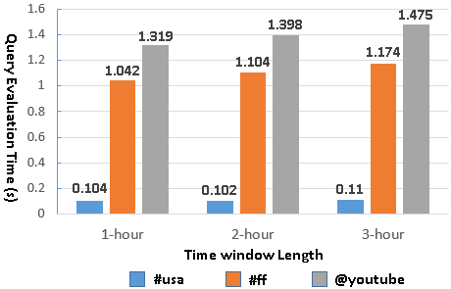
Query evaluation time with separate meme and time indices on Riak
Query evaluation time with customized meme index on IndexedHBase

Slide 25
Core components and interface to client applications
Client Application
index(dataRecord)
unindex(dataRecord)
search(indexConstraints)
General Customizable Indexer
Basic Index Operator
User Defined Index Operator
Index Configuration File
User Defined Indexer
User Defined Indexer
…
NoSQL database
Online indexing: index each inserted data record on the fly
Batch indexing: index existing original data sets on NoSQL database
search(indexConstraints): query an index with constraints on index key, entry ID, or entry fields.
Constraint type: value set, range, regular expression

Slide 26
Implementation on HBase - IndexedHBase
Region split and dynamic load balancing for index table
Distributed indexers
…
Text Index Table
Text Index Table
Text Index Table
Text Index Table
a - f
g - k
l - r
s - z
a - k
g - k
Region server
Region server
Region server
Region server
HMaster

Slide 27
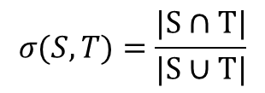
Apply customized indices in analysis algorithms
Related hashtag mining algorithm with Hadoop MapReduce
#mitt2012
$$σ(S,T)=\frac{|S∩T|}{|S∪T|}$$
Jaccard coefficient:
#p2
S: set of tweets containing seed hashtag s
T: set of tweets containing target hashtag t
σ > threshold means t is related to s
#vote
#obama
…
2012 presidential election
Step 1: use Meme Index to find S
Step 2 (Map): find every t that co-occurs with s
Step 3 (Reduce): for each t, compute σ using Meme Index to get T
Major computation done by using index instead of original data
Notes:
Question: if new index structures are needed for new analysis algorithms, then batch indexing mechanism will be useful

Slide 28
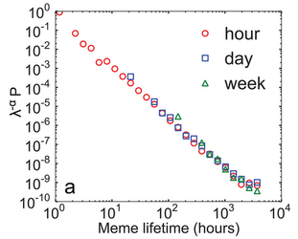
Apply customized indices in analysis algorithms
Hashtag daily frequency generation
#p2 : 2012-09-01|2344, 2012-09-02|32001, …
#tcot : 2012-09-01|5536, 2012-09-02|8849, …
…
Meme Index Table
tweets
259227
339330
… (tweet ids)
“#p2”
2012-09-23
2012-09-24
… (tweet creation time)
- Can be done by only scanning the index
- MapReduce over HBase index tables
Notes:
Include output visiualization

Slide 29
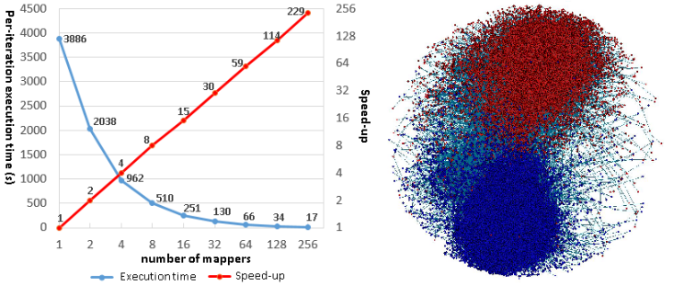
Other components for analysis workflow construction
Iterative MapReduce implementation of Fruchterman-Reingold algorithm
- Force-directed graph layout algorithm
- Twister-Ivy: distributed computation + chain-model broadcast
Notes:
Clarification: chain model on Twister, and new version on Harp using All-Gather. Harp: Hadoop based implementation

Slide 30
Suggested mappings for other NoSQL databases
Feature needed | Cassandra | Riak | MongoDB
Fast real time insertion and updates of index entries | Yes. Index key as row key and entry ID as column name, or index key + entry ID as row key. | Yes. Index key + entry ID as object key. | Yes. Index key + entry ID as “_id” of document.
Fast real time read of index entries | Yes. Index key as row key and entry ID as column name, or index key + entry ID as row key. | Yes. Index key + entry ID as object key. | Yes. Index key + entry ID as “_id” of document.
Scalable storage and access speed of index entries | Yes. | Yes. | Yes.
Efficient range scan on index keys | Yes with order preserving hash function, but “not recommended”. | Doable with a secondary index on an attribute whose value is object key, but performance unknown. | Doable with Index key + entry ID as “_id” of document, but performance unknown.
Efficient range scan on entry IDs | Yes with order preserving hash function and index entry ID as column name. | Doable with a secondary index on an attribute whose value is object key, but performance unknown. | Doable with Index key + entry ID as “_id” of document, but performance unknown.

