Slide 1

Advanced Virtualization Techniques for High Performance Cloud Cyberinfrastructure
Andrew J. Younge
Ph.D. Candidate
Indiana University
Advisor: Geoffrey C. Fox
http://futuregrid.org

Slide 2
HPC + Cloud?
HPC
Cloud
Fast, tightly coupled systems
Performance is paramount
Massively parallel applications
MPI applications for distributed memory computation
Leverage accelerator cards or co-processors (new)
Built on commodity PC components
User experience is paramount
Scalability and concurrency are key to success
Big Data applications to handle the Data Deluge
  4th Paradigm
Leverage virtualization
Challenge: Leverage performance of HPC with usability of Clouds

Slide 3
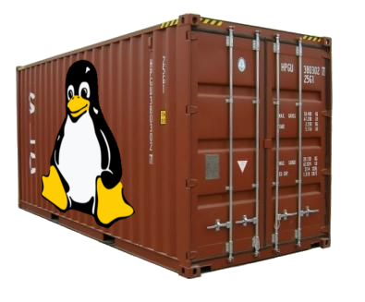
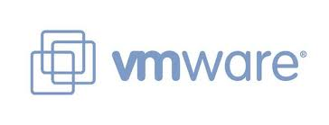
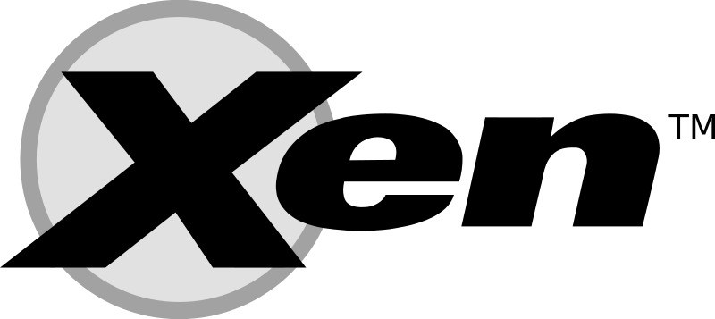



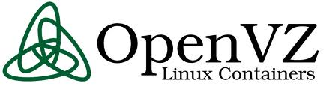
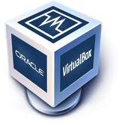
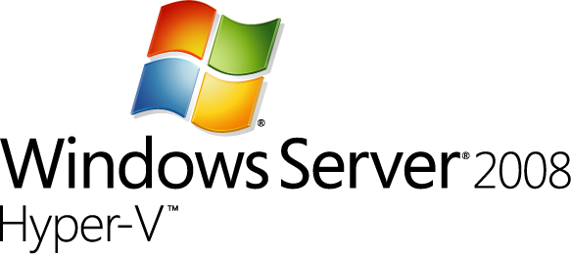

Current Hypervisors

Slide 4
Features
 | Xen | KVM | VirtualBox | VMWare
Paravirtualization | Yes | No | No | No
Full Virtualization | Yes | Yes | Yes | Yes
Host CPU | X86, X86_64, IA64 | X86, X86_64, IA64, PPC | X86, X86_64 | X86, X86_64
Guest CPU | X86, X86_64, IA64 | X86, X86_64, IA64, PPC | X86, X86_64 | X86, X86_64
Host OS | Linux, Unix | Linux | Windows, Linux, Unix | Proprietary Unix
Guest OS | Linux, Windows, Unix | Linux, Windows, Unix | Linux, Windows, Unix | Linux, Windows, Unix
VT-x / AMD-v | Opt | Req | Opt | Opt
Supported Cores | 128 | 16* | 32 | 8
Supported Memory | 4TB | 4TB | 16GB | 64GB
3D Acceleration | Xen-GL | VMGL | Open-GL | Open-GL, DirectX
Licensing | GPL | GPL | GPL/Proprietary | Proprietary

Slide 5
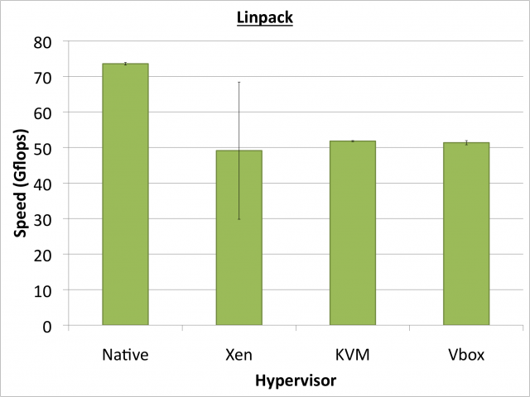
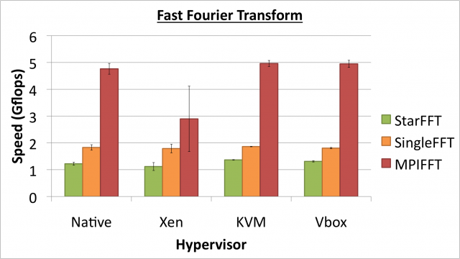
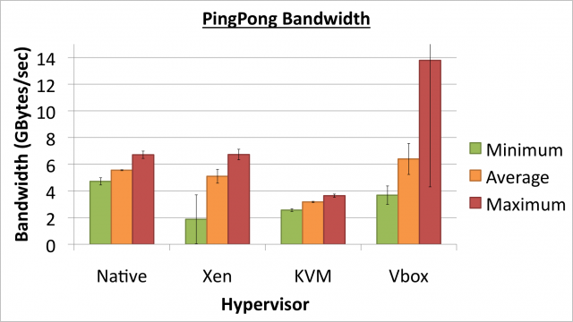
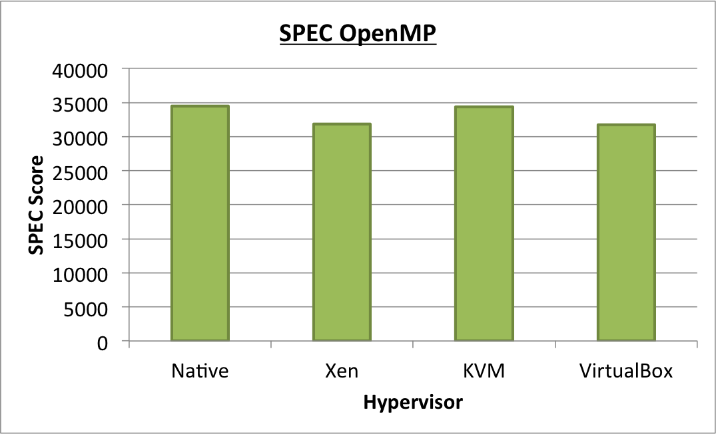
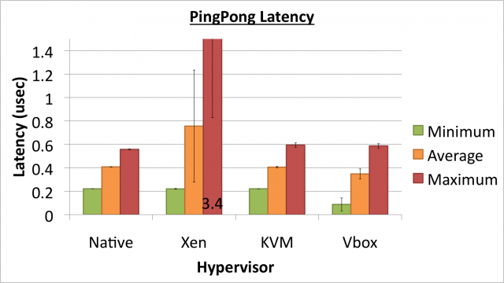
Notes:
HPL measures the floating point execution rate for solving a system of linear equations.
Hypervisor performance in Linpack reaches roughly 70% of native performance during our tests, with Xen showing a high degree of variation.

Slide 6
Virtualization in HPC
Initial Question: Is Cloud Computing viable for scientific High Performance Computing?
  Yes, some of the time
Features: All hypervisors are similar
Performance: KVM is fastest across most benchmarks, VirtualBox close. Overall, we have found KVM to be the best hypervisor choice for HPC.
  Latest Xen shows results just as promising
** Analysis of Virtualization Technologies for High Performance Computing
Environments, A. J. Younge et al **

Slide 7
IaaS with HPC Hardware
Providing near-native hypervisor performance cannot solve all challenges of supporting parallel computing in cloud infrastructure.
Need to leverage HPC hardware
  Accelerator cards
  High speed, low latency I/O interconnects
  Others…
Need to characterize and minimize overhead wherever it exists

Slide 8
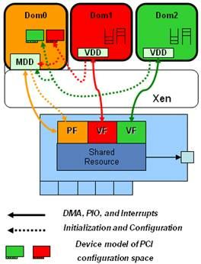
SR-IOV VM Support
Can use SR-IOV for 10GbE and InfiniBand
  Reduce host CPU utilization
  Maximize Bandwidth
  “Near native” performance
No InfiniBand in HVM VMs
  No IPoIB, EoIB and PCI-Passthrough are impractical
Requires extensive device driver support
From “SR-IOV Networking in Xen: Architecture, Design and Implementation”

Slide 9
SR-IOV InfiniBand
SR-IOV enabled InfiniBand drivers now available
OFED support for KVM, Xen still TBD
Initial evaluation shows promise for IB-enabled VMs
  SR-IOV Support for Virtualization on InfiniBand Clusters: Early Experience, Jose et al – CCGrid 2013
  ** Bridging the Virtualization Performance Gap for HPC Using SR-IOV for InﬁniBand, Musleh et al – Accepted CLOUD 2014 **
  Exploring Infiniband Hardware Virtualization in OpenNebula towards Efficient High-Performance Computing, Ruivo et al – here at CCGrid 2014
  SDSC Comet

Slide 10
GPUs in Virtual Machines
Need for GPUs on Clouds
  GPUs are becoming commonplace in scientific computing
  Great performance-per-watt
Different competing methods for virtualizing GPUs
  Remote API for CUDA calls
  Direct GPU usage within VM
Advantages and disadvantages to both solutions
Notes:
Can use remote GPUs, but all data goes over the network
Can be very inefficient for applications with non-trivial memory movement
Some implementations do not support CUDA extensions in C
Have to separate CPU and GPU code
Requires special decouple mechanism
Cannot directly drop in code with existing solutions.

Slide 11
Direct GPU Virtualization
Allow VMs to directly access GPU hardware
Enables CUDA and OpenCL code!
Utilizes PCI Passthrough of device to guest VM
  Uses hardware directed I/O virt (VT-d or IOMMU)
  Provides direct isolation and security of device
  Removes host overhead entirely
Similar to what Amazon EC2 uses

Slide 12
Hardware Virtualization

Slide 13
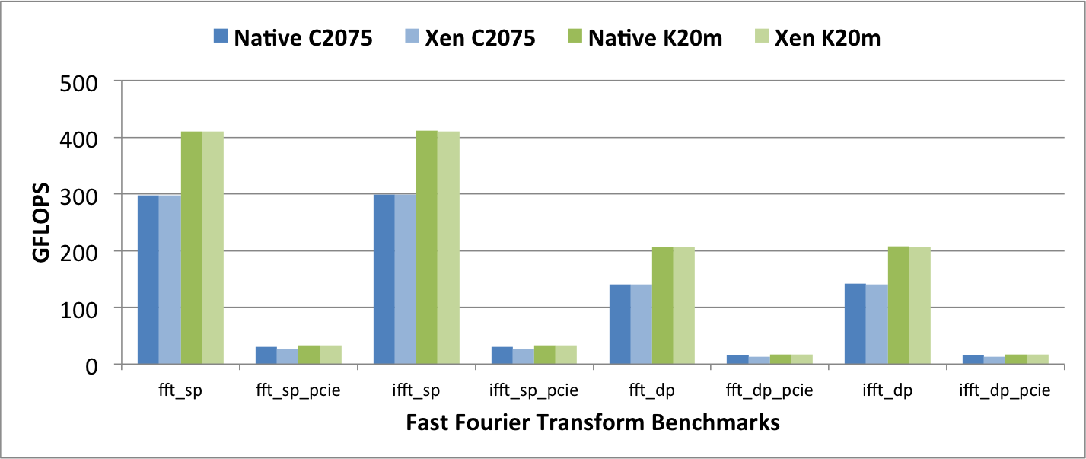
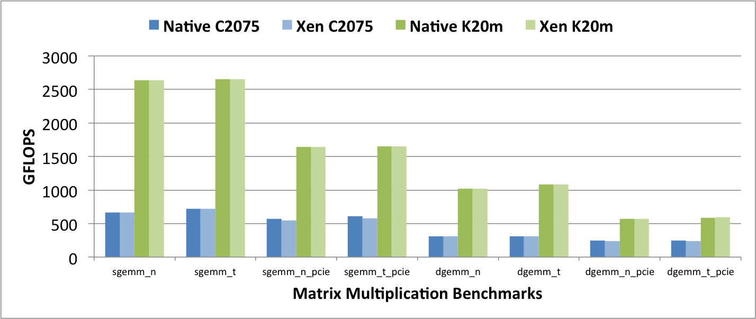
Notes:
Non-PCIe benchmarks = near- native performance using the Kepler GPUs and Fermi GPUs when compared to bare metal cases
overhead within Xen VMs is consistently less than 1%
some performance impact when calculating the total FLOPs with the pcie bus in the equation
With PCIE:
C2075 15% impact for FFT and 5% impact for Matrix Multi :/
K20m – only around 1% as worst, much better! ☺

Slide 14
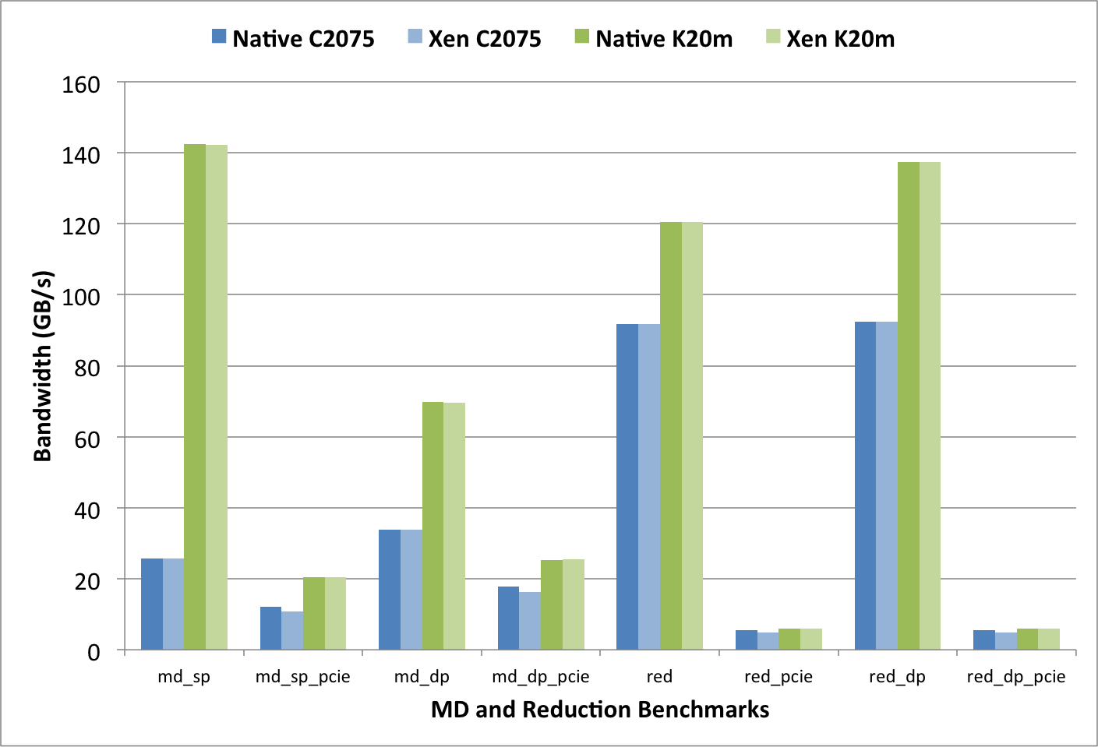
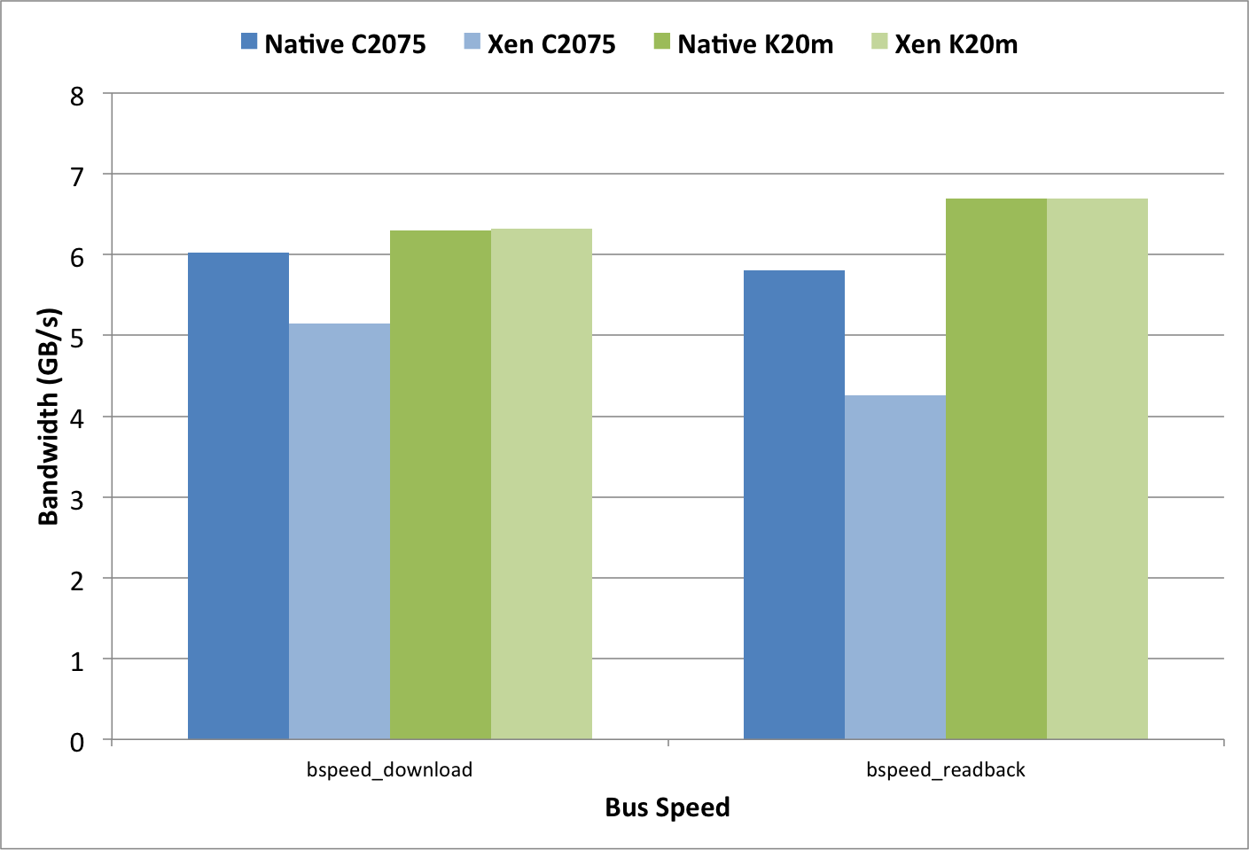
Notes:
consistent overhead in the Fermi C2075 VMs
-14.6% performance impact for download (to-device)
- 26.7% impact in readback (from- device).
Kepler K20 VMs do not experience the same overhead in the PCI-Express bus, and instead perform at near-native performance.
Results indicate that the overhead is minimal in the actual VT-d mechanisms, and instead due to other factors.

Slide 15
GPU Discussion
GPU Passthrough possible in Xen
Overhead is minimal for GPU computation
  Sandy-Bridge/Kepler has < 1.2% overall overhead Westmere/Fermi has < 1% computational overhead, but worst-case ~15% due to PCI-Express buss
  PCIE overhead not likely due to VT-d mechanisms
  NUMA configuration in Westmere CPU architecture
GPU PCI Passthrough performs better than other front-end remote API solutions
Developed similar methods in KVM now (new)
**Evaluating GPU Passthrough in Xen for High Performance Cloud Computing, A. J. Younge et al **

Slide 16
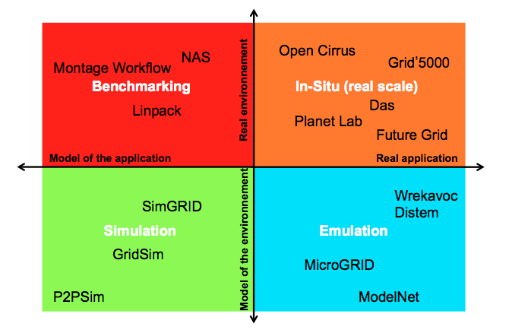
Experimental Computer Science
From “Supporting Experimental Computer Science”

Slide 17
Experimental Computer Science
From “Supporting Experimental Computer Science”

Slide 18
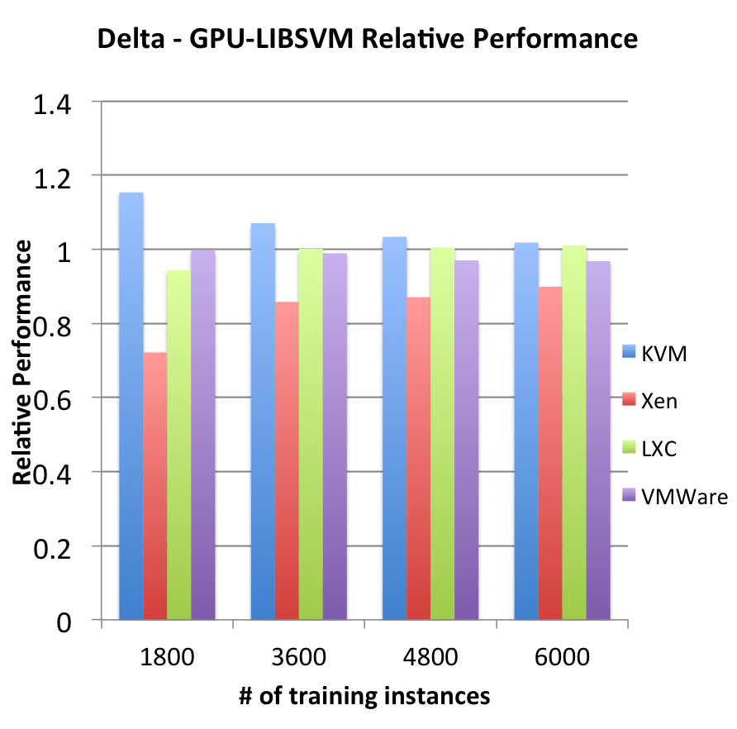
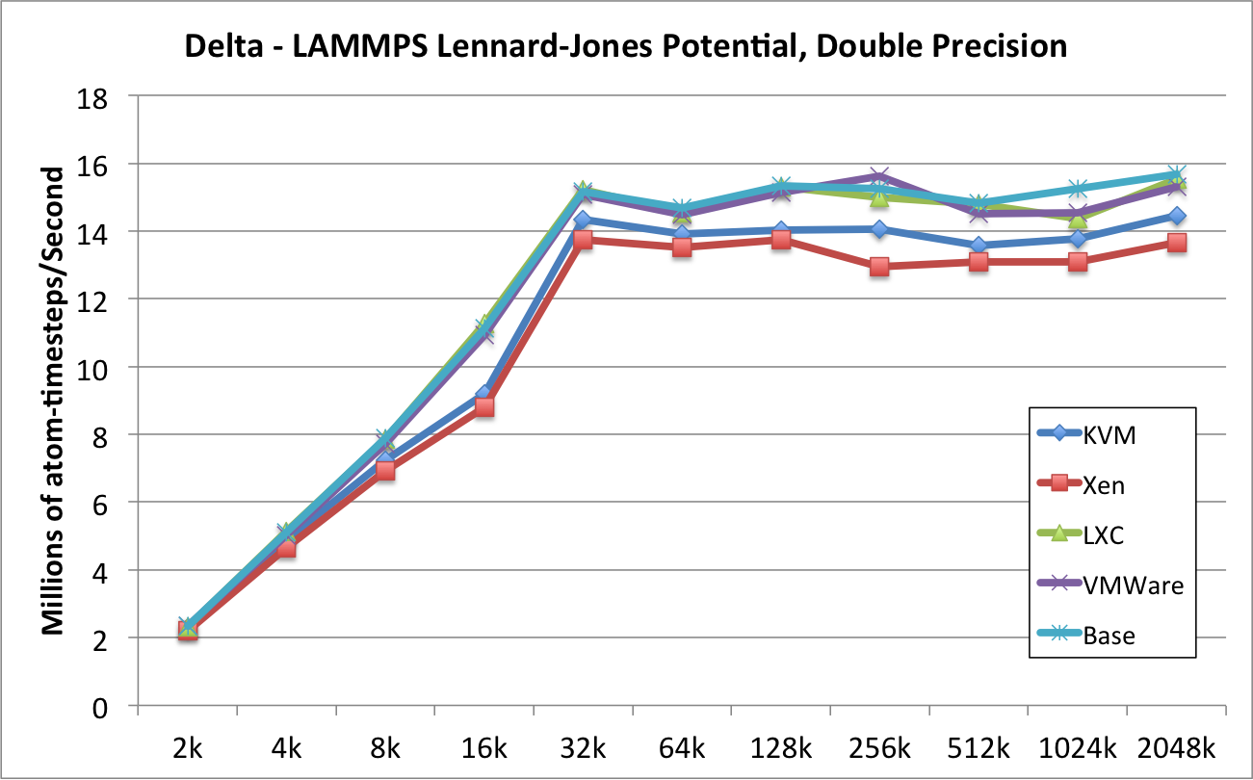
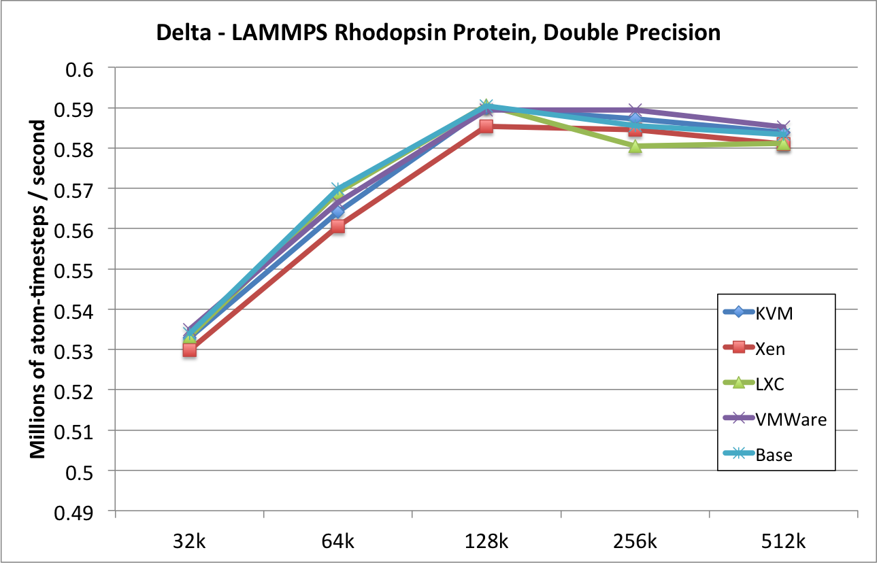
Scaling Applications in VMs
** GPU-Passthrough Performance: A Comparison of KVM, Xen, VMWare ESXi, and LXC for CUDA and OpenCL Applications, J. P. Walters et al **

Slide 19
Conclusion
Today’s hypervisors can provide near-native performance for many HPC workloads
  Additional VM tweaks can yield considerable performance improvements.
Pioneer efforts to support GPUs within VMs
  Promising performance
  Only minimal overhead in PCIE bus
QDR InfiniBand represents a leap in interconnect performance in VMs
Integrate into OpenStack IaaS Cloud
Support large scale scientific applications in HPC Cloud

Slide 20
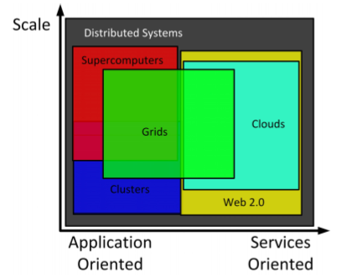
Cloud Computing
From: Cloud Computing and Grid Computing 360-Degree Compared, Foster et al.

Slide 21
Cloud Computing
High Performance Clouds
From: Cloud Computing and Grid Computing 360-Degree Compared, Foster et al.

Slide 22
Thanks!
Andrew J. Younge
Ph.D. Candidate
Indiana University
ajyounge@indiana.edu
http://ajyounge.com

