Slide 1
The State of Cloud Computing in Distributed Systems
Andrew J. Younge
Indiana University
http://futuregrid.org

Slide 2
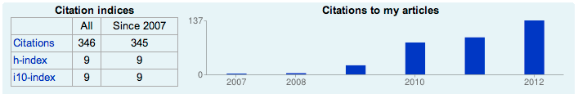
# whoami
PhD Student at Indiana University
  Advisor: Dr. Geoffrey C. Fox
  Been at IU since early 2010
  Worked extensively on the FutureGrid Project
Previously at Rochester Institute of Technology
  B.S. & M.S. in Computer Science in 2008, 2010
> dozen publications
  Involved in Distributed Systems since 2006 (UMD)
Visiting Researcher at USC/ISI East (2012)
Google summer code w/ Argonne National Laboratory (2011)
http://ajyounge.com

Slide 3
What is Cloud Computing?
“Computing may someday be organized as a public utility just as the telephone system is a public utility... The computer utility could become the basis of a new and important industry.”
  John McCarthy, 1961
“Cloud computing is a large-scale distributed computing paradigm that is driven by economies of scale, in which a pool of abstracted, virtualized, dynamically scalable, managed computing power, storage, platforms, and services are delivered on demand to external customers over the Internet.”
  Ian Foster, 2008

Slide 4
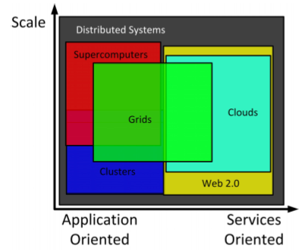
Cloud Computing
Distributed Systems encompasses a wide variety of technologies.
Per Foster, Grid computing spans most areas and is becoming more mature.
Clouds are an emerging technology, providing many of the same features as Grids without many of the potential pitfalls.
From “Cloud Computing and Grid Computing 360-Degree Compared”

Slide 5
Cloud Computing
Features of Clouds:
  Scalable
  Enhanced Quality of Service (QoS)
  Specialized and Customized
  Cost Effective
  Simplified User Interface
Notes:
Bottom line:
Added functionality and reliability with small penalties

Slide 6
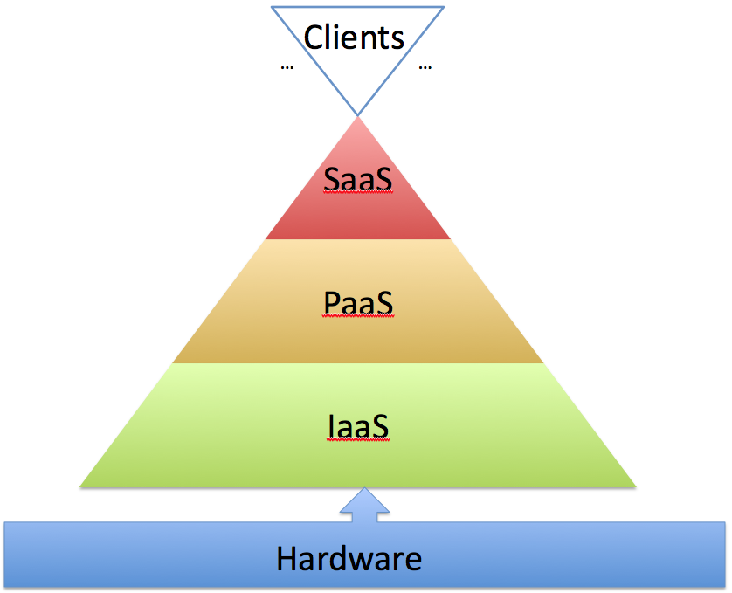
*-as-a-Service
Notes:
Clients – Browser
Saas – Google Docs
PaaS – Microsoft Azure, Google App Engine
IaaS – Amazon Elastic Compute Cloud

Slide 7
*-as-a-Service
Notes:
Clients – Browser
Saas – Google Docs
PaaS – Microsoft Azure, Google App Engine
IaaS – Amazon Elastic Compute Cloud

Slide 8
HPC + Cloud?
HPC
Cloud
Fast, tightly coupled systems
Performance is paramount
Massively parallel applications
MPI applications for distributed memory computation
Built on commodity PC components
User experience is paramount
Scalability and concurrency are key to success
Big Data applications to handle the Data Deluge
  4th Paradigm
Challenge: Leverage performance of HPC with usability of Clouds

Slide 9
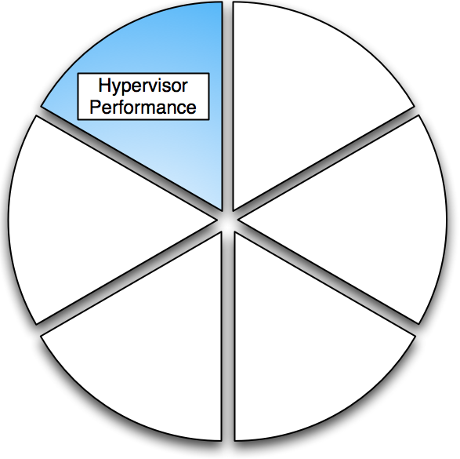
Virtualization Performance
From: “Analysis of Virtualization Technologies for High Performance Computing Environments”

Slide 10
Virtualization
Virtual Machine (VM) is a software implementation of a machine that executes as if it was running on a physical resource directly.
Typically uses a Hypervisor or VMM which abstracts the hardware from the OS.
Enables multiple OSs to run simultaneously on one physical machine.

Slide 11
Motivation
Most “Cloud” deployments rely on virtualization.
  Amazon EC2, GoGrid, Azure, Rackspace Cloud …
  Nimbus, Eucalyptus, OpenNebula, OpenStack …
Number of Virtualization tools or Hypervisors available today.
  Xen, KVM, VMWare, Virtualbox, Hyper-V …
Need to compare these hypervisors for use within the scientific computing community.
Notes:
When the only tool you have is a hammer, you tend to treat everything as if it were a nail. - Abraham Maslow

Slide 12







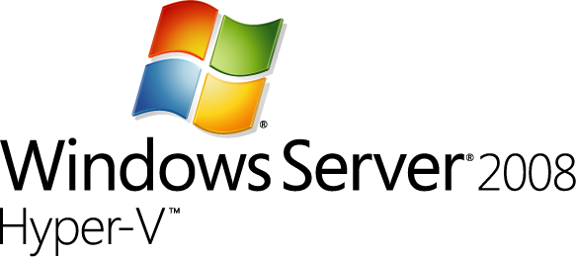

Current Hypervisors

Slide 13
Features
 | Xen | KVM | VirtualBox | VMWare
Paravirtualization | Yes | No | No | No
Full Virtualization | Yes | Yes | Yes | Yes
Host CPU | X86, X86_64, IA64 | X86, X86_64, IA64, PPC | X86, X86_64 | X86, X86_64
Guest CPU | X86, X86_64, IA64 | X86, X86_64, IA64, PPC | X86, X86_64 | X86, X86_64
Host OS | Linux, Unix | Linux | Windows, Linux, Unix | Proprietary Unix
Guest OS | Linux, Windows, Unix | Linux, Windows, Unix | Linux, Windows, Unix | Linux, Windows, Unix
VT-x / AMD-v | Opt | Req | Opt | Opt
Supported Cores | 128 | 16* | 32 | 8
Supported Memory | 4TB | 4TB | 16GB | 64GB
3D Acceleration | Xen-GL | VMGL | Open-GL | Open-GL, DirectX
Licensing | GPL | GPL | GPL/Proprietary | Proprietary

Slide 14
Benchmark Setup
HPCC
SPEC OMP
Industry standard HPC benchmark suite from University of Tennessee.
Sponsored by NSF, DOE, DARPA.
Includes Linpack, FFT benchmarks, and more.
Targeted for CPU and Memory analysis.
From the Standard Performance Evaluation Corporation.
Suite of applications aggrigated together
Focuses on well-rounded OpenMP benchmarks.
Full system performance analysis for OMP.
Notes:
Tried to keep it as fair and even as possible; Picked standardized benchmarks, no tweaks, no tricks, no optimization.

Slide 15
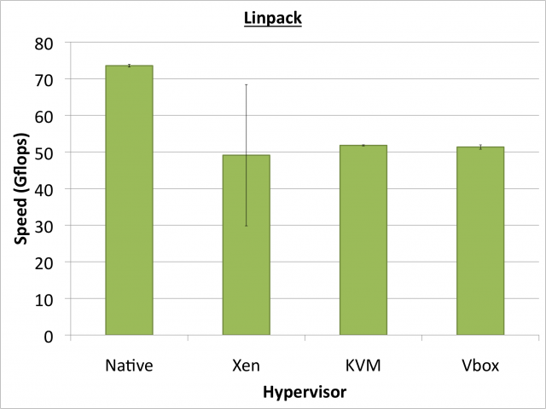
Notes:
HPL measures the floating point execution rate for solving a system of linear equations.
Hypervisor performance in Linpack reaches roughly 70% of native performance during our tests, with Xen showing a high degree of variation.

Slide 16
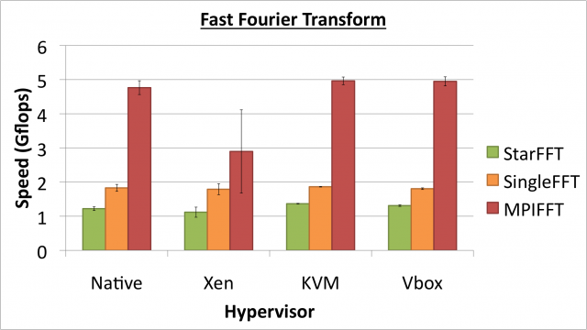
Notes:
EP-FFT aka "Star-FFT”, ----check on definition ---The Embarrassingly Parallel STREAM benchmark is a simple synthetic benchmark program that measures sustainable memory bandwidth and the corresponding computation rate for simple numerical vector kernels. It is run in embarrassingly parallel manner - all computational processes perform the benchmark at the same time, the arithmetic average rate is reported. Unit: Giga Bytes per Second
FFT benchmarks seem to be less influenced by hypervisors, with KVM and VirtualBox performing at native speeds yet Xen incurs a 50% performance hit with MPIFFT.

Slide 17
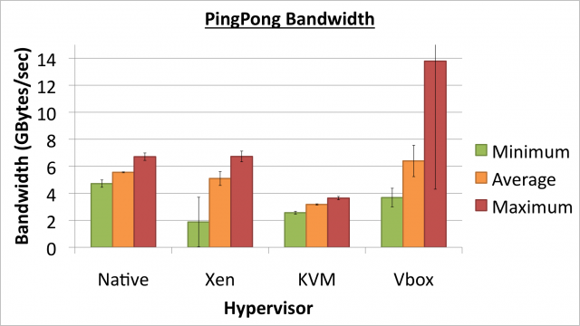
Notes:
Average Ping-Pong Bandwidth, reports the average bandwidth for a number of non-simultaneous ping-pong tests. The ping-pongs are performed between as many as possible (there is an upper bound on the time it takes to complete this test) distinct pairs of processors. The test uses MPI standard send and receive routines. Unit: Giga Bytes per second
Bandwidth tests vary largely, with the VirtualBox hypervisor performing the best, however having large performance variations.

Slide 18
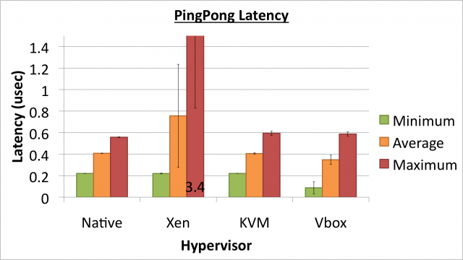
Notes:
Average Ping-Pong Latency, reports the average latency for a number of non-simultaneous ping-pong tests. The ping-pongs are performed between as many as possible (there is an upper bound on the time it takes to complete this test) distinct pairs of processors. The test uses MPI standard send and receive routines. Unit: micro-seconds
With PingPong latency KVM and VirtualBox perform close to native speeds while Xen has large latencies under maximum conditions.

Slide 19
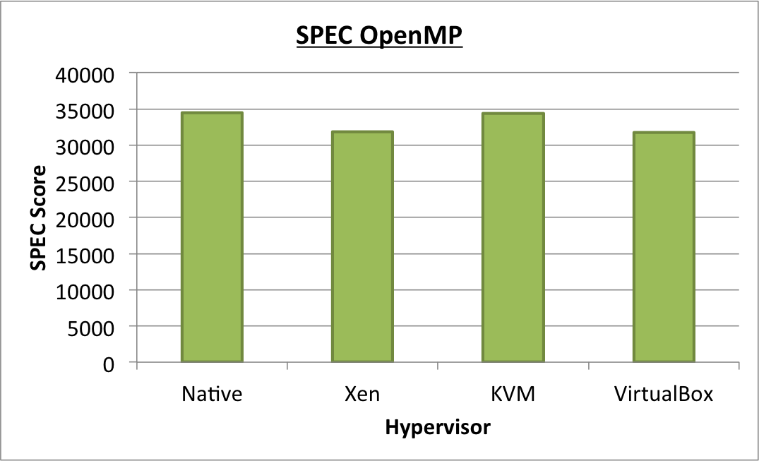
Notes:
KVM does really well – near native performance

Slide 20
Virtualization in HPC
Big Question: Is Cloud Computing viable for scientific High Performance Computing?
  Our answer is “Yes” (for the most part).
Features: All hypervisors are similar.
Performance: KVM is fastest across most benchmarks, VirtualBox close.
Overall, we have found KVM to be the best hypervisor choice for HPC.
  Latest Xen shows results just as promising

Slide 21
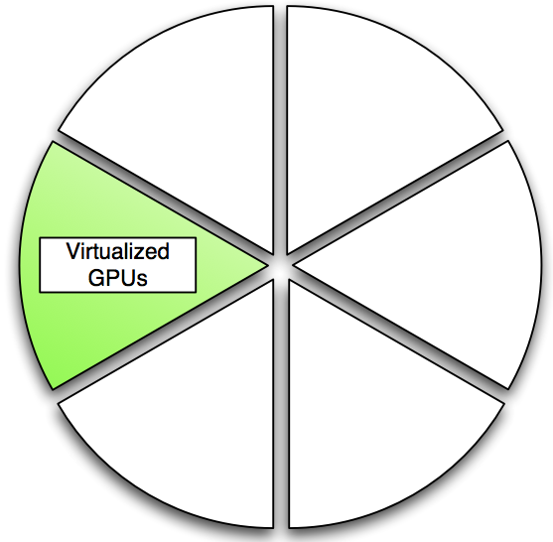
Advanced Accelerators

Slide 22
Motivation
Need for GPUs on Clouds
  GPUs are becoming commonplace in scientific computing
  Great performance-per-watt
Different competing methods for virtualizing GPUs
  Remote API for CUDA calls
  Direct GPU usage within VM
Advantages and disadvantages to both solutions

Slide 23
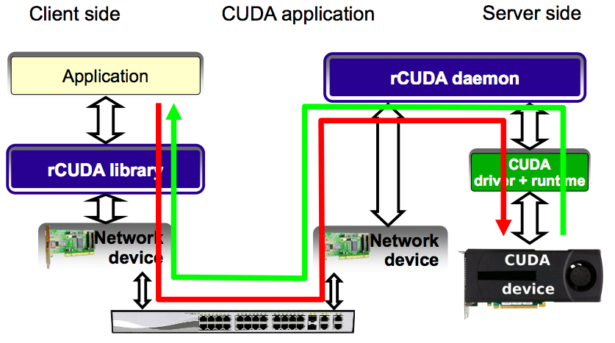
Front-end GPU API

Slide 24
Front-end API Limitations
Can use remote GPUs, but all data goes over the network
  Can be very inefficient for applications with non-trivial memory movement
Some implementations do not support CUDA extensions in C
  Have to separate CPU and GPU code
  Requires special decouple mechanism
  Cannot directly drop in code with existing solutions.

Slide 25
Direct GPU Virtualization
Allow VMs to directly access GPU hardware
Enables CUDA and OpenCL code!
Utilizes PCI-passthrough of device to guest VM
  Uses hardware directed I/O virt (VT-d or IOMMU)
  Provides direct isolation and security of device
  Removes host overhead entirely
Similar to what Amazon EC2 uses

Slide 26
Hardware Virtualization

Slide 27
Previous Work
LXC support for PCI device utilization
  Whitelist GPUs for chroot VM
  Environment variable for device
  Works with any GPU
Limitations: No security, no QoS
  Clever user could take over other GPUs!
  No security or access control mechanisms to control VM utilization of devices
  Potential vulnerability in rooting Dom0
  Limited to Linux OS

Slide 28
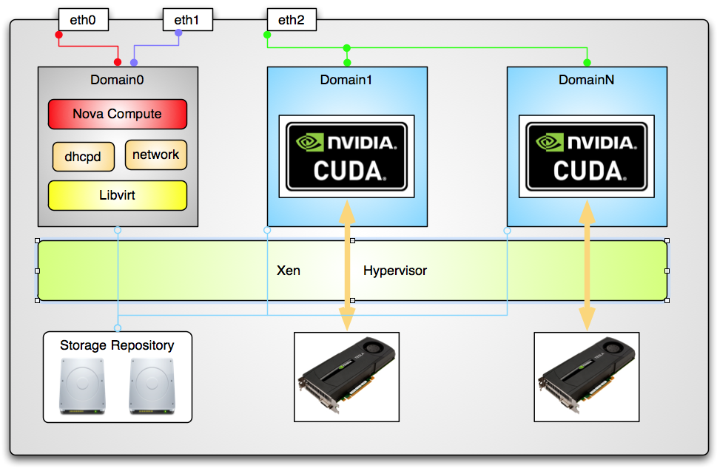
#2: Libvirt + Xen + OpenStack

Slide 29
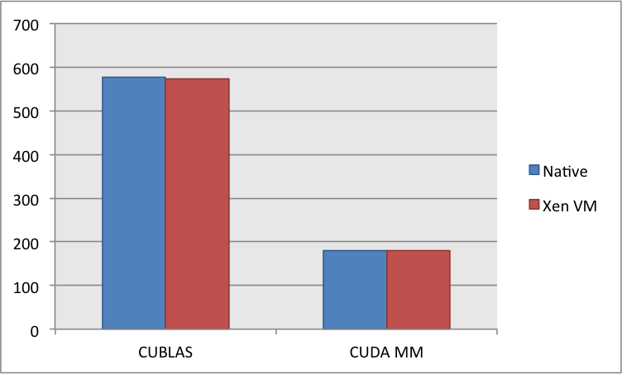
Performance
CUDA Benchmarks
  89-99% compared to
  Native performance
  VM memory matters
  Outperform rCUDA?

Slide 30
Performance

Slide 31
Future Work
Fix Libvirt + Xen configuration
Implementing Libvirt Xen code
  Hostdev information
  Device access & control
Discerning PCI devices from GPU devices
  Important for GPUs + SR-IOV IB
Deploy on FutureGrid

Slide 32
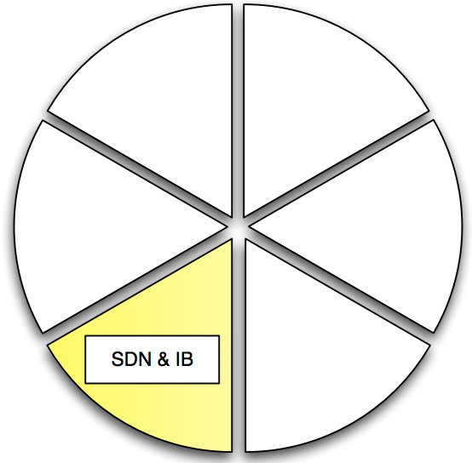
Advanced Networking

Slide 33
Cloud Networking
Networks are a critical part of any complex cyberinfrastructure
  The same is true in clouds
  Difference is clouds are on-demand resources
Current network usage is limited, fixed, and predefined.
Why not represent networks as-a-Service?
  Leverage Software Defined Networking (SDN)
  Virtualized private networks?

Slide 34
Network Performance
Develop best practices for networks in IaaS
Start with low hanging fruit
  Hardware selection – GbE, 10GbE, IB
  Implementation – Full virtualization, emulation, passthrough
  Drivers – SR-IOV compliant,
  Optimization tools – macvlan, ethtool, etc

Slide 35
Quantum
Utilize new and emerging networking technologies in OpenStack
  SDN – Openflow
  Overlay networks –VXLAN
  Fabrics – Qfabric
Plugin mechanism to extend SDN of choice
Allows for tenant control of network
  Create multi-tier networks
  Define custom services
  …

Slide 36
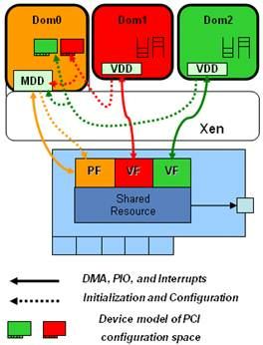
InfiniBand VM Support
No InfiniBand in VMs
  No IPoIB, EoIB and PCI-Passthrough are impractical
Can use SR-IOV for InfiniBand & 10GbE
  Reduce host CPU utilization
  Maximize Bandwidth
  “Near native” performance
Available in next OFED driver release
From “SR-IOV Networking in Xen: Architecture, Design and Implementation”

Slide 37
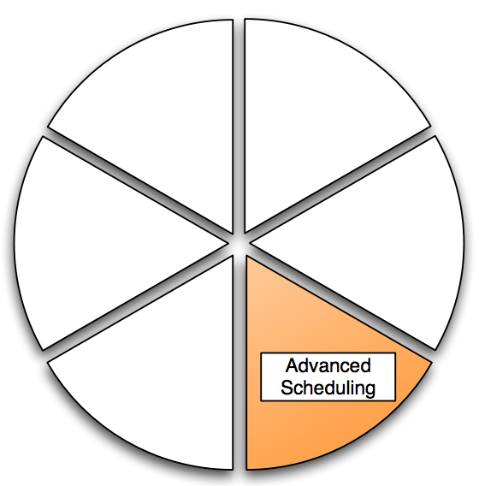
Advanced Scheduling
From: “Efficient Resource Management for Cloud Computing Environments”

Slide 38
VM scheduling on Multi-core Systems
There is a nonlinear relationship between the number of processes used and power consumption
We can schedule VMs to take advantage of this relationship in order to conserve power
Power consumption curve on an Intel Core i7 920 Server
(4 cores, 8 virtual cores with Hyperthreading)
Notes:
Mension core i7 system
Describe in more details, illustrating how I’ve created it

Slide 39
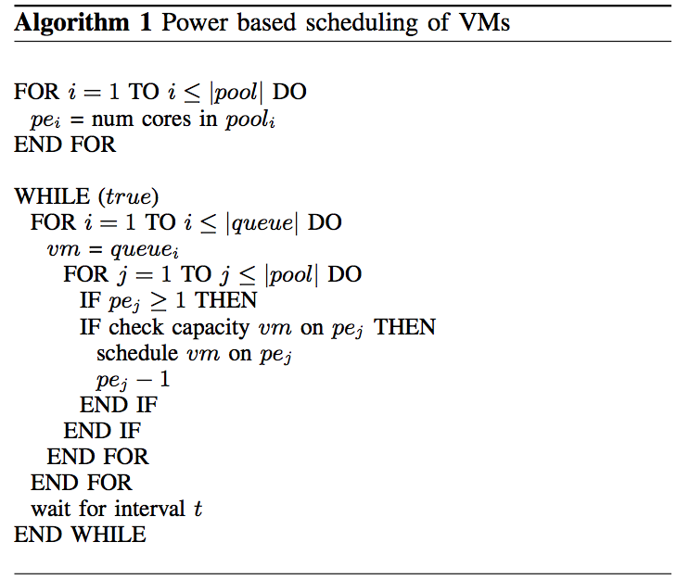
Power-aware Scheduling
Schedule as many VMs at once on a multi-core node.
  Greedy scheduling algorithm.
  Keep track of cores on a given node.
  Match vm requirements with node capacity
Notes:
Algorithm serves mainly as a template for further development.
As jobs finish and relinquish there resources, pe is incremented.
--Looking into scheduling based on expected execution time of VMs (TBD)

Slide 40
552 Watts vs 485 Watts
VM
VM
VM
VM
Node 1 @ 138W
Node 2 @ 138W
VM
VM
VM
VM
Node 3 @ 138W
Node 4 @ 138W
VS.
VM
VM
VM
VM
VM
VM
VM
VM
Node 1 @ 170W
Node 2 @ 105W
Node 3 @ 105W
Node 4 @ 105W
Notes:
Only using 87% energy as before
Assume we have 4 nodes with the same power consumption curve described in slide 10
My Algorithm 1 compared to a classic Round Robin scheduling algorithm (used in Eucalytus and OpenNebula)

Slide 41
VM Management
Monitor Cloud usage and load
When load decreases:
  Live migrate VMs to more utilized nodes
  Shutdown unused nodes
When load increases:
  Use WOL to start up waiting nodes
  Schedule new VMs to new nodes
Create a management system to maintain optimal utilization

Slide 42
VM
VM
VM
VM
1
Node 1
Node 2
VM
VM
VM
VM
VM
2
Node 1
Node 2
VM
VM
VM
VM
3
Node 1
Node 2
VM
VM
VM
VM
4
Node 1
Node 2 (offline)

Slide 43
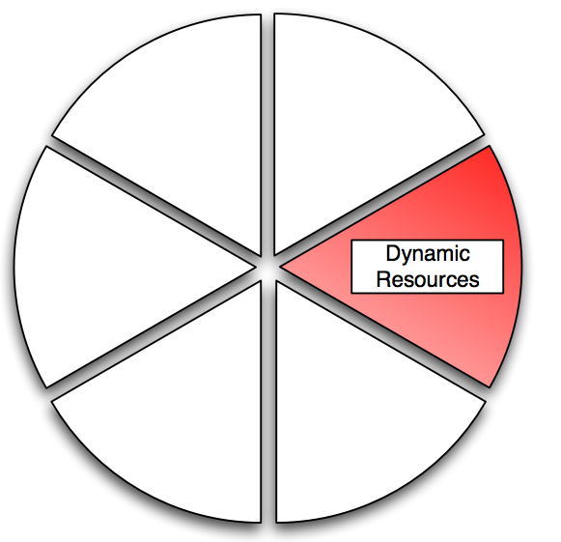
Dynamic Resource Management

Slide 44
Shared Memory in the Cloud
Instead of many distinct operating systems, there is a desire to have a single unified “middleware” OS across all nodes.
Distributed Shared Memory (DSM) systems exist today
  Use specialized hardware to link CPUs
  Called cache coherent Non-Uniform Memory Access (ccNUMA) architectures
    SGI Altix UV, IBM, HP Itaniums, etc.

Slide 45
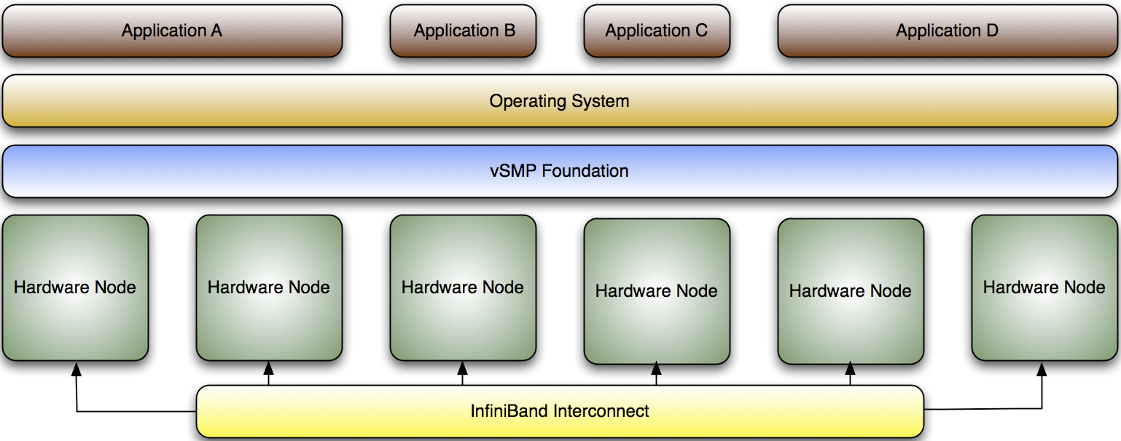
ScaleMP vSMP
vSMP Foundation is a virtualization software that creates a single virtual machine over multiple x86-based systems.
Provides large memory and compute SMP virtually to users by using commodity MPP hardware.
Allows for the use of MPI, OpenMP, Pthreads, Java threads, and serial jobs on a single unified OS.

Slide 46
vSMP Performance
Some benchmarks currently.
  More to come with ECHO?
SPEC, HPCC, Velvet benchmarks

Slide 47
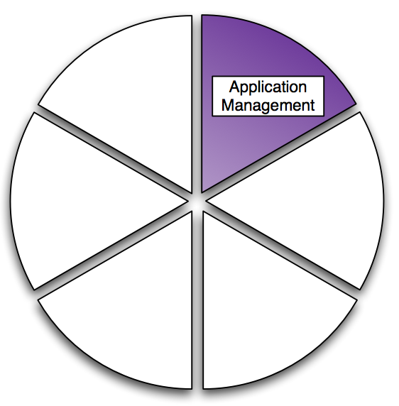
Applications

Slide 48
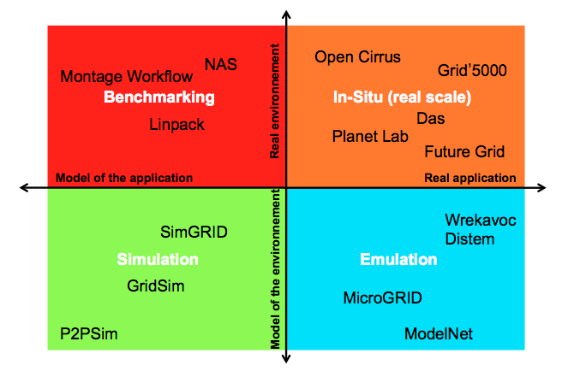
Experimental Computer Science
From “Supporting Experimental Computer Science”

Slide 49
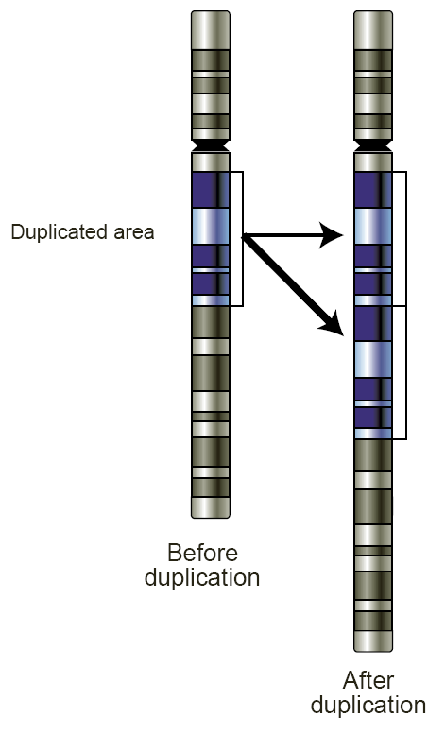
Copy Number Variation
Structural variations in a genome resulting in abnormal copies of DNA
  Insertion, deletion, translocation, or inversion
Occurs from 1 kilobase to many megabases in length
Leads to over-expression, function abnormalities, cancer, etc.
Evolution dictates that CNV gene gains are more common than deletions

Slide 50
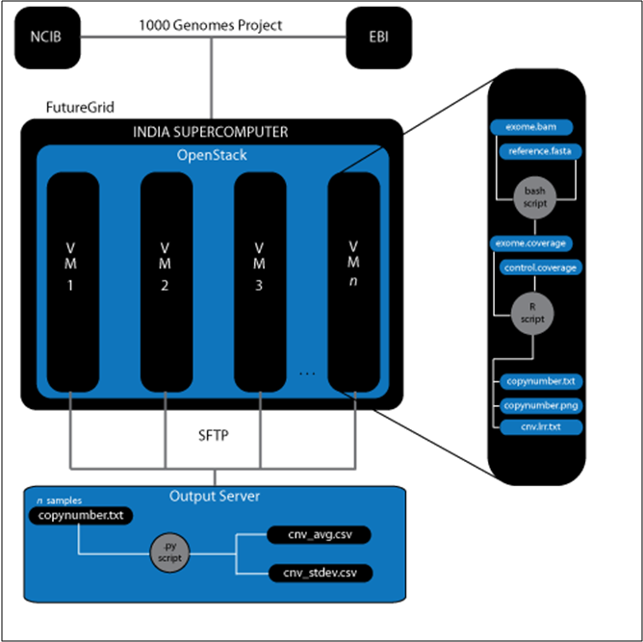
CNV Analysis w/ 1000 Genomes
Explore exome data available in 1000 Genomes Project.
  Human sequencing consortium
Experimented with SeqGene, ExomeCNV, and CONTRA
Defined workflow in OpenStack to detect CNV within exome data.

Slide 51
Daphnia Magna Mapping
CNV represents a large source for genetic variation within populations
Environmental contributions to CNVs remains relatively unknown.
Hypothesis: Exposure to environmental contaminants increases the rate of mutations in surviving sub-populations, due to more CNV
Work with Dr. Joseph Shaw (SPEA), Nate Keith (PhD student), and Craig Jackson (Researcher)

Slide 52
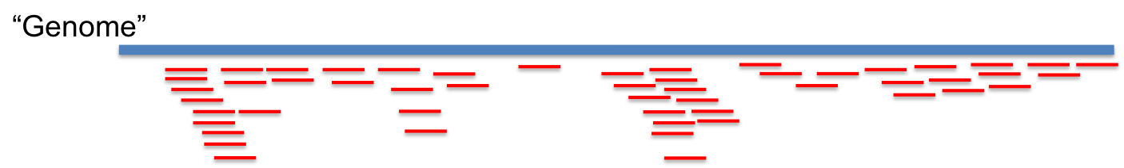
Read Mapping
“Genome”
Sequencing Reads
Individual A
“Genome”
(MT1)
6X
Individual B
(MT1)
18X

Slide 53
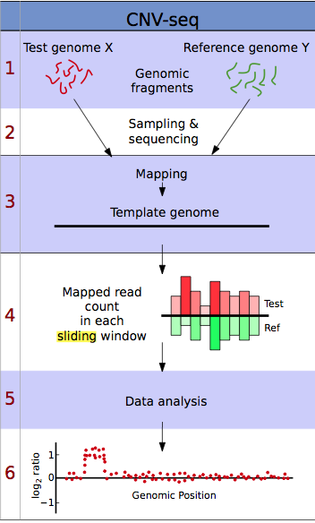

Slide 54
Statistical analysis
The software picks a sliding window small enough to maximize resolution, but large enough to provide statistical significance
Calculates a p-value (probability the ratio deviates from 1:1 ratio by chance)
    Coverage, and multiple, consecutive sliding windows showing high significance (p<0.002) provide evidence for CNV.

Slide 55
Daphnia Current work
Investigating tools for genome mapping of various sequenced populations
Compare tools that are currently available
  Bowtie, MrFAST, SOAP, Novalign, MAQ, etc…
Look at parallelizability of applications, implications in Clouds
Determine best way to deal with expansive data deluge of this work
  Currently 100+ samples at 30x coverage from BGI

Slide 56
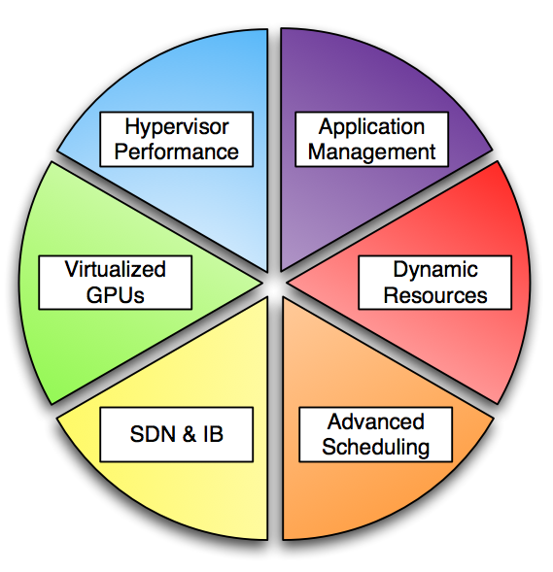
Heterogeneous High Performance Cloud Computing Environment

Slide 57
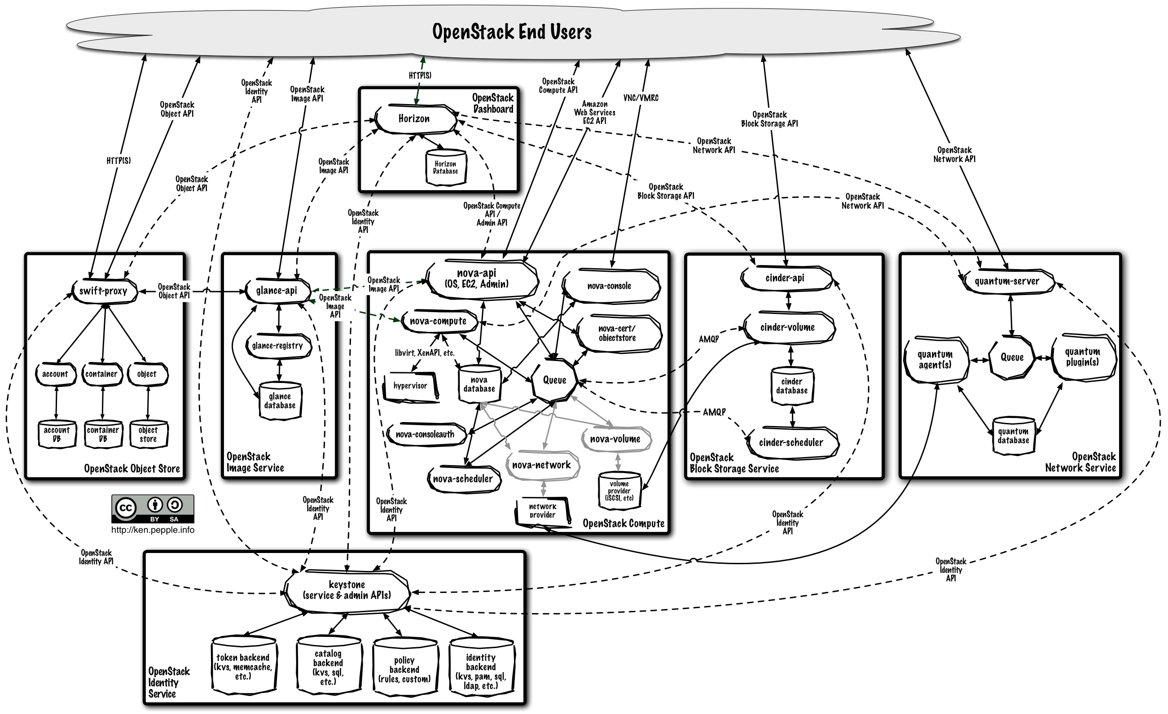

Slide 58
High Performance Cloud
Federate Cloud deployments across distributed resources using Multi-zones
Incorporate heterogeneous HPC resources
  GPUs with Xen and OpenStack
  Bare metal / dynamic provisioning (when needed)
  Virtualized SMP for Shared Memory
Leverage best-practices for near-native performance
Build rich set of images to enable new PaaS for scientific applications

Slide 59
Why Clouds for HPC?
Already-known cloud advantages
  Leverage economies of scale
  Customized user environment
  Leverage new programming paradigms for big data
But there’s more to be realized when moving to larger scale
  Leverage heterogeneous hardware
  Achieve near-native performance
  Provided advanced virtualized networking to IaaS
Targeting usable exascale, not stunt-machine excascale

Slide 60
Cloud Computing
High Performance Cloud

Slide 61
Questions?
  Thank You!

Slide 62
Pubications
Book Chapters and Journal Articles
[1] A. J. Younge, G. von Laszewski, L. Wang, and G. C. Fox, “Providing a Green Framework for Cloud Based Data Centers,” in The Handbook of Energy-Aware Green Computing, I. Ahmad and S. Ranka, Eds. Chapman and Hall/CRC Press, 2012, vol. 2, ch. 17.
[2] N. Stupak, N. DiFonzo, A. J. Younge, and C. Homan, “SOCIALSENSE: Graphical User Interface Design Considerations for Social Network Experiment Software,” Computers in Human Behavior, vol. 26, no. 3, pp. 365–370, May 2010.
[3] L. Wang, G. von Laszewski, A. J. Younge, X. He, M. Kunze, and J. Tao, “Cloud Computing: a Perspective Study,” New Generation Computing, vol. 28, pp. 63–69, Mar 2010.
Conference and Workshop Proceedings
[4] J. Diaz, G. von Laszewski, F. Wang, A. J. Younge, and G. C. Fox, “Futuregrid image repository: A generic catalog and storage system for heterogeneous virtual machine images,” in Third IEEE International Conference on Coud Computing Technology and Science (CloudCom2011), IEEE. Athens, Greece: IEEE, 12/2011 2011.
[5] G. von Laszewski, J. Diaz, F. Wang, A. J. Younge, A. Kulshrestha, and G. Fox, “Towards generic FutureGrid image management,” in Proceedings of the 2011 TeraGrid Conference: Extreme Digital Discovery, ser. TG ’11. Salt Lake City, UT: ACM, 2011
[6] A. J. Younge, R. Henschel, J. T. Brown, G. von Laszewski, J. Qiu, and G. C. Fox, “Analysis of Virtualization Technologies for High Performance Computing Environments,” in Proceedings of the 4th International Conference on Cloud Computing (CLOUD 2011). Washington, DC: IEEE, July 2011.
[7] A. J. Younge, V. Periasamy, M. Al-Azdee, W. Hazlewood, and K. Connelly, “ScaleMirror: A Pervasive Device to Aid Weight Analysis,” in Proceedings of the 29h International Conference Extended Abstracts on Human Factors in Computing Systems (CHI2011). Vancouver, BC: ACM, May 2011.
[8] J. Diaz, A. J. Younge, G. von Laszewski, F. Wang, and G. C. Fox, “Grappling Cloud Infrastructure Services with a Generic Image Repository,” in Proceedings of Cloud Computing and Its Applications (CCA 2011), Argonne, IL, Mar 2011.
[9] G. von Laszewski, G. C. Fox, F. Wang, A. J. Younge, A. Kulshrestha, and G. Pike, “Design of the FutureGrid Experiment Management Framework,” in Proceedings of Gateway Computing Environments 2010 at Supercomputing 2010. New Orleans, LA: IEEE, Nov 2010.
[10] A. J. Younge, G. von Laszewski, L. Wang, S. Lopez-Alarcon, and W. Carithers, “Efficient Resource Management for Cloud Computing Environments,” in Proceedings of the International Conference on Green Computing. Chicago, IL: IEEE, Aug 2010.

Slide 63
Publications (cont)
[11] N. DiFonzo, M. J. Bourgeois, J. M. Suls, C. Homan, A. J. Younge, N. Schwab, M. Frazee, S. Brougher, and K. Harter, “Network Segmentation and Group Segre- gation Effects on Defensive Rumor Belief Bias and Self Organization,” in Proceedings of the George Gerbner Conference on Communication, Conflict, and Aggres- sion, Budapest, Hungary, May 2010.
[12] G. von Laszewski, L. Wang, A. J. Younge, and X. He, “Power-Aware Scheduling of Virtual Machines in DVFS-enabled Clusters,” in Proceedings of the 2009 IEEE International Conference on Cluster Computing (Cluster 2009). New Orleans, LA: IEEE, Sep 2009.
[13] G. von Laszewski, A. J. Younge, X. He, K. Mahinthakumar, and L. Wang, “Experiment and Workflow Management Using Cyberaide Shell,” in Proceedings of the 4th International Workshop on Workflow Systems in e-Science (WSES 09) with 9th IEEE/ACM CCGrid 09. IEEE, May 2009.
[14] L. Wang, G. von Laszewski, J. Dayal, X. He, A. J. Younge, and T. R. Furlani, “Towards Thermal Aware Workload Scheduling in a Data Center,” in Proceedings of the 10th International Symposium on Pervasive Systems, Algorithms and Networks (ISPAN2009), Kao-Hsiung, Taiwan, Dec 2009.
[15] G. von Laszewski, F. Wang, A. J. Younge, X. He, Z. Guo, and M. Pierce, “Cyberaide JavaScript: A JavaScript Commodity Grid Kit,” in Proceedings of the Grid Computing Environments 2007 at Supercomputing 2008. Austin, TX: IEEE, Nov 2008.
[16] G. von Laszewski, F. Wang, A. J. Younge, Z. Guo, and M. Pierce, “JavaScript Grid Abstractions,” in Proceedings of the Grid Computing Environments 2007 at Supercomputing 2007. Reno, NV: IEEE, Nov 2007.
Poster Sessions
[17] A. J. Younge, J. T. Brown, R. Henschel, J. Qiu, and G. C. Fox, “Performance Analysis of HPC Virtualization Technologies within FutureGrid,” Emerging Research at CloudCom 2010, Dec 2010.
[18] A. J. Younge, X. He, F. Wang, L. Wang, and G. von Laszewski, “Towards a Cyberaide Shell for the TeraGrid,” Poster at TeraGrid Conference, Jun 2009.
[19] A. J. Younge, F. Wang, L. Wang, and G. von Laszewski, “Cyberaide Shell Prototype,” Poster at ISSGC 2009, Jul 2009.

Slide 64
Appendix

Slide 65
FutureGrid
  FutureGrid is an experimental grid and cloud test-bed with a wide variety of computing services available to users.
HW Resources at: Indiana University, San Diego Supercomputer Center, University of Chicago / Argonne National Lab, Texas Applied Computing Center, University of Florida, & Purdue
Software Partners: University of Southern California, University of Tennessee Knoxville, University of Virginia, Technische Universtität Dresden

Slide 66
High Performance Computing
Massively parallel set of processors connected together to complete a single task or subset of well-defined tasks.
Consist of large processor arrays and high speed interconnects
Used for advanced physics simulations, climate research, molecular modeling, nuclear simulation, etc
Measured in FLOPS
  LINPACK, Top 500

Slide 67
Related Research
Some work has already been done to evaluate performance…
Karger, P. & Safford, D. I/O for virtual machine monitors: Security and performance issues. Security & Privacy, IEEE, IEEE, 2008, 6, 16-23
Koh, Y.; Knauerhase, R.; Brett, P.; Bowman, M.; Wen, Z. & Pu, C. An analysis of performance interference effects in virtual environments. Performance Analysis of Systems & Software, 2007. ISPASS 2007. IEEE International Symposium on, 2007, 200209.
K. Jackson, L. Ramakrishnan, K. Muriki, S. Canon, S. Cholia, J. Shalf, H. Wasserman, and N. Wright, “Performance Analysis of High Performance Computing Applications on the Amazon Web Services Cloud,” in 2nd IEEE International Conference on Cloud Computing Technology and Science. IEEE, 2010, pp. 159–168.
P. Barham, B. Dragovic, K. Fraser, S. Hand, T. L. Harris, A. Ho, R. Neugebauer, I. Pratt, and A. Warfield, “Xen and the art of virtualization,” in Proceedings of the 19th ACM Symposium on Operating Systems Principles, New York, U. S. A., Oct. 2003, pp. 164–177.
Adams, K. & Agesen, O. A comparison of software and hardware techniques for x86 virtualization. Proceedings of the 12th international conference on Architectural support for programming languages and operating systems, 2006, 2-13.
Notes:
No fair and balanced metric

Slide 68
Hypervisors
Evaluate Xen, KVM, and VirtualBox hypervisors against native hardware
  Common, well documented
  Open source, open architecture
  Relatively mature & stable
Cannot benchmark VMWare hypervisors due to proprietary licensing issues.
  This is changing
Notes:
Josh Simons - VMWare

Slide 69
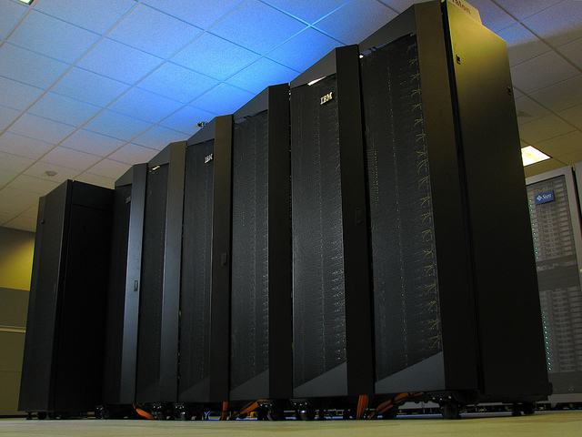
Testing Environment
All tests conducted on the IU India cluster as part of FutureGrid.
Identical nodes used for each hypervisor, as well as a bare-metal (native) machine for the control group.
Each host OS runs RedHat Enterprise Linux 5.5.
India: 256 1U compute nodes
  2 Intel Xeon 5570 Quad core CPUs at 2.93Ghz
  24GB DDR2 Ram
  500GB 10k HDDs
  InfiniBand DDR 20Gbs

Slide 70
Performance Roundup
Hypervisor performance in Linpack reaches roughly 70% of native performance during our tests, with Xen showing a high degree of variation.
FFT benchmarks seem to be less influenced by hypervisors, with KVM and VirtualBox performing at native speeds yet Xen incurs a 50% performance hit with MPIFFT.
With PingPong latency KVM and VirtualBox perform close to native speeds while Xen has large latencies under maximum conditions.
Bandwidth tests vary largely, with the VirtualBox hypervisor performing the best, however having large performance variations.
SPEC benchmarks show KVM at near-native speed, with Xen and VirtualBox close behind.

Slide 71
Front-end GPU API
Translate all CUDA calls into a remote method invocations
Users share GPUs across a node or cluster
Can run within a VM, as no hardware is needed, only a remote API
Many implementations for CUDA
  rCUDA, gVirtus, vCUDA, GViM, etc..
Many desktop virtualization technologies do the same for OpenGL & DirectX

Slide 72
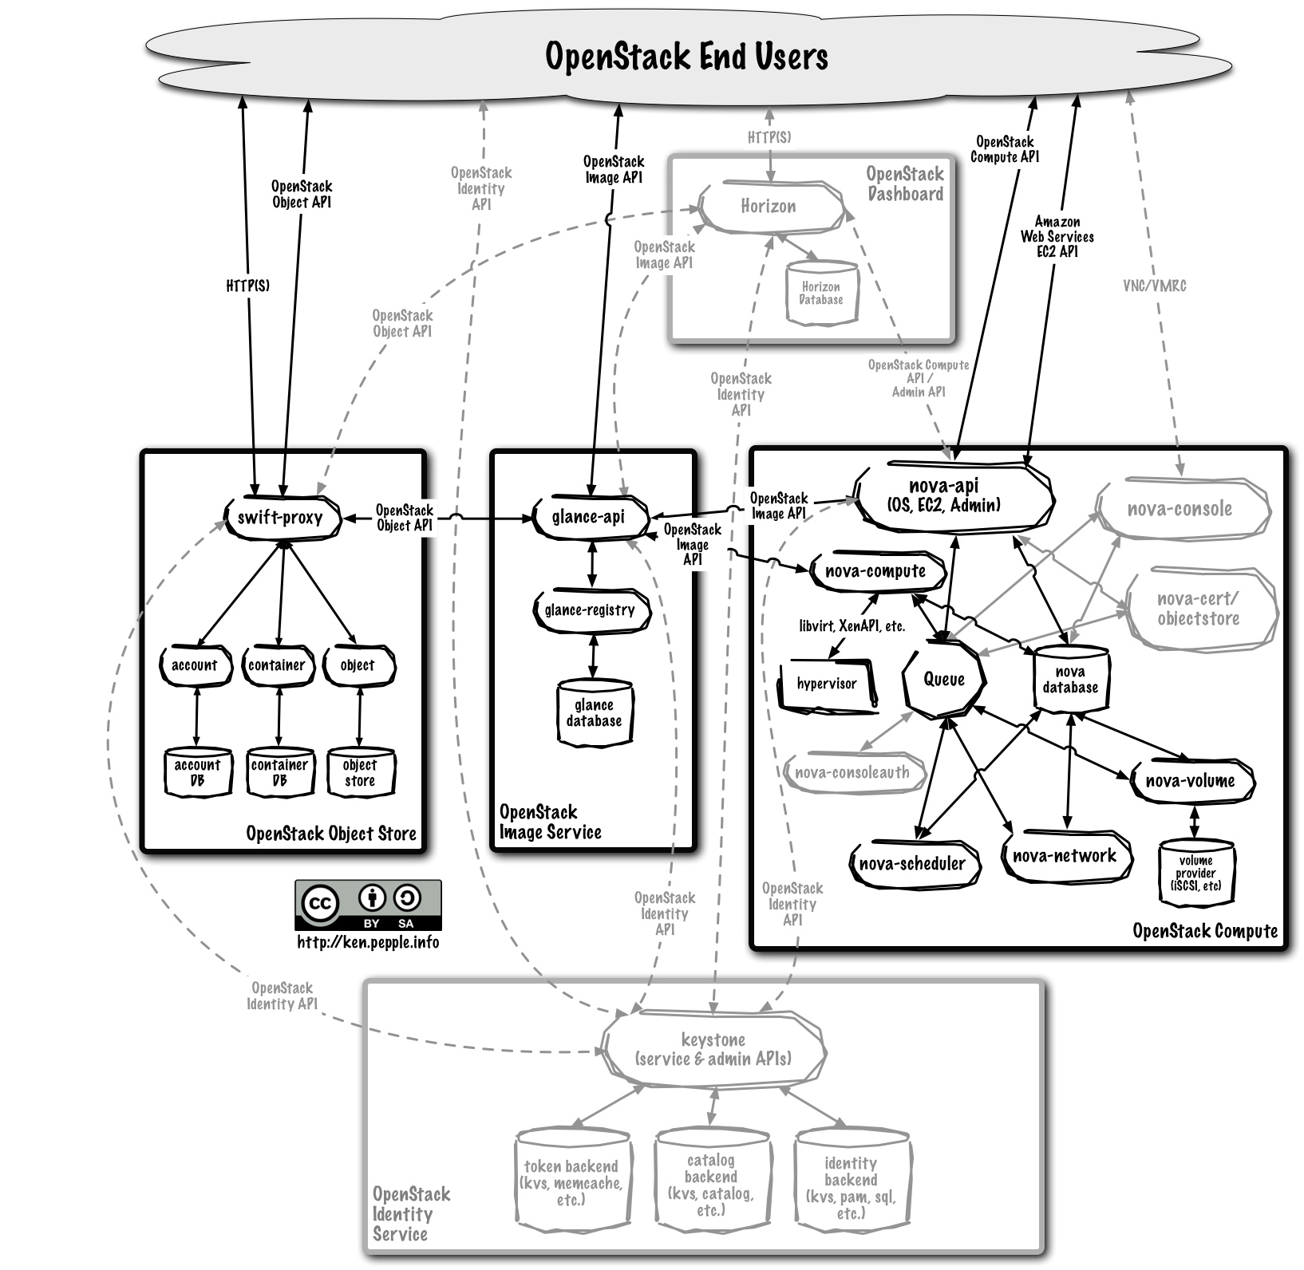
OpenStack Implementation

Slide 73
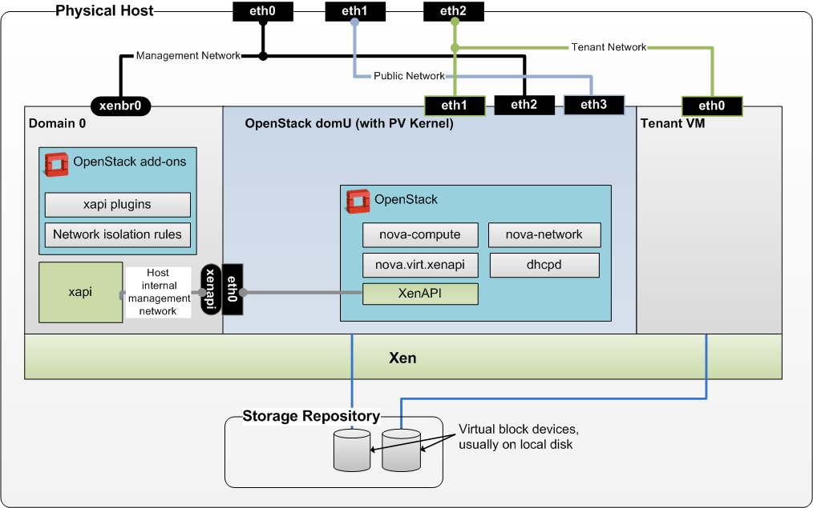

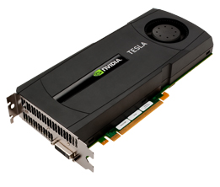
#1: XenAPI + OpenStack

Slide 74
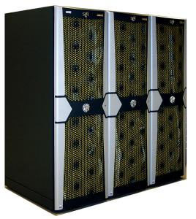
DSM NUMA Architectures
SGI Altix most common
  Uses Intel processors and special NUMALink interconnect
  Low latency, can build large DSM machine
  One instance of Linux OS
  VERY expensive
  Proprietary

Slide 75
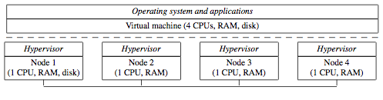
Virtual SMP DSM
Want to use commodity CPUs and interconnect
Maintain a single OS that’s distributed over many compute nodes
Possible to build using virtualization!

Slide 76

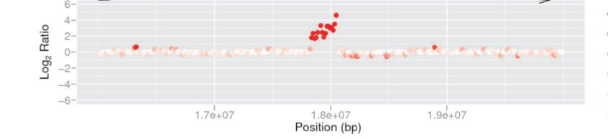

Slide 77
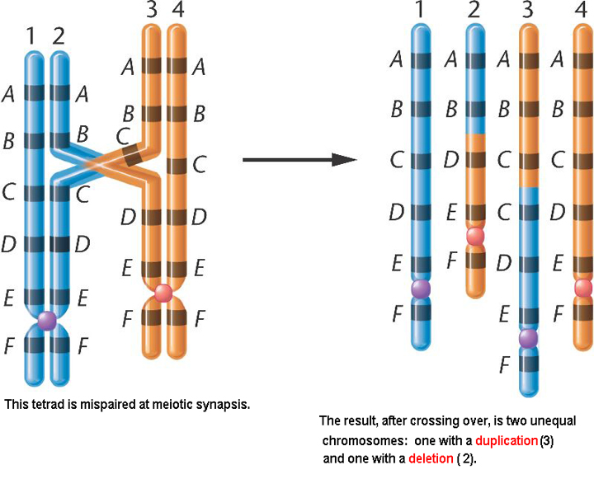
Non-homologous Recombination

Slide 78
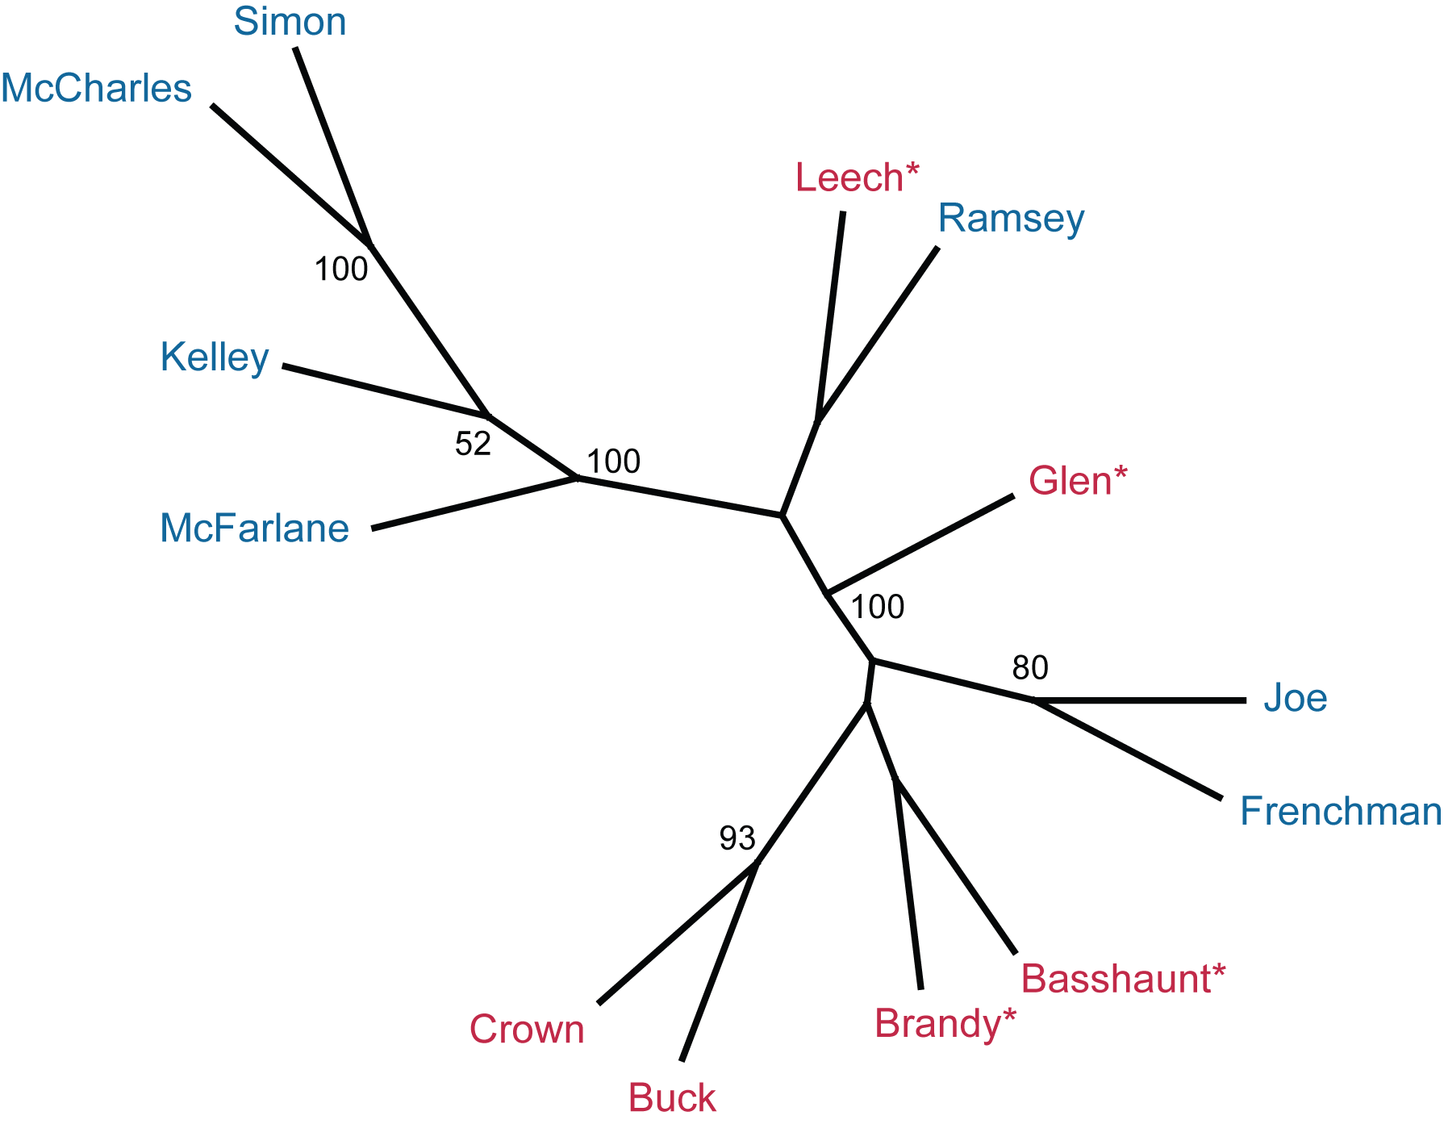
Two Clones Sequenced: S14 & BR16
Adapted
Hybrid
Nonadapted
D. pulicaria
A
Adapted
Hybrid
Nonadapted
D. pulicaria
B
Adapted
Hybrid
Nonadapted
D. pulicaria
Adapted
Hybrid
Nonadapted
D. pulicaria
Nonadapted
D. pulicaria
Nonadapted
D. pulicaria
Nonadapted
D. pulicaria
Nonadapted
D. pulicaria
C
Notes:
Based on LDH genotyping results, S14 is a hybrid, BR16 is D. pulicaria

