Slide 1
Creating Research Posters
Andrew J. Younge
Indiana University

Slide 2
Outline
Purpose
Process
Design
Sources
Practice

Slide 3
Purpose
What is the purpose of a research poster?
Notes:
Why are you doing this?

Slide 4
Purpose
What is the purpose of a research poster?
Present research
Findings/completed work
Proposed/early stage work
Presentation styles
Active – you are standing by your work
Passive – you are not standing by your work

Slide 5
Process
Determine contents (not layout)

Slide 6
Process
Determine contents (not layout)
Title
Answer to research question
Method
Results
Images
Charts
Conclusion
Sources
Acknowledgements
Notes:
What are you going to put on your research poster??

Slide 7
Design
Dimensions
Balance
Text
Charts
Color
Order of Information
Software

Slide 8
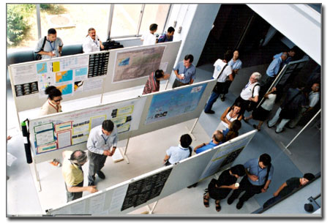
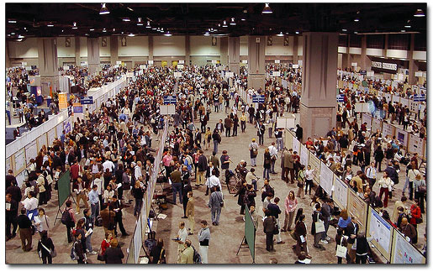
Dimensions
Know your constraints!
Landscape vs. Portrait
Venue
http://www.swarthmore.edu/NatSci/cpurrin1/posteradvice.htm

Slide 9
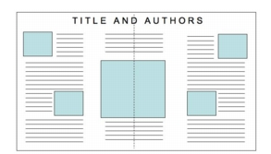
Balance

Slide 10
Balance

Slide 11
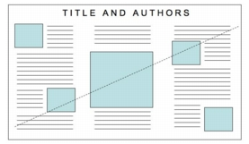
Balance

Slide 12
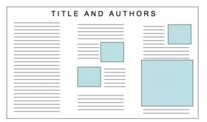
Balance
http://www.ncsu.edu/project/posters/NewSite/CreatePosterLayout.html

Slide 13
Text
Minimize use – think VISUAL
Bulleted lists preferred over paragraphs
Should be readable from 1-2 m (3-6 ft)
Organize in blocks
Columns help organize the organization
Not too big, not too small

Slide 14
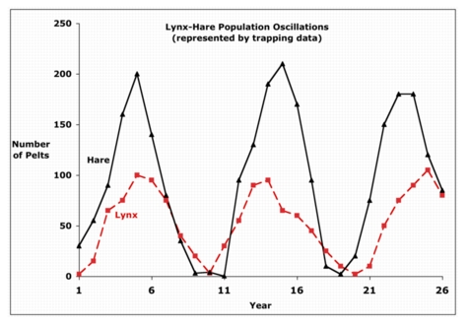
Charts
Avoid “Chart Junk”
Use Headings that describe results
http://www.ncsu.edu/project/posters/NewSite/SideWindows/MessageExample.html

Slide 15
Purposes of a a graph/visualization
Permit exploration – seek understanding
Provide communication – tell a story
Support calculation – visual algorithms
Bring information alive – give impact
Adapted from Howard Weiner, 1997

Slide 16
Maximize the data ink ratio, within reason

Slide 17
Maximize the data ink ratio, within reason

Slide 18
Erase non-data-ink, within reason

Slide 19
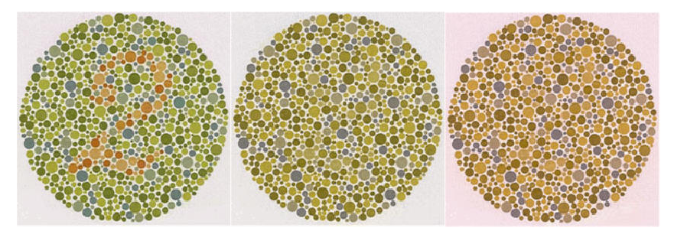
What is the number?
http://colorvisiontesting.com/what%20colorblind%20people%20see.htm

Slide 20
RGB vs. CMYK
Screens are RGB
Printers are CMYK
Crude distinction, but basically true
Set the color palette to CMYK if possible

Slide 21
Order
1
3
2

Slide 22
Software
Powerpoint
Set page size to dimensions of output
May not scale fonts appropriately
Adobe Illustrator/Photoshop

Slide 23
Sources
Research Posters 101
http://www.acm.org/crossroads/xrds3-2/posters.html
Poster Presentations
http://lorien.ncl.ac.uk/ming/dept/Tips/present/posters.htm
Google “Designing Research Posters”

Slide 24
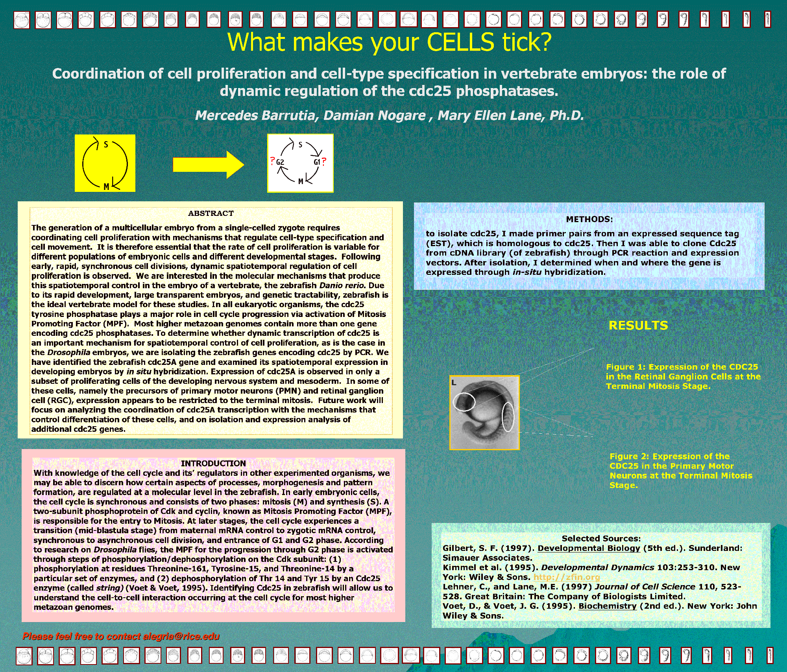
Critique these posters:

Slide 25
Critique these posters:

Slide 26
Critique these posters:

Slide 27
Critique these posters:

Slide 28
Critique these posters:

Slide 29
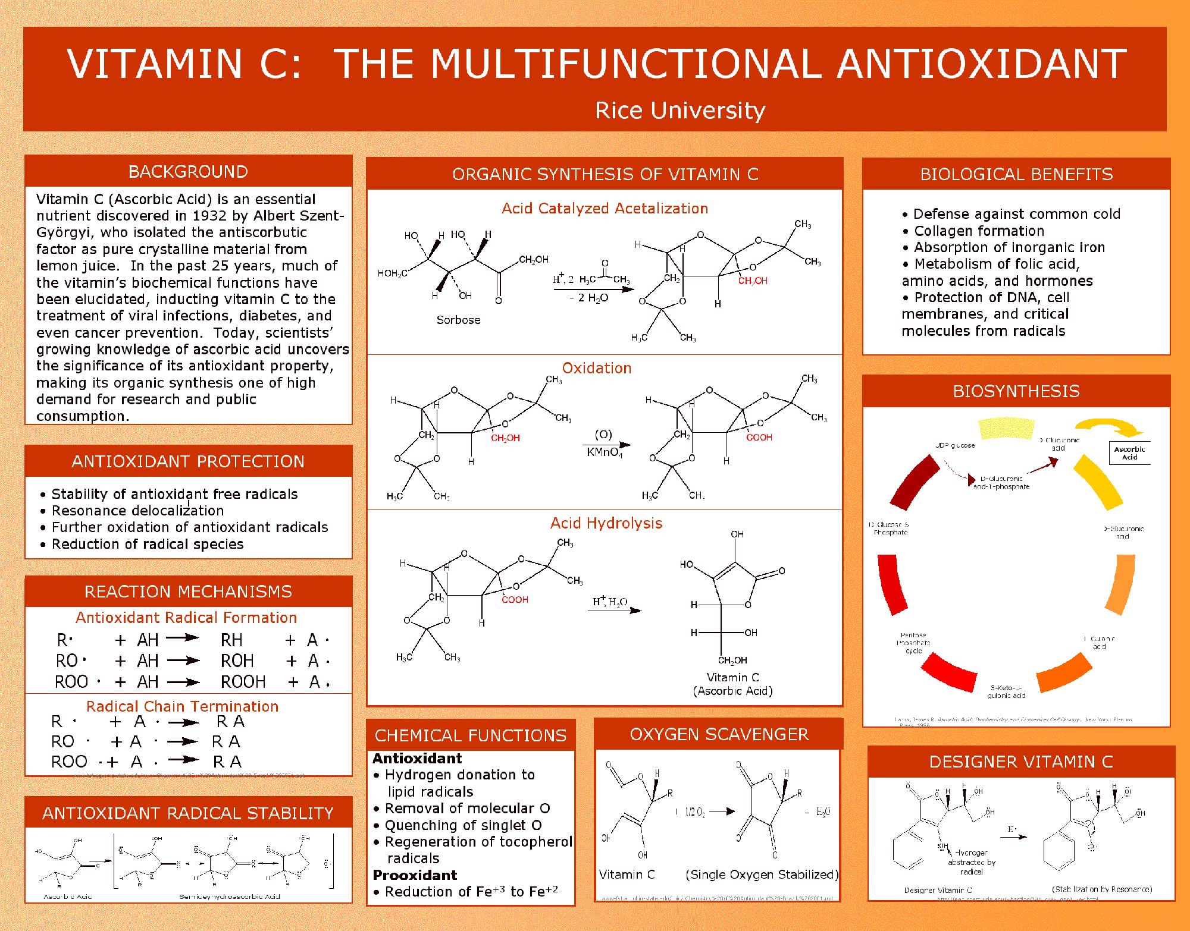
Critique these posters:

Slide 30
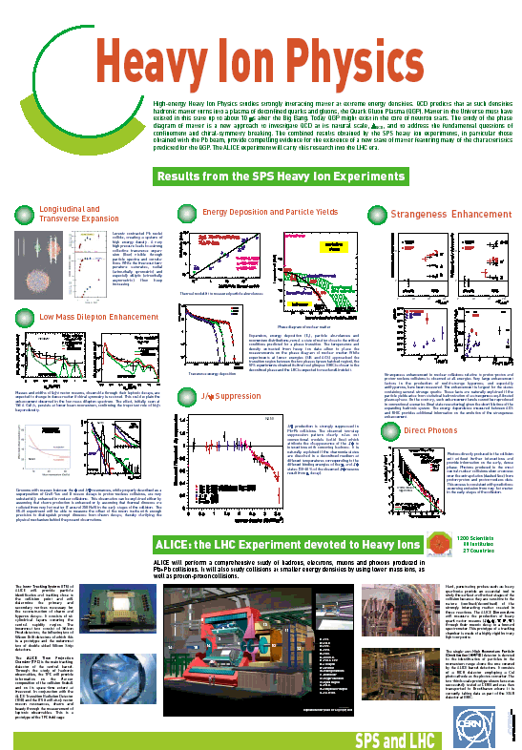
Critique these posters:

Slide 31
Critique these posters:

