Slide 1

Towards a Collective Layer in the Big Data Stack
Thilina Gunarathne (tgunarat@indiana.edu)
Judy Qiu (xqiu@indiana.edu)
Dennis Gannon (dennis.gannon@microsoft.com)
Notes:
Scalable parallel computing landscape has been traditionally dominated by the HPC. More specifically super computers and MPI. They were and they are hugely successful and well matured for the type of use cases, which were in the fields of Particle physics, thermodynamic simulations, etc.
But recently we saw 3 major disruptions happen to this landscape, mainly driven by the growing needs of the software industry.

Slide 2
Introduction
Three disruptions
  Big Data
  MapReduce
  Cloud Computing
MapReduce to process the “Big Data” in cloud or cluster environments
Generalizing MapReduce and integrating it with HPC technologies
Notes:
During the last decade three largely industry-driven disruptive trends have altered the landscape of scalable parallel computing, which has long been dominated by HPC applications.
These disruptions are the emergence of data intensive computing (aka big data), commodity cluster-based execution & storage frameworks such as MapReduce, and the utility computing model introduced by Cloud computing.
Oftentimes MapReduce is used to process the “Big Data” in cloud or cluster environments.
Although these disruptions have advanced remarkably, we argue that we can further benefit these technologies by generalizing MapReduce and integrating it with HPC technologies.

Slide 3
Introduction
Splits MapReduce into a Map and a Collective communication phase
Map-Collective communication primitives
  Improve the efficiency and usability
  Map-AllGather, Map-AllReduce, MapReduceMergeBroadcast and Map-ReduceScatter patterns
  Can be applied to multiple run times
Prototype implementations for Hadoop and Twister4Azure
  Up to 33% performance improvement for KMeansClustering
  Up to 50% for Multi-dimensional scaling
Notes:
This splits MapReduce into a Map and a Collective communication phase that generalizes the Reduce concept. We present a set of Map-Collective communication primitives that improve the efficiency and usability of large-scale parallel data intensive computations. We explore Map-AllGather, Map-AllReduce, MapReduceMergeBroadcast and Map-ReduceScatter patterns as the initial focus. Map-collectives improve the performance and efficiency of the computations while at the same time facilitating ease of use for the users.
These collective primitives can be applied to multiple runtimes and we propose building high performance robust implementations that cross cluster and cloud systems. We present 2 implementations, Hadoop (where we term our extension H-Collectives) on clusters and the Twister4Azure Iterative MapReduce for the Azure Cloud. Our prototype implementations of Map-AllGather and Map-AllReduce primitives achieved up to 33% performance improvement for K-means Clustering and up to 50% improvement for Multi-Dimensional Scaling, while also improving the user friendliness. In some cases, use of Map-collectives virtually eliminated almost all the overheads of the computations.

Slide 4
Outline
Introduction
Background
Collective communication primitives
  Map-AllGather
  Map-Reduce
Performance analysis
Conclusion

Slide 5
Outline
Introduction
Background
Collective communication primitives
  Map-AllGather
  Map-Reduce
Performance analysis
Conclusion

Slide 6
Data Intensive Iterative Applications
Growing class of applications
  Clustering, data mining, machine learning & dimension reduction applications
  Driven by data deluge & emerging computation fields
  Lots of scientific applications
k ← 0;
MAX ← maximum iterations
δ^{[0]} ← initial delta value
while ( k< MAX_ITER || f(δ^{[k]}, δ^{[k-1]}) )
foreach datum in data
β[datum] ← process (datum, δ^{[k]})
end foreach
δ^{[k+1]} ← combine(β[])
k ← k+1
end while
Notes:
Iterative computations are at the core of the vast majority of data intensive scientific computations, such as …
The application types are gaining even more popularity due to the data deluge and due to the emergence of data intensive computational fields, such as bioinformatics, chemical informatics and web mining.
These computations often has a structure like this, where inside an iteration, the individual data items would get processed independently and then the result of those would be combined to generate the iteration result. This result would often be used in the computations of the next iteration.

Slide 7
Data Intensive Iterative Applications
Smaller Loop-Variant Data
Broadcast
Compute
Communication
Reduce/ barrier
New Iteration
Larger Loop-Invariant Data
Notes:
We can specify this type applications structures as set of computation and communication steps where single iterations can easily be specified as MapReduce computations.
These would typically have large input data sizes which are loop-invariant and can be reused across iterations.
We call the iteration result as the loop-variant data.. This is Orders of magnitude smaller…
While these can be performed using traditional MapReduce frameworks, Traditional is not efficient for these types of computations. MR leaves lot of room for improvements in terms of iterative applications.

Slide 8
Iterative MapReduce
MapReduceMergeBroadcast
Extensions to support additional broadcast (+other) input data
      Map(<key>, <value>, list_of <key,value>)
      Reduce(<key>, list_of <value>, list_of <key,value>)
      Merge(list_of <key,list_of<value>>,list_of <key,value>)
Map
Combine
Shuffle
Sort
Reduce
Merge
Broadcast
Notes:
We extend the MR to support IMR. The goal is to support more patterns efficiently , while keeping the desirable features of MapReduce such as scalability, ease of use and fault tolerance of map reduce.
Add two steps..
Extend the programming model adding an extra dynamic input parameter to Map and Reduce functions.
Loop invariant data (static data) would be the traditional MR key-value pairs
Comparatively larger sized data
Cached between iterations
Loop variant data (dynamic data) – broadcast to all the map tasks in beginning of the iteration

Slide 9
Twister4Azure – Iterative MapReduce
Decentralized iterative MR architecture for clouds
  Utilize highly available and scalable Cloud services
Extends the MR programming model
Multi-level data caching
  Cache aware hybrid scheduling
Multiple MR applications per job
Collective communication primitives
Outperforms Hadoop in local cluster by 2 to 4 times
Sustain features of MRRoles4Azure
  dynamic scheduling, load balancing, fault tolerance, monitoring, local testing/debugging
Notes:
Twister4Azure implements the above mentioned architecture.

Slide 10
Outline
Introduction
Background
Collective communication primitives
  Map-AllGather
  Map-Reduce
Performance analysis
Conclusion

Slide 11
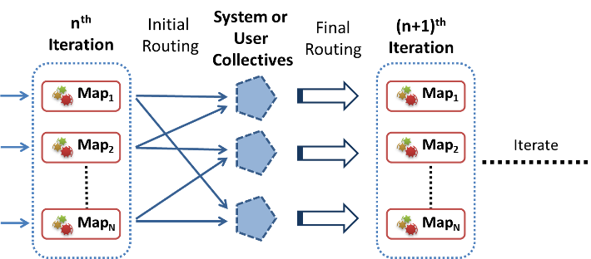
Collective Communication Primitives for Iterative MapReduce
Introducing All-to-All collective communications primitives to MapReduce
Supports common higher-level communication patterns
Notes:
Our collective work is focused more on the all-to-all communications primitives..
Map tasks followed by System or user collectives, that would execute in network or in instances
These primitives support higher-level communication patterns that occur frequently in data-intensive iterative applications by substituting certain steps of the MR-MB computation. As depicted in Figure 1, these Map-Collective primitives can be thought of as a Map phase followed by a series of framework-defined communication and computation operations leading to the next iteration.

Slide 12
Collective Communication Primitives for Iterative MapReduce
Performance
  Optimized group communication
  Framework can optimize these operations transparently to the users
    Poly-algorithm (polymorphic)
  Avoids unnecessary barriers and other steps in traditional MR and iterative MR
  Scheduling using primitives
Ease of use
  Users do not have to manually implement these logic
  Preserves the Map & Reduce API’s
  Easy to port applications using more natural primitives
Notes:
There are two types of benefits we’ll get from the collectives for MapReduce.
We envision a future where many MapReduce and iterative MapReduce frameworks support a common set of portable Map-Collectives, and we consider this work as a step towards that fulfilling that goal.

Slide 13
Goals
Fit with MapReduce data and computational model
  Multiple Map task waves
  Significant execution variations and inhomogeneous tasks
Retain scalability
Programming model simple and easy to understand
Maintain the same type of framework-managed excellent fault tolerance
Backward compatibility with MapReduce model
  Only flip a configuration option

Slide 14
Map-AllGather Collective
Traditional iterative Map Reduce
  The “reduce” step assembles the outputs of the Map Tasks together in order
  “merge” assembles the outputs of the Reduce tasks
  Broadcast the assembled output to all the workers.
Map-AllGather primitive,
  Broadcasts the Map Task outputs to all the computational nodes
  Assembles them together in the recipient nodes
  Schedules the next iteration or the application.
Eliminates the need for reduce, merge, monolithic broadcasting steps and unnecessary barriers.
  Example : MDS BCCalc, PageRank with in-links matrix (matrix-vector multiplication)
Notes:
In traditional iterative MapReduce, there are computations where…

Slide 15
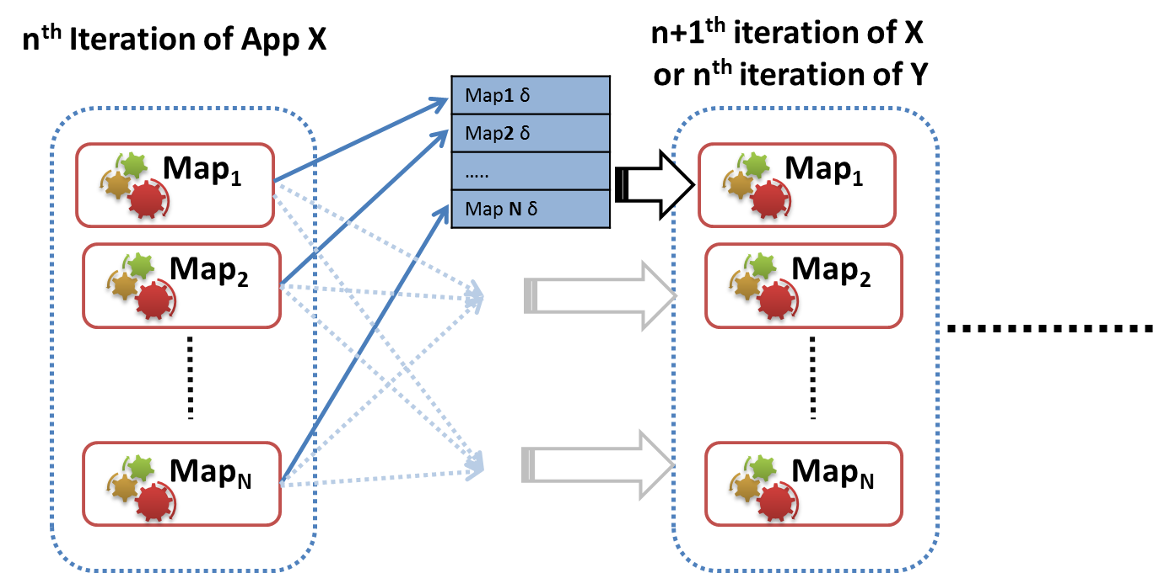
Map-AllGather Collective
Notes:
Using the Windows Communication Foundation (WCF) based Azure TCP inter-role communication mechanism
Uses the Azure table storage as a persistent backup.

Slide 16
Map-AllReduce
Map-AllReduce
  Aggregates the results of the Map Tasks
    Supports multiple keys and vector values
  Broadcast the results
  Use the result to decide the loop condition
  Schedule the next iteration if needed
Associative commutative operations
  Eg: Sum, Max, Min.
Examples : Kmeans, PageRank, MDS stress calc

Slide 17
Map-AllReduce collective
n^{th}
Iteration
(n+1)^{th}
Iteration
Map₁
Op
Map₁
Map₂
Op
Map₂
Iterate
Map_{N}
Op
Map_{N}
Notes:
Commutative associative
Uses a hierarchical reduction approach
The results are first aggregated in the local node
Final assembly performed in the destination nodes
The iteration check happens in the destination nodes
Examples : Kmeans, PageRank, MDS stress calc

Slide 18
Implementations
H-Collectives : Map-Collectives for Apache Hadoop
  Node-level data aggregations and caching
  Speculative iteration scheduling
  Hadoop Mappers with only very minimal changes
  Support dynamic scheduling of tasks, multiple map task waves, typical Hadoop fault tolerance and speculative executions.
  Netty NIO based implementation
Map-Collectives for Twister4Azure iterative MapReduce
  WCF Based implementation
  Instance level data aggregation and caching
Notes:
We did two implementations. One for Hadoop.. And one for Twister4Azure..

Slide 19
 | MPI | Hadoop | H-Collectives | Twister4Azure
All-to-One | Gather | shuffle-reduce* | shuffle-reduce* | shuffle-reduce-merge
 | Reduce | shuffle-reduce* | shuffle-reduce* | shuffle-reduce-merge
One-to-All | Broadcast | shuffle-reduce-distributedcache | shuffle-reduce-distributedcache | merge-broadcast
 | Scatter | shuffle-reduce-distributedcache** | shuffle-reduce-distributedcache** | merge-broadcast **
All-to-All | AllGather |  | Map-AllGather | Map-AllGather
 | AllReduce |  | Map-AllReduce | Map-AllReduce
 | Reduce-Scatter |  | Map-ReduceScatter (future work) | Map-ReduceScatter (future works)
Synchronization | Barrier | Barrier between Map & Reduce | Barrier between Map & Reduce and between iterations | Barrier between Map, Reduce, Merge and between iterations

Slide 20
Outline
Introduction
Background
Collective communication primitives
  Map-AllGather
  Map-Reduce
Performance analysis
Conclusion

Slide 21
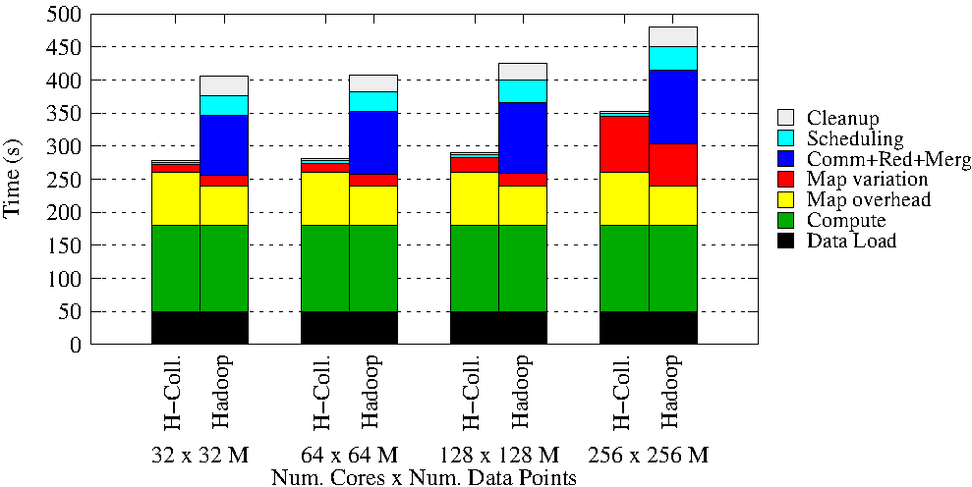
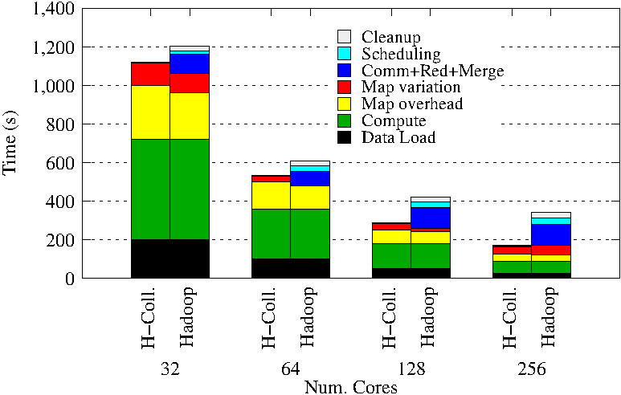
KMeansClustering
Weak scaling
Strong scaling
Hadoop vs H-Collectives Map-AllReduce.
500 Centroids (clusters). 20 Dimensions. 10 iterations.
Notes:
Hadoop K-means Clustering comparison with H-Collectives Map-AllReduce Weak scaling. 500 Centroids (clusters). 20 Dimensions. 10 iterations.
Hadoop K-means Clustering comparison with H-Collectives Map-AllReduce Strong scaling. 500 Centroids (clusters). 20 Dimensions. 10 iterations.

Slide 22
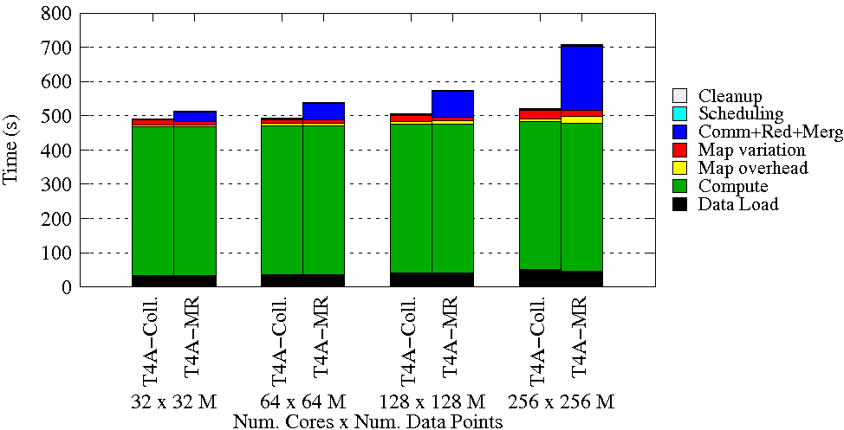
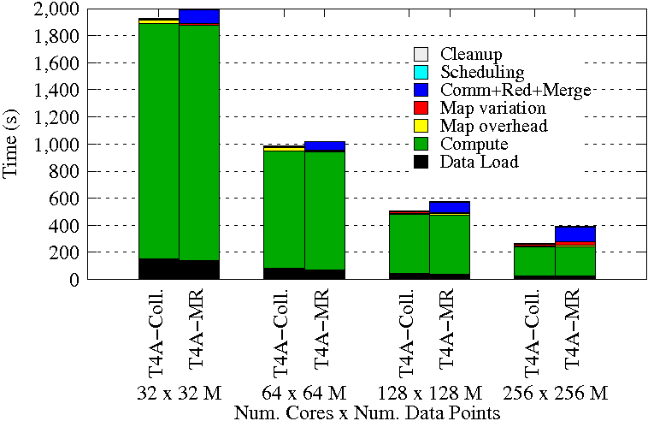
KMeansClustering
Weak scaling
Strong scaling
Twister4Azure vs T4A-Collectives Map-AllReduce.
500 Centroids (clusters). 20 Dimensions. 10 iterations.
Notes:
T4A already optimized,. Like ideal Hadoop.. Uses optimized broadcast, communications, etc..
Weak scaling - 32 to 256 Million data points.
String scaling – 128M data points

Slide 23
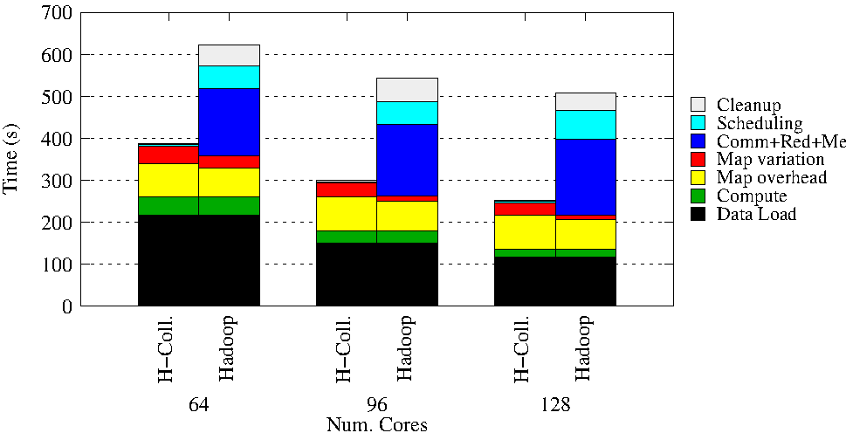
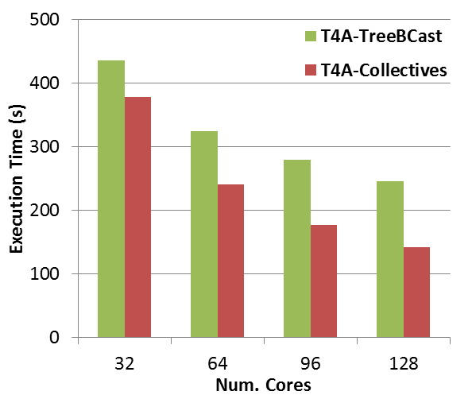
MultiDimensional Scaling
Hadoop MDS – BCCalc only
Twister4Azure MDS
Notes:
Figure 55 MDS Hadoop using only the BC Calculation MapReduce job per iteration to highlight the overhead. 20 iterations, 51200 data points
MDS application implemented using Twister4Azure. 20 iterations. 51200 data points (~5GB).

Slide 24
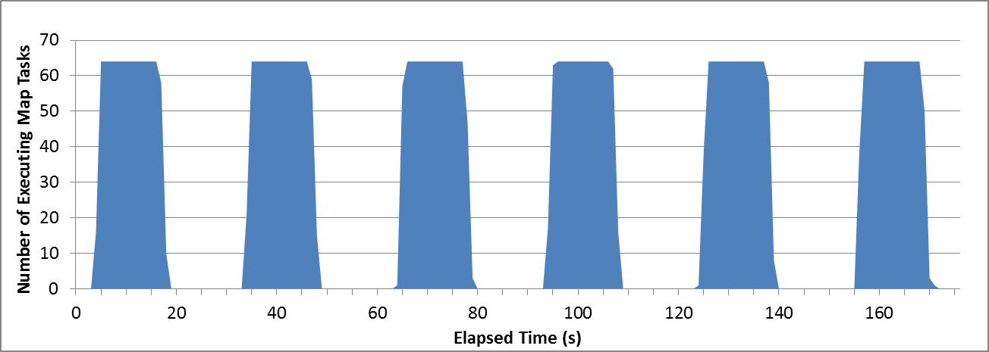
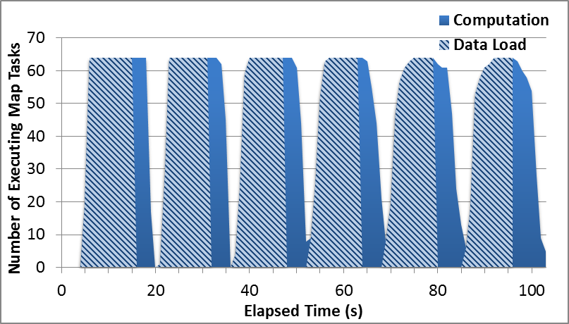
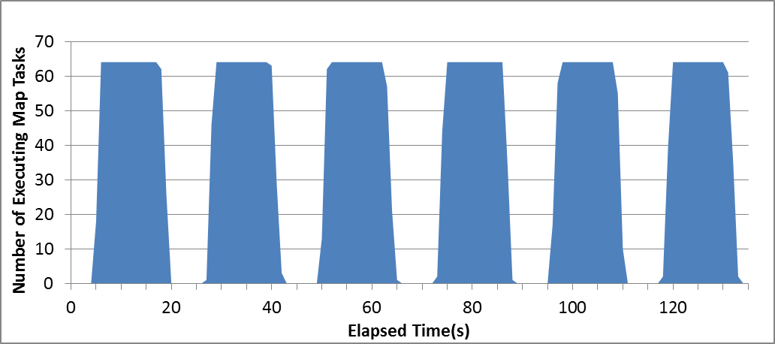
Hadoop MDS Overheads
Hadoop MapReduce MDS-BCCalc
H-Collectives AllGather MDS-BCCalc
H-Collectives AllGather MDS-BCCalc without speculative scheduling
Notes:
Following graphs gives us an alternate view in to the overheads. These graphs show the number of executing Map Tasks at a given moment. We can think of Blue bars as useful work.

Slide 25
Outline
Introduction
Background
Collective communication primitives
  Map-AllGather
  Map-Reduce
Performance analysis
Conclusion

Slide 26
Conclusions
Map-Collectives, collective communication operations for MapReduce inspired by MPI collectives
  Improve the communication and computation performance
    Enable highly optimized group communication across the workers
    Get rid of unnecessary/redundant steps
    Enable poly-algorithm approaches
  Improve usability
    More natural patterns
    Decrease the implementation burden
Future where many MapReduce and iterative MapReduce frameworks support a common set of portable Map-Collectives
Prototype implementations for Hadoop and Twister4Azure
  Up to 33% to 50% speedups
Notes:
We introduced Map-Collectives, collective communication operations for MapReduce inspired by MPI collectives, as a set of high level primitives that encapsulate some of the common iterative MapReduce application patterns. Map-Collectives improve the communication and computation performance of the applications by enabling highly optimized group communication across the workers, getting rid of unnecessary/redundant steps, and by enabling the frameworks to use a poly-algorithm approach based on the use case. Map-Collectives also improve the usability of the MapReduce frameworks by providing abstractions that closely resemble the natural application patterns. They also decrease the implementation burden on the developers by providing optimized substitutions for certain steps of the MapReduce model. We envision a future where many MapReduce and iterative MapReduce frameworks support a common set of portable Map-Collectives and consider this work as a step in that direction.
In this paper, we defined Map-AllGather and Map-AllReduce Map-Collectives and implemented Multi-Dimensional Scaling and K-means Clustering applications using these operations. We also presented the H-Collectives library for Hadoop, which is a drop-in Map-Collectives library that can be used with existing MapReduce applications with only minimal modification. We also presented a Map-Collectives implementation for Twister4Azure iterative MapReduce framework as well. MDS and K-means applications were used to evaluate the performance of Map-Collectives on Hadoop and on Twister4Azure, depicting up to 33% and 50% speedups over the non-collectives implementations by getting rid of the communication and coordination overheads.

Slide 27
Future Work
Map-ReduceScatter collective
  Modeled after MPI ReduceScatter
  Eg: PageRank
Explore ideal data models for the Map-Collectives model
Notes:
In this thesis, we presented Twister4Azure iterative MapReduce and Map-Collectives as solutions to perform scalable parallel computing in cloud environments. Several areas and directions exist through which we could build on f the foundation established by these frameworks.
If present, rather than downloading them from the cloud storage. Some use cases for this capability include the re-executions of failed tasks and the duplicate executions of straggling tasks. Further, we can expose a general API to the data caching layer, allowing applications other than Twister4Azure also to utilize the data caching layer. One option is to model this API as a distributed file system.
One option is to extend one of the existing MapReduce language layers such as Hive and Pig to support iterative MapReduce computations. We can also develop workflow layers on top of iterative Mapreduce to better compose the applications together; this would allow for a more richer and efficient data sharing (eg: share data stored in cache) process to occur between the applications.
There are iterative MapReduce applications where only a small subset of loop invariant data product is needed to process the subset of input data in a Map task. In such cases, it is inefficient to make all the loop invariant data available to such computations. In some of these applications, the size of the loop variant data is too large to fit into the memory and it can introduce communication and scalability bottlenecks as well. An example of such a computation is PageRank. The Map-ReduceScatter primitive can be modeled after MPI ReduceScatter to support such use cases in an optimized manner.
Given the relative novelty of the Big Data movement, cloud infrastructures and the MapReduce frameworks, there exist many more exciting topics to explore for future research work. Some of these examples include the large scale real time stream processing in cloud environments and large scale graph processing in cloud environments.

Slide 28
Acknowledgements
Prof. Geoffrey C Fox for his many insights and feedbacks
Present and past members of SALSA group – Indiana University.
Microsoft for Azure Cloud Academic Resources Allocation
National Science Foundation CAREER Award OCI-1149432
Persistent Systems for the fellowship

Slide 29
Thank You!

Slide 30
Backup Slides

Slide 31
Application Types
(a) Pleasingly Parallel
(b) Classic MapReduce
(c) Data Intensive Iterative Computations
(d) Loosely Synchronous
Input
Input
Iterations
Input
map
map
map
P_{ij}
reduce
reduce
Output
BLAST Analysis
Smith-Waterman Distances
Parametric sweeps
PolarGrid Matlab data analysis
Distributed search
Distributed sorting
Information retrieval
Expectation maximization clustering e.g. Kmeans
Linear Algebra
Multimensional Scaling
Page Rank
Many MPI scientific applications such as solving differential equations and particle dynamics
Slide from Geoffrey Fox Advances in Clouds and their application to Data Intensive problems University of Southern California Seminar February 24 2012
31
Notes:
Currently most of the cloud usage is for pleasingly parallel and MapReduce workloads..
MPI more low level interface..More flexible… but Makes things more complex.. Fault tolerance issues. More susceptible to jitter, etc…
Cloud : no guarantee things will deploy nearby..or communicaitpon time.
There are lot of applications that fall in between MR and MPI..
Iterative with map reduce is ineficient.. Programmer have to manually issue multiple MR jobs uisig drivers..
We believe there is a need to fill this gap and come up with solutions specifically designed for clouds, taking in to account the unique characteristis of clouds.

Slide 32
Feature | Programming Model | Data Storage | Communication | Scheduling & Load Balancing
Hadoop | MapReduce | HDFS | TCP | Data locality, Rack aware dynamic task scheduling through a global queue, natural load balancing
Dryad ^{[1]} | DAG based execution flows | Windows Shared directories | Shared Files/TCP pipes/ Shared memory FIFO | Data locality/ Network topology based run time graph optimizations, Static scheduling
Twister^{[2]} | Iterative MapReduce | Shared file system / Local disks | Content Distribution Network/Direct TCP | Data locality, based static scheduling
MPI | Variety of topologies | Shared file systems | Low latency communication channels | Available processing capabilities/ User controlled

Slide 33
Feature | Failure Handling | Monitoring | Language Support | Execution Environment
Hadoop | Re-execution of map and reduce tasks | Web based Monitoring UI, API | Java, Executables are supported via Hadoop Streaming, PigLatin | Linux cluster, Amazon Elastic MapReduce, Future Grid
Dryad^{[1]} | Re-execution of vertices |  | C# + LINQ (through DryadLINQ) | Windows HPCS cluster
Twister^{[2]} | Re-execution of iterations | API to monitor the progress of jobs | Java, Executable via Java wrappers | Linux Cluster, FutureGrid
MPI | Program level Check pointing | Minimal support for task level monitoring | C, C++, Fortran, Java, C# | Linux/Windows cluster

Slide 34
Iterative MapReduce Frameworks
Twister^{[1]}
  Map->Reduce->Combine->Broadcast
  Long running map tasks (data in memory)
  Centralized driver based, statically scheduled.
Daytona^{[3]}
  Iterative MapReduce on Azure using cloud services
  Architecture similar to Twister
Haloop^{[4]}
  On disk caching, Map/reduce input caching, reduce output caching
iMapReduce^{[5]}
  Async iterations, One to one map & reduce mapping, automatically joins loop-variant and invariant data
Notes:
iMapReduce, Twister -> single wave..
Iterative MapReduce: Haloop, Twister @IU, Spark
Map-Reduce-Merge: enable processing heterogeneous data sets
MapReduce online: online aggregation, and continuous queries

