Slide 1
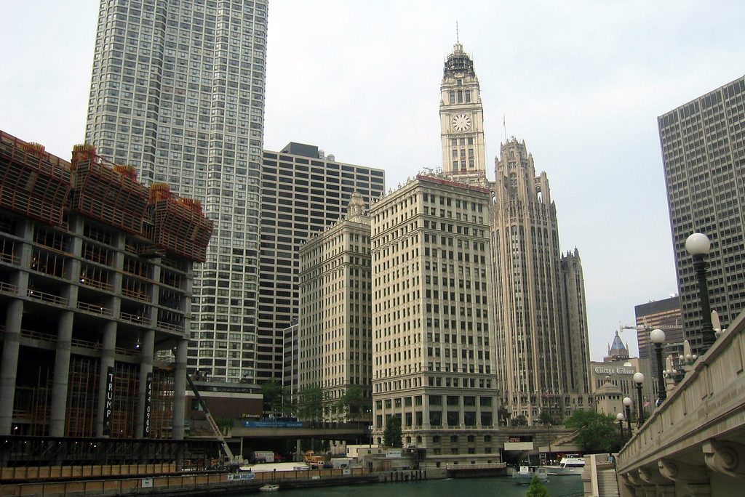
Human-Centered e-Science: A Group-Theoretic Perspective on Cyberinfrastructure Design
Tyler Pace, M.S.
Shaowen Bardzell, Ph.D.
Geoffrey Fox, Ph.D.
Indiana University School of Informatics and Computing
Notes:
Introduction
Names
Institution
Chicago pics

Slide 2
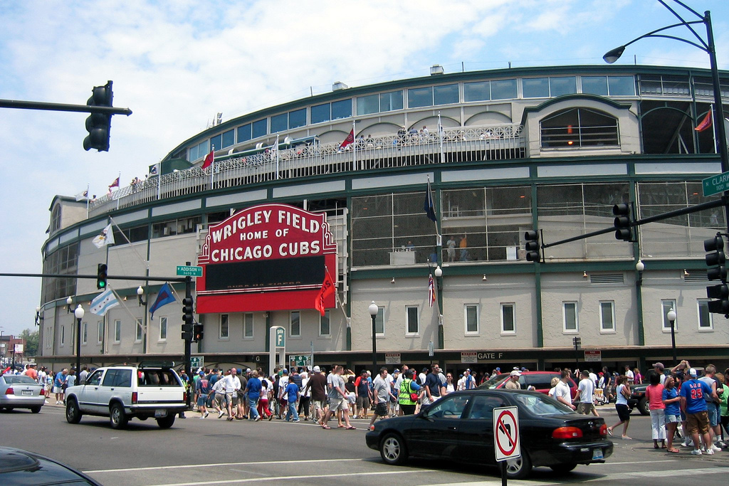
Group-Theoretic Perspective
Collaboration always fundamental to CI
CI long concerned with issues of scientific collaboration
However, limited theoretical work on small group collaborations via CI
Our goal is to introduce group theory to CI
Notes:
Early and recent CI vision statements highlight the fundamental role of collaboration in CI development
CI long concerned with social and organizational issues of scientific collaboration
However, limited theoretical work on small group collaborations in CI
Our goal is to introduce group theory to CI in an accessible and productive way

Slide 3
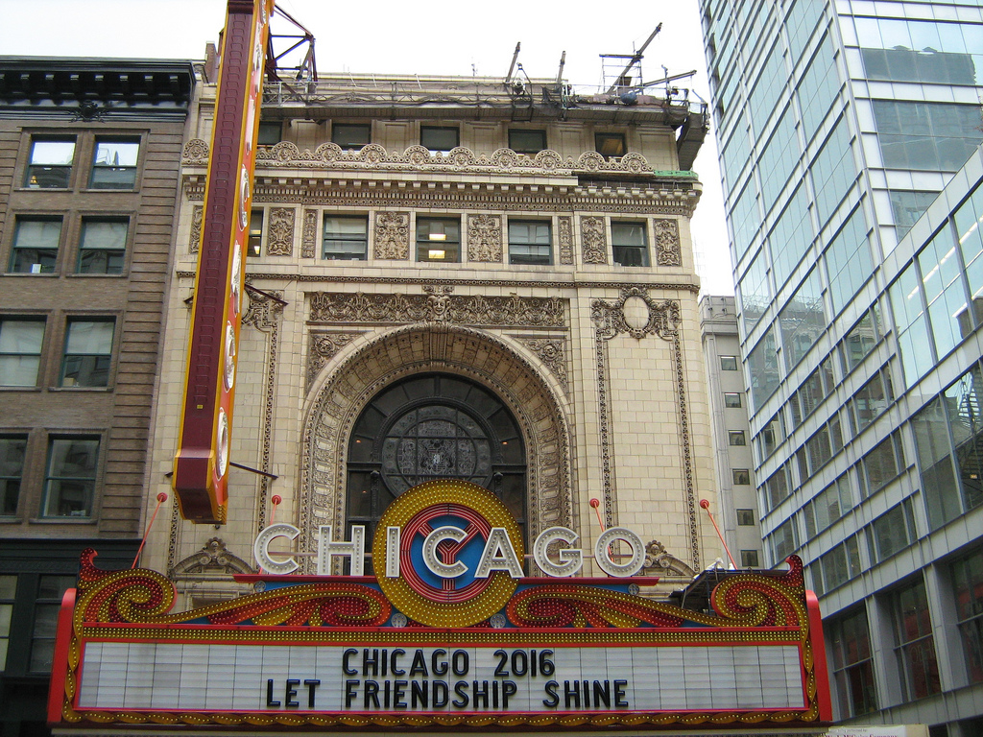
Method and Corpus
Critical analysis of over 150 articles and reports published post 2000
Venues range from HCI, CSCW, CMC and CE
Corpus is not meant to be exhaustive, but rather representative
Notes:
Critical analysis and review of over 150 peer reviewed articles and funding/project reports published since 2000 on CI
Venues from HCI, CSCW, CMC and CE
Corpus is not meant to be exhaustive, but hopefully representative

Slide 4
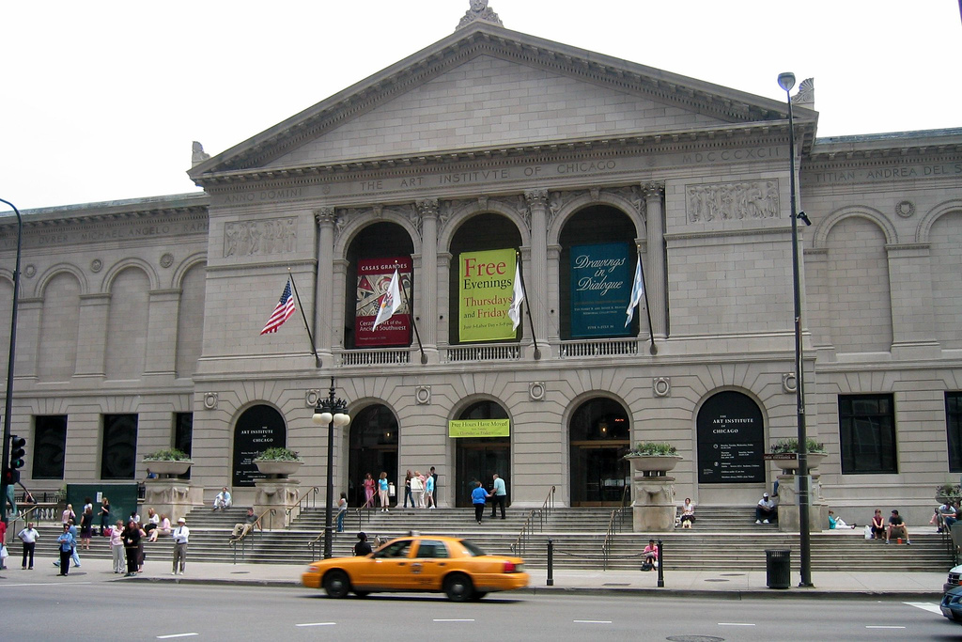
McGrath and Group Theory
Developed in 1980s-90s
Successfully used in CSCW
Concerned with the natural complexity of groups
Purpose of this work is not to introduce McGrath, but rather to highlight the group-centric nature of CI research
Notes:
Developed in 1980s-90s
Already successfully used in CSCW
Concerned with the natural complexity of groups, small and large, homogenous and intermingled, ad hoc and permanent
Purpose of this work is not primarily to introduce McGrath, but rather to highlight the group-centric nature of CI research
Shed further light on the centrality of the social and the human in our investigation of CI

Slide 5
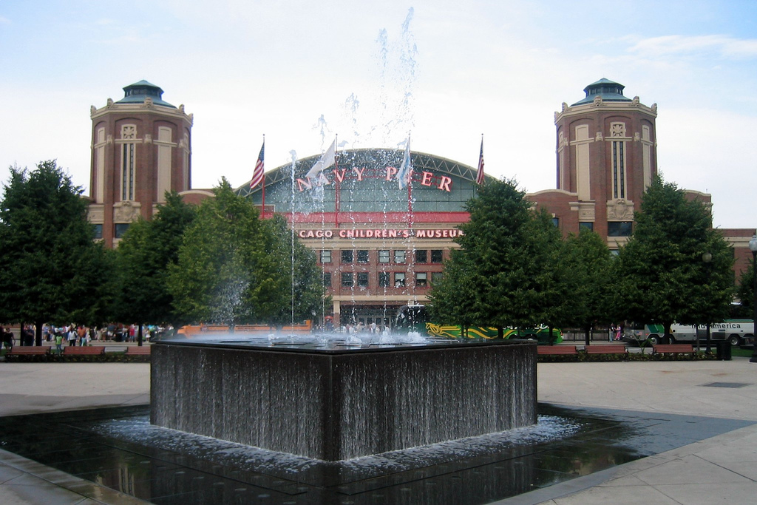
McGrath’s TIP Theory
Time, Interaction and Performance
Proposes a number of group functions
Functions are categorizations of tasks undertaken by all group in order to facilitate positive interactions
Production, Group Well-Being, Member Support
Notes:
Time, Interaction and Performance
Proposes a number of group functions
Functions are overarching categorizations of tasks undertaken by all group in order to facilitate positive interactions.
Production, Group Well-Being, Member Support

Slide 6
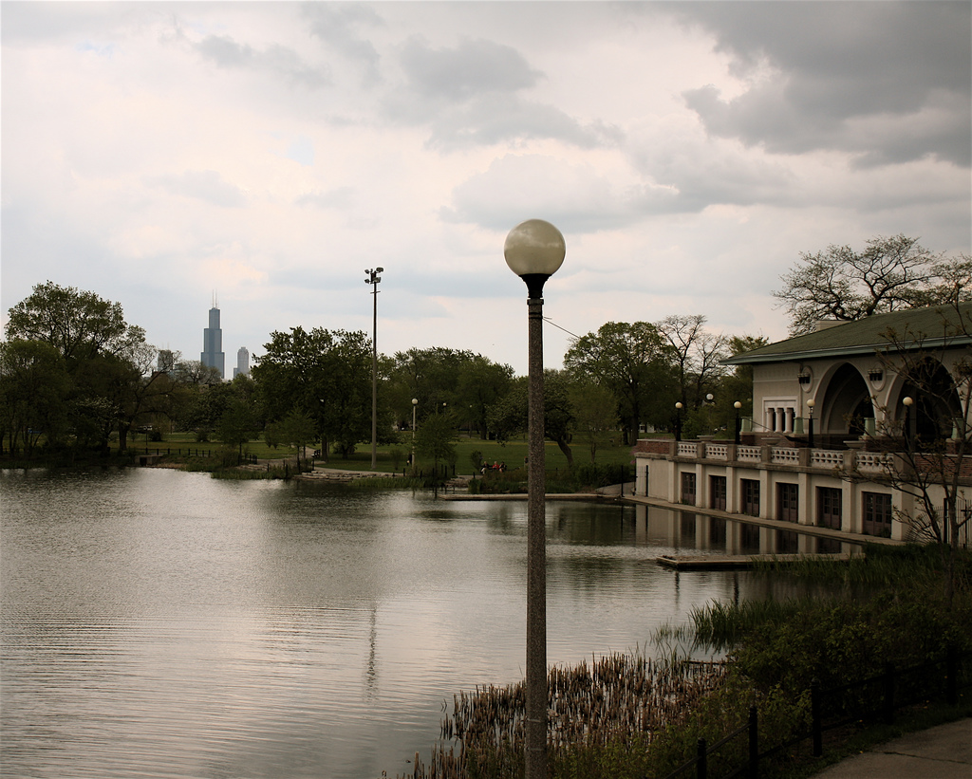
Production
Relation between groups and their environment
Tasks
choice of project
choice of project goals
technical problem-solving
political preference-solving
Notes:
McGrath: Relation between groups as functional units and the environment (technological and organizational) within which the groups operate.
Major tasks: choice of project, choice of project goals, technical problem-solving, political preference-solving

Slide 7
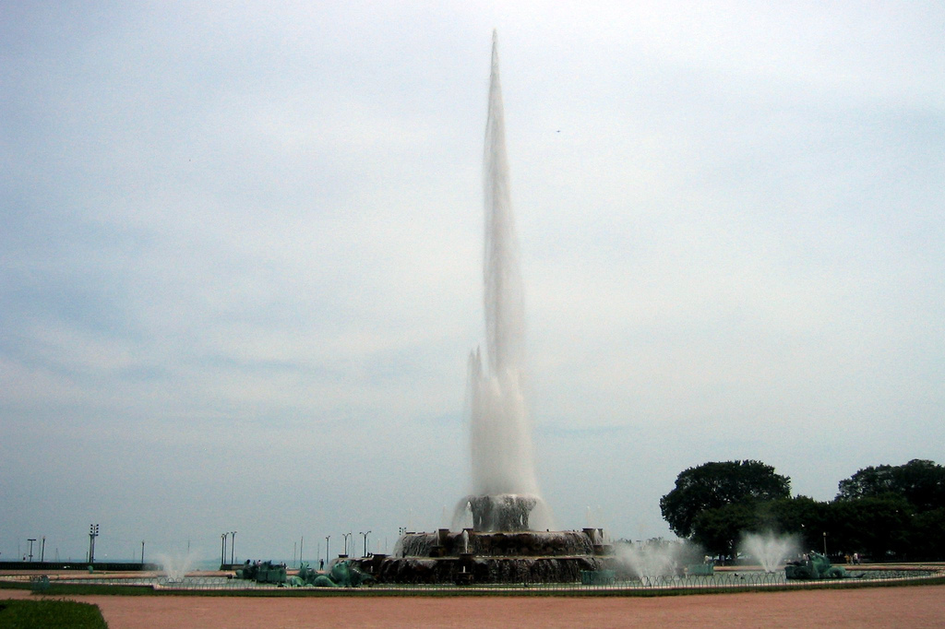
Production
Project Choice
Choosing the CI environment
Technical Problem-Solving
Access to the CI environment
Political Preference-Solving
Data management conflicts
Notes:
Project Choice = Choosing an appropriate CI environment
Technical Problem-Solving = Obtaining and maintaining sufficient access to the CI environment
Political Preference-Solving = Resolving data management conflicts

Slide 8
Well-Being
Activities that deal with the development and maintenance of the group as a system
Tasks
managing relations
carrying out interpersonal activities
defining member roles
Notes:
McGrath: Activities that deal with the development and maintenance of the group as a system.
Tasks: Managing relations among group members, carrying out interpersonal activities involved in the completion of work, defining member roles within the group.

Slide 9
Well-Being
Managing Relations
Issues of disciplinarity
Conducting interpersonal tasks
Trust in the CI environment
Defining member roles
Development of context and awareness
Notes:
Managing Relations = Issues of Disciplinarity
Carrying out interpersonal tasks = Trust in the CI environment
Defining member roles = development of context and awareness

Slide 10
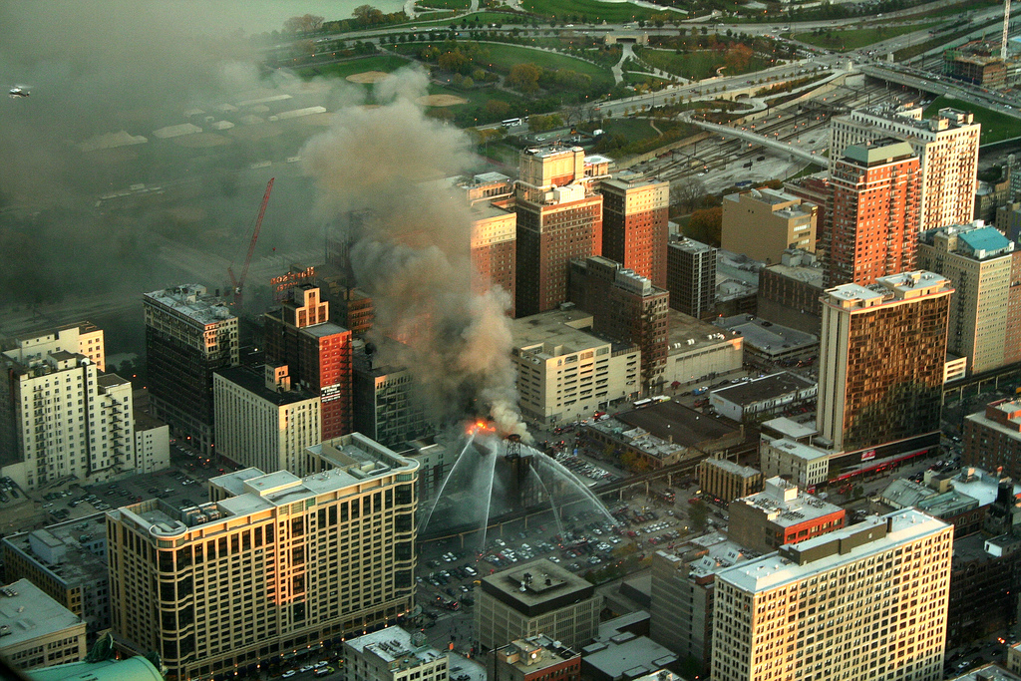
Member-Support
Activities that consider the ways in which individuals are embedded within a group
Tasks
policies for advancement
individual participation
negotiation of contribution and payoff
Notes:
McGrath: Activities that consider the ways in which individuals are embedded within a group, thereby reflecting the relations between individual members and the group.
Tasks: Policies for member advancement, individual participation in the group, negotiation of the member’s contribution and payoff.

Slide 11
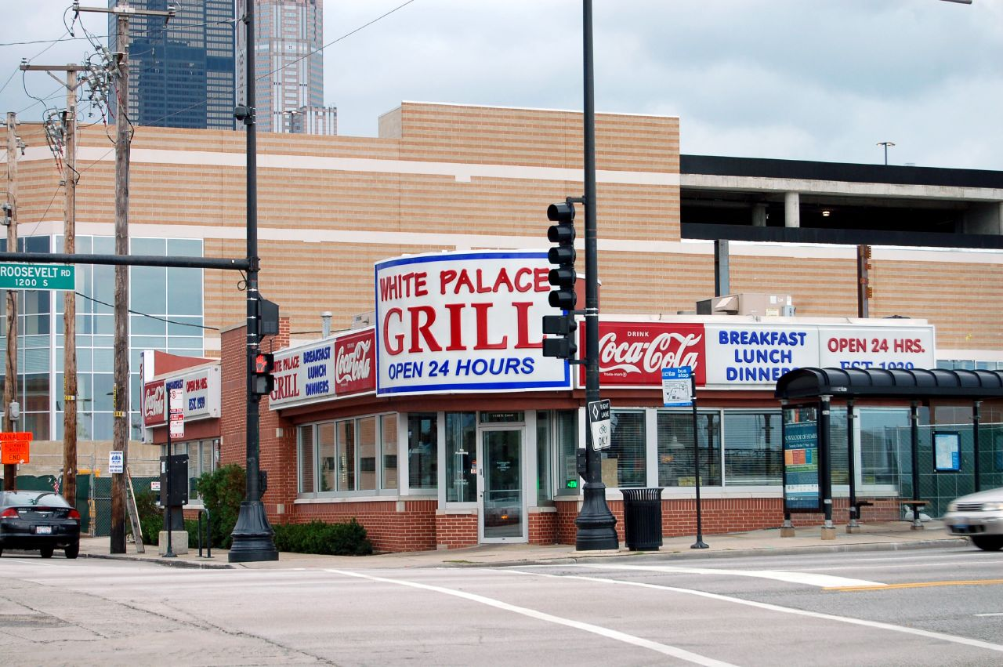
Member-Support
Policies for member advancement
Value of the member’s role
Individual participation
Issues of professional identity
Negotiation of contribution and payoff
Motivation/incentives for the use of CI
Notes:
Value of the member’s role with respect to the group = policies for member advancement
Issues of professional identity = individual participation in the group
Motivation/incentives for the use of CI = negotiation of the member’s contribution and payoff

Slide 12
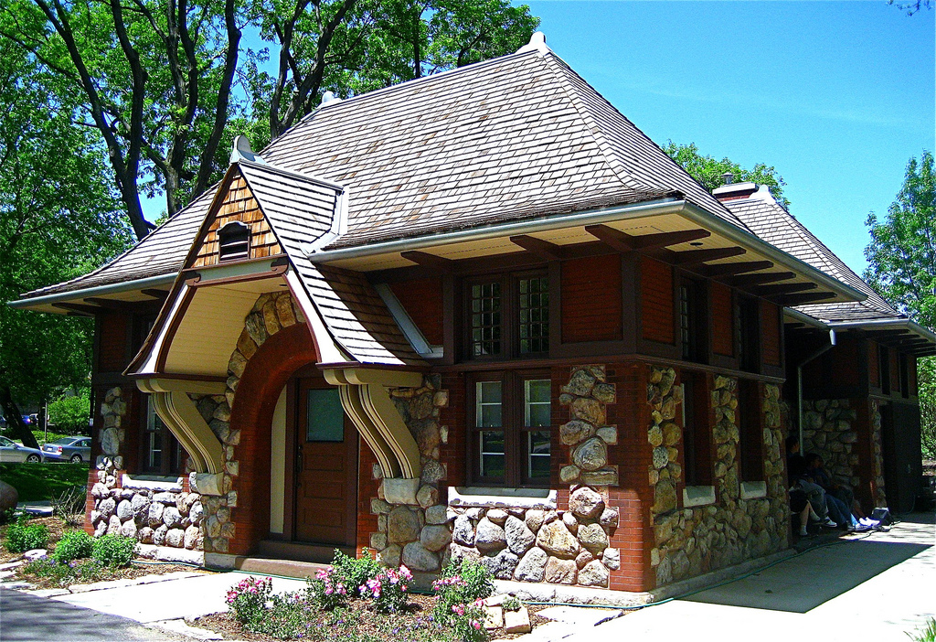
Implications for Design
Based on our group-centric review of CI lit we developed an early set of design implications
Implications for designers and developers offered to inspire and inform about the complex ways groups interact with and via CI
Notes:
Based on our group-centric review of CI lit we developed an early set of design implications
Implications for designers and developers offered to inspire and inform about the complex ways groups interact with and via CI

Slide 13
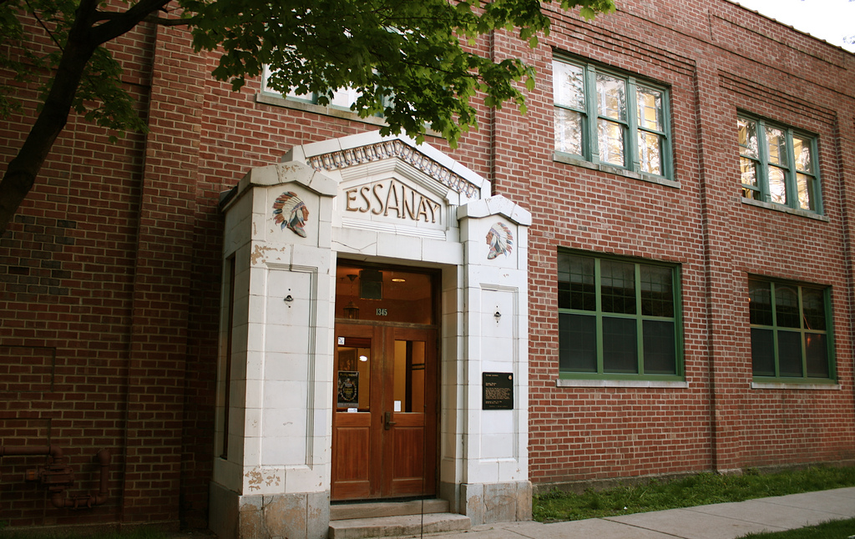
Improve Usability
Despite prior warnings, many CI environments are built with no considerations of usability or commitment to a user centered design process
Usability of a CI environment is a major factor in choosing and continuing to use that environment
Notes:
Despite prior warnings, many CI environments are built with no considerations of usability or commitment to a user centered design process
Usability of a CI environment is a major factor in choosing and continuing to use that environment (production function)

Slide 14
Enable External Access
CI is but one of many tools used by scientists
“Closed” CI environments are undesirable
“Open” CI environment can more readily be incorporated into existing work processes
Notes:
CI is but one of many tools uses by scientists
“Closed” CI environments are undesirable
“Open” CI environment that support external access and notifications can more readily be incorporated into existing personal and group work processes

Slide 15
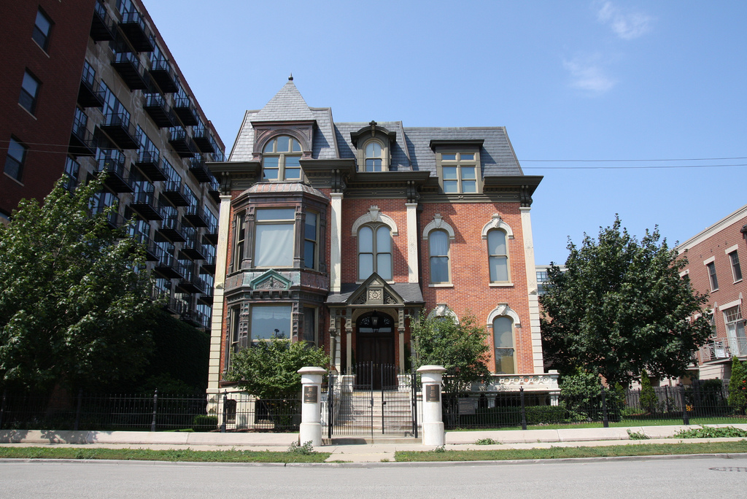
Support Telecommunication Diversity
Providing a wide range of telecommunication tools increases involvement with and use of CI
High availability of tools also supports diverse collaboration needs
Varied telecommunication tools help to mediate and develop context/awareness
Notes:
Providing a wide range of telecommunication tools increases involvement with and use of CI
High availability of tools also supports diverse collaboration needs
Varied telecommunication tools help to mediate and develop context/awarenss

Slide 16
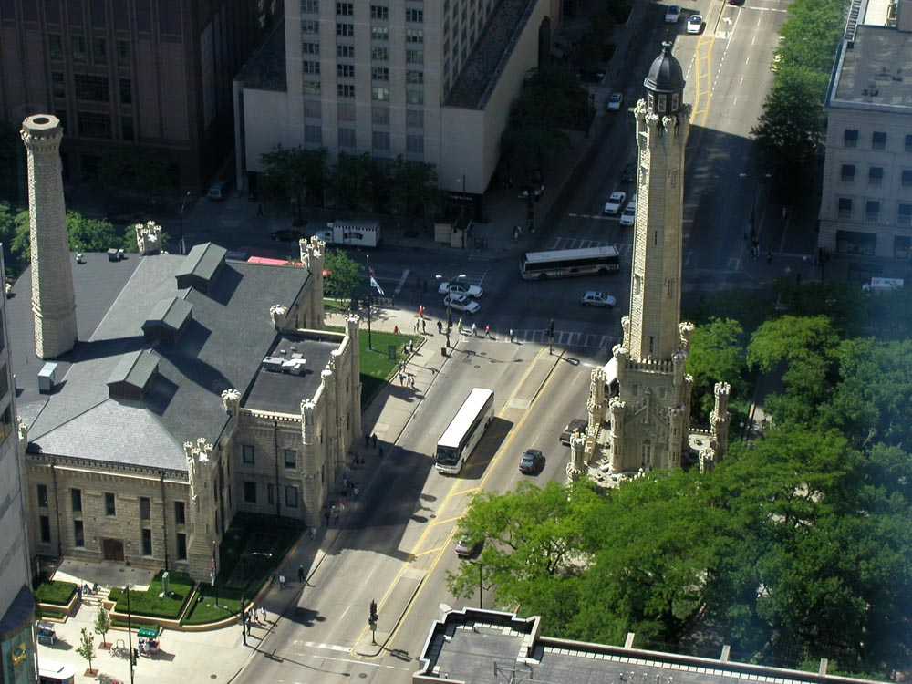
Provide Open Ended Data and Metadata Structures
CI depends on data that is both transportable and disseminative
Further explore the social practices around data use
Move beyond our reliance on existing metadata structures
Improve our understanding of data abstractions more broadly
Notes:
CI depends on data that is both transportable and disseminative
However, current data and metadata structures have fallen short of our lofty goals
Further explore the social practices around data use, move beyond our reliance on existing metadata structures, and improve our understanding of data abstractions more broadly
Example: Quantitative vs Qualitative
Example: Digital vs Non-Digital

Slide 17
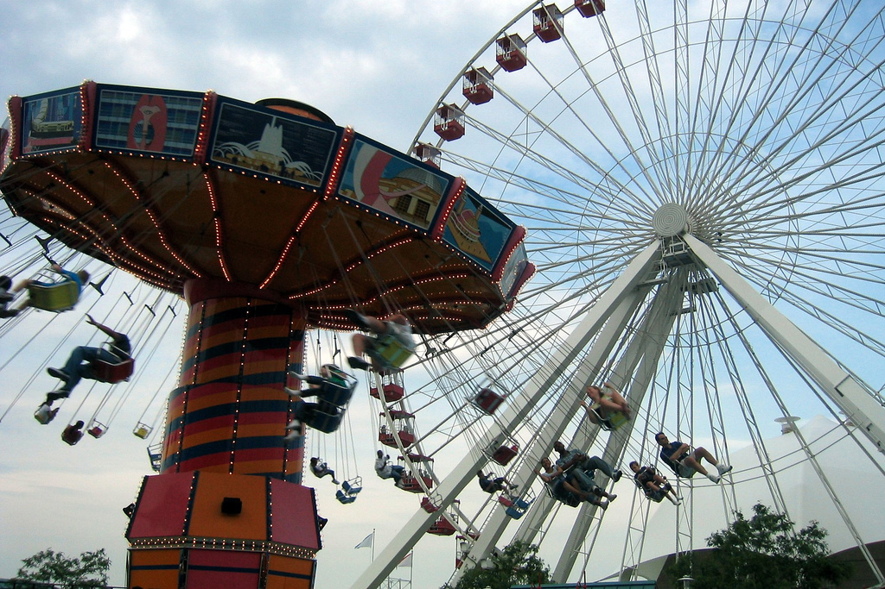
Facilitate Social Entrainment
Collaborators must be ready and willing to use CI, these are issues of “social entrainment”
Education about the value of CI
Motivation to use CI
Social incentives and support for/when using CI
Notes:
Collaborators must be ready and willing to use CI, these are issues of “social entrainment”
Education about the value of CI
Motivation to use CI
Social incentives and support for/when using CI

Slide 18
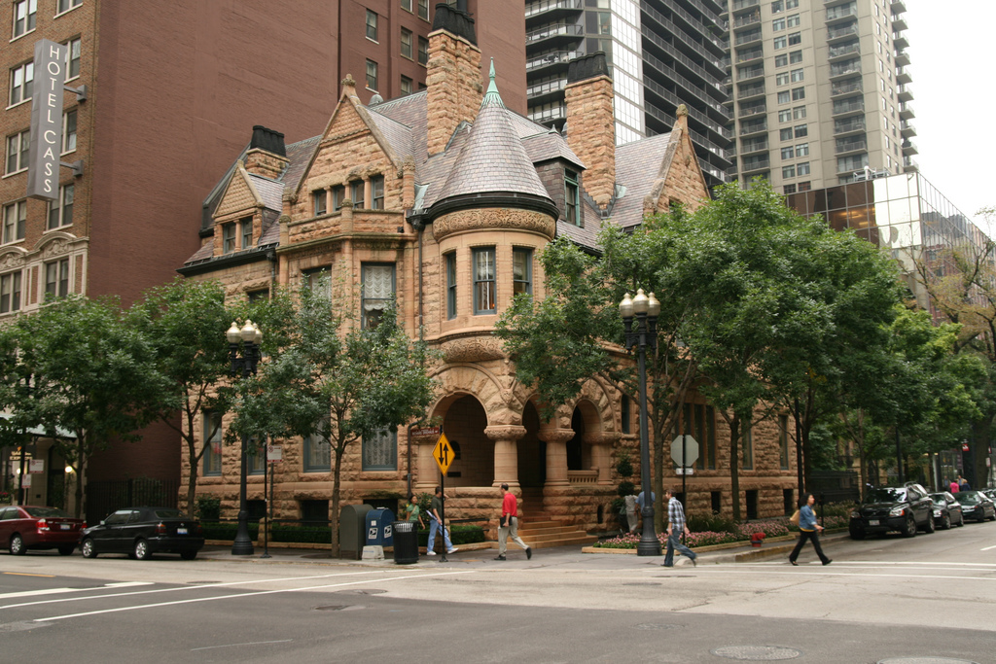
Support the Development and Sharing of Multiple Contexts of Work
CI research establishes the importance of a shared context of work
Group theory notes the importance of *multiple* contexts and hierarchies of work
Look to CSCW for help, early suggestions include flexible calendaring systems
Notes:
CI research establishes the importance of a shared context of work
Group theory notes the importance of *multiple* contexts and hierarchies of work
Not all members in a project are equally engaged in the CI work, therefore different priorities
Look to CSCW for help, early suggestions include flexible calendaring systems

Slide 19
Offer Familiar Tools and Assistance in Use
Word-of-mouth and peer referrals the major driving forces in CI adoption
These referrals are largely based on the extent to which CI tools reflect existing work practices
Amount and accessibility of support documentation also an issue
Notes:
Word-of-mouth and peer referrals the major driving forces in CI adoption
These referrals are largely based on the extent to which CI tools reflect existing work practices
Amount and accessibility of support documentation also an issue
Tends to be written in domain specific languages (mostly comp sci)

Slide 20
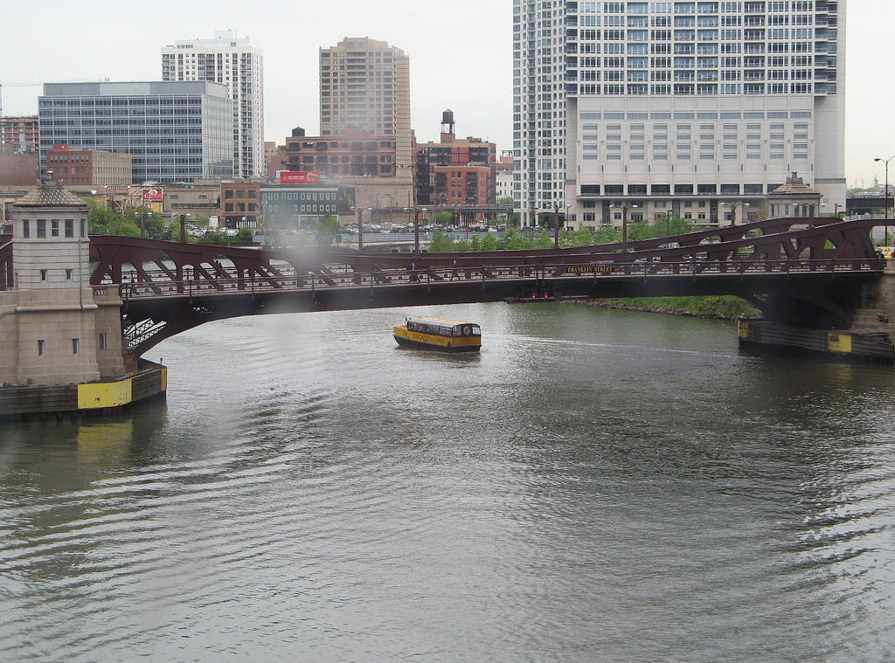
Conclusion
Group theory is a critical and productive tool for evaluating CI
Serves to decenter the technology laden discussion of CI research
Reveals the complex and nuanced ways in which CI and groups influence each other
Leaves us with an early set of research questions for moving forward
Notes:
Group theory is a critical and productive tool for evaluating CI
Serves to decenter the technology laden discussion of CI research while revealing the complex and nuanced ways in which CI and groups influence each other
Leaves us with an early set of research questions for moving forward

Slide 21
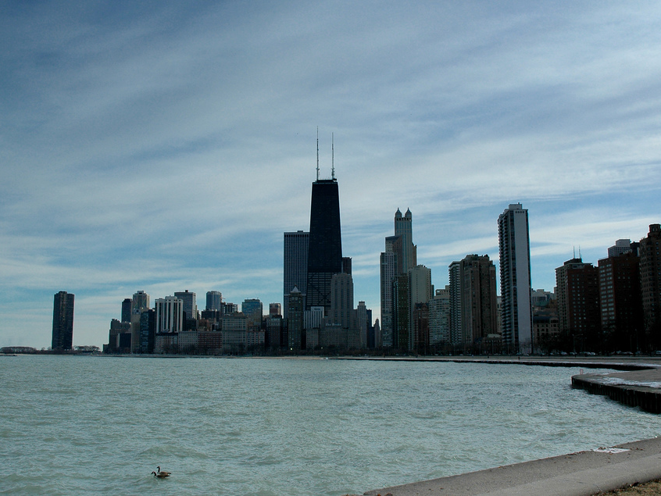
How do groups choose appropriate CI environments?
How do groups obtain and maintain access (social and technological) to their CI environments?
How do groups resolve socio-politically rooted data management (i.e., collection, storage, processing, sharing) conflicts?
In what ways do the differing epistemological and ontological practices of scientific disciplines influence group well-being?
What role does trust play in fostering group well-being with regard to the use of CI environments?
How are technologically rooted contexts of work used to maintain group well-being?
How do group members negotiate their value within the group with respect to the use of CI environments?
How do scientists overcome the challenges to their professional identity presented by the adoption of CI tools?
How can individual motivation and incentives be used to facilitate the participation of group members in CI oriented work?
Notes:
How do groups choose appropriate CI environments?
How do groups obtain and maintain access (social and technological) to their CI environments?
How do groups resolve socio-politically rooted data management (i.e., collection, storage, processing, sharing) conflicts?
In what ways do the differing epistemological and ontological practices of scientific disciplines influence group well-being?
What role does trust play in fostering group well-being with regard to the use of CI environments?
How are technologically rooted contexts of work used to maintain group well-being?
How do group members negotiate their value within the group with respect to the use of CI environments?
How do scientists overcome the challenges to their professional identity presented by the adoption of CI tools?
How can individual motivation and incentives be used to facilitate the participation of group members in CI oriented work?

Slide 22
Thank You
Tyler Pace
tympace@indiana.edu
Flickr Credits
http://www.flickr.com/photos/wallyg/170815745/
http://www.flickr.com/photos/wallyg/169880784/
http://www.flickr.com/photos/zol87/3986512406/
http://www.flickr.com/photos/wallyg/170180928/
http://www.flickr.com/photos/wallyg/170435086/
http://www.flickr.com/photos/bluebike/3526850803/
http://www.flickr.com/photos/wallyg/170576191/
http://www.flickr.com/photos/chicagoceli/133890748/
http://www.flickr.com/photos/jbolles/848559970/
http://www.flickr.com/photos/chicagogeek/3172083492/
http://www.flickr.com/photos/bithead/278824664/
http://www.flickr.com/photos/chicagoceli/270667231/
http://www.flickr.com/photos/chicagogeek/3571881330/
http://www.flickr.com/photos/bluebike/3526852651/
http://www.flickr.com/photos/yooperann/3821611176/
http://www.flickr.com/photos/m500/2778956038/
http://www.flickr.com/photos/charlestilford/266488295/
http://www.flickr.com/photos/wallyg/170024684/
http://www.flickr.com/photos/brostad/3343854310/
http://www.flickr.com/photos/sectionz/49548872/
http://www.flickr.com/photos/biverson/2515629013/
http://www.flickr.com/photos/vsmithuk/370773841/sizes/l/
http://www.flickr.com/photos/zol87/2923242557/
http://www.flickr.com/photos/24894289@N08/4359755949/
All photos used in this presentation are CC licensed.
Notes:
Flickr Credits
http://www.flickr.com/photos/wallyg/170815745/
http://www.flickr.com/photos/wallyg/169880784/
http://www.flickr.com/photos/zol87/3986512406/
http://www.flickr.com/photos/wallyg/170180928/
http://www.flickr.com/photos/wallyg/170435086/
http://www.flickr.com/photos/bluebike/3526850803/
http://www.flickr.com/photos/wallyg/170576191/
http://www.flickr.com/photos/chicagoceli/133890748/
http://www.flickr.com/photos/jbolles/848559970/
http://www.flickr.com/photos/chicagogeek/3172083492/
http://www.flickr.com/photos/bithead/278824664/
http://www.flickr.com/photos/chicagoceli/270667231/
http://www.flickr.com/photos/chicagogeek/3571881330/
http://www.flickr.com/photos/bluebike/3526852651/
http://www.flickr.com/photos/yooperann/3821611176/
http://www.flickr.com/photos/m500/2778956038/
http://www.flickr.com/photos/charlestilford/266488295/
http://www.flickr.com/photos/wallyg/170024684/
http://www.flickr.com/photos/brostad/3343854310/
http://www.flickr.com/photos/sectionz/49548872/
http://www.flickr.com/photos/biverson/2515629013/
http://www.flickr.com/photos/vsmithuk/370773841/sizes/l/
http://www.flickr.com/photos/zol87/2923242557/
http://www.flickr.com/photos/24894289@N08/4359755949/

