Slide 1
Collaborative Annotation of Real Time Streams on Android-Enabled Devices
Tao Huang
Geoffrey C. Fox
Indiana University Bloomington
{taohuang, gcf}@indiana.edu

Slide 2
Outline
Introduction
Collaborative Annotation Framework on Real Time Streams
Collaboration Research On Mobile
System Architecture & Design
Experiments & Conclusions

Slide 3
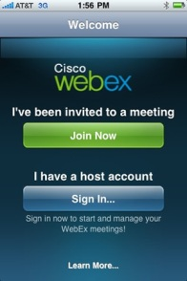

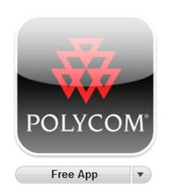



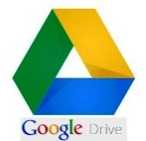
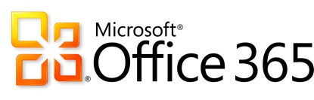
Introduction
Collaboration Systems
  Traditional
  Online
Trends
  Everything goes mobile
  Everything stores in Cloud
Mobile Extension of Collaborative Annotation Framework on Real Time Streams (introduced on CTS 2009)

Slide 4
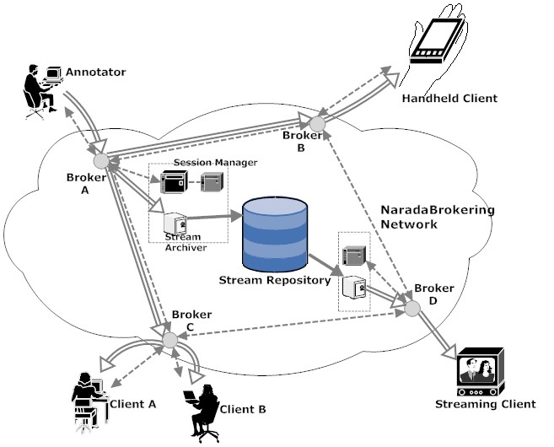
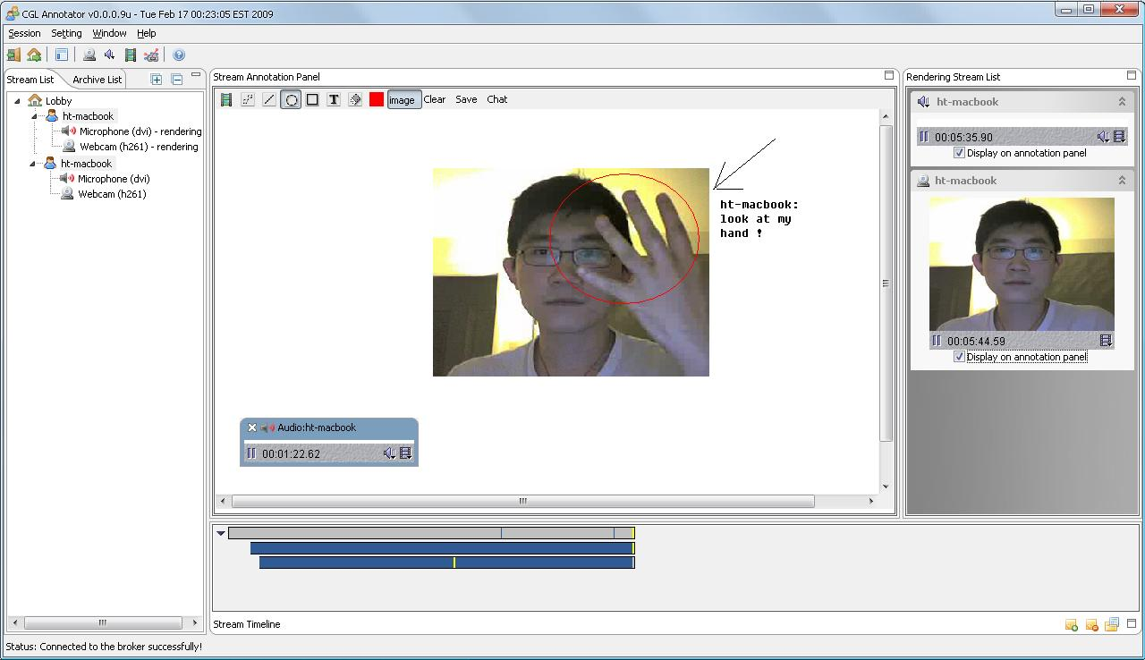
Collaborative Annotation Framework on Real Time Streams
Distributed annotation clients over the NaradaBrokering Network.
Session management with two recovery strategies
Distributed stream archiving and replaying
Easy to add support to handheld and streaming clients

Slide 5
Collaboration Research On Mobile
Popular topics
  Image/Text Based Location Recognition
  Digital Content/Place Annotation
  Tag/Scene Based Recommendation
Problems
  Thin client
  Limited Collaboration
  Limited Interaction on Content Data

Slide 6
Why android?
Features | iOS | Windows Phone | Android
Multimedia Support | ✔ | ✔ | ✔
Tablet Support | ✔ | End of 2012 | ✔
Easy Deployment and Debugging |  | ✔ | ✔
Java Support |  |  | ✔
Open Source |  |  | ✔

Slide 7
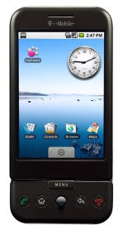
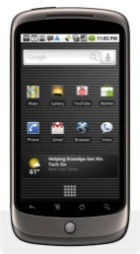
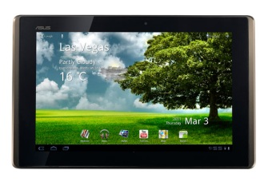
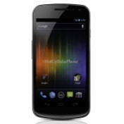
Android History
Time Period | Major Versions | Flagship Device | Major updates
09/08-09/09 | 1.X, Cupcake, Donut |  | N/A
10/09-Now | Éclair, Froyo, Gingerbread |  | Camera Improvement, Multitouch, Flash support, NFC, etc
02/11-Now | HoneyComb 3.x |  | Tablet support, UI redesign, Multi Core support
10/11-Now | Ice Cream Sandwich 4.0.x |  | Hardware Acceleration, etc

Slide 8
Technology prerequisites
Features | Collaborative Annotation Framework | Android Platform
User interface | SWT, AWT | Android UI framework
Audiovisual Capturing | JMF based | Android Multimedia Framework
Image Processing | SWT, AWT | Android canvas and OpenGL ES 1.0/2.0
Data Transmitting, Streaming | NaradaBrokering RabbitMQ | Simple RTSP based video streaming
Data Storage | Raw data file, XML Based metadata | SQLLite, raw file and xml file

Slide 9
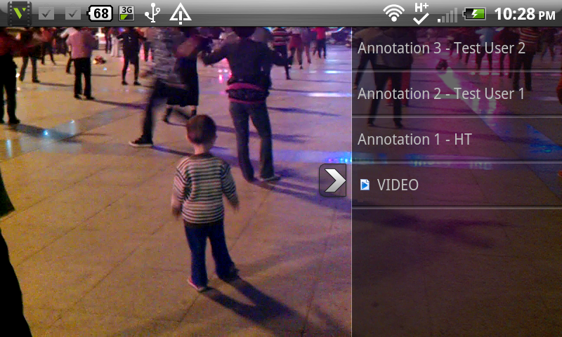
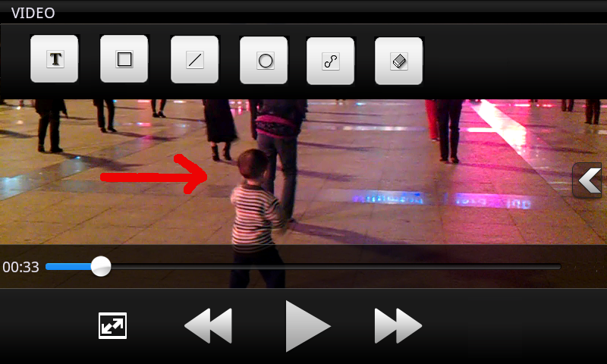
System Architecture & Design
Difference between Desktop and Mobile Clients
Extra layer of event translation: Stream Proxies

Slide 10
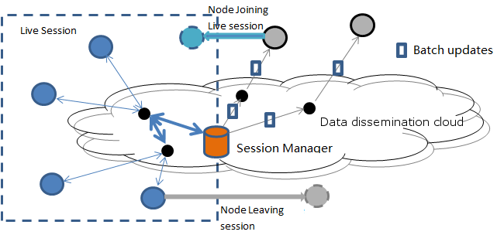
Session Control and Management
Batch Session Updates
Ignore heartbeat events

Slide 11
Multimedia Proxy for android

Slide 12
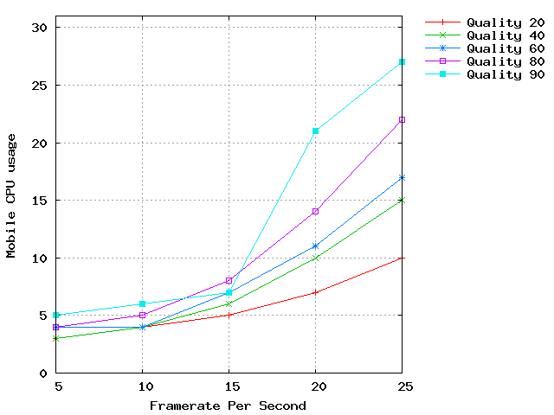
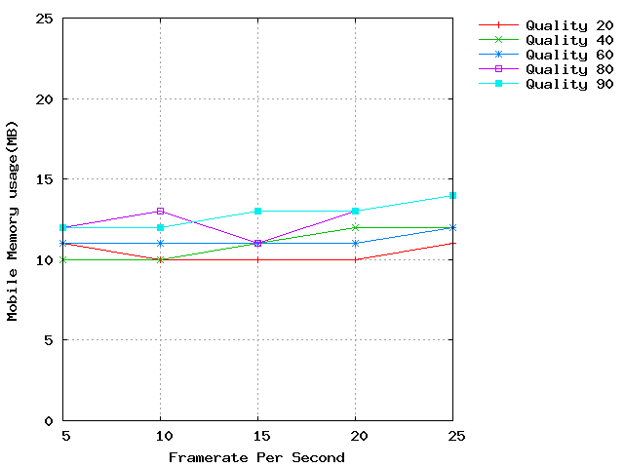
Experiments
Computing Resource Usage Test

Slide 13
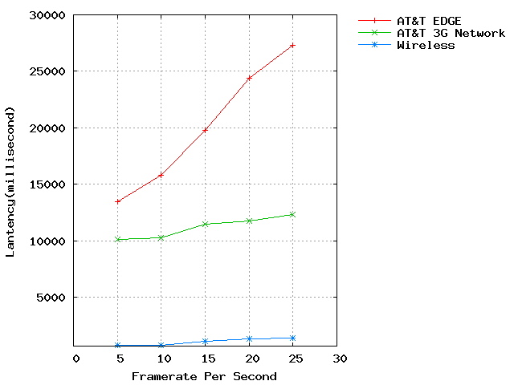
Experiments - cont
Latency Tests in Different Networks

Slide 14
Summary
Conclusion
  Support sync/a-sync collaboration between desktop and mobile clients
  Satisfying performance and user experience on android-based mobile devices (wireless only)
Future Work
  Stability Improvement and More sophisticated user cases
  Support on different mobile platforms

Slide 15
Questions?
Thanks

