Slide 1
Multidimensional Scaling by Deterministic Annealing with Iterative Majorization Algorithm
Seung-Hee Bae, Judy Qiu, and Geoffrey Fox
SALSA group in Pervasive Technology Institute
at Indiana University Bloomington

Slide 2
Outline
Motivation
Background and Related Work
DA-SMACOF
Experimental Analysis
Conclusions

Slide 3
Outline
Motivation
Background and Related Work
DA-SMACOF
Experimental Analysis
Conclusions

Slide 4
Motivation
Data explosion
Information visualization makes data analysis feasible for such a vast and high-dimensional scientific data.
e.g.) Biological sequence, chemical Compound data, etc.
Dimension reduction alg. helps people to investigate unknown data distribution of the high-dimensional data.
Multidimensional Scaling (MDS) for Data Visualization
Construct a mapping in the target dimension w.r.t. the proximity (dissimilarity) information.
Non-linear optimization problem.
Easy to trapped in local optima →How to avoid local optima?

Slide 5
Mapping examples

Slide 6
Outline
Motivation
Background and Related Work
Multidimensional Scaling
SMACOF algorithm
Deterministic Annealing method
DA-SMACOF
Experimental Analysis
Contributions

Slide 7
Multidimensional Scaling (MDS)
Given the proximity information among points.
Optimization problem to find mapping in target dimension of the data based on given pairwise proximity information while minimize the objective function.
Objective functions: STRESS (1) or SSTRESS (2)
Only needs pairwise dissimilarities δ_{ij} between original points
(not necessary to be Euclidean distance)
d_{ij}(X) is Euclidean distance between mapped (3D) points

Slide 8
Scaling by MAjorizing a COmplicated Function. (SMACOF)
Iterative majorizing algorithm to solve MDS problem.
EM-like hill-climbing approach.
Decrease STRESS value monotonically.
Tend to be trapped in local optima.
Computational complexity and memory requirement is O(N²).

Slide 9
Deterministic Annealing (DA)
Simulated Annealing (SA) applies Metropolis algorithm to minimize F by random walk.
Gibbs Distribution at T (computational temperature).
Minimize Free Energy (F)
As T decreases, more structure of problem space is getting revealed.
DA tries to avoid local optima w/o random walking.
DA finds the expected solution which minimize F by calculating exactly or approximately.
DA applied to clustering, GTM, Gaussian Mixtures etc.

Slide 10
Outline
Motivation
Background and Related Work
DA-SMACOF
Experimental Analysis
Conclusions

Slide 11
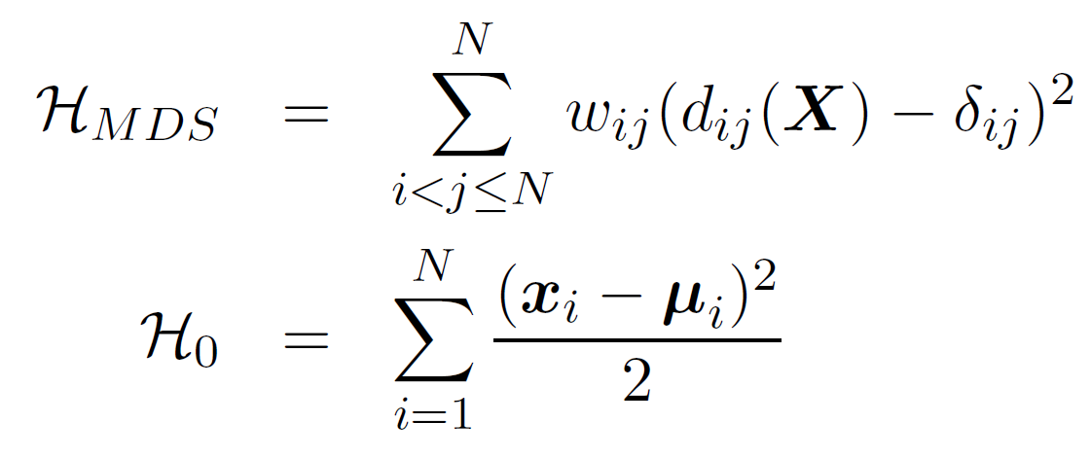
DA-SMACOF
If we use STRESS objective function as an expected energy function of MDS problem, then
Also, we define P⁰ and F₀ as following:
minimize F_{MDS}(P⁰) = <H_{MDS} −H₀>|₀ + F₀(P⁰) w.r.t. μ_{i}
− <H₀>|₀ + F₀(P⁰) is independent to μ_{i}
<H_{MDS}> part is necessary to be minimized w.r.t. μ_{i}.

Slide 12
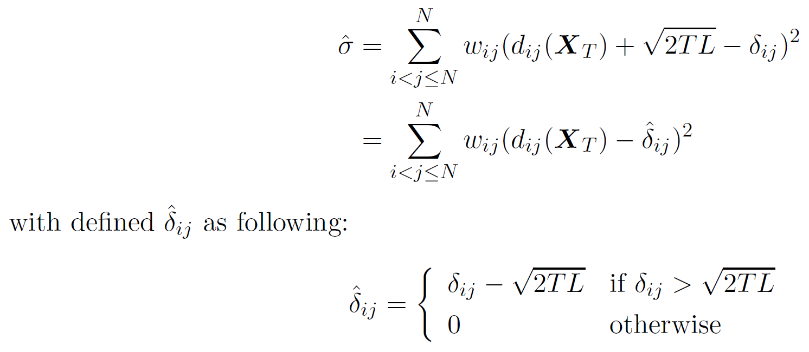
DA-SMACOF (2)
Use EM-like SMACOF alg. to calculate expected mapping which minimize <H_{MDS}> at T.
New STRESS is following:

Slide 13
DA-SMACOF (3)
The MDS problem space could be smoother with higher T than with the lower T.
T represents the proportion of entropy to the free energy F.
Generally DA approach starts with very high T, but if T₀ is too high, then all points are mapped at the origin.
We need to find appropriate T₀ which makes at least one of the points is not mapped at the origin.

Slide 14
DA-SMACOF (4)

Slide 15
Outline
Motivation
Background and Related Work
DA-SMACOF
Experimental Analysis
Conclusions

Slide 16
Experimental Analysis
Data
UCI ML Repository
Iris (150), cancer (683), and yeast (1484)
Chemical compounds
155 featured real-value vector of 333 instances.
Biological Sequence
30,000 Metagenomics sequences
N by N dissimilarity matrix through SW alg.
Algorithms
SMACOF
Distance Smoothing (MDS-DistSmooth)
Proposed DA-SMACOF
Compare the avg. of 50 (10 for seq. data) random initial runs.

Slide 17
Mapping Quality (iris)
4D real-value vector
3 diff. classes
150 instances
DA-exp95 improves
57.1/45.8% of SMACOF
43.6/13.2% of DS-s100

Slide 18
Mapping Quality (compounds)
155-D real-value vector
333 instances
avg. STRESS of
SMACOF: 2.50/1.88
DS-s100: 2.66/1.57
times larger than DA-exp95

Slide 19
Mapping Quality (breast cancer)
9-D int-value vector
683 instances
avg. STRESS of
SMACOF: 18.6/11.3%
DS-s100: 8.3/comparable
worse than DA-exp95
DA-exp99 is worse than DA-exp95/90

Slide 20
Mapping Quality (yeast)
8 real-value attributes
1484 instances
SMACOF shows higher divergence

Slide 21
Mapping Quality (metagenomics)
N x N dissimilarity matix
30,000 sequences
Run w/ Parallel SMACOF
DA-exp95 improves
12.6/10.4% of SMACOF

Slide 22
Mapping Examples

Slide 23
Runtime Comparison

Slide 24
Outline
Motivation
Background and Related Work
DA-SMACOF
Experimental Analysis
Conclusions

Slide 25
Conclusions
Dimension reduction could be a very useful tool for high dimensional scientific data visualization.
SMACOF is easy to be trapped in local optima.
Apply DA approach to SMACOF alg. to prevent trapping local optima. DA-SMACOF
outperforms SMACOF and MDS-DistSmooth in
Quality by better STRESS value.
Reliability by consistent result (less sensitive to initial conf).
uses compatible runtimes, 1.12 ~ 4.2 times longer than SMACOF and 1.3 ~ 9.1 times shorter than DistSmooth.

Slide 26
Thanks! Questions?

