Slide 1
Investigation of Data Locality and Fairness in MapReduce
Zhenhua Guo, Geoffrey Fox, Mo Zhou

Slide 2
Outline
Introduction
Data Locality and Fairness
Experiments
Conclusions

Slide 3
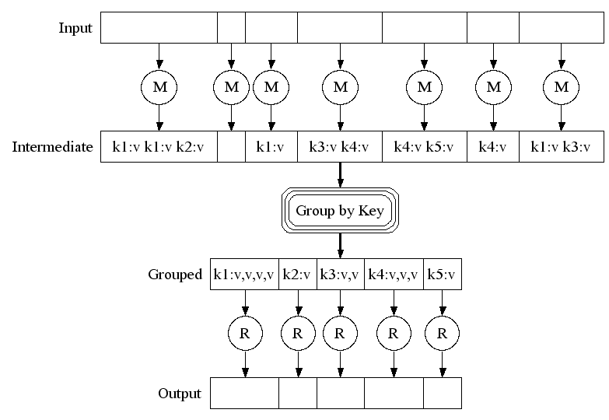
MapReduce Execution Overview
Google File System
Input file
block 0
1
2
Read input data Data locality
map tasks
Stored locally
Shuffle between map tasks and reduce tasks
reduce tasks
Stored in GFS
Google File System

Slide 4
Hadoop Implementation
Metadata mgmt.
Task scheduler
Storage: HDFS
- Files are split into blocks.
- Each block has replicas.
- All blocks are managed by central name node.
HDFS
Name node
MapReduce
Job tracker
Replication mgmt.
Fault tolerance
Block placement
……
Compute: MapReduce
- Each node has map and reduce slots - Tasks are scheduled to task slots
# of tasks <= # of slots
Hadoop
Hadoop
……
Operating System
Operating System
task slot
data block
Worker node 1
Worker node N

Slide 5
Data Locality
“Distance” between compute and data
Different levels: node-level, rack-level, etc.
The tasks that achieve node-level DL are called data local tasks
For data-intensive computing, data locality is important
Energy consumption
Network traffic
Research goals
Analyze state-of-the-art scheduling algorithms in MapReduce
Propose a scheduling algorithm achieving optimal data locality
Integrate Fairness
Mainly theoretical study

Slide 6
Outline
Introduction
Data Locality and Fairness
Experiments
Conclusions

Slide 7
Data Locality – Factors and Metrics
Important factors
Symbol | Description
N | the number of nodes
S | the number of map slots on each node
I | the ratio of idle slots
T | the number of tasks to execute
C | replication factor
Metrics
the goodness of data locality | the percent of data local tasks (0% – 100%)
data locality cost | the data movement cost of job execution
The two metrics are not directly related.
The goodness of data locality is good ⇏ Data locality cost is low
The number of non data local tasks ⇎ The incurred data locality cost
Depends on scheduling strategy, dist. of input, resource availability, etc.

Slide 8
Non-optimality of default Hadoop sched.
Problem: given a set of tasks and a set of idle slots, assign tasks to idle slots
Hadoop schedules tasks one by one
Consider one idle slot each time
Given an idle slot, schedule the task that yields the “best” data locality
Favor data locality
Achieve local optimum; global optimum is not guaranteed
Each task is scheduled without considering its impact on other tasks

Slide 9
Optimal Data Locality
All idle slots need to be considered at once to achieve global optimum
We propose an algorithm lsap-sched which yields optimal data locality
Reformulate the problem
Use a cost matrix to capture data locality information
Find a similar mathematical problem: Linear Sum Assignment Problem (LSAP)
Convert the scheduling problem to LSAP (not directly mapped)
Prove the optimality

Slide 10
Optimal Data Locality – Reformulation
m idle map slots {s₁,…s_{m}} and n tasks {T₁,…T_{n}}
Construct a cost matrix C
Cell C_{i,j} is the assignment cost if task T_{i} is assigned to idle slot s_{j} 0: if compute and data are co-located 1: otherwise (uniform net. bw) Reflects data locality
Represent task assignment with a function Φ
Given task i, Φ(i) is the slot where it is assigned
Cost sum:
Find an assignment to minimize C_{sum}
 | s₁ | s₂ | … | s_{m-1} | s_{m}
T₁ | 1 | 1 | … | 0 | 0
T₂ | 0 | 1 | … | 0 | 1
… | … | … | … | … | …
T_{n-1} | 0 | 1 | … | 0 | 0
T_{n} | 1 | 0 | … | 0 | 1
lsap-uniform-sched

Slide 11
Optimal Data Locality – Reformulation (cont.)
Refinement: use real network bandwidth to calculate cost
Cell C_{i,j} is the incurred cost if task T_{i} is assigned to idle slot s_{j} 0: if compute and data are co-located : otherwise
 | s₁ | s₂ | … | s_{m-1} | s_{m}
T₁ | 1 | 3 | … | 0 | 0
T₂ | 0 | 2 | … | 0 | 2.5
… | … | … | … | … | …
T_{n-1} | 0 | 0.7 | … | 0 | 0
T_{n} | 1.5 | 0 | … | 0 | 3
Network Weather Service (NWS) can be used for network monitoring and prediction
lsap-sched

Slide 12
Optimal Data Locality – LSAP
LSAP: matrix C must be square
When a cost matrix C is not square, cannot apply LSAP
Solution 1: shrink C to a square matrix by removing rows/columns û
Solution 2: expand C to a square matrix ü
If n < m, create m-n dummy tasks, and use constant cost 0
Apply LSAP, and filter out the assignment of dummy tasks
If n > m, create n-m dummy slots, and use constant cost 0
Apply LSAP, and filter our the tasks assigned to dummy slots
 | s₁ | s₂ | … | s_{m-1} | s_{m}
T₁ | 1.2 | 2.6 | 0 | 0 | 0
… | … | … | … | … | …
T_{n} | 0 | 2 | 3 | 0 | 0
T_{n+1} | 0 | 0 | 0 | 0 | 0
… | … | … | … | … | …
T_{m} | 0 | 0 | 0 | 0 | 0
 | s₁ | … | s_{m} | s_{m+1} | … | s_{n}
T₁ | 1.8 | … | 0 | 0 | … | 0
… | … | … | … | … | … | …
T_{i} | 0 | … | 2.3 | 0 | … | 0
T_{i+1} | 1.3 | … | 3 | 0 | … | 0
… | … | … | … | … | … | …
T_{n} | 4 | … | 0 | 0 | … | 0
dummy tasks
(a) n < m
(b) n > m
dummy slots
Notes:
For solution 1, need to decide which rows/columns to purge without impacting the optimality.
Linear Sum Assignment Problem: Given n items and n workers, the assignment of an item to a worker incurs a known cost. Each item is assigned to one worker and each worker has one item assigned. Find the assignment that minimizes the sum of cost.

Slide 13
Optimal Data Locality – Proof
Do our transformations preserve optimality? Yes!
Assume LSAP algorithms give optimal assignments (for square matrices)
Proof sketch (by contradiction):
The assignment function found by lsap-sched is φ-lsap. Its cost sum is C_{sum}(φ-lsap)
The total assignment cost of the solution given by LSAP algorithms for the expanded square matrix is C_{sum}(φ-lsap) as well The key point is that the total assignment cost of dummy tasks is |n-m| no matter where they are assigned.
Assume that φ-lsap is not optimal. Another function φ-opt gives smaller assignment cost. C_{sum}(φ-opt) < C_{sum}(φ-lsap).
We extend function φ-opt, cost sum is C_{sum}(φ-opt) for expanded square matrix C_{sum}(φ-opt) < C_{sum}(φ-lsap) ⇨ The solution given by LSAP algorithm is not optimal. ⇨ This contradicts our assumption

Slide 14
Integration of Fairness
Data locality and fairness conflict sometimes
Assignment Cost = Data Locality Cost (DLC) + Fairness Cost (FC)
Group model
Jobs are put into groups denoted by G.
Each group is assigned a ration w (the expected share of resource usage)
Real usage share:
(rt_{i}: # of running tasks of group i)
Group Fairness Cost:
Slots to allocate:
(AS: # of all slots)
Approach 1: task FC ← GFC of the group it belongs to
Issue: oscillation of actual resource usage (all or none are scheduled)
A group i)slightly underuses its ration ii) has many waiting tasks → drastic overuse of resources

Slide 15
Integration of Fairness (cont.)
Approach 2: For group G_{i},
the FC of sto_{i} tasks are set to GFC_{i},
the FC of other tasks are set to a larger value
Configurable DLC and FC weights to control the tradeoff
Assignment Cost = α· DLC + ϐ· FC
Notes:
The FC of other tasks: (1-w_{i})· γ

Slide 16
Outline
Introduction
Data Locality and Fairness
Experiments (Simulations)
Conclusions

Slide 17
Experiments – Overhead of LSAP Solver
Goal: to measure the time needed to solve LSAP
Hungarian algorithm (O(n³)): absolute optimality is guaranteed
Matrix Size | Time
100 x 100 | 7ms
500 x 500 | 130ms
1700 x 1700 | 450ms
2900 x 2900 | 1s
Appropriate for small- and medium-sized clusters
Alternative: use heuristics to sacrifice absolute optimality in favor of low compute time

Slide 18
Experiment – Background Recap
Scheduling Algorithm | Description
dl-sched | Default Hadoop scheduling algorithm
lsap-uniform-sched | Our proposed LSAP-based algorithm (Pairwise bandwidth is identical)
lsap-sched | Our proposed LSAP-based algorithm (is network topology aware)
Metric | Description
the goodness of data locality | the percent of data local tasks (0% – 100%)
data locality cost | The data movement cost of job execution
Example: 10 tasks 9 data-local tasks, 1 non data local task with data movement cost 5
The goodness of data locality is 90% (9 / 10)
Data locality cost is 5

Slide 19
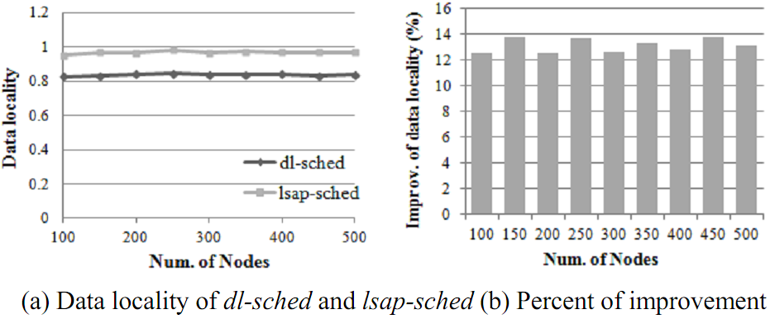
Experiment – The goodness of data locality
Measure the ratio of data-local tasks (0% – 100%)
# of nodes is from 100 to 500 (step size 50). Each node has 4 slots. Replication factor is 3. The ratio of idle slots is 50%.
better
lsap-sched consistently improves the goodness of DL by 12% -14%

Slide 20
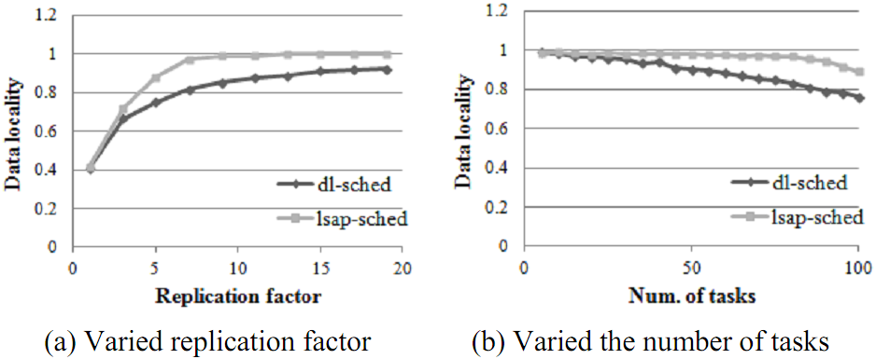
Experiment – The goodness of data locality (cont.)
Measure the ratio of data-local tasks (0% – 100%)
# of nodes is 100
better
Increase replication factor ⇒ better data locality
More tasks ⇒ More workload ⇒ Worse data locality
lsap-sched outperforms dl-sched

Slide 21
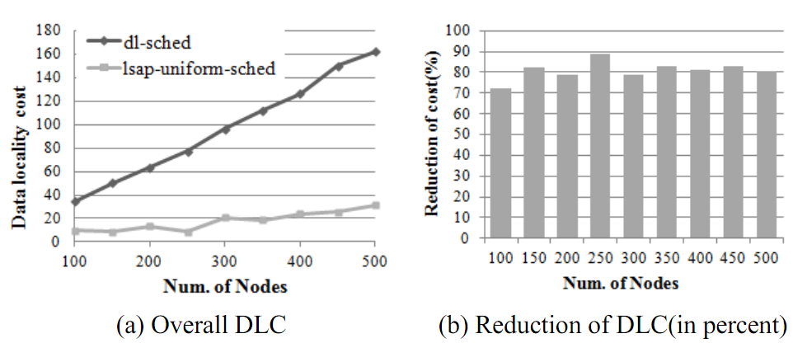
Experiment – Data Locality Cost
With uniform network bandwidth
lsap-sched and lsap-uniform-sched become equivalent
better
better
lsap-uniform-sched outperforms dl-sched by 70% – 90%

Slide 22
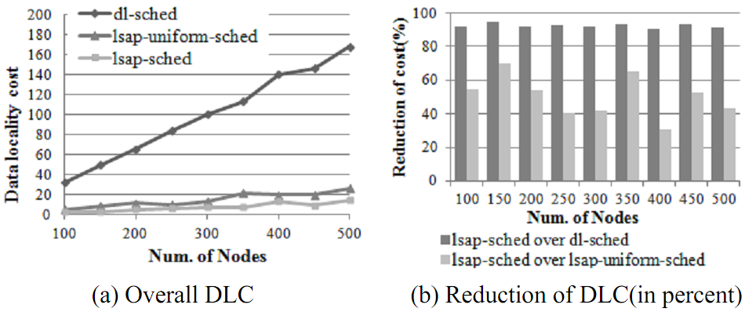
Experiment – Data Locality Cost (cont.)
Hierarchical network topology setup
50% idle slots
better
better
Introduction of network topology does not degrade performance substantially.
dl-sched, lsap-sched, and lsap-uniform-sched are rack aware
lsap-sched outperforms dl-sched by up to 95%
lsap-sched outperforms lsap-uniform-sched by up to 65%

Slide 23
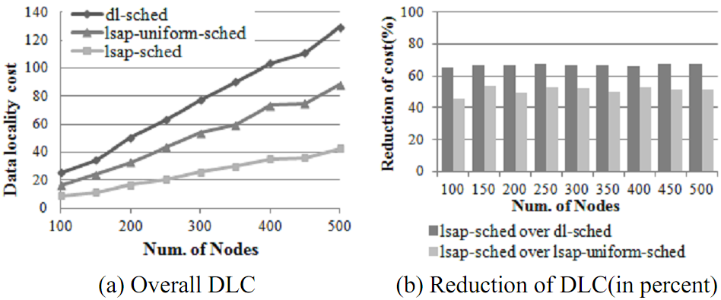
Experiment – Data Locality Cost (cont.)
Hierarchical network topology setup
20% idle slots
better
better
lsap-sched outperforms dl-sched by 60% - 70%
lsap-sched outperforms lsap-uniform-sched by 40% - 50%
With less idle capacity, the superiority of our algorithms decreases.

Slide 24
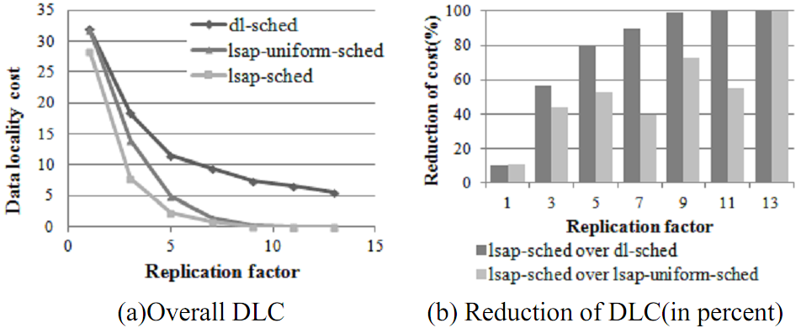
Experiment – Data Locality Cost (cont.)
# of nodes is 100, vary replication factor
better
better
Increasing replication factor reduces data locality cost.
lsap-sched and lsap-uniform-sched have faster DLC decrease
Replication factor is 3 → lsap-sched outperforms dl-sched by over 50%
Notes:
50% idle slots,

Slide 25
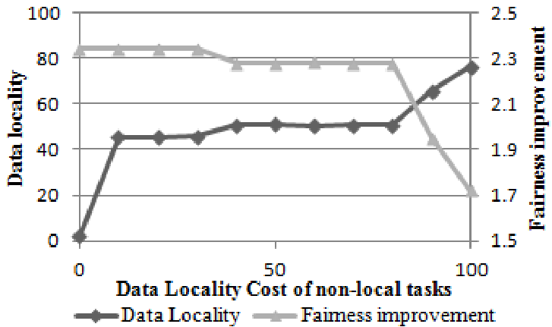
Experiment – Tradeoff between Data Locality and Fairness
Fairness distance:
Average:
Increase the weight of data locality cost

Slide 26
Conclusions
Hadoop scheduling favors data locality
Hadoop scheduling is not optimal
We propose a new algorithm yielding optimal data locality
Uniform network bandwidth
Hierarchical network topology
Integrate fairness by tuning cost
Conducted experiments to demonstrate the effectiveness
More practical evaluation is part of future work

Slide 27
Questions?

Slide 28
Backup slides

Slide 29
MapReduce Model
Input & Output: a set of key/value pairs
Two primitive operations
map: (k₁,v₁) → list(k₂,v₂)
reduce: (k₂,list(v₂)) → list(k₃,v₃)
Each map operation processes one input key/value pair and produces a set of key/value pairs
Each reduce operation
Merges all intermediate values (produced by map ops) for a particular key
Produce final key/value pairs
Operations are organized into tasks
Map tasks: apply map operation to a set of key/value pairs
Reduce tasks: apply reduce operation to intermediate key/value pairs
Each MapReduce job comprises a set of map and reduce (optional) tasks.
Use Google File System to store data
Optimized for large files and write-once-read-many access patterns
HDFS is an open source implementation

