Slide 1


Cloud Computing Paradigms for Pleasingly Parallel Biomedical Applications
Thilina Gunarathne, Tak-Lon Wu
Judy Qiu, Geoffrey Fox
School of Informatics, Pervasive Technology Institute
Indiana University

Slide 2
Introduction
Forth Paradigm – Data intensive scientific discovery
  DNA Sequencing machines, LHC
Loosely coupled problems
  BLAST, Monte Carlo simulations, many image processing applications, parametric studies
Cloud platforms
  Amazon Web Services, Azure Platform
MapReduce Frameworks
  Apache Hadoop, Microsoft DryadLINQ
Notes:
Today we live in a research world full of data. And the amount of data is increasing constantly. Jim Gray named this data intensive scientific discovery as the fourth paradigm of science. We require massive compute power to process these massive amounts of data. More often than not, these data intensive scientific problems fall in to the category of pleasingly parallel or in other words loosely coupled problems.
Pleasingly parallel is an application that can be parallelized requiring minimal effort to divide an application in to independent parallel parts, each having no or minimal data, synch or ordering dependencies among each other. There exist many interesting pleasingly parallel computational problems. Examples of popular pleasingly parallel problems are BLAST, Monte Carlo simulations, many image processing applications, parametric studies. Data clensing, pre-processing.
The number of pleasingly parallel problems are increasing with the move towards the data intensive computing.
Automated DNA sequencers, Large Hadron Collider

Slide 3
Cloud Computing
On demand computational services over web
  Spiky compute needs of the scientists
Horizontal scaling with no additional cost
  Increased throughput
Cloud infrastructure services
  Storage, messaging, tabular storage
  Cloud oriented services guarantees
  Virtually unlimited scalability
Notes:
Horizontal scaling increase throughput – 100 hours in 10 nodes == 10 hours in 100 nodes
Virtually Unlimited resource availability

Slide 4
Amazon Web Services
Elastic Compute Service (EC2)
  Infrastructure as a service
Cloud Storage (S3)
Queue service (SQS)
Instance Type | Memory | EC2 compute units | Actual CPU cores | Cost per hour
Large | 7.5 GB | 4 | 2 X (~2Ghz) | 0.34$
Extra Large | 15 GB | 8 | 4 X (~2Ghz) | 0.68$
High CPU Extra Large | 7 GB | 20 | 8 X (~2.5Ghz) | 0.68$
High Memory 4XL | 68.4 GB | 26 | 8X (~3.25Ghz) | 2.40$
Notes:
EC2
Rich set of instance choices. Both Windows as well as Linux.
Root access
High CPU extra large
Single compute unit – 1.0 – 1.2 GHz
Billed hourly
SQS – eventual consistent, reliable, scalable and distributed web scale queue service. Ideal for short lived transient messages. Unlimited queues, unlimited messages. At least once delivery guarantee.
Visibility time out.
Billed for number of messages & the size of data.
S3 provides a web-scale distributed storage service where users can store and retrieve any type of data through a web services interface. S3 is accessible from anywhere in the web. Data objects in S3 are access controllable and can be organized in to buckets. S3 pricing is based on the size of the stored data, amount of data transferred and the number of API requests.

Slide 5
Microsoft Azure Platform
Windows Azure Compute
  Platform as a service
Azure Storage Queues
Azure Blob Storage
Instance Type | CPU Cores | Memory | Local Disk Space | Cost per hour
Small | 1 | 1.7 GB | 250 GB | 0.12$
Medium | 2 | 3.5 GB | 500 GB | 0.24$
Large | 4 | 7 GB | 1000 GB | 0.48$
ExtraLarge | 8 | 15 GB | 2000 GB | 0.96$
Notes:
Windows virtual machines only. .net runtime as a platform.
1.5 to 1.7 GHz.
In cap3 8 azure small instances == One Amazon High CPU (20 EC2 compute units)
Deploy as Azure deployment package through a web app.

Slide 6
Classic cloud architecture

Slide 7
MapReduce
General purpose massive data analysis in brittle environments
  Commodity clusters
  Clouds
Apache Hadoop
  HDFS
Microsoft DryadLINQ
Notes:
Even thought the concept was there in PL & DB world, the use of MapReduce model for large parallel data processing was introduced by Google.
A MapReduce framework divides the input data in to parts, process them in parallel using a ‘Map’ function and then collect/combine the processed data using a ‘Reduce’ function.
Simple interface to the programmers. Use sequential Map & Reduce functions for massively parallel computations.
Fault tolerance.

Slide 8
MapReduce Architecture
HDFS
Input Data Set
Data File
exe
exe
Map()
Map()
Executable
Optional
Reduce
Phase
Reduce
HDFS
Results

Slide 9
 | AWS/ Azure | Hadoop | DryadLINQ
Programming patterns | Independent job execution | MapReduce | DAG execution, MapReduce + Other patterns
Fault Tolerance | Task re-execution based on a time out | Re-execution of failed and slow tasks. | Re-execution of failed and slow tasks.
Data Storage | S3/Azure Storage. | HDFS parallel file system. | Local files
Environments | EC2/Azure, local compute resources | Linux cluster, Amazon Elastic MapReduce | Windows HPCS cluster
Ease of Programming | EC2 : ** Azure: *** | **** | ****
Ease of use | EC2 : *** Azure: ** | *** | ****
Scheduling & Load Balancing | Dynamic scheduling through a global queue, Good natural load balancing | Data locality, rack aware dynamic task scheduling through a global queue, Good natural load balancing | Data locality, network topology aware scheduling. Static task partitions at the node level, suboptimal load balancing
Notes:
Ease of programming : Azure SDK

Slide 10
Cap3 – Sequence Assembly
Assembles DNA sequences by aligning and merging sequence fragments to construct whole genome sequences
Increased availability of DNA Sequencers.
Size of a single input file in the range of hundreds of KBs to several MBs.
Outputs can be collected independently, no need of a complex reduce step.
Notes:
It removes the poor regions of the DNA fragments, calculates the overlaps between the fragments, identifies and removes the false overlaps, joins the fragments to form contigs of one or more overlapping DNA segments and finally through multiple sequence alignment generates consensus sequences.

Slide 11
Sequence Assembly Performance with different EC2 Instance Types
Notes:
Instance Type CPU Cores Memory Local Disk Space Cost per hour
Small 1 1.7 GB 250 GB 0.12$
Medium 2 3.5 GB 500 GB 0.24$
Large 4 7 GB 1000 GB 0.48$
Extra Large 8 15 GB 2000 GB 0.96$

Slide 12


Sequence Assembly in the Clouds
Cap3 parallel efficiency
Cap3 – Per core per file (458 reads in each file) time to process sequences

Slide 13
Cost to assemble to process 4096 FASTA files*
Amazon AWS total :11.19 $
    Compute 1 hour X 16 HCXL (0.68$ * 16) = 10.88 $
    10000 SQS messages = 0.01 $
    Storage per 1GB per month = 0.15 $
    Data transfer out per 1 GB = 0.15 $
Azure total : 15.77 $
    Compute 1 hour X 128 small (0.12 $ * 128) = 15.36 $
    10000 Queue messages = 0.01 $
    Storage per 1GB per month = 0.15 $
    Data transfer in/out per 1 GB = 0.10 $ + 0.15 $
Tempest (amortized) : 9.43 $
  24 core X 32 nodes, 48 GB per node
  Assumptions : 70% utilization, write off over 3 years, including support
* ~ 1 GB / 1875968 reads (458 reads X 4096)

Slide 14
GTM & MDS Interpolation
Finds an optimal user-defined low-dimensional representation out of the data in high-dimensional space
  Used for visualization
Multidimensional Scaling (MDS)
  With respect to pairwise proximity information
Generative Topographic Mapping (GTM)
  Gaussian probability density model in vector space
Interpolation
  Out-of-sample extensions designed to process much larger data points with minor trade-off of approximation.

Slide 15
GTM Interpolation performance with different EC2 Instance Types
EC2 HM4XL best performance. EC2 HCXL most economical. EC2 Large most efficient
Notes:
Horizontal axis labeling : “Instance Type – Number of instances X Number of workers per instance”
GTM interpolation is memory bound. Hence, less cores per memory (less memory & memory bandwidth contention) has the advantage.

Slide 16
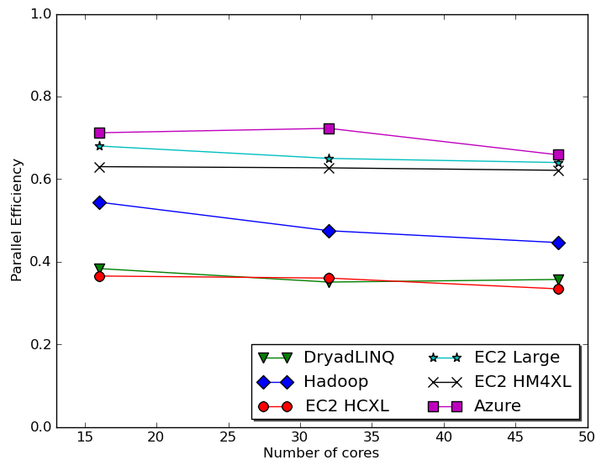
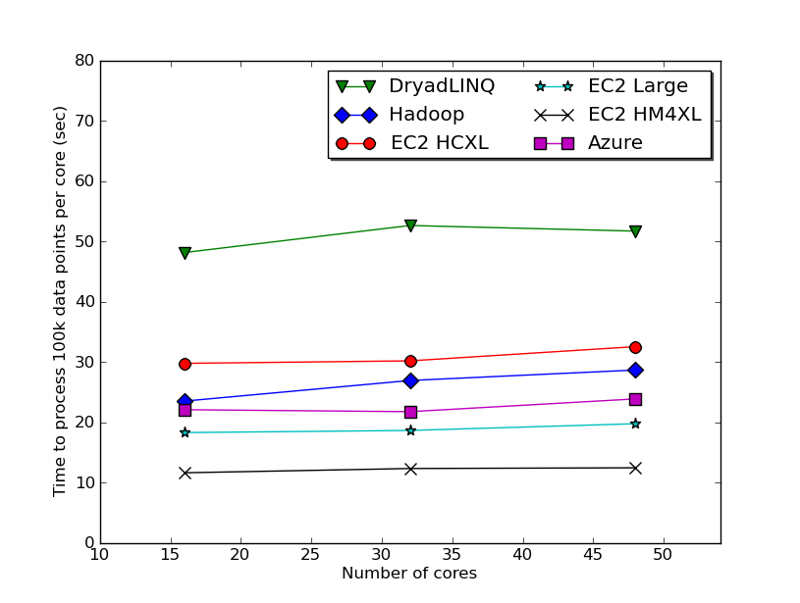
Dimension Reduction in the Clouds -
GTM interpolation
GTM Interpolation parallel efficiency
GTM Interpolation–Time per core to process 100k data points per core
26.4 million pubchem data
DryadLINQ using a 16 core machine with 16 GB, Hadoop 8 core with 48 GB, Azure small
instances with 1 core with 1.7 GB.
Notes:
EC2 HM4XL - High memory large instances (8 * 3.25 Ghz cores, 68GB memory)
EC2 HCXL – High CPU extra large (8 * 2.4 Ghz, 7GB memory)
EC2 Large – 2 * 2.4 Ghz , 7.5 GB memory
GTM interpolation is memory bound. Hence, less cores per memory (less memory & memory bandwidth contention) has the advantage. DryadLINQ efficiency suffers due to 16 core 16 GB machines.

Slide 17
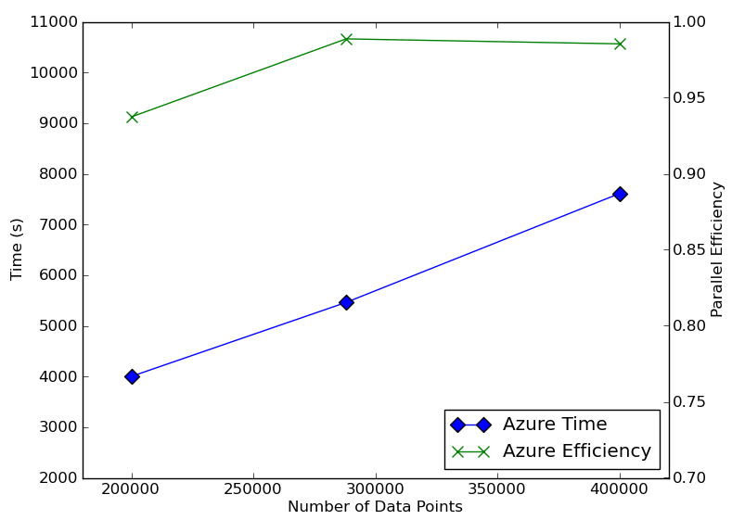
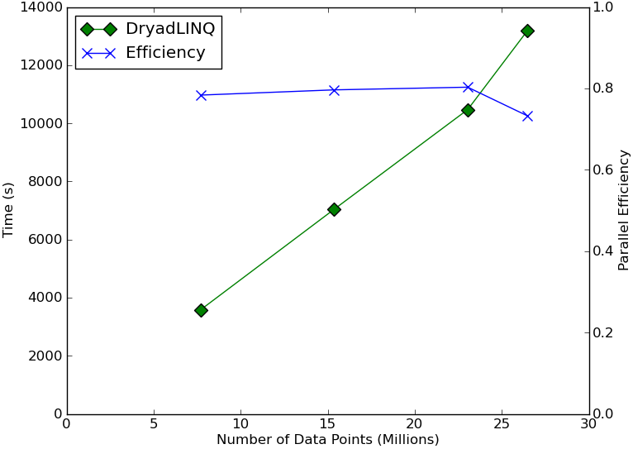
Dimension Reduction in the Clouds -
MDS Interpolation
DryadLINQ on 32 nodes X 24 Cores cluster with 48 GB per node. Azure using small instances
Notes:
Efficiency drop in MDS DryadLINQ at the last point is due to unbalanced partition (2600 blocks in to 768 cores)

Slide 18
Acknowlegedments
SALSA Group (http://salsahpc.indiana.edu/)
  Jong Choi
  Seung-Hee Bae
  Jaliya Ekanayake & others
Chemical informatics partners
  David Wild
  Bin Chen
Amazon Web Services for AWS compute credits
Microsoft Research for technical support on Azure & DryadLINQ

Slide 19
Thank You!!
Questions?

