Slide 1
FutureGrid: a Testbed for Cloud and Grid Computing
SC2010
Gregor von Laszewski (*)
laszewski@gmail.com
http://www.futuregrid.org
(*) Assistant Director of Cloud Computing, CGL, Pervasive Technology Institute
Indiana University Bloomington
Acknowledgement: Many of the overview slides are developed as part of the FG team including Geoffrey Fox. To keep presentations uniform we reuse these slides.
Presentation also includes Pegasus slides provided by Ewa Deelman and Jens Voekler.
This document was developed with support from the National Science Foundation (NSF) under Grant No. 0910812.

Slide 2
Outline
Overview
Software Architecture
Dynamic Provisioning
Security
Image Management
Portal
Information Services
Performance Subsystem
Status

Slide 3
Overview

Slide 4
FutureGrid key Issues
FutureGrid will provide an experimental testbed with a wide variety of computing services to its users.
The testbed provides to its users:
A rich development and testing platform for middleware and application users allowing comparisons in functionality and performance.
A variety of environments, many be instantiated dynamically, on demand. Available resources include, VMs, cloud, grid systems …
The ability to reproduce experiments at a later time (an experiment is the basic unit of work on the FutureGrid).
A rich education an teaching platform for advanced cyberinfrastructure
The ability to collaborate with the US industry on research projects.
Web Page: www.futuregrid.org
E-mail: help@futuregrid.org.

Slide 5
FutureGrid Partners and Resources
HW Resources at: Indiana University, SDSC, UC/ANL, TACC, University of Florida, Purdue,
Software Partners: USC ISI, University of Tennessee Knoxville, University of Virginia, Technische Universtität Dresden
However, users of FG do not have to be from these partner organizations. Furthermore, we hope that new organizations in academia and industry can partner with the project in the future.

Slide 6
Current HW Overview
FutureGrid has dedicated network (except to TACC) and a network fault and delay generator
Can isolate experiments on request; IU runs Network for NLR/Internet2
(Many) additional partner machines will run FutureGrid software and be supported (but allocated in specialized ways)
(*) IU machines share same storage; (**) Shared memory and GPU Cluster in year 2

Slide 7
Storage and Interconnect Hardware
System Type | Capacity (TB) | File System | Site | Status
DDN 9550 (Data Capacitor) | 339 | Lustre | IU | Existing System
DDN 6620 | 120 | GPFS | UC | New System
SunFire x4170 | 72 | Lustre/PVFS | SDSC | New System
Dell MD3000 | 30 | NFS | TACC | New System
Machine | Name | Internal Network
IU Cray | xray | Cray 2D Torus SeaStar
IU iDataPlex | india | DDR IB, QLogic switch with Mellanox ConnectX adapters Blade Network Technologies & Force10 Ethernet switches
SDSC iDataPlex | sierra | DDR IB, Cisco switch with Mellanox ConnectX adapters Juniper Ethernet switches
UC iDataPlex | hotel | DDR IB, QLogic switch with Mellanox ConnectX adapters Blade Network Technologies & Juniper switches
UF iDataPlex | foxtrot | Gigabit Ethernet only (Blade Network Technologies; Force10 switches)
TACC Dell | alamo | QDR IB, Mellanox switches and adapters Dell Ethernet switches

Slide 8
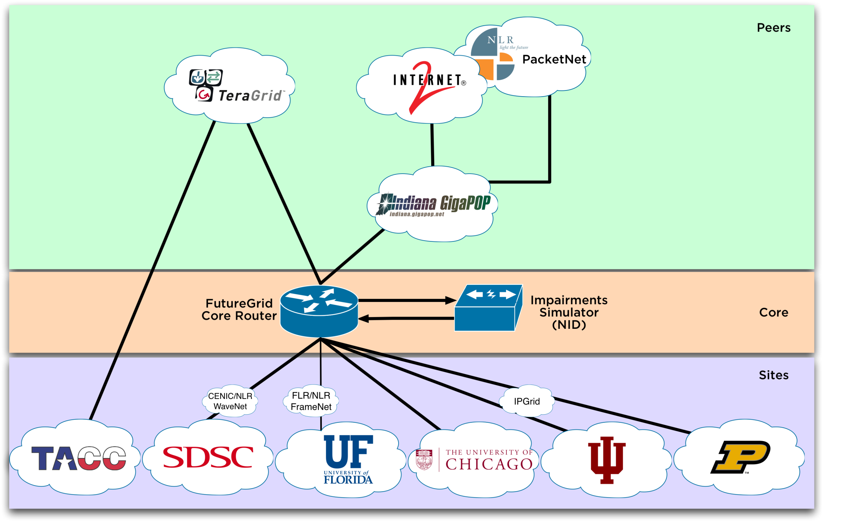
Logical Diagram

Slide 9
Network Impairment Device
Spirent XGEM Network Impairments Simulator for jitter, errors, delay, etc
Full Bidirectional 10G w/64 byte packets
up to 15 seconds introduced delay (in 16ns increments)
0-100% introduced packet loss in .0001% increments
Packet manipulation in first 2000 bytes
up to 16k frame size
TCL for scripting, HTML for manual configuration
Need exciting proposals to use!!

Slide 10
FutureGrid Usage Model
Support the research on the future of distributed, grid, and cloud computing.
Build on a robustly managed simulation environment and test-bed to support the development and early use in science of new technologies at all levels of the software stack: from networking to middleware to scientific applications.
Mimic TeraGrid and/or general parallel and distributed systems – FutureGrid is part of TeraGrid and one of two experimental TeraGrid systems (other is GPU)
It will also mimic commercial clouds (initially IaaS not PaaS)
Small (~5000 core) Science/Computer Science Cloud but it is more accurately a virtual machine or bare-metal based simulation environment
Snables major advances in science and engineering through collaborative development of science applications and related software.

Slide 11
Software Architecture

Slide 12
Software Architecture Overview
Flexible Architecture
allows one to configure resources based on images
Based on concept of experiments
Experiment management allows reproducible activities
Manages images
allows to create similar experiment environments
Through our modular design we allow different clouds and images to be “rained” upon hardware.
Will support deployment of “important” middleware including TeraGrid stack, Condor, BOINC, gLite, Unicore, Genesis II, MapReduce, Bigtable …..
Will accumulate more supported software as system used!
Will support links to external clouds, GPU clusters etc.
Grid5000 initial highlight with OGF29 Hadoop deployment over Grid5000 and FutureGrid
Interested in more external system collaborators!
Encourage viral community integration

Slide 13
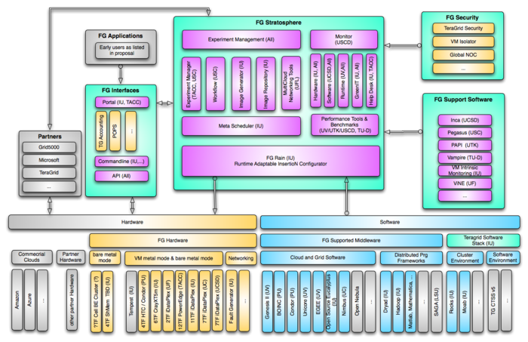
Conceptual Overview

Slide 14
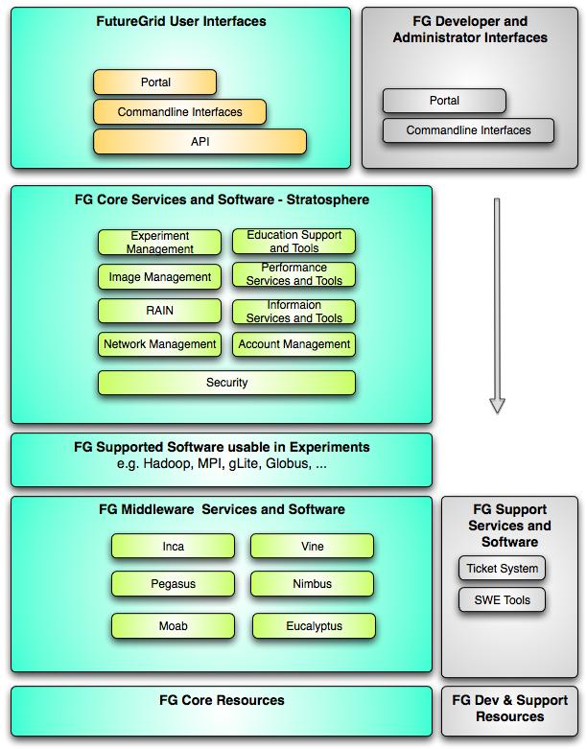
Simplified Architecture Diagram

Slide 15
Software Components
Portal - Support - Use - Outreach
Monitoring – INCA – Custom
Experiment Manager – specify workflow
Image Generation and Repository
Intercloud Networking ViNE
Performance Library
Rain or Runtime Adaptable InsertioN Service: Schedule and Deploy images
Security (including use of isolated network), Authentication, Authorization,

Slide 16
Dynamic Provisioning
Supporting Experiments through dynamic provisioning

Slide 17
Classical Dynamic Provisioning
dynamically partition a set of resources
dynamically allocate the resources to users
dynamically define the environment that the resource use
dynamically assign them based on user request
deallocate the resources so they can be dynamically allocated again

Slide 18
Use cases of dynamic provisioning
Static provisioning:
Resources in a cluster may be statically reassigned based on the anticipated user requirements, part of an HPC or cloud service. It is still dynamic, but control is with the administrator. (Note some call this also dynamic provisioning.)
Automatic Dynamic provisioning:
Replace the administrator with intelligent scheduler.
Queue-based dynamic provisioning:
provisioning of images is time consuming, group jobs using a similar environment and reuse the image. User just sees queue.
Deployment:
dynamic provisioning features are provided by a combination of using XCAT and Moab

Slide 19
Dynamic provisioning Examples
Give me a virtual cluster with 30 nodes based on Xen
Give me 15 KVM nodes each in Chicago and Texas linked to Azure and Grid5000
Give me a Eucalyptus environment with 10 nodes
Give 32 MPI nodes running on first Linux and then Windows
Give me a Hadoop environment with 160 nodes
Give me a 1000 BLAST instances linked to Grid5000
Run my application on Hadoop, Dryad, Amazon and Azure … and compare the performance

Slide 20
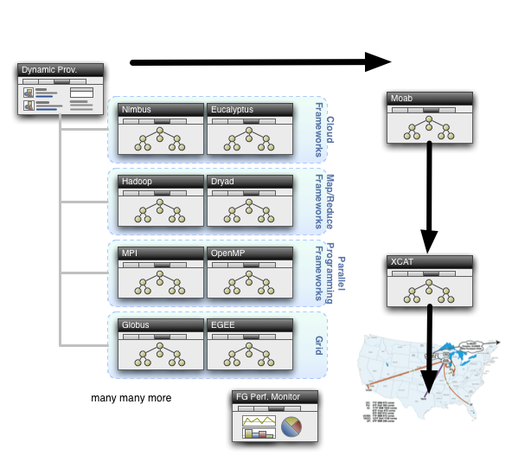
Dynamic Provisioning

Slide 21
FG RAIN
Runtime Adaptable INsertion Configurator
dynamic provisioning is one of the central features of FG
allowing users to instantiate images at runtime and execute their applications as part of these images.
multiple mechanisms exist to dynamically provision resources for the users need. RAIN will provide a comprehensive set of components to satisfy the different provisioning scenarios.

Slide 22
FG RAIN Command
fg-rain –h hostfile –iaas nimbus –image img
fg-rain –h hostfile –paas hadoop …
fg-rain –h hostfile –paas dryad …
fg-rain –h hostfile –gaas gLite …
fg-rain –h hostfile –image img
Authorization is required to use fg-rain without virtualization.

Slide 23
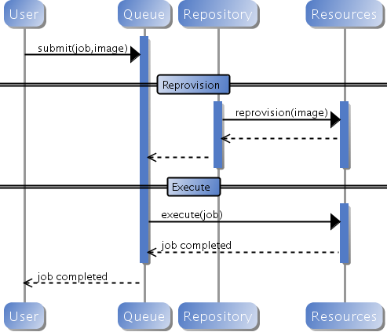
Custom Reprovisioning
Normal approach to job submission

Slide 24
Reprovisioning based on prior state
The user submits a job to a general queue. This job specifies an OS (re-used stateless image) type attached to it.
The queue evaluates the OS requirement.
If an available node has OS already running, run the job there.
If there are no OS types available, reprovision an available node and submit the job to the new node.
Repeat the provisioning steps if the job requires multiple processors (such as a large MPI job).
Use case: reusing the same stateless image between usages

Slide 25
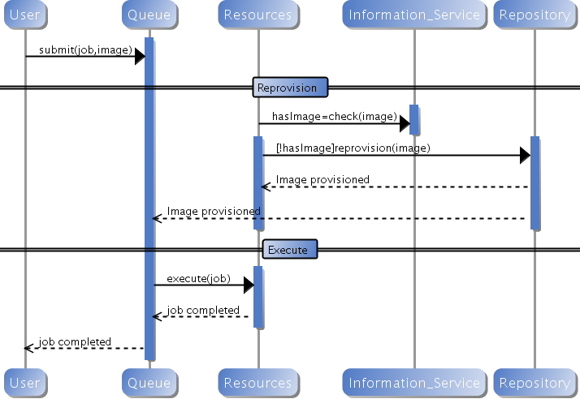
Generic Reprovisioning

Slide 26
Example Own VO QUEUE as A Service

Slide 27
Manage your own VO queue
This use case illustrates how a group of users or a Virtual Organization (VO) can handle their own queue to specifically tune their application environment to their specification.
A VO sets up a new queue, and provides an Operating System image that is associated to this image.
Can aid in image creation through the use of advanced scripts and a configuration management tool.
A user within the VO submits a job to the VO queue.
The queue is evaluated, and determines if there are free resource nodes available.
If there is an available node and the VO OS is running on it, then the Job is scheduled there.
If an un-provisioned node is available, the VO OS is provisioned and the job is then submitted to that node.
If there are other idle nodes without jobs running, a node can be re-provisioned to the VO OS and the job is then submitted to that node.
Repeat the provisioning steps if multiple processors are required (such as an MPI job).
Use case: Provide a service to the users of a VO. For example: submit a job that uses particular software. For example provide a queue called Genesis or Hadoop for the associated user community. Provisioning is hidden from the users.

Slide 28
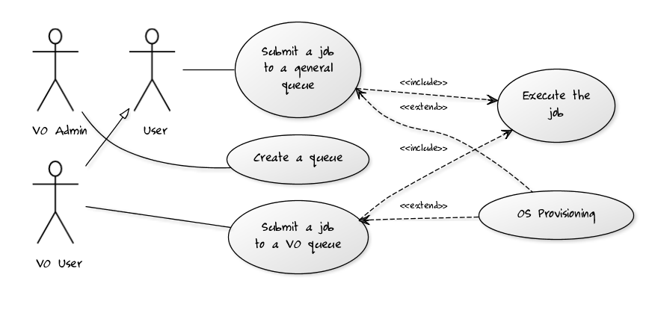
VO Queue

Slide 29
Example HETEROGENOUS CLOUD INTEGRATION

Slide 30
Pegasus FG Interaction
Drawing contributed by Ewa Deelman and Jens Voeckler
Notes:
The blue arrows, dealing with the provisioning of resources, are currently executed manually.
The “Moab” path does not exist yet – this is an architecture plan.
The red arrows are automatic, i.e. once the provision request starts remote resources, the Condor startd embedded into the image will report back to the submit machine.
Once the resource becomes part of the Condor pool, jobs can be staged to the resource. The Pegasus planner and Condor DAGMan will execute a workflow utilizing remote machines.
File staging is currently dependent on Condor-I/O.

Slide 31
Pegasus Periodogram
Search for extra-solar planets
Wobbles in radial velocity of star, or
Dips in star’s intensity
200k light curves released by Kepler
Current Experiment is a “ramp-up”:
Try to see where things trip
16k light curves
33k computations (every light curve twice)
Already found places needing adjustments

Slide 32
Periodogram Workflow
Notes:
Mostly independent computations.
Using clustering to reduce communication overhead: fastest plav computations run in sub-second time, but remote grids work best, if you have several minutes of work for them.
“stage-out” is an artificial step required by Pegasus planning that we are working on removing. However, it is neither harmful nor slow.
“True” periodogram computations run 3 algorithms (“ls”, “bls”, “plav”) on all 200k light curves. Estimated 1000 hours of work (41 days).

Slide 33
Requested Resources
Notes:
Running across multiple clouds is sky computing.
30 euca-india + 30 euca-sierra + 20 nimbus-sierra + 20 nimbus-foxtrot + 50 nimbus-hotel = 150 resources

Slide 34
Hosts, Tasks, and Duration
Notes:
Available Hosts: Machines that actually reported back (149)
Active Hosts: Machines that actually partook in the workflow (123)
Jobs: Number of Condor jobs completed (799)
Tasks: Number of Periodogram tasks computed (33082)
Duration: Cumulative duration (in hours) for tasks – totals over 22 days!

Slide 35
Image Management
Create your own …

Slide 36
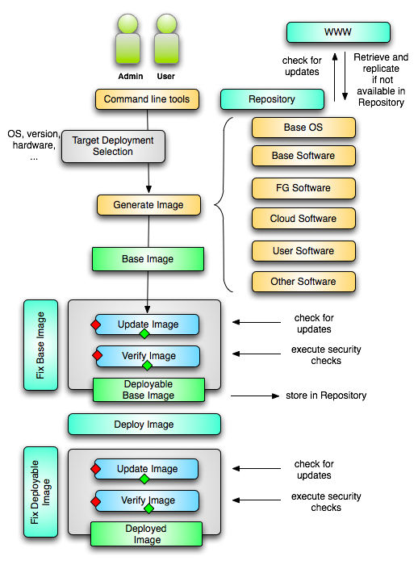
Image Creation
Creating deployable image
User chooses one base mages
User decides who can access the image; what additional software is on the image
Image gets generated; updated; and verified
Image gets deployed
Deployed image gets continuously
Updated; and verified
Note: Due to security requirement an image must be customized with authorization mechanism
We are not creating NxN images as many users will only need the base image
Administrators will use the same process to create the images that are vetted by them
An image gets customized through integration via a CMS process

Slide 37
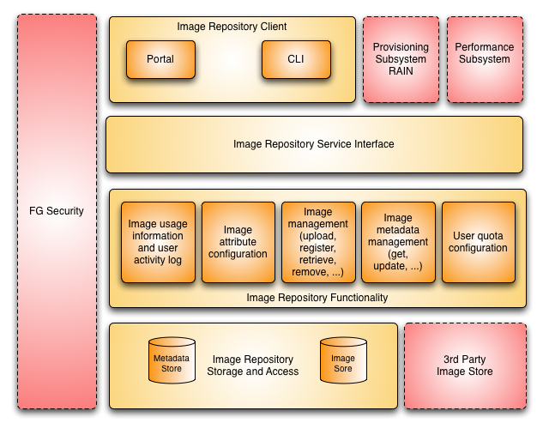
Image Repository

Slide 38
Portal
Plan to foster a community

Slide 39
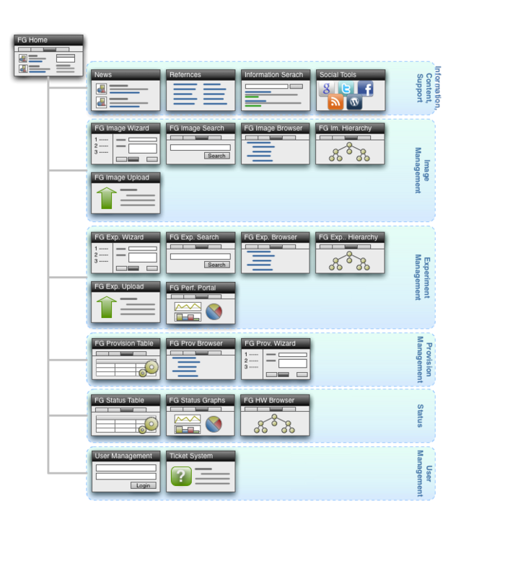
Portal Subsystem

Slide 40
Information Services
Plan to provide information about the system

Slide 41
Information Services
What is happening on the system?
System administrator
User
Project Management & Funding agency
Remember FG is not just an HPC queue!
Which software is used?
Which images are used?
Which FG services are used (Nimbus, Eucalyptus, …?)
Is the performance we expect reached?
What happens on the network

Slide 42
Simple Overview

Slide 43
The usual Google Map ;-)

Slide 44
Performance tests

Slide 45
What is happening in Nimbus?

Slide 46
Status

Slide 47
Milestones
Acceptance tests
Phase I
Phase II
Phase III

Slide 48
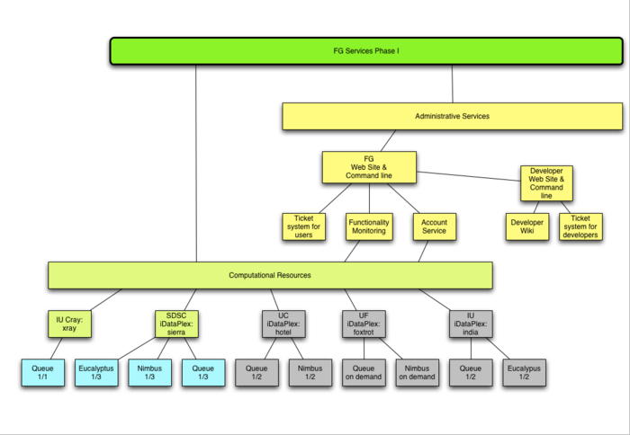
Phase I: Service View
= Now

Slide 49
Conclusion
Introduced FG Resource overview
Introduced concept of “raining”
Described how experiments are managed
Described reproducibility goal
Provided details on how we
Creating, managing, organizing, images and how the images can be created and accessed while supporting the experiment execution.
Showed a heterogenous cloud example with FG Pegasus integration
Status
System is ready for use in Phase I.
Phase I is static and does not include experiment management capabilities introduced here.
We are working now on Phase II
Demos in Booth show progress in Experiment management (e.g. image creation, repository, …, rain)
Stop by the IU booth
send mail to: laszewski@gmail.com
Not available Tuesday morning

