Slide 1
2010 FutureGrid User Advisory Meeting Architecture Roadmap Status Now – October –Next year 11:15-12:00, Monday, August 2, 2010 Pittsburgh, PA
Gregor von Laszewski
Representing the Software Architecture Committee
http://futuregrid.svn.sourceforge.net/viewvc/futuregrid/presentations/software/tg2010/ fg-tg2010-arch-timeline.pptx

Slide 2
Milestones
Acceptance tests
Phase I
Phase II
Phase III

Slide 3
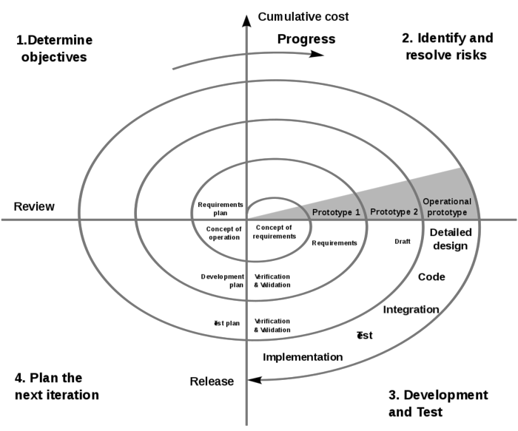
Approach: Spiral
Phase instead of prototype
Established method
Document templates
Task tracking

Slide 4
Phases
Phase I: Enabling the early adopters to use the system. The system will only have limited services available, this includes queuing systems and basic cloud services. Establishing essential administrative services for supporting the FG team, FG developers, FG users, and FG operations.
Phase II: Delivering a first operated FG deployment for users. focusing on the delivery of basic dynamic provision activities in FG. Improving the administrative services for supporting the FG team, FG developers, FG users, and FG operations.
Phase III: Delivers a first officially operated FG deployment for users focusing on the delivery of basic dynamic provision activities in FG. Integration into the TeraGrid.
We may add additional Phases as needed.

Slide 5
Now = Phase I
Now = within this month
Aug & Sept. Gradually improved
With outlook for dynamic provisioning.

Slide 6
Selected Use Cases Supported in Phase I
Providing support and information:
In order for FG to function we must provide sufficient support infrastructure to deliver information to the uesers, the ability to interact with system staff through Forums/Mailinglists, tracking Issues, and contributing to the dissemination and sharing of information.
Ability to run a HPC job
In order to compare the performance of different non HPC frameworks we need to also provide the ability to run HPC jobs on the same hardware as the other experiments.
Ability to use clouds such as Nimbus and Eucalyptus
In order to test out other than HPC jobs, we need to allow the user to use a cloud environment such as Nimbus or Eucalyptus.
Ability to store images
Users need to be able to store some of the images the use as part of the cloud experiments
Ability authenticate to FG computational resources
Users need the ability to authenticate to the FG resources to utilize them (all computational resources are managed through an account service so users have only one account).
Nimbus service, Eucalyptus service, hpc service, web site, authentication

Slide 7
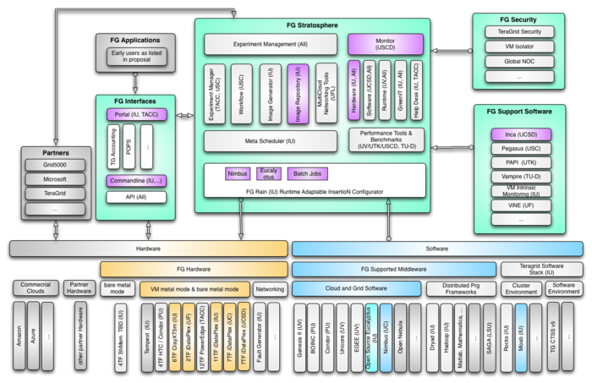
Phase I: Conceptual View

Slide 8
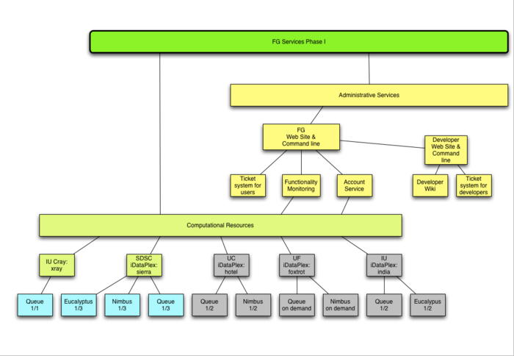
Phase I: Service View
= Now

Slide 9
Services: Admin
Administrative Services Web server for FG developers
Ticket system for developers
Wiki like service for contributing documentation
Web server for FG users
Ticket system for user ticket
Account Service
Hardware Monitor via Inca

Slide 10
Services: Computing
Computational Resources and Services IU iDataPlex: india.futuregrid.org
HPC Queue
IU Cray: xray.futuregrid.org
HPC Queue
Eucalyptus Cloud
SDSC iDataPlex: sierra.futuregrid.org
HPC Queue
Eucalyptus Cloud
Nimbus Cloud
UC iDataPlex: hotel.futuregrid.org
HPC Queue
Nimbus Cloud
UF iDataPlex: foxtrot.futuregrid.org
HPC Queue
Nimbus Cloud

Slide 11
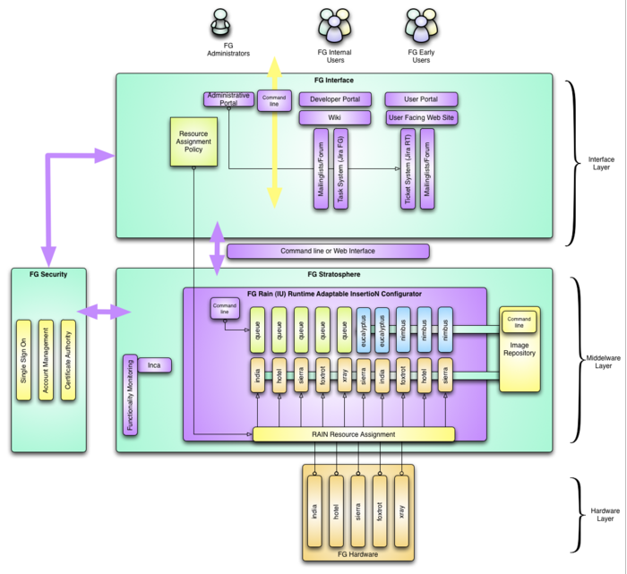
Layered Architecture View

Slide 12
Deployment View
Robert Henshel: HPC software
Tasks: describe which HPC software should be installed where. Determine who is installing the software (consult David H.).
David Hancock: Queuing systems, Eucalyptus
Outstanding tasks: Complete the Queuing system install for the HPC related jobs, the Nimbus, and Eucalyptus system. Document if it is possible already at this stage to shrink and increase the number of nodes used for the various split usage between HPC, Nimbus, and Eucalyptus.
Rich Knepper: Operational Services
Outstanding tasks: Describe how the operational services have been deployed so that they can be maintained by a group of system administrators. Describe and develop processes for managing accounts and other operational activities. List if additional software development activities are needed.
Jonathan Bolte: Support Services and KB
Outstanding tasks: Describe which support software is available for Phase I, how is it deployed and operator remote groups are responsible for furthering their deployment in collaboration with the above group.
Leads at the organizations are
UF: Mauricio
UC: Ti Legget
SDSC: Shava Smallen + some people at UC

Slide 13
Deployment view
Security: based on ssh keys
Managed through LDAP, keys are populated into the local file system of each machine
Filesystem:
Details from David Hancock
Queueing system
Moab, each machine has their own queue

Slide 14
Status: Admin
A FG web server that provides documentation about FG (http://futuregrid.org). The web server is based on Drupal.
A wiki that provides internal information to FG developers (https://wiki.futuregrid.org). The wiki is based on Mediawiki.
An email list server for internal and external email lists. The e-mail server is based on Mailman.
A project tracking system for managing tasks (http://jira.futuregrid.org). The project tracking system is based on JIRA.
A ticketing system for tracking user support requests (send e-mail to mailto:help@futuregrid.org). The user ticket system is RT. Where appropriate tickets, will be transfered to other systems (e.g. JIRA) and tracked there.
An account management system allowing to register projects and account based on LDAP is available. Scripts populate the account information to the resources.
A public SVN repository in Sourceforge was created.
A private SVN repository to manage security related code has been created.

Slide 15
Status: Computing
We have enabled a status report of FG to the portal.
status page (updated by the system administrators)
inca page (updated by the inca system automatically)
The exact status can be found at on the FutureGrid status page.
Sites
IU iDataPlex india.fuguregrid.org Torque/Moab
IU Cray xray.futuregrid.org Torque/Moab SDSC iDataPlex sierra.futuregrid.org Torque/Moab
UC iDataPlex hotel.futuregrid.org Torque/Moab
UF iDataPlex foxtrot.futuregrid.org Torque/Moab
An exact status of the systems is conducted by Greg Pike
(versions, functionality)
Status of Nimbus and Eucalyptus is being tested.

Slide 16
Risks
Systems just became available
Cray is a bit different to users (statically binding)
Nimbus needs user CA
We let users access the system what is considered a “really early user”
Documentation must be of high priority
No task can be resolved without making sure it is documented properly.
Not everything has been tested or is working
This includes Moab, Nimbus, Eucalyptus
Outdated as of yesterday.

Slide 17
Phase I: Service View (August)
= Now
= August

Slide 18
Phase I: Service View (Sept.)
= Now
= August
= Sept.

Slide 19
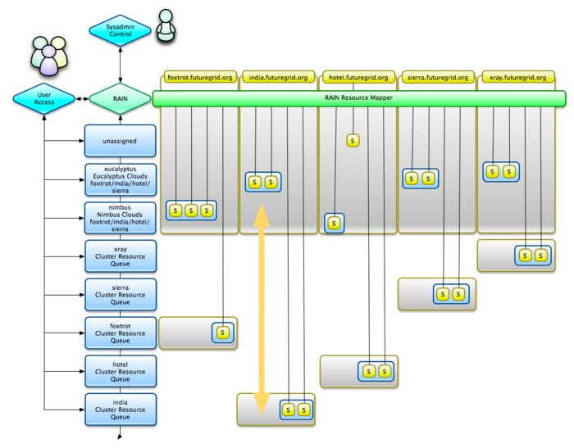
Moving between a service and
HPC by administrator

Slide 20
October: Phase II

Slide 21
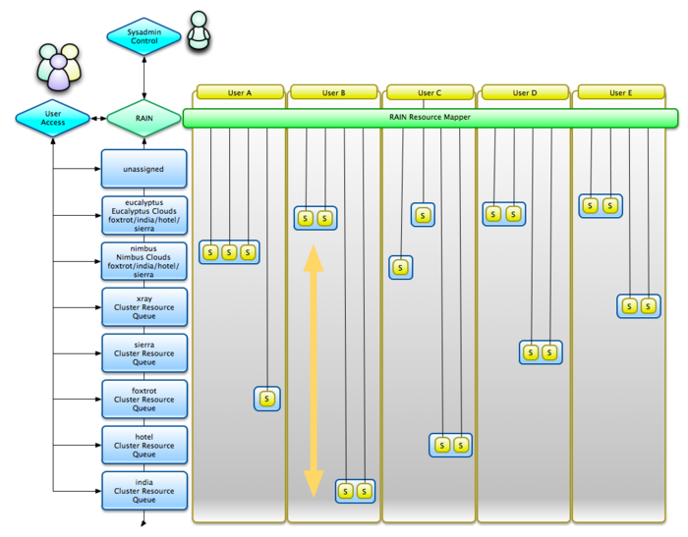
Moving between a service and
HPC by user

Slide 22
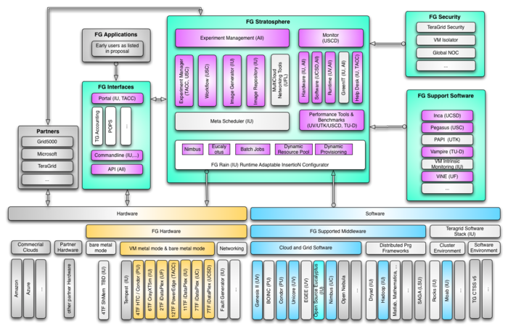
Conceptual View

Slide 23
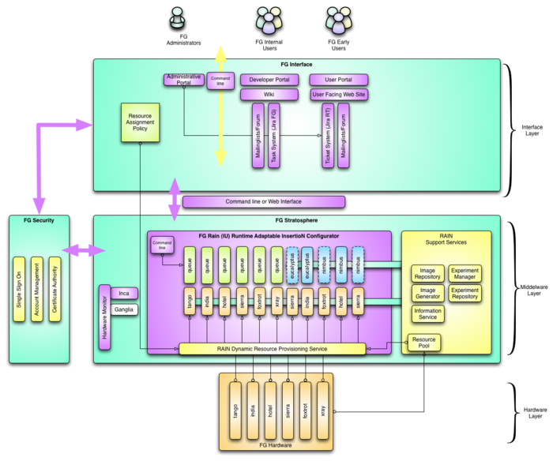
Layered View

Slide 24
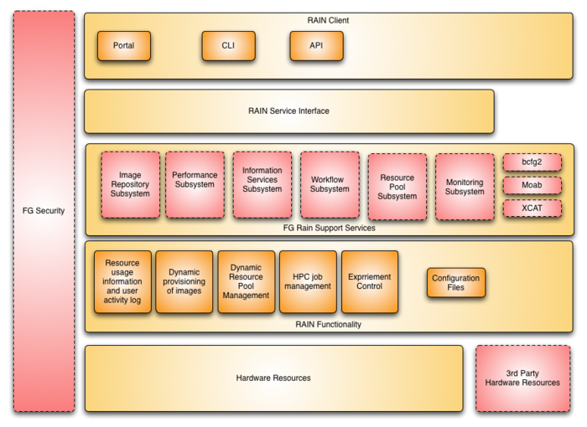
Dynamic Provisioning

Slide 25
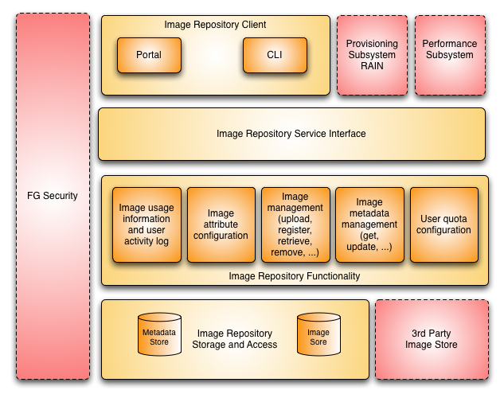
Image Repository

Slide 26
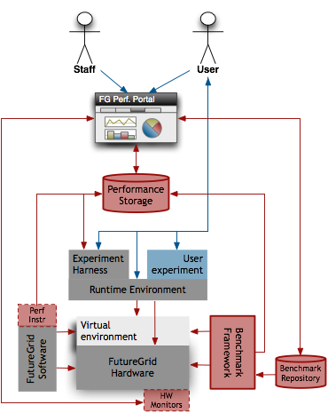
Performance Subsystem

Slide 27
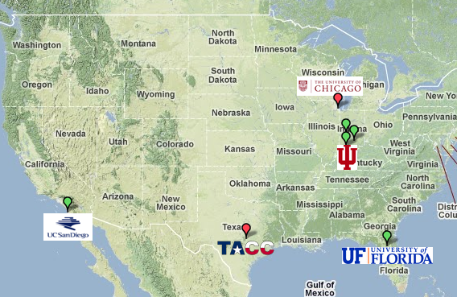
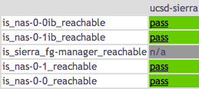
Current - Inca Functional Monitoring http://inca.futuregrid.org
Google Map View
FutureGrid Core Services Tests
FutureGrid Cluster Storage Tests
FutureGrid Basic Cluster Tests
Notes:
More tests needs need to be added – e.g., for Nimbus, Image repository, etc. Testing will be deployed as FutureGrid components become functional.

Slide 28
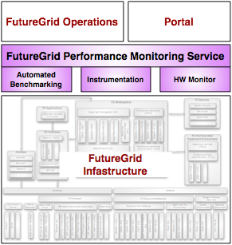
Performance Monitoring Service
Collect performance and load data from all FutureGrid components – use passive measurements when possible
(Passive) Instrumentation of FutureGrid components via NetLogger (in testing)
(Active) Automated benchmarking via Inca – HPCC (deployed), SPEC, UTK’s Grid Benchmark Challenge
Other hardware monitoring systems - Ganglia, Nagios, perfSONAR, etc. - (planned)
Comparative studies with other clouds and grids
Notes:
Use both active and passive measurements. Passive measurements don’t introduce load to the component (e.g., reading logs, integrated into code) so we will try to leverage that as much as possible. We are using NetLogger for passive measurements (instrumentation). Somethings can’t be passively measured such as benchmarks like HPCC so we use Inca for automated benchmarking. Benchmarks can be used to detect performance problems and provide users with data on the performance of FutureGrid. Might highlight Grid Benchmark Challenge which will be developed by UTK. Hope to as well become a repository for user’s comparitive studies with Azure, Amazon, TG, etc.

Slide 29
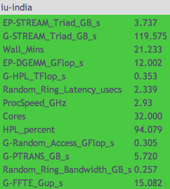
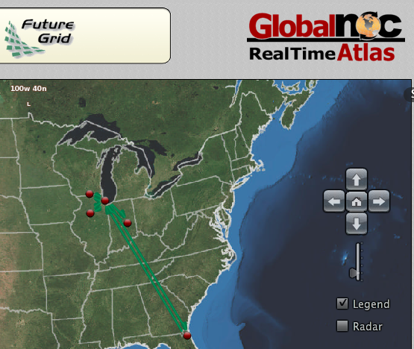
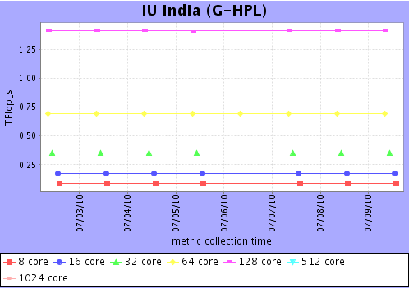
Current - Performance Monitoring http://www.futuregrid.org/status
Automated benchmarking (HPCC)
Global NOC Network Monitoring
HPCC
metrics
HPCC
metrics
(history)
Notes:
automated benchmark of HPCC and Global NOC network monitoring deployed now.

Slide 30
Performance Tools
Provide full support of partner tools
Provide best effort support of external tools
(UTK)
(TU-D)
(LBNL, SDSC)
(Tau – U of Oregon)
(JSC)
(HLRS)
Notes:
Can provide full support of partner tools because FG has internal expertise. For other tools, we will provide best effort support based on available expertise and relationships with tool developers (e.g., Shava has worked with IPM developers from LBNL, Thomas with Marmot developers, etc.).

Slide 31
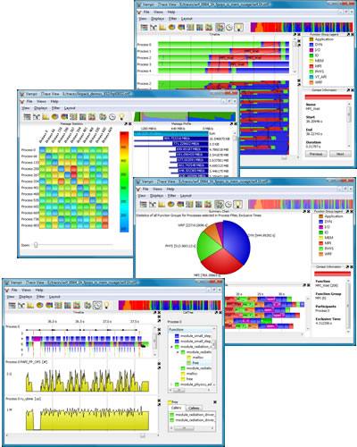
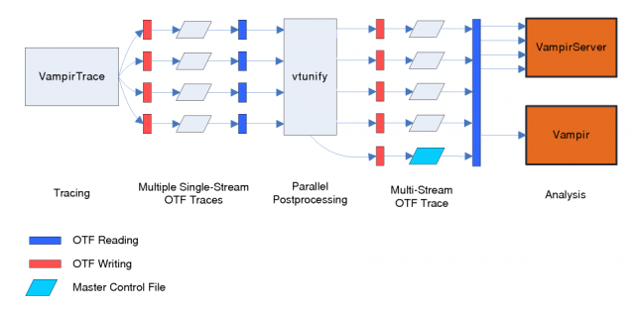
Current - Vampir
FutureGrid install in progress - available today on IU Quarry and BigRed machines
Vampir GUI screenshots
Vampir architecture
Notes:
User instruments their application with VampirTrace – often this is just relinking their MPI application. Then they execute their application which writes data to OTF files. The files get normalized using vtunify and the traces can then be visualized using Vampir GUI interface.

Slide 32
General Milestones
Allow dynamic provisioning of Eucalyptus Clouds
Allow dynamic provisioning of Nimbus Clouds
Demonstrate the use of non Cloud technologies

Slide 33
Next Year: Phase III

Slide 34
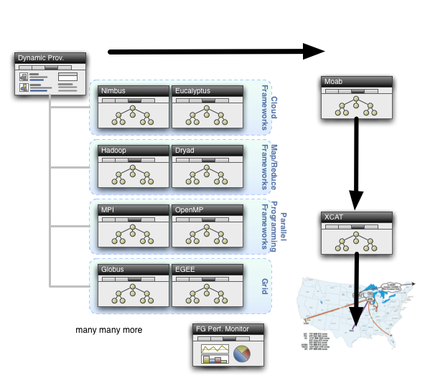

Slide 35
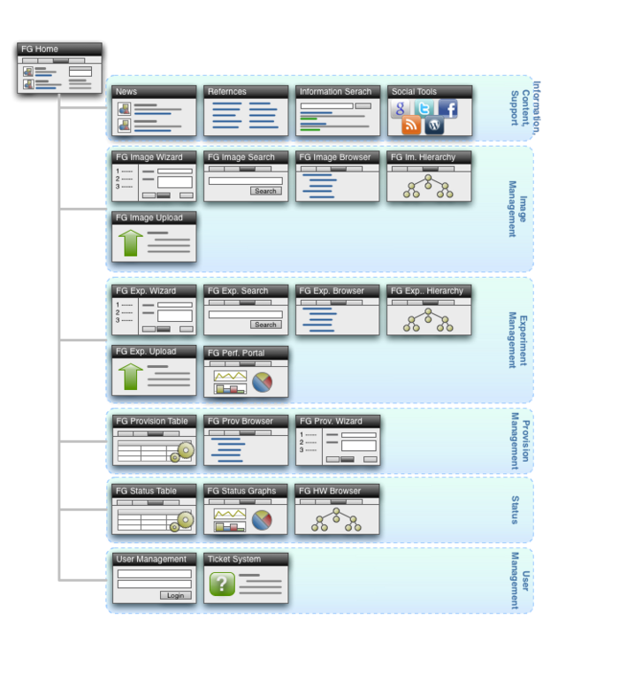
Portal Subsystem

Slide 36
FutureGrid Architecture

Slide 37
General Milestones
Allow dynamic provisioning of other stacks
Dryad, other frameworks, gather feedback from users
Demonstrate how to do performance comparisons
Identify an example for using the Network Interruption Device
Distributed Image Repository
Integration with TG

Slide 38
Milestones

