Slide 1
FutureGrid 100 and 101 (part one)
Virtual School for Computational Science and Engineering
July 27 2010
Geoffrey Fox
gcf@indiana.edu
http://www.infomall.org http://www.futuregrid.org
Director, Digital Science Center, Pervasive Technology Institute
Associate Dean for Research and Graduate Studies, School of Informatics and Computing
Indiana University Bloomington

Slide 2







FutureGrid 100
Grids and Clouds Context for FutureGrid

Slide 3
Important Trends
Data Deluge in all fields of science
  Including Socially Coupled Systems?
Multicore implies parallel computing important again
  Performance from extra cores – not extra clock speed
  GPU enhanced systems can give big power boost
Clouds – new commercially supported data center model replacing compute grids (and your general purpose computer center)
Light weight clients: Sensors, Smartphones and tablets accessing and supported by backend services in cloud
Commercial efforts moving much faster than academia in both innovation and deployment

Slide 4

Gartner 2009 Hype Curve
Clouds, Web2.0
Service Oriented Architectures

Slide 5



Data Centers Clouds & economies of scale I
Range in size from “edge” facilities to megascale.
Economies of scale
  Approximate costs for a small size center (1K servers) and a larger, 50K server center.
2 Google warehouses of computers on the banks of the Columbia River, in The Dalles, Oregon
Such centers use 20MW-200MW
(Future) each with 150 watts per CPU
Save money from large size, positioning with cheap power and access with Internet
Technology | Cost in small-sized Data Center | Cost in Large Data Center | Ratio
Network | $95 per Mbps/ month | $13 per Mbps/ month | 7.1
Storage | $2.20 per GB/ month | $0.40 per GB/ month | 5.7
Administration | ~140 servers/ Administrator | >1000 Servers/ Administrator | 7.1
Each data center is
11.5 times
the size of a football field

Slide 6


Data Centers, Clouds
& economies of scale II
Builds giant data centers with 100,000’s of computers;
~ 200-1000 to a shipping container with Internet access
“Microsoft will cram between 150 and 220 shipping containers filled with data center gear into a new 500,000 square foot Chicago facility. This move marks the most significant, public use of the shipping container systems popularized by the likes of Sun Microsystems and Rackable Systems to date.”

Slide 7
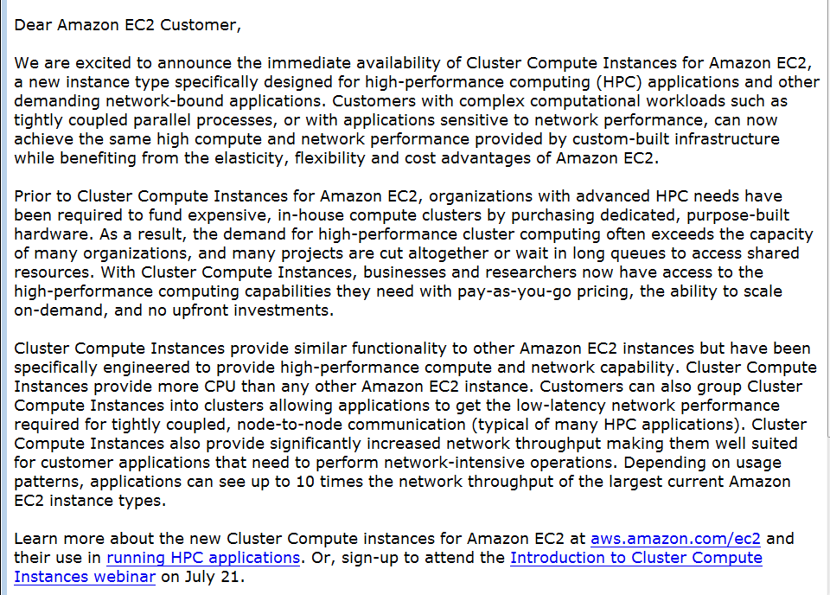
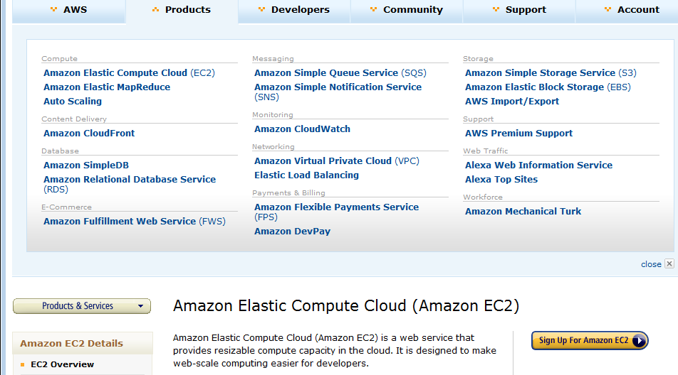
Amazon offers a lot!
The Cluster Compute Instances use hardware-assisted (HVM) virtualization instead of the paravirtualization used by the other instance types and requires booting from EBS, so you will need to create a new AMI in order to use them. We suggest that you use our Centos-based AMI as a base for your own AMIs for optimal performance. See the EC2 User Guide or the EC2 Developer Guide for more information.
The only way to know if this is a genuine HPC setup is to benchmark it, and we've just finished doing so. We ran the gold-standard High Performance Linpack benchmark on 880 Cluster Compute instances (7040 cores) and measured the overall performance at 41.82 TeraFLOPS using Intel's MPI (Message Passing Interface) and MKL (Math Kernel Library) libraries, along with their compiler suite. This result places us at position 146 on the Top500 list of supercomputers. The input file for the benchmark is here and the output file is here.

Slide 8
















X as a Service
SaaS: Software as a Service imply software capabilities
(programs) have a service (messaging) interface
  Applying systematically reduces system complexity to being linear in number of components
  Access via messaging rather than by installing in /usr/bin
IaaS: Infrastructure as a Service or HaaS: Hardware as a Service – get your computer time with a credit card and with a Web interface
PaaS: Platform as a Service is IaaS plus core software capabilities on which you build SaaS
Cyberinfrastructure is “Research as a Service”
SensaaS is Sensors (Instruments) as a Service (cf. Data as a Service)
Can define ScienceaaS or Science as a Service (Wisdom as a Service)
Other Services
Clients

Slide 10
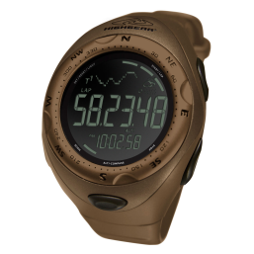

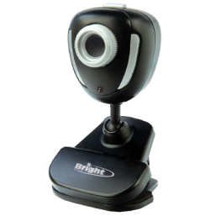


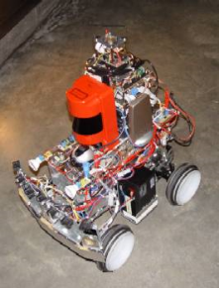
Sensors as a Service sensor clients backend by dynamic cloud proxy and analyzed in parallel by Mapreduce
Sensors as a Service
Sensor Processing as a Service (MapReduce)

Slide 11
Cyberinfrastructure
Cyberinfrastructure “…consists of computing systems, data storage systems, advanced instruments and data repositories, visualization environments, and people, all linked together by software and high performance networks to improve research productivity and enable breakthroughs not otherwise possible.”
Nothing in this definition says anything about ‘easy’

Slide 12
Clouds hide Complexity
Cyberinfrastructure
Is “Research as a Service”
SaaS: Software as a Service
(e.g. CFD or Search documents/web are services)
PaaS: Platform as a Service
IaaS plus core software capabilities on which you build SaaS
(e.g. Azure is a PaaS; MapReduce is a Platform)
IaaS (HaaS): Infrastructure as a Service
(get computer time with a credit card and with a Web interface like EC2)

Slide 13
Philosophy of Clouds and Grids
Clouds are (by definition) commercially supported approach to large scale computing
  So we should expect Clouds to replace Compute Grids
  Current Grid technology involves “non-commercial” software solutions which are hard to evolve/sustain
  Maybe Clouds ~4% IT expenditure 2008 growing to 14% in 2012 (IDC Estimate)
Public Clouds are broadly accessible resources like Amazon and Microsoft Azure – powerful but not easy to customize and perhaps data trust/privacy issues
Private Clouds run similar software and mechanisms but on “your own computers” (not clear if still elastic)
  Platform features such as Queues, Tables, Databases limited
Services still are correct architecture with either REST (Web 2.0) or Web Services
Clusters are still critical concept

Slide 14
Tremendous uncertainty
None of the following are likely correct:
  90% of all research computing can be done in clouds
  All computing that matters can be done in clouds
  Computing that really matters must be done on large, scalable MPI clusters; clouds are just for toy applications and selling books
  Computing must be sent to the Data
  All data must be sent (by Fedex) to Clouds
How do we assess the overall value, and perhaps more importantly the match of particular applications and platforms, without just repeating this hype curve over and over?

Slide 15
Grids MPI and Clouds + and -
Grids are useful for managing distributed systems
  Pioneered service model for Science
  Developed importance of Workflow
  Performance issues – communication latency – intrinsic to distributed systems
  Can never run differential equation based simulations or most datamining in parallel
Clouds can execute any job class that was good for Grids plus
  More attractive due to platform plus elastic on-demand model
  Currently have performance limitations due to poor affinity (locality) for compute-compute (MPI) and Compute-data
  These limitations are not “inevitable” and should gradually improve as in July 13 Amazon Cluster announcement
  Will never be best for most sophisticated differential equation based simulations
Classic Supercomputers (MPI Engines) run communication demanding differential equation based simulations

Slide 16
MapReduce
Data Partitions
Map(Key, Value)
A hash function maps the results of the map tasks to reduce tasks
Reduce(Key, List<Value>)
Reduce Outputs
Hadoop and Dryad Implementations support:
  Splitting of data
  Passing the output of map functions to reduce functions
  Sorting the inputs to the reduce function based on the intermediate keys
  Quality of service

Slide 17






MapReduce v MPI Parallelism
Map = (data parallel) computation reading and writing data
Reduce = Collective/Consolidation phase e.g. forming multiple global sums as in histogram
Instruments
Iterative MapReduce
Map Map Map Map
Reduce Reduce Reduce
Communication
Reduce
Portals
/Users
Disks
Map₁
Map₂
Map₃

Slide 18
Fault Tolerance and
MapReduce
MPI does “maps” followed by “communication” including “reduce” but does this iteratively
There must (for most communication patterns of interest) be a strict synchronization at end of each communication phase
  Thus if a process fails then everything grinds to a halt
In MapReduce, all Map processes and all reduce processes are independent and stateless and read and write to disks
  As 1 or 2 (reduce+map) iterations, no difficult synchronization issues
Thus failures can easily be recovered by rerunning process without other jobs hanging around waiting
Re-examine MPI fault tolerance in light of MapReduce
  Twister will interpolate between MPI and MapReduce

Slide 19
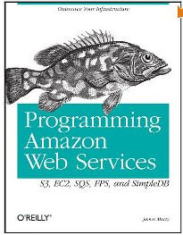
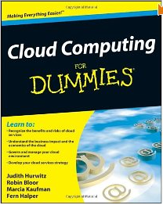
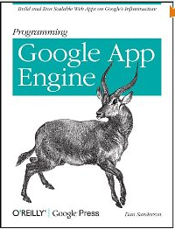
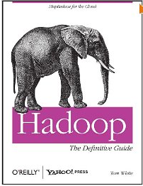

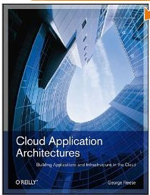
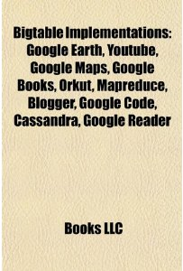
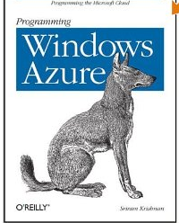
Plenty of Instant Books

Slide 20
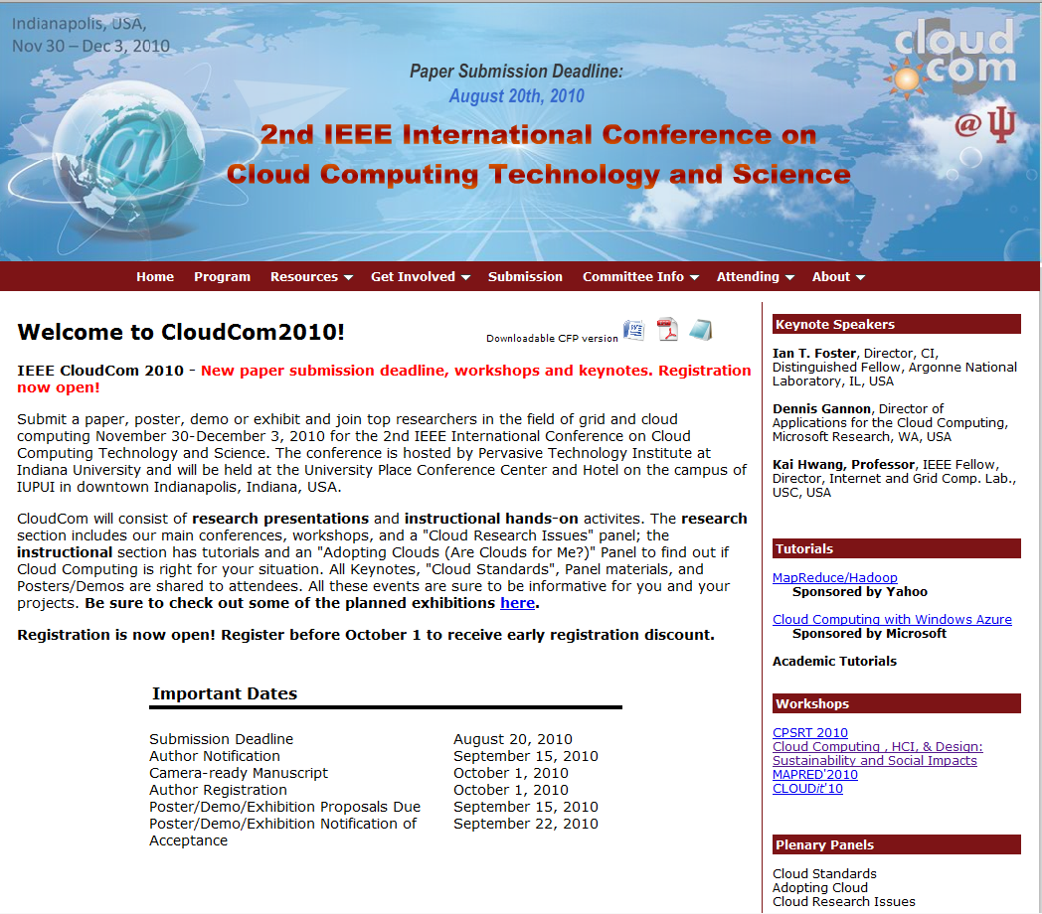

Slide 21

Why are we covering Clouds and MapReduce?
Note Clouds were developed to process Internet data
  Szalay noted 20% of servers sold to Internet giants
Information Retrieval is world’s largest data intensive problem
  In 2008 MapReduce processed 20 petabytes of data per day at Google
  LHC “only” produces tens of petabytes per year
  Szalay said that > 100 Terabytes scientific datasets are challenging
Data Analysis favors the loosely coupled dynamic fault tolerant approach of clouds over tightly coupled MPI
FutureGrid supports exploration of both traditional and new approaches to (data intensive) Cyberinfrastructure

Slide 22
FutureGrid 101
Part 1. Geoffrey Fox
Given the changing state of the universe,
We need an experimental platform

Slide 23
FutureGrid Concepts
Support development of new applications
and new middleware using Cloud, Grid and Parallel computing (Nimbus, Eucalyptus, Hadoop, Globus, Unicore, MPI, OpenMP. Linux, Windows …) looking at functionality, interoperability, performance
Enable replicable experiments in computer science of grid and cloud computing – “a cyberinfrastructure for computational science”
Open source software built around Moab/xCAT to support dynamic provisioning from Cloud to HPC environment, Linux to Windows ….. with monitoring, benchmarks and support of important existing middleware
Key early milestones:
  June 2010 Initial users (accomplished)
  September 2010 All hardware (except IU “shared memory system”) accepted and significant use starts; October 2011 FutureGrid allocatable via TeraGrid process

Slide 24
FutureGrid Partners
Indiana University (Architecture, core software, Support)
  Collaboration between research and infrastructure groups
Purdue University (HTC Hardware)
San Diego Supercomputer Center at University of California San Diego (INCA, Monitoring)
University of Chicago/Argonne National Labs (Nimbus)
University of Florida (ViNE, Education and Outreach)
University of Southern California Information Sciences (Pegasus to manage experiments)
University of Tennessee Knoxville (Benchmarking)
University of Texas at Austin/Texas Advanced Computing Center (Portal)
University of Virginia (OGF, Advisory Board and allocation)
Center for Information Services and GWT-TUD from Technische Universtität Dresden. (VAMPIR)
Red institutions have FutureGrid hardware

Slide 25
Compute Hardware
System type | # CPUs | # Cores | TFLOPS | Total RAM (GB) | Secondary Storage (TB) | Site | Status
Dynamically configurable systems
IBM iDataPlex | 256 | 1024 | 11 | 3072 | 339* | IU | Operational
Dell PowerEdge | 192 | 768 | 8 | 1152 | 30 | TACC | Being installed
IBM iDataPlex | 168 | 672 | 7 | 2016 | 120 | UC | Operational
IBM iDataPlex | 168 | 672 | 7 | 2688 | 96 | SDSC | Operational
Subtotal | 784 | 3136 | 33 | 8928 | 585
Systems not dynamically configurable
Cray XT5m | 168 | 672 | 6 | 1344 | 339* | IU | Operational
Shared memory system TBD | 40 | 480 | 4 | 640 | 339* | IU | New System TBD
IBM iDataPlex | 64 | 256 | 2 | 768 | 1 | UF | Operational
High Throughput Cluster | 192 | 384 | 4 | 192 |  | PU | Not yet integrated
Subtotal | 464 | 1792 | 16 | 2944 | 1
Total | 1248 | 4928 | 49 | 11872 | 586

Slide 26
Storage Hardware
System Type | Capacity (TB) | File System | Site | Status
DDN 9550 (Data Capacitor) | 339 | Lustre | IU | Existing System
DDN 6620 | 120 | GPFS | UC | New System
SunFire x4170 | 96 | ZFS | SDSC | New System
Dell MD3000 | 30 | NFS | TACC | New System

Slide 27
Network & Internal Interconnects
FutureGrid has dedicated network (except to TACC) and a network fault and delay generator
Can isolate experiments on request; IU runs Network for NLR/Internet2
(Many) additional partner machines will run FutureGrid software and be supported (but allocated in specialized ways)
Machine | Name | Internal Network
IU Cray | xray | Cray 2D Torus SeaStar
IU iDataPlex | india | DDR IB, QLogic switch with Mellanox ConnectX adapters Blade Network Technologies & Force10 Ethernet switches
SDSC iDataPlex | sierra | DDR IB, Cisco switch with Mellanox ConnectX adapters Juniper Ethernet switches
UC iDataPlex | hotel | DDR IB, QLogic switch with Mellanox ConnectX adapters Blade Network Technologies & Juniper switches
UF iDataPlex | foxtrot | Gigabit Ethernet only (Blade Network Technologies; Force10 switches)
TACC Dell | alamo | QDR IB, Mellanox switches and adapters Dell Ethernet switches

Slide 28
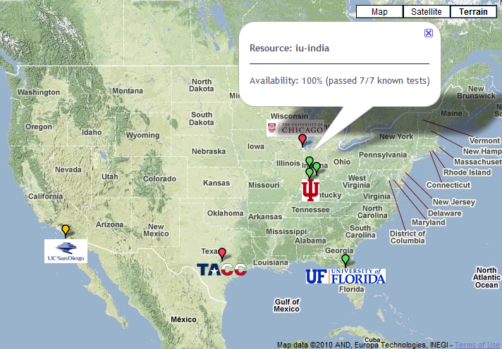

FutureGrid: a Grid/Cloud Testbed
Operational: IU Cray operational; IU , UCSD, UF & UC IBM iDataPlex operational
Network, NID operational
TACC Dell running acceptance tests
NID: Network Impairment Device
Private
Public
FG Network

Slide 29
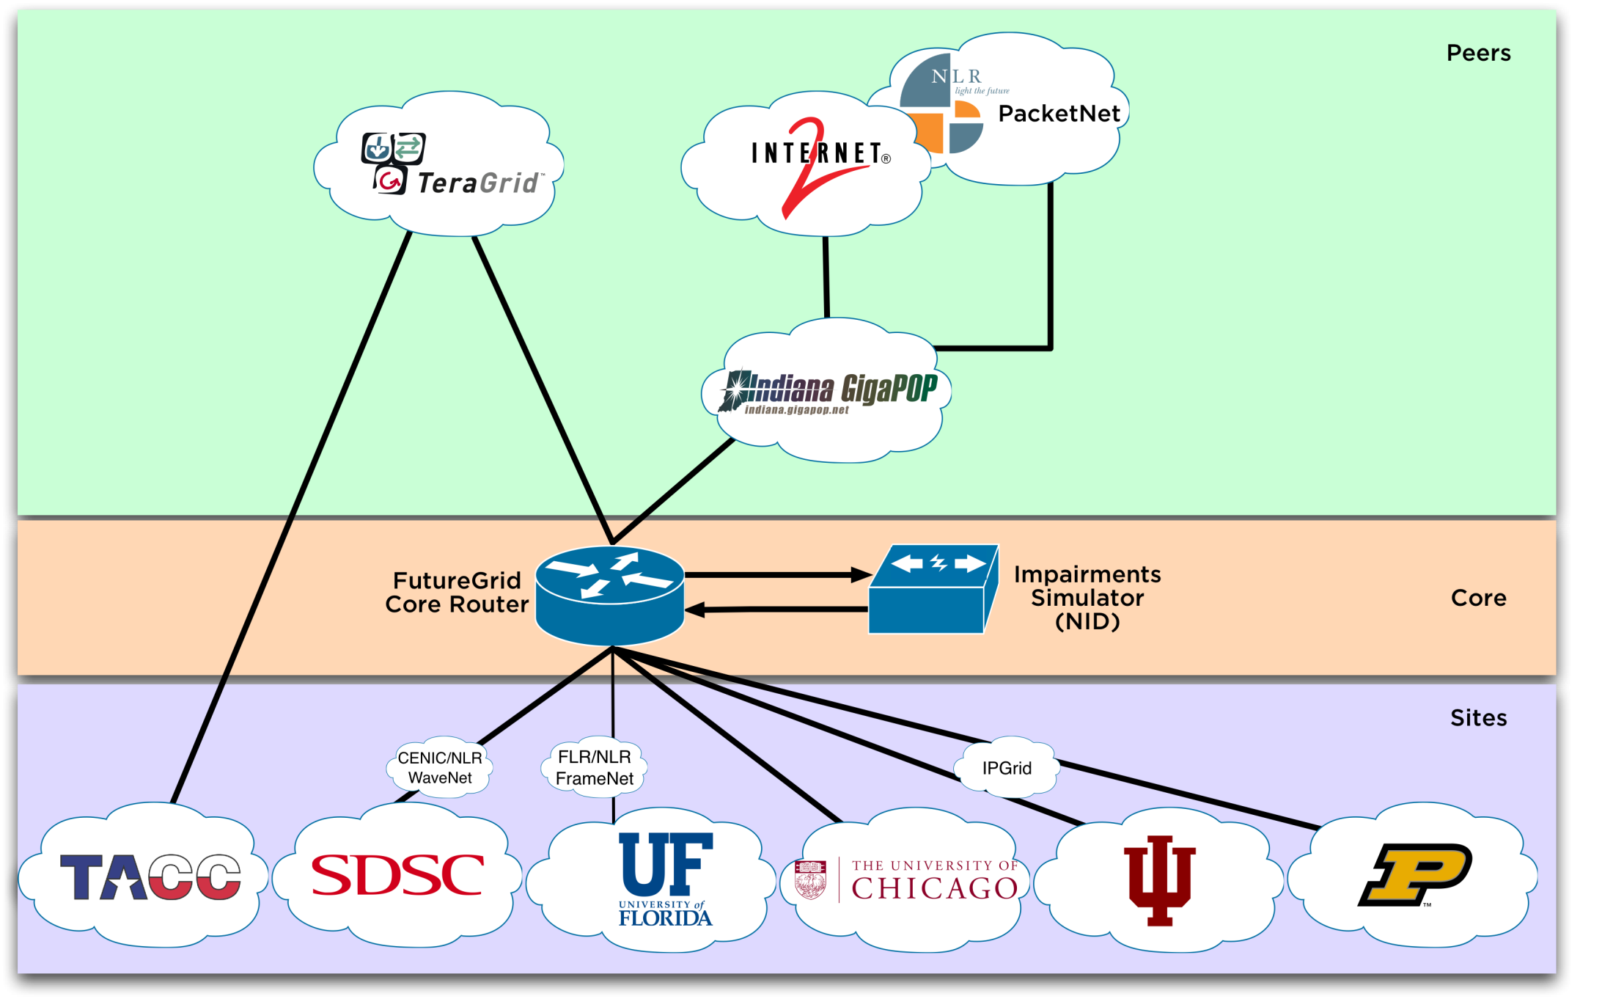
Logical Diagram

Slide 30
Network Impairment Device
Spirent XGEM Network Impairments Simulator for jitter, errors, delay, etc
Full Bidirectional 10G w/64 byte packets
up to 15 seconds introduced delay (in 16ns increments)
0-100% introduced packet loss in .0001% increments
Packet manipulation in first 2000 bytes
up to 16k frame size
TCL for scripting, HTML for manual configuration
Need more proposals to use (have one from University of Delaware)

Slide 31
FutureGrid Usage Model
The goal of FutureGrid is to support the research on the future of distributed, grid, and cloud computing
FutureGrid will build a robustly managed simulation environment and test-bed to support the development and early use in science of new technologies at all levels of the software stack: from networking to middleware to scientific applications
The environment will mimic TeraGrid and/or general parallel and distributed systems – FutureGrid is part of TeraGrid (but not part of formal TeraGrid process for first two years)
  Supports Grids, Clouds, and classic HPC
  It will mimic commercial clouds (initially IaaS not PaaS)
  Expect FutureGrid PaaS to grow in importance
FutureGrid can be considered as a (small ~5000 core) Science/Computer Science Cloud but it is more accurately a virtual machine or bare-metal based simulation environment
This test-bed will succeed if it enables major advances in science and engineering through collaborative development of science applications and related software

Slide 32
Some Current FutureGrid early uses
Investigate metascheduling approaches on Cray and iDataPlex
Deploy Genesis II and Unicore end points on Cray and iDataPlex clusters
Develop new Nimbus cloud capabilities
Prototype applications (BLAST) across multiple FutureGrid clusters and Grid’5000
Compare Amazon, Azure with FutureGrid hardware running Linux, Linux on Xen or Windows for data intensive applications
Test ScaleMP software shared memory for genome assembly
Develop Genetic algorithms on Hadoop for optimization
Attach power monitoring equipment to iDataPlex nodes to study power use versus use characteristics
Industry (Columbus IN) running CFD codes to study combustion strategies to maximize energy efficiency
Support evaluation needed by XD TIS and TAS services
Investigate performance of Kepler workflow engine
Study scalability of SAGA in difference latency scenarios
Test and evaluate new algorithms for phylogenetics/systematics research in CIPRES portal
Investigate performance overheads of clouds in parallel and distributed environments
Support tutorials and classes in cloud, grid and parallel computing
~12 active/finished users out of ~32 early user applicants

Slide 33


Sequence Assembly in the Clouds
Cap3 parallel efficiency
Cap3 – Per core per file (458 reads in each file) time to process sequences

Slide 34
Education on FutureGrid
Build up tutorials on supported software
Support development of curricula requiring privileges and systems destruction capabilities that are hard to grant on conventional TeraGrid
Offer suite of appliances (customized VM based images) supporting online laboratories
Supporting ~200 students in Virtual Summer School on “Big Data” July 26-30 with set of certified images – first offering of FutureGrid 101 Class; TeraGrid ‘10 “Cloud technologies, data-intensive science and the TG”; CloudCom conference tutorials Nov 30-Dec 3 2010
Experimental class use fall semester at Indiana and Florida

Slide 35
FutureGrid Software
Architecture
Flexible Architecture allows one to configure resources based on images
Managed images allows to create similar experiment environments
Experiment management allows reproducible activities
Through our modular design we allow different clouds and images to be “rained” upon hardware.
Note will eventually be supported at “TeraGrid Production Quality”
Will support deployment of “important” middleware including TeraGrid stack, Condor, BOINC, gLite, Unicore, Genesis II, MapReduce, Bigtable …..
  Will accumulate more supported software as system used!
Will support links to external clouds, GPU clusters etc.
  Grid5000 initial highlight with OGF29 Hadoop deployment over Grid5000 and FutureGrid
  Interested in more external system collaborators!

Slide 36
Software Components
Portals including “Support” “use FutureGrid” “Outreach”
Monitoring – INCA, Power (GreenIT)
Experiment Manager: specify/workflow
Image Generation and Repository
Intercloud Networking ViNE
Performance library
Rain or Runtime Adaptable InsertioN Service: Schedule and Deploy images
Security (including use of isolated network), Authentication, Authorization,

Slide 37
Dynamic provisioning Examples
Give me a virtual cluster with 30 nodes based on Xen
Give me 15 KVM nodes each in Chicago and Texas linked to Azure and Grid5000
Give me a Eucalyptus environment with 10 nodes
Give 32 MPI nodes running on first Linux and then Windows with Cray iDataPlex Dell comparisons
Give me a Hadoop or Dryad environment with 160 nodes
  Compare with Amazon and Azure
Give me a 1000 BLAST instances linked to Grid5000

Slide 38
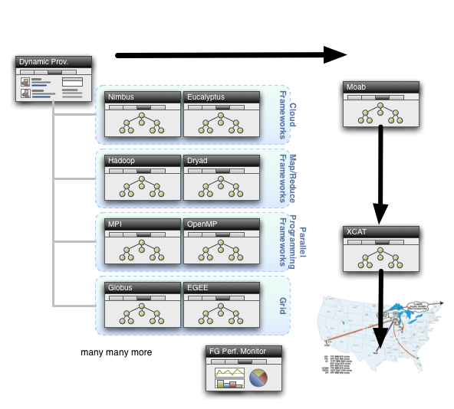
Dynamic Provisioning

Slide 39
Security Issues
Need to provide dynamic flexible usability and preserve system security
Still evolving process but initial approach involves
Encouraging use of “as a Service” approach e.g. “Database as a Software” not “Database in your image”; clearly possible for some cases as in “Hadoop as a Service”
  Commercial clouds use aaS for database, queues, tables, storage …..
  Makes complexity linear in #features rather than exponential if need to support all images with or without all features
Have a suite of vetted images that can be used by users with suitable roles
  Typically do not allow root access; can be VM or not VM based
  Can create images and requested that they be vetted
“Privileged images” (e.g. allow root access) use VM’s and network isolation

Slide 40
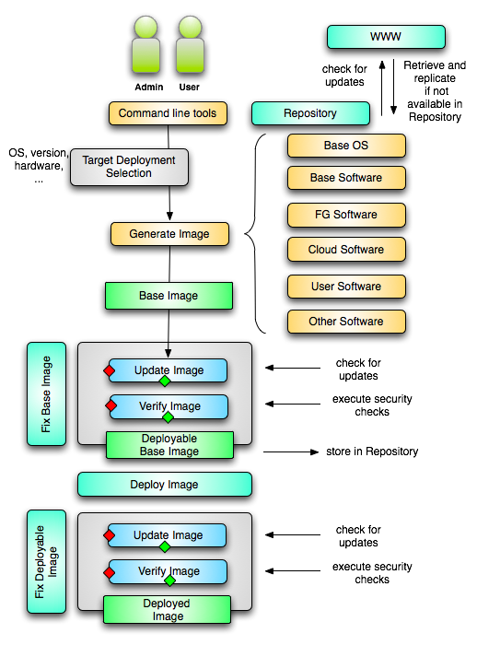
Image Creation Process
Creating deployable image
  User chooses one base image
  User decides who can access the image; what additional software is on the image
  Image gets generated; updated; and verified
Image gets deployed
Deployed image gets continuously
  Updated
  Verified
Note: Due to security requirement an image must be customized with authorization mechanism
  We are not creating NxN images as many users will only need the base image
  Administrators will use the same process to create the images that are vetted by them
  An image gets customized through integration via a CMS process

Slide 41
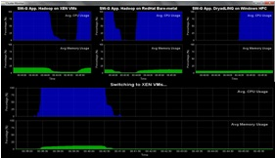
Dynamic Virtual Clusters
Dynamic Cluster Architecture
Monitoring & Control Infrastructure
Monitoring Infrastructure
Monitoring Interface
Pub/Sub Broker Network
SW-G Using Hadoop
SW-G Using Hadoop
SW-G Using DryadLINQ
Linux
Bare-system
Linux on Xen
Windows Server 2008 Bare-system
Virtual/Physical Clusters
Summarizer
XCAT Infrastructure
XCAT Infrastructure
Switcher
iDataplex Bare-metal Nodes
(32 nodes)
iDataplex Bare-metal Nodes
Switchable clusters on the same hardware (~5 minutes between different OS such as Linux+Xen to Windows+HPCS)
Support for virtual clusters
SW-G : Smith Waterman Gotoh Dissimilarity Computation as an pleasingly parallel problem suitable for MapReduce style application

Slide 42
SALSA HPC Dynamic Virtual Clusters Demo
At top, these 3 clusters are switching applications on fixed environment. Takes ~30 seconds.
At bottom, this cluster is switching between Environments – Linux; Linux +Xen; Windows + HPCS. Takes ~7 minutes.
It demonstrates the concept of science on Clouds using a FutureGrid cluster.

Slide 43
FutureGrid Interaction with Commercial Clouds
We support experiments that link Commercial Clouds and FutureGrid with one or more workflow environments and portal technology installed to link components across these platforms
We support environments on FutureGrid that are similar to Commercial Clouds and natural for performance and functionality comparisons
  These can both be used to prepare for using Commercial Clouds and as the most likely starting point for porting to them
  One example would be support of MapReduce-like environments on FutureGrid including Hadoop on Linux and Dryad on Windows HPCS which are already part of FutureGrid portfolio of supported software
We develop expertise and support porting to Commercial Clouds from other Windows or Linux environments
We support comparisons between and integration of multiple commercial Cloud environments – especially Amazon and Azure in the immediate future
We develop tutorials and expertise to help users move to Commercial Clouds from other environments

