Slide 1
Optimizing OpenCL Kernels for Iterative Statistical Applications on GPUs
Thilina Gunarathne, Bimalee Salpitkorala, Arun Chauhan, Geoffrey Fox
{tgunarat,ssalpiti,achauhan,gcf} @cs.indiana.edu
2nd International Workshop on GPUs and Scientific Applications
Galveston Island, TX

Slide 2
Outline
Motivation
Overview
Applications
  KMeansClustering
  Multi-Dimensional Scaling
  PageRank
Lessons learned
Future Work

Slide 3
Iterative Statistical Applications
Consists of iterative computation and communication steps
Growing set of applications
  Clustering, data mining, machine learning & dimension reduction applications
  Driven by data deluge & emerging computation fields
Compute
Communication
Reduce/ barrier
New Iteration
Notes:
Describe using the figure – reduce or barrier

Slide 4
Iterative Statistical Applications
Compute
Communication
Reduce/ barrier
New Iteration
Data intensive
Larger loop-invariant data
Smaller loop-variant delta between iterations
  Result of an iteration
  Broadcast to all the workers of the next iteration
High memory access to floating point operations ratio
Notes:
Large input data sizes which are loop-invariant and can be reused across iterations.
Loop-variant results.. Orders of magnitude smaller…
Software controlled memory hierarchy of GPU’s and the higher memory bandwidth allows us to optimize these applications.
We restrict ourselves to problem sizes that that fit GPU memory…

Slide 5
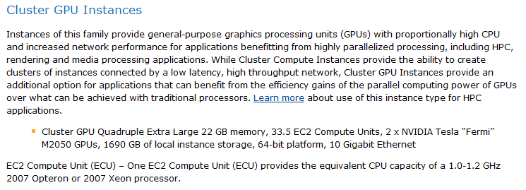
Motivation
Important set of applications
Increasing power and availability of GPGPU computing
Cloud Computing
  Iterative MapReduce technologies
  GPGPU computing in clouds
from http://aws.amazon.com/ec2/
Notes:
These types of applications are widely used today and the use cases are growing fast with all the data analytics applications.
There exists frameworks, such as iterative map reduce, which takes advantage of those characteristics.
Whether we can do same improvements for GPGPU programs.. And whether we can use them in a distributed fashion with the above mentioned map reduce frameworks.

Slide 6
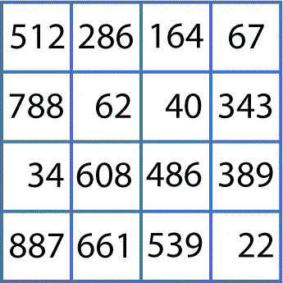
Motivation
A sample bioinformatics pipeline
O(NxN)
Clustering
O(NxN)
Cluster Indices
Pairwise Alignment & Distance Calculation
Gene Sequences
Visualization
3D Plot
O(NxN)
Coordinates
Distance Matrix
Multi-Dimensional Scaling
http://salsahpc.indiana.edu/

Slide 7
Overview
Three iterative statistical kernels implemented using OpenCl
  Kmeans Clustering
  Multi Dimesional Scaling
  PageRank
Optimized by,
  Reusing loop-invariant data
  Utilizing different memory levels
  Rearranging data storage layouts
  Dividing work between CPU and GPU
Notes:
Where to put this slide
In this paper we present out experience on implementing 3 iterative statistical applications using OpenCL..

Slide 8
OpenCL
Cross platform, vendor neutral, open standard
  GPGPU, multi-core CPU, FPGA…
Supports parallel programming in heterogeneous environments
Compute kernels
  Based on C99
  Basic unit of executable code
Work items
  Single element of the execution domain
  Grouped in the work groups
    Communication & synchronization within work groups
Notes:
5 minutes….

Slide 9
OpenCL Memory Hierarchy
Compute Unit 1
Compute Unit 2
Private
Private
Private
Private
Work Item 1
Work Item 2
Work Item 1
Work Item 2
Local Memory
Local Memory
CPU
Global GPU Memory
Constant Memory

Slide 10

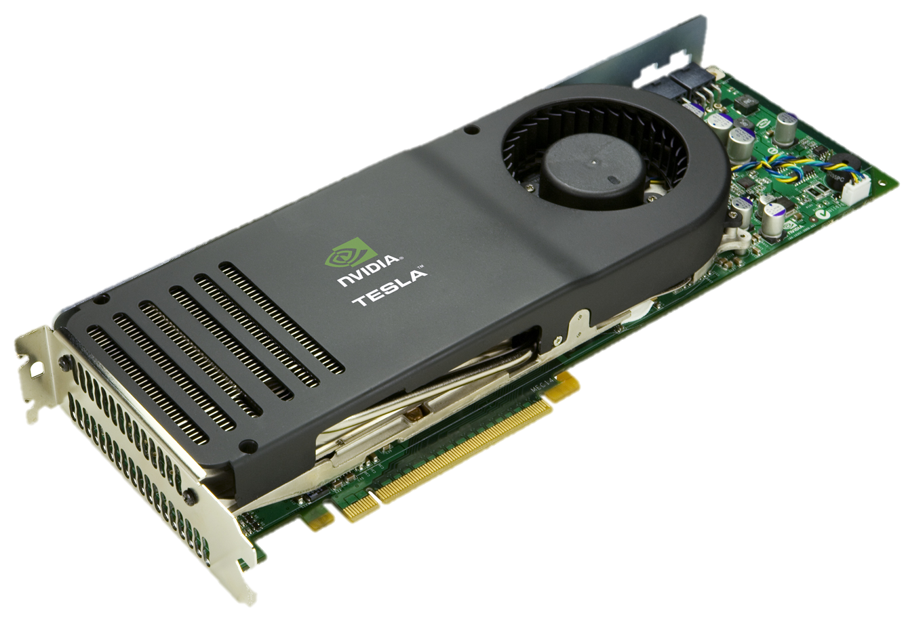
Environment
NVIDIA Tesla C1060
  240 scalar processors
  4GB global memory
  102 GB/sec peak memory bandwidth
  16KB shared memory per 8 cores
  CUDA compute capability 1.3
  Peak Performance
    933 GFLOPS Single with SF
    622 GFLOPS Single MAD
    77.7 GFLOPS Double
Notes:
2 instruction issue ports.
Port 0 (622 GFLOPS)
Port 1 (311GFLOPS) can issue instructions to two Special Function Units (SFU) each of which can process packed 4-wide vectors. The SFUs perform transcendental operations like sin, cos, etc. or single precision multiplies (like the Intel SSE instruction: MULPS)
http://www.beyond3d.com/content/articles/77/1

Slide 11

KMeans Clustering
Partition a given data set into disjoint clusters
Each iteration
  Cluster assignment step
  Centroid update step
Flops per work item (3DM+M)
  D :number of dimensions
  M :number of centroids
Notes:
http://www.aishack.in/2010/07/k-means-clustering/

Slide 12
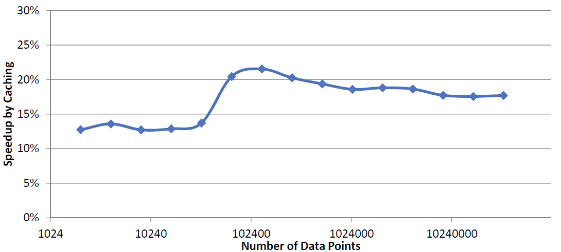
Re-using loop-invariant data

Slide 13
KMeansClustering Optimizations
Naïve (with data re-using)

Slide 14
KMeansClustering Optimizations
Data points copied to local memory

Slide 15
KMeansClustering Optimizations
Cluster centroid points copied to local memory

Slide 16
KMeansClustering Optimizations
Local memory data points in column major order

Slide 17
KMeansClustering Performance
Varying number of clusters (centroids)

Slide 18
KMeansClustering Performance
Varying number of dimensions

Slide 19
KMeansClustering Performance
Increasing number of iterations

Slide 20
KMeans Clustering Overhead

Slide 21
Multi Dimesional Scaling
Map a data set in high dimensional space to a data set in lower dimensional space
Use a NxN dissimilarity matrix as the input
  Output usually in 3D (Nx3) or 2D (Nx2) space
Flops per work item (8DN+7N+3D+1)
  D : target dimension
  N : number of data points
SMACOF MDS algorithm
http://salsahpc.indiana.edu/
Notes:
13
Scaling by majorizing a complicated function

Slide 22
MDS Optimizations
Re-using loop-invariant data

Slide 23
MDS Optimizations
Naïve (with loop-invariant data reuse)

Slide 24
MDS Optimizations
Naïve (with loop-invariant data reuse)

Slide 25
MDS Optimizations
Naïve (with loop-invariant data reuse)

Slide 26
MDS Optimizations
Naïve (with loop-invariant data reuse)

Slide 27
MDS Performance
Increasing number of iterations

Slide 28
MDS Overhead

Slide 29
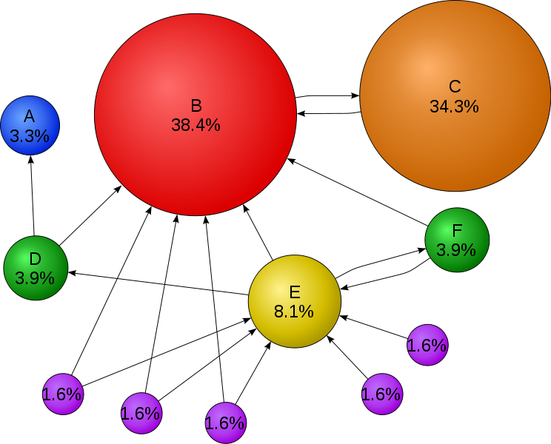
Page Rank
Analyses the linkage information to measure the relative importance
Sparse matrix and vector multiplication
Web graph
  Very sparse
  Power law distribution
Notes:
20

Slide 30
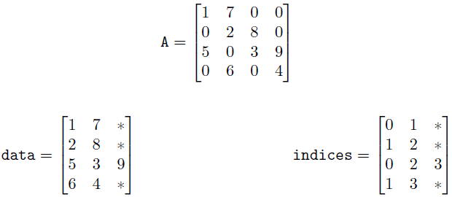
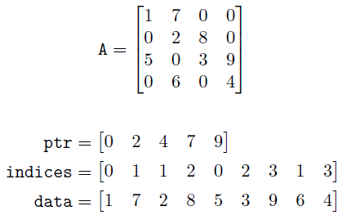
Sparse Matrix Representations
ELLPACK
Compressed Sparse Row (CSR)
http://www.nvidia.com/docs/IO/66889/nvr-2008-004.pdf

Slide 31
PageRank implementations

Slide 32
Lessons
Reusing of loop-invariant data
Leveraging local memory
Optimizing data layout
Sharing work between CPU & GPU

Slide 33
OpenCL experience
Flexible programming environment
Support for work group level synchronization primitives
Lack of debugging support
Lack of dynamic memory allocation
Compilation target than a user programming environment?

Slide 34
Future Work
Extending kernels to distributed environments
Comparing with CUDA implementations
Exploring more aggressive CPU/GPU sharing
Studying more application kernels
Data reuse in the pipeline
Notes:
Studying more application kernels > to identify any patterns or high level constructs

Slide 35
Acknowledgements
This work was started as a class project for CSCI-B649:Parallel Architectures (spring 2010) at IU School of Informatics and Computing.
Thilina was supported by National Institutes of Health grant 5 RC2 HG005806-02.
We thank Sueng-Hee Bae, BingJing Zang, Li Hui and the Salsa group (http://salsahpc.indiana.edu/) for the algorithmic insights.

Slide 36
Questions

Slide 37
Thank You!

Slide 38
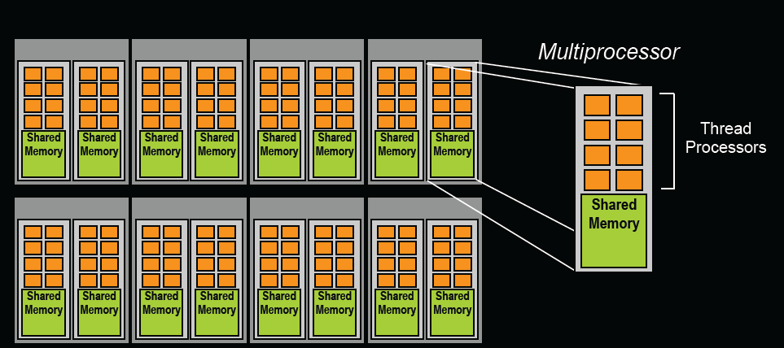

Slide 39
KMeansClustering Optimizations
Data in global memory coalesced

