Slide 1
Dimension Reduction and Visualization of Large High-Dimensional Data via Interpolation
Seung-Hee Bae, Jong Youl Choi, Judy Qiu, and Geoffrey Fox
School of Informatics and Computing
Pervasive Technology Institute
Indiana University
SALSA project
http://salsahpc.indiana.edu

Slide 2
Outline
Introduction to Point Data Visualization
Review of Dimension Reduction Algorithms.
Multidimensional Scaling (MDS)
Generative Topographic Mapping (GTM)
Challenges
Interpolation
MDS Interpolation
GTM Interpolation
Experimental Results
Conclusion

Slide 3
Point Data Visualization
Visualize high-dimensional data as points in 2D or 3D by dimension reduction.
Distances in target dimension approximate to the distances in the original HD space.
Interactively browse data
Easy to recognize clusters or groups
An example of chemical data (PubChem)
Visualization to display disease-gene relationship, aiming at finding cause-effect relationships between disease and genes.

Slide 4
Multi-Dimensional Scaling
Pairwise dissimilarity matrix
N-by-N matrix
Each element can be a distance, score, rank, …
Given Δ, find a mapping in the target dimension
Criteria (or objective function)
STRESS
SSTRESS
SMACOF is one of algorithms to solve MDS problem
Notes:
Microarray data

Slide 5
Generative Topographic Mapping
K latent points
N data points
Input is high-dimensional vector points
Latent Variable Model (LVM)
Define K latent variables (z_{k})
Map K latent points to the data space by using a non-linear function f (by EM approach)
Construct maps of data points in the latent space based on Gaussian Mixture Model

Slide 6
GTM vs. MDS
GTM
MDS (SMACOF)
Purpose
Non-linear dimension reduction
Find an optimal configuration in a lower-dimension
Iterative optimization method
Objective Function
Maximize Log-Likelihood
Minimize STRESS or SSTRESS
Complexity
O(KN) (K << N)
O(N²)
Optimization
Method
EM
Iterative Majorization (EM-like)
Input
Format
Vector representation
Pairwise Distance as well as Vector

Slide 7
Challenges
Data is getting larger and high-dimensional
PubChem : database of 60M chemical compounds
Our initial results on 100K sequences need to be extended to millions of sequences
Typical dimension 150-1000
MDS Results on 768 (32x24) core cluster with 1.54TB memory
Data Size | Run time | Memory Requirement
100K | 7.5 hours | 480 GB
1 million | 750 hours | 48 TB
Interpolation reduces the computational complexity
O(N²) → O(n² + (N-n)n)

Slide 8
Interpolation Approach
Two-step procedure
A dimension reduction alg. constructs a mapping of n sample data (among total N data) in target dimension.
Remaining (N-n) out-of-samples are mapped in target dimension w.r.t. the constructed mapping of the n sample data w/o moving sample mappings.
MPI
n In-sample
Training
Trained data
1
N-n
Out-of-sample
Interpolated map
2
Interpolation
......
P-1
p
Total N data
MapReduce

Slide 9
MDS Interpolation
Assume it is given the mappings of n sampled data in target dimension (result of normal MDS).
Landmark points (do not move during interpolation)
Out-of-samples (N-n) are interpolated based on the mappings of n sample points.
Find k-NN of the new point among n sample data.
Based on the mappings of k-NN, find a position for a new point by the proposed iterative majorizing approach.
Computational Complexity – O(Mn), M = N-n

Slide 10
GTM Interpolation
Assume it is given the position of K latent points based on the sample data in the latent space.
The most time consuming part of GTM
Out-of-samples (N-n) are positioned directly w.r.t. Gaussian Mixture Model between the new point and the given position of K latent points.
Computational Complexity – O(M), M = N-n

Slide 11
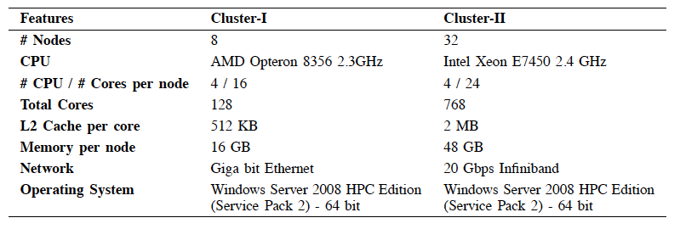
Experiment Environments

Slide 12
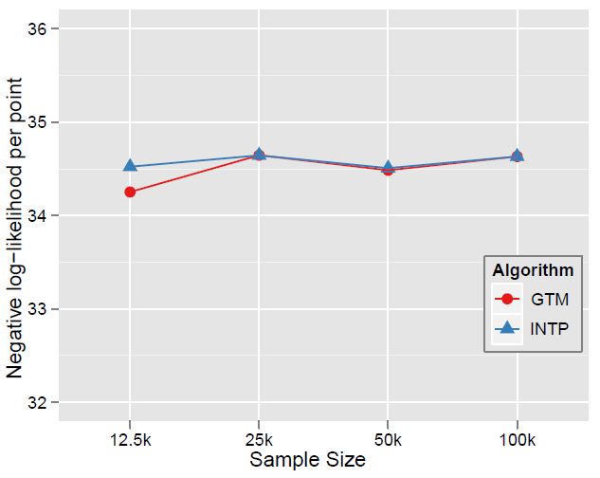
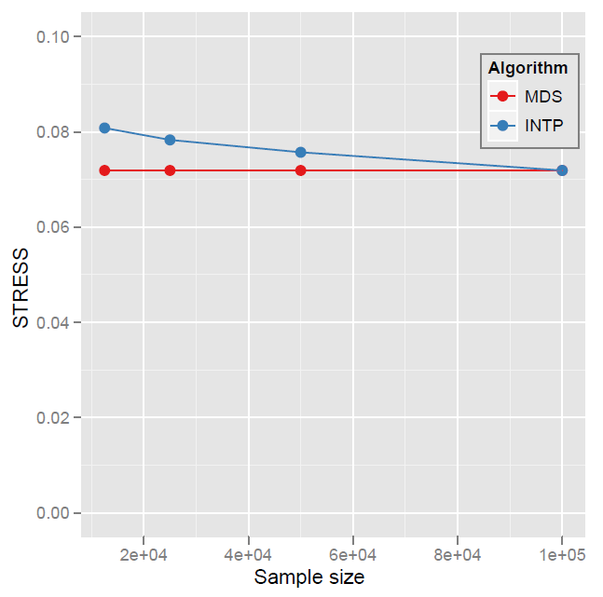
Quality Comparison (1)
GTM interpolation quality comparison
w.r.t. different sample size of N = 100k
MDS interpolation quality comparison
w.r.t. different sample size of N = 100k

Slide 13
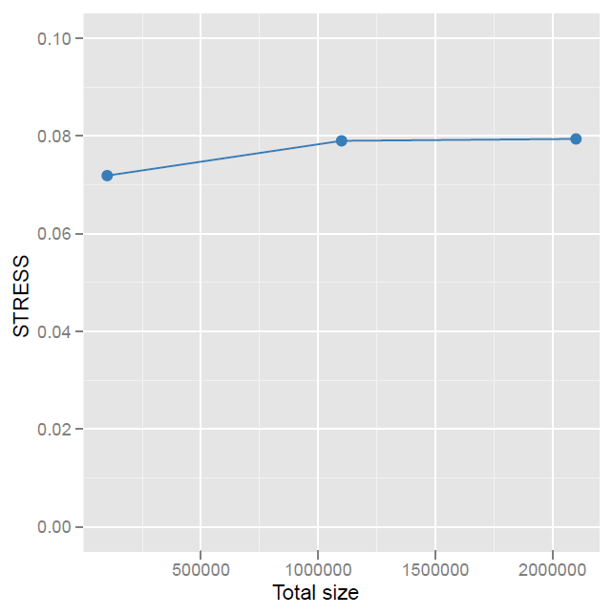
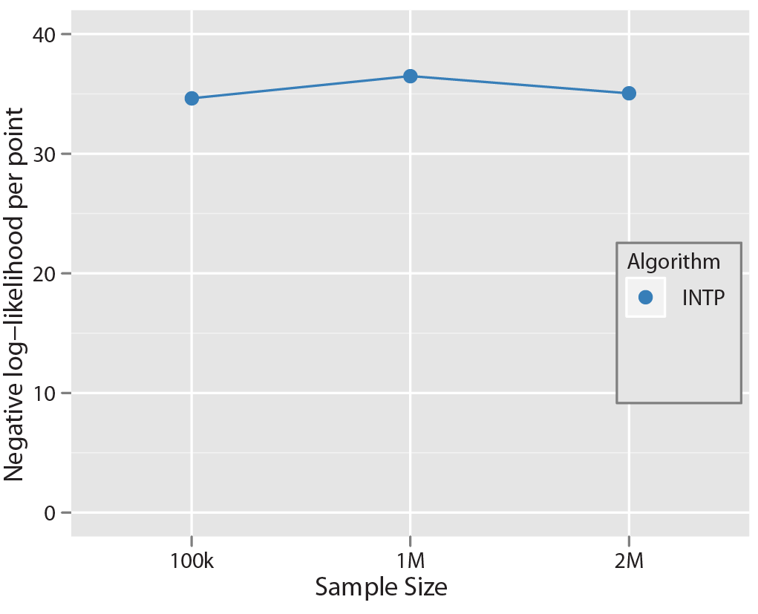
Quality Comparison (2)
GTM interpolation quality up to 2M
MDS interpolation quality up to 2M

Slide 14
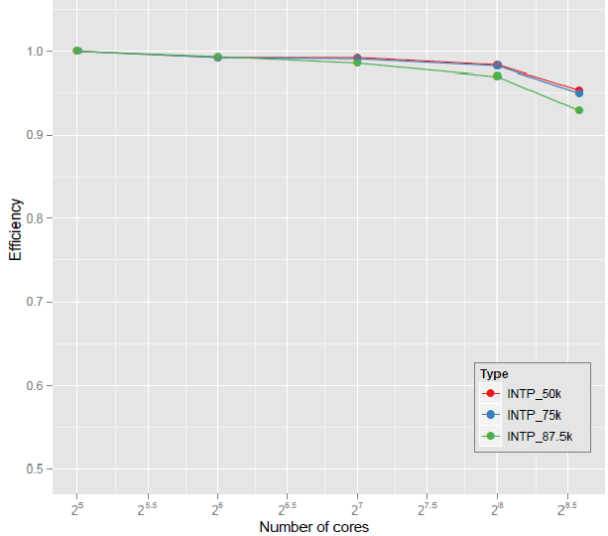
Parallel Efficiency
GTM parallel efficiency on Cluster-II
MDS parallel efficiency on Cluster-II

Slide 15
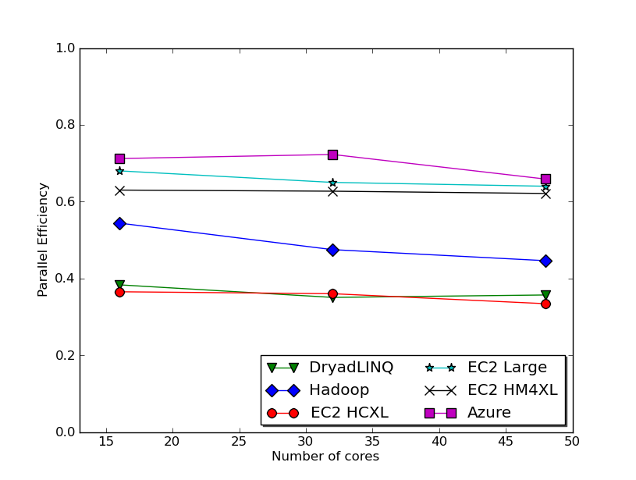
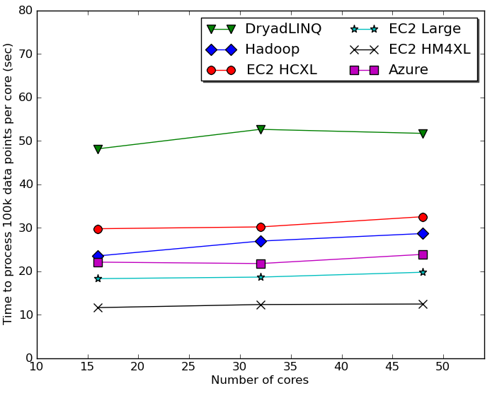
GTM Interpolation via MapReduce
GTM Interpolation parallel efficiency
GTM Interpolation–Time per core to process 100k data points per core
26.4 million pubchem data
DryadLINQ using a 16 core machine with 16 GB, Hadoop 8 core with 48 GB, Azure small instances with 1 core with 1.7 GB.
Thilina Gunarathne, Tak-Lon Wu, Judy Qiu, and Geoffrey Fox, “Cloud Computing Paradigms for Pleasingly Parallel
Biomedical Applications,” in Proceedings of ECMLS Workshop of ACM HPDC 2010
Notes:
EC2 HM4XL - High memory large instances (8 * 3.25 Ghz cores, 68GB memory)
EC2 HCXL – High CPU extra large (8 * 2.4 Ghz, 7GB memory)
EC2 Large – 2 * 2.4 Ghz , 7.5 GB memory
GTM interpolation is memory bound. Hence, less cores per memory (less memory & memory bandwidth contention) has the advantage. DryadLINQ efficiency suffers due to 16 core 16 GB machines.

Slide 16
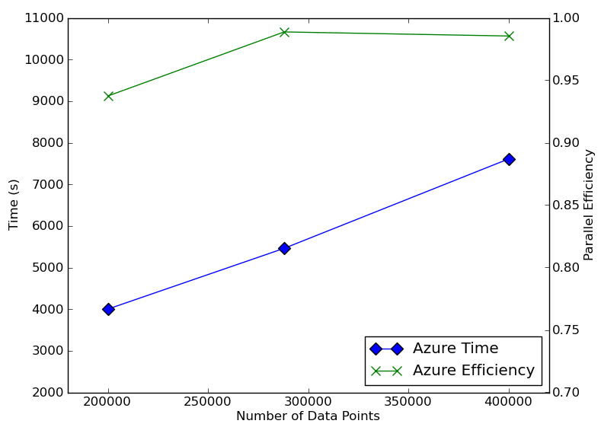
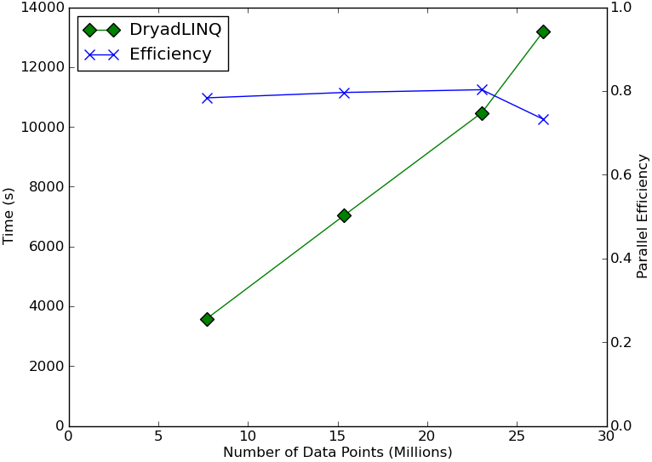
MDS Interpolation via MapReduce
DryadLINQ on 32 nodes X 24 Cores cluster with 48 GB per node. Azure using small instances
Thilina Gunarathne, Tak-Lon Wu, Judy Qiu, and Geoffrey Fox, “Cloud Computing Paradigms for Pleasingly Parallel
Biomedical Applications,” in Proceedings of ECMLS Workshop of ACM HPDC 2010
Notes:
Efficiency drop in MDS DryadLINQ at the last point is due to unbalanced partition (2600 blocks in to 768 cores)

Slide 17
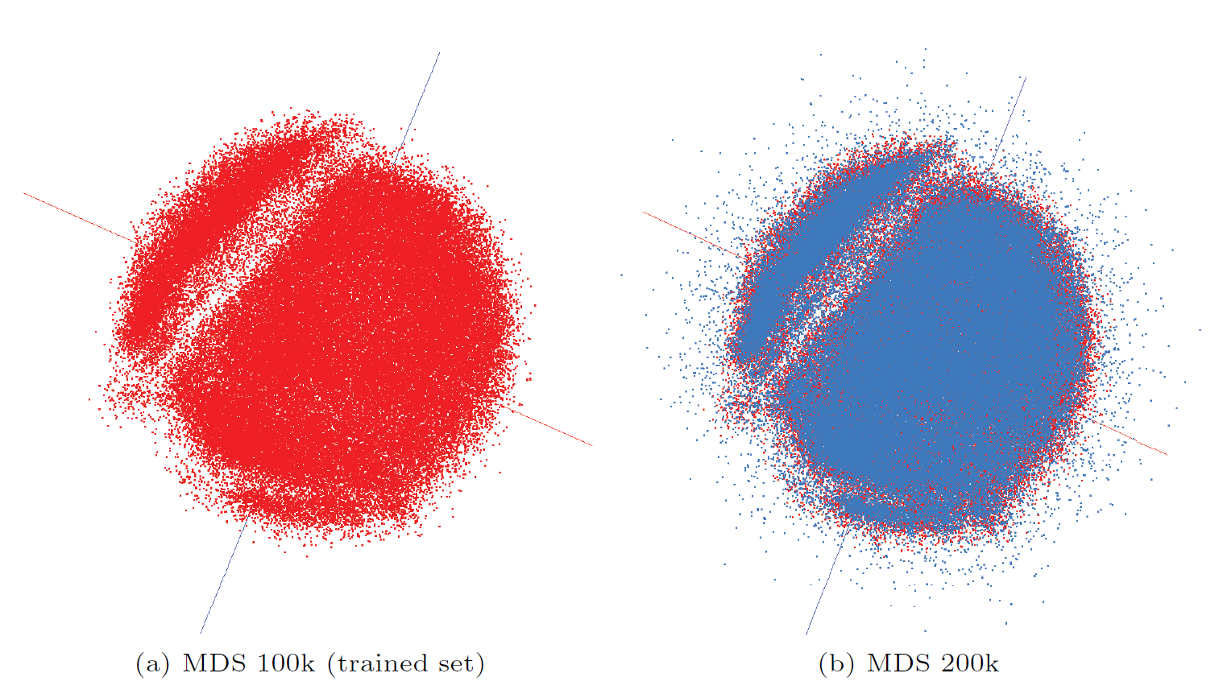
MDS Interpolation Map
PubChem data visualization by using MDS (100k) and Interpolation (100k+100k).

Slide 18
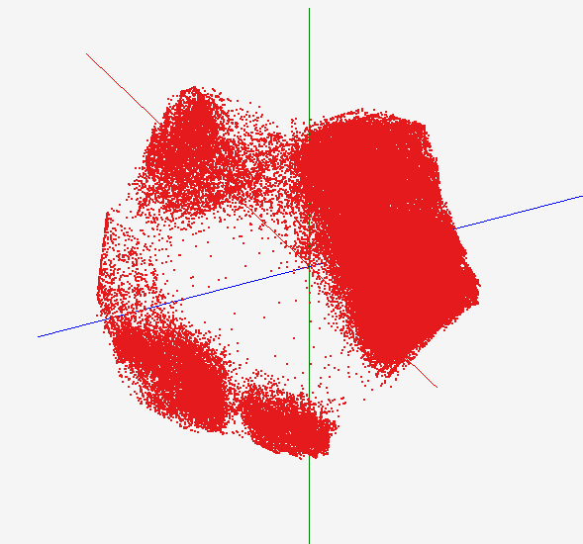
GTM Interpolation Map
PubChem data visualization by using GTM (100k) and Interpolation (2M + 100k).

Slide 19
Conclusion
Dimension reduction algorithms (e.g. GTM and MDS) are computation and memory intensive applications.
Apply interpolation (out-of-sample) approach to GTM and MDS in order to process and visualize large- and high-dimensional dataset.
It is possible to process millions data point via interpolation.
Could be parallelized by MapReduce fashion as well as MPI fashion.

Slide 20
Future Works
Make available as a Service
Hierarchical Interpolation could reduce the computational complexity
O(Mn) → O(Mlog(n))

Slide 21
Acknowledgment
Our internal collaborators in School of Informatics and Computing at IUB
Prof. David Wild
Dr. Qian Zhu

Slide 22
Thank you
Question?
Email me at sebae@cs.indiana.edu

Slide 23
EM optimization
Find K centers for N data
K-clustering problem, known as NP-hard
Use Expectation-Maximization (EM) method
EM algorithm
Find local optimal solution iteratively until converge
E-step:
M-step:

Slide 24
Parallelization
Interpolation is pleasingly parallel application
Out-of-sample data are independent each other.
We can parallelize interpolation app. by MapReduce fashion as well as MPI fashion.
Thilina Gunarathne, Tak-Lon Wu, Judy Qiu, and Geoffrey Fox, “Cloud Computing Paradigms for Pleasingly Parallel Biomedical Applications,” in Proceedings of ECMLS Workshop of ACM HPDC 2010
n In-sample
Training
Trained data
N-n
Out-of-sample
1
Interpolated map
2
Interpolation
......
P-1
p
Total N data

