Slide 1
Security: systems, clouds, models, and privacy challenges
iDASH Symposium http://idash.ucsd.edu
San Diego CA October 10-11 2011
Geoffrey Fox
gcf@indiana.edu
http://www.infomall.org http://www.futuregrid.org
Director, Digital Science Center, Pervasive Technology Institute
Associate Dean for Research and Graduate Studies, School of Informatics and Computing
Indiana University Bloomington

Slide 2
Philosophy of
Clouds and Grids
Clouds are (by definition) commercially supported approach to large scale computing (data-sets)
  So we should expect Clouds to continue to replace Compute Grids
  Current Grid technology involves “non-commercial” software solutions which are hard to evolve/sustain
Public Clouds are broadly accessible resources like Amazon and Microsoft Azure – powerful but not easy to customize and data trust/privacy issues
Private Clouds run similar software and mechanisms but on “your own computers” (not clear if still elastic)
  Platform features such as Queues, Tables, Databases currently limited
  Still shared for cost effectiveness?
Services still are correct architecture with either REST (Web 2.0) or Web Services
Clusters are still critical concept for either MPI or Cloud software

Slide 3
2 Aspects of Cloud Computing:
Infrastructure and Runtimes
Cloud infrastructure: outsourcing of servers, computing, data, file space, utility computing, etc.
  Handled through Web services that control virtual machine lifecycles.
Cloud runtimes or Platform: tools (for using clouds) to do data-parallel (and other) computations.
  Apache Hadoop, Google MapReduce, Microsoft Dryad, Bigtable, Chubby and others
  MapReduce designed for information retrieval but is excellent for a wide range of science data analysis applications
  Can also do much traditional parallel computing for data-mining if extended to support iterative operations
  Data Parallel File system as in HDFS and Bigtable

Slide 4
Biomedical Cloud Issues
Operating cost of a large shared (public) cloud ~20% that of traditional cluster
Gene sequencing cost decreasing much faster than Moore’s law
Biomedical computing does not need low latency (microsecond) synchronization of HPC Cluster
  Amazon a factor of 6 less effective on HPC workloads than state of art HPC cluster
  i.e. Clouds work for biomedical applications if we can make convenient and address privacy and trust
Deduce natural infrastructure for biomedical data analysis is cloud plus (iterative) MapReduce
Software as a Service likely to be dominant usage model
  Paid by “credit card” whether commercial, government or academic
  “standard” services like BLAST plus services with your software

Slide 5
What is Modern Data System Architecture I?
Traditionally each new instrument or major project has a new data center established
  e.g. in Astronomy each wavelength has its data center
Such centers offer
  Data access with low level FTP/Web interface OR
  Database access or other sophisticated search (e.g. GIS)
No agreement across fields if significant computing needed on data
  Life Sciences tend to need substantial computing from assembly, alignment, clustering, ….
“Old model” was scientist downloading data for analysis in local computer system
  Is this realistic with multi-petabyte datasets?
  Maybe with Content Delivery Network (Caching)

Slide 6
What is Modern Data System Architecture II?
We are taught to “bring the computing to the data” but
  Downloading data from central repository violates this
Could have a giant cloud with a co-located giant data store but not very plausible politically or technically
More likely multiple distributed 1-10 petabyte data archives with associated cloud (MapReduce) infrastructure
  Analyses could still involve data and computing from multiple such environments
  Need hierarchical algorithms but usually natural
These can be private or public clouds
For cost reasons, they will always be multi-user shared systems but can be ~single function

Slide 7
Trustworthy Cloud Computing
Public Clouds are elastic (can be scaled up and down) as large and shared
  Sharing implies privacy and security concerns; need to learn how to use shared facilities
Private clouds are not easy to make elastic or cost effective (as too small)
  Need to support public (aka shared) and private clouds
“Amazon is 100X more secure than your infrastructure” (Bio-IT Boston April 2011)
  But how do we establish this trust?
“Amazon is more or less useless as NIH will only let us run 20% of our genomic data on it so not worth the effort to port software to cloud” (Bio-IT Boston)
  Need to establish trust

Slide 8
Inside Modern Data System Architecture III?
Even within our cloud, we can examine data architecture with ~3 major choices
  Shared file system (Lustre, GPFS, NFS …) as used to support high performance computing
  Object Store such as S3(Amazon) or Swift (OpenStack)
  Data Parallel File Systems such as Hadoop or Google File Systems
Shared File or Object Stores separate computing and data and are limited by bandwidth of compute cluster to storage system connection
  Intra cluster bandwidth >> inter cluster bandwidth?
Data Parallel File Systems canNOT put computing on same NODE as data in a multi-user environment
  Can put data on same CLUSTER as computing

Slide 9
Traditional 3-level File System?

Slide 10
Data Parallel File System?
Block1
Replicate each block
File1
Block2
……
Breakup
BlockN
C
C
C
C
Data
Data
Data
Data
C
C
C
C
Data
Data
Data
Data
C
C
C
C
Data
Data
Data
Data
C
C
C
C
Data
Data
Data
Data
Block1
File1
Block2
……
Breakup
Replicate each block
BlockN
No archival storage and computing brought to data

Slide 11
Trustworthy Cloud Approaches
Rich access control with roles and sensitivity to combined datasets
Anonymization & Differential Privacy – defend against sophisticated datamining and establish trust that it can
Secure environments (systems) such as Amazon Virtual Private Cloud – defend against sophisticated attacks and establish trust that it can
Application specific approaches such as database privacy
Hierarchical algorithms where sensitive computations need modest computing on non-shared resources
Iterative MapReduce can be built on classic pub-sub communication software with known security approaches

Slide 12

Twister v0.9
March 15, 2011
  New Interfaces for Iterative MapReduce Programming
  http://www.iterativemapreduce.org/
SALSA Group
Bingjing Zhang, Yang Ruan, Tak-Lon Wu, Judy Qiu, Adam Hughes, Geoffrey Fox, Applying Twister to Scientific Applications, Proceedings of IEEE CloudCom 2010 Conference, Indianapolis, November 30-December 3, 2010
Twister4Azure to be released May 2011
MapReduceRoles4Azure available now at
http://salsahpc.indiana.edu/mapreduceroles4azure/

Slide 13
Twister4Azure
Architecture

Slide 14

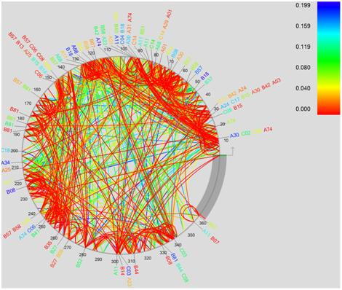
Performance Comparisons
BLAST Sequence Search
Smith Waterman
Sequence Alignment
Cap3 Sequence Assembly

Slide 15
Multidimensional Scaling MDS Performance
# Instances | Speedup
6 | 6
12 | 16.4
24 | 35.3
48 | 52.8
Probably super linear as used small instances
30,000*30,000 Data points, 15 instances, 3 MR steps per iteration
30 Map tasks per application

Slide 16
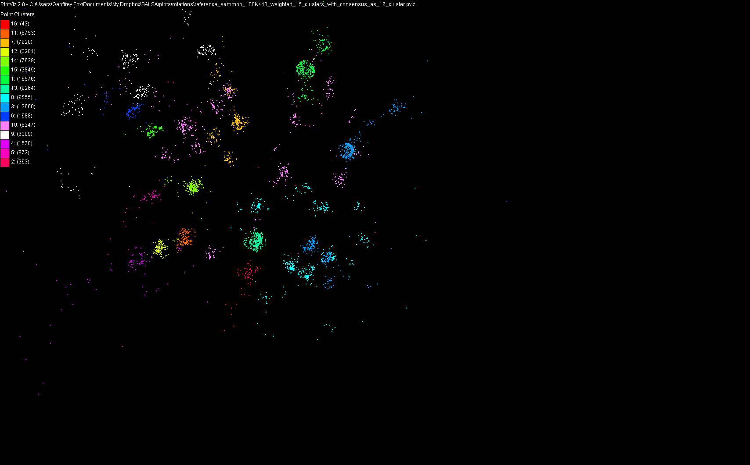
100,043 Metagenomics Sequences Scaling to 10’s of millions with Twister on cloud

