Slide 1


Layer-finding in Radar Echograms using Probabilistic Graphical Models
David Crandall
Geoffrey C. Fox
School of Informatics and Computing
Indiana University, USA
John D. Paden
Center for Remote Sensing of Ice Sheets
University of Kansas, USA
Crandall, Fox, Paden, International Conference on Pattern Recognition (ICPR), 2012.

Slide 2
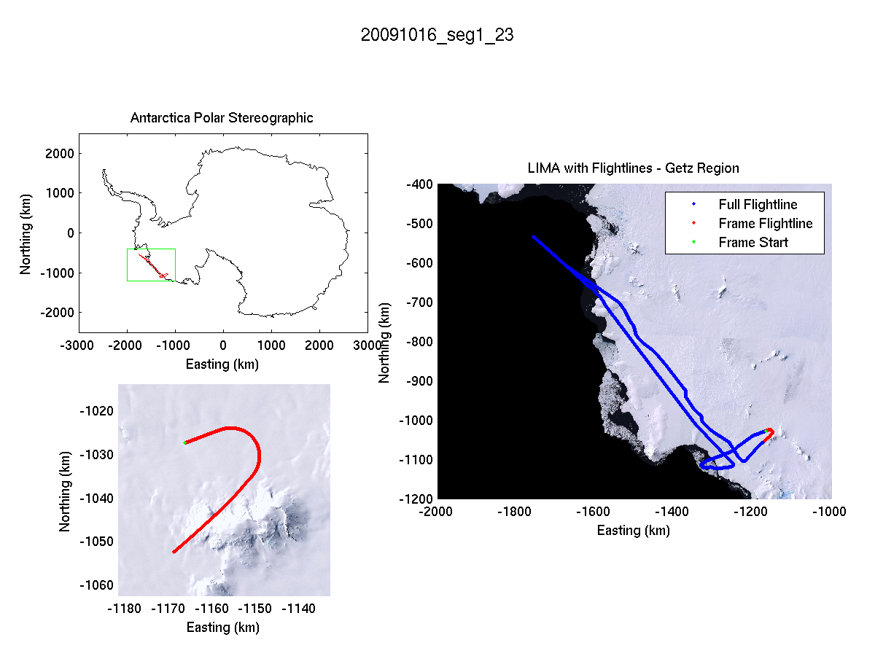
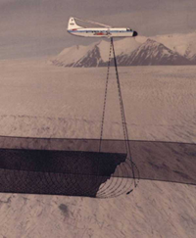
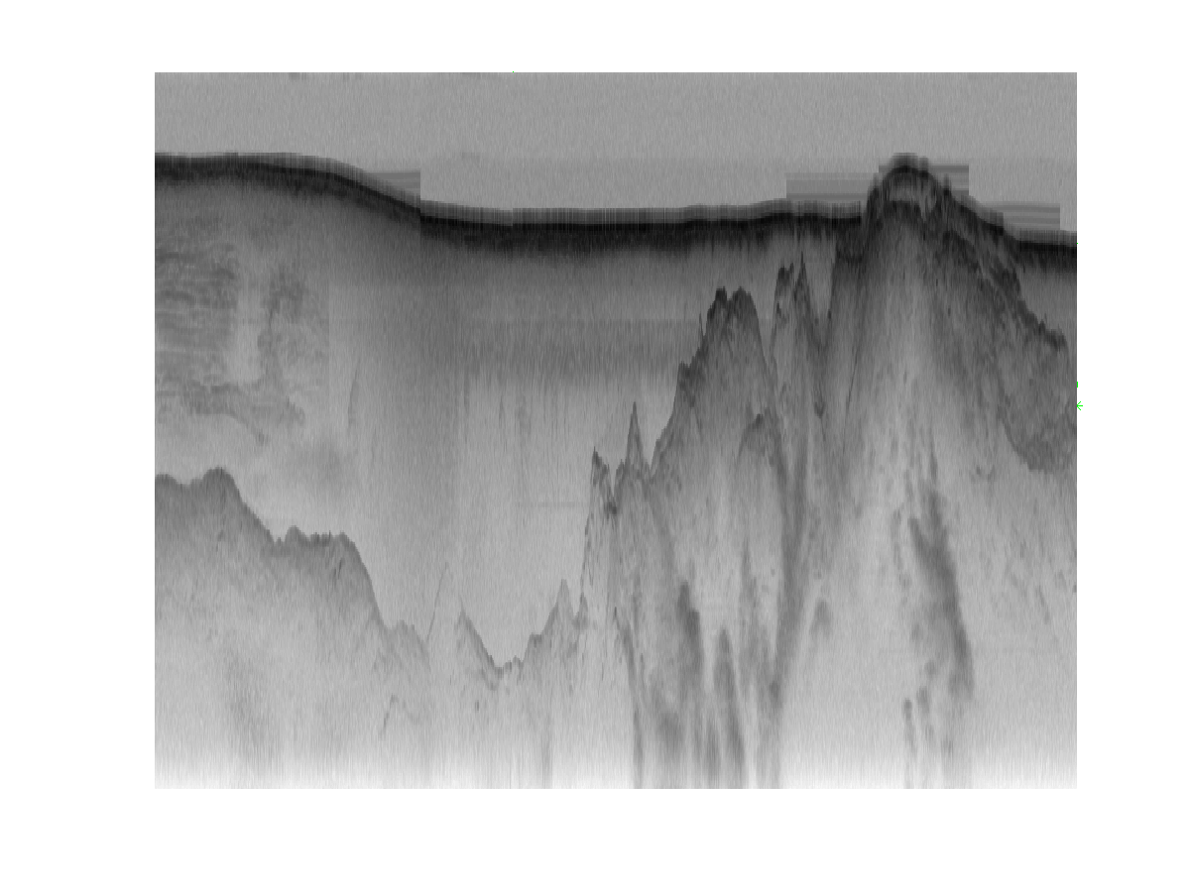
Ice sheet radar echograms
Distance along flight line
Distance below aircraft

Slide 3
Ice sheet radar echograms
Distance along flight line
Air
Distance below aircraft
Ice
Bedrock

Slide 4
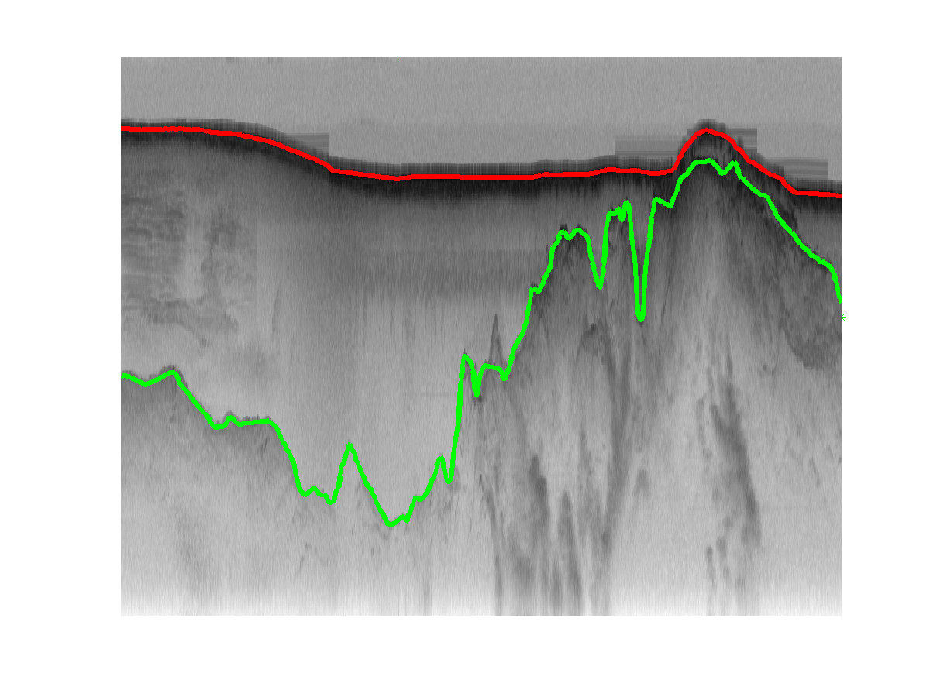
Ice sheet radar echograms
Distance along flight line
Air
Distance below aircraft
Ice
Bedrock

Slide 5
Related work
Subsurface imaging
  [Turk2011], [Allen2012], …
Buried object detection
  [Trucco1999], [Gader2001], [Frigui2005], …
Layer finding in ground-penetrating echograms
  [Freeman2010], [Ferro2011], …
General-purpose image segmentation
  [Haralick1985], [Kass1998], [Shi2000], [Felzenszwalb2004], …

Slide 6
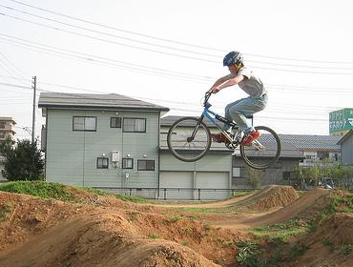
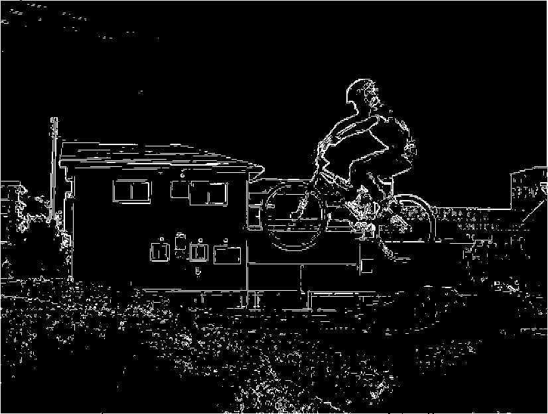
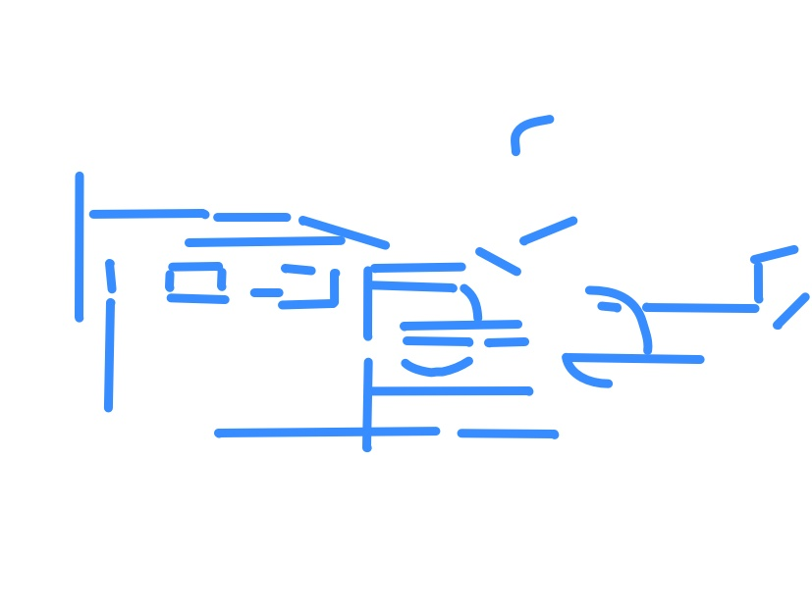
Pipelined approaches to CV
Edge detection
Group edge pixels into lines and circles
Assemble lines & circles into objects

Slide 7
Pipelined approaches to CV
Edge detection
Group edge pixels into line and curve fragments
Grow line and curve fragments
Assemble lines & circles into objects
Group nearby line and curve fragments together
Break apart complex fragments
Group into circles and curves

Slide 8
“Unified” approaches to CV
Use features derived from raw image data
Consider all evidence together, at the same time
  Probabilistic frameworks can naturally model uncertainty and combine weak evidence
  Probabilistic graphical models provide framework for making inference tractable (see e.g. Koller 2009)
Set parameters and thresholds automatically, by learning from training data

Slide 9
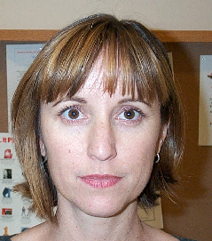

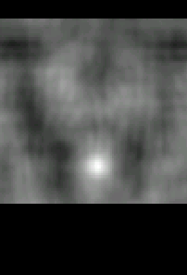
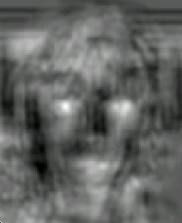
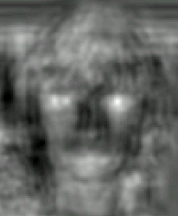
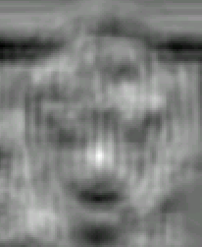
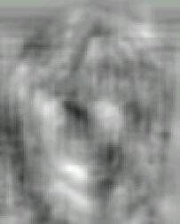
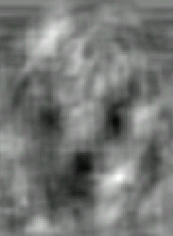
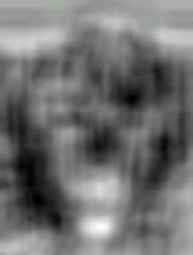
Unified inference example
Marginal on
Nose
Left eye
Right eye
Nose
Graphical
model
inference
Left mouth
Right mouth
Chin
From: Crandall, Felszenswalb, Huttenlocher, CVPR 2005.

Slide 10
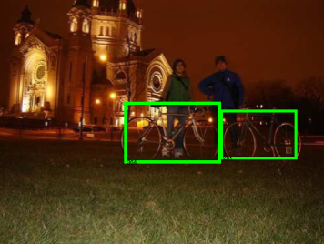
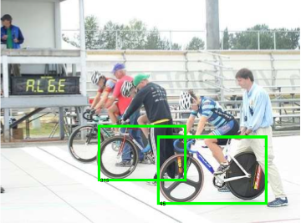
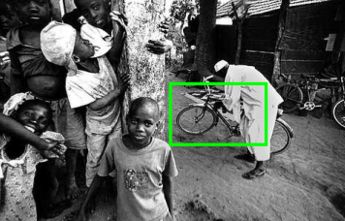
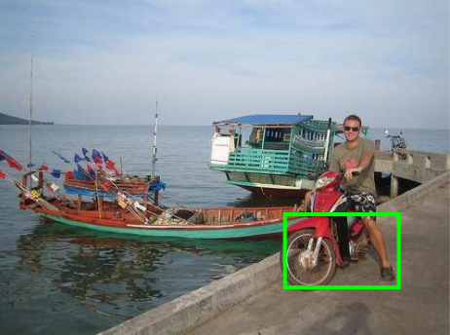
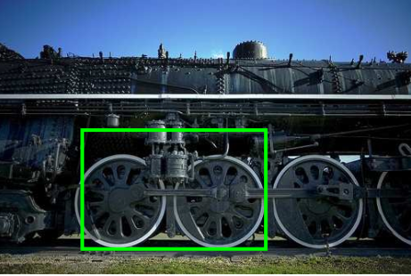
Sample “bicycle” localizations
Correct detections:
False positives:

Slide 11
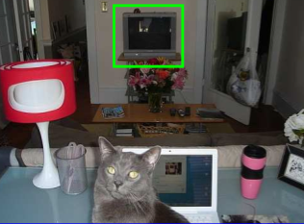
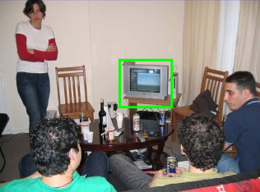
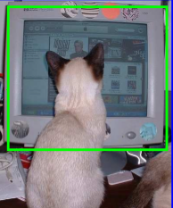
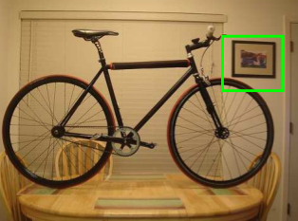
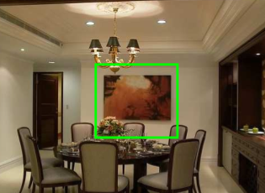
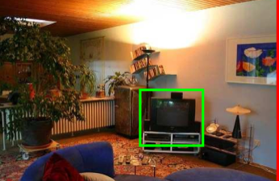
Sample “TV/monitor” detections
Correct detections:
False positives:

Slide 12
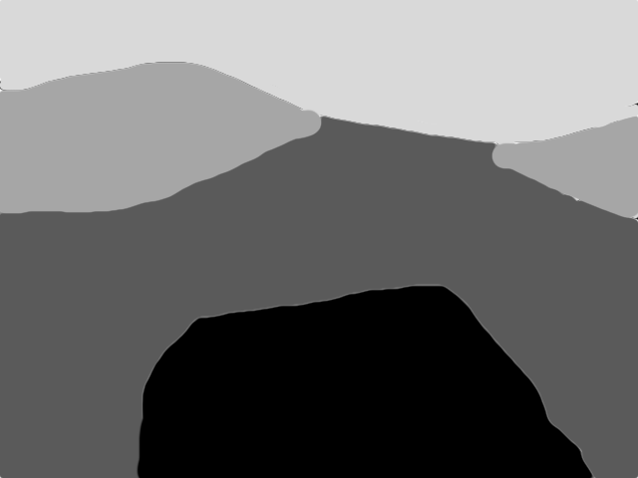

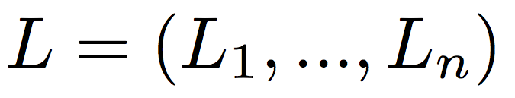
Tiered segmentation
Layer-finding is a tiered segmentation problem [Felzenszwalb2010]
  Label each pixel with one of [1, K+1], under the constraint that if y < y’, label of (x, y) ≤ label of (x, y’)
l_{i}¹
1
2
l_{i}²
2
l_{i}³
3
4
L_{i}
Equivalently, find K boundaries in each column
  Let denote the row indices of the K region boundaries in column i
  Goal is to find labeling of whole image,
Crandall, Fox, Paden, International Conference on Pattern Recognition (ICPR), 2012.

Slide 13

Probabilistic formulation
Goal is to find most-likely labeling given image I,
Likelihood term models how well labeling agrees with image
Prior term models how well labeling agrees with typical ice layer properties
Crandall, Fox, Paden, ICPR 2012.

Slide 14
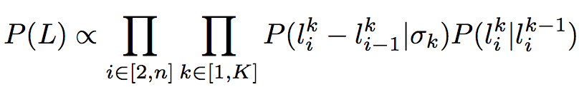

Prior term
Prior encourages smooth, non-crossing boundaries
Zero-mean Gaussian penalizes discontinuities in layer boundaries across columns
Repulsive term prevents boundary crossings; is 0 if
and uniform otherwise
l_{i}¹
₁
l_{i+1}
l_{i}²
₂
l_{i+1}
₃
l_{i}³
l_{i+1}
Crandall, Fox, Paden, ICPR 2012.

Slide 15
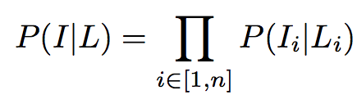
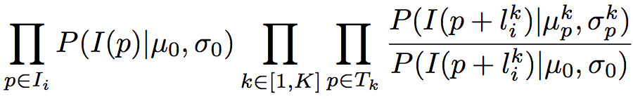
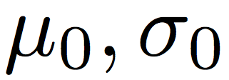
Likelihood term
Likelihood term encourages labels to coincide with layer boundary features (e.g. edges)
  Learn a single-column appearance template T_{k} consisting of Gaussians at each position p, with
  Also learn a simple background model, with
  Then likelihood for each column is,
Crandall, Fox, Paden, ICPR 2012.

Slide 16
Efficient inference
Finding L that maximizes P(L | I) involves inference on a Markov Random Field
  Simplify problem by solving each row of MRF in succession, using the Viterbi algorithm
  Naïve Viterbi requires O(Kmn²) time, for m x n echogram with K layer boundaries
  Can use min-convolutions to speed up Viterbi (because of the Gaussian prior), reducing time to O(Kmn) [Crandall2008]
  Very fast: ~100ms per image
Crandall, Fox, Paden, ICPR 2012.

Slide 17
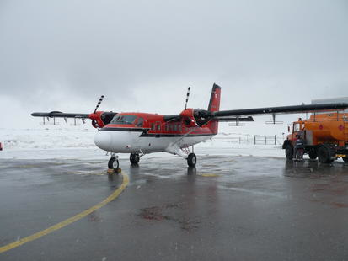
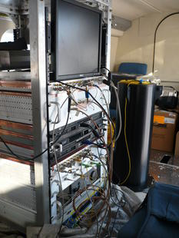
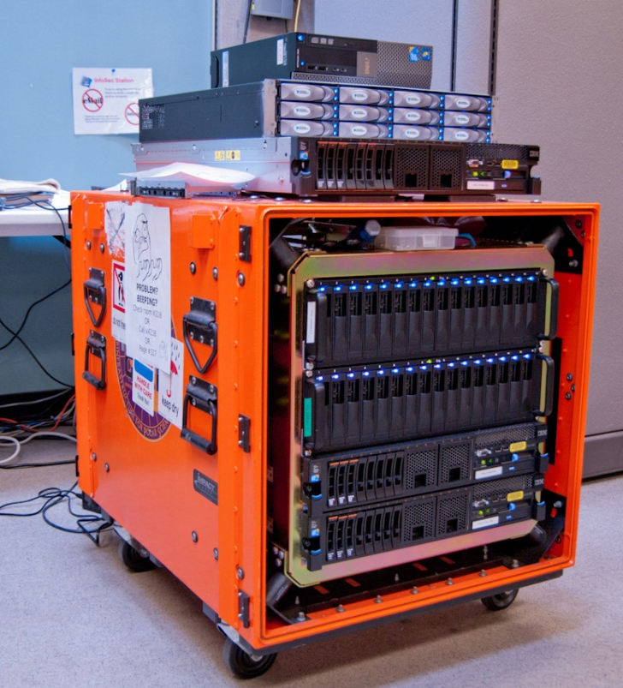
Experimental results
Tested with 827 echograms from Antarctica
  From Multichannel Coherent Radar Depth Sounder system in 2009 NASA Operation Ice Bridge [Allen12]
  About 24,810 km of flight data
  Split into equal-size training and test datasets
Crandall, Fox, Paden, ICPR 2012.

Slide 18
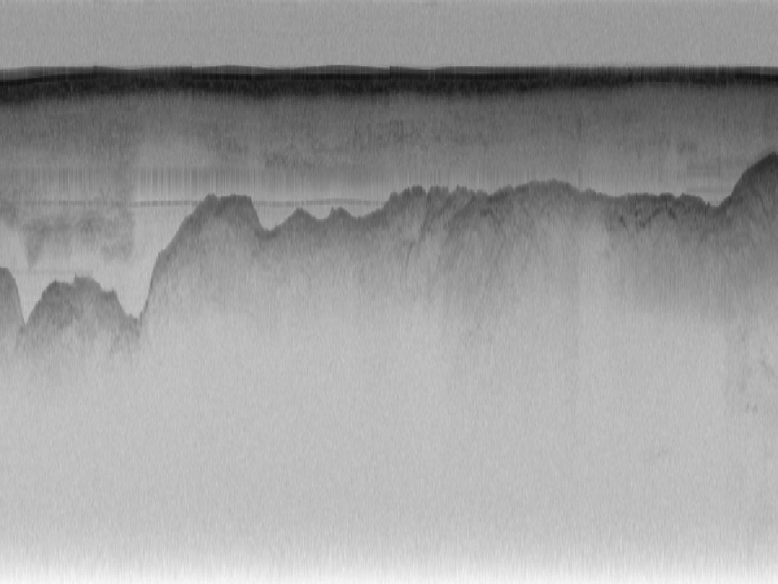
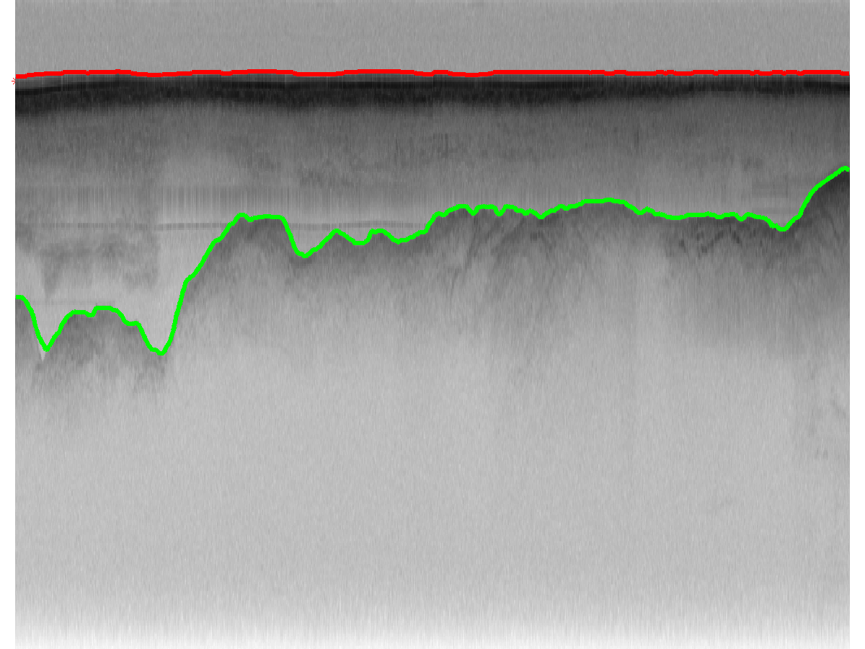
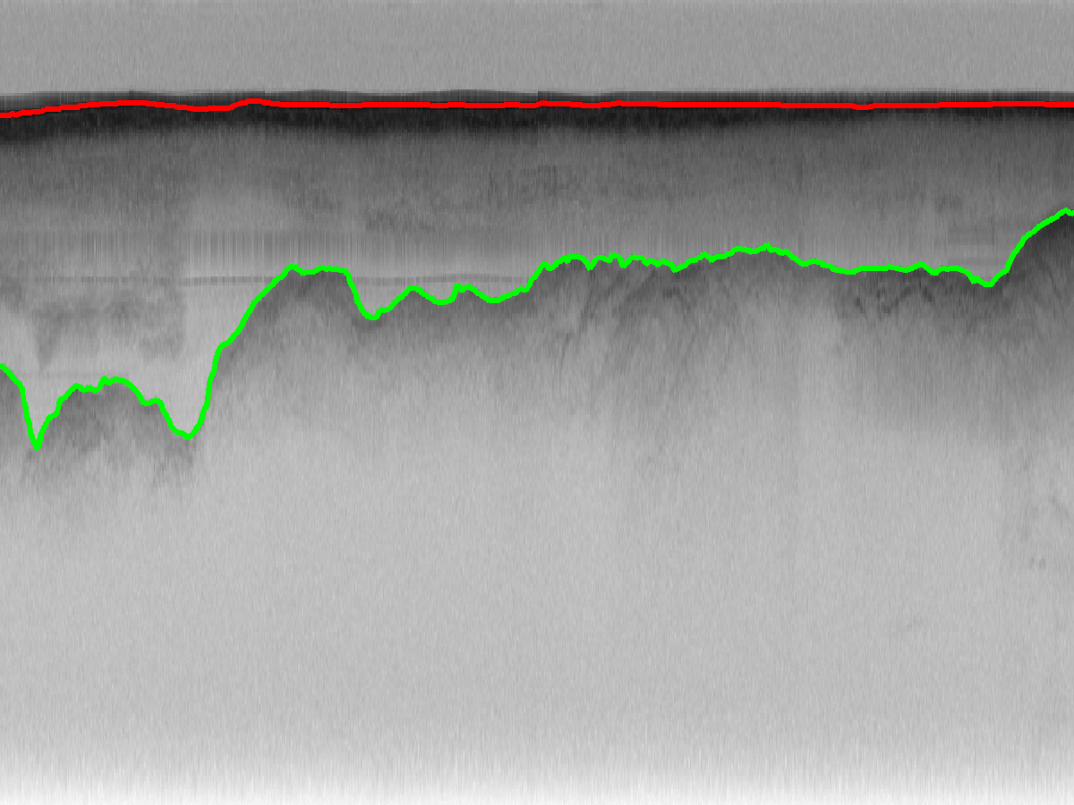
Original echogram
Automatic labeling
Ground truth
Crandall, Fox, Paden, ICPR 2012.

Slide 19
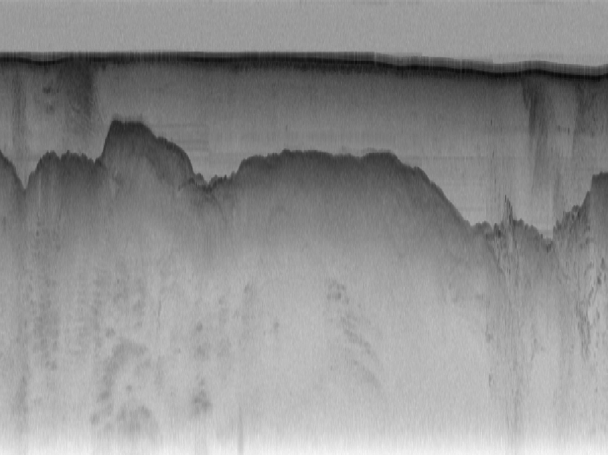
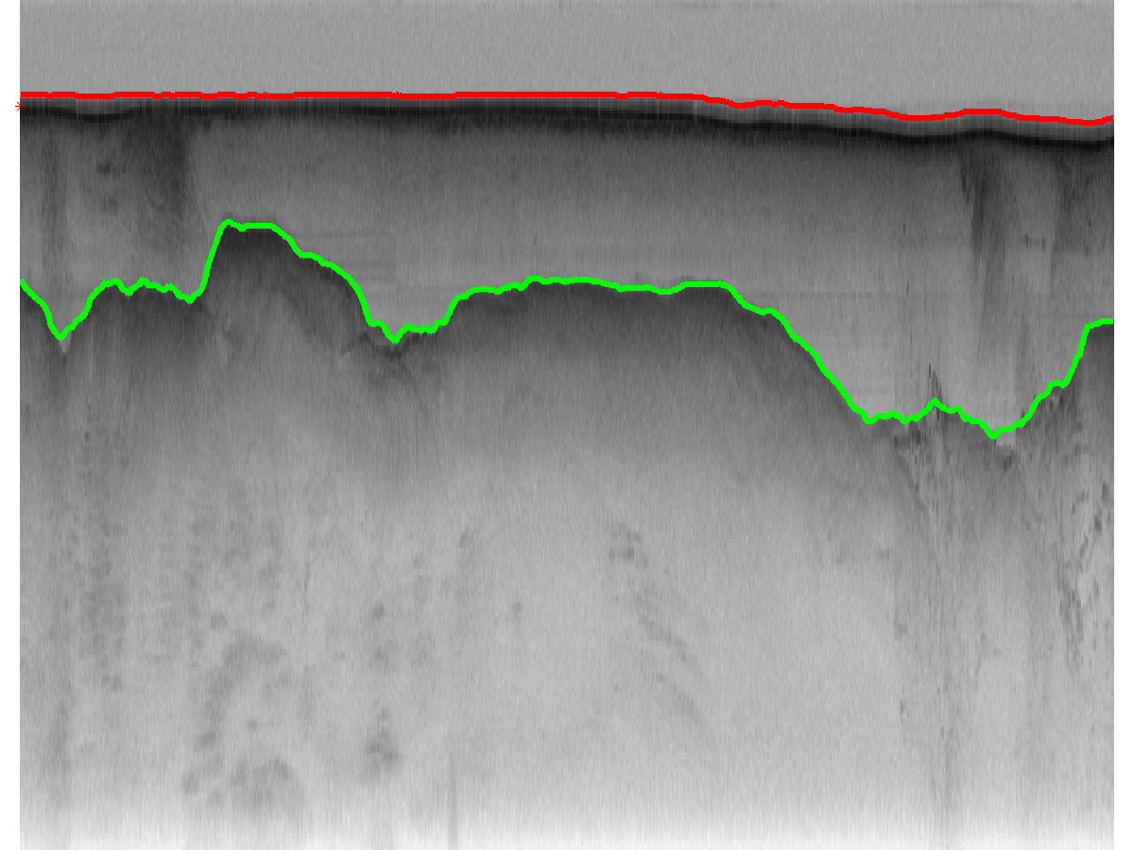
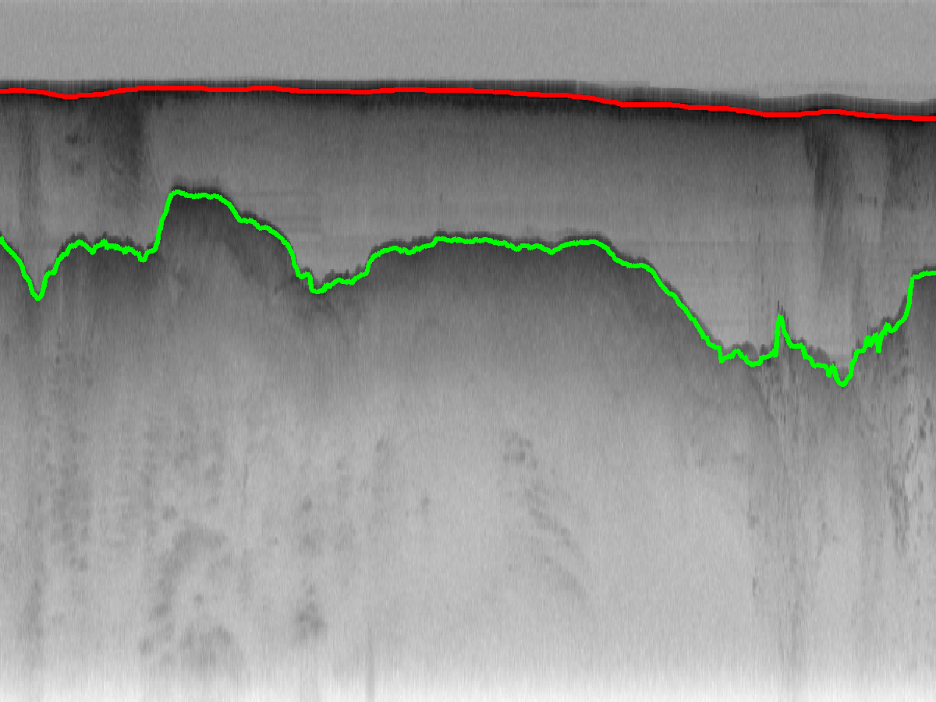
Original echogram
Automatic labeling
Ground truth
Crandall, Fox, Paden, ICPR 2012.

Slide 20
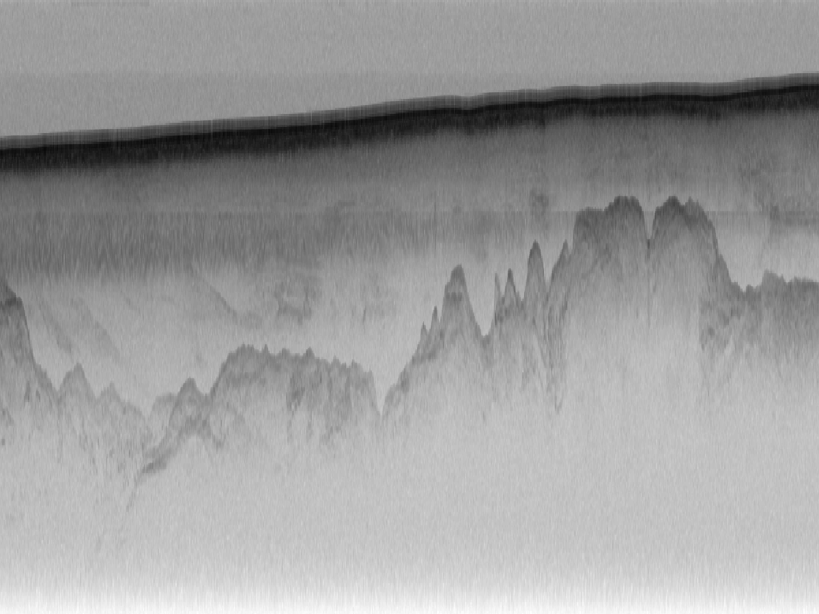
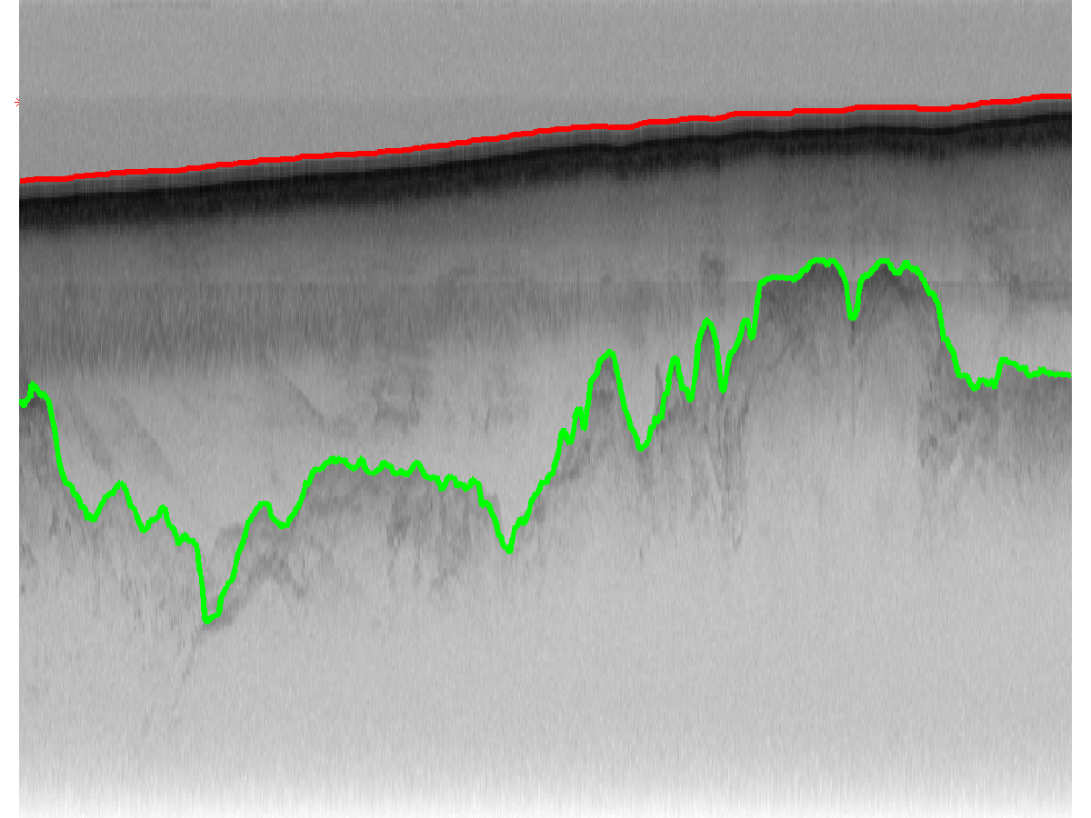
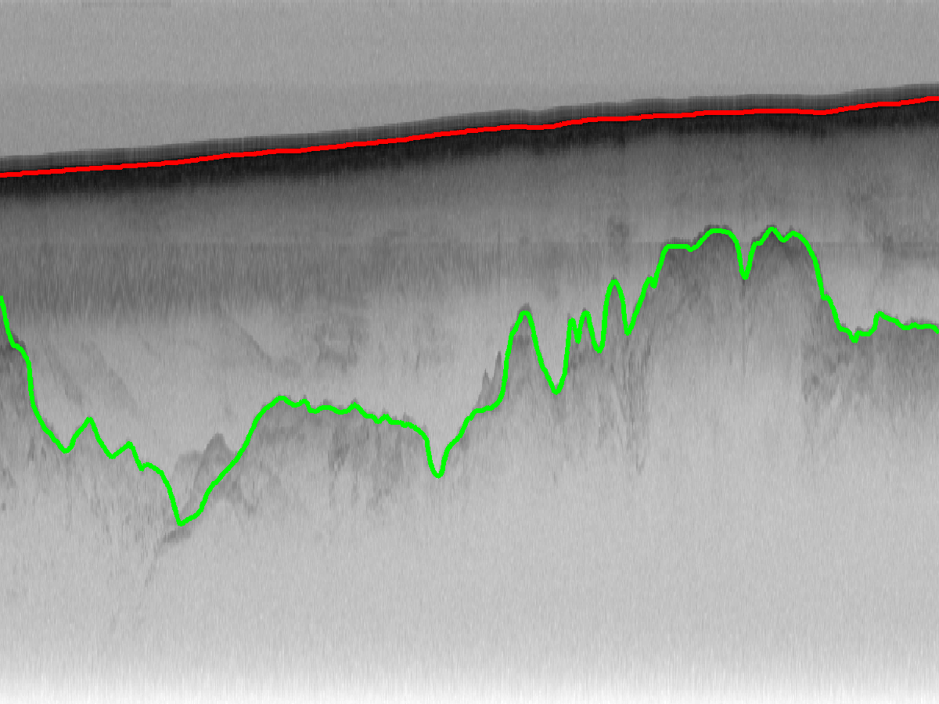
Original echogram
Automatic labeling
Ground truth
Crandall, Fox, Paden, ICPR 2012.

Slide 21

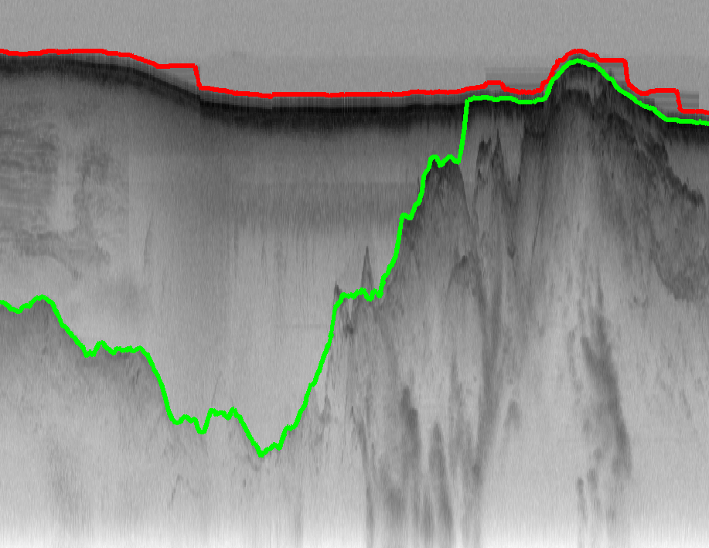
Original echogram
Automatic labeling
Ground truth

Slide 22
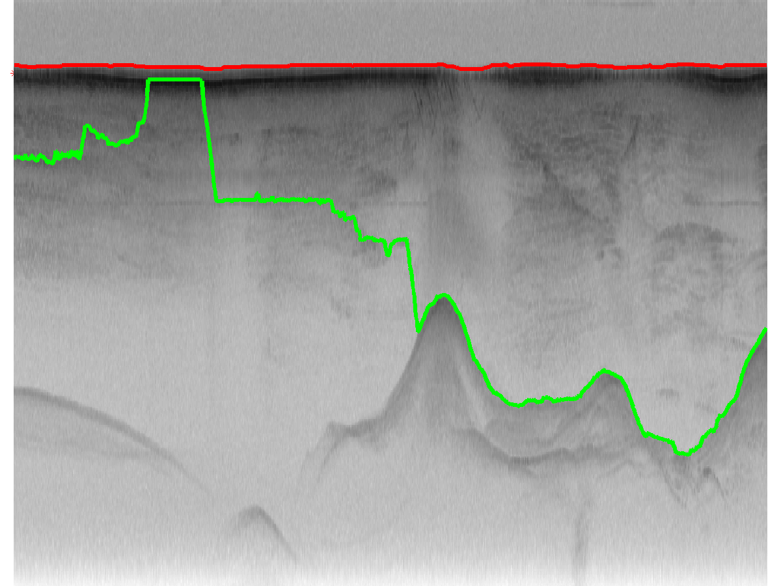
User interaction
Crandall, Fox, Paden, ICPR 2012.

Slide 23
User interaction
*
*
Crandall, Fox, Paden, ICPR 2012.

Slide 24
User interaction
*
*
Modify P(L) such that this label has probability 1
Crandall, Fox, Paden, ICPR 2012.

Slide 25
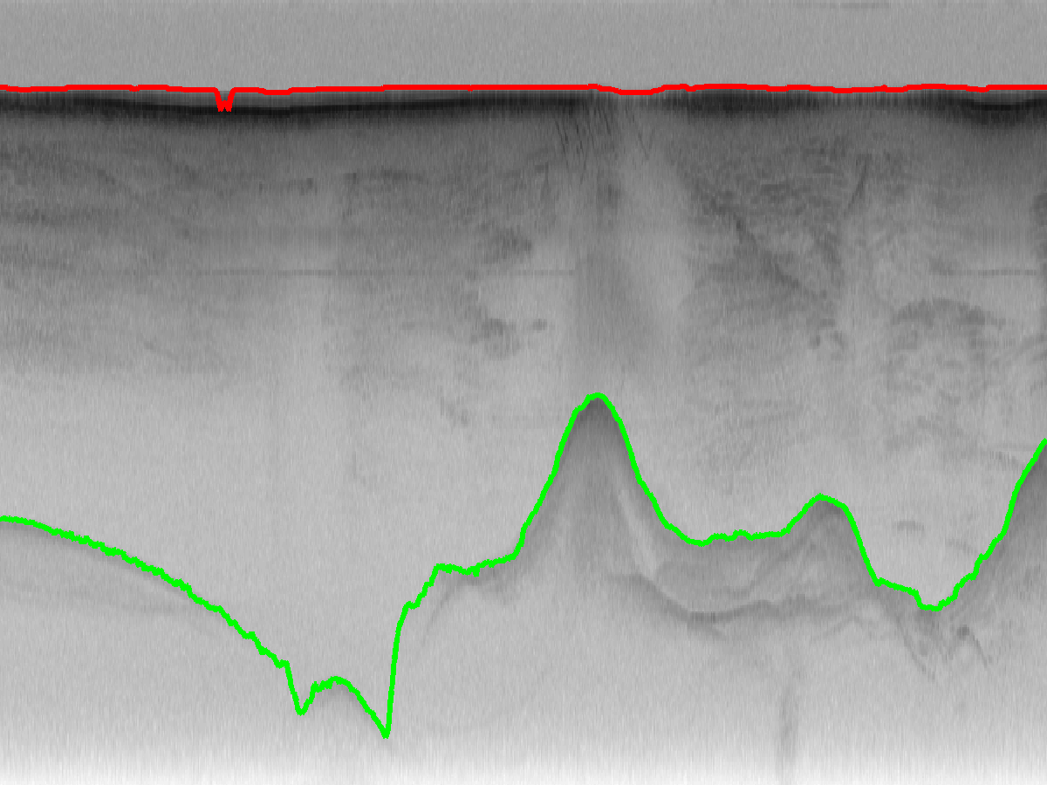
User interaction
*
*
Modify P(L) such that this label has probability 1
Crandall, Fox, Paden, ICPR 2012.

Slide 26
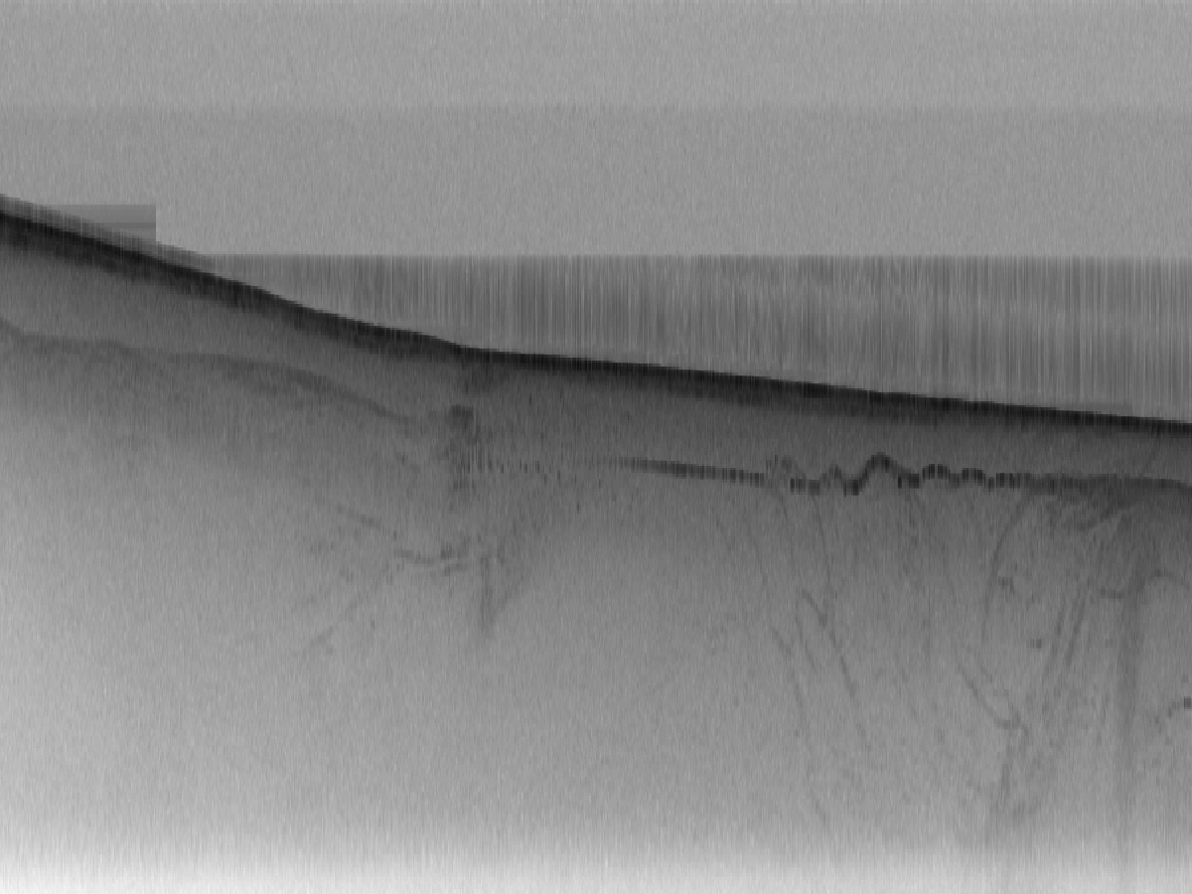
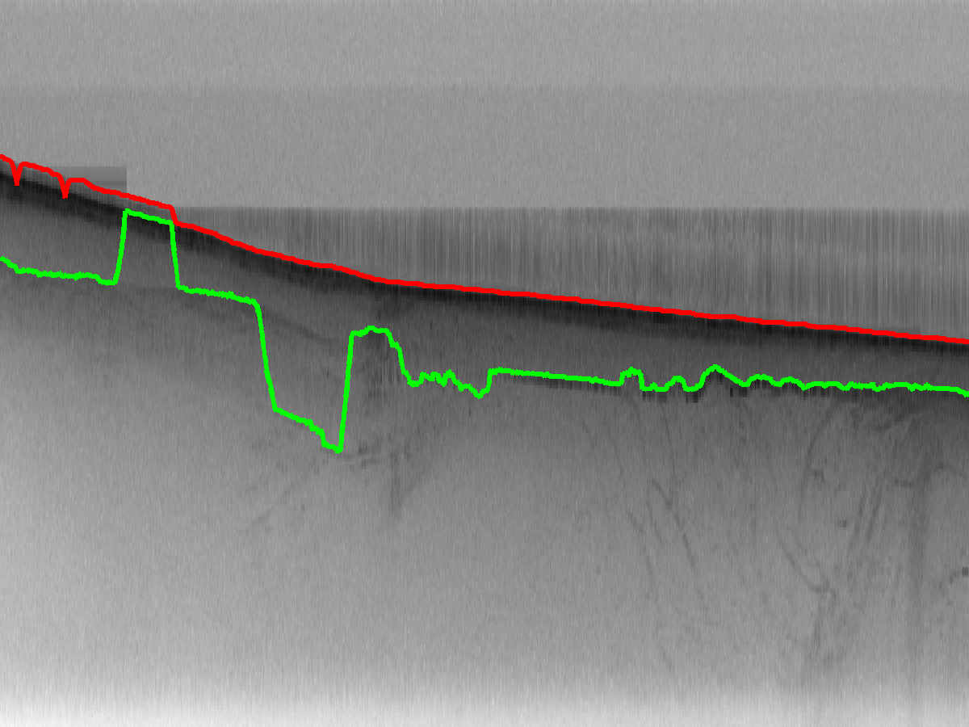
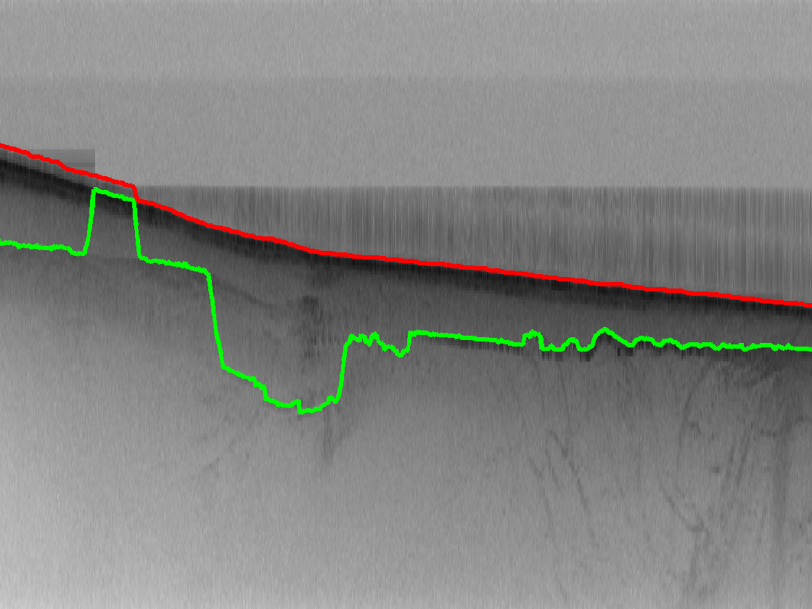

Sampling from the posterior
Instead of maximizing P(L|I), sample from it
Sample 1
Sample 2
Sample 3

Slide 27

Quantitative results
Comparison against simple baselines:
  Fixed simply draws a straight line at mean layer depth
  AppearOnly maximizes likelihood term only
Crandall, Fox, Paden, ICPR 2012.

Slide 28
Quantitative results
Comparison against simple baselines:
  Fixed simply draws a straight line at mean layer depth
  AppearOnly maximizes likelihood term only
  Further improvement with human interaction:
Crandall, Fox, Paden, ICPR 2012.

Slide 29

Summary and Future work
We present a probabilistic technique for ice sheet layer-finding from radar echograms
  Inference is robust to noise and very fast
  Parameters can be learned from training data
  Easily include evidence from external sources
Ongoing work: Internal layer-finding

Slide 30




Thanks!
More information available at:
http://vision.soic.indiana.edu/icelayers/
This work was supported in part by:

