Slide 1
Raining Compute Environments on Resources by Application Users
Gregor von Laszewski
Indiana University
laszewski@gmail.com
Open Cirrus Summit 2011, Oct. 13, 2011

Slide 2
Acknowledgment: People
Many people have worked on FuturGrid and we are not be able to list all them here.
We will attempt to keep a list available on the portal Web site.
Many others have contributed to this tutorial!!
    Thanks!!
https://portal.futuregrid.org

Slide 3
Acknowledgement
The FutureGrid project is funded by the National Science Foundation (NSF) and is led by Indiana University with University of Chicago, University of Florida, San Diego Supercomputing Center, Texas Advanced Computing Center, University of Virginia, University of Tennessee, University of Southern California, Dresden, Purdue University, and Grid 5000 as partner sites.

Slide 4
Reuse of slides
If you reuse the slides please indicate that they are copied from this tutorial. Include a link to https://portal.futuregrid.org
We discourage the printing the tutorial material on paper due to two reasons:
  We like to minimize the impact on the environment for paper and ink usage
  We intend to keep the tutorials up to date on the Web site at https://portal.futuregrid.org

Slide 5
Outline
FutureGrid
Portal (we will skip this today)
Rain
Conclusions

Slide 6
FutureGrid

Slide 7
US Cyberinfrastructure Context
There are a rich set of facilities
  Production TeraGrid facilities with distributed and shared memory
  Experimental “Track 2D” Awards
    FutureGrid: Distributed Systems experiments cf. Grid5000
    Keeneland: Powerful GPU Cluster
    Gordon: Large (distributed) Shared memory system with SSD aimed at data analysis/visualization
  Open Science Grid aimed at High Throughput computing and strong campus bridging

Slide 8
FutureGrid key Concepts I
FutureGrid is an international testbed modeled on Grid5000
Supporting international Computer Science and Computational Science research in cloud, grid and parallel computing (HPC)
  Industry and Academia
The FutureGrid testbed provides to its users:
  A flexible development and testing platform for middleware and application users looking at interoperability, functionality, performance or evaluation
  Each use of FutureGrid is an experiment that is reproducible
  A rich education and teaching platform for advanced cyberinfrastructure (computer science) classes

Slide 9
FutureGrid key Concepts II
FutureGrid has a complementary focus to both the Open Science Grid and the other parts of TeraGrid.
  FutureGrid is user-customizable, accessed interactively and supports Grid, Cloud and HPC software with and without virtualization.
  FutureGrid is an experimental platform where computer science applications can explore many facets of distributed systems
  and where domain sciences can explore various deployment scenarios and tuning parameters and in the future possibly migrate to the large-scale national Cyberinfrastructure.
  FutureGrid supports Interoperability Testbeds – OGF really needed!
Note much of current use Education, Computer Science Systems and Biology/Bioinformatics

Slide 10

FutureGrid key Concepts III
Rather than loading images onto VM’s, FutureGrid supports Cloud, Grid and Parallel computing environments by dynamically provisioning software as needed onto “bare-metal” using Moab/xCAT
  Image library for MPI, OpenMP, Hadoop, Dryad, gLite, Unicore, Globus, Xen, ScaleMP (distributed Shared Memory), Nimbus, Eucalyptus, OpenNebula, KVM, Windows …..
Growth comes from users depositing novel images in library
FutureGrid has ~4000 (will grow to ~5000) distributed cores with a dedicated network and a Spirent XGEM network fault and delay generator
Image1
Image2
…
ImageN
Choose
Load
Run

Slide 11
Dynamic Provisioning Results
Number of nodes
Time elapsed between requesting a job and the jobs reported start time on the provisioned node. The numbers here are an average of 2 sets of experiments.

Slide 12
FutureGrid Partners
Indiana University (Architecture, core software, Support)
Purdue University (HTC Hardware)
San Diego Supercomputer Center at University of California San Diego (INCA, Monitoring)
University of Chicago/Argonne National Labs (Nimbus)
University of Florida (ViNE, Education and Outreach)
University of Southern California Information Sciences (Pegasus to manage experiments)
University of Tennessee Knoxville (Benchmarking)
University of Texas at Austin/Texas Advanced Computing Center (Portal)
University of Virginia (OGF, Advisory Board and allocation)
Center for Information Services and GWT-TUD from Technische Universtität Dresden. (VAMPIR)
Red institutions have FutureGrid hardware

Slide 13

FutureGrid: a Grid/Cloud/HPC Testbed
NID: Network Impairment Device
Private
Public
FG Network

Slide 14
Compute Hardware
System type | # CPUs | # Cores | TFLOPS | Total RAM (GB) | Secondary Storage (TB) | Site | Status
IBM iDataPlex | 256 | 1024 | 11 | 3072 | 339* | IU | Operational
Dell PowerEdge | 192 | 768 | 8 | 1152 | 30 | TACC | Operational
IBM iDataPlex | 168 | 672 | 7 | 2016 | 120 | UC | Operational
IBM iDataPlex | 168 | 672 | 7 | 2688 | 96 | SDSC | Operational
Cray XT5m | 168 | 672 | 6 | 1344 | 339* | IU | Operational
IBM iDataPlex | 64 | 256 | 2 | 768 | On Order | UF | Operational
Large disk/memory system TBD | 128 | 512 | 5 | 7680 | 768 on nodes | IU | New System TBD
High Throughput Cluster | 192 | 384 | 4 | 192 |  | PU | Not yet integrated
Total | 1336 | 4960 | 50 | 18912 | 1353

Slide 15
Storage Hardware
System Type | Capacity (TB) | File System | Site | Status
DDN 9550 (Data Capacitor) | 339 | Lustre | IU | Existing System
DDN 6620 | 120 | GPFS | UC | New System
SunFire x4170 | 96 | ZFS | SDSC | New System
Dell MD3000 | 30 | NFS | TACC | New System
Will add substantially more disk on node and at IU and UF as shared storage

Slide 16
Network Impairment Device
  Spirent XGEM Network Impairments Simulator for jitter, errors, delay, etc
  Full Bidirectional 10G w/64 byte packets
  up to 15 seconds introduced delay (in 16ns increments)
  0-100% introduced packet loss in .0001% increments
  Packet manipulation in first 2000 bytes
  up to 16k frame size
  TCL for scripting, HTML for manual configuration

Slide 17
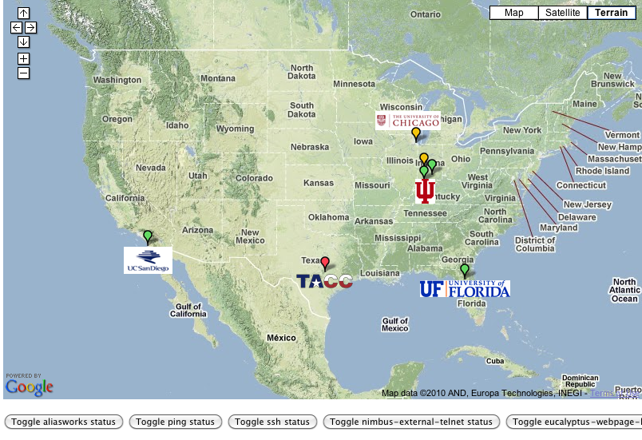
FutureGrid: Online Inca Summary

Slide 18
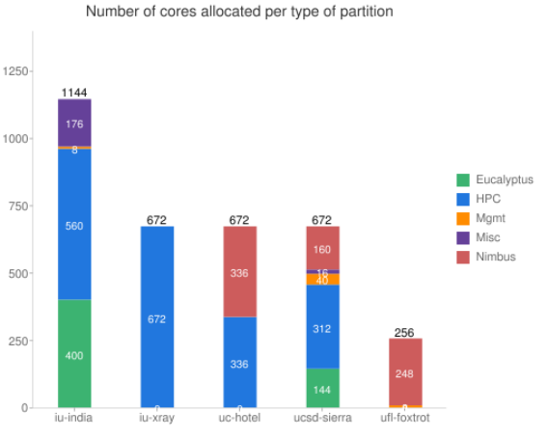
FutureGrid: Inca Monitoring

Slide 19
5 Use Types for FutureGrid
~100 approved projects over last 6 months
Training Education and Outreach
  Semester and short events; promising for non research intensive universities
Interoperability test-beds
  Grids and Clouds; Standards; Open Grid Forum OGF really needs
Domain Science applications
  Life science highlighted
Computer science
  Largest current category (> 50%)
Computer Systems Evaluation
  TeraGrid (TIS, TAS, XSEDE), OSG, EGI
Clouds are meant to need less support than other models; FutureGrid needs more user support …….

Slide 20
FutureGrid Viral Growth Model
Users apply for a project
Users improve/develop some software in project
This project leads to new images which are placed in FutureGrid repository
Project report and other web pages document use of new images
Images are used by other users
And so on ad infinitum ………
Please bring your nifty software up on FutureGrid!!

Slide 21

OGF’10 Demo from Rennes
SDSC
Rennes
Grid’5000 firewall
UF
Lille
UC
Sophia
ViNe provided the necessary inter-cloud connectivity to deploy CloudBLAST across 6 Nimbus sites, with a mix of public and private subnets.

Slide 22
Education & Outreach on FutureGrid
Build up tutorials on supported software
Support development of curricula requiring privileges and systems destruction capabilities that are hard to grant on conventional TeraGrid
Offer suite of appliances (customized VM based images) supporting online laboratories
Supported ~200 students in Virtual Summer School on “Big Data” July 26-30 with set of certified images – first offering of FutureGrid 101 Class; TeraGrid ‘10 “Cloud technologies, data-intensive science and the TG”; CloudCom conference tutorials Nov 30-Dec 3 2010
Experimental class use fall semester at Indiana, Florida and LSU; follow up core distributed system class Spring at IU
Offering ADMI (HBCU CS depts) Summer School on Clouds and REU program at Elizabeth City State University

Slide 23
FutureGrid Software Architecture
Note on Authentication and Authorization
We have different environments and requirements from XSEDE
Non trivial to integrate/align security model with XSEDE

Slide 24
Detailed Software Architecture

Slide 25
Overview of Existing Services
Gregor von Laszewski
laszewski@gmail.com

Slide 26
Categories
PaaS: Platform as a Service
  Delivery of a computing platform and solution stack
IaaS: Infrastructure as a Service
  Deliver a compute infrastructure as a service
Grid:
  Deliver services to support the creation of virtual organizations contributing resources
HPCC: High Performance Computing Cluster
  Traditional high performance computing cluster environment
Other Services
  Other services useful for the users as part of the FG service offerings

Slide 27

Selected List of Services Offered
FutureGrid
User
IaaS
Nimbus
PaaS
Hadoop
(Twister)
(Sphere/Sector)
MPI
Others
Portal
Inca
Eucalyptus
ViNE
(OpenStack)
(OpenNebula)
HPCC
Ganglia
(Exper. Manag./(Pegasus
(Rain)
OpenMP
ScaleMP
(XD Stack)
Grid
(Globus)
Unicore
SAGA
Genesis II
(will be added in future)

Slide 28
Services Offered
 | India | Sierra | Hotel | Foxtrot | Alamo | Xray | Bravo
myHadoop | ✔ | ✔ |  |  | ✔
Nimbus |  | ✔ | ✔ | ✔ | ✔
Eucalyptus | ✔ | ✔
ViNe¹ | ☑ | ✔ | ☑ | ✔ | ☑
Genesis II | ✔ | ✔ |  |  | ✔ | ✔
Unicore | ✔ | ✔ |  |  |  | ✔
MPI | ✔ | ✔ | ✔ | ✔ | ✔ | ✔ | ✔
OpenMP |  |  |  |  |  | ✔
ScaleMP | ✔
Ganglia | ✔ |  | ✔
Pegasus³ | ☑ | ☑ | ☑ | ☑ | ☑
Inca | ✔ | ✔ | ✔ | ✔ | ✔ | ✔
Portal² | ☒ | ☒ | ☒ | ☒ | ☒ | ☒
PAPI |  |  |  |  |  | ✔
Vampir
ViNe can be installed on the
other resources via Nimbus ☑
Access to the resource is requested through the portal ☒
Pegasus available via Nimbus and Eucalyptus images

Slide 29
Which Services should we install?
We look at statistics on what users request
We look at interesting projects as part of the project description
We look for projects which we intend to integrate with: e.g. XD TAS, XD XSEDE
We leverage experience from the community

Slide 30
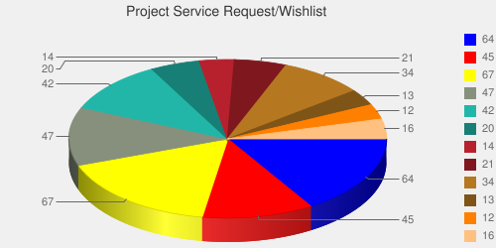
User demand influences service deployment
Based on User input we focused on
  Nimbus (53%)
  Eucalyptus (51%)
  Hadoop (37%)
  HPC (36%)
Eucalyptus: 64(50.8%)
High Performance Computing Environment: 45(35.7%)
Nimbus: 67(53.2%)
Hadoop: 47(37.3%)
MapReduce: 42(33.3%)
Twister: 20(15.9%)
OpenNebula: 14(11.1%)
Genesis II: 21(16.7%)
Common TeraGrid Software Stack: 34(27%)
Unicore 6: 13(10.3%)
gLite: 12(9.5%)
OpenStack: 16(12.7%)
* Note: We will improve the way we gather statistics in order to avoid inaccuracy during the information gathering at project and user registration time.

Slide 31
Portal
Gregor von Laszewski
http://futuregrid.org

Slide 32
Portal Subsystem
http://futuregrid.org

Slide 33
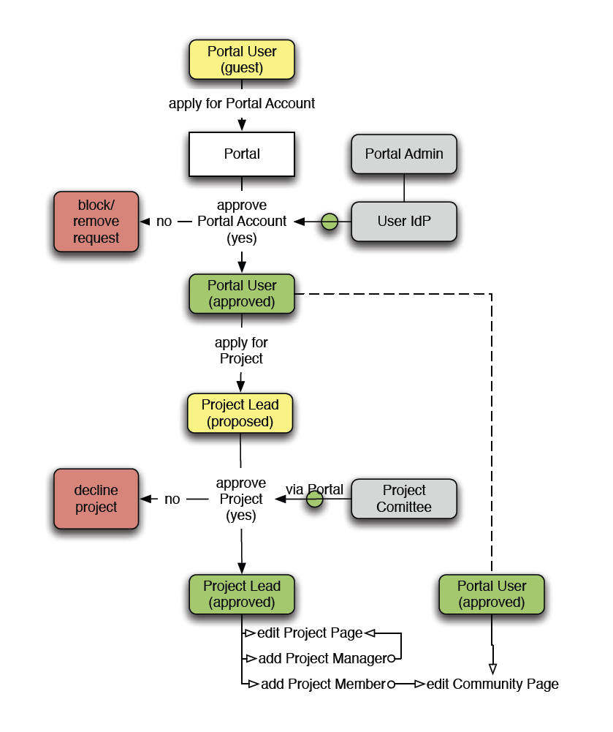
The Process: A new Project
(1) get a portal account
  portal account is approved
(2) propose a project
  project is approved
(3) ask your partners for their portal account names and add them to your projects as members
  No further approval needed
(4) if you need an additional person being able to add members designate him as project manager (currently there can only be one).
  No further approval needed
You are in charge who is added or not!
  Similar model as in Web 2.0 Cloud services, e.g. sourceforge
(1)
(2)
(4)
(3)

Slide 34
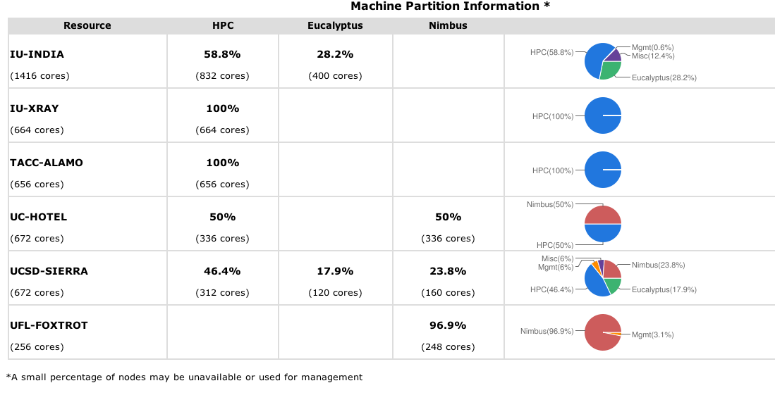
Simple Overview
http://futuregrid.org

Slide 35
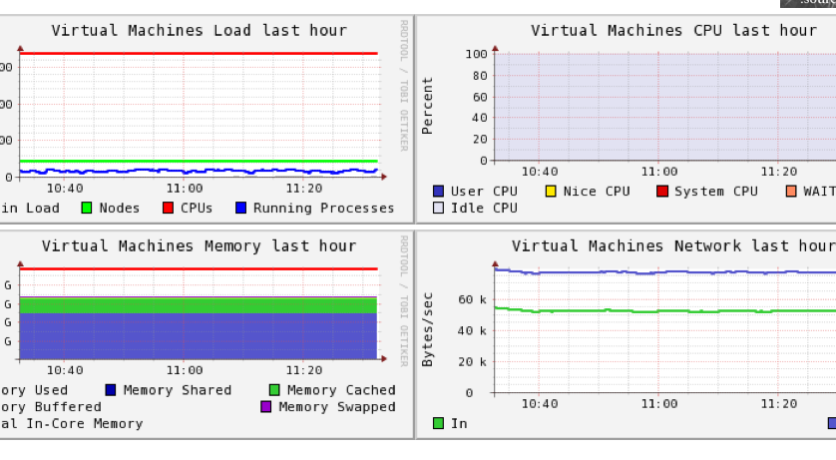
Ganglia
On India

Slide 36
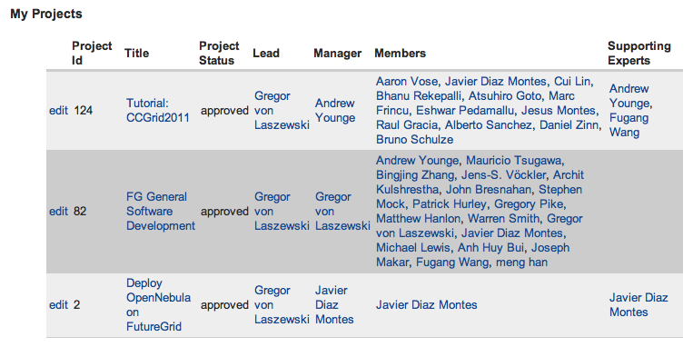
My Projects

Slide 37
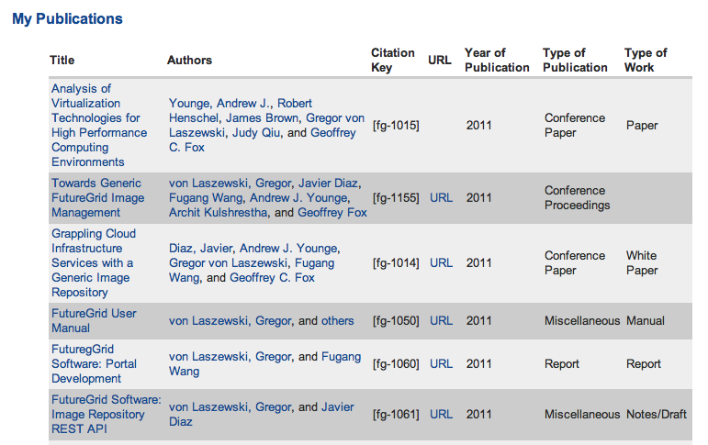
My References

Slide 38
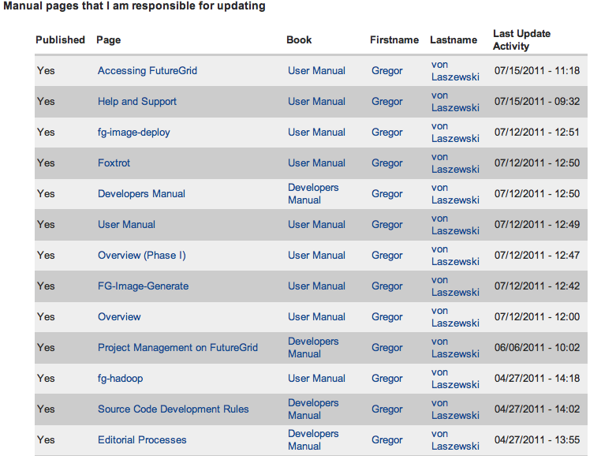
Pages I Manage

Slide 39
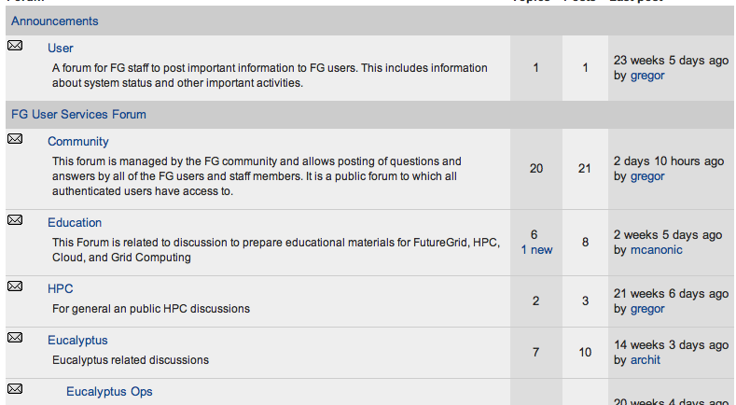
Forums

Slide 40
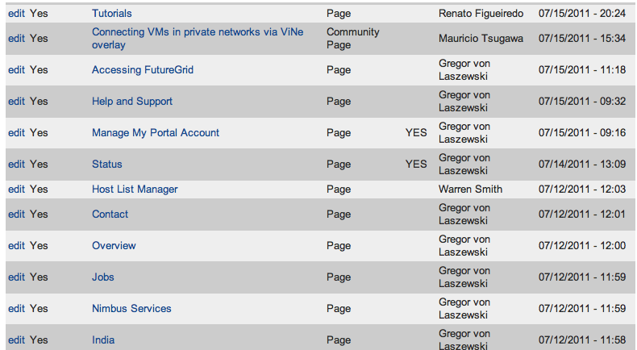
My Ticket Queue

Slide 41
General Portal Features
 | Y1 | Y2 | Y3
Account Management | Partially | Yes | Yes
Project Management | Partially | Yes | Yes
Content Vetting | No | Yes | Yes
Knowledgebase in Portal/IUKB | No/Partially | Yes/No | Yes/Yes
Forums | No | Yes | Yes
ACL | Partially | Yes | Yes
Ticket System | No | Yes | Yes
Community Space | No | Yes | Yes
Bibliography Management | Yes | Yes | Yes
News | Yes | Yes | Yes
Outage Management | No | Yes | Yes
SSO with OpenID/InCommon | No/No | Yes/No | Yes/Yes

Slide 42
Service Portal Interfaces
 | Y1 | Y2 | Y3 | Y4
FG Status | Partially | Yes | Yes (significant improvements) | Yes
+ Performance Portal | No | No | Yes | Yes
Image Repository | No | No | Yes | Yes
Image Generation | No | No | Yes | Yes
RAIN - Images | No | No | Yes | Yes
RAIN – Resource Reallocation/schedule/reservation | No | No | Yes | Yes
Experiment Management | No | No | Yes(?) | Yes
Eucalyptus | No | No | Yes (?) | Yes
OpenStack | No | No | Yes (?) | Yes
Storage | No | No | Yes (?) | Yes
SSO XSEDE | No | No | TBD | TBD

Slide 43
Rain in FutureGrid
http://futuregrid.org

Slide 44
Next we present selected Services
☒
☒
☒

Slide 45
Image Management and Dynamic Provisioning

Slide 46
Terminology
Image Management provides the low level software (create, customize, store, share and deploy images) needed to achieve Dynamic Provisioning and Rain
Dynamic Provisioning is in charge of providing “machines” with the requested OS. The requested OS must have been previously deployed in the infrastructure
RAIN is our highest level component that uses Dynamic Provisioning and Image Management to provide custom environments that may or may not exits. Therefore, a Rain request may involve the creation, deployment and provision of one or more images in a set of machines

Slide 47
Motivation
The goal is to create and maintain platforms in custom FG images that can be retrieved, deployed, and provisioned on demand
Imagine the following scenario for FG:
  fg-image-generate –o ubuntu –v maverick -s openmpi-bin,gcc,fftw2,emacs –n ubuntu-mpi-dev (store img in repo with id 1234)
  fg-image-deploy –x india.futuregrid.org –r 1234
  fg-rain –provision -n 32 ubuntu-mpi-dev

Slide 48
Architecture
Image management is supported by a number of tightly-coupled services essential for FG
The major services are
  Image Repository
  Image Generator
  Image Deployment
  RAIN – Dynamic provisioning
  External Services

Slide 49
Image Management

Slide 50
Image Generation
  Users who want to create a new FG image specify the following:
    OS type
    OS version
    Architecture
    Kernel
    Software Packages
  Image is generated, then deployed to specified target.
  Deployed image gets continuously scanned, verified, and updated.
  Images are now available for use on the target deployed system.
http://futuregrid.org

Slide 51
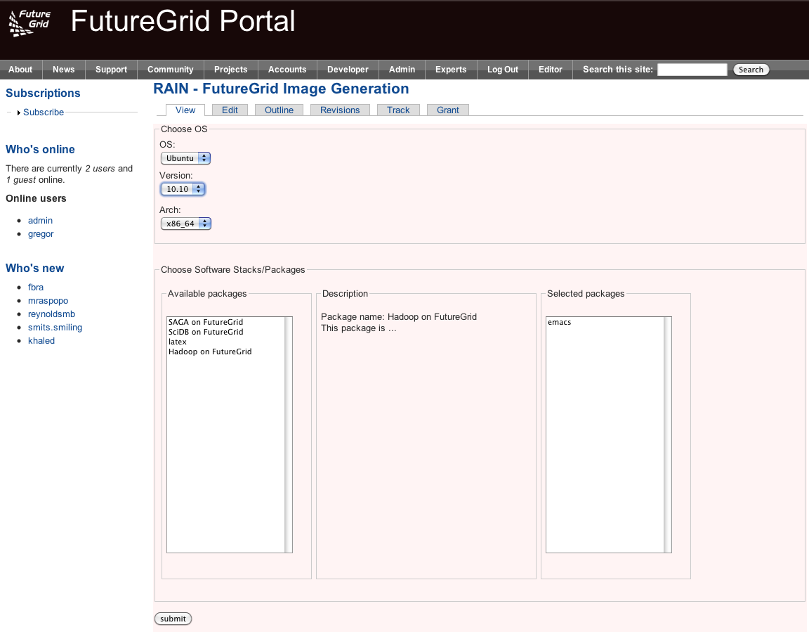

Slide 52
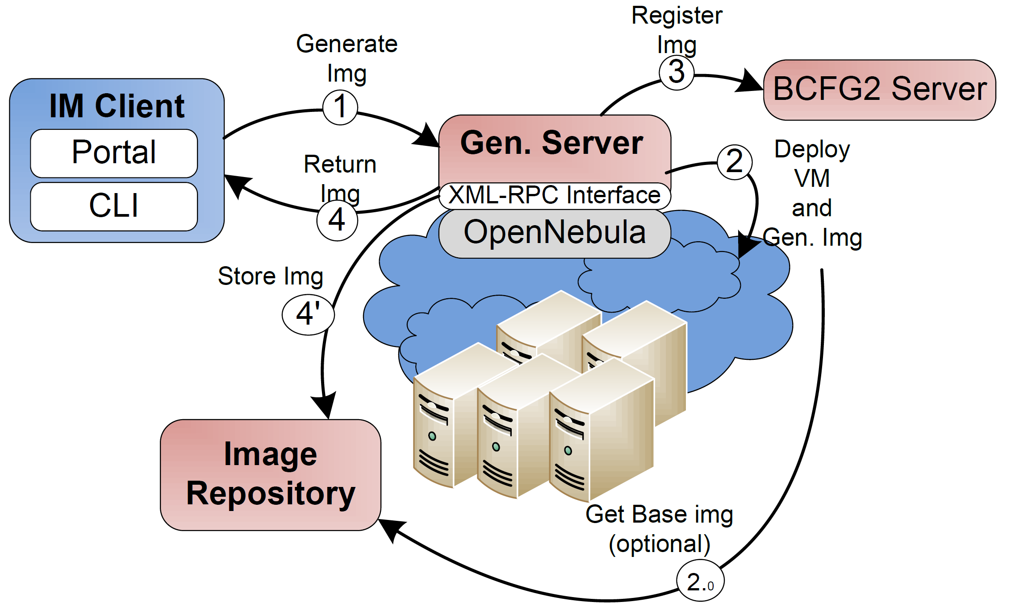
Image Generation (Implementation View)
Notes:
1. The client requests an image that fulfill some requirements.
2. The Image Generate Server deploy a VM to create the image. The image can be created from scratch or we can use a base image stored in the repository (2.0).
3. The new image is registered in the BCFG2 server.
4. The image is stored in the Image repository or it is given to the user. The first option is the default one because in this way the image is flagged as secure.

Slide 53
Image Verification (I)
Images will be verified to guarantee some minimum security requirements
Only if the image passes predefined tests, it is marked as deployable
Verification takes place several times on an image
  Time of generation
  Before and after the deployment
  Once a time threshold is reached
  Periodically

Slide 54
Image Deployment
Customizes (network IP, DNS, file system table, kernel modules, etc) and deploys images for specific infrastructures
Two main infrastructures types
  HPC deployment: it means that we are going to create network bootable images that can run in bare metal machines
  Cloud deployment: it means that we are going to convert the images in VMs

Slide 55
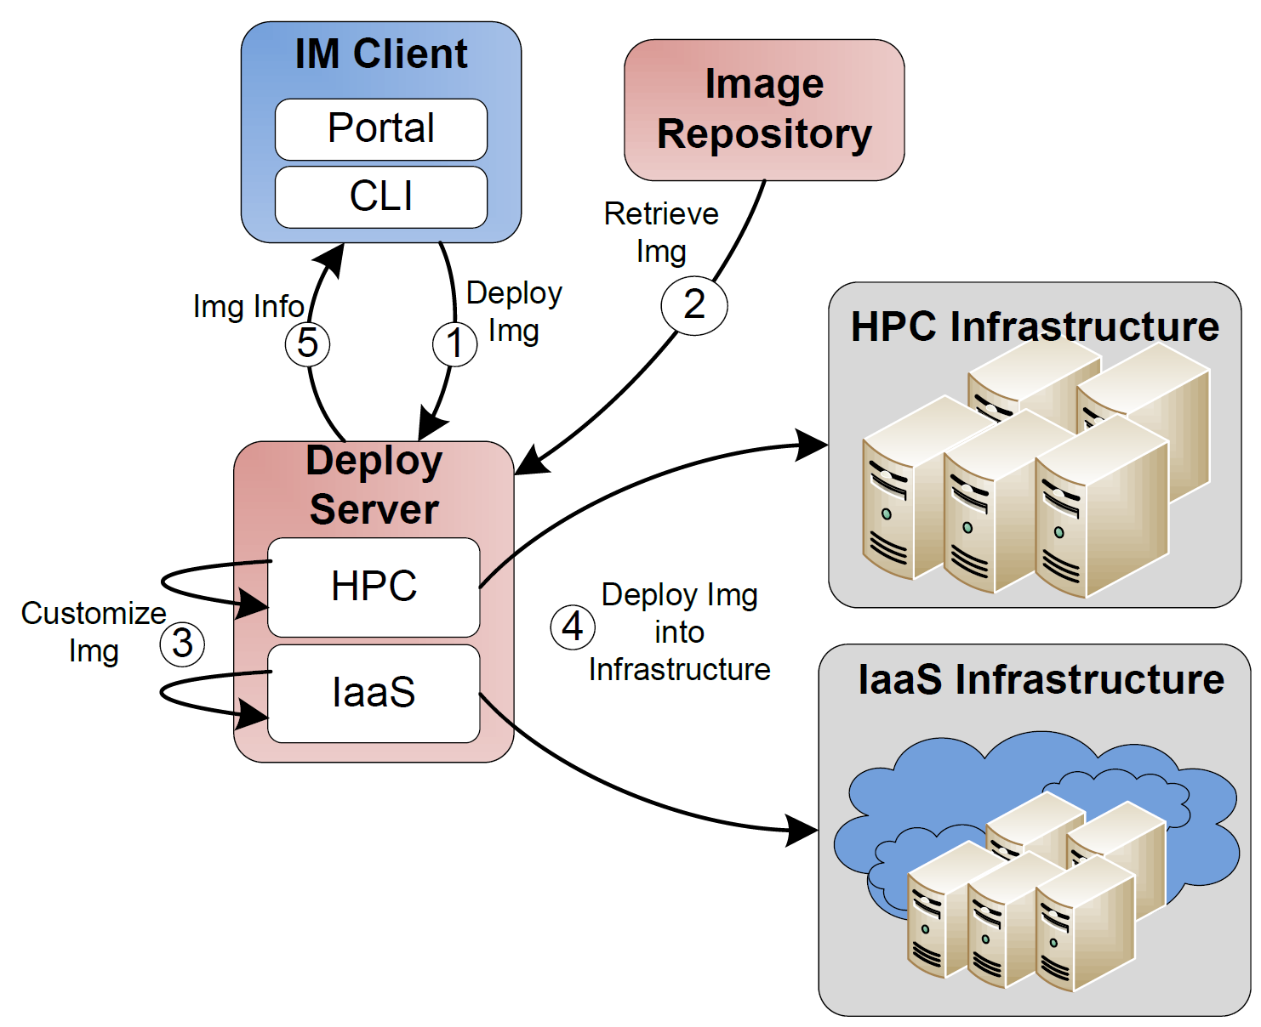
Image Deployment
(Implementation View)
Notes:
User want to deploy an image into HPC or some IaaS framework.
The image is retrieved from Image Repository. Optionally the user can choose an image from his local disk. This option is not available for HPC deployment due to security reasons
Deploy server customize the image
The image is deployed in the corresponding infrastructure
User get information about how to use its image.

Slide 56
Image Repository (I)
Integrated service that enables storing and organizing images from multiple cloud efforts in the same repository
Images are augmented with metadata to describe their properties like the software stack installed or the OS
Access to the images can be restricted to single users, groups of users or system administrators

Slide 57
Image Repository (II)
Maintains data related with the usage to assist performance monitoring and accounting
Quota management to avoid space restrictions
Pedigree to recreate image on demand
Repository’s interfaces: API's, a command line, an interactive shell, and a REST service
Other cloud frameworks could integrate with this image repository by accessing it through an standard API

Slide 58
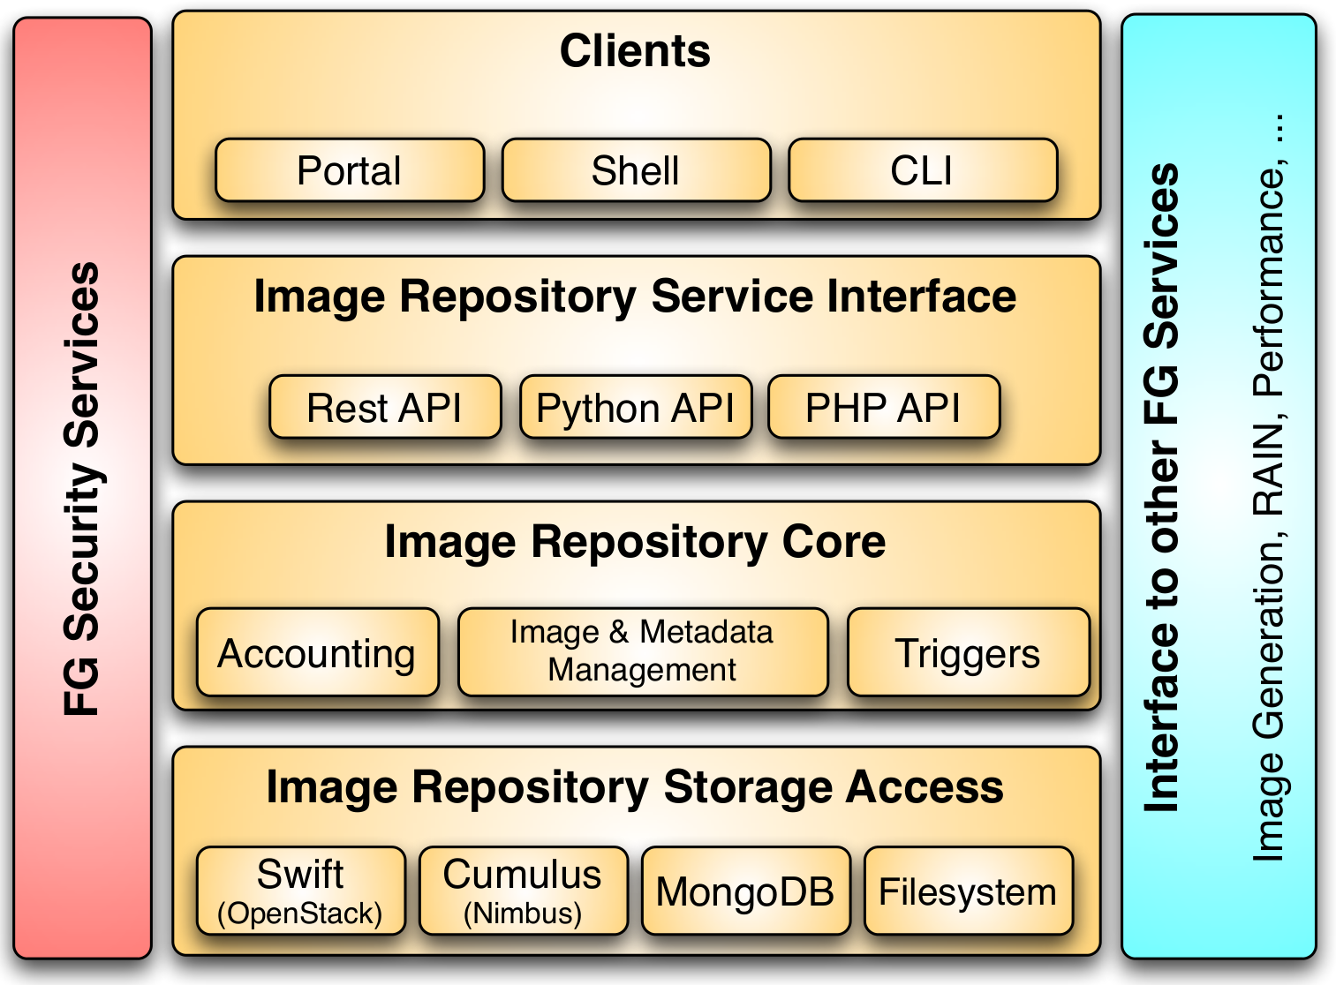
Image Repository II

Slide 59
Rain – Dynamic Provisioning

Slide 60
Classical Dynamic Provisioning
Dynamically partition a set of resources
Dynamically allocate resources to users
Dynamically define the environment that a resource is going to use
Dynamically assign them based on user request
Deallocate the resources so they can be dynamically allocated again

Slide 61
Use Cases of Dynamic Provisioning
Static provisioning:
  Resources in a cluster may be statically reassigned based on the anticipated user requirements, part of an HPC or cloud service. It is still dynamic, but control is with the administrator. (Note some call this also dynamic provisioning.)
Automatic Dynamic provisioning:
  Replace the administrator with intelligent scheduler.
Queue-based dynamic provisioning:
  provisioning of images is time consuming, group jobs using a similar environment and reuse the image. User just sees queue.
Deployment:
  dynamic provisioning features are provided by a combination of using XCAT and Moab
http://futuregrid.org

Slide 62
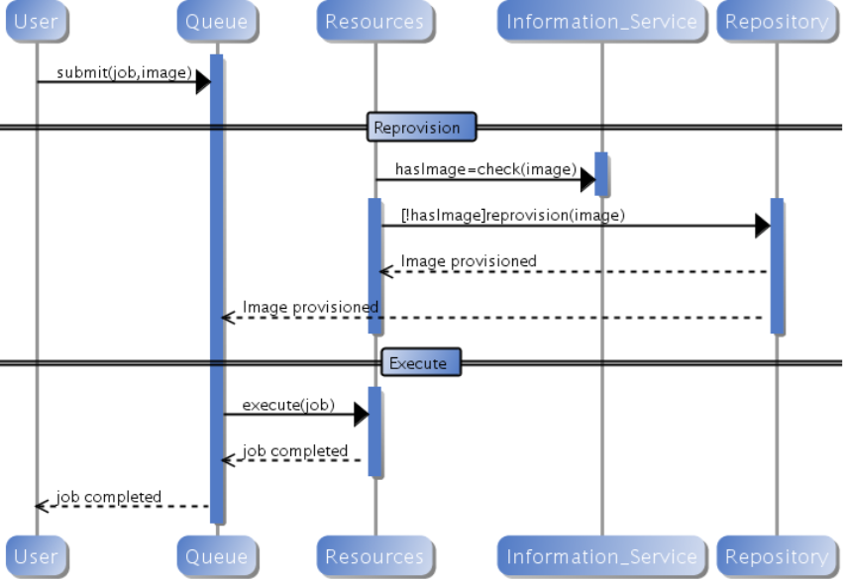
Generic Reprovisioning
http://futuregrid.org

Slide 63
Dynamic Provisioning Examples
Give me a virtual cluster with 30 nodes based on Xen
Give me 15 KVM nodes each in Chicago and Texas linked to Azure and Grid5000
Give me a Eucalyptus environment with 10 nodes
Give 32 MPI nodes running on first Linux and then Windows
Give me a Hadoop environment with 160 nodes
Give me a 1000 BLAST instances linked to Grid5000
Run my application on Hadoop, Dryad, Amazon and Azure … and compare the performance
http://futuregrid.org

Slide 64
From Dynamic Provisioning to “RAIN”
In FG, dynamic provisioning goes beyond the services offered by common scheduling tools that provide such features
RAIN (Runtime Adaptable INsertion Configurator)
We want to provide custom HPC environment, Cloud environment, or virtual networks on-demand with little effort
Example: “rain” a Hadoop environment into a set of machines
  fg-rain -n 8 -app Hadoop …
  Users and administrators do not have to set up the Hadoop environment as it is being done for them

Slide 65
Future FG RAIN Commands
  fg-rain –h hostfile –iaas nimbus –image img
  fg-rain –h hostfile –paas hadoop …
  fg-rain –h hostfile –paas dryad …
  fg-rain –h hostfile –gaas gLite …
  fg-rain –h hostfile –image img
  Additional Authorization is required to use fg-rain without virtualization.
http://futuregrid.org

Slide 66
What happens internally in RAIN ?
Technology Preview
Generate a Centos image with several packages
  fg-image-generate –o centos –v 5.6 –a x86_64 –s emacs, openmpi –u javi
  > returns image: centosjavi3058834494.tgz
Deploy the image for HPC (xCAT)
  ./fg-image-register -x im1r –m india -s india -t /N/scratch/ -i centosjavi3058834494.tgz -u jdiaz
Submit a job with that image
  qsub -l os=centosjavi3058834494 testjob.sh

Slide 67
Rain in FutureGrid
http://futuregrid.org

Slide 68
Dynamic Provisioning Results
Number of nodes
Time elapsed between requesting a job and the jobs reported start time on the provisioned node. The numbers here are an average of 2 sets of experiments.

Slide 69
Status and Plan

Slide 70
Image Generation
Feature | Y1 | Y2 | Y3
Quality | Prototype (proof of concept scripts) | Production development and deployment for selected users | General Deployment
OS supported | Ubuntu | CentOS/Ubuntu | CentOS/Ubuntu/Fedora/Suse
Multi-tenancy | No | Yes | Yes
Security | No | Yes | Yes
Authentication | No | Yes – LDAP | Yes - LDAP
Client Interface | CLI | CLI | CLI, Rest API, Portal Interface
Scalability | No | High (uses OpenNebula to deploy a VM per request) | High (uses OpenNebula to deploy a VM per request)
Interoperability | Poor (based on base-images) | High (VM with different OS) | High (VM with different OS)

Slide 71
Image Deployment
Feature | Y1 | Y2 | Y3
Quality | Prototype (proof of concept scripts) | Production development and deployment for selected users | General Deployment
Deployment type | - Eucalyptus - Proof of Concept for HPC | Eucalyptus, HPC (Moab/torque – xCAT) | Eucalyptus, OpenStack, Nimbus, OpenNebula, HPC (Moab/torque)
OS supported | Ubuntu for Eucalyptus | CentOS for HPC | CentOS/Ubuntu/Fedora/Suse
Multi-tenancy | No | Yes | Yes
Security | No | Yes | Yes
Authentication | No | Yes – LDAP | Yes - LDAP
Client Interface | CLI | CLI | CLI, Rest API, Portal Interface

Slide 72
Image Repository
Feature | Y1 | Y2 | Y3
Quality | Early development | Production development | General Deployment
Client-Server Communication | Ssh | TLS/SSL Sockets | TLS/SSL Sockets
Multi-tenancy | Yes – limited | Yes | Yes
Security | Yes - ssh | Yes | Yes
Authentication | Yes – ssh | Yes – LDAP | Yes - LDAP
Client Interface | CLI | CLI, Rest API | CLI, Rest API, Portal Interface
Manage Images | Store, retrieve, modify metadata, share | Store, retrieve, modify metadata, share | Store, retrieve, modify metadata, share
Manage Users | No | users, roles and quotas | users, roles and quotas
Statistics | No | Yes (#Images, usage,logs) | Yes (#Images, usage,logs)
Storage Backend | Filesystem | Filesystem, MongoDB, Cumulus, Swift, Mysql | Filesystem, MongoDB, Cumulus, Swift, Mysql

Slide 73
Lessons Learned
Users can customize bare metal images
We provide base images that can be extended
We have developed an environment allowing multiple users to do this at the same time
Changing version of XCAT
Moab supports a different kind of dynamic provisioning. E.g. Administrator needs to provide the image (not scalable)

