Slide 1
DACIDR for Gene Analysis
Deterministic Annealing Clustering and Interpolative Dimension Reduction Method (DACIDR)
Use Hadoop for pleasingly parallel applications, and Twister (replacing by Yarn) for iterative MapReduce applications
Pairwise Clustering
All-Pair Sequence Alignment
Streaming
Visualization
Multidimensional Scaling
Simplified Flow Chart of DACIDR

Slide 2
PWA vs MSA
Pairwise sequence alignment (PWA) is much faster and has very high correlation with multiple sequence alignment (MSA).
The comparison using Mantel between distances generated by three sequence alignment methods and RAxML

Slide 3
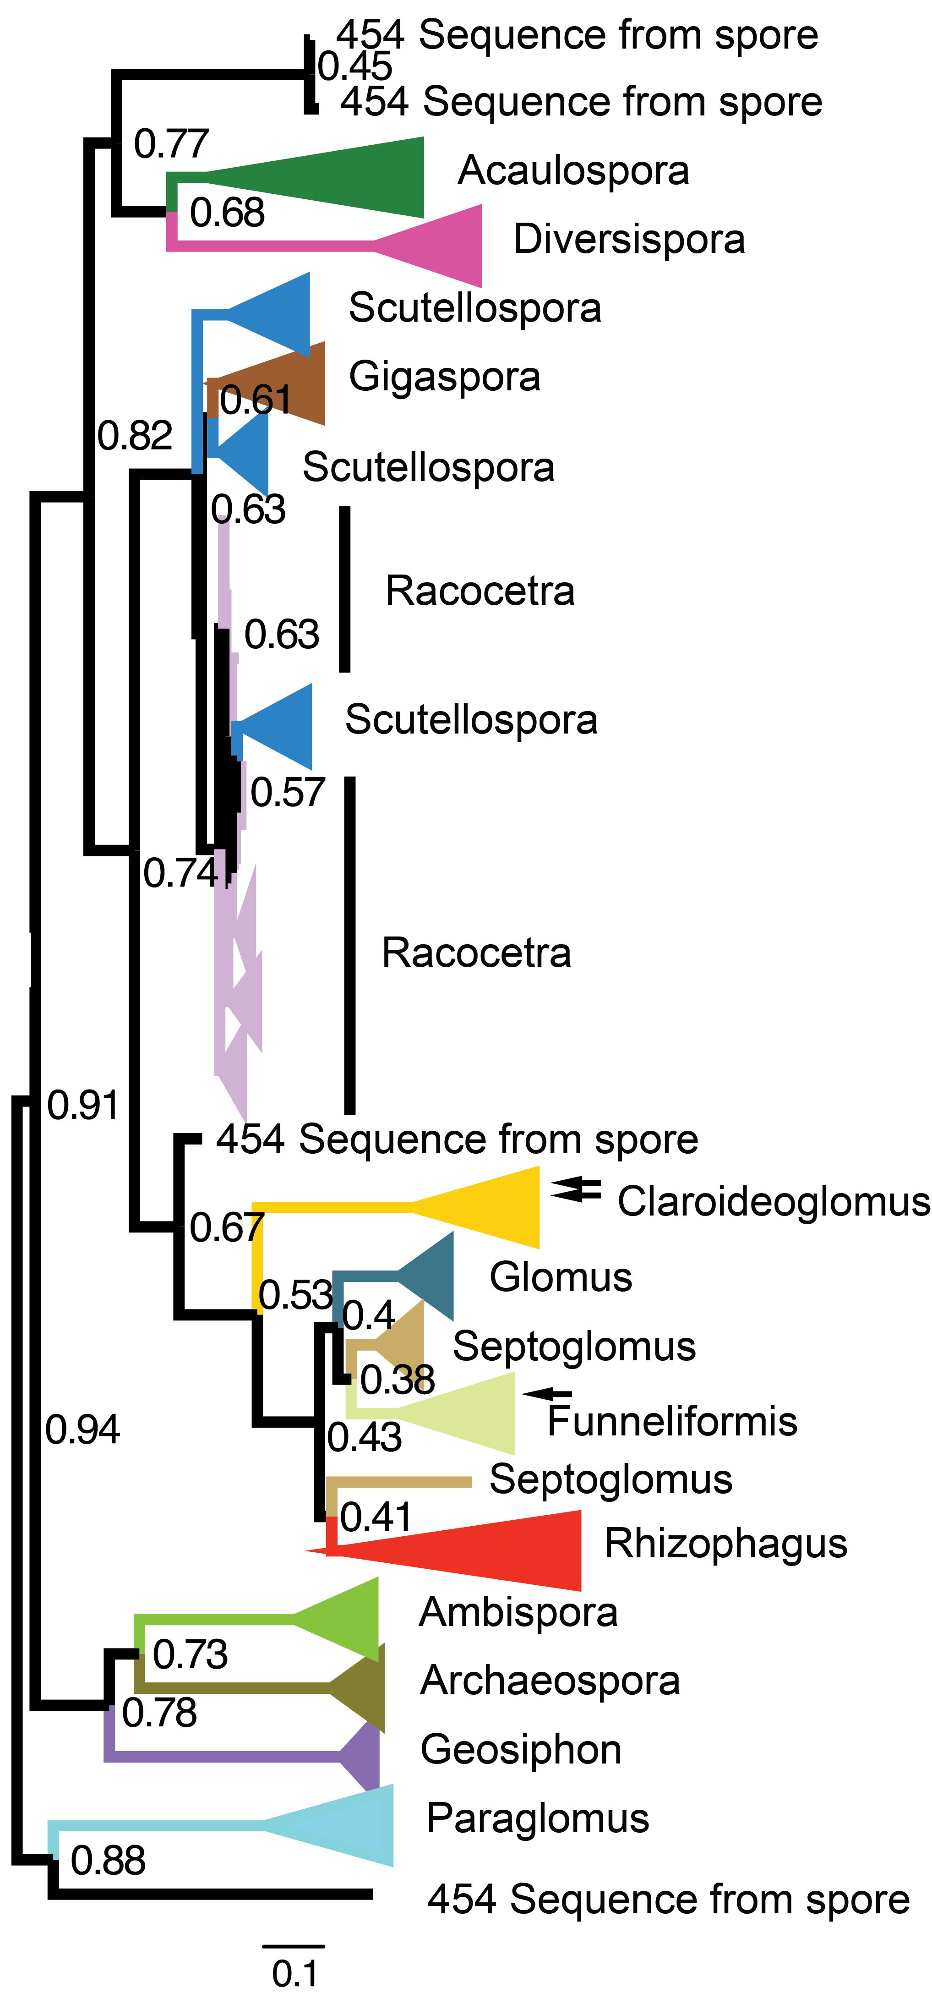
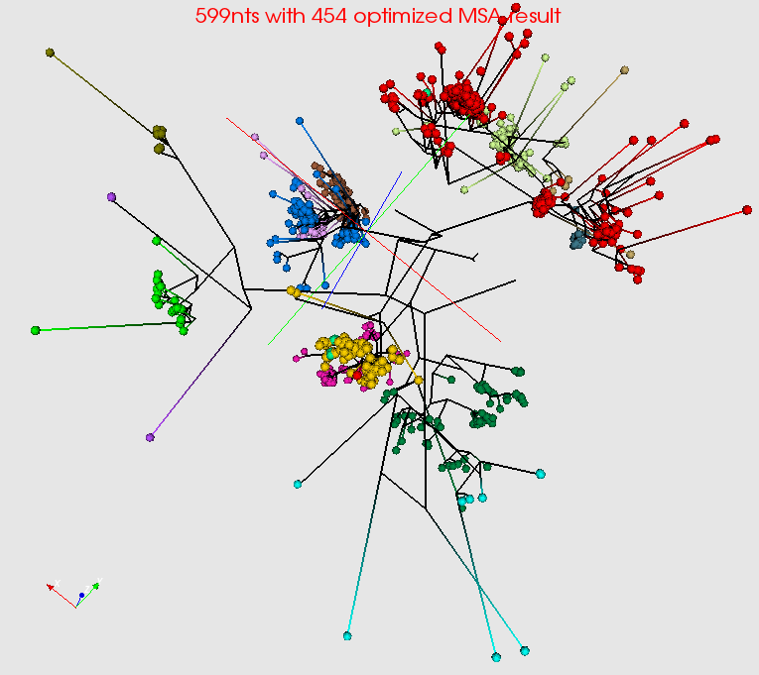
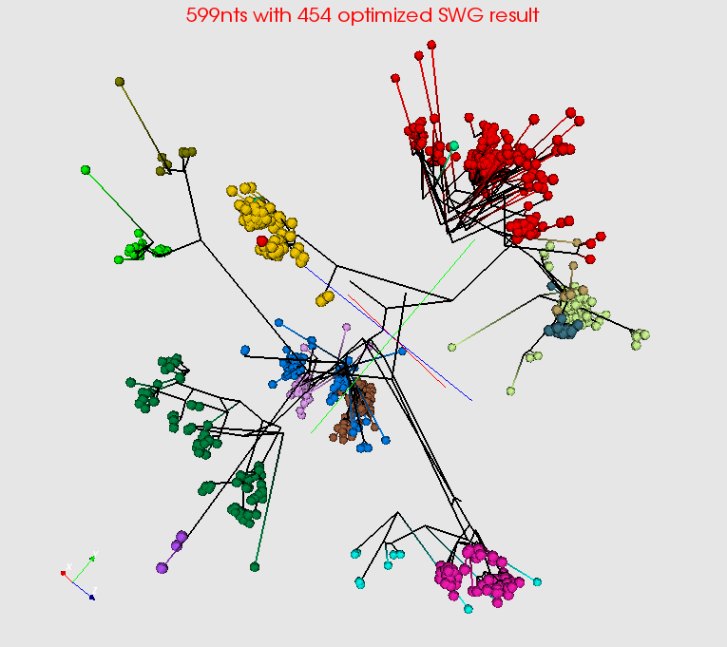
Summarize a million Fungi Sequences Spherical Phylogram Visualization
RAxML result visualized in FigTree.
Spherical Phylogram visualized in PlotViz

Slide 4
MDS methods
Sum of branch lengths will be lower if a better dimension reduction method is used.
WDA-SMACOF finds global optima
Sum of branch lengths of the SP generated in 3D space on 599nts dataset optimized with 454 sequences and 999nts dataset

