Slide 1
Integration of Clustering and Multidimensional Scaling to Determine Phylogenetic Trees as Spherical Phylogram Visualized in 3 Dimensions
Presenter: Yang Ruan
Indiana University Bloomington

Slide 2
Outline
Motivation
Background
Spherical Phylogram Construction
Experiment
Conclusions and Future Work

Slide 3
Motivation
Existing phylogenetic tree visualization methods (computationally slow) show the tree and clustering results separately.
We wanted to display the phylogenetic tree and the sequence clustering simultaneously
How well do sequence clusters from a fast clustering algorithm match the phylogenetic tree for genetically diverse DNA sequences?

Slide 4
Background
Pairwise Sequence Alignment
Distance Calculation
Multidimensional Scaling
Interpolation
DACIDR
Traditional Phylogenetic Tree Construction

Slide 5
Pairwise Sequence Alignment (PWA)
Finds an overlapping region of the given two sequences that has the highest similarity as computed by a score measure.
  Global Alignment: the overlap defined over the entire length of the two sequences. E.g. Needleman-Wunsch (NW).
  Local Alignment: the overlap defined over a portion of the two sequences. E.g. Smith-Waterman Gotoh (SWG).
Each pair of sequence alignment computation is independent from each other.

Slide 6
Distance Calculation
Align Sequence and calculate.
  E.g. use Percentage Identity (PID)
Sequence A:
ACATCCTTAACAA - - ATTGC-ATC - AGT - CTA
Sequence B:
ACATCCTTAGC - - GAATT - - TATGAT - CACCA
PID(A, B) = identical pairs / alignment length
Sequence (FASTA) File
Pairwise Sequence Alignment
Dissimilarity Matrix

Slide 7
Multidimensional Scaling
A set of techniques that reduce the dimensionality of a certain dataset into a target dimension (usually 2 or 3)
Scaling by Majorizing a Complicated Function (SMACOF) algorithm.
  EM-like algorithm, could trapped to local optima
  Weighting function requires an order N matrix inversion
Weighted Deterministic Annealing SMACOF (WDA-SMACOF)
  Use Deterministic Annealing technique to avoid local optima
  Use Conjugated Gradient to avoid matrix inversion for weighting function.

Slide 8
Interpolation
MDS uses O(N²) memory, limitation for very large data.
  data is divided into two sets, in-sample set for MDS, out-of-sample set for interpolation.
Majorizing Interpolative MDS (MI-MDS)
  Interpolation algorithm that assumes all weights equal one
Weighted Deterministic Annealing MI-MDS (WDA-MI-MDS)
  Robust interpolation algorithm handles various weights
…
Out-of-sample points
in-sample points

Slide 9
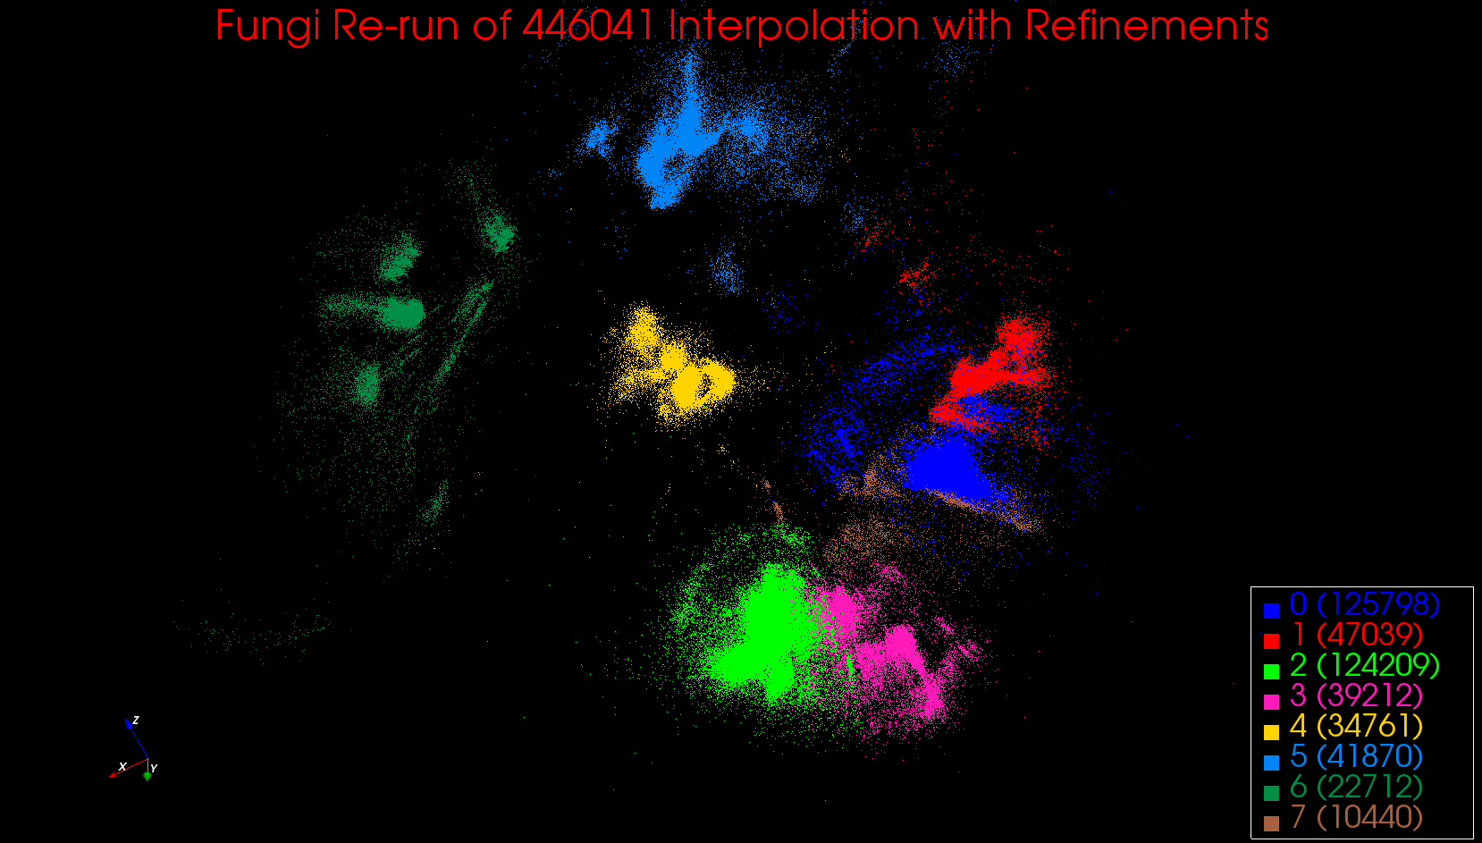
DACIDR
  Deterministic Annealing Clustering and Interpolative Dimension Reduction Method (DACIDR)
  Use Hadoop for parallel applications, and Twister (Harp) for iterative MapReduce applications
>G4P2R5E01A49DL
GTCGTTTAAAGCC…
>G4P2R5E01CT7SS
GTCGTTTAAAGCC…
…
…
>G0H13NN01AMLS2
GTCGTTTAAAGCC…
Pairwise Clustering
All-Pair Sequence Alignment
Interpolation
Visualization
DACIDR
Multidimensional Scaling
Simplified Flow Chart of DACIDR
Input FASTA file
Output 3D result

Slide 10
Traditional Phylogenetic Tree Construction
Multiple Sequence Alignment (MSA)
  Used for three or more sequences and is usually used in phylogenetic analysis.
  All sequences has to be aligned with all other sequences in each iteration.
  It has a higher computational cost compared to PWA.
A popular tree construction tool: RAxML
  Reads from MSA result.
  A standard maximum likelihood method used to generate phylogenetic trees from a MSA.

Slide 11
Spherical Phylogram Construction
Traditional Phylogenetic Tree Display
Distance Calculation
  Sum of Branches
  Neighbor Joining
Interpolative Joining

Slide 12
Phylogenetic Tree Display
Show the inferred evolutionary relationships among various biological species by using diagrams.
2D/3D display, such as rectangular or circular phylogram.
Preserves the proximity of children and their parent.
Example of a 2D Cladogram
Examples of a 2D Phylogram

Slide 13
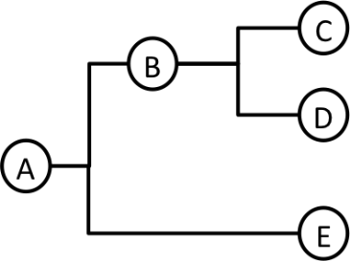
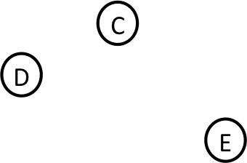
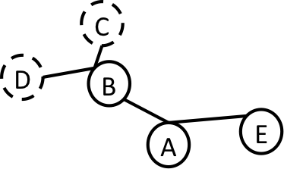
Distance Calculation (1)
Sum of Branches
  The distance between point C and E can be calculated by summing over branch(C, B), branch(B, A) and branch(A, E
  Distance between leaf node C and E shown in (3) is clearly not equal to branch(B, C) + branch(B, D).
  The result will have a high bias because different distances were used for leaf nodes.
(1) The cladogram of a tree with 5 nodes
(2) The leaf nodes of the tree in 2D space after dimension reduction
(3) The tree in 2D space after interpolation of the internal nodes

Slide 14
Distance Calculation (2)
Neighbor Joining
  Select a pair of existing nodes a and b, and find a new node c, all other existing nodes are denoted as k, and there are a total of r existing nodes. New node c has distance:
  The existing nodes are in-sample points in 3D, and the new node is an out-of-sample point, thus can be interpolated into 3D space.
(1)
(2)
(3)

Slide 15
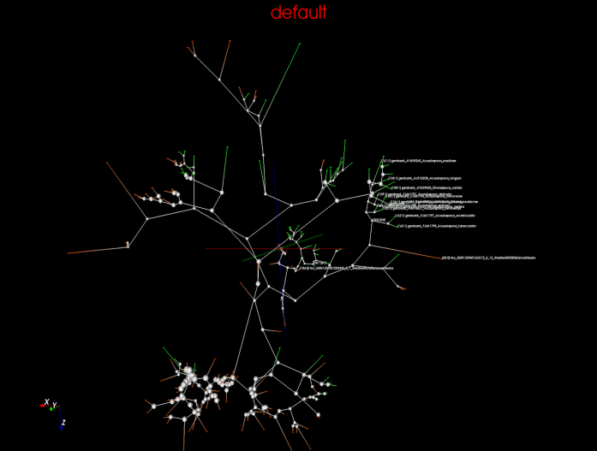
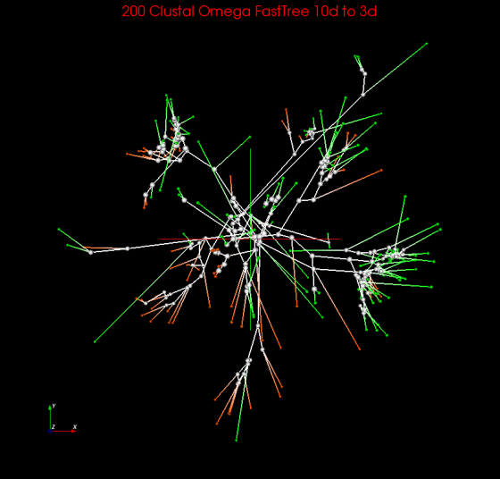
Interpolative Joining
Spherical Phylogram
  For each pair of leaf nodes, compute the distance their parent to them and the distances of their parent to all other existing nodes.
  Interpolate the parent into the 3D plot by using that distance.
  Remove two leaf nodes from leaf nodes set and make the newly interpolated point an in-sample point.
  Tree determined by
    Existing tree, e.g. From RAxML
    Generate tree, i.e. neighbor joining
Spherical Phylogram Examples

Slide 16
Experiments
Environment
Dataset
Construct Spherical Phylogram
  Construct Phylogenetic Tree
  Dimension Reduction using DACIDR
  Visualization Result
MSA vs PWA
WDA-SMACOF vs Other MDS methods

Slide 17
Environment
Running Environment
  Quarry Cluster at Indiana University
  Xray Cluster of FutureGrid
Parallel Runtimes
  Hadoop, Twister, MPI
Applications
  DACIDR
  RAxML

Slide 18
Dataset
DNA sequences from genetically diverse arbuscular mycorrhizal (AM) fungi were selected from three sources to include as much of the known genetic variation as possible:
  Sequences from the most comprehensive AM fungal phylogenetic tree to date (Kruger et al 2011)
  Sequences supplemented with well-characterized GenBank sequences to expand the range of genetic variation
  Representative sequences selected from clustering over 446k AM fungal sequences from spores using DACIDR
Two datasets (599nts and 999nts) with different trim lengths
  599nts shorter than 999nts
  599nts includes representative sequences clustered with DACIDR
999 nts
Start
599 nts

Slide 19
Construct Spherical Phylogram (1)
Phylogenetic Tree Generation
  MSA is done by using MAFFT
    Fix the existing alignment from Kruger et al
    Align GenBank and DACIDR-clustered sequences to the alignment from Kruger et al
  Created a maximum likelihood unrooted phylogenetic tree with RAxML
    100 iterations
    General time reversible (GTR) nucleotide substitution model with gamma rate heterogeneity (GTRGAMMA).

Slide 20
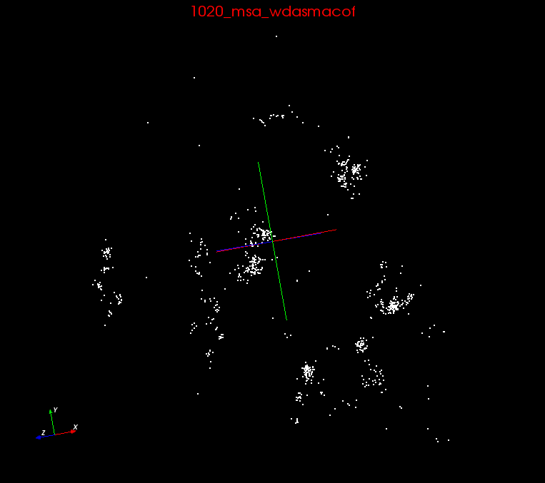
Construct Spherical Phylogram (2)
MDS Visualization
  Use simplified DACIDR to generate the plot in 3D
  Distance Calculation from MSA, SWG, NW.
MSA
Dissimilarity Matrix
3D plot
SWG
MDS
NW

Slide 21
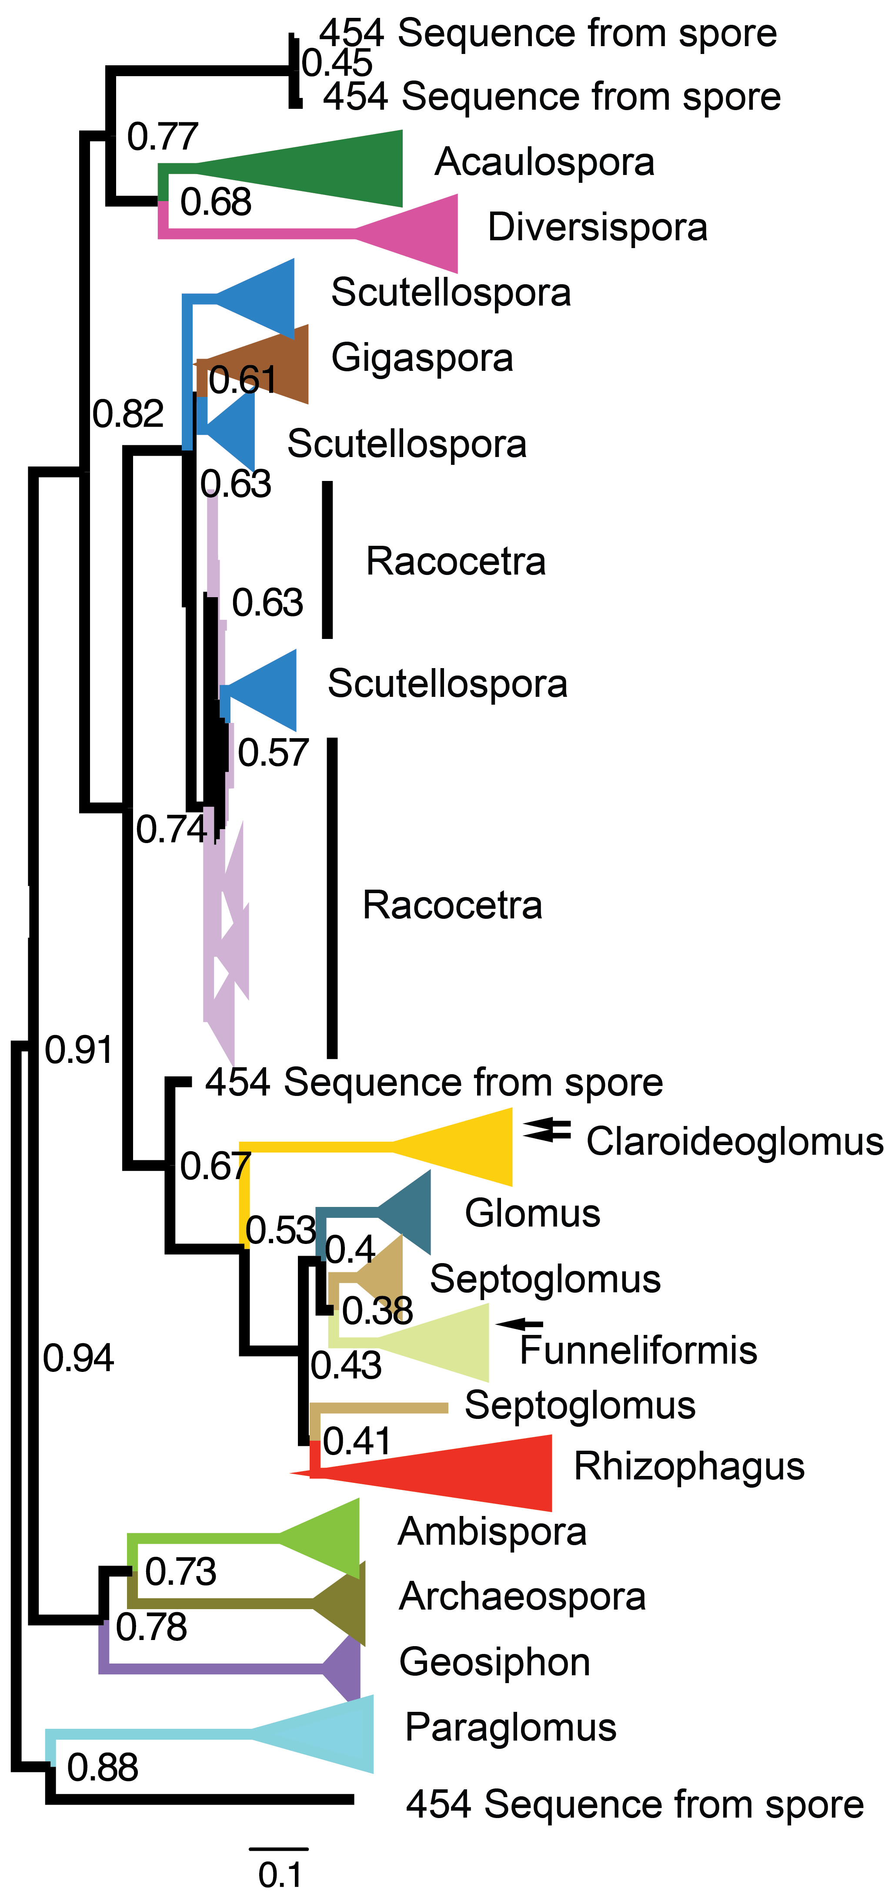
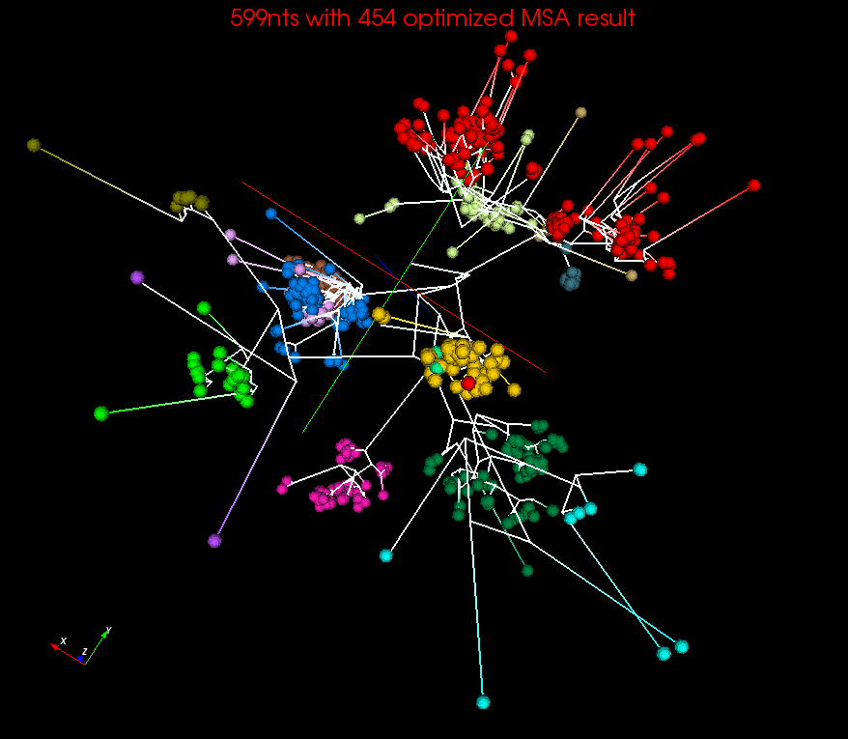
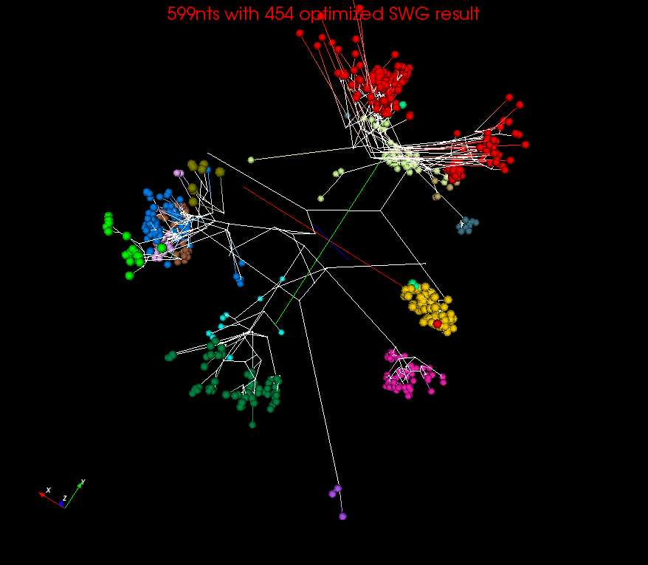
Construct Spherical Phylogram (3)
RAxML result visualized in FigTree.
Spherical Phylogram visualized in PlotViz

Slide 22
Correlation of distance values between PWA and MSA
Distance values for MSA, SWG and NW used in DACIDR were compared to baseline RAxML pairwise distance values
Higher correlations from Mantel test better match RAxML distances. All correlations statistically significant (p < 0.001)
The comparison using Mantel between distances generated by three sequence alignment methods and RAxML

Slide 23
MDS methods
Sum of branch lengths will be lower if a better dimension reduction method is used.
WDA-SMACOF finds global optima
Sum of branch lengths of the SP generated in 3D space on 599nts dataset optimized with 454 sequences and 999nts dataset

Slide 24
Conclusions and Future Work
Conclusions
  Spherical Phylograms give an efficient way of displaying phylogenetic tree and clustering result together.
  For sequence analysis where datasets are large, the clustering could be used instead of phylogenetic analysis since it is much faster yet still gives reliable results.
Future improvements
  Instead of just displaying the representative or consensus sequences from each cluster found from the original input dataset, it is possible to display the tree with entire dataset in the 3D space with the help of IJ.
  The interpolation algorithm used in DACIDR could also be improved to help identify the sequences that are poorly defined.
  Determine the phylogenetic tree without using RAxML but instead using a similar method on the distances generated after dimension reduction.

Slide 25
Questions?
Yang Ruan (yangruan@indiana.edu)
Geoffrey House (glhouse@indiana.edu)
Geoffrey Fox (gcf@indiana.edu)

Slide 26
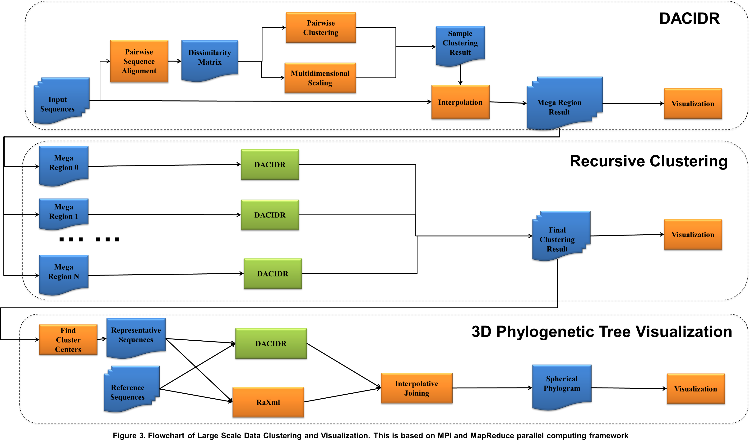
Whole pipeline

Slide 27
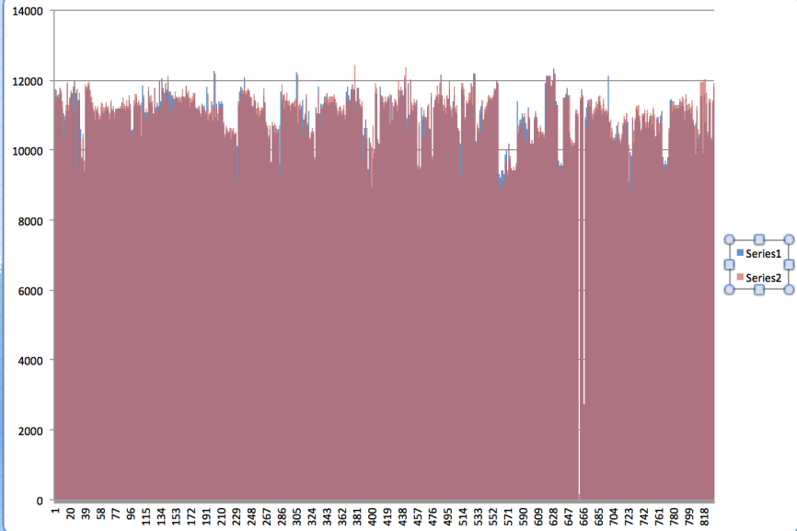
Why Local Optima Matters
Spherical Phylogram using different dimension reduction methods
  Edge Sum
    Sum over all the length of edges
  Local Optima (examples)
    FR750020_Arc_Sch_K
    FR750022_Arc_Sch_K
    Original distances from FR750020_Arc_Sch_K and FR750022_Arc_Sch_K to all other 832 points.
Notes:
Add new data

