Slide 1
MapReduce, GPGPU and Iterative Data mining algorithms
Oral exam Yang Ruan

Slide 2
Outline
MapReduce Introduction
MapReduce Frameworks
General Purpose GPU computing
MapReduce on GPU
Iterative Data Mining Algorithms
LDA and MDS on distributed system
My own research
Notes:
Merging computing models
Give some examples, what kind of problems I tries to solve?
Add slide number
35 minutes talk and 1 hour total
Hadoop slide
Put the table to the end
Add salsa hpc

Slide 3
MapReduce
What is MapReduce
  Google MapReduce / Hadoop
  MapReduce merge
Different MapReduce Runtimes
  Dryad
  Twister
  Haloop
  Spark
  Pregel

Slide 4
MapReduce
Introduced by Google MapReduce
Hadoop is an open source MapReduce framework
User
Program
Mapper: read input data, emit key/value pairs
Reducer: accept a key and all the values belongs to that key, emits final output
fork
fork
fork
Master
Map
assign
map
assign
reduce
Reduce
Input Data
Worker
write
Output
File 0
Split 0
local
write
Worker
Split 1
read
Worker
Split 2
Output
File 1
Worker
Worker
remote read, sort
Notes:
Word count for example
Sort example

Slide 5
MapReduce-Merge
Can handle heterogeneous inputs with a Merge step after MapReduce
Driver
coordinator
split
mapper
split
reducer
mapper
split
reducer
mapper
split
merger
output
merger
output
split
mapper
reducer
split
mapper
reducer
split
split
mapper
Notes:
Can only handle two different input type?
Red line: DFS access
Blue line: remote transfer
Blue doted line: internal transfer
Why mergers and reducers on same node? Reducer number = merger number?

Slide 6
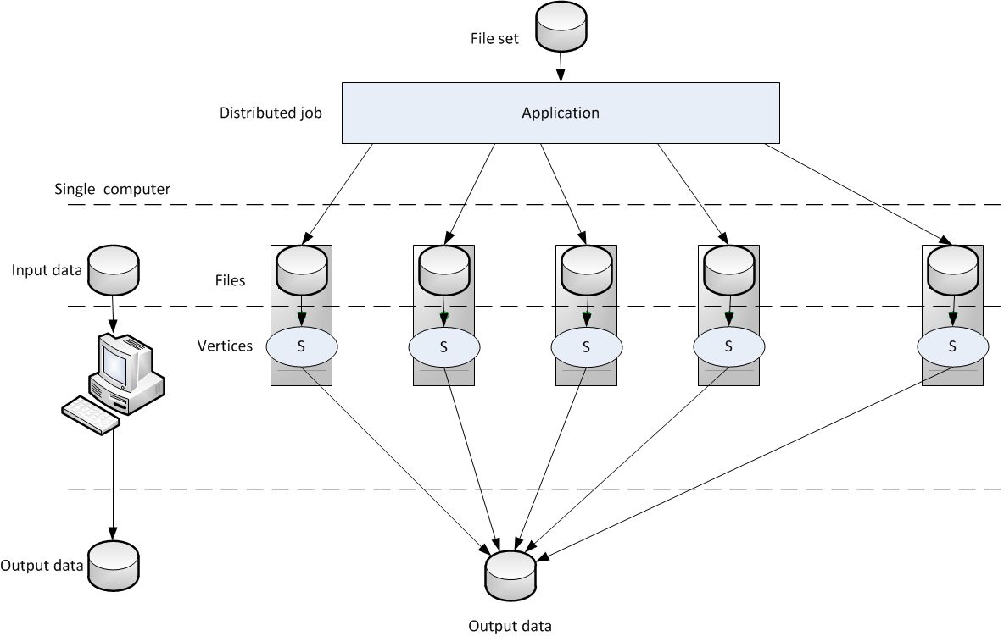
Dryad
Use computational as
“vertices” and
communication as
“channels”
to draw DAG.
Using DryadLINQ to
program
Always use one node
as the head node to
run graph manager (scheduler) for a DryadLINQ job (besides the head
node of the cluster)
Notes:
Channel include internal temporary files, TCP pipelines and shared memory.
Dynamic scheduling
Fault tolerance by keeping replicas, duplicate vertexes when running slow
SQL query
Data mining: MDS search service, extracts the query strings and builds a histogram of query frequency.
Terasort bechmark, page rank, Sloan Digital Sky Survey database and machine learning iterative algorithms.
----- Meeting Notes (8/5/11 14:43) -----
distinguish PLINQ from processes, thread
change the PLINQ to Dryad
threshold versus fixed number of iterations
check it again

Slide 7
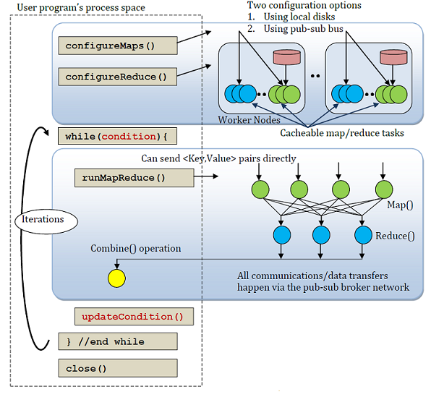
Twister
Iterative MapReduce by keeping long running mappers and reducers.
Use data streaming instead of
file I/O
Use broadcast to send out
updated data to all mappers
Load static data into memory
Use a pub/sub messaging
infrastructure
No file system, the data are
saved in local disk or NSF
Notes:
Fault tolerance: replicas, check point by heart beat
SWG, k-means and MDS
Cache the data in the first iteration and reuse them in the next computations.

Slide 8
Other iterative MapReduce runtimes
Haloop | Spark | Pregel
Extension based on Hadoop | Iterative MapReduce by keeping long running mappers and reducers | Large scale iterative graphic processing framework
Task Scheduler keeps data locality for mappers and reducers Input and output are cached on local disks to reduce I/O cost between iterations | Build on Nexus, a cluster manger keep long running executor on each node. Static data are cached in memory between iterations. | Use long living workers to keep the updated vertices between Super Steps. Vertices update their status during each Super Step. Use aggregator for global coordinates.
Fault tolerance same as Hadoop. Reconstruct cache to the worker assigned with failed worker’s partition. | Use Resilient Distributed Dataset to ensure the fault tolerance | Keep check point through each Super Step. If one worker fail, all the other work will need to reverse.

Slide 9
Different Runtimes
Name | Iterative | Fault Tolerance | File System | Scheduling | Higher level language | Caching | Worker Unit | Environment
Google | No | Strong | GFS | Dynamic | Sawzall | -- | Process | C++
Hadoop | No | Strong | HDFS | Dynamic | Pig | -- | Process | Java
Dryad | No | Strong | DSC | Dynamic | Dryad-LINQ | -- | -- | .NET
Twister | Yes | Weak | -- | Static | -- | Memory | Thread | Java
Haloop | Yes | Strong | HDFS | Dynamic | -- | Disk | Process | Java
Spark | Yes | Weak | HDFS | Static | Scala | Memory | Thread | Java
Pregel | Yes | Weak | GFS | Static | -- | Memory | Process | C++
Notes:
----- Meeting Notes (8/5/11 14:43) -----
add definition for iterative mapreduce

Slide 10
General Purpose GPU Computing
Runtimes on GPU
  CUDA
  OpenCL
Different MapReduce framework for Heterogeneous data
  Mars/Berkley’s MapReduce
  DisMarc/Volume Rendering MapReduce
  MITHRA

Slide 11
CUDA architecture
Scalable parallel programming model on heterogeneous data
Based on NVIDIA’s TESLA architecture
CUDA Optimized Libraries
Integrated CPU + GPU C Source Code
NVIDIA C Compiler (NVCC)
NVIDIA Assembly for Computing (PTX)
CPU Host Code
CUDA Driver
Profiler
Standard C Compiler
GPU
CPU

Slide 12
GPU programming
CPU(host) and GPU(device) are separate devices with separate DRAMs
CUDA and openCL are two very similar libraries
Host
Device
GPU
CPU
MultiProcessor
DRAM
MultiProcessor
Local memory
MultiProcessor
Register
Shared Memory
DRAM
Chipset
Global Memory

Slide 13
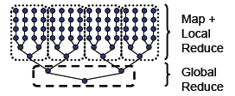
GPU MapReduce on single GPU
Map Split
Scheduler
on CPU
Mars
  Static scheduling
  Mapper: one thread per partition
  Reducer: one thread per key
  Hiding the GPU programming from
  the programmer
GPU MapReduce (GPUMR)
  Use hierarchical reduce
M
M
GPU
Processing
Sort
Reduce Split
R
R
Merge
Notes:
Generate the results saved into array by pre-generate number of intermediate results, the total size of keys and the total size of values. Each mapper save the result in a different location.
Optimization: thread parallelism, Handling variable-sized type, Hashing, File manipulation.

Slide 14
GPU MapReduce on multiple nodes
Distributed MapReduce framework on GPU cluster (DisMaRC)
Use MPI (Message Passing Interface) cross node communication
Volume Rendering MapReduce (VRMR)
Use data streaming for cross node communication
Inter keys & vals
sorted keys & vals
M
R
output
Input
G1
G1
Master
M
Master
R
… …
… …
… …
… …
Gn
M
Gn
R
Notes:
No fault tolerance
4 times faster than Mars

Slide 15
MITHRA
Based on Hadoop for cross node communication, use Hadoop Streaming as mapper
Use CUDA to write the map function kernel
Intermediate key/value pairs will be grouped by just one key
Node 1
CUDA
M
GPU
M
GPU
R
Hadoop
Hadoop
…
…
M
GPU
Node n
Notes:
One map per item
Input is generated by each mapper as random sample point, use to evaluate the sampling function
Only a single reducer is used
Focused on Monte Carlo application
Application is Black Scholes problem

Slide 16
Different GPU MapReduce Framework
Name | MultiNode | Fault tolerance | Communi-cation | GPU Programming | Scheduling | Largest Test
Mars | No | No | -- | CUDA | Static | 1 node/ 1 GPU
GPUMR | No | No | -- | CUDA | Static | 1 node/ 1 GPU
DisMaRC | Yes | No | MPI | CUDA | Static | 2 node/ 4 GPU
VRMR | Yes | No | Data Streaming | CUDA | Static | 8 node/ 32 GPU
MITHRA | Yes | Yes | Hadoop | CUDA | Dynamic | 2 node/ 4 GPU
Notes:
1) For Mars and GPUMR has 128 processors on that GPU

Slide 17
Data Mining Algorithms
Latent Drichlet Allocation (LDA)
  Gibbs sampling in LDA
  Approximate Distributed LDA (AD-LDA)
  Parallel LDA (pLDA)
Multidimensional Scaling
  Scaling by Majorizing a Complex Function (SMACOF)
  Parallel SMACOF
  MDS Interpolation

Slide 18
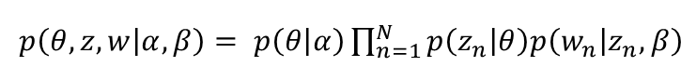
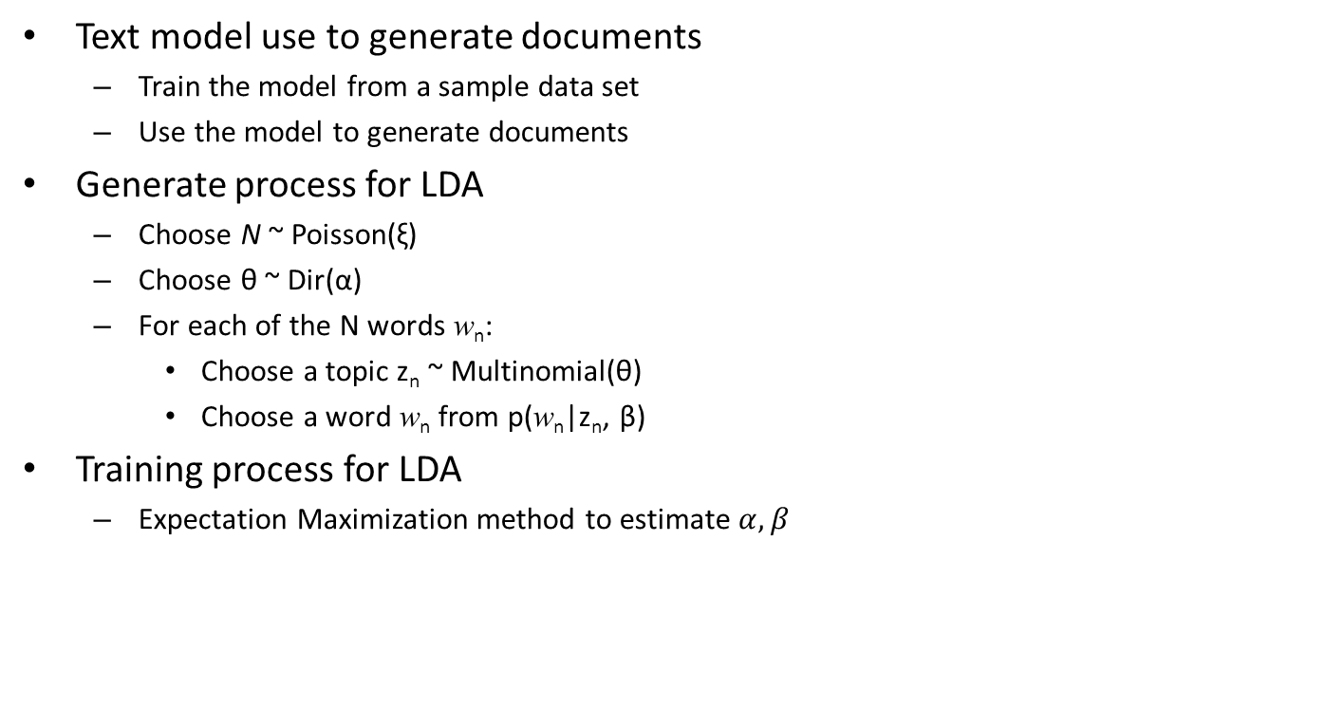
Latent Dirichlet Allocation
Text model use to generate documents
  Train the model from a sample data set
  Use the model to generate documents
Generate process for LDA
  Choose N ~ Poisson(ξ)
  Choose θ ~ Dir(α)
  For each of the N words w_{n}:
    Choose a topic z_{n} ~ Multinomial(θ)
    Choose a word w_{n} from p(w_{n}|z_{n}, β)
Training process for LDA
  Expectation Maximization method to estimate $α,β$
α
θ
z
w
β
N
M
Notes:
The dimensionality k of the Dirichlet distribution is assumed known and fixed
The word probabilities are parameterized by a k * V matrix β where β_{ij} = p(w_{j} = 1 | z_{i} = 1)
The Poisson assumption is not critical to anything that document length distributions can be used as needed.
N is independent from all the variables
The Dirichlet is a convenient distribution on the simplex – it is in the exponential family, has finite dimensional sufficient statistics, and is conjugate to the multinomial distribution.
Main difference between the pLSI and LDA is PLSI can only trained the sample dataset (where may leads to overfitting) while the LDA can predict the out-sample dataset by using dirichlet distribution.

Slide 19
Gibbs Sampling in LDA
Used for generating a sequence of sample from the joint probability distribution of two or more random variables
In LDA model, the sample refers to the topic assignment of word i in document d; the joint probability distribution are from the topic distribution over words and the document distribution over topics.
  Given a corpus D ={w₁,w₂,…,w_{M}}, a vocabulary {1,…,V} and a sequence of words in Document w = (w₁,w₂,…,w_{n}) and a topic collection T={0,1,2,…K}, we can have 3 2D matrices to complete Gibbs sampling process:
  nw: topic frequency over words(terms)
  nd: document frequency over topics
  z: topic assignment for a word in document

Slide 20
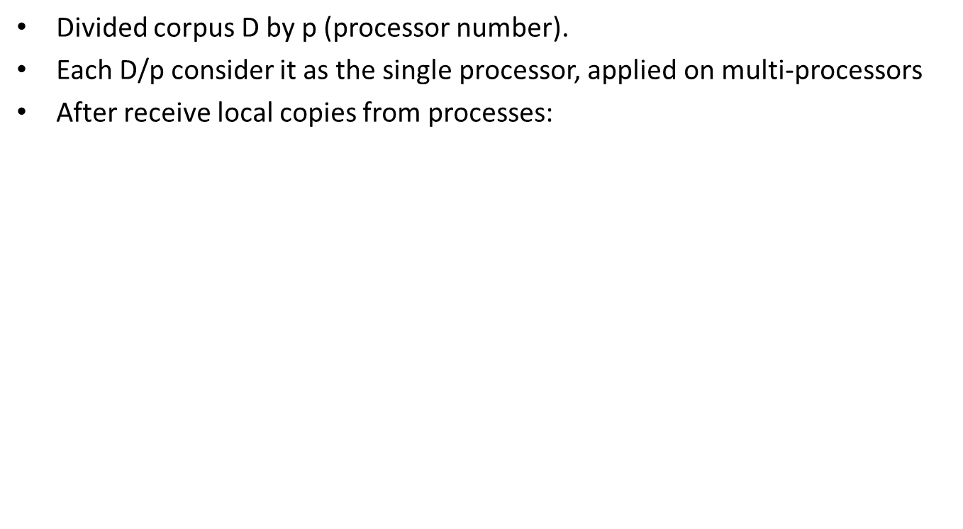
Approximate Distributed LDA
Divided corpus D by p (processor number).
Each D/p consider it as the single processor, applied on multi-processors
After receive local copies from processes:
Merge
Input
Processor
…
…
Input
Processor
Notes:
1) Only use 2 processors for the test

Slide 21
PLDA
Use MPI and MapReduce to parallel LDA, applied on multi-nodes
Apply global reduction after each iteration
Test up to 256 nodes
MapReduce Model
1
nd and z
nw
MPI Model
W
M
…
worker 0
C
W
……
……
R
R
W
p
Updated nd and z
Updated nw
Notes:
Fault tolerance:
(MPI) check point the workers before AllReduce, roll back if one or more workers failed
(MapReduce) map output were buffered on the local disk before shuffle. Use check point and make sure same map worker runs for same buffered data.
2) Static Scheduling as D/P as each shard.

Slide 22
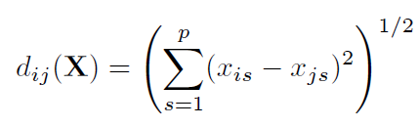
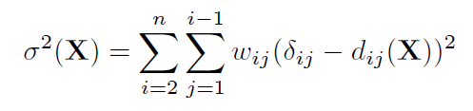
Multidimentional Scaling (MDS)
A statistical technique to visualize dissimilarity data
Input: dissimilarity matrix with diagonal part all 0 (N * N)
Output: target dimension matrix X (N * L), usually 3D or 2D (l=3 | l =2).
Target matrix Euclidean distance:
Raw Stress Value:
Many possible algorithms: Gradient Descent-Type algorithms, Newton-Type algorithms and Quasi-Newton algorithms

Slide 23
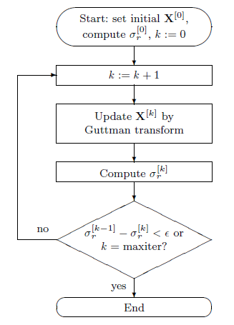

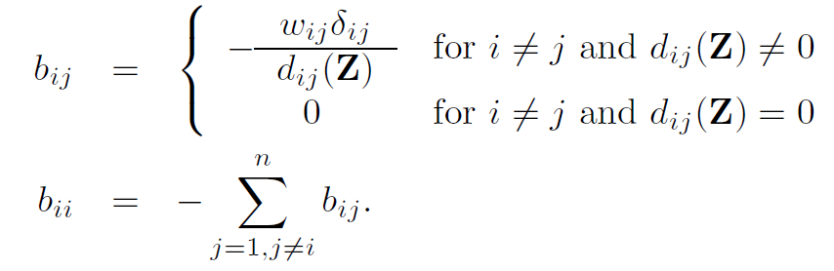


SMACOF
Scaling by Majorizing a Complex Function, given by equation:
Where B(X) is
And V is a matrix with weight information. Assume all w_{ij} = 1, then:
with weight
Notes:
One of the most efficient algorithms, among Newton-type algorithm which need a Hessian matrix O(N^3*m^3).

Slide 24
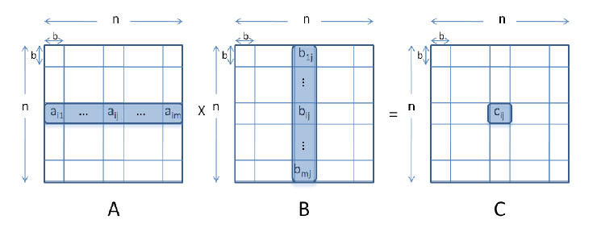
Parallel SMACOF
The main computation part is the matrix multiplication: B(Z) * Z
Achieved Multicore matrix multiplication parallelism by block decomposition
The computation block can be fit into cache line.
Multi-node using Message Passing Interface and Twister.
Broadcast X
Input
Dissimilarity
Matrix
M
M
…
…
R
C
…
R
C
M
M
B(Z)Z Calculation
Stress Calculation

Slide 25
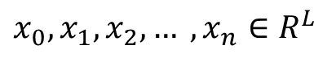
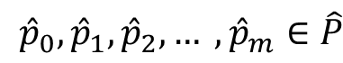
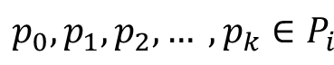

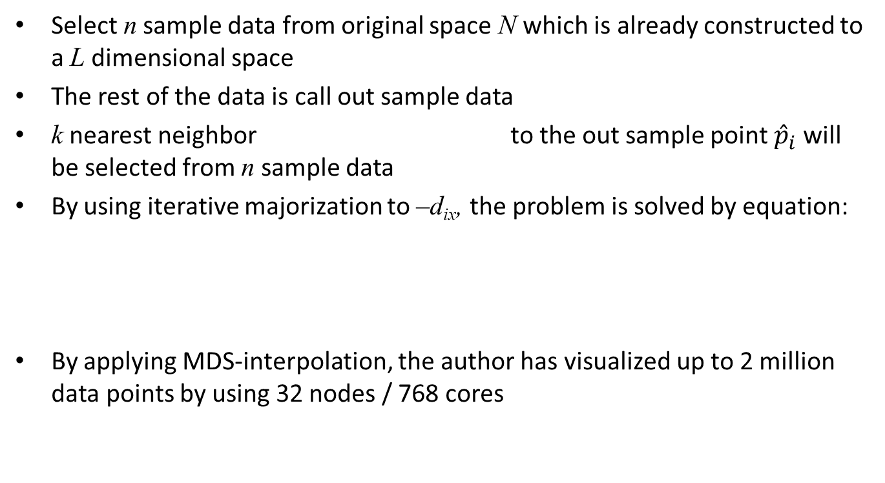
MDS Interpolation
Select n sample data from original space N which is already constructed to a L dimensional space
The rest of the data is call out sample data
k nearest neighbor to the out sample point ${\hat{p}}_{i}$ will be selected from n sample data
By using iterative majorization to –d_{ix}, the problem is solved by equation:
By applying MDS-interpolation, the author has visualized up to 2 million data points by using 32 nodes / 768 cores

Slide 26
My Research
Million Sequence Clustering
  Hierarchical MDS Interpolation
  Heuristic MDS Interpolation
Reduced Communication Parallel LDA
  Twister-LDA
  MPJ-LDA
Hybrid Model in DryadLINQ programming
  Matrix Multiplication
    Row Split Algorithm
    Row Column Split Algorithm
    Fox-Hey Algorithm

Slide 27
Hierarchical/Heuristic MDS Interpolation
The k-NN problem in MDS interpolation can be time costing

Slide 28
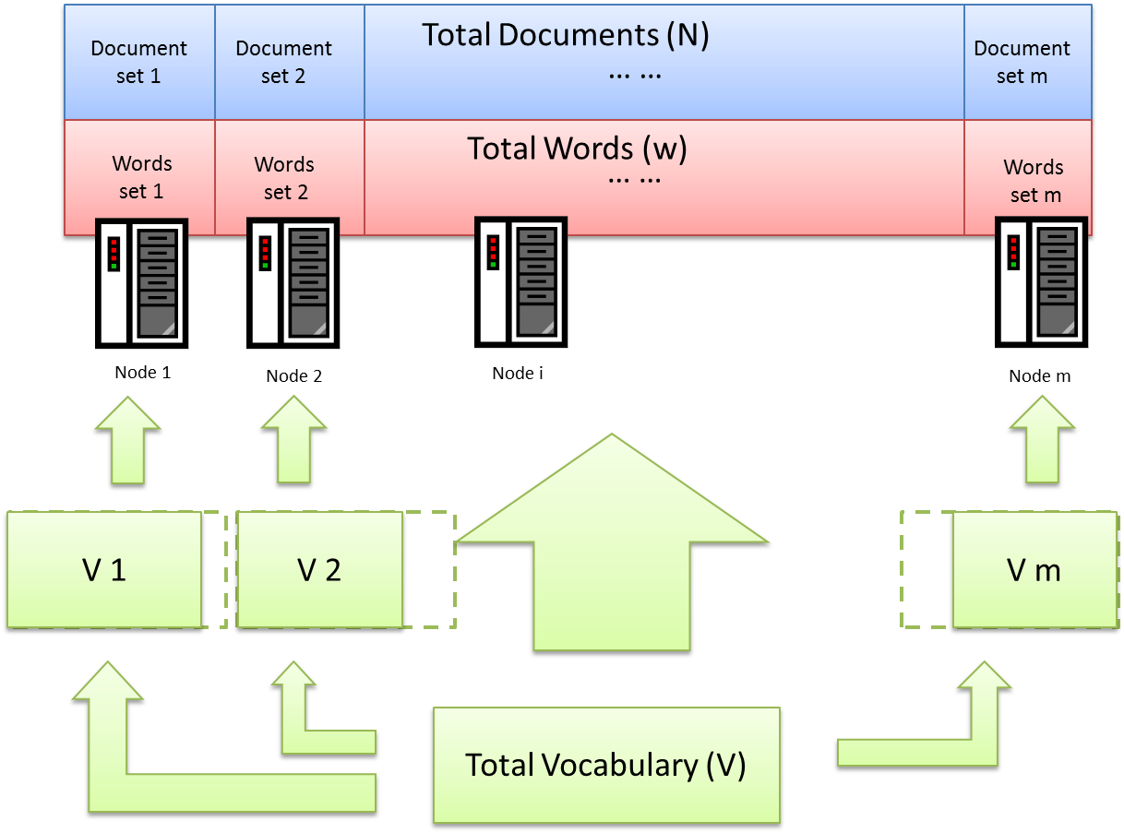
Twister/MPJ-LDA
The global matrix nw does not need to be transferred as a full matrix since some of the documents might not having this term on it.

Slide 29
Hybrid Model in DryadLINQ
Applying different algorithms of matrix multiplication on Dryad, by porting multicore technology, the performance improves significantly

Slide 30
Conclusion and
Research Opportunities
Iterative MapReduce
  Fault tolerance
  Dynamic scheduling
  Scalability
GPU MapReduce
  Scalability
  Hybrid Computing
Application
  Twister-LDA, Twister-MDS Scalability
  Port LDA, MDS to GPU MapReduce system

Slide 31
Thank you!

Slide 32
APPENDIX

Slide 33
Hadoop
Concept are same as Google MapReduce
Input, Intermediate and output files are saved into HDFS
Using replicas for fault tolerance
Each file is saved into blocks, which makes load balance
Each worker is a process
Can use Hadoop Streaming to intergrade it into multiple languages
Notes:
1) hdfs, namenode, datanode

Slide 34
Hadoop Streaming
Hadoop streaming is a utility that comes with the Hadoop distribution. The utility allows you to create and run Map/Reduce jobs with any executable or script as the mapper and/or the reducer. For example:
  $HADOOP_HOME/bin/hadoop jar $HADOOP_HOME/hadoop-streaming.jar \
    -input myInputDirs \
    -output myOutputDir \
    -mapper /bin/cat \
    -reducer /bin/wc

Slide 35
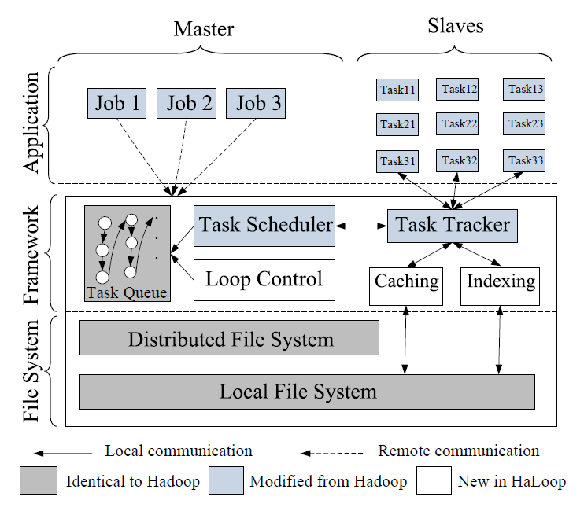
Haloop
Extend based on Hadoop
framework
The Task Scheduler tries to
keep data locality for mapper
and reducer
Caches the input and output
on the physical node’s local
disk to reduce I/O cost
Reconstructing caching for
node failure or work node full
load.
Notes:
Page rank and k-means
Experiment was done on EC2

Slide 36
Spark
Use resilient distributed dataset (RDD) to achieve fault tolerance and memory cache.
RDD can recover a lost partition
by information on other RDDs,
using distributed nodes.
Integrates into Scala
Built on Nexus, using long-lived
Nexus executor to keep re-usable
dataset in the memory cache.
Data can be read from HDFS
Application
Scala high level language
Spark runtime
Nexus cluster manager
Node 1
Node 2
…
Node n
Notes:
One RDD fails, the other RDDs can recover it without reloading. What if multiple partitions lost?
Nexus is a cluster manager which allows running multiple framework (hadoop, Dryad, Spark) on same cluster. It’s more likely a resource manager.
Text search
logistic regression from two sets of points, trying to find best hyperplane w that seperates two set of points
ALS, has a R containing the know ratings for some user-movie pairs, has a M matrix m * k for each movie has k feature vector and a U matrix k * u each user’s rating for a k feature vector movie.

Slide 37
Pregel
Inactive
active
Support large scale graph
processing.
Each iteration is defined as
SuperStep.
Introduce inactive and active for
each vertices.
Load balance is good since vertices
number is much more than workers.
Fault tolerance is achieved by using
checkpoint. Developing confined
recovery
3
6
2
1
Superstep 0
6
6
2
6
Superstep 1
6
6
6
6
Superstep 2
6
6
6
6
Superstep 3
Notes:
Partitioned either by manager assign each worker one or more partitions.
Each partition consisting of a set of vertices and all of those vertices’ out going edges.
Default partition is hash(ID) mod N where N is the number of parititions, ID is the vertex ID.
A vertex can send out any number of messages in a SuperStep S, vertex can directly communicate with each other.
Communicate: message passing
Partition are on the local disk of compute node
Combiner: reduce several incoming messages to the same vertex by system.
Aggregator: like a combiner in twister, use to send out the global value to all vertex.
Page Rank, Shortest Paths, Bipartite Matching and a Semi-Clustering algorithm
----- Meeting Notes (8/5/11 14:43) -----
partition strategy
messaging strategy

Slide 38
OpenCL
A similar library to CUDA
Can run on heterogeneous devices, i.e. ATI cards and nVidia cards
Host
Compute Device
Host memory
Global/
Constant Memory
Local Memory
Work-Item
Private Memory
Work-Item
Private Memory
Local Memory
Work-Item
Private Memory
Work-Item
Private Memory

Slide 39
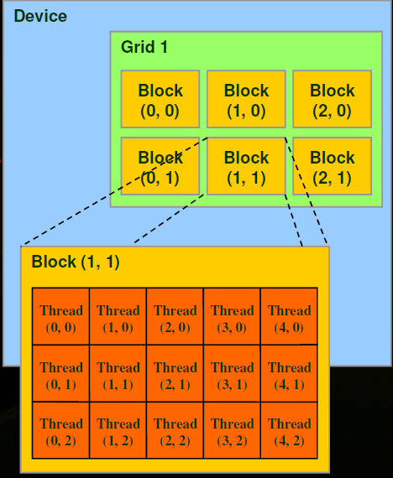
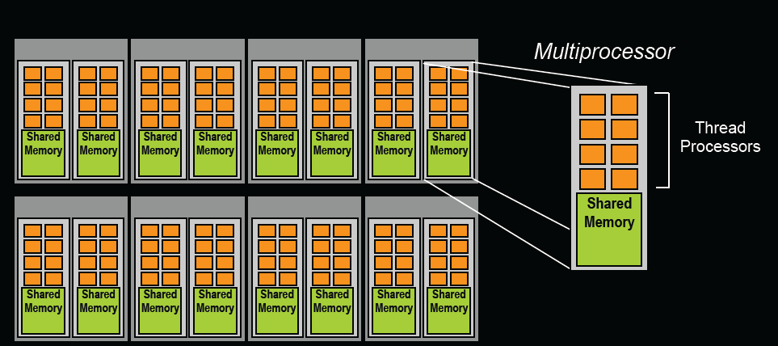
CUDA thread/block/memory
Threads are grouped into thread blocks
Grid is all blocks for a given launch
Registers, block shared memory on-chip, fast
Thread local memory is off-chip, uncached
Kernel to global memory will has I/O cost

Slide 40
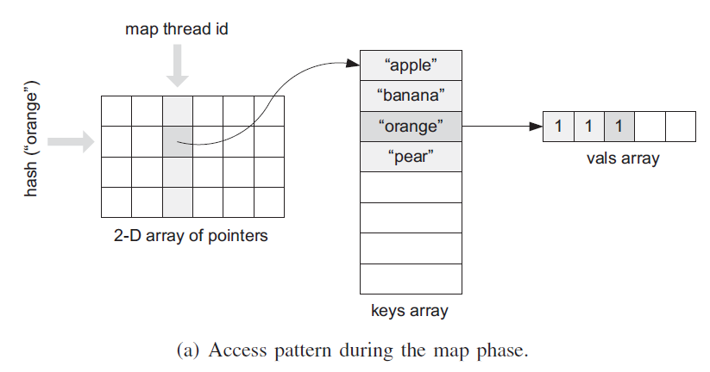
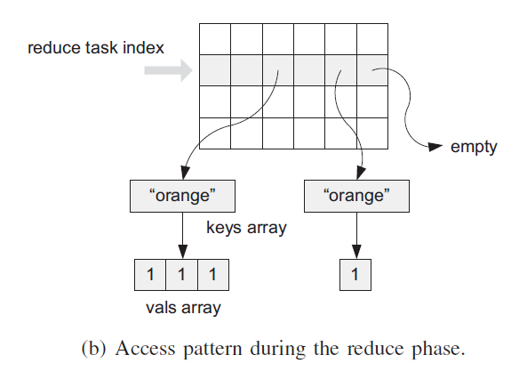
Phoenix
Mapreduce on multicore CPU system.

Slide 41
Common GPU mapreduce
MAP_COUNT counts result size of the map function
MAP
REDUCE_COUNT counts result size of the reduce function
REDUCE
EMIT_INTERMEDIATE_COUNT emit the key size and the value size in MAP_COUNT
EMIT_INTERMEDIATE emit an intermediate result in MAP
EMIT_COUNT emit the key size and the value size in REDUCE_COUNT
EMIT emits a final result in REDUCE

Slide 42
Volume Rendering MapReduce
Use data streaming for cross node communication
Brick
…
M
Partition
Sort
R
Brick
…
…
…
…
…
Brick
…
M
Partition
Sort
R
Brick
Notes:
Use ray casting which is pleasantly parallel in volume rendering
Any single partition/brick must be able to fit into the main memory
The reduce is done on CPU
Map: use ray to discard un-intersect rays and remove the un-seen parts
Reduce: Draw the seen parts

Slide 43
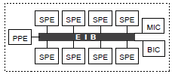
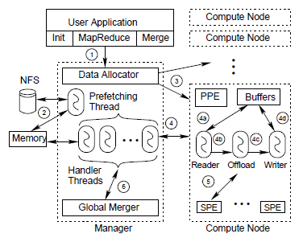
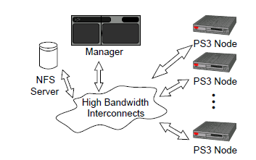
CellMR
Tested on Cell-based clusters
Use data streaming across nodes
Keep streaming chunks until all task
finish
Notes:
Use 8 ps3 to form a cluster with 8 nodes
PPE: PowerPC Processing Element
SPE: Synergistic Processing Element
EIB: Element Interconnect Bus
BIC: Bus Interface Controller
MIC: Memory and I/O Controller
Divided the inputs into small work units
256 MB main memory
Linear regression, k-means and word count.

Slide 44
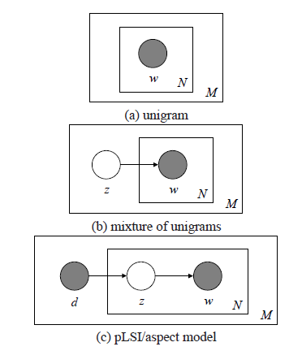




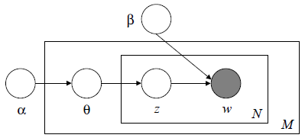
Topic models
From unigram, mixture of unigrams and PLSI to LDA
Notes:
Dirichlet distribution
Parameters grows with the size of corpus

Slide 45
Text Mining
Name | Topic number | Feature | Drawback
Unigram | 1
Mixture of Unigram | 1 per document
Probalistic Latent Semantic Indexing | K per document | d is fixed as a multinomial random variable | Over fitting
Latent Drichlet Allocation | K per document | Predict un-sampled words/terms
The pLSI model does not make any assumptions about how the mixture weights θ are generated, making it difficult to test the generalizability of the model to new documents.

Slide 46
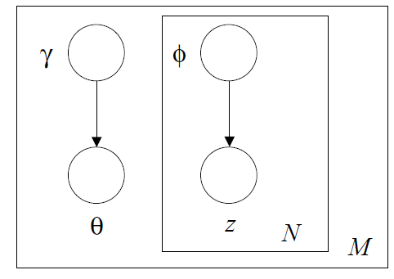


Latent Dirichlet Allocation
Common defined terms:
  A word is the basic unit of discrete data, vocabulary
  indexed by {1,…,V}
  A document is a sequence of N words donated by
  w = (w₁,w₂,…,w_{n})
  A corpus is a collection of M documents denoted
  by D ={w₁,w₂,…,w_{M}}
Different algorithms:
  Variational Bayes (shown below)
  Expectation propagation
  Gibbs sampling
Variational inference
Notes:
The dimensionality k of the Dirichlet distribution is assumed known and fixed
The word probabilities are parameterized by a k * V matrix β where β_{ij} = p(w_{j} = 1 | z_{i} = 1)
The Poisson assumption is not critical to anything that document length distributions can be used as needed.
N is independent from all the variables
The Dirichlet is a convenient distribution on the simplex – it is in the exponential family, has finite dimensional sufficient statistics, and is conjugate to the multinomial distribution.

Slide 47
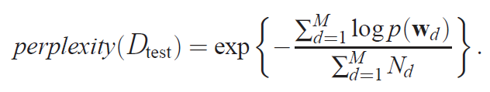
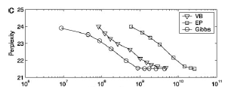
Different algorithms for LDA
Gibbs sampling can converge faster than the Variational Bayes algorithm proposed in the original paper and Expectation propagation.

Slide 48
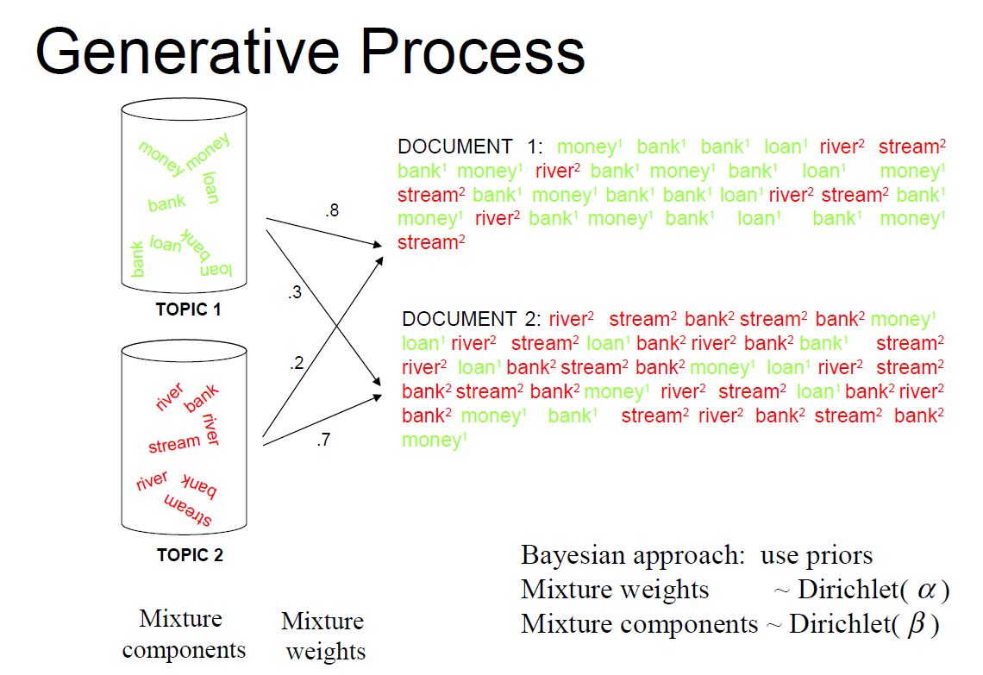
From D.Blei, A.Ng, M.Jordan, Latent Drichlet Allocation

Slide 49
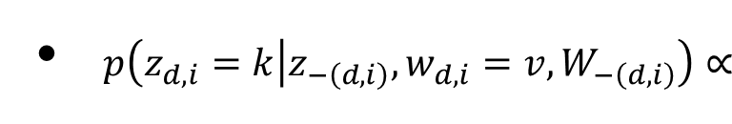
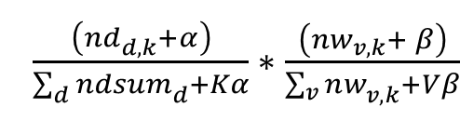
Gibbs Sampling in LDA
Initial set nw, nd and z; count=0
3 2D matrices
  nw: topic frequency over words(terms)
  nd: document frequency over topics
  z: topic assignment for a word in document
Each word w_{i} is estimate by the probability of it assigned to each topic conditioned on all other word tokens. Written as
So the final probability distribution can be calculate by:
  Probability of word w under topic k
  Probability of topic k has under document d
count:=count+1
k=z[d][i]
nw[v][k]--;
nd[d][k]--;
For word i in document d
Calculate posterior probability of z and update k to k’
z[d][i]:=k’
nw[v][k’]++;
nd[d][k’]++;
end of all documents?
No
Yes
count > threshold?
No
Yes
end
Notes:
1) Gibbs sampling converges faster than either VEM or EP.

Slide 50
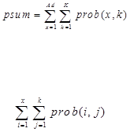
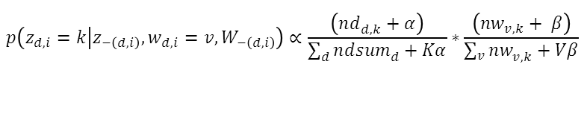
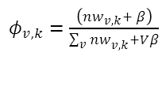
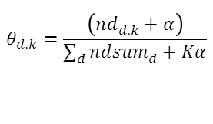
Gibbs Sampling
1. For each iteration (2000 times):
2. For each document d:
3. For each word wd in document d:
4. nw[word][topic]-=1; nd[document][topic]-=1;
nwsum[topic]-=1;
5. For each author x in document d:
6. For each topic k:
topicdocumentprob = (nd[m][k] + alpha)/(ndsum[m] + M*alpha);
wordtopicprob = (nw[wd][k] + beta) / (nwsum[k] + V*beta);
prob[x,k] = wordtopicprob * topicdocumentprob;
7. End for topic k;
8. End for author x;
9.
10. Random select u~Multi(1/(Ad*K));
11. For each x in Ad:
12. For each topic k:
13. If >=u then
14. Break;
15. End
16. Assign word=current x; topic=current k;
17. All parameters for word, topic, document should be added 1. Recover the original situation for last instance.
18. End
19. End

Slide 51

KL-diverse
In probability theory and information theory, the Kullback–Leibler divergence (also information divergence, information gain, relative entropy, or KLIC) is a non-symmetric measure of the difference between two probability distributions P and Q.
In words, it is the average of the logarithmic difference between the probabilities P and Q, where the average is taken using the probabilities P. The K-L divergence is only defined if P and Q both sum to 1 and if Q(i) > 0 for any i such that P(i) > 0. If the quantity 0log0 appears in the formula, it is interpreted as zero.

Slide 52
MDS algorithms
Newton-type algorithms | Quasi-Newton algorithms
Second-order algorithms for stress minimization | Extend on Newton-type algorithms
Use a Hessian which is a fourth-order tensor which can be very time costing. | Construct an approximate inverse Hessian at each iteration, using gradients from a few previous iterations
SMACOF can be faster than these two algorithms from the computational complexity angle
SMACOF can converge faster than these two algorithms to achieve a lower stress value

Slide 53
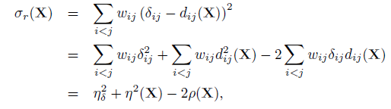

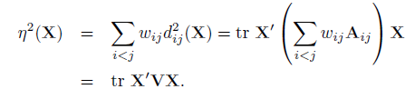
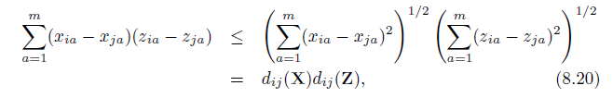



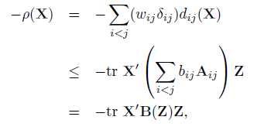

SMACOF
Notes:
The matrix Aij is simply a matrix with aii = ajj = 1, aij = aji = −1, and all other elements zero.
Transposed matrix : 转置矩阵

Slide 54
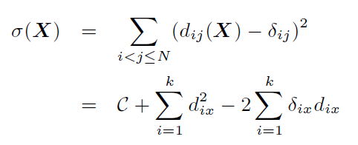
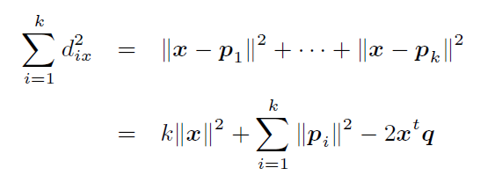
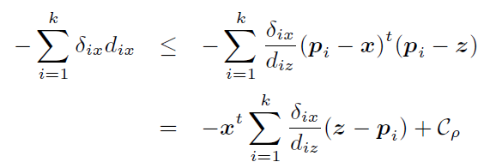
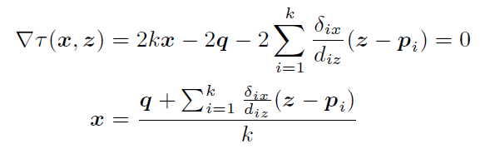
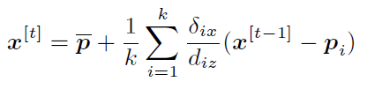
MDS Interpolation

