Slide 1
Supporting Queries and Analyses of Large-Scale Social Media Data with Customizable and Scalable Indexing Techniques over NoSQL databases
Thesis Proposal
Xiaoming Gao
Advisor: Judy Qiu

Slide 2
Motivation – characteristics of social media data analysis
Large size for the entire data set:
- TBs/PBs of historical data, 10s of millions of streaming social updates per day
- Fine-grained social update records, mostly write-once-read-many
Analyses focus on data subsets about specific social events/activities
- Presidential election, protest events, the Oscars, etc.
Requirement for data storage and processing stack:
- Efficient queries about interesting data subsets
E.g. get-retweet-edges(#euro2012, [06/12, 07/12])
- Limit analysis computation to data subsets

Slide 3
Motivation – characteristics of social media data analysis
Analysis workflows contain multiple stages and analysis tasks
- Algorithms have different computation + communication patterns
Requirement for data analysis stack:
- Dynamically adopt different processing frameworks for different analysis tasks

Slide 4
Motivation – research goal of thesis
Address requirement for efficient queries of data subsets:
- Customizable and scalable indexing framework on NoSQL databases
Address requirement for efficient execution of analysis workflows:
- An analysis stack based on YARN
- Development of analysis algorithms as basic building blocks
Explore value of indexing for both queries and analysis algorithms
Evaluation with real applications from Truthy
Notes:
Building blocks as research contribution

Slide 5
Related work – indexing for Big Data
Hadoop++, HAIL, Eagle-Eyed-Elephant:
- Indexing for data stored in HDFS to facilitate MapReduce queries
- Tasks scheduled at level of data blocks or splits
- Tasks may scan irrelevant data blocks or records to do query evaluation
- Indices only used for queries, not for post-query analysis algorithms
Record level data access and indexing are needed
- Suggest distributed NoSQL databases for the storage solution

Slide 6
Related work – indexing on current NoSQL databases
Single-dimensional indexes
Multidimensional indexes
Sorted (B+ tree)
Unsorted (Hash)
Inverted index
(Lucene)
R tree
K-d tree
Quad tree
Single-field
Composite
Single-field
Composite
Single-field
HBase
Cassandra
Yes
Yes
Riak
Yes
Yes
MongoDB
Yes
Yes
Yes
Yes
Yes
Varied level of indexing support among different NoSQL databases.

Slide 7
Related work – indexing on current NoSQL databases
Distributed Lucene indices not good for get-retweet-edges(#euro2012, [06/12, 07/12])
- Retrieve top-N ‘most relevant’ documents, instead of processing all related social updates
- Term frequency, position information, and rank computation are unnecessary
- Only index individual fields, while result size for [2012-06, 2012-07] >> result size for #euro2012
Need customizability in index structure design
Research questions:
- A general customizable indexing mechanism that can be supported by most NoSQL databases?
- If yes, how to achieve scalable index storage?
- How to achieve scalable indexing speed, especially for high-volume streaming data?

Slide 8
Customizable and scalable indexing framework
Definition of dataset and index
- dataset S = {<field₁, field₂, … field_{N}> | N > 0}
- index I = {<k, e> | $∃r.r∈S∧$ <k, e> $∈idx(r)$}; idx is a function f : r → {<k, e>}.
Abstract data model for original data to be indexed
- JSON type of nested key-value pair list
{"id":34077,
"text":"Enjoy the great #euro2012",
"created_at":"2012-06-12 23:22:16",
"geo":{ "type":"Point",
"coordinates":[-6.2219492,
52.8767352] },
...
}
HBase (BigTable data model):
Riak (key-value model):
MongoDB (document model):
…
Tweet Table
Tweet Bucket
Tweet Collection
details
Key: 34077
Value: JSON file
Document: JSON document
34077
text
created_at
geo
… (other fields)
“Enjoy …”
2012-06-02
{“type”:”Point”, …}
…

Slide 9
Customizable and scalable indexing framework
Abstract index structure
- A sorted list of index keys.
- Each key associated with multiple entries sorted by unique entry IDs.
- Each entry contains multiple additional fields.
enjoy
34077
Entry ID
Entry ID
2012-06-02
Field2
Field1
Field2
Field1
Field2
great
34077
Entry ID
2012-06-02
Field2
Field1
Field2
key3
Entry ID
Entry ID
Entry ID
Entry ID
Field1
Field2
Field1
Field2
Field1
Field2
Field1
Field2
key4
Entry ID
Entry ID
Entry ID
Field1
Field2
Field1
Field2
Field1
Field2
…

Slide 10
Customizable and scalable indexing framework
Customizability through index configuration file
<index-config>
<source-set>tweets</source-set>
<source-field>text</source-field>
<source-field-type>full-text</source-field-type>
<index-name>textIndex</index-name>
<index-entry-id>{source-record}.id</index-entry-id>
<index-entry-field>{source-record}.created_at</index-entry-field>
</index-config>
<index-config>
<source-set>users</source-set>
<index-name>snameIndex</index-name>
<indexer-class>iu.pti.hbaseapp.truthy.UserSnameIndexer</indexer-class>
</index-config>

Slide 11
Demonstration of Customizability
Sorted single filed index with similar functions to a B+ tree
2012-06-02
34077
2012-06-03
45327
…
Sorted composite index on multiple fields
Retweet Index
Retweet Index
34077
2012-06-02|43125
34077
43125
2012-06-02
25233
2012-06-02|44331
2012-06-03|45327
25233
44331
tweet id
2012-06-02
time
…
…

Slide 12
Demonstration of Customizability
Inverted index for text data
- store frequency/position for ranking
Composite index on both text and non-text fields
- not supported by any current NoSQL databases
enjoy
34077
doc id
doc id
enjoy
34077
tweet id
tweet id
1
frequency
frequency
2012-06-02
time
time
great
34077
doc id
great
34077
Entry id
1
frequency
2012-06-02
time
…
…
Multikey index similar to what is supported by MongoDB
Original data record
Zip Index
{
"id":123456,
“name":“Shawn Williams!",
“zips":[
10036,
34301
],
...
}
10036
123456
34301
123456
Entry ID
…
Simulating K-d tree and Quad-tree are also possible with necessary extensions

Slide 13
Core components and interface to client applications
Client Application
index(dataRecord)
unindex(dataRecord)
search(indexConstraints)
General Customizable Indexer
Basic Index Operator
User Defined Index Operator
Index Configuration File
User Defined Indexer
User Defined Indexer
…
NoSQL database
search(indexConstraints): query an index with constraints on index key, entry ID, or entry fields.
Constraint type: value set, range, regular expression, prefix
Online indexing: index each inserted data record on the fly
Batch indexing: index existing original data sets on NoSQL database

Slide 14
Implementation on HBase - IndexedHBase
Text Index Table
Text Index
entries
enjoy
34077
Entry ID
Entry ID
2012-06-02
Field2
Field1
Field2
Field1
Field2
enjoy
34077
Entry ID
Entry ID
2012-06-02
Filed2
Field1
Filed2
Field1
Filed2
great
34077
Entry ID
2012-06-02
Field2
Field1
Field2
34077
Entry ID
great
2012-06-02
Filed2
Field1
Filed2
HBase designed for real-time updates of single column values – efficient access of individual index entries
Data storage with HDFS – reliable and scalable index data storage
Region split and dynamic load balancing – scalable index read/write speed
Data stored under the hierarchical order of <rowkey, column name, timestamp> - efficient range scan of index keys and entry IDs

Slide 15
Performance tests – indexing and query evaluation
Real applications from Truthy
- Analyze and visualize the diffusion of information on Twitter
- Tweets data collected through Twitter’s streaming access API
- 40+ million tweets per day, 10s of GB in compressed format
- 10+ TB of historical data in .json.gz files
- Queries:
get-tweets-with-meme(#euro2012, [2012-06-01, 2012-07-31])
get-retweet-edges(#euro2012, [2012-06-01, 2012-07-31])
…

Slide 16
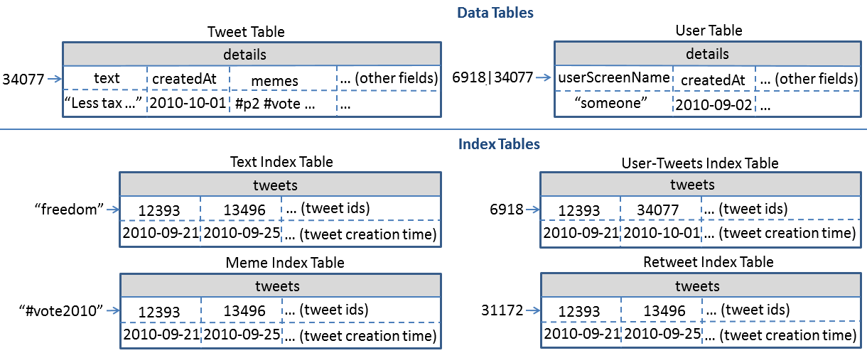
Tables designed for Truthy

Slide 17
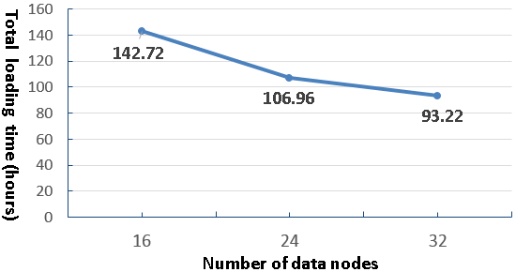
Scalable historical data loading
Measure total loading time for two month’s data with different cluster size on Alamo
- Total data size: 719 GB compressed, ~1.3 billion tweets
- Online indexing when loading each tweet

Slide 18
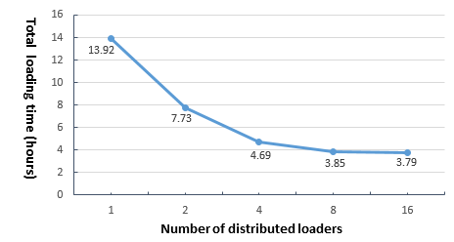
Scalable indexing of streaming data
Test potential data rate faster than current stream
Split 2013-07-03.json.gz into fragments distributed across all nodes
HBase cluster size: 8
Average loading and indexing speed observed on one loader: 2ms per tweet

Slide 19
Parallel query evaluation strategy
get-retweet-edges(#euro2012, <2012-05-01, 2012-06-20>)
memeIndexTable-2012-05
memeIndexTable-2012-06
# euro2012
# euro2012
…
…
Tweet ID Search Phase
Parallel Evaluation Phase
Mapper
…
Mapper
Mapper
…
Mapper
Reducer
Reducer
1568 -> 2334 : 8
…
3677 -> 2099 : 5
…

Slide 20
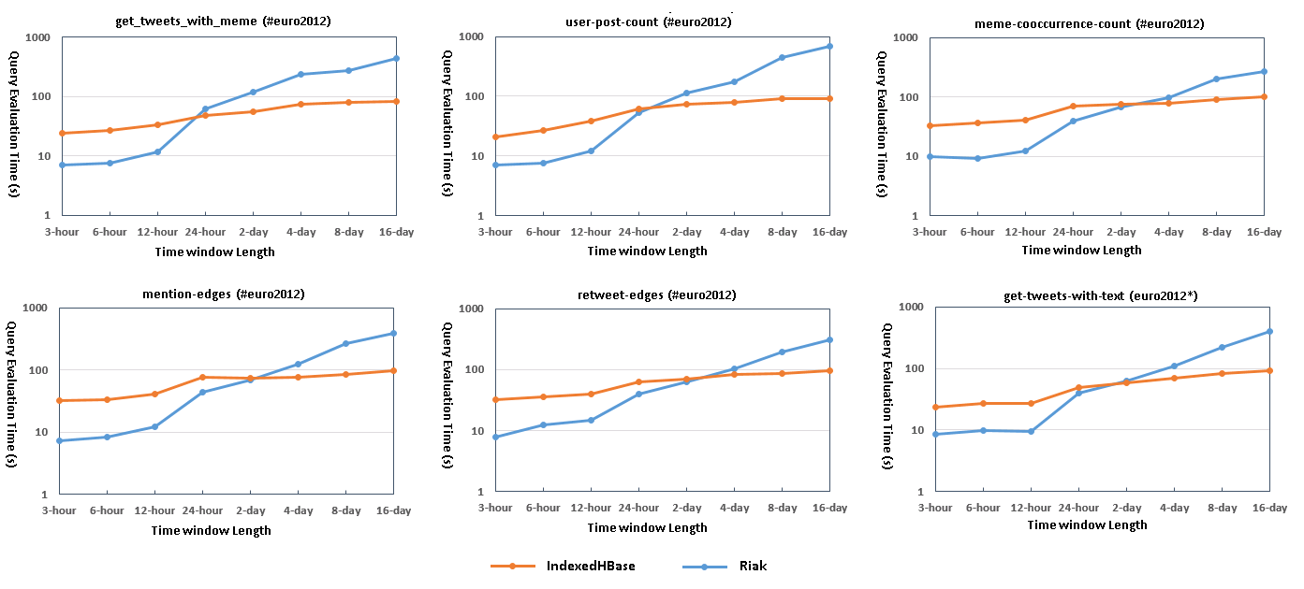
Query evaluation performance comparison
Riak implementation uses original text indices and MapReduce support on Riak
IndexedHBase is more efficient at queries with large intermediate data and result sizes.
Most queries involve time windows of weeks or months.

Slide 21
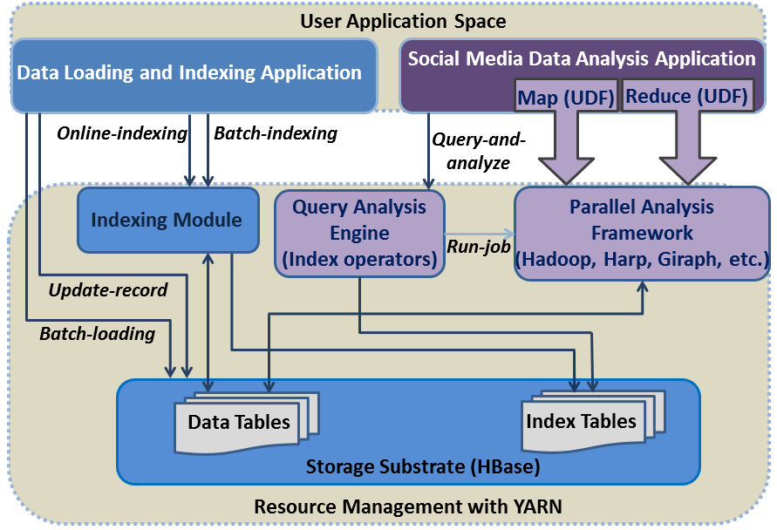
Beyond queries - analysis stack based on YARN
Basic building blocks for constructing workflows:
- Parallel query evaluation using Hadoop MapReduce
- Related hashtag mining algorithm using Hadoop MapReduce
- Meme daily frequency generation using MapReduce over index tables
- Parallel force-directed graph layout algorithm using Twister (Harp) iterative MapReduce

Slide 22
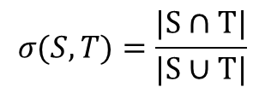
Apply customized indices in analysis algorithms
Related hashtag mining algorithm with Hadoop MapReduce
$$σ(S,T)=\frac{|S∩T|}{|S∪T|}$$
Jaccard coefficient:
S: set of tweets containing a seed hashtag s
T: set of tweets containing a target hashtag t
If σ is larger than a threshold, t is recognized as related to s
Step 1: use the Meme Index to find tweet IDs containing s
Step 2 (Map): find every hashtag t that co-occurs with s in any tweet
Step 3 (Reduce): for each t, compute σ using the Meme Index to get T
Major mining computation is done by accessing index instead of original data.
Notes:
Question: if new index structures are needed for new analysis algorithms, then batch indexing mechanism will be useful

Slide 23
Apply customized indices in analysis algorithms
Hashtag daily frequency generation
- Useful for many analysis scenarios, e.g. meme time line generation and meme life time distribution analysis
- Can be completely done by only scanning the index
- Parallel scan with MapReduce over HBase index tables
Meme Index Table
tweets
12393
13496
… (tweet ids)
“#euro2012”
2012-06-01
2012-06-05
… (tweet creation time)

Slide 24
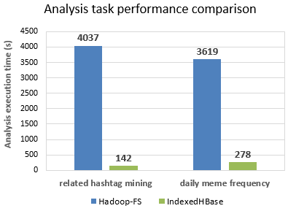
Performance comparison against raw-data-scan solutions
Hadoop-FS: Hadoop MapReduce programs that complete analysis tasks by scanning .json.gz files with mappers
Related hashtag mining: [2012-09-24, 2012-11-06]; Daily meme frequency: 2012-06
Demonstrate value of indexing for analysis algorithms beyond basic queries.
Notes:
Wrong sentence:

Slide 25
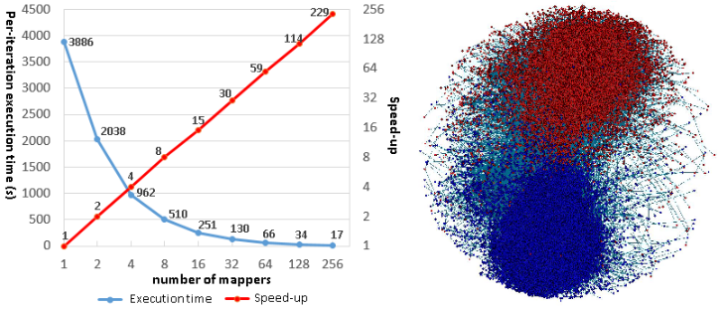
Other building blocks for analysis workflow construction
Iterative MapReduce implementation for the Fruchterman-Reingold algorithm
- Force-directed graph layout algorithm
- Iterative MapReduce implementation on Twister-Ivy: distributed computation + broadcast with chain model
- Per-iteration time on sequential R implementation: 6035 seconds
- New implementation on Harp: YARN-compatible version of Twister
Under development: a parallel version of label propagation algorithm with Giraph
Notes:
Clarification: chain model on Twister, and new version on Harp using All-Gather.

Slide 26
Future work and research plan
To complete the last part of my thesis
- Top priority: apply customized indices to streaming analysis algorithms of social media data
- Back up: apply our indexing framework to support Spatial Big Data application
Time | Milestone for streaming algorithm | Milestone for extended scalability tests
04/06/2014 | Initial investigation of streaming algorithms | Initial investigation of Spatial Big Data problems
04/26/2014 | Design improved streaming algorithm using customized index structures | Design index structures and query strategies for spatial data sets
05/31/2014 | Implementation of improved streaming algorithm | Finish indexing and implementation of query algorithms
06/30/2014 | Complete performance tests, and submission of another research paper | Complete performance tests, and submission of another research paper
07/01/2014 | Start writing dissertation | Start writing dissertation
09/20/2014 | Final wrap up and defense | Final wrap up and defense
Notes:
Use ‘improve efficiency’ instead of design for streaming algorithms

Slide 27
Thanks!
Notes:
Highlight the research issues and contribution
Talk about related work and distinguish our contribution
Use Truthy applications and algorithms as validation
8 – 10 pages for each part

Slide 28
Performance tests
Historical data loading
MapReduce program for loading one month’s data
Each mapper loads tweets from one .json.gz file, building index on the fly
Riak: 8 distributed loaders using Riak text index with “inline fields”
 | Loading time (hours) | Loaded total data size (GB) | Loaded original data size (GB) | Loaded index data size (GB)
Riak | 294.11 | 3258 | 2591 | 667
IndexedHBase | 45.47 | 1167 | 955 | 212
Comparative ratio of Riak / IndexeHBase | 6.47 | 2.79 | 2.71 | 3.15
Reasons for difference:
Data model normalization by using tables – less redundant data
Tweets in JSON parsed twice on Riak, once on IndexedHBase
Customized index tables – no overheads from traditional inverted indices
Indexing overhead on Riak for frequency and position extraction

Slide 29
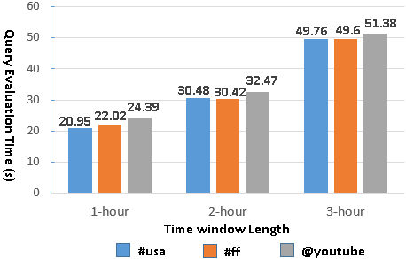
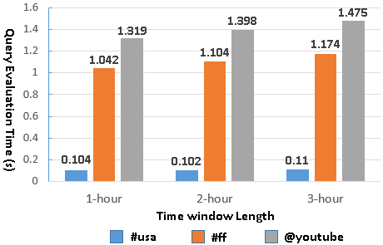
Query evaluation time with separate meme and time indices on Riak
Query evaluation time with customized meme index on IndexedHBase

Slide 30
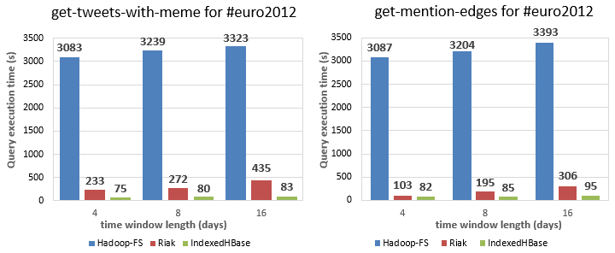

Slide 31
Performance tests
Queries that can be finished by only accessing indices in IndexedHBase
Evaluation on Riak:
- meme-post-count: Execute a Solr query to get all tweet IDs and then find “numFound” in the response
- timestamp-count: Riak MapReduce over related tweets

Slide 32
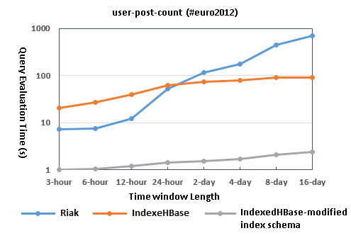
Performance tests
Improve query performance by changing customized index structure
Meme Index Table
tweets
12393
13496
… (tweet ids)
“#euro2012”
2012-06-01: 3213409
2012-06-05: 6918355
… (time: user ID)

Slide 33
Performance tests
Scalability of the iterative MapReduce version of Fruchterman-Reingold algorithm
Graph size: 477,111 vertices, 665,599 edges
Graph partitioned by vertices among mappers, reducer collects mapper outputs and broadcast
Per-iteration time on sequential R implementation: 6035 seconds

Slide 34
Summary
Characteristics of social media data analysis
Focus on data subsets about specific social events and activities
Involve analysis algorithms using different computation and communication patterns
Customizable and scalable indexing framework over NoSQL databases
Customizable index structures for best query evaluation performance
Scalable indexing performance achieved through proper mapping to NoSQL databases
IndexedHBase: reliable index storage, scalable indexing performance, proper interface for both random access and parallel batch analysis
Analysis stack based on YARN
Parallel query evaluation strategy, various analysis building blocks for easy workflow construction
Conclusion
Customizability of index structures is important for achieving optimal query evaluation speed
Indices are not only valuable for query evaluation, but also for data analysis tasks
Extendable (YARN-based) analysis stack is crucial for efficient execution of social data analysis workflows

Slide 35
Online indexing and batch indexing mechanisms
Twitter streaming API
Data table region
Data table region
Stream input client
Stream distribution mechanism
mapper
mapper
Construct input data records
Construct input data records
Construct input data records
Construct input data records
…
…
General Customizable Indexer
General Customizable Indexer
General Customizable Indexer
General Customizable Indexer
Loader 1
Loader N
Node 1
Node N
HBase
HBase
…
Data tables
Index tables
Text Index table
Meme Index table
Online indexing for streaming data
Batch indexing for existing data tables

Slide 36
Streaming and historical data loading mechanisms
Twitter streaming API
.json.gz file
.json.gz file
Stream input client
Stream distribution mechanism
mapper
mapper
Construct input data records
Construct input data records
Construct input data records
Construct input data records
…
…
General Customizable Indexer
General Customizable Indexer
General Customizable Indexer
General Customizable Indexer
Loader 1
Loader N
Loader 1
Loader N
HBase
HBase
Data tables
Index tables
Data tables
Index tables

Slide 37
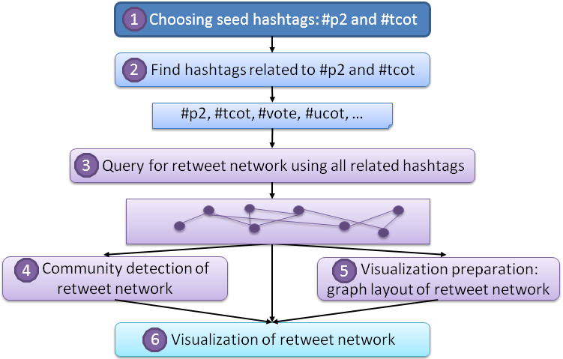
Motivation – an example from Truthy
Analysis workflow for “Political Polarization on Twitter”

Slide 38
Implementation using NoSQL databases for index storage
Key features needed for efficient and scalable indexing
- Fast real time insertion and updates of single index entries
- Fast real time read of index entries
- Scalable storage and access speed of index entries
- Efficient range scan of index keys
- Efficient range scan of entry IDs
Need proper mapping between abstract index structure and NoSQL storage units

Slide 39
Suggested mappings for other NoSQL databases
Feature needed | Cassandra | Riak | MongoDB
Fast real time insertion and updates of index entries | Yes. Index key as row key and entry ID as column name, or index key + entry ID as row key. | Yes. Index key + entry ID as object key. | Yes. Index key + entry ID as “_id” of document.
Fast real time read of index entries | Yes. Index key as row key and entry ID as column name, or index key + entry ID as row key. | Yes. Index key + entry ID as object key. | Yes. Index key + entry ID as “_id” of document.
Scalable storage and access speed of index entries | Yes. | Yes. | Yes.
Efficient range scan on index keys | Yes with order preserving hash function, but “not recommended”. | Doable with a secondary index on an attribute whose value is object key, but performance unknown. | Doable with Index key + entry ID as “_id” of document, but performance unknown.
Efficient range scan on entry IDs | Yes with order preserving hash function and index entry ID as column name. | Doable with a secondary index on an attribute whose value is object key, but performance unknown. | Doable with Index key + entry ID as “_id” of document, but performance unknown.

Slide 40
Early Work – Distributed Block Storage System for Cloud Computing

Slide 41
Virtual Block Store System
A distributed block storage system for cloud infrastructures
Provide persistent and extendable “virtual disk” type of storage service to virtual machines
V1 – single volume server architecture
V2 – VBS-Lustre: distributed architecture based on the Lustre file system
VBS-Lustre
Cloud environment
Snapshot s
/lost+found
/etc
/usr
…
LV1
Attachment
VM 1
VM 2
….
LV2
Attachment
….
LV: logical volume
VM: virtual machine
Snapshot: a static “copy” of a logical volume at a specific time point

Slide 42
VBS-Lustre architecture
Lustre servers
File 1
Obj 1
File 1
Obj 2
File 1
Obj n
File 2
Obj 1
……
File 2
Obj m
MDS
OSS
OSS
OSS
Vol 1
Vol 2
Volume Delegate
VBD
VBD
……
VM
VMM Delegate
VMM Delegate
VM
Volume Delegate
VMM Lustre Client
VMM Lustre Client
Non-VMM Lustre Client
Volume Metadata Database
VBSLustre
Service
: Data transmission
Client
: Invocation

Slide 43
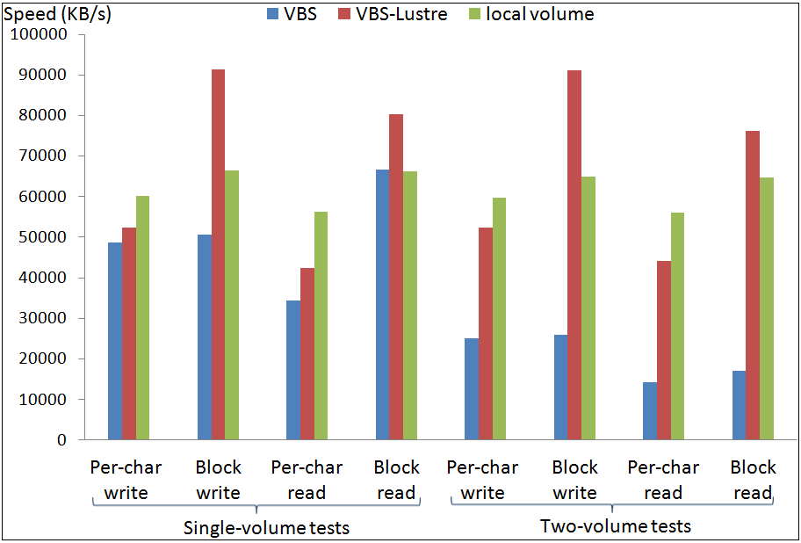
Performance tests
I/O throughput tests done with Bonnie++
Scalable storage size and total bandwidth using Lustre as the backend
Scalable I/O throughput by leveraging striping in Lustre

Slide 44
Publications
[1] X. Gao, J. Qiu. Supporting Queries and Analyses of Large-Scale Social Media Data with Customizable and Scalable Indexing Techniques over NoSQL Databases. Under review for Doctoral Symposium of CCGRID 2014.
[2] X. Gao, J. Qiu. Social Media Data Analysis with IndexedHBase and Iterative MapReduce. In Proceedings of the 6th Workshop on Many-Task Computing on Clouds, Grids, and Supercomputers (MTAGS 2013) at Super Computing 2013. Denver, CO, USA, November 17th, 2013.
[3] X. Gao, E. Roth, K. McKelvey, C. Davis, A. Younge, E. Ferrara, F. Menczer, J. Qiu. Supporting a Social Media Observatory with Customizable Index Structures - Architecture and Performance. Book chapter to appear in Cloud Computing for Data Intensive Applications, to be published by Springer Publisher, 2014.
[4] X. Gao, V. Nachankar, J. Qiu. Experimenting Lucene Index on HBase in an HPC Environment. In Proceedings of the 1st workshop on High-Performance Computing meets Databases (HPCDB 2011) at Supercomputing 2011. Seattle, WA, USA, November 12-18, 2011.
[5] X. Gao, Y. Ma, M. Pierce, M. Lowe, G. Fox. Building a Distributed Block Storage System for Cloud Infrastructure. In Proceedings of CloudCom 2010 Conference. IUPUI Conference Center, Indianapolis, IN, USA, November 30-December 3, 2010.
[6] X. Gao, M. Lowe, Y. Ma, M. Pierce. Supporting Cloud Computing with the Virtual Block Store System. In Proceedings of 5th IEEE International Conference on e-Science. Oxford, UK, December 9-11, 2009.
[7] R. Granat, X. Gao, M. Pierce. The QuakeSim Web Portal Environment for GPS Data Analysis. In Proceedings of Workshop on Sensor Networks for Earth and Space Science Applications. San Francisco, CA, USA, April 16, 2009.
[8] Y. Bock, B. Crowell, L. Prawirodirdjo, P. Jamason, R. Chang, P. Fang, M. Squibb, M. Pierce, X. Gao, F. Webb, S. Kedar, R. Granat, J. Parker, D. Dong. Modeling and On-the-Fly Solutions for Solid Earth Sciences: Web Services and Data Portal for Earthquake Early Warning System. In Proceedings of IEEE International Geoscience & Remote Sensing Symposium. Boston, MA, USA, July 8-11, 2008.
[9] M. Pierce, X. Gao, S. Pallickara, Z. Guo, G. Fox. QuakeSim Portal and Services: New Approaches to Science Gateway Development Techniques. Concurrency & Computation: Practice & Experience, Special Issue on Computation and Informatics in Earthquake Science: The ACES Perspective. 6th ACES International workshop. Cairns, Australia, May 11-16, 2008.
[10] M. Pierce, G. Fox, J. Choi, Z. Guo, X. Gao, and Y. Ma. Using Web 2.0 for Scientific Applications and Scientific Communities. Concurrency and Computation: Practice and Experience Special Issue for 3rd International Conference on Semantics, Knowledge and Grid (SKG2007). Xian, China, October 28-30, 2007.

