Slide 1
Projects for Summer Students
Gregor von Laszewski
laszewski@gmail.com

Slide 2
Who is Gregor?
Adjunct Associate Professor Computer Science Department
Expert in Grid and Cloud Computing
Written many academic papers
Works intensely with students
Has significant programming skills and is known to have helped students when they “tank” a project
Has significant experience in undergraduate including REUs
In the past coPI of an REU site
Best mentor award from the Department of Energy
Undergraduates in his supervision won awards

Slide 3
Which student are we looking for
Is enthusiastic about the project
Has work ethic
Can work in a team
But can work on a task without supervision over multiple days
We do not do the project for you ;-)
Wants to make a contribution they can be proud about
Can manage the deliverables from the REU site and the project
Works 40 hours a week (e.g. 40/5 = 8 hours a day)
GRE Prep Course is not included in the 40 hours, this is your freetime
Spends time in the free time to expand knowledge
Comes to us in case he experiences problems

Slide 4
Outline
What is FutureGrid?
Why chose a FutureGrid Project?
What type of projects exist?
What is expected from me?
Deliverables
Timeline

Slide 5
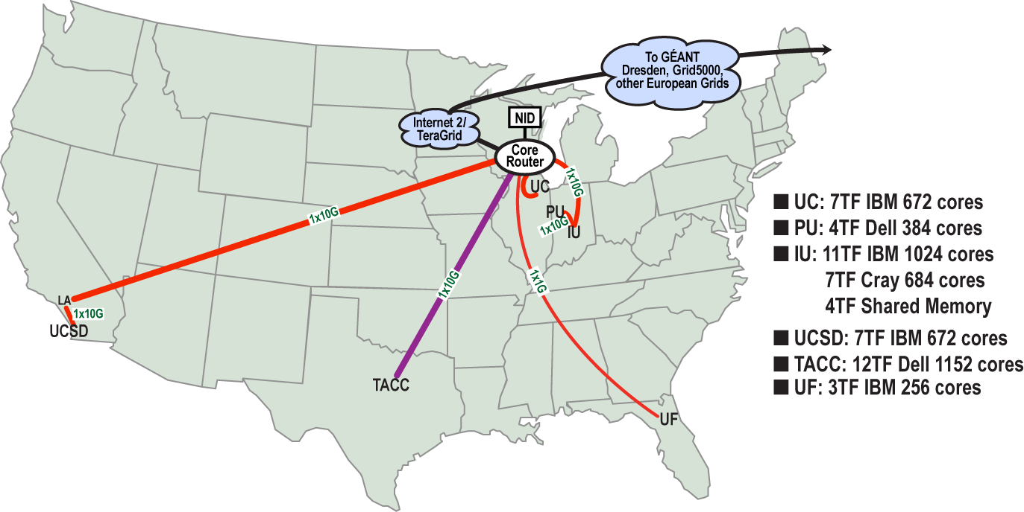
FutureGrid Distributed Resources
12TF Disk rich + GPU 512 cores
NID: Network Impairment Device
Private Public
FG Network

Slide 6
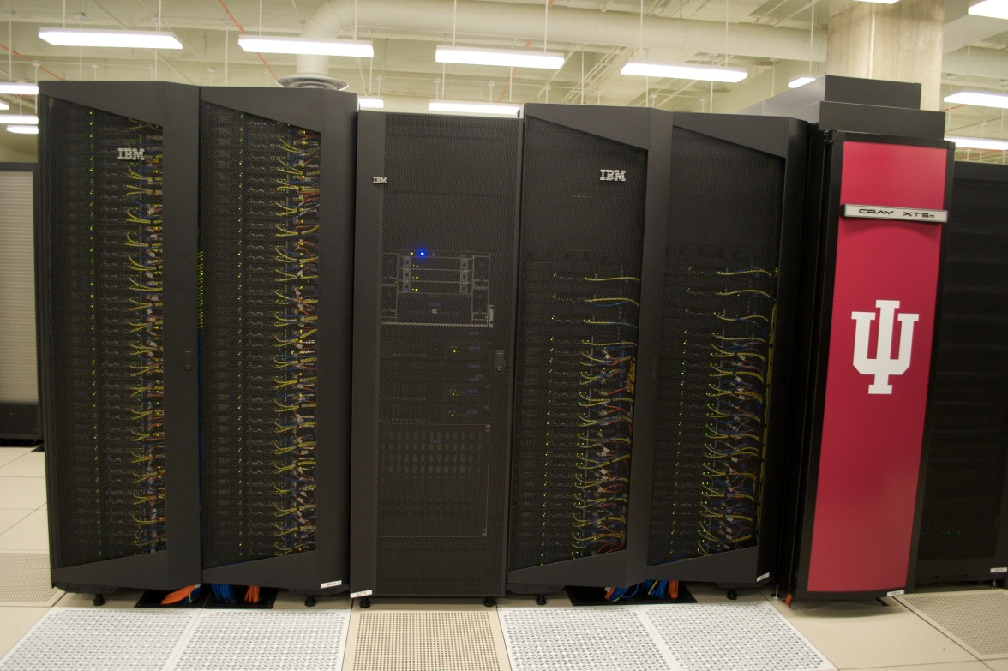
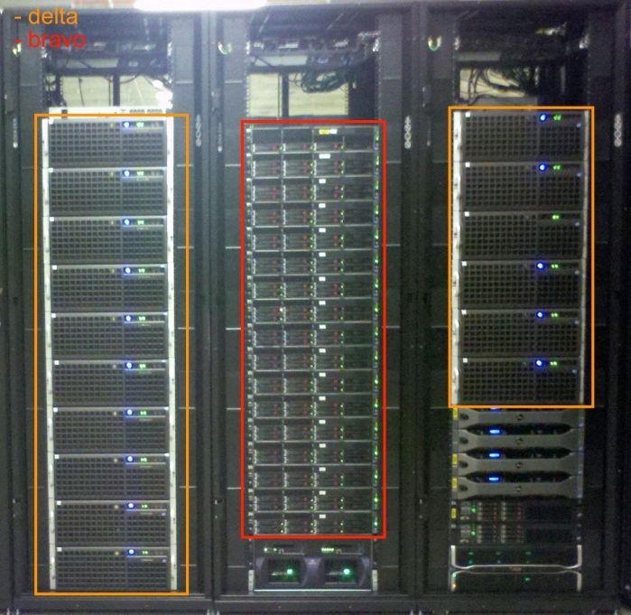
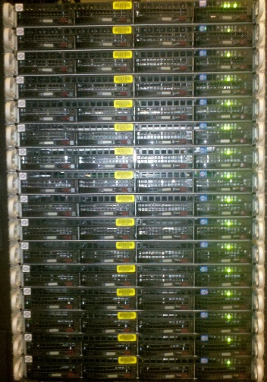
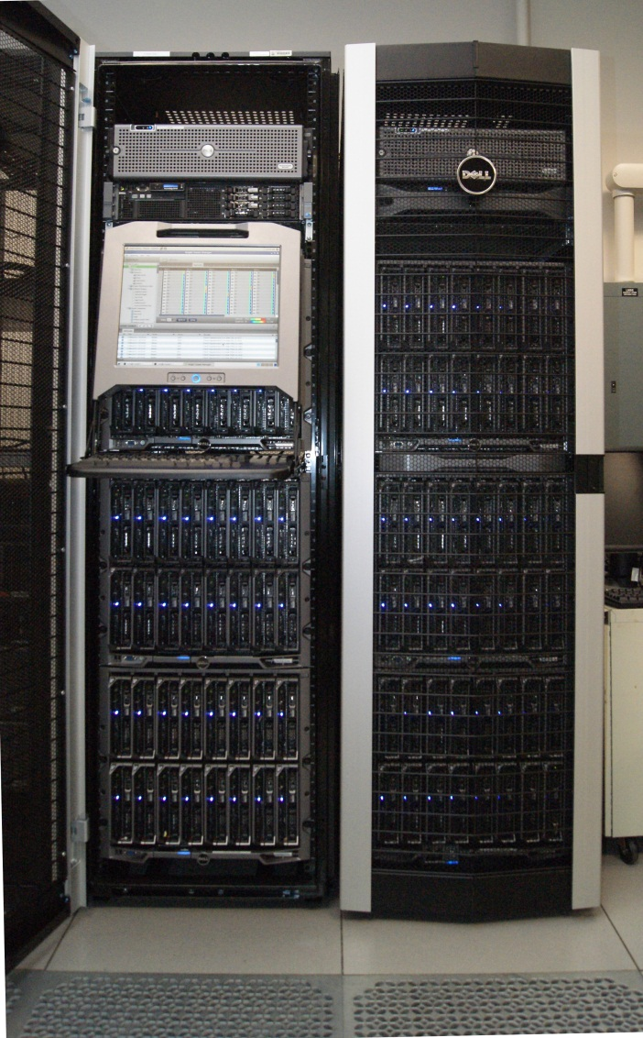
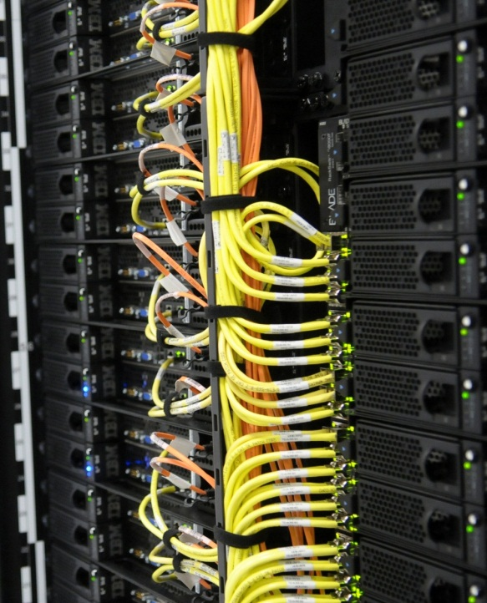
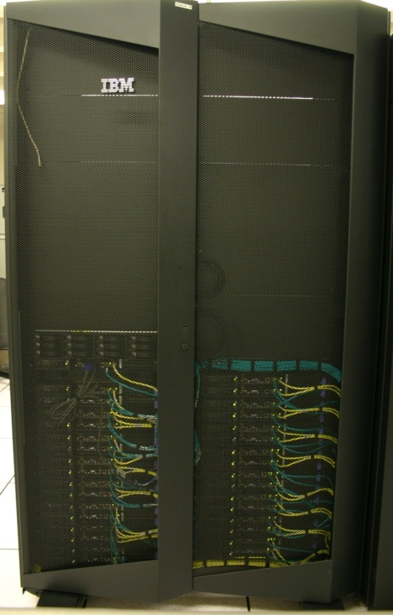
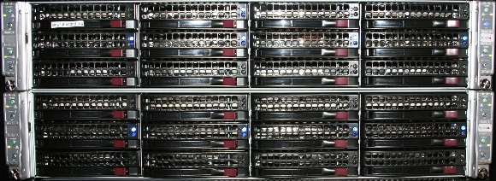
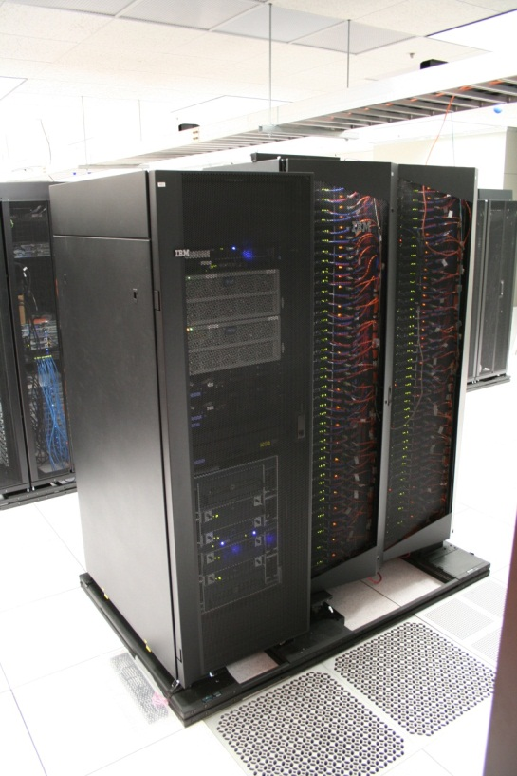
FutureGird Computd Resources
Bravo Delta Echo (IU)
India (IBM) and Xray (Cray) (IU)
Lima (SDSC)
Hotel (Chicago)
Foxtrot (UF)
Sierra (SDSC)
Alamo (TACC)

Slide 7
Name | System type | # CPUs | # Cores | TFLOPS | Total RAM (GB) | Secondary Storage (TB) | Site | Status
India | IBM iDataPlex | 256 | 1024 | 11 | 3072 | 512 | IU | Operational
Alamo | Dell PowerEdge | 192 | 768 | 8 | 1152 | 30 | TACC | Operational
Hotel | IBM iDataPlex | 168 | 672 | 7 | 2016 | 120 | UC | Operational
Sierra | IBM iDataPlex | 168 | 672 | 7 | 2688 | 96 | SDSC | Operational
Xray | Cray XT5m | 168 | 672 | 6 | 1344 | 180 | IU | Operational
Foxtrot | IBM iDataPlex | 64 | 256 | 2 | 768 | 24 | UF | Operational
Bravo | Large Disk & memory | 32 | 128 | 1.5 | 3072 (192GB per node) | 192 (12 TB per Server) | IU | Operational
Delta | Large Disk & memory With Tesla GPU’s | 32 CPU 32 GPU’s | 192 | 9 | 3072 (192GB per node) | 192 (12 TB per Server) | IU | Operational
Lima | SSD Test System | 16 | 128 | 1.3 | 512 | 3.8(SSD) 8(SATA) | SDSC | Operational
Echo | Large memory ScaleMP | 32 | 192 | 2 | 6144 | 192 | IU | Beta
TOTAL |  | 1128 + 32 GPU | 4704 +14336 GPU | 54.8 | 23840 | 1550

Slide 8
Why choose a FutureGrid Project?
Cloud computing is important
FutureGrid is an international leading project
2000+ users
300+ projects
500+ computers, 10 clusters, 4000+ cores
Go ahead and by 500+ computers at best buy and put in your dorm room ;-)
You will be working on one project and complete it well
You will be working in a team
You will do something that is actually used and you can be proud about
The projects are interesting and have various degrees of difficulty (freshmen – PhD level)

Slide 9
Projects
We have many projects
We can define a project that is suited to your background
We will help you in the course of the project
You must understand that there is a difference between a course homework assignment and a project in the REU
Larger
We like to make use of the project after you leave
Its not to be designed to just have you do busy work
Flaws must be communicated before you leave
Professional

Slide 10
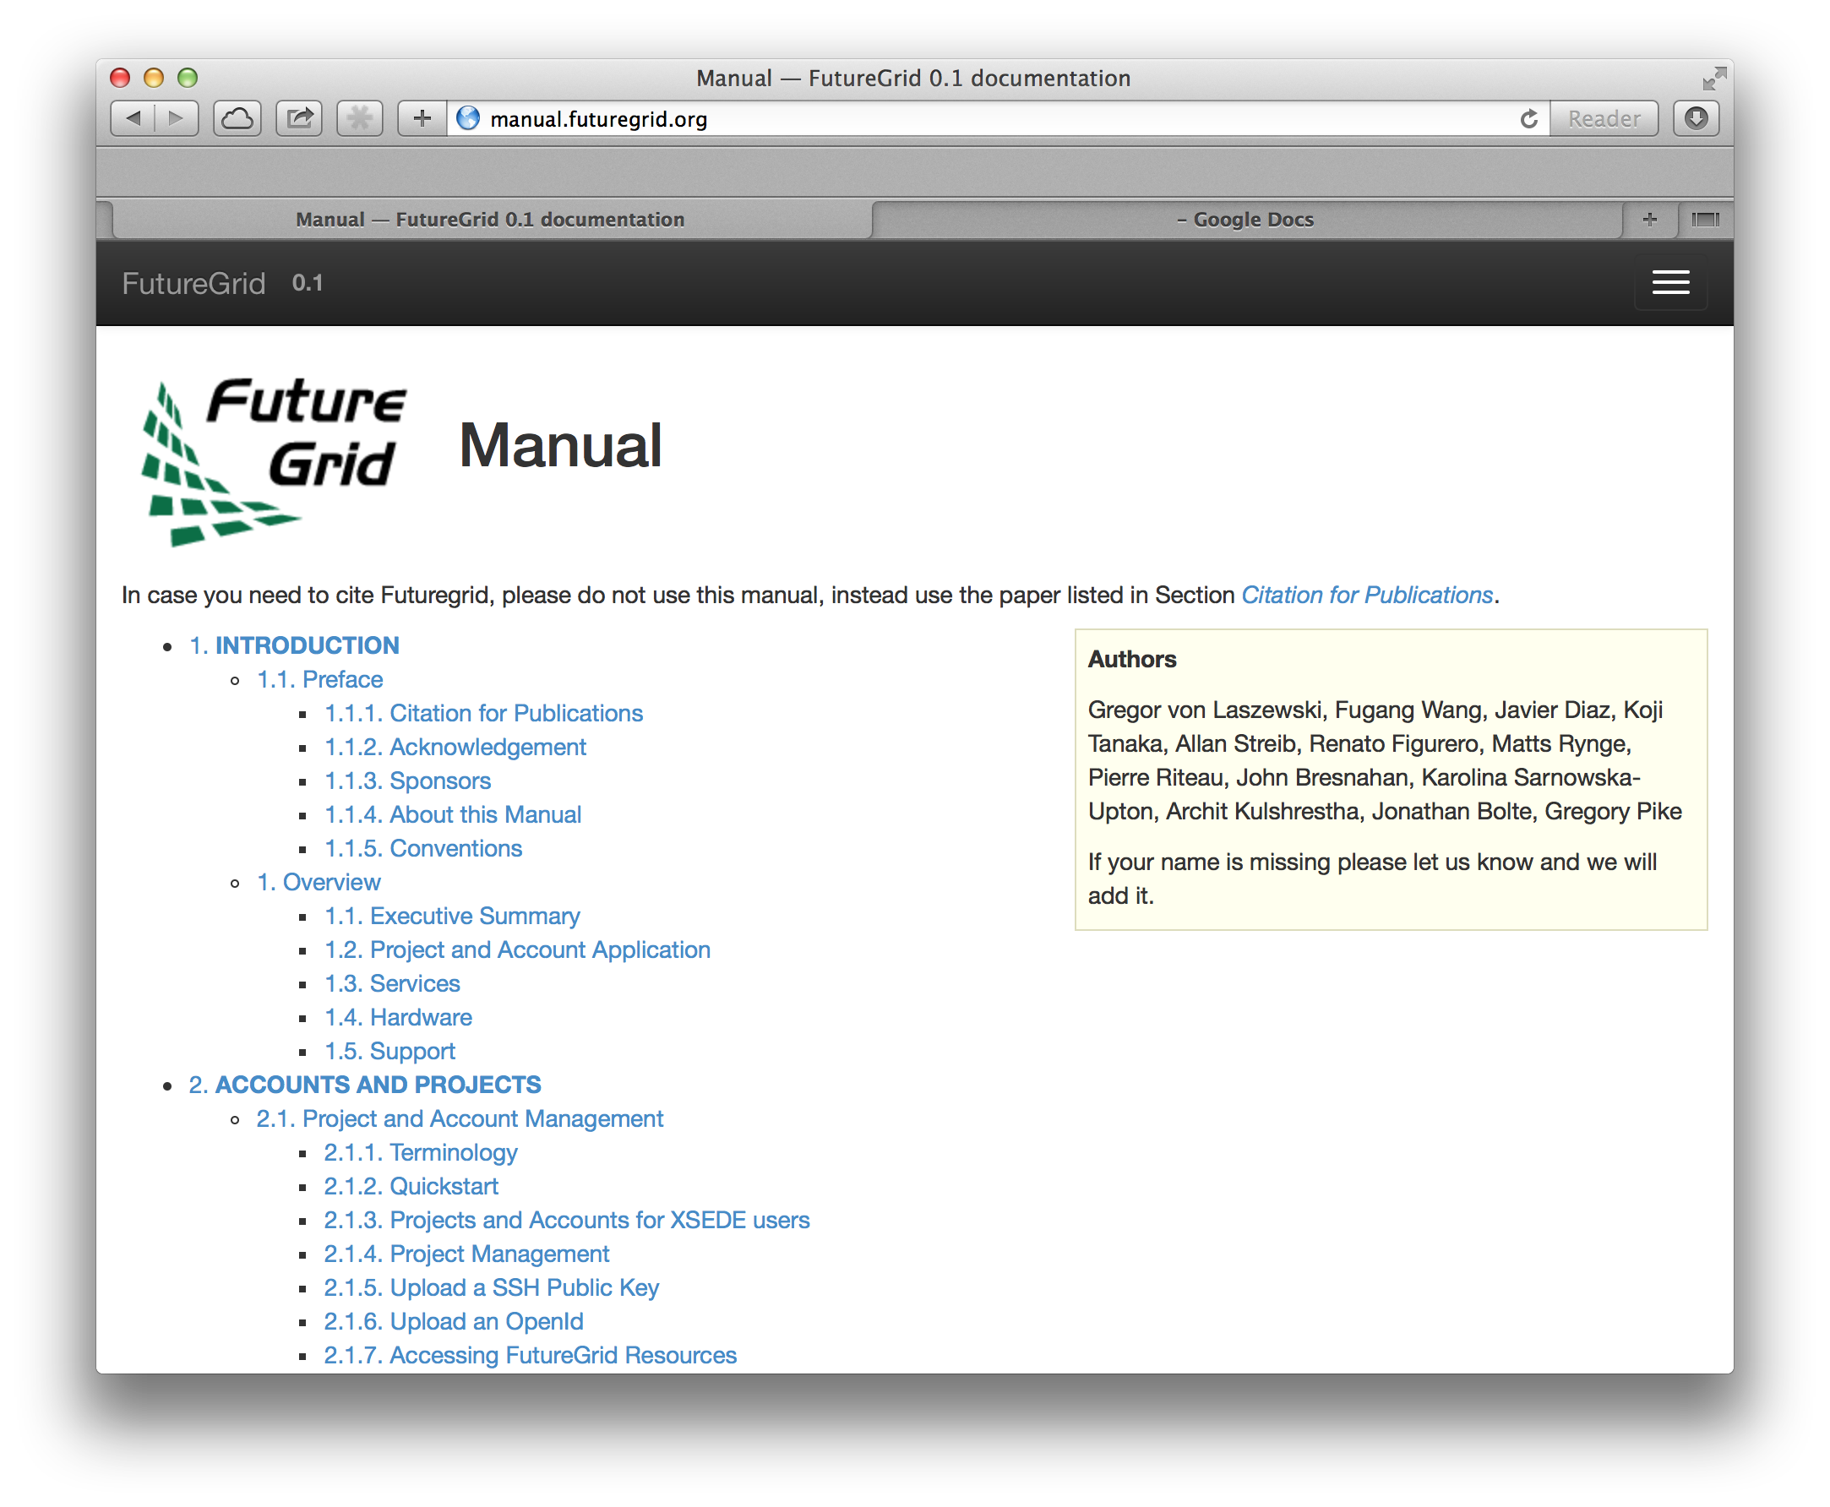
Project: Quality Control
Difficulty
Problem:
We need to improve documentation, tutorial, and code
Deliverables:
You can participate in cleanup and improvements
Background
tittle
What you do depends on your skills
Dependent on task excellent English language skills

Slide 11
Project: iPython for Clouds
Difficulty
Problem:
Students need a set of simple educational exercises to learn how to program and access the cloud from python
Deliverables:
iPython notebooks for simple python language features while relating them to cloud computing examples.
iPython notebooks for using cloudmesh to interface with clouds
iPython to sphinx integration (already done by Gregor) to publish the iPython notebooks in sphinx
Background
Understanding of programming
If no programming background is available, you will learn to program

Slide 12
Example of what users will see

Slide 13
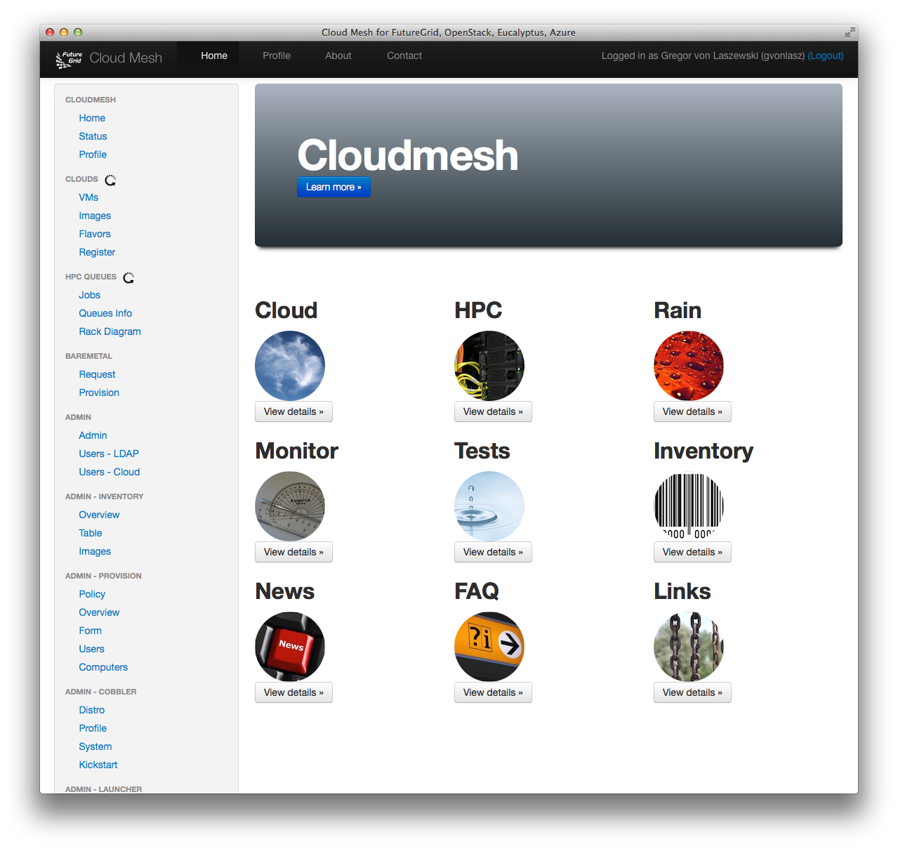
Project: django for cloudmesh
Problem:
Cloudmesh currently uses flask. Develop a prototype django server and integrate a very simple subset of functions to demonstrate use and applicability of django for cloudmesh
Deliverables:
Working django setup on clean ubuntu machine.
Django bootstrap theme similar to our flask theme
List of virtual machines on various clouds using the convenient cloudmesh databases
Background
Understanding of python programming

Slide 14
Project: Cloudmesh.v3 Account and Project Management
Problem:
Currently projects and accounts are managed via the FutureGrid portal. We like to develop an account and project management framework this is independent from the previous portal
Deliverables:
Deliver this either in flask or django (dependent on background of student)
Focus on account and project management
Use a database (possibly mongodb) and develop a prototype data structure for projects and users based on what we have in the portal
Manage multiuser application processes and registration via this portal
Provide management functions – list – review – roles
Integrate with OpenStack keystone
Background
Understanding of python programming

Slide 15
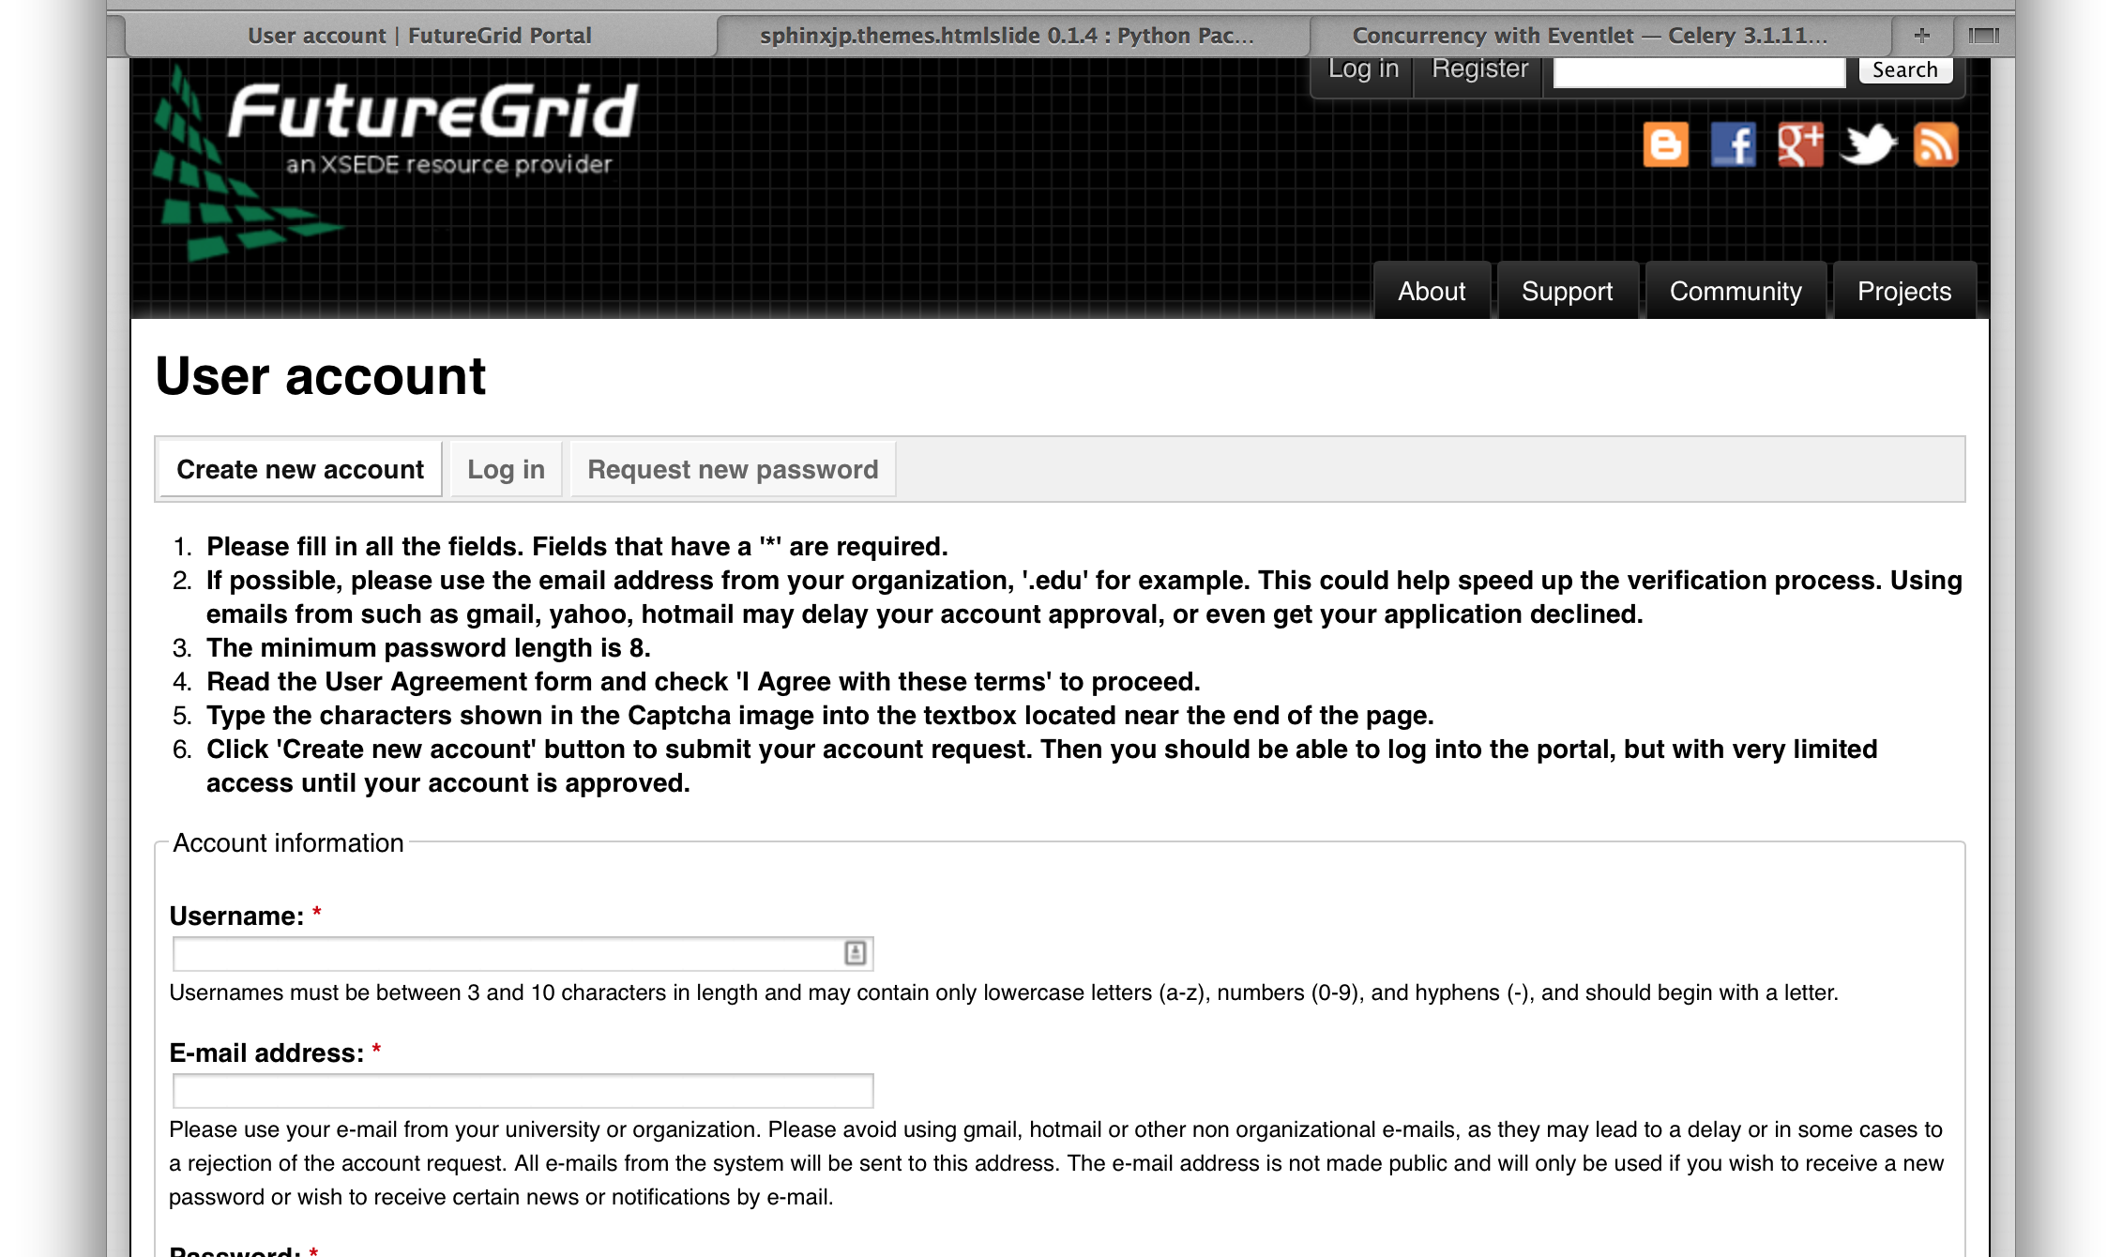
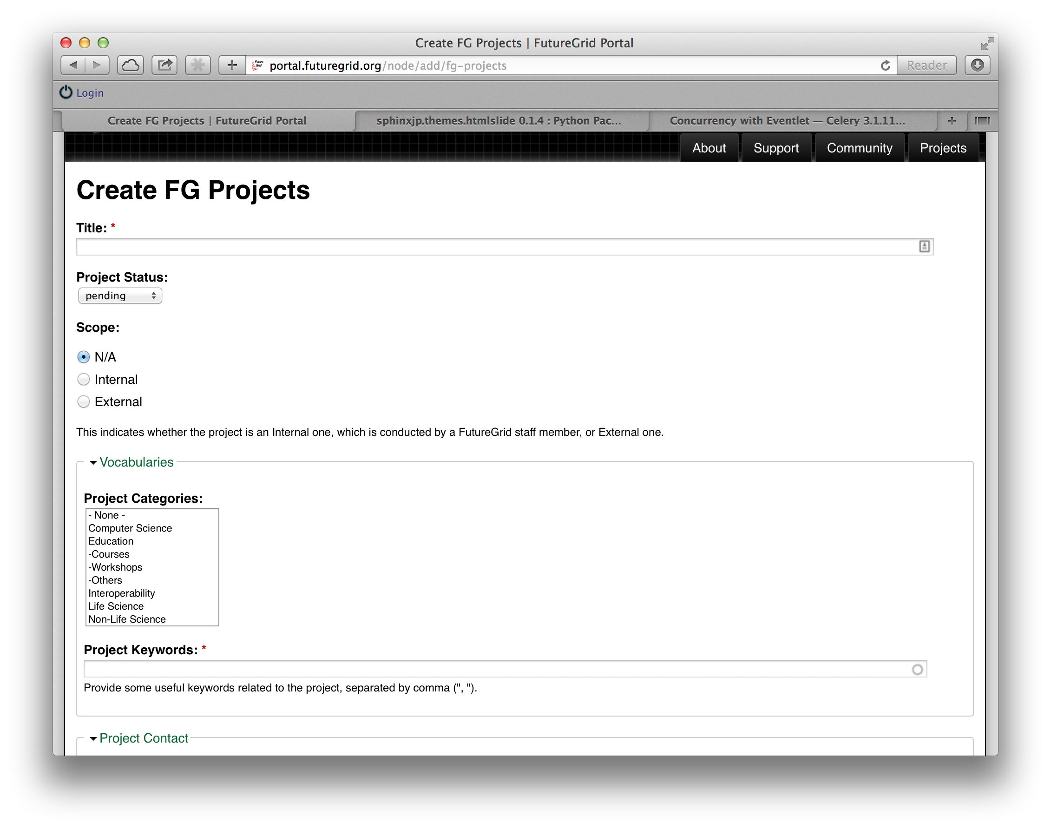
Example Screenshots from current system

Slide 16
Project: Cloudmesh JavaScript GUIs
Problem:
Currently cloudmesh has a number of Javascripts GUIs. Implement missing features
Deliverables:
Many improvements can be done in the GUis
Background
Understanding of python programming (can be learned)
Understanding of jinja2 (can be learned)
Understanding of Javascript

Slide 17
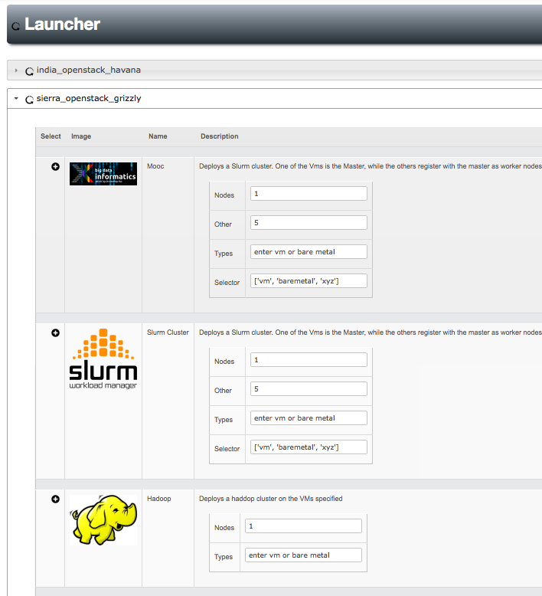
Example panels that need improvements

Slide 18
Project Design your own project with us
Problem:
You may want to work on something else or explore what project you are best suited for
Delivery:
Work today with Gregor to identify and formulate a wonderful project

Slide 19
Deliverables
General Rules
Concrete Deliverables
Deliverables depend on role within the project and will be agreed upon once you commit to the project.
You have general deliverables to do as part of the REU. You will have to deliver them also! They have to be submitted also to Gregor.
REU requirements
Academic paper about what you did
Poster about what you did
Weekly updates
Project Requirements
20 hours work
Come to work rested
Working Code
2-4 pages of REU long evolving academic paper (no timeline report)
Weekly updates (see above)

Slide 20
Commitment and time management
You must be committed to the project. This includes actually spending time on the project ;-)
But I have so many other commitments
such as lectures and outings and trips and parties and sports activities and phone calls and lunch and dinner and TV and social network updates that I need to check and respond to in seconds as my friends expect this …
so there is really no time to do a project … ;-)
Time management
8 weeks is a very short time
Do things early – procrastination is real bad – dont start your project in week 7
Find a balance between your project and social life, remember you have social life also after you finish the 8 weeks
You are allowed to work more hours, including the weekend and evenings. You have access to the building
Switch off your twitter and facebook tweets or sounds and IGNORE them if they are not essential. Create an uninterrupted time for work
20 hours work means be in the office Mo-Fri for at least 4 hours! If you have other things to do that day, add the hours to another day.
Make sure you work at least 20 hours on the project

Slide 21
Time management
Weekly updates in written form:
Avoid double work for REU site and project: COMBINE!!!!
What have I done this week?
What am I planning to do next week?
What have I not achieved this week?
How did I contribute this weed to
Final poster?
Final ppt?
Final paper?
Final code?
If it takes you more than 10 minutes to answer the question something is wrong … come to Gregor

Slide 22
Timeline
Week 1: Identify Project and Communicate to others what you do
Identify FutureGrid Project
Write 1 page summary of what the project is about and what the goal is
Prepare slides
Slide 1: Project Objective – What is the problem and what am I doing ?
Slide 2: Background – What is the motivation ?
Slide 3: Project Plan - What are you doing when
Slide 4: Project Deliveries – What will I deliver and what will be achieved
Slide 5: Gap Analysis – What knowledge do I not have yet to conduct the project
Communicate general REU timeline to Gregor so time adjustments can be made
For example REU may have additional lectures, ….

Slide 23
Week 1
Week 2
Week 3
Week 4
Select Project
Identify Gaps
Git
Technologies
FG Accounts
OpenStack
Design
Implementation plan
Start Implementation
Midterm
Week 5
Week 6
Week 7
Week 8
Midterm

Slide 24
Timeline
Week 2 – 4
Conduct the design and start the project
Each week improve your paper and presentation
Daily check in your progress into github
Week 4
Identify gaps that you need to fill and de
Midterm evaluation
Identify with Gregor what needs to be done for the rest of the time, adjust deliverables
Week 5-7
Complete the project
Each week improve your paper and presentation
Daily check in your progress into github

Slide 25
Timeline
Week 8
You should have most of the project completed
Spend time cleaning up the project
Prepare a professional document
Will be done throughout the semester in google docs with acm template
Prepare a professional PPT
Use this template
If no access to ppt, use google presentations
Code
In case code is deliverable make sure its all checked in and works
In case documentation is deliverable make sure everything is checked in and it is documented

