Slide 1
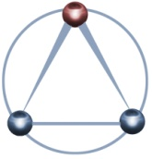
AMSA TO 4 Advanced Technology for Sensor Clouds 09 May 2012
Anabas Inc.
Indiana
University

Slide 2
IU/Anabas Final Review Agenda
Cloud and Grid Computing
Overview of Status of Clouds
Geoffrey Fox (Indiana University)
Adaptive Multi-Layered Sensing Architecture
Alex Ho (Anabas Inc.)
Sensor Cloud Middleware
Discussion of the Middleware
Ryan Hartman (Indiana University)
Demonstration
Vignesh Ravindran (Indiana University)
Performance Results/Future Work
Ryan Hartman (Indiana University)

Slide 3
Sensor Cloud Middleware
The IU Middleware Team lead by Dr. Geoffrey Fox of the IU Community Grids Lab
Special thanks to Sankarbala Manoharan and Vignesh Ravindran
Project Website https://sites.google.com/site/sensorcloudproject
Continuing the SCGMMS work of Alex Ho from Anabas, Inc.

Slide 4
Definitions
Middleware
Asynchronous message-passing vs request-response
Message queues (topics)
Delivery managed by the Message Broker
Message Broker
Validation
Transformation (aggregation, decomposition, representation etc.)
Routing
Many out there we use Narada Broker (http://www.naradabrokering.org/)
Cloud
Perhaps we could persuade Dr. Fox to say a few words on this!

Slide 5
Sensor Cloud Middleware
Middleware then provides a messaging system that is:
Loosely-coupled
Reliable
Application Integration
Clouds provide:
Elastic Infrastructure
Our goal then was to:
Create a cloud-based messaging system for distributed sensor-centric applications
Great, except what do you mean by a sensor?

Slide 6
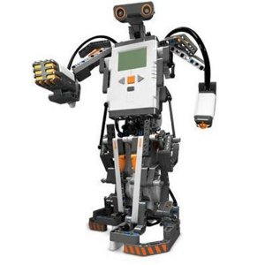
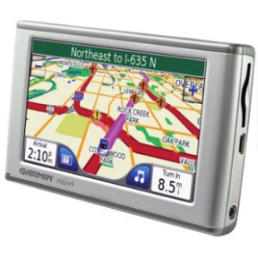
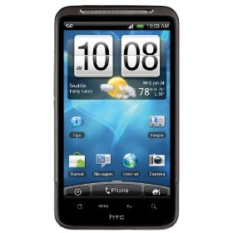
Sensors
Physical Devices
Computational Services
Anything producing a time-dependent data stream,
Usually with geolocation information

Slide 7
Sensor Cloud Middleware Review
Goal for the IU Middleware Team:
Create a cloud-based messaging system for distributed sensor-centric applications
Questions to this point?

Slide 8
Senor-Centric Grid Middleware Management System
Collaboration between AFRL-Ball-Anabas-IU
Research using a distributed messaging network to connect a collection of spatially separated sensor grids
Sensor Cloud builds on this technology

Slide 9
Pub/Sub Messaging
At the core Sensor Cloud is a pub/sub system
Publishers send data to topics with no information about potential subscribers
Subscribers subscribe to topics of interest and similarly have no knowledge of the publishers
Notes:
The publish/subscribe (pub/sub) design pattern [5] describes a loosely-coupled architecture based message-oriented communication between distributed applications. In such an arrangement applications may fire-and-forget messages to a broker that manages the details of message delivery. This is an especially powerful benefit in heterogeneous environments, allowing clients to be written using different languages and even possibly different wire protocols. The pub/sub provider acts as the middle-man, allowing heterogeneous integration and interaction in an asynchronous (non-blocking) manner.
The pub/sub architecture uses destinations known as topics. Publishers address messages to a topic and subscribers register to receive messages from the topic. Publishers and subscribers are generally anonymous and may dynamically publish or subscribe to the content hierarchy. The system takes care of distributing the messages arriving from a topic's multiple publishers to its multiple subscribers. Topics retain messages only as long as it takes to distribute them to current subscribers. Figure 1 illustrates pub/sub messaging.
Message publication is inherently asynchronous in that no fundamental timing dependency exists between the production and the consumption of a message. Messages can be consumed in either of two ways:
Synchronously. A subscriber or a receiver explicitly fetches the message from the destination by calling the receive method. The receive method can block until a message arrives or can time out if a message does not arrive within a specified time limit.
Asynchronously. A client can register a message listener with a consumer. A message listener is similar to an event listener.

Slide 10
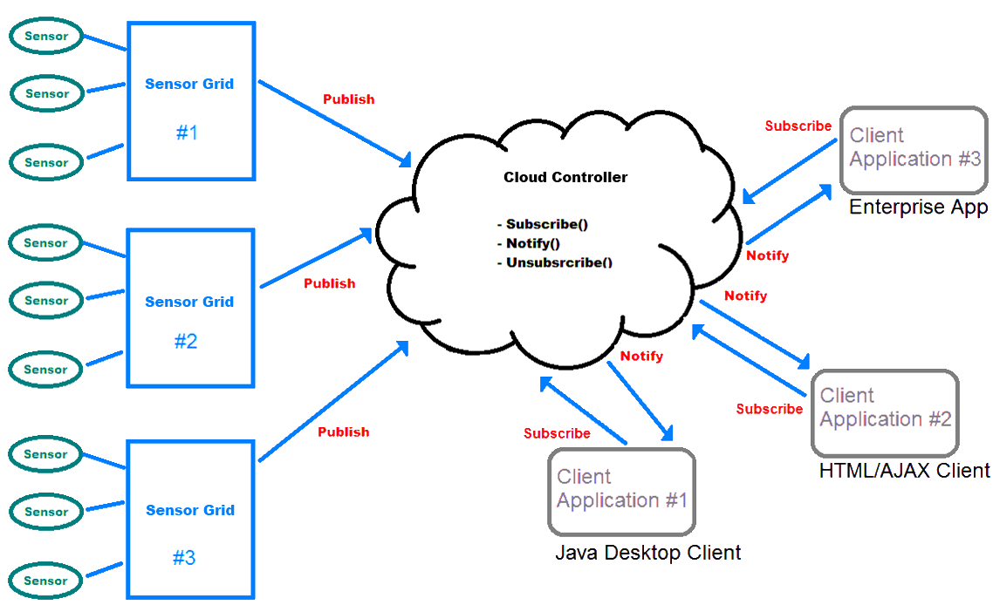
Sensor Cloud 10,000’ View

Slide 11
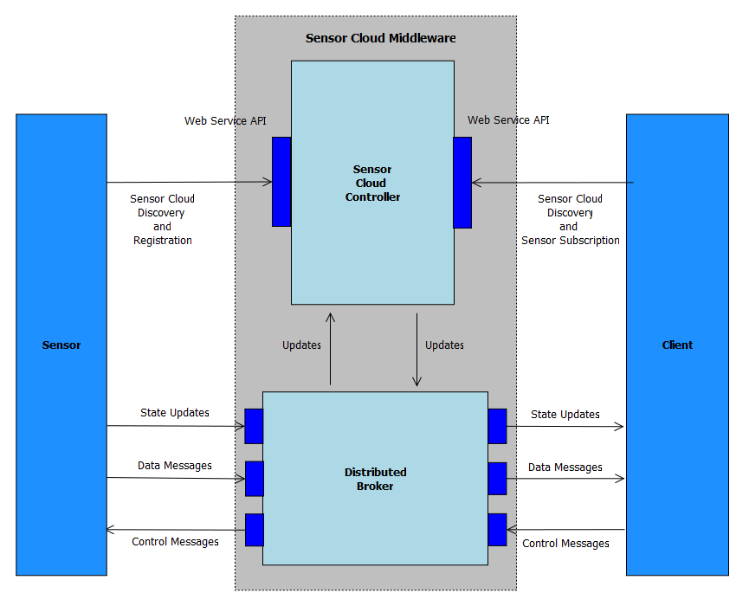
Sensor Cloud Architecture

Slide 12
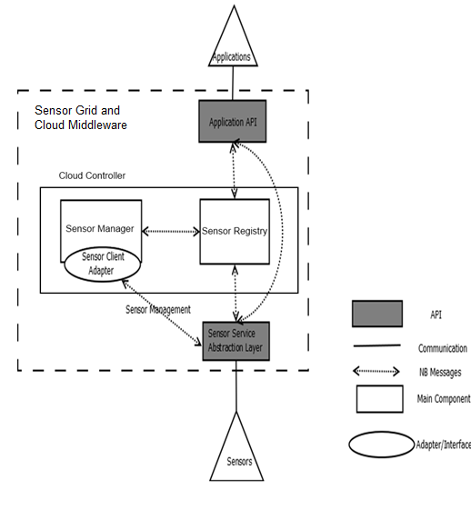
Sensor Cloud Middleware
Sensors are deployed in Grid Builder Domains
Sensors are discovered through the Sensor Grid
Grid Builder and Sensor Grid are abstractions on top of the underlying Message Broker
Sensors Applications connect via simple Java API

Slide 13
Key Middleware Components
Grid Builder
Sensor Grid
Sensor and Client API’s
Sensor Service Abstraction Layer
Client/Application API

Slide 14
Grid Builder
GB is a sensor management module
1. Define the properties of sensors
2. Deploy sensors according to defined properties
3. Monitor deployment status of sensors
4. Remote Management - Allow management irrespective of the location of the sensors
5. Distributed Management – Allow management irrespective of the location of the manager / user
GB itself posses the following characteristics:
1. Extensible – the use of Service Oriented Architecture (SOA) to provide extensibility and interoperability
2. Scalable - management architecture should be able to scale as number of managed sensors increases
3. Fault tolerant - failure of transports OR management components should not cause management architecture to fail

Slide 15
Sensor Grid
SG communicates with
Sensors
Applications
Grid Builder to mediate the collaboration of the three parties
Primary functions of SG are to manage and broker sensor message flows.

Slide 16
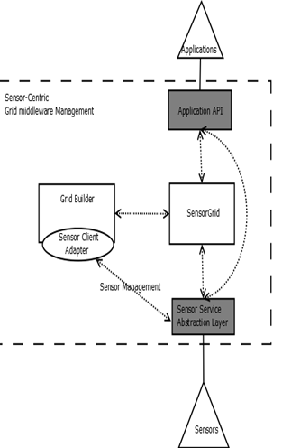
Sensor to Sensor Grid Communication
SG keeps track of the status of all sensors when they are deployed or disconnected
Applications using the sensors will be notified of changes
Sensor data normally does not pass through SG except when it intentionally has to be recorded
In this case SG will subscribe to data of that particular sensor
The point is data flow is done efficiently!

Slide 17
Application (Client) to Sensor Grid Communication
Applications communicate with SCMW through the Application API layer
Application API in turn communicates with SG
Applications can define their own filtering criteria e.g. location, sensor id, and type to select which sensors they are interested in.
These filters are sent to SG for discovering and linking appropriate sensors
Once a client registers a filter SG automatically sends an update message when there are changes to the list of relevant sensors

Slide 18
Grid Builder to Sensor Grid Communication
Sensors’ properties are defined in GB.
Applications obtain this information through SG.
Filtering requests are periodically sent to GB for updating the lists of sensors needed for each application according to their defined filter parameters.
Much of the information will be stored in a SG to minimize queries to Grid Builder.

Slide 19
Application (client) to Sensor Communication
Applications Discover Sensors through SG
Applications then communicates directly with sensors through the Application API for:
receiving data
sending control messages
Efficient data flow

Slide 20
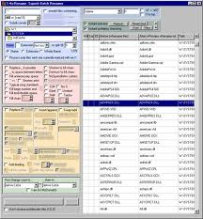
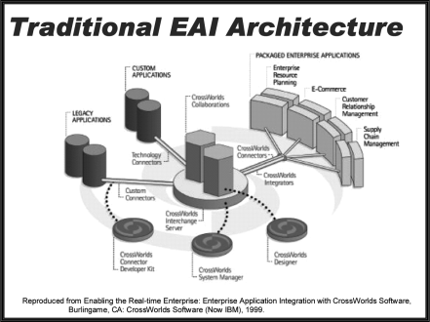
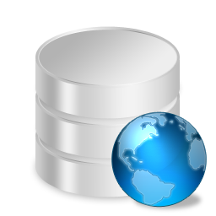
Client Applications
Clients connect via simple Java API or Web Services
Discovery, Subscription and Control services are provided
Clients and also be Sensors or Computational Units
Sensors Publishers Clients Subscribers

Slide 21
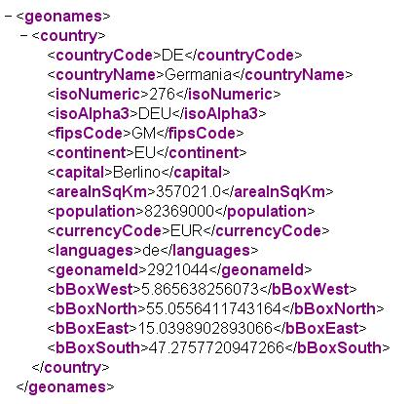
Sensor Cloud Data to Web Clients
Sensor Cloud data to web clients
Great for mobile devices
Excellent Security Model
RESTful Web Services
For Sensor Discovery
Useful with discrete sensor data
Streaming Web Services
Useful for continuous data e.g. audio/video

Slide 22
Web Servers Cont.
RESTful Service
Discovery: http://162.18.94.32:8080/sensorcloud/restful-services/sgxservice/getSensors
Properties: http://162.18.94.32:8080/sensorcloud/restful-services/sgxservice/getSensor/properties/{id}
Data: http://162.18.94.32:8080/sensorcloud/restful-services/sgxservice/getSensors/Data/{id}
Streaming Service
Native WebM Video Support:

Slide 23
Performance Results
Single Broker
Distributed Brokers

Slide 24
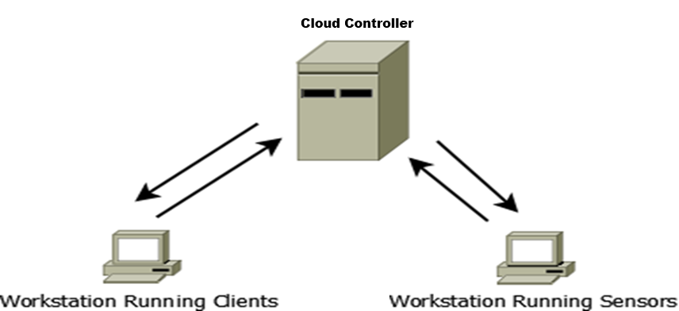
Single Broker

Slide 25
Single Broker Results
Single Broker/Single Domain
Hosting simulated video data
Acceptable performance for ~175 clients

Slide 26
Single Broker GPS Sensors

Slide 27
Distributed Brokers

Slide 28
Distributed Broker Performance
Video Sensors with Distributed NB

Slide 29
Future Work
Elastic Scaling
Robust User Management
Data Protection with Hybrid Clouds

Slide 30
Questions?
Ryan Hartman
rdhartman@indiana.edu

