Slide 1
salsaDPI
A Dynamic Provisioning Interface for IaaS
Tak-Lon (Stephen) Wu

Slide 2

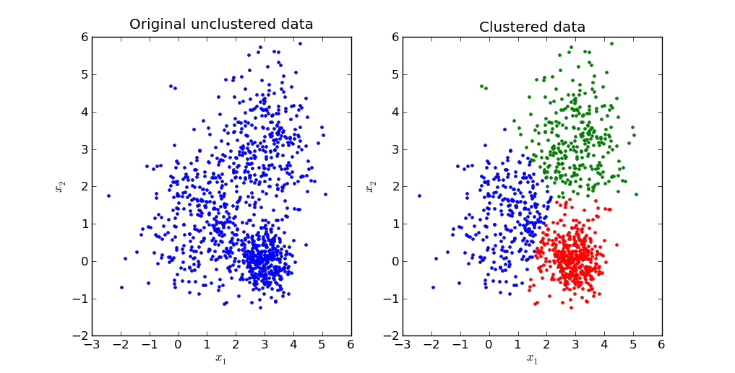





Motivations
Background knowledge
  Environment setting
  Different cloud infrastructure tools
  Software dependencies
  Long learning path
Automatic these complicated steps?
Solution: Salsa Dynamic Provisioning Interface (SalsaDPI).
  batch-like program

Slide 3

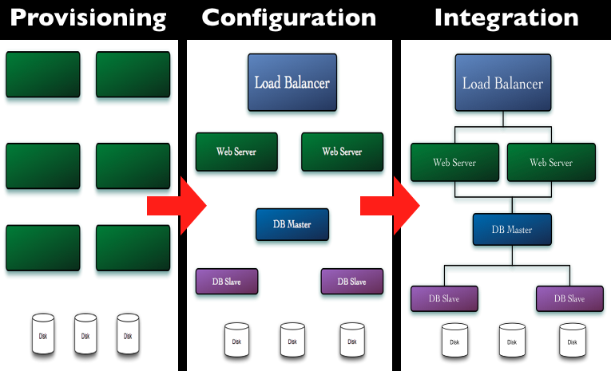
Chef
open source system
traditional client-server software
Provisioning, configuration management and System integration
contributor programming interface
Graph source: http://wiki.opscode.com/display/chef/Home

Slide 4



What is SalsaDPI? (High-Level)
SalsaDPI Jar
Chef Client
Chef Server
OS
User
Conf.
2. Retrieve conf. Info. and request Authentication and Authorization
3. Authenticated and Authorized to execute software run-list
5. Submit application
commands
Bootstrap VMs
with a conf. file
6. Obtain Result
4. VM(s) Information
Apps
Apps
Apps
S/W
S/W
S/W
Chef
Chef
Chef
OS
OS
OS
VM
VM
VM
* Chef architecture http://wiki.opscode.com/display/chef/Architecture+Introduction

Slide 5
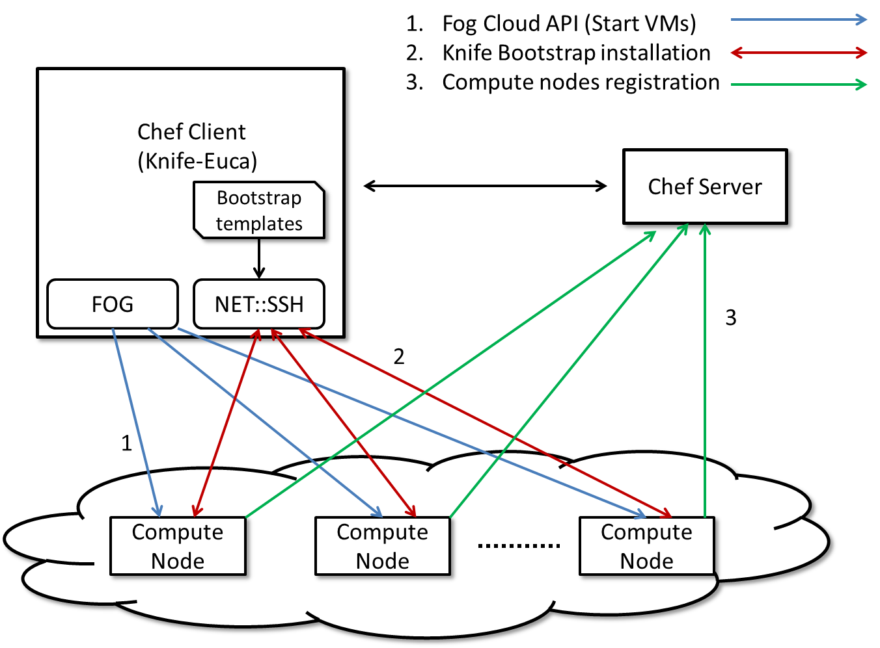
Chef Study

Slide 6

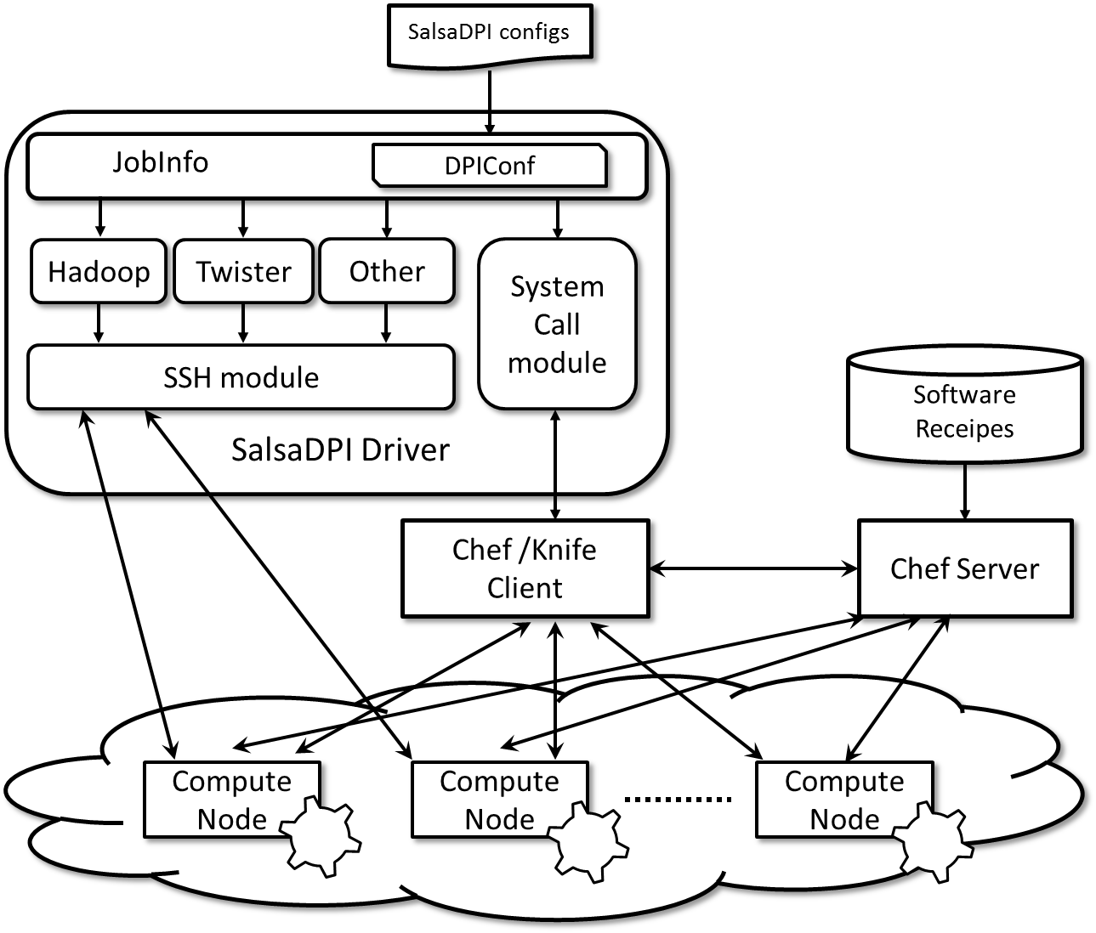
What is SalsaDPI? (Cont.)
SalsaDPI
  Provide configurable (API later) interface
  Automate Hadoop/Twister/other binary execution
*Chef Official website: http://www.opscode.com/chef/

Slide 7
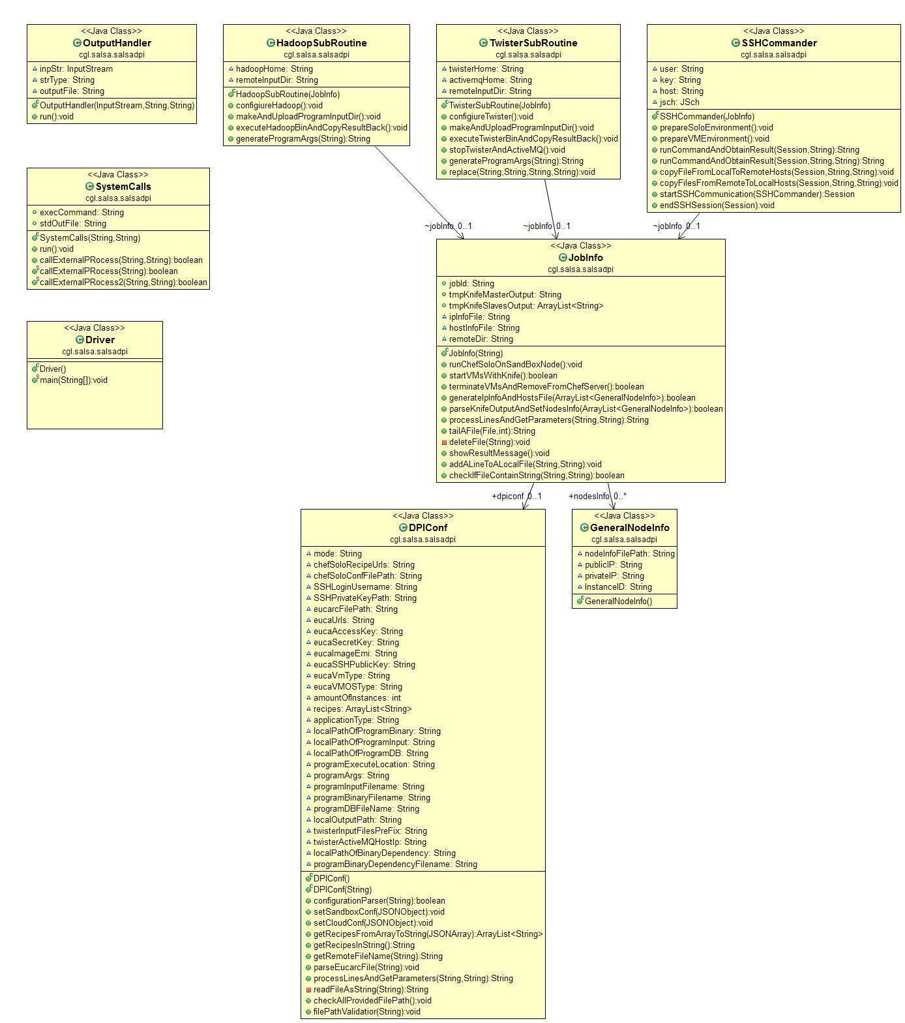

Slide 8
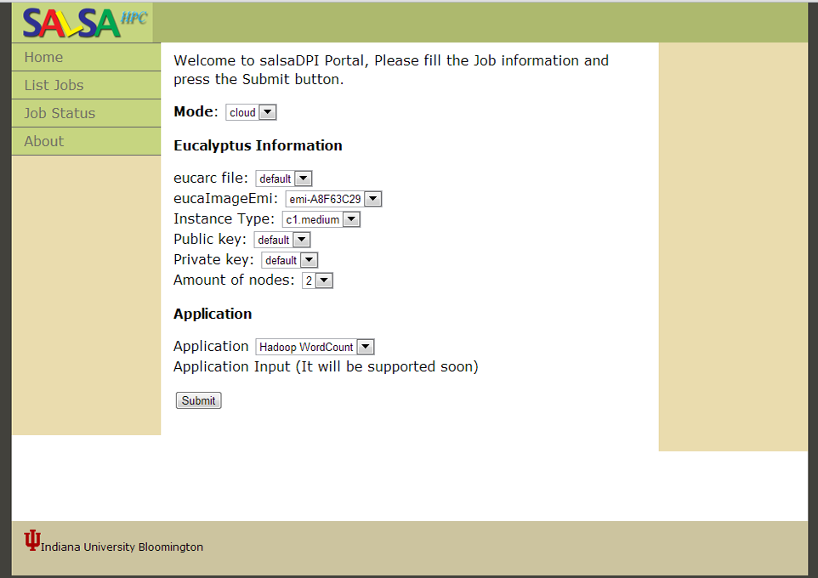
Web Interface
http://salsahpc.indiana.edu/salsaDPI/

Slide 9
Features
One-Click solution
Possibly could support various IaaS
Support Walrus-S3-like/HTTP/local input

Slide 10
Possible Experiments
Test different runtimes and different algorithm, understand their behaviors.
Record the internal communication time of each component of salsaDPI package
Record and investigate SSH message redirect time and weight of salsaDPI
Test salsaDPI with different permanent storage such NFS, SFTP/HTTP, Object-storage Walrus
How many data could salsaDPI handle?
How is the scalability on federal cloud?

Slide 11
Q & A
Any suggestion?

Slide 12
Thank you

Slide 13
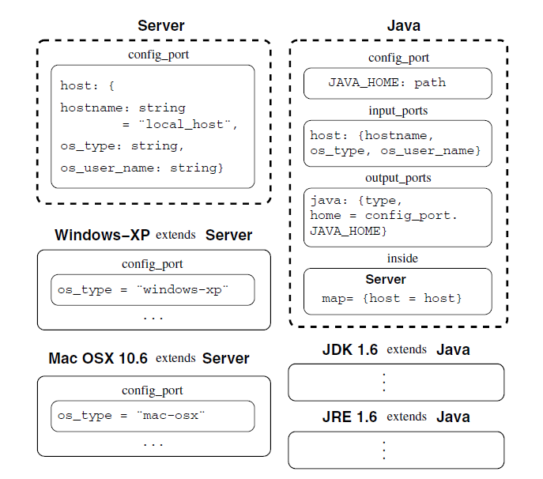
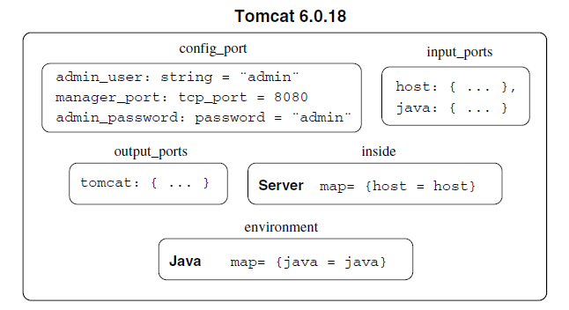
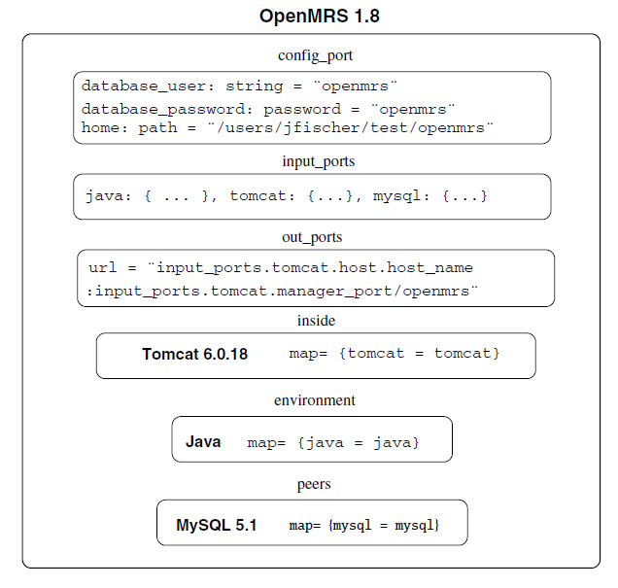
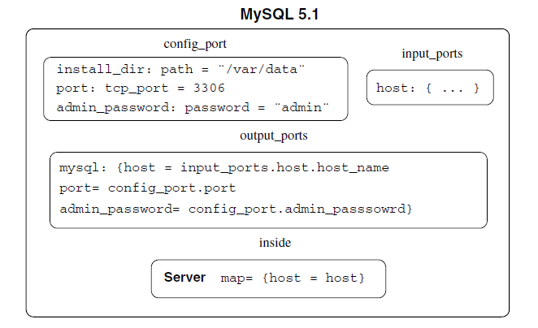
Related Work - Engage
Resource Type = Component
J. Fischer, R. Majumdar, and S. Esmaeilsabzali, "Engage: a deployment management system," SIGPLAN Not., vol. 47, pp. 263-274, 2012.

Slide 14
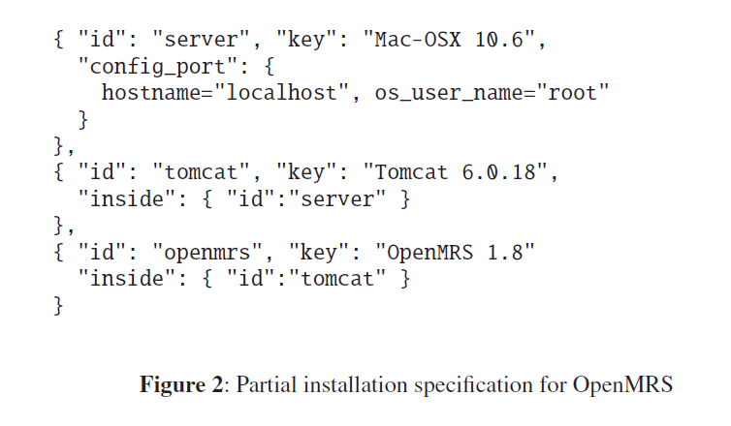
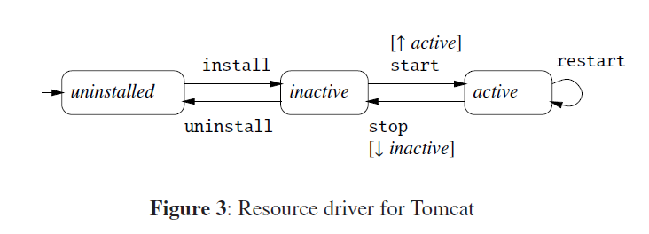
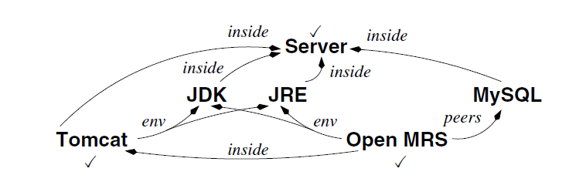
Related Work – Engage (cont.)

Slide 15
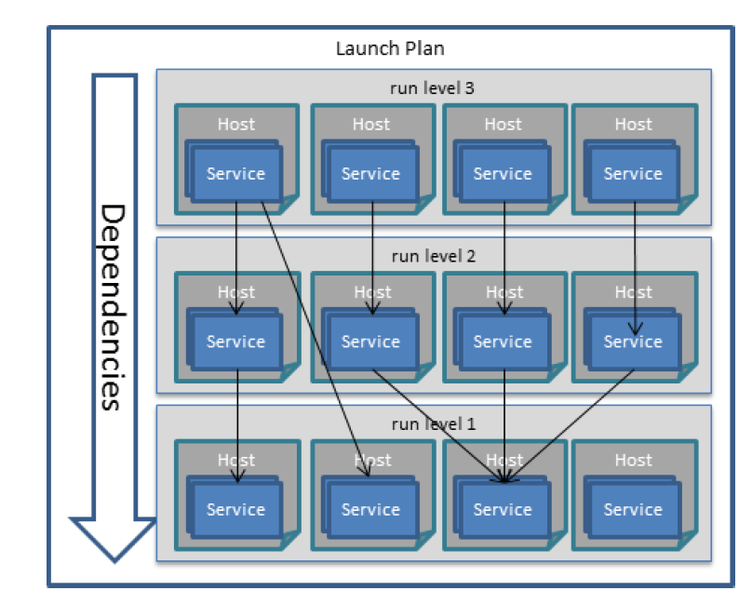
Related Work (Cloudinit.d)
They use chef to do bootstrap on every starting VMs.
J. Bresnahan, T. Freeman, D. LaBissoniere, and K. Keahey, "Managing appliance launches in infrastructure clouds," presented at the Proceedings of the 2011 TeraGrid Conference: Extreme Digital Discovery, Salt Lake City, Utah, 2011.
K. Keahey, P. Armstrong, J. Bresnahan, D. LaBissoniere, and P. Riteau, "Infrastructure Outsourcing in Multi-Cloud Environment," presented at the the 8th Open Cirrus Summit, San Jose, CA, 2012.

Slide 16
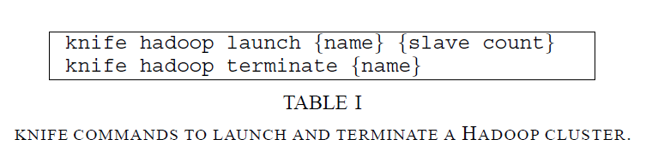
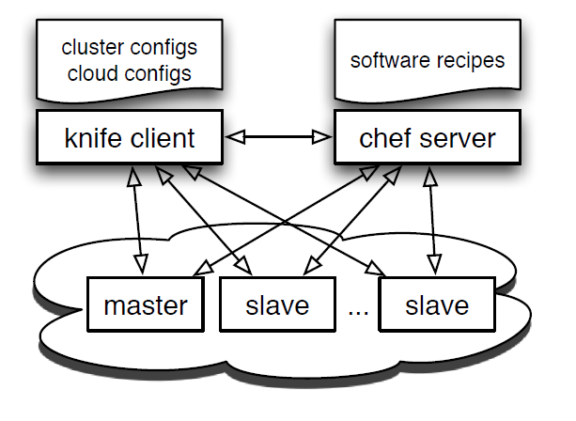
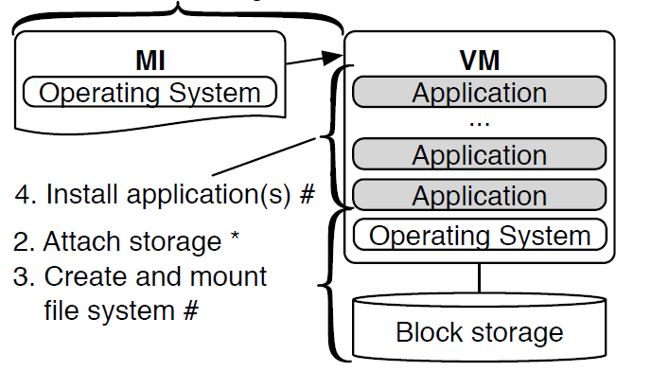
Related Work (Jon’s Work)
J. Klinginsmith, M. Mahoui, and Y. M. Wu, "Towards Reproducible eScience in the Cloud," presented at the Proceedings of the 2011 IEEE Third International Conference on Cloud Computing Technology and Science, 2011.

Slide 17
Cloud Hadoop WordCount
{ // mode = 'cloud'
'mode':'cloud',
// euca cloud parameters
'eucaInfo':{'eucarcFilePath':'/root/eucarc',
'eucaImageEmi':'emi-A8F63C29',
'eucaSSHPublicKey':'stephen', // replace stephen to your pub key name
'eucaVmType':'m1.small',
'amountOfInstances':2},
'ssh':{'SSHLoginUsername':'root',
'SSHPrivateKeyPath':'/root/stephen.pem'}, // replace stephen.pem to your private key
'softwareRecipes':['recipe[hadoopCloud]'],
'applicationParameters':{
'applicationType':'Hadoop',
'localPathOfProgramBinary':'/root/salsaDPI/apps/hadoopWordCount.jar',
'localPathOfProgramInput':'/root/salsaDPI/input/hadoopWordCountInput.txt',
'localPathOfProgramDB':'',
'programExecuteLocation':'',
'programArgs':'bin/hadoop jar #_JAR_# #_HDFS_INPUTDIR_# #_HDFS_OUTPUTDIR_#'}
}

Slide 18
applicationParameters | A json object that contains user-defined application's information
applicationType | Type of user-defined application, options: Hadoop or Twister
localPathOfProgramBinary | Full path of user-defined Hadoop or Twister compiled jar executable on the working machine
localPathOfProgramInput | Full path of user-defined input file on the working machine, normally, a plaintext or a *.tar.gz file
localPathOfBinaryDependency | Full path of user-defined program dependency file on the working machine, such as Twister Kmeans initial cluster file
programExecuteLocation | Path to Twister program execution script refer to Twister package, such as samples/wordcount/bin or samples/kmeans/bin
twisterInputFilesPreFix | Twister Input files prefix. Refer to the provided package, for Twister WordCount, the file prefixed is wc_data, for Twister Kmeans is km_data.
programArgs | User-defined program execution command

Slide 19
eucaInfo | A json object that contains cloud mode Eucalyptus related information, 'eucarcFilePath', 'eucaImageEmi', 'eucaSSHPublicKey', 'eucaVmType', and 'amountOfInstances'
eucarcFilePath | Full path to downloaed eucarc file
eucaImageEmi | Eucalyptus VM image registered on FutureGrid, e.g. emi-52C93AC2
eucaSSHPublicKey | Eucalyptus public key name (which you setup during the FutureGrid Eucalyptus setting)
eucaVmType | Eucalypus VM type, e.g. c1.medium
amountOfInstances | Amount of instances for this job, e.g. 2
ssh | A json object that contains ssh information, SSHLoginUsername and SSHPrivateKeyPath
SSHLoginUsername | Ssh login username, for cloud mode, it must be root.
SSHPrivateKeyPath | Full path to ssh private key which uses to login to VM.

Slide 20
Video Links
Hadoop WordCount
Twister WordCount

