Slide 1



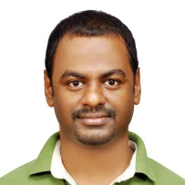

Presenter Introduction
Twister Bingjing Zhang, Fei Teng, Yuduo Zhou
 | Twister4Azure Thilina Gunarathne
Building Virtual Cluster Towards Reproducible eScience in the Cloud Jonathan Klinginsmith

Slide 2



Presenter Introduction
 | Experimenting Lucene Index on HBase in an HPC Environment Xiaoming Gao
Testing Hadoop / HDFS (CDH3u2) Multi-users with Kerberos on a Shared Environment Stephen Wu
 | DryadLINQ CTP Evaluation Hui Li, Yang Ruan

Slide 3





Presenter Introduction
High-Performance Visualization Algorithms For Data-Intensive Analysis Seung-Hee Bae and Jong Youl Choi
 | Million Sequence Challenge Saliya Ekanayake, Adam Hughs, Yang Ruan
Cyberinfrastructure for Remote Sensing of Ice Sheets Jerome Mitchell

Slide 4
Demos
Yang & Bingjing – Twister MDS + PlotViz + Workflow (HPC)
Thilina – Twister for Azure (Cloud)
  Jonathan – Building Virtual Cluster
Xiaoming – HBase-Lucene indexing
Seung-hee – Data Visualization
Saliya – Metagenomics and Protemics

Slide 5
Computation and Communication Pattern in Twister
Bingjing Zhang

Slide 6
Intel’s Application Stack

Slide 7
Broadcast
Broadcasting
  Data could be large
  Chain & MST
Map Collectors
  Local merge
Reduce Collectors
  Collect but no merge
Combine
  Direct download or Gather
Map Tasks
Map Tasks
Map Tasks
Map Collector
Map Collector
Map Collector
Reduce Tasks
Reduce Tasks
Reduce Tasks
Reduce Collector
Reduce Collector
Reduce Collector
Gather

Slide 8
Experiments
Use Kmeans as example.
Experiments are done on max 80 nodes and 2 switches.
Some numbers from Google for reference
  Send 2K Bytes over 1 Gbps network: 20,000 ns
  We can roughly conclude ….
    E.g., send 600MB: 6 seconds

Slide 9
Broadcast 600MB Data with Max-Min Error Bar

Slide 10
Execution Time Improvements

Slide 11
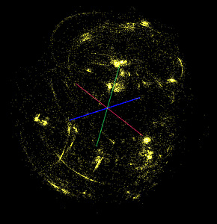
Twister-MDS Demo
II. Send intermediate results
Master Node
ActiveMQ
Broker
Twister
Driver
MDS Monitor
Twister-MDS
PlotViz
I. Send message to start the job
Client Node

Slide 12
Twister4Azure – Iterative MapReduce
Decentralized iterative MR architecture for clouds
  Utilize highly available and scalable Cloud services
Extends the MR programming model
Multi-level data caching
  Cache aware hybrid scheduling
Multiple MR applications per job
Collective communication primitives
Outperforms Hadoop in local cluster by 2 to 4 times
Sustain features of MRRoles4Azure
  dynamic scheduling, load balancing, fault tolerance, monitoring, local testing/debugging
http://salsahpc.indiana.edu/twister4azure/
Notes:
Collective communications increasing the performance and giving users more easy options to perform their computations.

Slide 13

http://salsahpc.indiana.edu/twister4azure
Extensions to support broadcast data
Iterative MapReduce for Azure Cloud
Hybrid intermediate data transfer
Merge step
Cache-aware Hybrid Task Scheduling
Collective Communication Primitives
Multi-level caching of static data
Portable Parallel Programming on Cloud and HPC: Scientific Applications of Twister4Azure, Thilina Gunarathne, BingJing Zang, Tak-Lon Wu and Judy Qiu, (UCC 2011) , Melbourne, Australia.
Notes:
The tasks of iterative computations are much finer grained and the intermediate data are relatively smaller than typical map reduce computations. We added support for hydrid transfer of intermediate data.

Slide 14
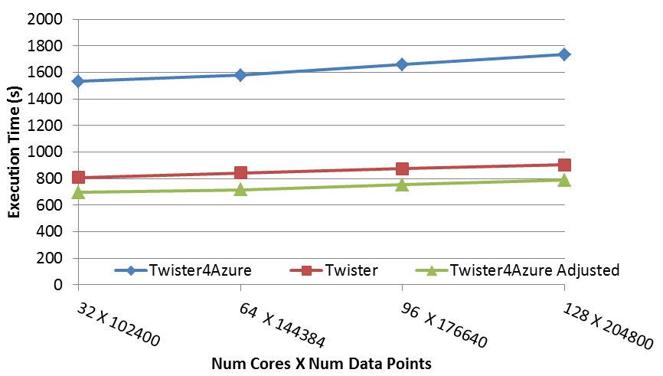
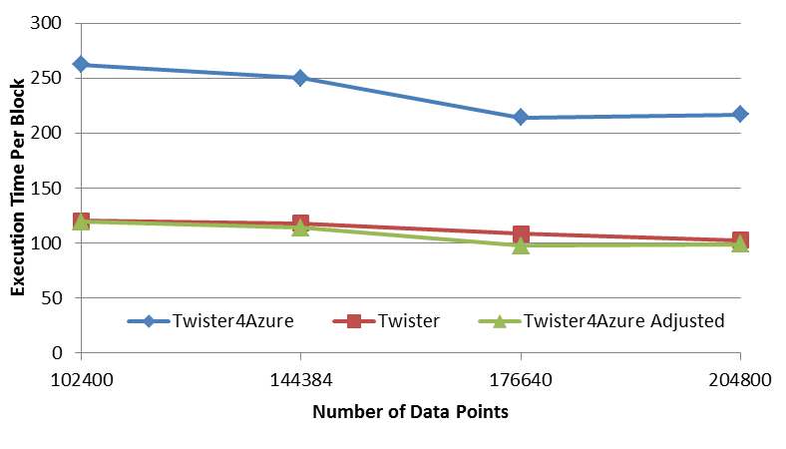
Performance – Multi Dimensional Scaling
BC: Calculate BX
X: Calculate invV (BX)
Calculate Stress
Map
Reduce
Merge
Map
Reduce
Merge
Map
Reduce
Merge
New Iteration
Performance adjusted for sequential performance difference
Weak Scaling
Data Size Scaling
Scalable Parallel Scientific Computing Using Twister4Azure. Thilina Gunarathne, BingJing Zang, Tak-Lon Wu and Judy Qiu. Submitted to Journal of Future Generation Computer Systems. (Invited as one of the best 6 papers of UCC 2011)
Notes:
The Java HPC Twister experiment was performed in a dedicated large-memory cluster of Intel(R) Xeon(R) CPU E5620 (2.4GHz) x 8 cores with 192GB memory per compute node and with Gigabit Ethernet on Linux. Java HPC Twister results do not include the initial data distribution time.
Azure large instances with 4 workers per instances is used. Memory mapped based caching and AllGather primitive are used.
Left: Weak scaling where workload per core is ~constant. Ideal is a straight horizontal line. X axis is
Right: Data size scaling with 128 Azure small instances/cores, 20 iterations.
The Twister4Azure adjusted (t_{a}) depicts the performance of Twister4Azure normalized according to the sequential MDS BC calculation and Stress calculation performance ratio between the Azure(t_{sa}) and Cluster(t_{sc}) environments used for Java HPC Twister. It is calculated using t_{a} x (t_{sc}/t_{sa}). This estimation however does not account for the overheads that remain constant irrespective of the computation time. Hence Twister4Azure seems to perform better, but in reality when the task execution times become smaller, twister4Azure overheads will become relatively larger and the performance would not be as good as shown in the adjusted curve.

Slide 15

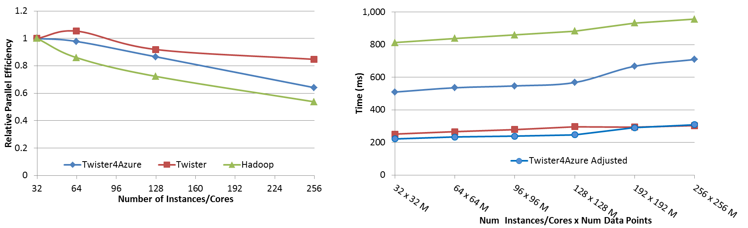




Performance – Kmeans Clustering
Overhead between iterations
First iteration performs the initial data fetch
Task Execution Time Histogram
Number of Executing Map Task Histogram
Scales better than Hadoop on bare metal
Strong Scaling with 128M Data Points
Weak Scaling
Performance with/without
data caching
Speedup gained using data cache
Scaling speedup
Increasing number of iterations
Notes:
Right(c): Twister4Azure executing Map Task histogram for 128 million data points in 128 Azure small instances
Figure 5. KMeansClustering Scalability. Left(a): Relative parallel efficiency of strong scaling using 128 million data points.
Center(b): Weak scaling. Workload per core is kept constant (ideal is a straight horizontal line).

Slide 16

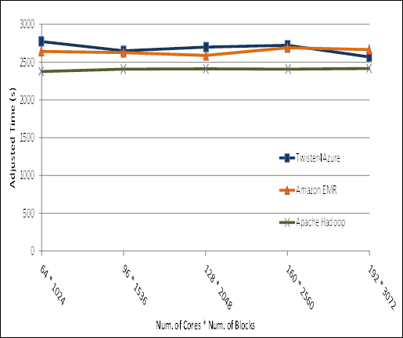
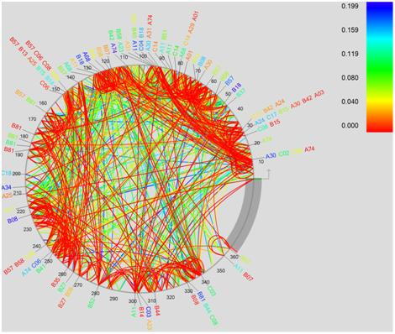
Performance Comparisons
BLAST Sequence Search
Smith Watermann
Sequence Alignment
Cap3 Sequence Assembly
MapReduce in the Clouds for Science, Thilina Gunarathne, et al. CloudCom 2010, Indianapolis, IN.

Slide 17
MRRoles4Azure
Azure Cloud Services
Highly-available and scalable
Decentralized
Avoids Single Point of Failure
Utilize eventually-consistent , high-latency cloud services effectively
Minimal maintenance and management overhead
Dynamically scale up/down
Global queue based dynamic scheduling
MapReduce
First pure MapReduce for Azure
Typical MapReduce fault tolerance
Notes:
We built MRR4Azure decentralized MapReduce framework for Azure cloud utilizing the highly-available and scalable, Azure infrastructure services as the building blocks.
MRRoles4Azure hides the complexity of cloud services from the users and
is designed to co-exist with the eventual consistent nature of cloud services.
The decentralized architecture avoid the single point of failure and bottleneck, while global queue based dynamic scheduling achieves better load balancing.
We selected Azure platform, as at that time there weren’t any distributed data processing frameworks available for Azure. We performed the first public release of MRRoles4Azure in the 4th quarter of 2010 as the first pure MapReduce framework for Azure.

Slide 18
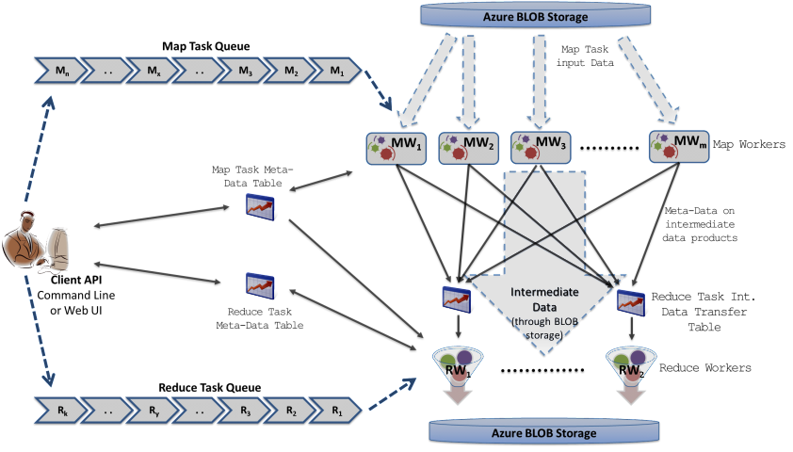
MRRoles4Azure
Azure Queues for scheduling, Tables to store meta-data and monitoring data, Blobs for input/output/intermediate data storage.
Notes:
Ability to dynamically scale up/down
Easy testing and deployment
Combiner step
Web based monitoring console

Slide 19
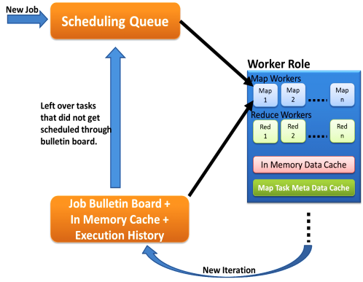
Hybrid Task Scheduling
First iteration through queues
Left over tasks
Data in cache + Task meta data history
New iteration in Job Bulleting Board
Notes:
Use task histories to minimize the scheduling overhead.. Needs only the new iteration information.. Task meta data from the cache..
No master with global knowledge of cached data products. Rather than pushing the workers pick tasks.
Multiple MapReduce applications within an iteration supporting much richer application patterns

Slide 20
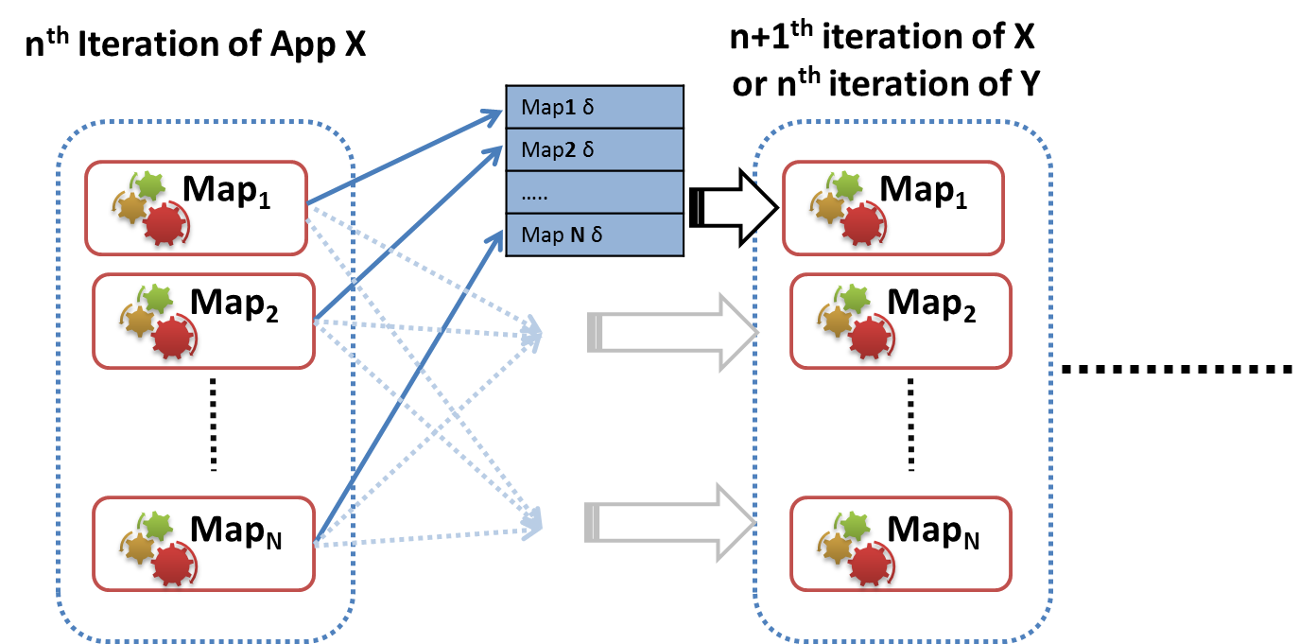
Iterative MapReduce Collective Communication Primitives
Supports common higher-level communication patterns
Framework can optimize these operations transparently to users
Ease of use
SumReduce
AllGather
Notes:
Broadcasts the Map outputs to all other nodes
Assembles them together in the recipient nodes
Schedules the next iteration of the application
Eliminates the shuffle, reduce, merge overhead
Currently implemented using Azure inter-role TCP based all-to-all broadcast
We have noticed up to 8% speedup
much larger improvement in terms of reduction of overhead

Slide 21
Faster twister based on InfiniBand interconnect
Fei Teng
2/23/2012

Slide 22
Motivation
InfiniBand successes in HPC community
  More than 42% of Top500 clusters use InfiniBand
  Extremely high throughput and low latency
    Up to 40Gb/s between servers and 1μsec latency
  Reduce CPU utility up to 90%
Cloud community can benefit from InfiniBand
  Accelerated Hadoop (sc11)
  HDFS benchmark tests
Having access to ORNL’s large InfiniBand cluster
Notes:
Even higher between switches

Slide 23
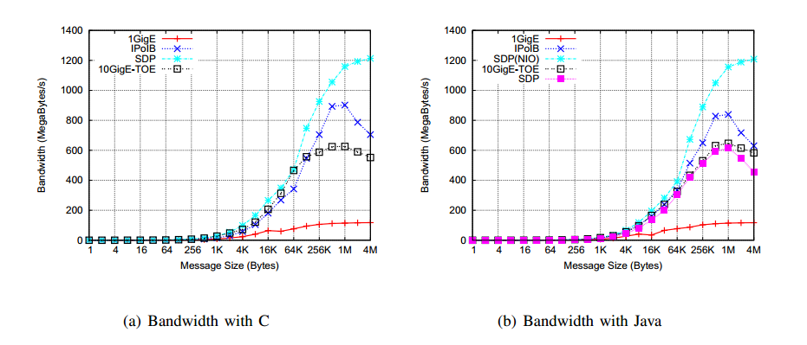
Motivation(Cont’d)
Bandwidth comparison of HDFS on various network technologies

Slide 24
Twister on InfiniBand
Twister – Efficient iterative Mapreduce runtime framework
RDMA can make Twister faster
  Accelerate static data distribution
  Accelerate data shuffling between mappers and reducers
State of the art of IB RDMA

Slide 25
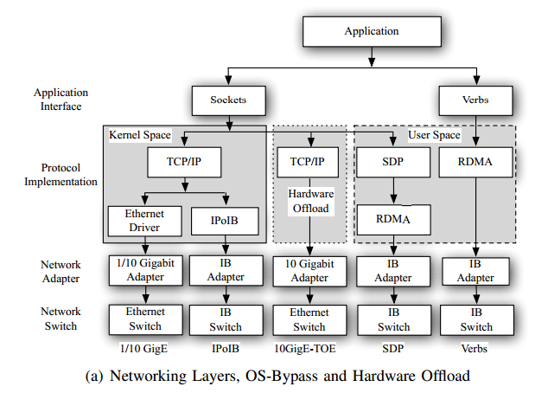
RDMA stacks

Slide 26
Building Virtual Clusters
Towards Reproducible eScience in the Cloud
Jonathan Klinginsmith
jklingin@indiana.edu
School of Informatics and Computing
Indiana University Bloomington

Slide 27

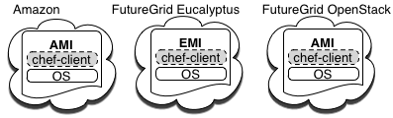
Separation of Concerns
Separation of concerns between two layers
Infrastructure Layer – interactions with the Cloud API
Software Layer – interactions with the running VM
Equivalent machine images (MI) in separate clouds
Common underpinning for software

Slide 28
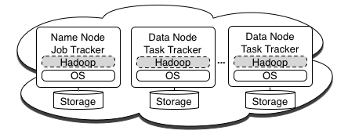
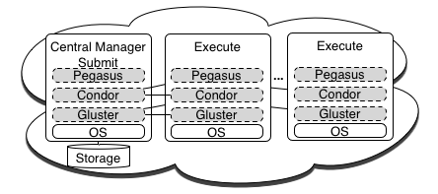
Virtual Clusters
Hadoop Cluster
Condor Pool

Slide 29
Running CloudBurst on Hadoop
Running CloudBurst on a 10 node Hadoop Cluster
knife hadoop launch cloudburst 9
echo ‘{"run list": "recipe[cloudburst]"}' > cloudburst.json
chef-client -j cloudburst.json
CloudBurst on a 10, 20, and 50 node Hadoop Cluster

Slide 30
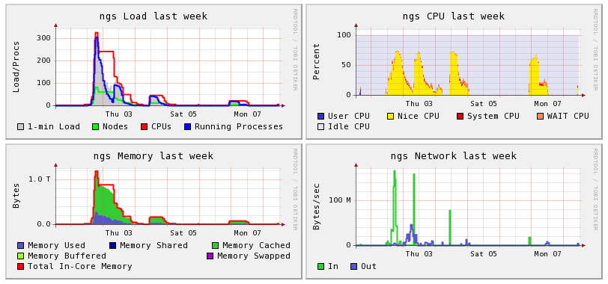
Implementation - Condor Pool
Ganglia screen shot of a Condor pool in Amazon EC2
80 node – (320 core) at this point in time

Slide 31
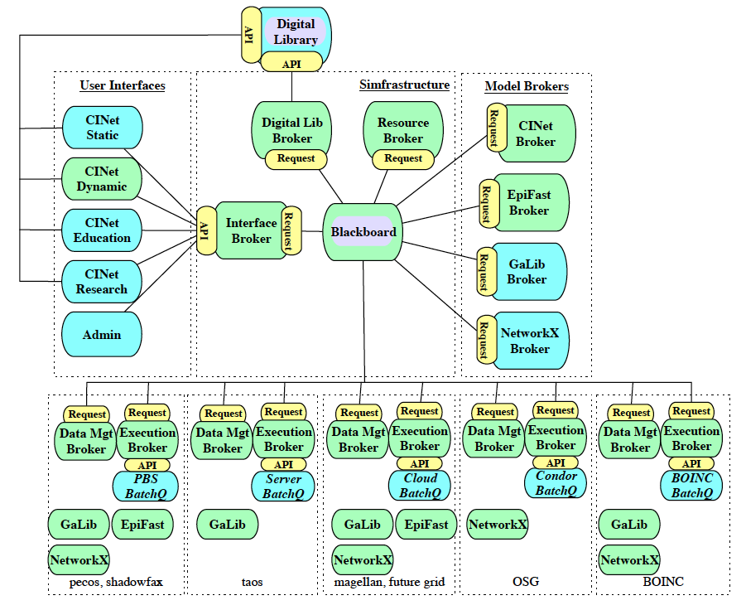
CINET Project: Further architectural details

Slide 32
PolarGrid
Jerome Mitchell
Collaborators: University of Kansas, Indiana University, and Elizabeth City State University

Slide 34
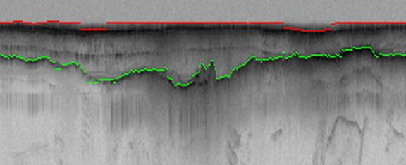
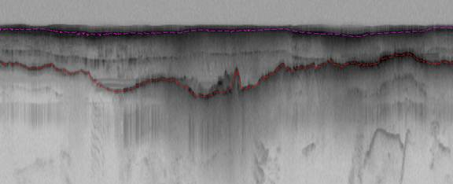
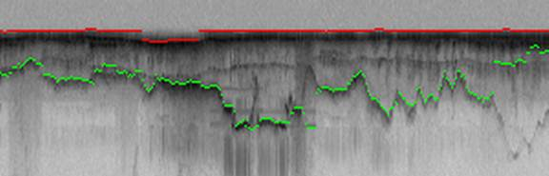
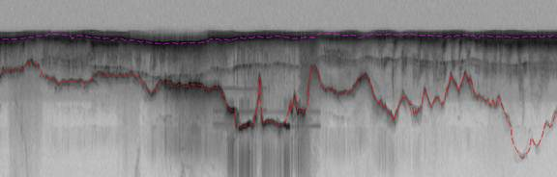
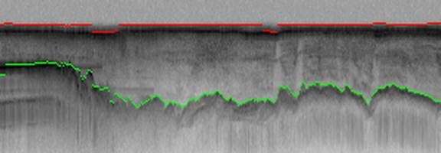
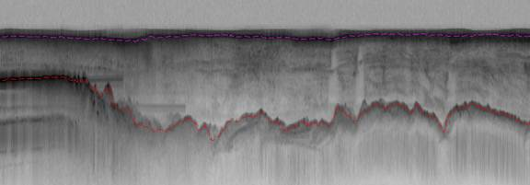
Hidden Markov Method based Layer Finding
P. Felzenszwalb, O. Veksler, Tiered Scene Labeling with Dynamic Programming, IEEE Conference on Computer Vision and Pattern Recognition (CVPR), 2010

Slide 35
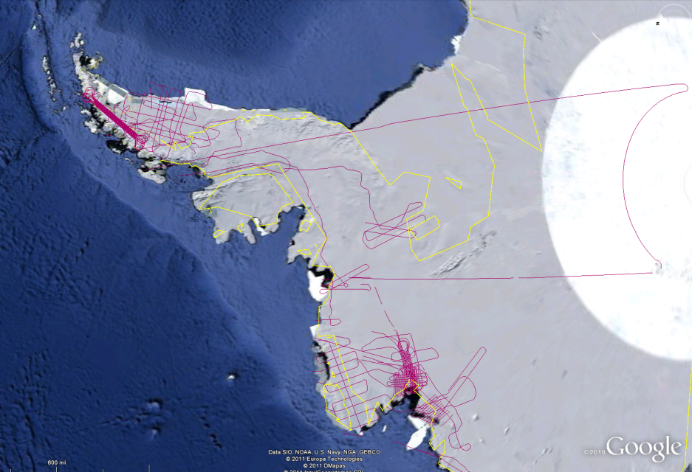
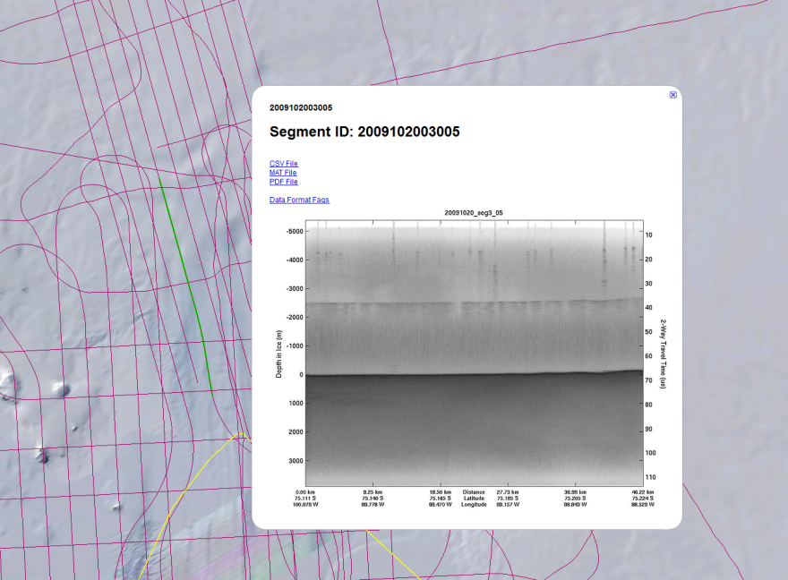
PolarGrid Data Browser:
Cloud GIS Distribution Service
Google Earth example: 2009 Antarctica season
Left image: overview of 2009 flight paths
Right image: data access for single frame

Slide 36
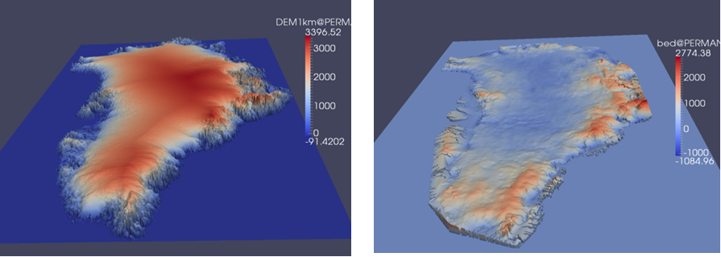
3D Visualization of Greenland

Slide 37
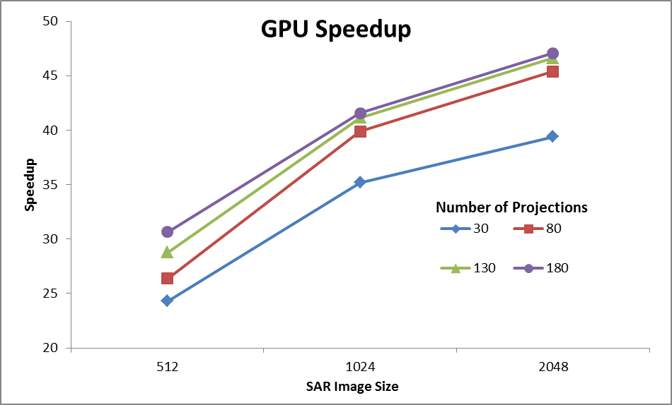
Testing Environment:
GPU: Geforce GTX 580, 4096 MB, CUDA toolkit 4.0
CPU: 2 Intel Xeon X5492 @ 3.40GHz with 32 GB memory

Slide 38
Bridge Twister and HDFS
Yuduo Zhou

Slide 39

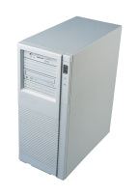
Twister + HDFS
User Client
Semi-manually Data Copy
Data Distribution
HDFS
Compute Nodes
Computation
TCP, SCP, UDP
Result Retrieval
HDFS

Slide 40
What we can gain from HDFS?
Scalability
Fault tolerance, especially in data distribution
Simplicity in coding
Potential for dynamic scheduling
Maybe no need to move data between local FS and HDFS in future
Upload data to HDFS
  A single file
  A directory
List a directory on HDFS
Download data from HDFS
  A single file
  A directory

Slide 41
Maximizing Locality
Creating pseudo partition file using max-flow algorithm base on block distribution
Compute nodes will fetch assigned data based on this file
Maximal data locality is achieved
User doesn’t need to bother with partition file, it’s automatical
File 1
File 2
File 3
Node 1
Node 2
Node 3
0, 149.165.229.1, 0, hdfs://pg1:9000/user/yuduo/File1
1, 149.165.229.2, 1, hdfs://pg1:9000/user/yuduo/File3
2, 149.165.229.3, 2, hdfs://pg1:9000/user/yuduo/File2

Slide 42
Performance
Data Distribution
Data size (G) | 1 | 4 | 16
HDFS | 20.3871 | 26.9711 | 257.374
ORI | 12.8644 | 36.33 | 202.14
The data distribution performance in original Twister depends on threads working on it. 8 threads doing SCP in this particular experiment.
HDFS distribution is one process only.

Slide 43
Performance

Slide 44
What we gain?
Slightly longer execution time, if any
Functions provided by HDFS
  Fault tolerance
  Various file operations
  Scalability
  Rack awareness, load balancer, etc…
Data can be used by Hadoop without any processing

Slide 45
Future Work
HDFS operates on block level while Twister is on file level. How to bridge this gap?
Original Twister has 100% data locality. How can HDFS-Twister maximize its data locality and how does it impact?

Slide 46
Testing Hadoop / HDFS (CDH3u2) Multi-users with Kerberos on a Shared Environment
Tak-Lon (Stephen) Wu

Slide 47
Motivation
Supports multi-users simultaneously read/write
  Original Hadoop simply lookup a plaintext permission table
  Users’ data may be overwritten or be deleted by others
Provide a large Scientific Hadoop
Encourage scientists upload and run their application on Academic Virtual Clusters
Hadoop 1.0 or CDH3 has a better integration with Kerberos
* Cloudera’s Distribution for Hadoop (CDH3) is developed by Cloudera

Slide 48

What is Hadoop + Kerberos
Network authentication protocol provides strong authentication for client/server applications
Well-known in Single-Login System
Integrates as a third party plugin to Hadoop
Only “ticket” user can perform File I/Os and job submission

Slide 49
 | HDFS Files I/O |  | MapReduce Job Submission
Users | Local (within Hadoop Cluster) | Remote (same/ diff host domain) | Local(within Hadoop Cluster) | Remote (same/diff host domain)
hdfs/ (main/slave) | Y | Y | Y | Y
mapred/ (main/slave) | Y | Y | Y | Y
User w/o Kerberos authen. | N | N | N | N

Slide 50
Deployment Progress
Tested on Two nodes environment
Plan to deploy on a real shared environemnt (FutureGrid, Alamo or India)
Works with System Admin to have a better Kerberos setup (may integrate with LDAP)
Add runtime periodic user list update

Slide 51
Integrate Twister into Workflow Sytems
Yang Ruan

Slide 52
Implementation approaches
Enable Twister to use RDMA by spawning C processes
Directly use RMDA SDP (socket direct protocal)
  Supported in latest Java 7, less efficient than C verbs
Mapper Java JVM
Java JVM space
Reducer Java JVM
RDMA data transfer
RDMA client
RDMA server
C virtual memory

Slide 53
Further development
Introduce ADIOS IO system to Twister
  Achieve the best IO performance by using different IO methods
Integrate parallel file system with Twister by using ADIOS
  Take advantage of types of binary file formats, such as HDF5, NetCDF and BP
Goal - Cross the chasm between Cloud and HPC
Notes:
e.g, RDMA for data transfer between work nodes and other binary file transfer method for visualization or checkpoint writing
Binary file format to do online analysis and demostration

Slide 54

Integrate Twister with ISGA Analysis Web Server
ISGA
<<XML>>
Ergatis
<<XML>>
TIGR Workflow
Cloud,
Other DCEs
SGE
Condor
clusters
clusters

Slide 55
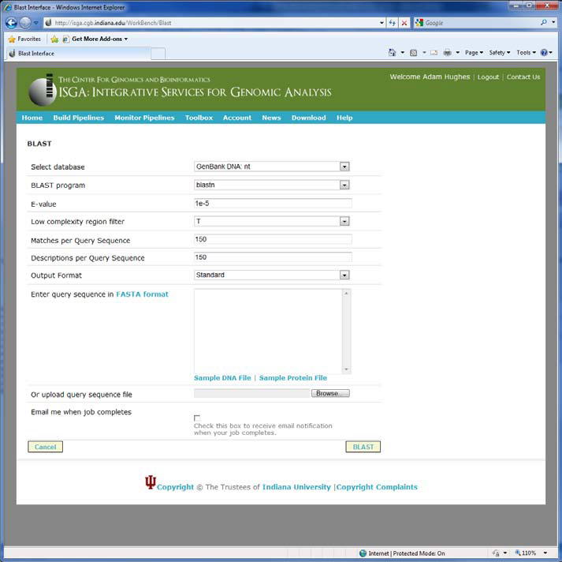
Screenshot of ISGA Workbench BLAST interface

Slide 56
Hybrid Sequence Clustering Pipeline
Multidimensional Scaling
Sample Result
Sample Data
Sequence alignment
Pairwise Clustering
Out-Sample Result
Out-Sample Data
MDS Interpolation
Hybrid Component
Sample Data Channel
Out-Sample Data Channel
Visualization
PlotViz
The sample data is selected randomly from whole input fasta file dataset
All critical components are formed by Twister and should able be automatically done.

Slide 57
Pairwise Sequence Alignment
Block (0,0)
Map
Reduce
Input Sample Fasta Partition 1
Dissimilarity Matrix Partition 1
Block (0,1)
M
Input Sample FastaPartition 2
R
Dissimilarity Matrix Partition 2
Dissimilarity Matrix
Block (0,3)
M
C
…
…
…
…
…
R
Input Sample Fasta Partition n
Dissimilarity Matrix Partition n
Block
(n-1,n-1)
M
Sample Data File I/O
Network Communication
Block (0,0)
Block (0,1)
Block (0,2)
Block (0,n-1)
Block (1,0)
Block (1,1)
Block (1,2)
Block (1,n-1)
Left figure is the sample of target dimension N*N dissimilarity matrix where the input is divided into n partitions
The Sequence Alignment has two choices:
  Needleman-Wunsch
  Smith-Waterman
Block (2,0)
Block (2,1)
Block (2,2)
Block (2,n-1)
Block (n-1, 0)
Block
(n-1, 1)
Block
(n-1,n-1)

Slide 58
Multidimensional Scaling
Sample Data File I/O
Sample Label File I/O
Network Communication
Pairwise Clustering
Map
Reduce
Map
Reduce
Input Dissimilarity Matrix Partition 1
M
M
Input Dissimilarity Matrix Partition 2
M
M
R
C
R
C
Sample Coordinates
…
…
…
Input Dissimilarity Matrix Partition n
M
M
Parallelized SMACOF Algorithm
Stress
Calculation

Slide 59
MDS interpolation
Input Sample Coordinates
Sample Data File I/O
Input Sample Fasta
Map
Reduce
Out-Sample Data File I/O
Network Communication
Input Out-Sample Fasta Partition 1
M
R
The first method is for fast calculation, i.e use hierarchical/heuristic interpolation
The seconds method is for multiple calculation
Input Out-Sample Fasta Partition 2
M
…
C
Final Output
…
…
R
Input Out-Sample Fasta Partition n
M
Input Sample Fasta
Input Sample Coordinates
Map
Reduce
Map
Input Out-Sample Fasta Partition 1
M
Distance File Partition 1
M
Input Out-Sample Fasta Partition 2
M
Distance File Partition 2
R
M
…
C
Final Output
…
…
…
…
R
Input Out-Sample Fasta Partition n
M
Distance File Partition n
M

Slide 60
Million Sequence Challenge
Input DataSize: 680k
Sample Data Size: 100k
Out-Sample Data Size: 580k
Test Environment: PolarGrid with 100 nodes, 800 workers.
Salsahpc.indiana.edu/nih

Slide 61
Metagenomics and Protemics
Saliya Ekanayake

Slide 62
Projects
Protein Sequence Analysis - In Progress
  Collaboration with Seattle Children’s Hospital
Fungi Sequence Analysis - Completed
  Collaboration with Prof. Haixu Tang in Indiana University
  Over 1 million sequences
  Results at http://salsahpc.indiana.edu/millionseq
16S rRNA Sequence Analysis - Completed
  Collaboration with Dr. Mina Rho in Indiana University
  Over 1 million sequences
  Results at http://salsahpc.indiana.edu/millionseq

Slide 63
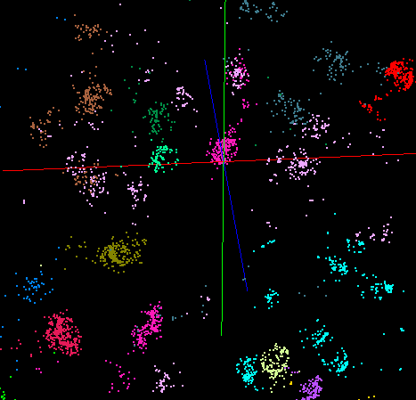
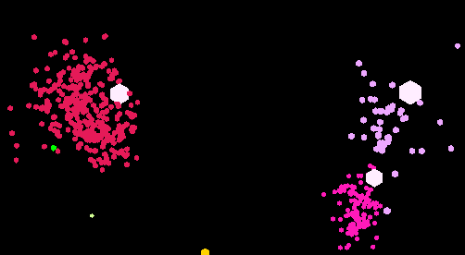
Goal
Identify Clusters
  Group sequences based on a specified distance measure
Visualize in 3-Dimension
  Map each sequence to a point in 3D while preserving distance between each pair of sequences
Identify Centers
  Find one or several sequences to represent the center of each cluster
Sequence | Cluster
S₁ | C_{a}
S₂ | C_{b}
S₃ | C_{a}

Slide 64
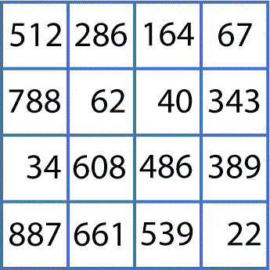
Architecture (Basic)
[2]
Pairwise Clustering
Cluster Indices
[1]
Pairwise Alignment & Distance Calculation
3D Plot
Gene Sequences
[4]
Visualization
[3]
Multi-dimensional Scaling
Distance Matrix
Coordinates
[1] Pairwise Alignment & Distance Calculation
  Smith-Waterman, Needleman-Wunsch and Blast
  Kimura 2, Jukes-Cantor, Percent-Identity, and BitScore
  MPI, Twister implementations
[2] Pairwise Clustering
  Deterministic annealing
  MPI implementation
[3] Multi-dimensional Scaling
  Optimize Chisq, Scaling by MAjorizing a COmplicated Function (SMACOF)
  MPI, Twister implementations
[4] Visualization
  PlotViz – a desktop point visualization application built by SALSA group
  http://salsahpc.indiana.edu/pviz3/index.html

Slide 65
High-Performance
Visualization Algorithms
For Data-Intensive Analysis
Seung-hee Bae

Slide 66
GTM vs. MDS
GTM
MDS (SMACOF)
Purpose
Non-linear dimension reduction
Find an optimal configuration in a lower-dimension
Iterative optimization method
Input
Vector-based data
Non-vector (Pairwise similarity matrix)
Objective
Function
Maximize Log-Likelihood
Minimize STRESS or SSTRESS
Complexity
O(KN) (K << N)
O(N²)
Optimization
Method
EM
Iterative Majorization (EM-like)

Slide 67
Interpolation extension to GTM/MDS
MPI, Twister
n
In-sample
Training
Trained data
1
N-n
Out-of-sample
Interpolated map
2
Interpolation
......
P-1
p
Total N data
MapReduce
Full data processing by GTM or MDS is computing- and memory-intensive
Two step procedure
  Training : training by M samples out of N data
  Interpolation : remaining (N-M) out-of-samples are approximated without training

Slide 68

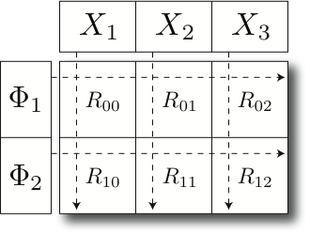
Parallel GTM
GTM / GTM-Interpolation
A
1
A
B
C
Parallel HDF5
ScaLAPACK
B
2
1
MPI / MPI-IO
C
Parallel File System
K latent
points
N data
points
2
Cray / Linux / Windows Cluster
Finding K clusters for N data points
    Relationship is a bipartite graph (bi-graph)
    Represented by K-by-N matrix (K << N)
Decomposition for P-by-Q compute grid
    Reduce memory requirement by 1/PQ
GTM Software Stack

Slide 69
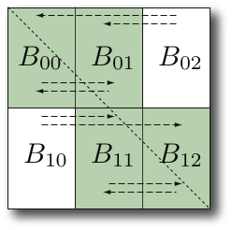
Scalable MDS
Parallel MDS
MDS Interpolation
O(N²) memory and computation required.
  100k data → 480GB memory
Balanced decomposition of NxN matrices by P-by-Q grid.
  Reduce memory and computing requirement by 1/PQ
Communicate via MPI primitives
Finding approximate mapping position w.r.t. k-NN’s prior mapping.
Per point it requires:
  O(M) memory
  O(k) computation
Pleasingly parallel
Mapping 2M in 1450 sec.
  vs. 100k in 27000 sec.
  7500 times faster than estimation of the full MDS.
c1
c2
c3
r1
r2

Slide 70
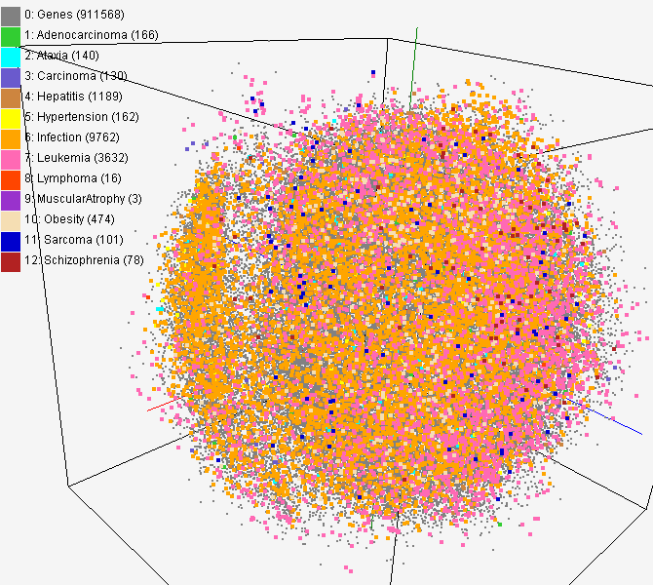
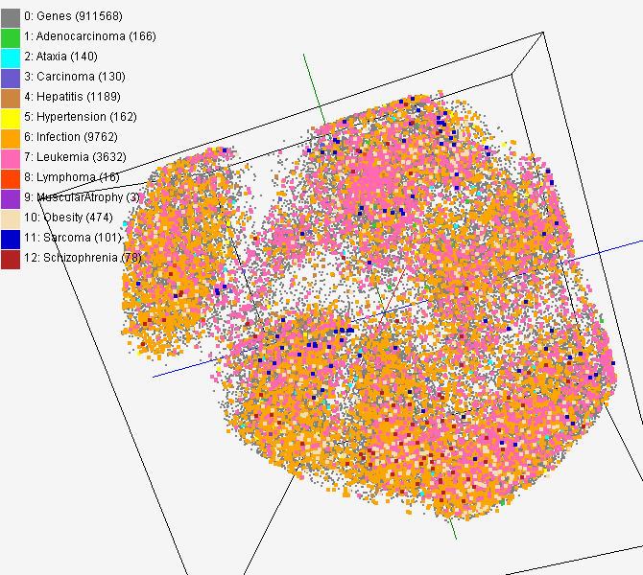
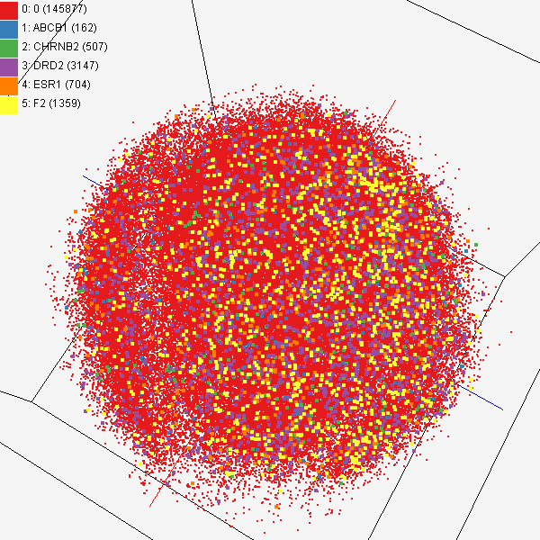
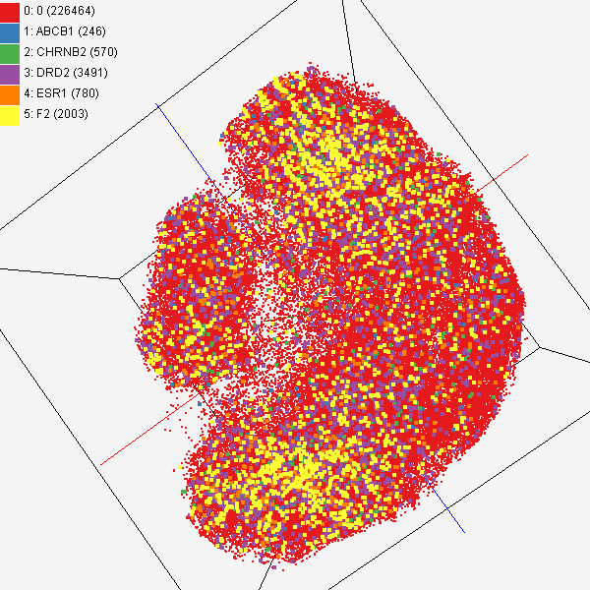
GTM/MDS Applications
PubChem data with CTD visualization by using MDS (left) and GTM (right)
About 930,000 chemical compounds are visualized as a point in 3D space, annotated by the related genes in Comparative Toxicogenomics Database (CTD)
Chemical compounds shown in literatures, visualized by MDS (left) and GTM (right)
Visualized 234,000 chemical compounds which may be related with a set of 5 genes of interest (ABCB1, CHRNB2, DRD2, ESR1, and F2) based on the dataset collected from major journal literatures which is also stored in Chem2Bio2RDF system.

Slide 71
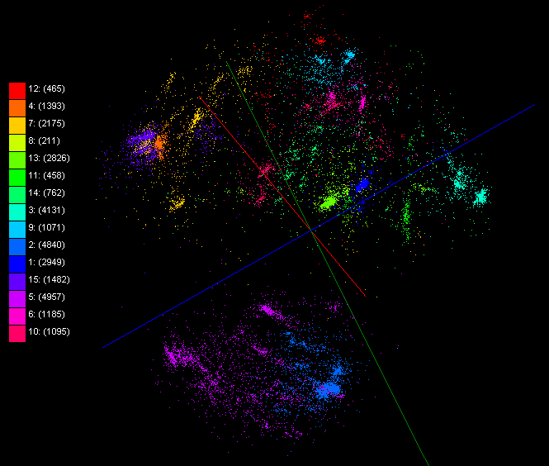
Mapping by Dissimilarity
ALU 35339
Metagenomics 30000

Slide 72
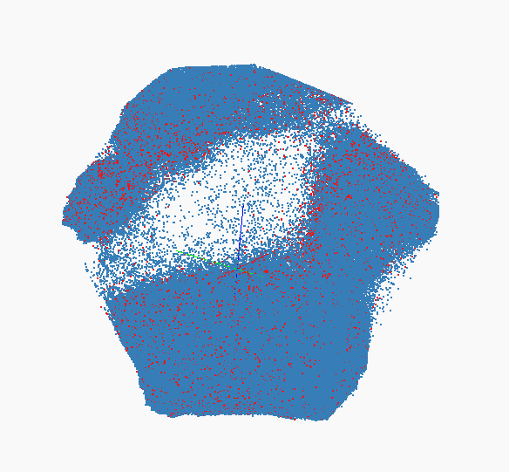
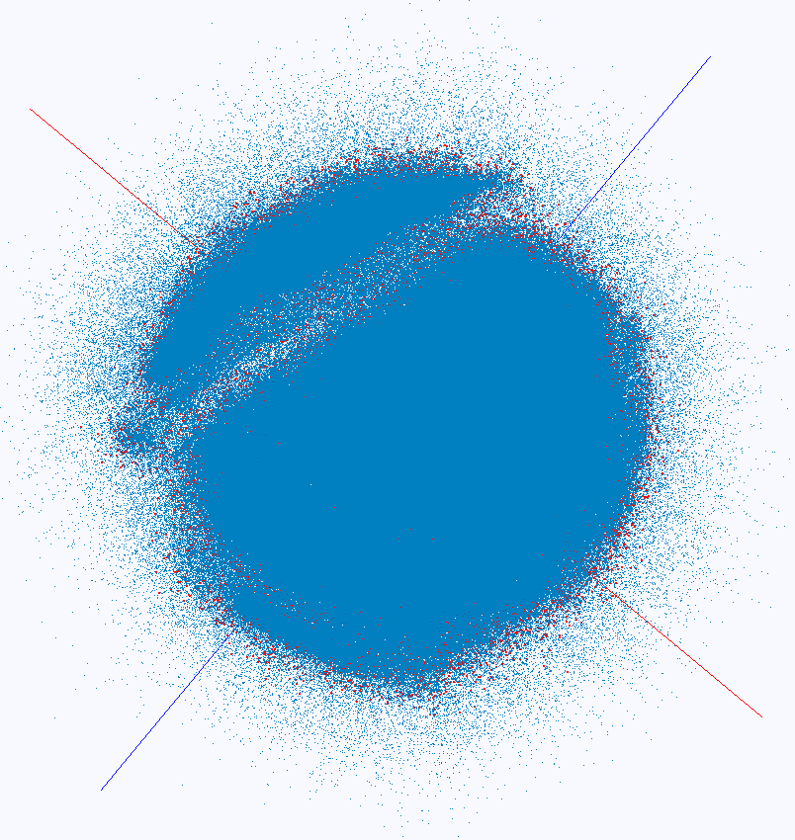
Interpolation
100K training and 2M interpolation of PubChem Interpolation MDS (left) and GTM (right)

Slide 73
Experimenting Lucene Index on HBase in an HPC Environment
Xiaoming Gao

Slide 74
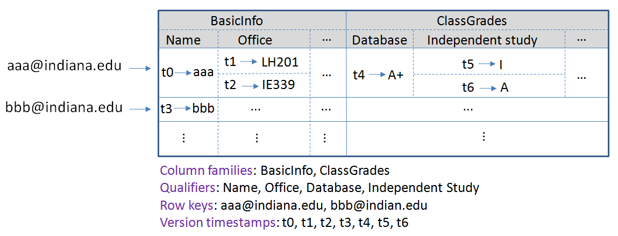
Introduction
Background: data intensive computing requires storage solutions for huge amounts of data
One proposed solution: HBase, Hadoop implementation of Google’s BigTable

Slide 75
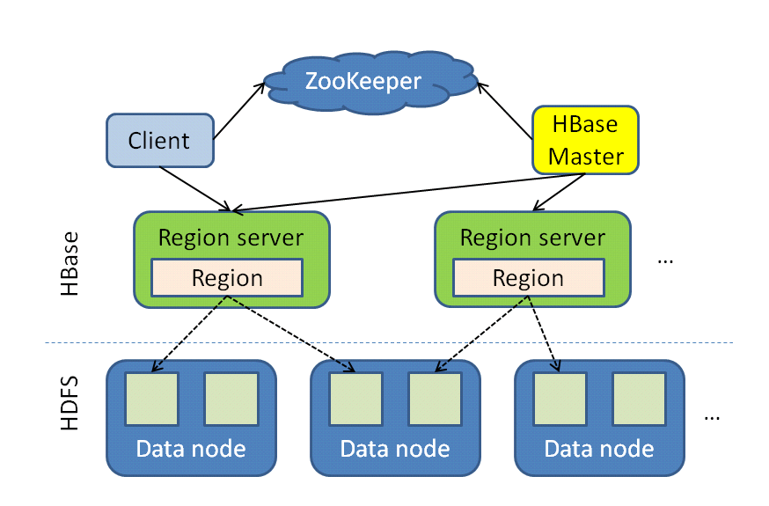
Introduction
HBase architecture:
Tables split into regions and served by region servers
Reliable data storage and efficient access to TBs or PBs of data, successful application in Facebook and Twitter
Problem: no inherent mechanism for field value searching, especially for full-text values

Slide 76
Our solution
Get inverted index involved in HBase
Store inverted indices in HBase tables
Use the data set from a real digital library application to demonstrate our solution: bibliography data, image data, text data
Experiments carried out in an HPC environment

Slide 77
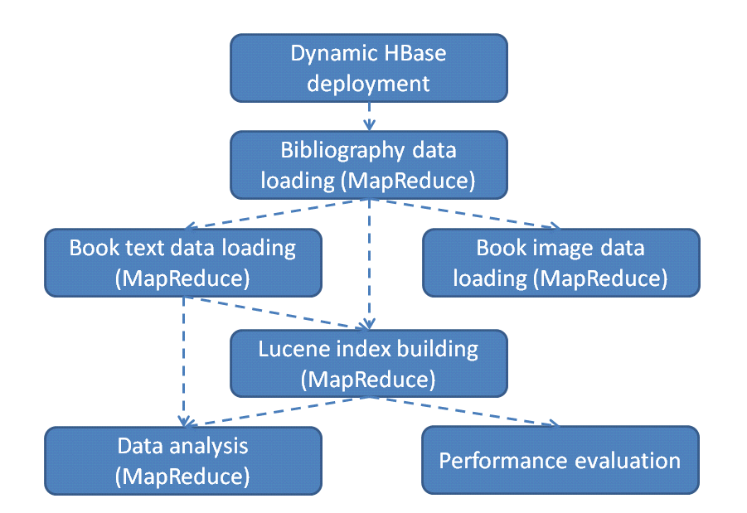
System implementation

Slide 78
Future work
Experiments with a larger data set: ClueWeb09 CatB data
Distributed performance evaluation
More data analysis or text mining based on the index support

Slide 79
Parallel Fox Algorithm
Hui Li

Slide 80
Timing model for Fox algorithm
problem model -> machine model-> performance model->measure parameters->show model fits with data->compare with other runtime
Simplify assumption:
  Tcomm = time to transfer one floating point word
  Tstartup = software latency for core primitive operations,
Evaluation goals:
  f / c average number of flops per network transformation: the algorithm model: key to distributed algorithm efficiency

Slide 81





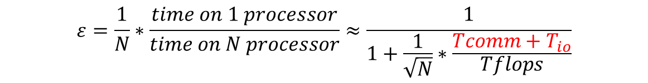
Timing model for Fox LINQ to HPC on TEMPEST
Multiply M*M matrices on a grid of nodes. Size of sub-block is m*m, where
Overhead:
  To broadcast A sub-matrix:
  To roll up B sub-matrix:
  To compute A*B
Total computation time:
$$\left(\sqrt{N}−1\right)∗T_{startup}+m^{2}∗(T_{io}+T_{comm})$$
$${T_{startup}+m}^{2}∗{(T}_{io}+T_{comm})$$
$${2∗m}^{3}∗T_{flops}$$
$$T=\sqrt{N}∗\left(\sqrt{N}∗T_{startup}+m^{2}∗\left(T_{io}+T_{comm}\right)+2∗m^{3}∗T_{flops}\right)$$
$$ε=\frac{1}{N}∗\frac{time on 1 processor}{time on N processor}≈\frac{1}{1+\frac{1}{\sqrt{N}}∗\frac{Tcomm+T_{io}}{Tflops}}$$
Notes:
$$T=\sqrt{N}∗\left(\sqrt{N}∗T_{startup}+m^{2}∗\left(T_{io}+T_{comm}\right)+2∗m^{3}∗T_{flops}\right)$$

Slide 82
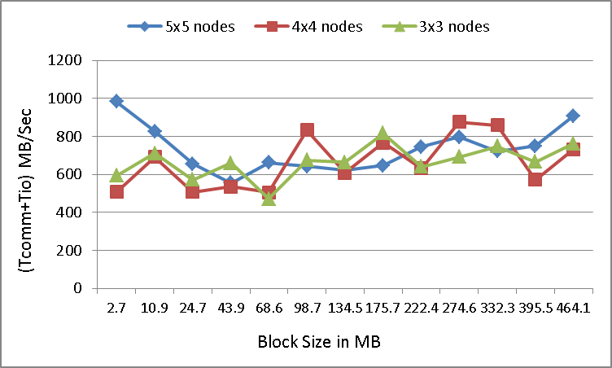
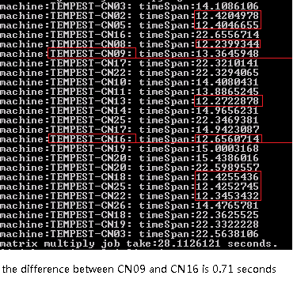
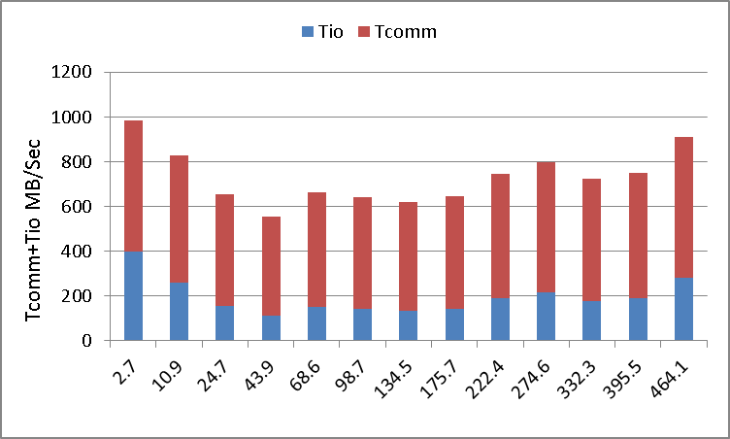
Measure network overhead and runtime latency
Weighted average Tio+Tcomm with 5x5 nodes = 757.09 MB/second
Weighted average Tio+Tcomm with 4x4 nodes = 716.09 MB/second
Weighted average Tio+Tcomm with 3x3 nodes = 703.09 MB/second
Notes:
For most cases the Tstartup is less than 100 milliseconds, but there are several cases Tstartup even larger than 500 milliseconds. (please see the measure in attachment)
The reason is Dryad job manager's interference with HPC scheduler or running the callback function when optimizing execution plan.

Slide 83
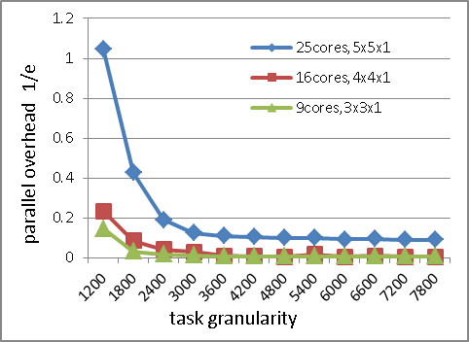
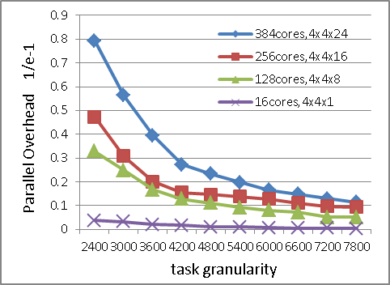


Performance analysis Fox LINQ to HPC on TEMPEST
Running time with 5x5,4x4, 3x3 nodes with single core per node
Running time with 4x4 nodes with 24,16,8,1 core per node
1/e-1 vs. 1/Sqrt(n) showing linear rising term of (Tcomm+Tio)/Tflops
1/e-1 vs. 1/Sqrt(n), show universal behavior for fixed workload

