Slide 1
Jonathan Klinginsmith Reproducibility and Scalability in Experimentation through Cloud Computing Technologies Indiana University Advisor: Judy Qiu

Slide 2
Reproducible Experimentation
Common research situations
Researcher reads paper →
Reproduce its experiments
Benchmark and compare
Our goals
Expedite empirical research →
Reduce experimental setup time
Provide experimental integrity

Slide 3
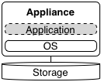
Experimental Conditions
Reproducibility needs
Infrastructure Software Parameters Data
Cloud computing (IaaS)
Compute instance types
Virtual appliance
Block and object storage
Reproducibility Scalability

Slide 4
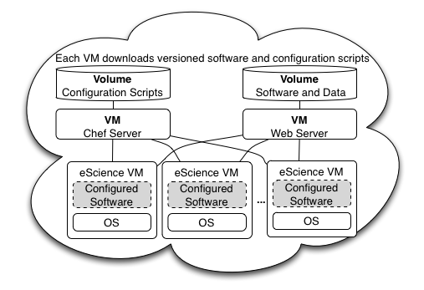
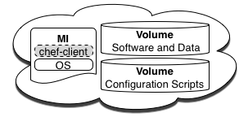
Reproducibility and Scalability
Separation of Concerns
Persistent objects
Recipe & ingredients to build a scalable experiment

Slide 5
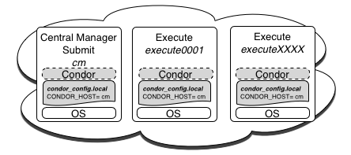
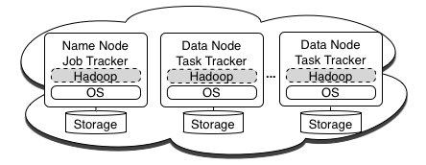
Reproducibility and Scalability
Virtual Clusters
Replicate images across IaaS clouds
Reproduce experiments across clouds

Slide 6
Thank You!

