Slide 1
Scalable High Performance Dimension Reduction
Seung-Hee Bae

Slide 2
Outline
Motivation
Background and Related Work
Research Issues
Experimental Analysis
Contributions
References

Slide 3
Motivation
Data deluge era
Biological sequence, Chemical Compound data
Data intensive computing
Data analysis or mining is getting important.
High-dimensional data
Dimension reduction alg. helps people to investigate distribution of the original data.
For some dataset, it is hard to represent with feature vectors but proximity information.
Multidimensional Scaling (MDS)
Find a mapping in the target dimension w.r.t. the proximity (dissimilarity) information.
Non-linear optimization problem.
Require O(N²) memory and computation.

Slide 4
Motivation (2)
How to deal with large high-dimensional scientific data?
Parallelization
MPI based parallelization to utilize distributed memory system, e.g. cluster systems, in order to deal with large amount of data.
Hybrid (MPI-Threading) parallelism for multicore cluster systems.
Interpolation (Out-of-Sample approach)
Reduce required memory and computation based on pre-mapping result of a subset of data (called in-sampled data).

Slide 5
Outline
Motivation
Background and Related Work
Research Issues
Experimental Analysis
Contributions
References

Slide 6
Background and Related Work
Multidimensional Scaling (MDS) [1]
Given the proximity information among points.
Optimization problem to find mapping in target dimension of the given data based on pairwise proximity information while minimize the objective function.
Objective functions: STRESS (1) or SSTRESS (2)
Only needs pairwise dissimilarities δ_{ij} between original points
(not necessary to be Euclidean distance)
d_{ij}(X) is Euclidean distance between mapped (3D) points
[1] I. Borg and P. J. Groenen. Modern Multidimensional Scaling: Theory and Applications. Springer, New York, NY, U.S.A., 2005.

Slide 7
Background (2)
Scaling by MAjorizing a COmplicated Function. (SMACOF)
Iterative majorizing algorithm to solve MDS problem.
EM-like hill-climbing approach.
Decrease STRESS value monotonically.
Tend to be trapped in local optima.
Computational complexity and memory requirement is O(N²).

Slide 8
Background (3)
Deterministic Annealing (DA)
Simulated Annealing (SA) applies Metropolis algorithm to find a solution by random walk.
Gibbs Distribution at T (computational temperature).
Minimize Free Energy (F)
DA tries to avoid local optima w/o random walking.
DA finds the expected solution which minimize F by calculating exactly or approximately.
As T decreases, more structure of problem space is getting revealed.

Slide 9
Outline
Motivation
Background and Related Work
Research Issues
DA-SMACOF
Interpolation (MI-MDS)
Parallelization
Non-uniform Weight
Experimental Analysis
Contributions
References

Slide 10
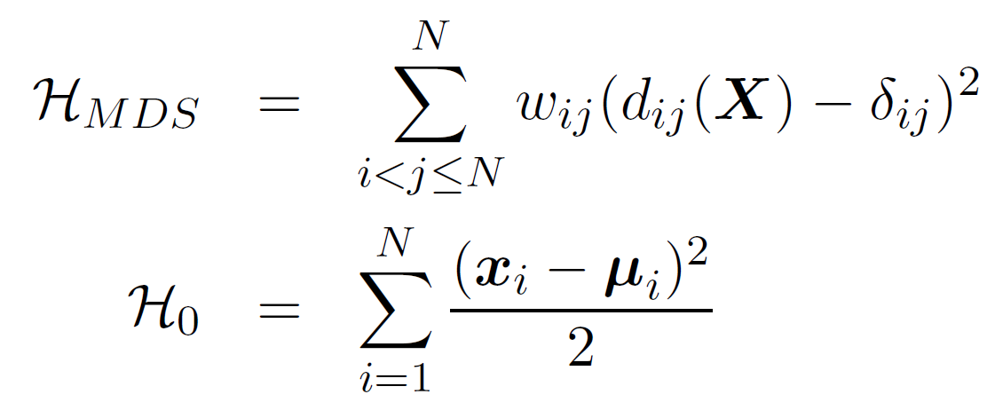
DA-SMACOF
If we use STRESS objective function as an expected energy function of MDS problem, then
Also, we define P⁰ and F₀ as following:
minimize F_{MDS}(P⁰) = <H_{MDS} −H₀>|₀ + F₀(P⁰) w.r.t. μ_{i}
− <H₀>|₀ + F₀(P⁰) is independent to μ_{i}
<H_{MDS}> part is necessary to be minimized w.r.t. μ_{i}.

Slide 11
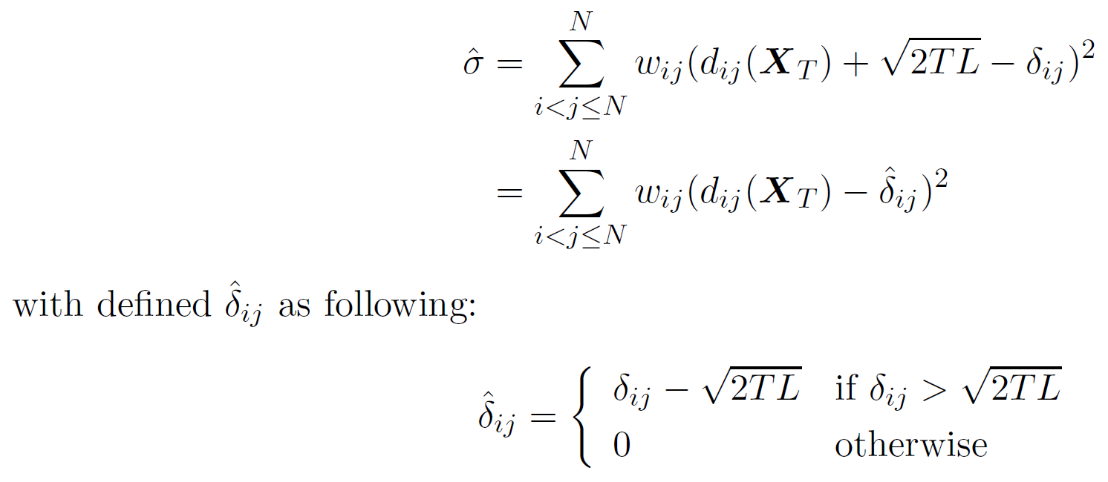
DA-SMACOF (2)
Apply <x_{i}x_{i}> = μ_{i}μ_{i} + TL to <H_{MDS}>
Use EM-like SMACOF alg. to calculate expected mapping which minimize <H_{MDS}> at T.
New STRESS is following:

Slide 12
DA-SMACOF (3)
The MDS problem space could be smoother with higher T than with the lower T.
T represents the portion of entropy to the free energy F.
Generally DA approach starts with very high T, but if T₀ is too high, then all points are mapped at the origin.
We need to find appropriate T₀ which makes at least one of the points is not mapped at the origin.

Slide 13
MI-MDS
Why do we need interpolation?
MDS requires O(N²) memory and computation.
For SMACOF, six N * N matrices are necessary.
N = 100,000 → 480 GB of main memory required
N = 200,000 → 1.92 TB ( > 1.536 TB) of memory required
Data deluge era
PubChem database contains 60 millions chemical compounds
Biology sequence data are also produced very fast.
How to construct a mapping in a target dimension with millions points by MDS?
Interpolation (Out-of-Sample approach)

Slide 14
MI-MDS (2)
Majorizing Interpolation MDS (MI-MDS)
Based on pre-mapped MDS result of n sample data.
Find a new mapping of the new point based on the position of k nearest neighbors (k-NN) among n sample data.
Iterative majorization method is used.
Given
N data in high-dimensional space (D-dimension)
Proximity information of the N data (∆ = [δ_{ij}])
Pre-mapped result of n sample data in target dimensional space (L-dimension). (x₁,…,x_{n} in R^{L})

Slide 15
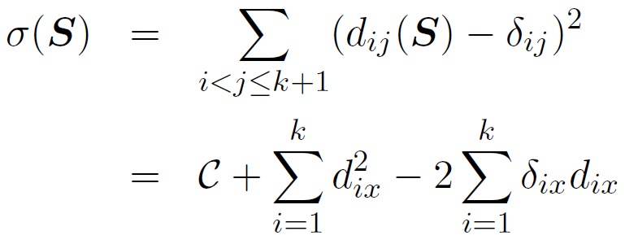
MI-MDS (3)
MI-MDS procedures
Select k-NN w.r.t. δ_{ix}, x represents newly added point.
p₁, …, p_{k} in P
Say S = P U {x}.
Finding new mapping position for a new point (x) is considered as a minimization problem of STRESS eq. as similar as normal MDS problem with k+1 points.
However, ONLY one point x is movable among k+1 pts.
We can summarize STRESS eq. as belows:

Slide 16
MI-MDS (4)
We can deploy 2nd term of the above STRESS:
In order to establish majorizing inequality, apply Cauchy-Schwarz inequality to –d_{ix} of the 3rd term.
Apply those to the STRESS eq. for MI-MDS, then

Slide 17
MI-MDS (5)
Through setting the derivative of τ(x, z) equal to 0, we can obtain minimum of it; that is
If we substitute z with x^{[t-1]}, then we generate an iterative majorizing eq. like following:

Slide 18
Parallelization
Why do we need to parallelize MDS algorithm?
For the large data set, like 100k points, a data mining alg. is no more cpu-bounded but memory-bounded.
For instance, SMACOF algorithm requires six NxN matrices, so at least 480 GB of memory is required to run SMACOF with 100k data points.
So, we have to utilize distributed memory to overcome memory shortage.
Main issue of parallelization is Load Balance and efficiency.
How to decompose a matrix to blocks?
m by n block decomposition, where m * n = p.

Slide 19
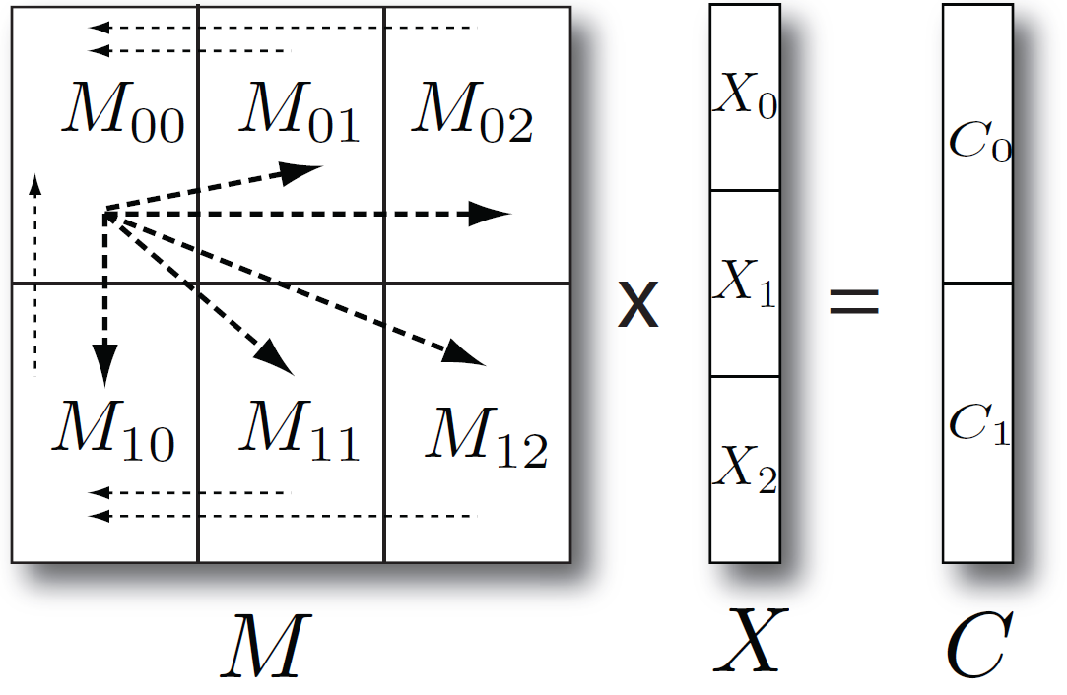
Parallelization (2)
Parallelize followings:
Computing STRESS, updating B(X) and matrix multiplication.

Slide 20
Parallelization (3)
Hybrid Parallel Model
After multicore chip invented, most of cluster systems are now multicore cluster systems in that each compute node contains multi computing units.
MPI only model is still used a lot and shows good performance some cases but not all cases with multicore cluster systems.
Hybrid (combine MPI and Threading) model used other data mining algorithms, and outperforms in some cases.
I will apply hybrid parallel model to the parallel SMACOF and investigate which parallel model is better for it.

Slide 21
Parallelization (4)
Parallel MI-MDS
Though MI-MDS (O(Mn)) is much faster than SMACOF algorithm (O(N²)), it still needs to be parallelize since it deals with millions of points.
MI-MDS is pleasingly parallel, since interpolated points (out-of-sample points) are totally independent each other.

Slide 22
Non-uniform Weight
STRESS eq. could be considered as the sum of weighted squared error.
Due to simplicity and easy computation, uniform weight is assumed in many case.
However, mapping can be different w.r.t. weight function.
Uniform weight will do more focus on larger distance entries than small distances, but reciprocal weight method will do the opposite way.
I will investigate various weight functions
e.g.) 1/δ², 1/√δ, as well as uniform and 1/δ.

Slide 23
Outline
Motivation
Background and Related Work
Research Issues
Experimental Analysis
SMACOF vs. DA-SMACOF
Parallel Performance of MPI-SMACOF
Interpolation Performance
Contributions
References

Slide 24
Experimental Analysis
Data
Biological Sequence data
ALU sequences, Meta genomics sequences
It is hard to find a feature vector of sequences, but it is possible to measure pairwise dissimilarity of two sequences.
Chemical Compound data
About 60 millions of compounds are in PubChem database.
166 binary finger print of each compound is used as a feature vector of it.
Euclidean distance of the finger prints is used as dissimilarity information of them.

Slide 25
SMACOF vs. DA-SMACOF

Slide 26
SMACOF vs. DA-SMACOF (2)

Slide 27
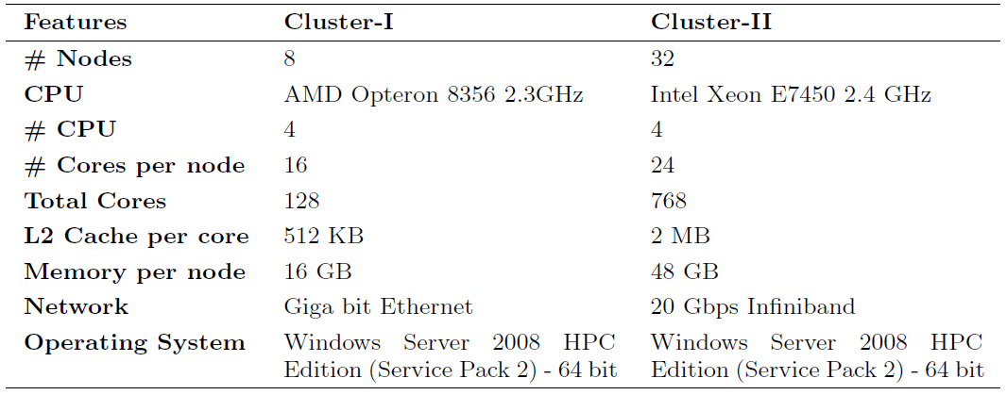
Parallel Performance
Experimental Environments

Slide 28
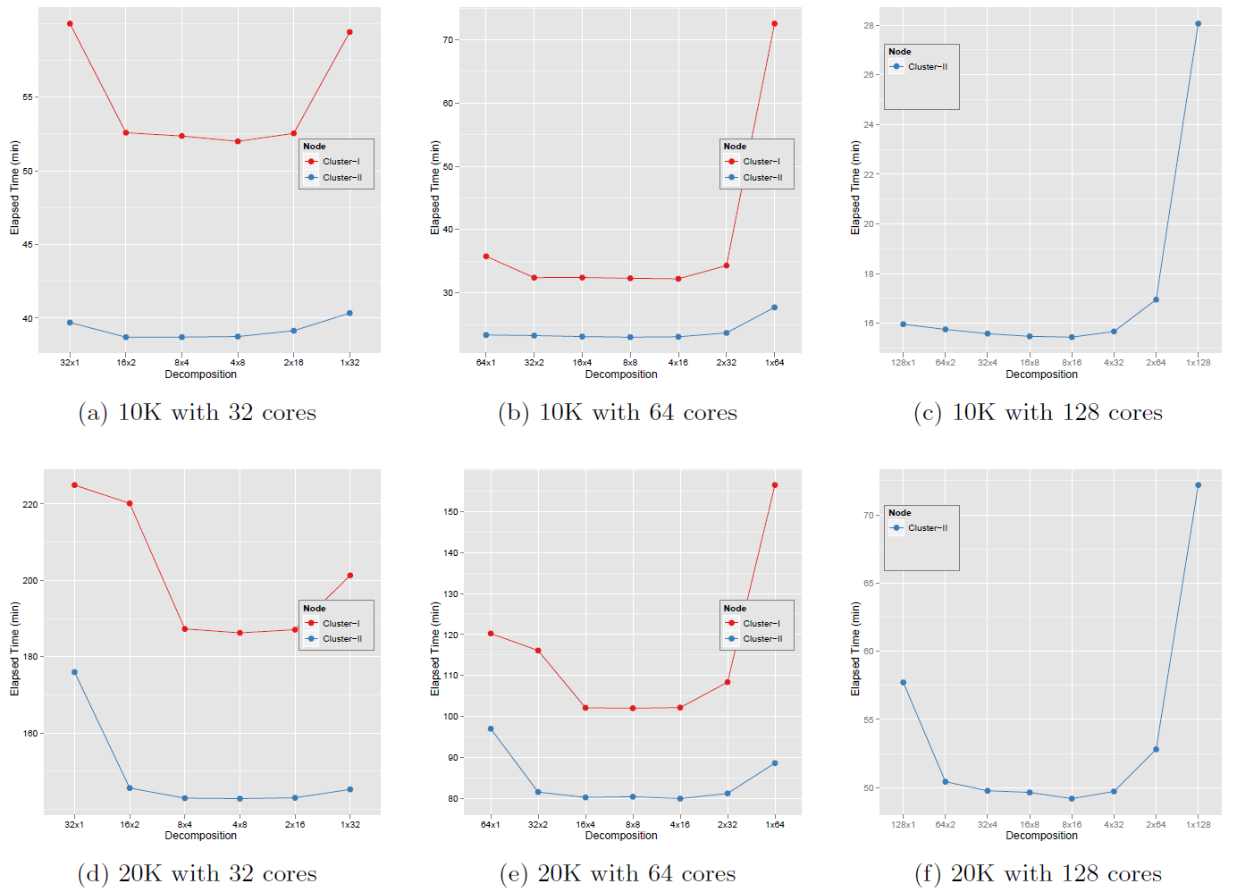
Parallel Performance (2)
Performance comparison w.r.t. how to decompose

Slide 29
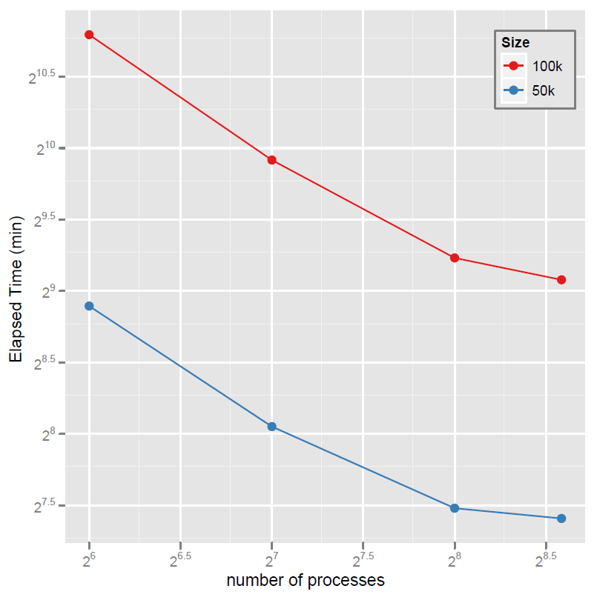
Parallel Performance (3)
Scalability Analysis

Slide 30
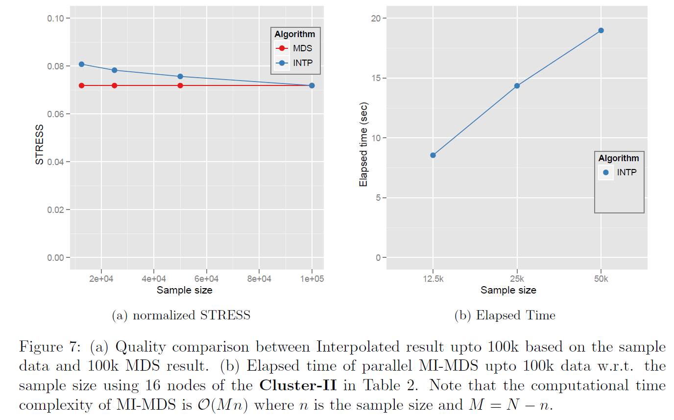
MI-MDS Performance
N = 100k points

Slide 31
MI-MDS Performance (2)
STRESS values
100k: 0.0719
1M+100k: 0.0790
2M+100k: 0.0794

Slide 32
MI-MDS Performance (3)

Slide 33
Outline
Motivation
Background and Related Work
Research Issues
Experimental Analysis
Contributions
References

Slide 34
Contributions
Main Goal: construct low dimensional mapping of the given large high-dimensional data as good as possible and as many as possible.
Apply DA approach to MDS problem to prevent trapping local optima.
The proposed DA-SMACOF outperforms SMACOF in quality and shows consistent result.
Parallelize both SMACOF and DA-SMACOF via MPI only model and hybrid parallel model.
it is possible to run faster and to deal with larger data.
Propose interpolation algorithm based on iterative majorizing method, called MI-MDS.
To deal with even more points, like millions of data, which is not eligible to run normal MDS algorithm in cluster systems.
Also, I will investigate and analyze how weight values affect to the MDS mapping.

Slide 35
References
Seung-Hee Bae. Parallel multidimensional scaling performance on multicore systems. In Proceedings of the Advances in High-Performance E-Science Middleware and Applications workshop (AHEMA) of Fourth IEEE International Conference on eScience, pages 695–702, Indianapolis, Indiana, Dec. 2008. IEEE Computer Society.
G. Fox, S. Bae, J. Ekanayake, X. Qiu, and H. Yuan. Parallel data mining from multicore to cloudy grids. In Proceedings of HPC 2008 High Performance Computing and Grids workshop, Cetraro, Italy, July 2008.
Jong Youl Choi, Seung-Hee Bae, Xiaohong Qiu and Geoffrey Fox. High Performance Dimension Reduction and Visualization for Large High-dimensional Data Analysis. to appear in the Proceedings of the The 10th IEEE/ACM International Symposium on Cluster, Cloud and Grid Computing (CCGrid 2010), Melbourne, Australia, May 17-20 2010.
Seung-Hee Bae, Jong Youl Choi, Judy Qiu, Geoffrey Fox. Dimension Reduction Visualization of Large High-dimensional Data via Interpolation. to appear in the Proceedings of The ACM International Symposium on High Performance Distributed Computing (HPDC), Chicago, IL, June 20-25 2010.

Slide 36
Thanks! Questions?

