Slide 1
Adaptive Interpolation of Multidimensional Scaling
Seung-Hee Bae, Judy Qiu, and Geoffrey C. Fox
School of Informatics and Computing
Pervasive Technology Institute
Indiana University

Slide 2
Outline
Data Visualization
Multidimensional Scaling (MDS)
Interpolation of MDS
Adaptive Interpolation of MDS
Experimental Analysis
Conclusion

Slide 3
Data Visualization
Visualize high-dimensional data as points in 2D or 3D by dimension reduction.
Distances in target dimension approximate to the distances in the original HD space.
Interactively browse data
Easy to recognize clusters or groups
An example of Biological Sequence data
MDS Visualization of 73885 biological sequence data colored by clustering results. The number of cluster centers is 26.

Slide 4
Multidimensional Scaling
Given the proximity information [Δ] among points.
Optimization problem to find mapping in target dimension.
Objective functions: STRESS (1) or SSTRESS (2)
Only needs pairwise dissimilarities δ_{ij} between original points
(not necessary to be Euclidean distance)
d_{ij}(X) is Euclidean distance between mapped (3D) points
Various MDS algorithms have been proposed:
Classical MDS, SMACOF, force-based algorithms, …

Slide 5
Interpolation of MDS
Why do we need interpolation?
MDS requires O(N²) memory and computation.
For SMACOF, six N * N matrices are necessary.
N = 100,000 → 480 GB of main memory required
N = 200,000 → 1.92 TB ( > 1.536 TB) of memory required
Data deluge era
PubChem database contains millions chemical compounds
Biology sequence data are also produced very fast.
How to construct a mapping in a target dimension with millions of points by MDS?

Slide 6
Interpolation Approach
Two-step procedure
A dimension reduction alg. constructs a mapping of n sample data (among total N data) in target dimension.
Remaining (N-n) out-of-samples are mapped in target dimension w.r.t. the constructed mapping of the n sample data w/o moving sample mappings.
n In-sample
Training
Prior Mapping
N-n
Out-of-sample
Interpolated map
Interpolation
Total N data

Slide 7
Interpolation of MDS
Merits
Reduce time complexity O(N²) → O(n(N – n))
Reduce memory requirement
Pleasingly parallel application
Cost
Quality degradation of the mapping due to the approximation.
How to reduce the quality gap
between full MDS and Interpolation of MDS?

Slide 8
Adaptive Interpolation of MDS
Distance ratio
: avg. of distances
: avg. of dissimilarities
1/r
1/r > 1.0 : 96%
1.0 < 1/r < 5.0: 75%

Slide 9
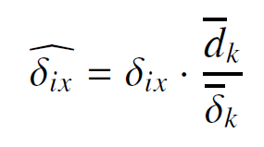
Adaptive Interpolation of MDS
Adaptive Interpolation of MDS (AI-MDS)
Interpolate points based on prior mappings of the sample data in terms of the adaptive dissimilarities between interpolated points and k-NNs.
Adaptive dissimilarity:

Slide 10
AI-MDS Algorithm

Slide 11
Experimental Environment

Slide 12
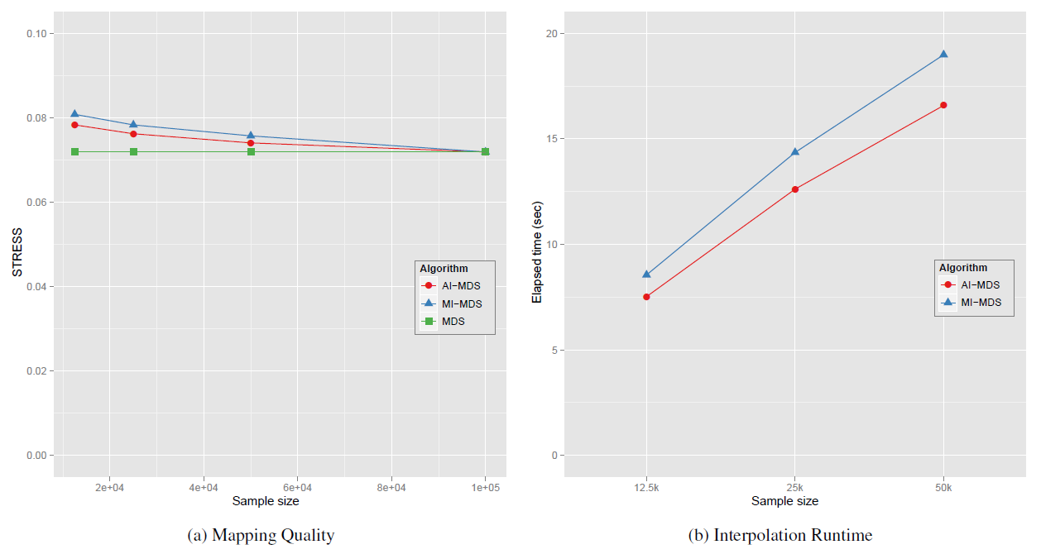
AI-MDS Performance
N = 100k points

Slide 13
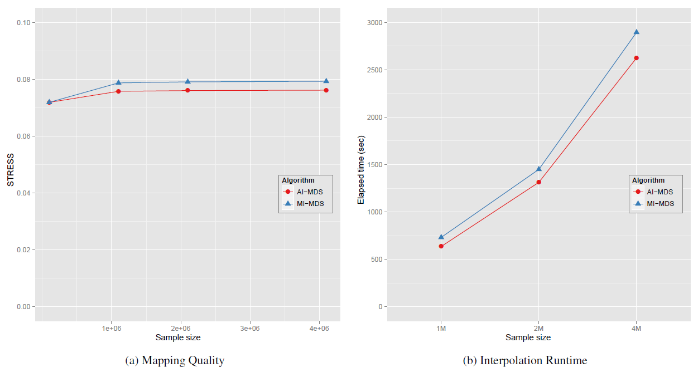
AI-MDS Performance

Slide 14
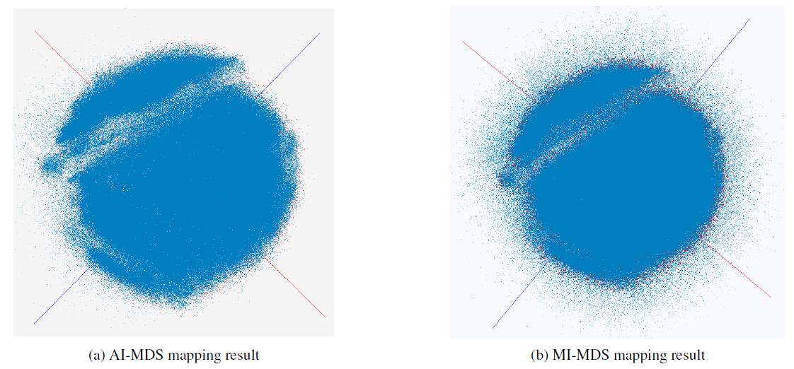
MDS Interpolation Map
PubChem data visualization by using AI-MDS and MI-MDS (2M+100k).

Slide 15
Conclusion
MDS is computation and memory intensive algorithm.
MI-MDS was proposed for reducing time complexity with minor quality loss.
This paper proposes an adaptive interpolation of MDS (AI-MDS) to reduce the quality loss by adapting the dissimilarity based on distance ratio.
AI-MDS configures millions of points with more than 40% improvement.
The proposed AI-MDS generates better mappings of the tested data during faster running time than MI-MDS.

Slide 16
Acknowledgement
NIH Grant No. 5 RC2 HG 005806- 02
Microsoft for supporting experimental environment.
Prof. Wild and Dr. Zhu at Indiana University for providing pubchem data.

Slide 17
Thanks!
Questions?
Email me at sebae@cs.indiana.edu

Slide 18
Data Visualization
Visualize high-dimensional data as points in 2D or 3D by dimension reduction.
Distances in target dimension approximate to the distances in the original HD space.
Interactively browse data
Easy to recognize clusters or groups
An example of Solvent data
MDS Visualization of 215 solvent data (colored) with 100k PubChem dataset (gray) to navigate chemical space.

