Slide 1
Big Data, Stream Processing & Algorithms
Supun Kamburugamuve
For the PhD Qualifying Exam
12-19-2013
Advisory Committee
Prof. Geoffrey Fox
Prof. David Leake
Prof. Judy Qiu

Slide 2
Outline
Big Data Analytics Stack
Stream Processing
Stream Processing Model
Fault Tolerance
Distributed Stream Processing Engines
Comparison of DSPEs
Streaming Data Algorithms
Clustering Algorithms
Classification
Quantile Computation
Frequent Item Sets Mining
Discussion and Q/A

Slide 3
Apache Software Foundation
Started with Apache Web Server
Official staring date June 1, 1999
Apache License Version 2.0
The access right were given based on Meritocracy
Roles
User | developer | committer | PMC member | PMC Chair | ASF member
Lazy Consensus based approach for decision making
+1 Positive, 0 No Opinion, -1 Negative
New projects enter the organization through Incubator

Slide 4
365 PB + Data stored in HDFS
More than 100 PB stored in
HDFS in 2012
30,000 Nodes managed by Yarn
Reported running 1 trillion
graph computation with
1 trillion edges
400,000 Jobs/day
100 billion events (clicks, impressions, email content & meta-data, etc.) are collected daily, across all of the company’s systems

Slide 5
Continuous Processing
Huge number of events (100 billion?)
The batch jobs take time to run
While the batch jobs are running new events come
Why run the complete batch jobs for machine learning tasks when only small fraction of the model changes?
Long Running
Real time streaming
Iterative Processing
Interactive Data Mining Queries

Slide 6
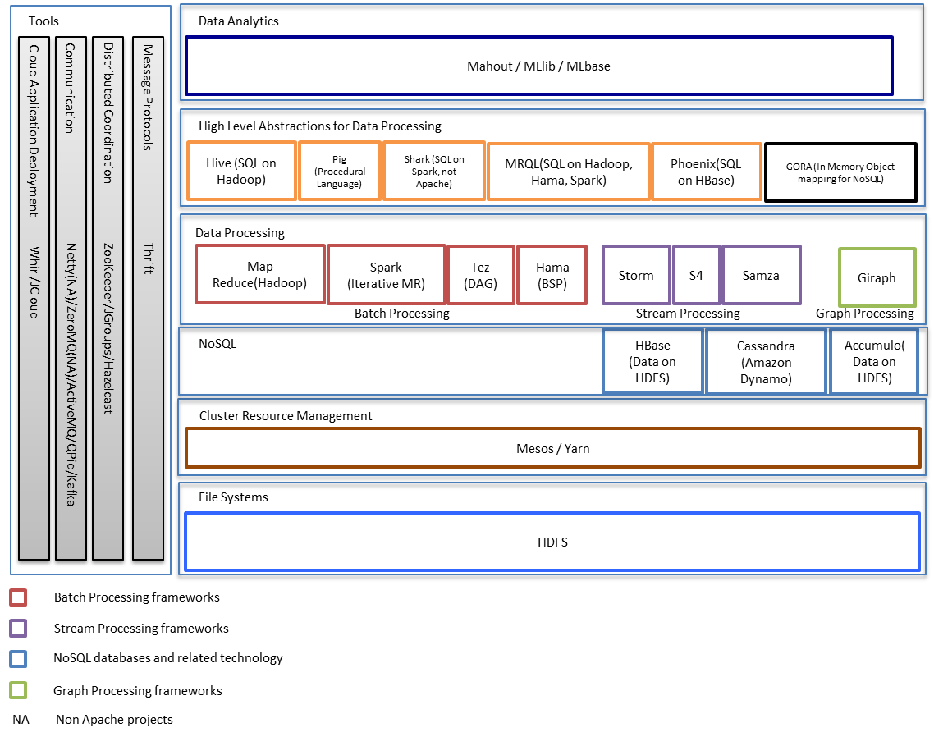
Big Data Stack

Slide 7
Static Partitioning of Resources
Map Reduce
Giraph
Storm
HDFS-1
HDFS-2
HDFS-3
Cluster of 15 Nodes, Partitioned to 3 clusters

Slide 8
Sharing the File System
Map Reduce
Giraph
Storm
HDFS
Make the file system shared

Slide 9
Resource Management
Yarn / Mesos
HDFS

Slide 10
Resource Management
Yarn / Mesos
HDFS
Night time

Slide 11
Continuous Processing
Real time streaming
Iterative Processing
Hbase/Cassandra
Update the models incrementally
Yarn/Mesos
Long Running
HDFS
Interactive Data Mining Queries
Create the models
Test hypothesis

Slide 12
HDFS 2.0
Automated failover with hot standby
NFS
FS Namespace
Namenode
Block Management
DataNode
DataNode
Block Storage

Slide 13
Apache Yarn
Framework specific Application Master
Application Master instance for each job
Resource Manager
Node Manager
Container
Container
AM 1
Application 2
Node Manager
Container
Container
Application 1
AM 2

Slide 14
Apache Mesos
ZooKeeper
Hadoop Scheduler
Storm Scheduler
ZooKeeper
ZooKeeper
Master
Master
Slave
Slave
Storm Executor
Storm Executor
Task
Task

Slide 15
Moab, Torque, Slurm vs Yarn, Mesos
Both allocate resources
Big data clusters
x86 based commodity clusters
Data locality is important
HPC Clusters
Specialized hardware
NFS
Diskless nodes, data stored in separate servers
Yarn & Mesos scheduling
Data locality
Fault tolerance of the applications?

Slide 16
NoSQL
Semi Structured data storage
HBase
Big table data model & architecture
HDFS as the data storage
Tight integration with Hadoop
Hive for HBase
Accumulo
Same as HBase, only less popular
Cassandra
BigTable data model & Dynamo architecture
CQL
Cassandra File System for interfacing with Hadoop

Slide 17
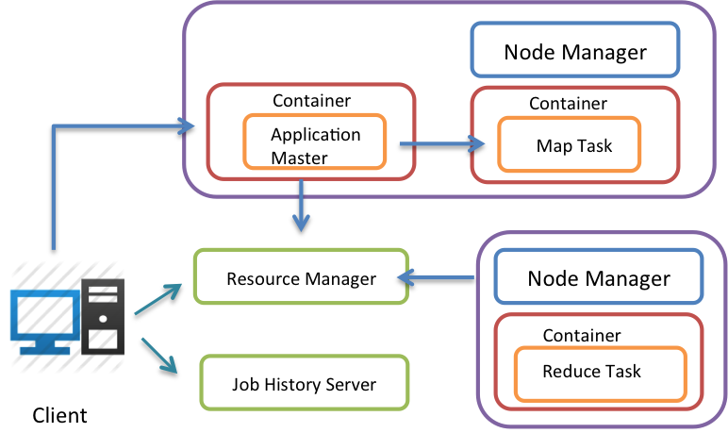
Hadoop MapReduce ver. 2.0
Based on Yarn
No Job Track and Task Tracker
Only supports Memory based
resource allocation
Client contacts the resource manager (RM)
Specify the Application Master information along with Job information
Resource Manager allocates a container to start ApplicationMaster(AM)
AM request resources from RM
AM manages the job

Slide 18
Spark
Hadoop is too slow for iterative jobs
In Memory computations
Resilient Distributed Data Sets
Abstraction for immutable distributed collections
Use Lineage data for fault tolerance
Not MapReduce, claims to be general enough
RDD
Operations on RDD

Slide 19
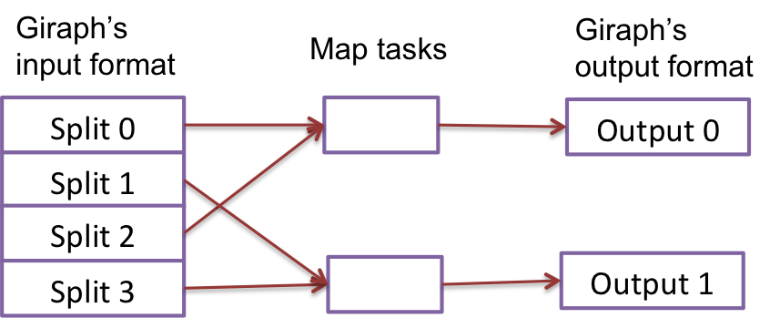
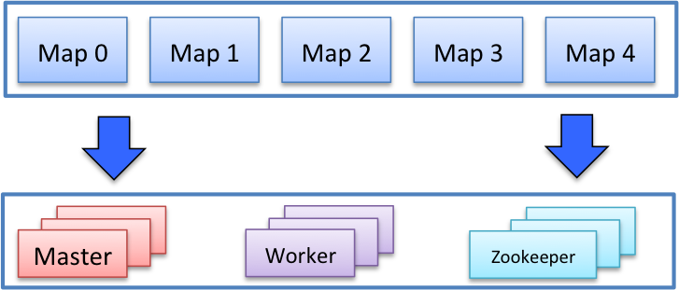
Giraph
V1
V2
Bulk Synchronous model
Vertex and edges, computation done at vertex
V3
Giraph is a MapReduce Job
Use Hadoop for Data Distribution +
Distributed Task execution
Natural Fit for Yarn

Slide 20
Hive
Hive is SQL
Suitable for processing structured data
Create a table structure on top of HDFS
Queries are compiled in to MapReduce jobs
CREATE TABLE myinput (line STRING);
LOAD DATA LOCAL INPATH '/user/someperson/mytext.txt' INTO TABLE myinput;
CREATE TABLE wordcount AS
SELECT word, count(1) AS count
FROM (SELECT EXPLODE(SPLIT(LCASE(REGEXP_REPLACE(line,'[\\p{Punct},\\p{Cntrl}]','')),' '))
AS word FROM myinput) words
GROUP BY word
ORDER BY count DESC, word ASC;
SELECT CONCAT_WS(',', CONCAT("\(",word), CONCAT(count,"\)")) FROM wordcount;

Slide 21
Pig
Pig is procedural language
Suitable for data pipe line applications
Get raw data, transform and store in HDFS
More control over the operations
A = load './input.txt'; B = foreach A generate flatten(TOKENIZE((chararray)$0)) as word; C = group B by word; D = foreach C generate COUNT(B), group; store D into './wordcount';

Slide 22
Analytics
Mahout
Mostly Hadoop based, Under active development
Mllib – Spark
Task | Algorithms
Classification | Boosting, Neural Networks, Logistic Regression, Naive Bayes
Clustering | Canopy Clustering, K-Means, Fuzzy K-Means, Mean Shift Clustering, Hierarchical Clustering, Dirichlet Process Clustering, Latent Dirichlet Allocation, Spectral Clustering, Minhash Clustering, Top Down Clustering
Pattern Mining | Frequent Item Mining
Regression | Work in progress
Dimension Reduction | Work in progress
Task | Algorithms
Binary classifications | Linear support vector machines, Logistic Regression
Regression | Linear regression, L1 (lasso) regression, L2 (ridge) regularized.
Clustering | K-means,
Collaborative filtering | Alternating Least Squares

Slide 23
50 Billion Devices by 2020
Report by Cisco

Slide 24
A Scenario from Cisco
Your meeting was delayed by 45 minutes
Your car knows it needs gas to make it to the train station. Fill-ups usually takes 5 minutes.
This communicated to your alarm clock, which allows you extra 5 mins sleep
There was an accident on your driving route causing a 15 mins detour
Your train is running 20 mins behind the schedule
And signals your car to start in 5 mins late to melt the ice accumulated overnight
And signals your coffee maker to turn on 5 mins late as well

Slide 25
Applications
Behavior Tracking
Netflix, Amazon, Car Insurance Companies tracking driving
Situational Awareness
Surveillance, traffic routing
Data collected for a long time
Patient monitoring, weather data to help farmers
Process optimization
Factory process optimization
Resource consumption Monitoring
Smart grid

Slide 26
Attributes
Data Mobility
High Availability & Data processing guarantees
Stream partitioning
Data Querying
Deterministic or Non-Deterministic processing
Data storage
Handling Stream Imperfections

Slide 27
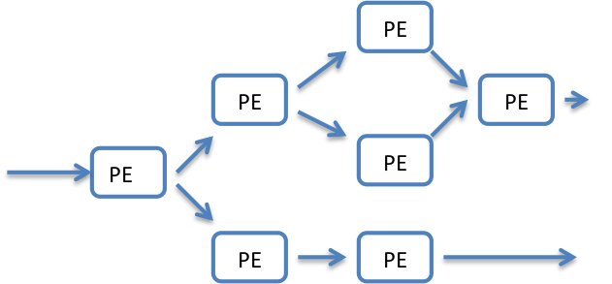
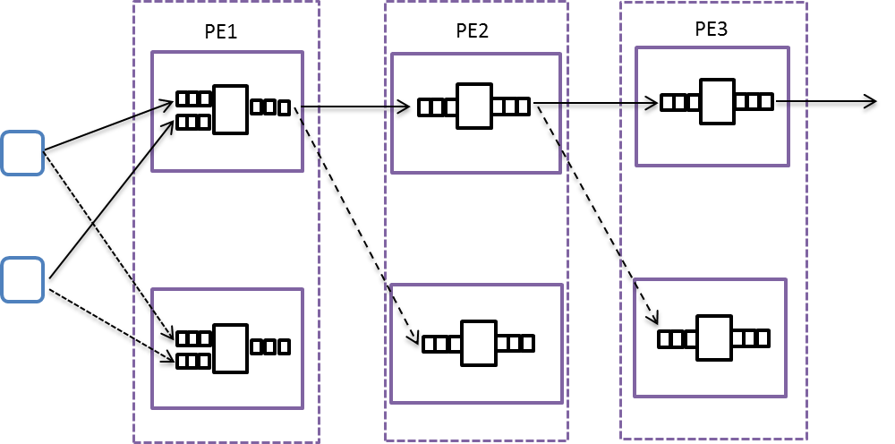
Stream Processing
Stream – Sequence of unbounded tuples
Queue
Processing Elements
Replication
Stream
Macro view
Microscopic View

Slide 28
Fault Tolerance
3 Strategies
Upstream backup
Active backup
Passive backup
3 Recovery guarantees
Gap Recovery
Rollback Recovery
Divergent recovery
Precise Recovery

Slide 29
Distributed Stream Processing Engines
Aurora
Borealis
Apache Storm
Apache S4
Apache Samza

Slide 30
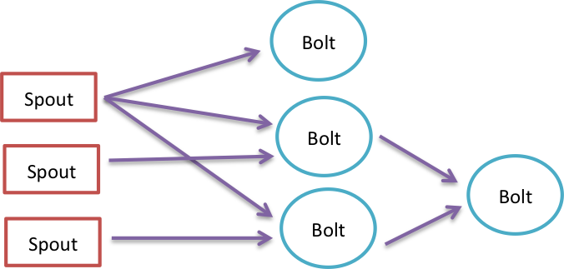
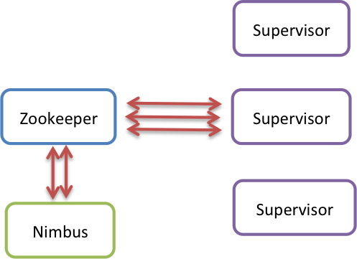
Apache Storm
Storm is the Hadoop for distributed stream processing?
Storm is Stream Partitioning + Fault Tolerance + Parallel Execution
Topology
Programming Model
Architecture
Java, Ruby, Python, Javascript, Perl, and PHP

Slide 31
Apache Storm
Data Mobility
No blocking operations, ZeroMQ and Netty Based communication
Fault Tolerance
Rollback Recovery with Upstream backup
The messages are saved in out queue of Spout until acknowledged
Stream Partition
User defined, based on the grouping
Storm Query Model
Trident, A Java library providing high level abstraction

Slide 32
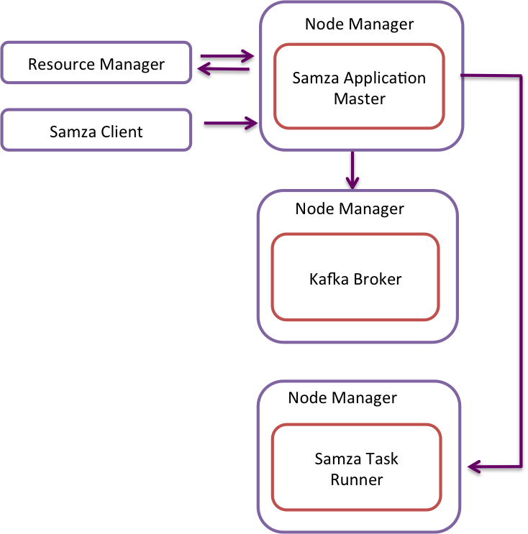
Apache Samza
Stream
Stream Task
Stream
Architecture based on Yarn

Slide 33
Apache Samza
Data Mobility
Brokers at the middle
Fault Tolerance
For now Gap recovery, because a faulty broker node can loose messages, targeting Rollback recovery
Stream partitioning
Based on key attributes in messages
Data storage
Kafka stores the messages in the file system

Slide 34
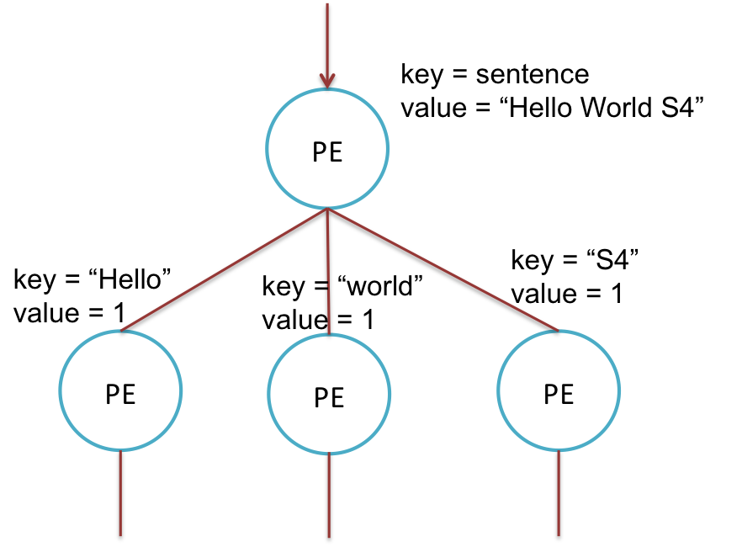
S4
Inspired by MapReduce
For each Key-Value pair a new PE is created
Has a model other than stream partitioning
Processing Node
Processing Element Container
PE1
PE2
PEn
Communication Layer
State Saved Internally
i.e. current count
Zookeeper
Counting words
What if we get very large number of words?

Slide 35
S4
Data mobility
Push based
Fault Tolerance
Gap recovery, data lost at processing nodes due to overload
Stream partitioning
Based on key value pairs

Slide 36
DSPE Comparison

Slide 37
Streaming Data Algorithms
Characteristics of Stream Processing Algorithms
The data is processed continuously in single items or small batches of data
Single pass over the data
Memory and time bounded
The results of the processing available continuously
3 Processing models
Landmark model
Damping model
Sliding window

Slide 38
Clustering Algorithms
STREAM Algorithm

Slide 39
Clustering Algorithms
Evolving Data Streams
Start by running K-Means on some initial data
When new data arrives create micro cluster
Add them to existing clusters or create new clusters
Delete existing clusters or merge existing clusters
Save the cluster to disk
Run K-Means on these clusters to create a Macro view

Slide 40
Classification
Hoeffding Trees
Usually node split happens based on Information Gain, Gini Index
Easy in batch algorithms because all the data is present
How to split the nodes to create the tree without seeing all the data
Hoeffding bound

Slide 41
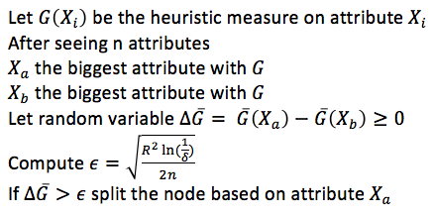
Hoeffding Trees
Every sample is filtered down to the leaf node

Slide 42
Quantile Computation
A ϕ-qunatile of an ordered sequence of N data items is the value with rank ϕN
GK-Algorithm
Sliding windows
Input set:
11 21 24 61 81 39 89 56 12 51
After sorting:
11 12 21 24 39 51 56 61 81 89
The 0.1-quantile = 11
The 0.2-quantile = 12
If ε=.1 0.1-quantile = {11, 12}
If ε=.1 0.2-quantile = {11, 12,13}

Slide 43
GK-Algorithm
If ε=.1
Rank | 1 | 2 | 3 | 4 | 5 | 6 | 7 | 8 | 9
Value | 12 | 13 | 14 | 24 | 26 | 45 | 55 | 89 | 98
The algorithm can keep only values
Rank | 1 | 2 | 3 | 4 | 5 | 6 | 7 | 8 | 9
Value |  | 13 |  |  | 26 |  |  | 89
Simple solution is to keep
( [v1,min1,max1], [v2,min2,max2], …) Too inefficient
Rank | 1 | 2 | 3 | 4 | 5 | 6 | 7 | 8 | 9
Value |  | 13 |  |  | 26 |  |  | 89

Slide 44
GK-Algorithm
Maintains S an ordered subset of elements chosen from the items seen so far.
Algorithm maintains the smallest and largest seen so far

Slide 45
Frequent Item Sets Mining
Exact Frequent Items
The ε-approximate frequent items problem
Count based algorithms
Frequent Algorithm
Lossy Counting
Sketch Algorithms
CountS-Sketch
CountMin Sketch
Sliding Windows

Slide 46
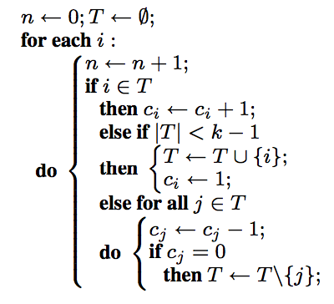
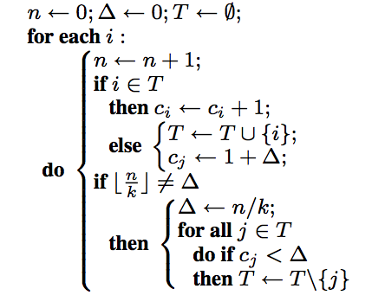
Count Based
Frequent Algorithm
Lossy Counting

Slide 47
Summary
Apache Software Foundation is attracting more and more big data projects
The computation is moving from batch processing to a hybrid model
Yarn and Mesos are solidifying the big data analytics stack
Different models for Distributed Stream Processing

Slide 48
Q / A

