Slide 1

RAIN: A system to Dynamically Generate & Provision Images on Bare Metal by Application Users
Presented by
Gregor von Laszewski
Authors:
Javier Diaz, Gregor von Laszewski, Fugang Wang, Geoffrey Fox,
Andrew Younge

Slide 2
Acknowledgment: People
Many people have worked on FuturGrid and we are not be able to list all them here.
We will attempt to keep a list available on the portal Web site.
Many others have contributed to this tutorial!!
    Thanks!!
https://portal.futuregrid.org

Slide 3
Acknowledgement
The FutureGrid project is funded by the National Science Foundation (NSF) and is led by Indiana University with University of Chicago, University of Florida, San Diego Supercomputing Center, Texas Advanced Computing Center, University of Virginia, University of Tennessee, University of Southern California, Dresden, Purdue University, and Grid 5000 as partner sites.

Slide 4
Reuse of slides
If you reuse the slides please indicate that they are copied from this tutorial. Include a link to its biblographical entry that you can find at
  https://portal.futuregrid.org/biblio
We discourage the printing the slide material on paper due to two reasons:
  We like to minimize the impact on the environment for paper and ink usage
  We intend to keep the tutorials up to date on the Web site

Slide 5
FutureGrid
Overview

Slide 6
Selected FutureGrid key Features
International testbed for Grids, Clouds, HPC
Can be used by Industry and Academia
Education & Training
A flexible development and testing platform for middleware and application
  users looking at interoperability, functionality, performance or evaluation
In future each use of FutureGrid is an experiment that is reproducible
Distributed infrastructure
  Indiana University, University of Chicago, University of Florida, San Diego Supercomputing Center, Texas Advanced Computing Center, University of Virginia, University of Tennessee, University of Southern California, Dresden, Purdue University, and Grid 5000 as partner sites.

Slide 7

Selected List of Services Offered
FutureGrid
User
IaaS
Nimbus
PaaS
Hadoop
(Twister)
(Sphere/Sector)
MPI
Others
Portal
Inca
Eucalyptus
ViNE
(OpenStack)
(OpenNebula)
HPCC
Ganglia
(Exper. Manag./(Pegasus
(Rain)
OpenMP
ScaleMP
(XD Stack)
Grid
(Globus)
Unicore
SAGA
Genesis II
(will be added in future)

Slide 8
Services Offered
 | India | Sierra | Hotel | Foxtrot | Alamo | Xray | Bravo
myHadoop | ✔ | ✔ |  |  | ✔
Nimbus |  | ✔ | ✔ | ✔ | ✔
Eucalyptus | ✔ | ✔
ViNe¹ | ☑ | ✔ | ☑ | ✔ | ☑
Genesis II | ✔ | ✔ |  |  | ✔ | ✔
Unicore | ✔ | ✔ |  |  |  | ✔
MPI | ✔ | ✔ | ✔ | ✔ | ✔ | ✔ | ✔
OpenMP |  |  |  |  |  | ✔
ScaleMP | ✔
Ganglia | ✔ |  | ✔
Pegasus³ | ☑ | ☑ | ☑ | ☑ | ☑
Inca | ✔ | ✔ | ✔ | ✔ | ✔ | ✔
Portal² | ☒ | ☒ | ☒ | ☒ | ☒ | ☒
PAPI |  |  |  |  |  | ✔
Vampir
ViNe can be installed on the
other resources via Nimbus ☑
Access to the resource is requested through the portal ☒
Pegasus available via Nimbus and Eucalyptus images

Slide 9
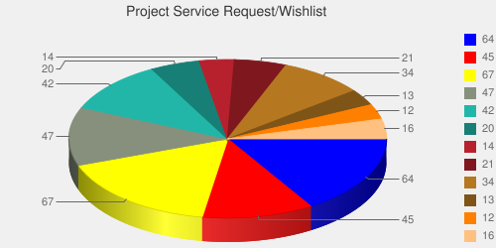
User demand influences service deployment
Based on User input we focused on
  Nimbus (53%)
  Eucalyptus (51%)
  Hadoop (37%)
  HPC (36%)
Eucalyptus: 64(50.8%)
High Performance Computing Environment: 45(35.7%)
Nimbus: 67(53.2%)
Hadoop: 47(37.3%)
MapReduce: 42(33.3%)
Twister: 20(15.9%)
OpenNebula: 14(11.1%)
Genesis II: 21(16.7%)
Common TeraGrid Software Stack: 34(27%)
Unicore 6: 13(10.3%)
gLite: 12(9.5%)
OpenStack: 16(12.7%)
* Note: We will improve the way we gather statistics in order to avoid inaccuracy during the information gathering at project and user registration time.

Slide 10
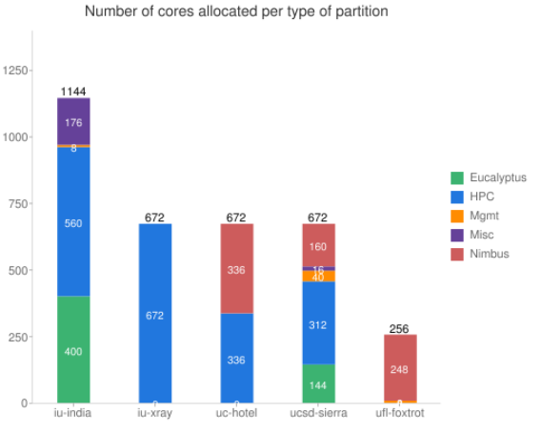
Dynamic Service Allocation

Slide 11
Rain in FutureGrid
http://futuregrid.org

Slide 12
Software Architecture

Slide 13
FutureGrid Software Architecture
Note on Authentication and Authorization
We have different environments and requirements from XSEDE
Non trivial to integrate/align security model with XSEDE

Slide 14
Detailed Software Architecture

Slide 15
Next we present selected Services
☒
☒
☒

Slide 16
Image Management and Dynamic Provisioning

Slide 17
Terminology
Image Management provides the low level software (create, customize, store, share and deploy images) needed to achieve Dynamic Provisioning and Rain
Dynamic Provisioning is in charge of providing machines with the requested OS. The requested OS must have been previously deployed in the infrastructure
RAIN is our highest level component that uses Dynamic Provisioning and Image Management to provide custom environments that may or may not exits. Therefore, a Rain request may involve the creation, deployment and provision of one or more images in a set of machines

Slide 18
Motivation
The goal is to create and maintain platforms in custom FG images that can be retrieved, deployed, and provisioned on demand
Imagine the following scenario for FG:
  fg-image-generate –o ubuntu –v maverick -s openmpi-bin,gcc,fftw2,emacs –n ubuntu-mpi-dev (store img in repo with id 1234)
  fg-image-deploy –x india.futuregrid.org –r 1234
  fg-rain –provision -n 32 ubuntu-mpi-dev

Slide 19
Architecture
Image management is supported by a number of tightly-coupled services essential for FG
The major services are
  Image Repository
  Image Generator
  Image Deployment
  RAIN – Dynamic provisioning
  External Services

Slide 20
Image Management

Slide 21
Image Generation
  Creates and customizes images according to user requirements:
  OS type
  OS version
  Architecture
  Software Packages
Image is stored in the Image Repository or returned to the users
Images are not aimed to any specific infrastructure

Slide 22
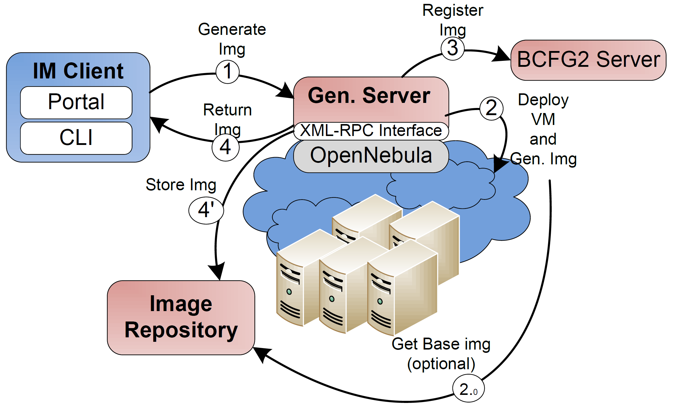
Image Generation (Implementation View)
Notes:
1. The client requests an image that fulfill some requirements.
2. The Image Generate Server deploy a VM to create the image. The image can be created from scratch or we can use a base image stored in the repository (2.0).
3. The new image is registered in the BCFG2 server.
4. The image is stored in the Image repository or it is given to the user. The first option is the default one because in this way the image is flagged as secure.

Slide 23
Image Verification (I)
Images will be verified to guarantee some minimum security requirements
Only if the image passes predefined tests, it is marked as deployable
Verification takes place several times on an image
  Time of generation
  Before and after the deployment
  Once a time threshold is reached
  Periodically

Slide 24
Image Deployment
Customizes (network IP, DNS, file system table, kernel modules, etc) and deploys images for specific infrastructures
Two main infrastructures types
  HPC deployment: it means that we are going to create network bootable images that can run in bare metal machines
  Cloud deployment: it means that we are going to convert the images in VMs

Slide 25
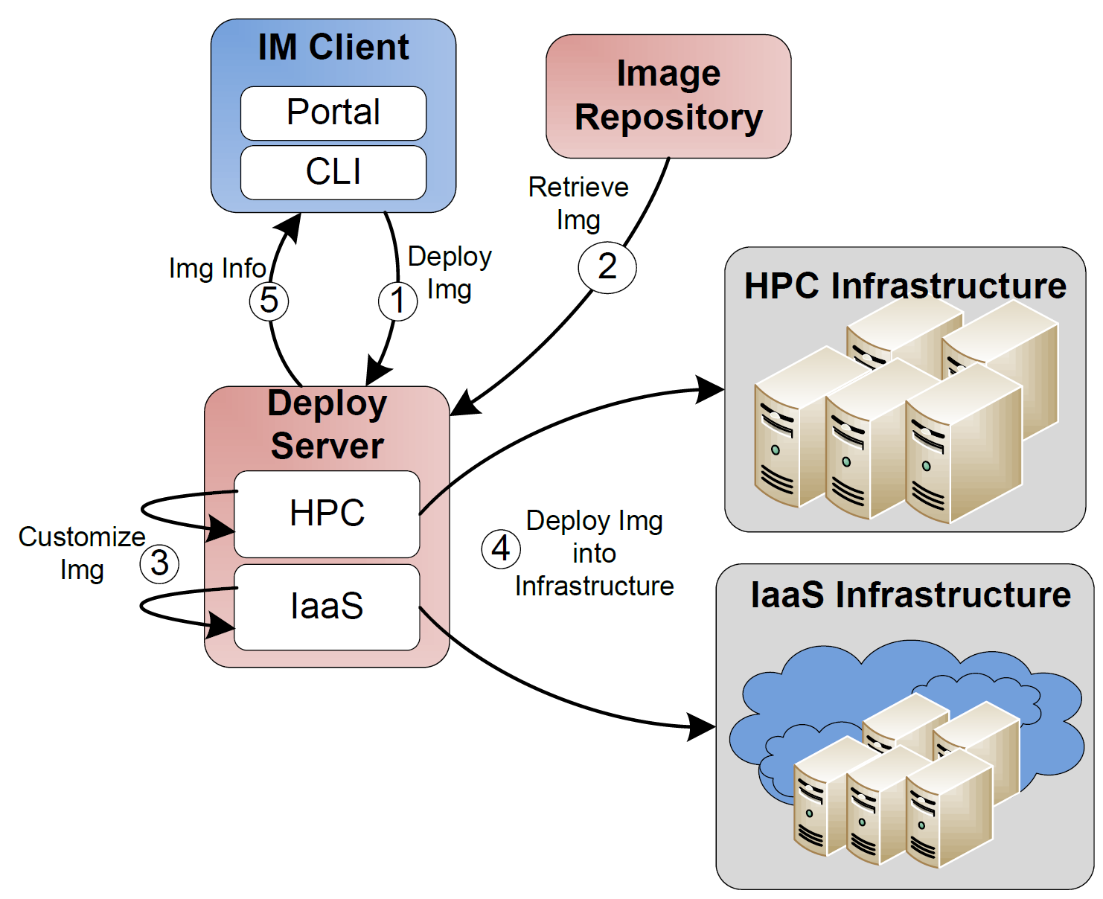
Image Deployment
(Implementation View)
Notes:
User want to deploy an image into HPC or some IaaS framework.
The image is retrieved from Image Repository. Optionally the user can choose an image from his local disk. This option is not available for HPC deployment due to security reasons
Deploy server customize the image
The image is deployed in the corresponding infrastructure
User get information about how to use its image.

Slide 26
Image Repository (I)
Integrated service that enables storing and organizing images from multiple cloud efforts in the same repository
Images are augmented with metadata to describe their properties like the software stack installed or the OS
Access to the images can be restricted to single users, groups of users or system administrators

Slide 27
Image Repository (II)
Maintains data related with the usage to assist performance monitoring and accounting
Quota management to avoid space restrictions
Pedigree to recreate image on demand
Repository’s interfaces: API's, a command line, an interactive shell, and a REST service
Other cloud frameworks could integrate with this image repository by accessing it through an standard API

Slide 28
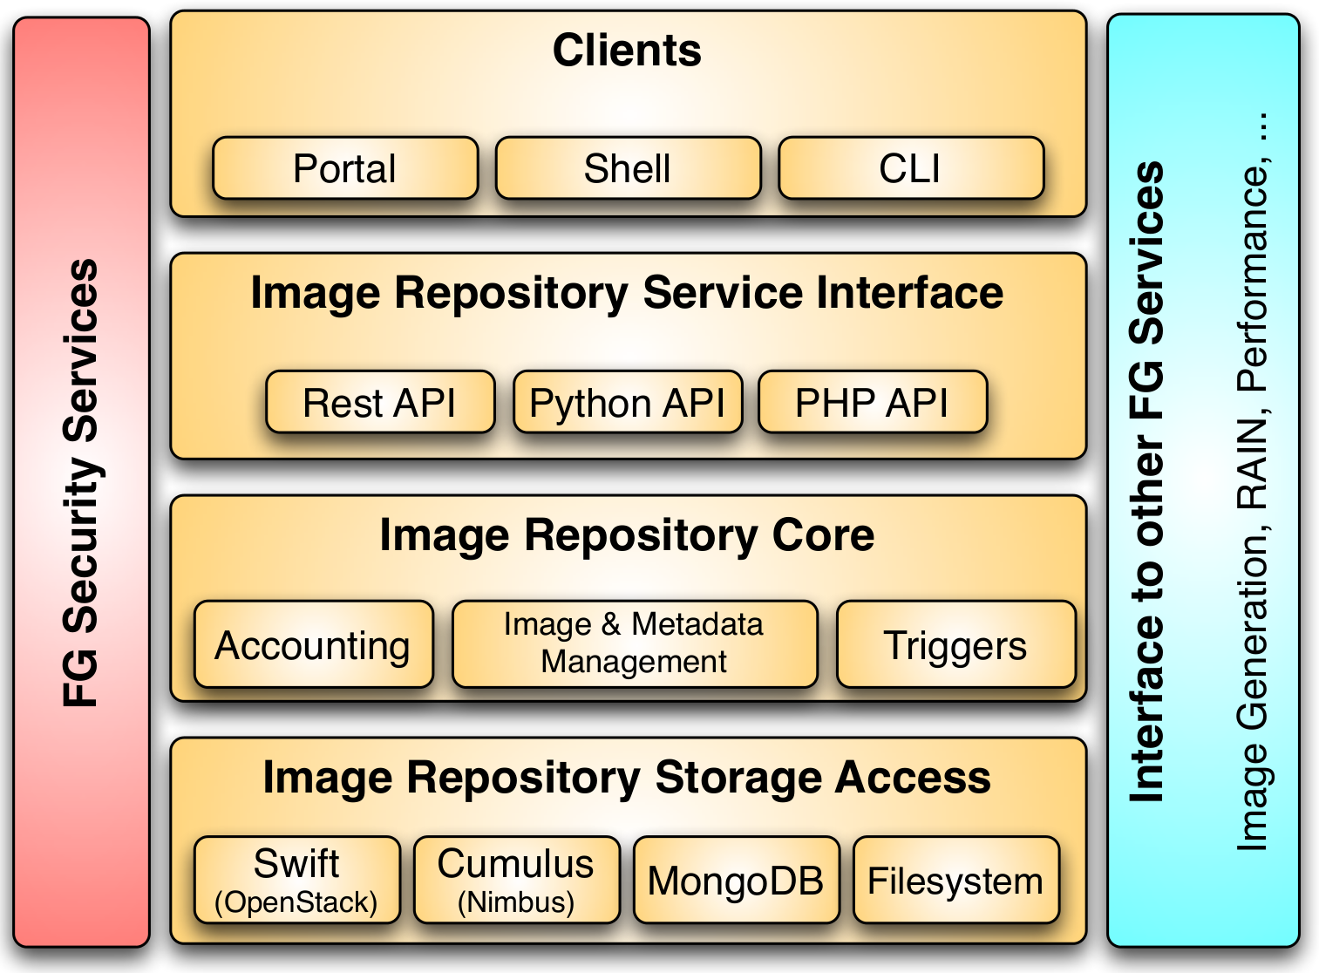
Image Repository II

Slide 29
Rain – Dynamic Provisioning

Slide 30
Classical Dynamic Provisioning
Dynamically partition a set of resources
Dynamically allocate resources to users
Dynamically define the environment that a resource is going to use
Dynamically assign them based on user request
Deallocate the resources so they can be dynamically allocated again

Slide 31
Use Cases of Dynamic Provisioning
Static provisioning:
  Resources in a cluster may be statically reassigned based on the anticipated user requirements, part of an HPC or cloud service. It is still dynamic, but control is with the administrator. (Note some call this also dynamic provisioning.)
Automatic Dynamic provisioning:
  Replace the administrator with intelligent scheduler.
Queue-based dynamic provisioning:
  provisioning of images is time consuming, group jobs using a similar environment and reuse the image. User just sees queue.
Deployment:
  dynamic provisioning features are provided by a combination of using XCAT and Moab
http://futuregrid.org

Slide 32
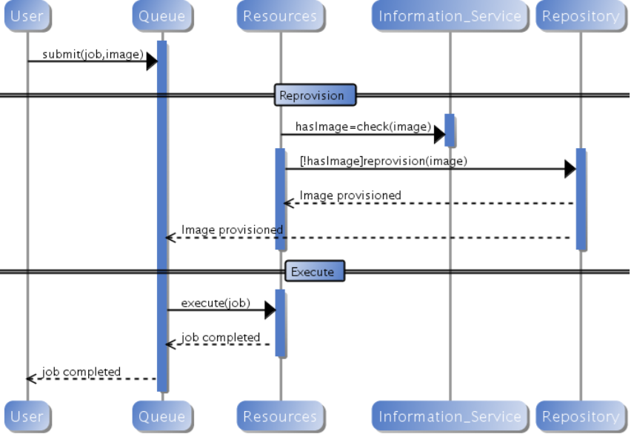
Generic Reprovisioning
http://futuregrid.org

Slide 33
Dynamic Provisioning Examples
Give me a virtual cluster with 30 nodes based on Xen
Give me 15 KVM nodes each in Chicago and Texas linked to Azure and Grid5000
Give me a Eucalyptus environment with 10 nodes
Give 32 MPI nodes running on first Linux and then Windows
Give me a Hadoop environment with 160 nodes
Give me a 1000 BLAST instances linked to Grid5000
Run my application on Hadoop, Dryad, Amazon and Azure … and compare the performance
http://futuregrid.org

Slide 34
From Dynamic Provisioning to “RAIN”
In FG, dynamic provisioning goes beyond the services offered by common scheduling tools that provide such features
RAIN (Runtime Adaptable INsertion Configurator)
We want to provide custom HPC environment, Cloud environment, or virtual networks on-demand with little effort
Example: “rain” a Hadoop environment into a set of machines
  fg-rain -n 8 -app Hadoop …
  Users and administrators do not have to set up the Hadoop environment as it is being done for them

Slide 35
Future FG RAIN Commands
  fg-rain –h hostfile –iaas nimbus –image img
  fg-rain –h hostfile –paas hadoop …
  fg-rain –h hostfile –paas dryad …
  fg-rain –h hostfile –gaas gLite …
  fg-rain –h hostfile –image img
  Additional Authorization is required to use fg-rain without virtualization.
http://futuregrid.org

Slide 36
Rain in FutureGrid
http://futuregrid.org

Slide 37
Dynamic Provisioning Results
Number of nodes
Time elapsed between requesting a job and the jobs reported start time on the provisioned node. The numbers here are an average of 2 sets of experiments.

Slide 38
Status and Plan

Slide 39
Image Generation
Feature | Y1 | Y2 | Y3
Quality | Prototype (proof of concept scripts) | Production development and deployment for selected users | General Deployment
OS supported | Ubuntu | CentOS/Ubuntu | CentOS/Ubuntu/Fedora/Suse
Multi-tenancy | No | Yes | Yes
Security | No | Yes | Yes
Authentication | No | Yes – LDAP | Yes - LDAP
Client Interface | CLI | CLI | CLI, Rest API, Portal Interface
Scalability | No | High (uses OpenNebula to deploy a VM per request) | High (uses OpenNebula to deploy a VM per request)
Interoperability | Poor (based on base-images) | High (VM with different OS) | High (VM with different OS)

Slide 40
Image Deployment
Feature | Y1 | Y2 | Y3
Quality | Prototype (proof of concept scripts) | Production development and deployment for selected users | General Deployment
Deployment type | - Eucalyptus - Proof of Concept for HPC | Eucalyptus, HPC (Moab/torque – xCAT) | Eucalyptus, OpenStack, Nimbus, OpenNebula, HPC (Moab/torque)
OS supported | Ubuntu for Eucalyptus | CentOS for HPC | CentOS/Ubuntu/Fedora/Suse
Multi-tenancy | No | Yes | Yes
Security | No | Yes | Yes
Authentication | No | Yes – LDAP | Yes - LDAP
Client Interface | CLI | CLI | CLI, Rest API, Portal Interface

Slide 41
Image Repository
Feature | Y1 | Y2 | Y3
Quality | Early development | Production development | General Deployment
Client-Server Communication | Ssh | TLS/SSL Sockets | TLS/SSL Sockets
Multi-tenancy | Yes – limited | Yes | Yes
Security | Yes - ssh | Yes | Yes
Authentication | Yes – ssh | Yes – LDAP | Yes - LDAP
Client Interface | CLI | CLI, Rest API | CLI, Rest API, Portal Interface
Manage Images | Store, retrieve, modify metadata, share | Store, retrieve, modify metadata, share | Store, retrieve, modify metadata, share
Manage Users | No | users, roles and quotas | users, roles and quotas
Statistics | No | Yes (#Images, usage,logs) | Yes (#Images, usage,logs)
Storage Backend | Filesystem | Filesystem, MongoDB, Cumulus, Swift, Mysql | Filesystem, MongoDB, Cumulus, Swift, Mysql

Slide 42
Lessons Learned
Users can customize bare metal images
We provide base images that can be extended
We have developed an environment allowing multiple users to do this at the same time
Changing version of XCAT
Moab supports a different kind of dynamic provisioning. E.g. Administrator needs to provide the image (not scalable)

