Slide 1
Study of MapReduce for Data Intensive Applications, NoSQL Solutions, and a Practical Provisioning Interface for IaaS Cloud
Tak-Lon (Stephen) Wu

Slide 2
Outline
MapReduce
  Challenges with large scale data analytic applications
  Researches
NoSQL
  Typical Types of solutions
  Practical Use Cases
salsaDPI (salsa Dynamic Provisioning Interface)
  System design and architecture
  Future Directions
Notes:
Large-scale data analytics

Slide 3
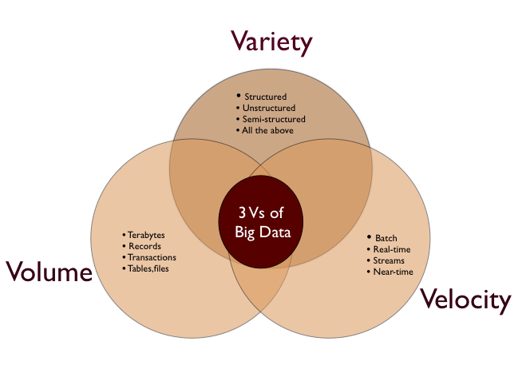
Big Data Challenging issues
Graph obtained from http://kavyamuthanna.wordpress.com/2013/01/07/big-data-why-enterprises-need-to-start-paying-attention-to-their-data-sooner/
Notes:
3V for data http://kavyamuthanna.wordpress.com/2013/01/07/big-data-why-enterprises-need-to-start-paying-attention-to-their-data-sooner/
Volume – capacity to handle large data
Velocity – speed to write data
Product categories for handling streaming data divide into established proprietary products such as IBM’sInfoSphere Streams, and the less-polished and still emergent open source frameworks originating in the web industry: Twitter’s Storm, and Yahoo S4.
Variety – data is diverse, need flexible schema

Slide 4
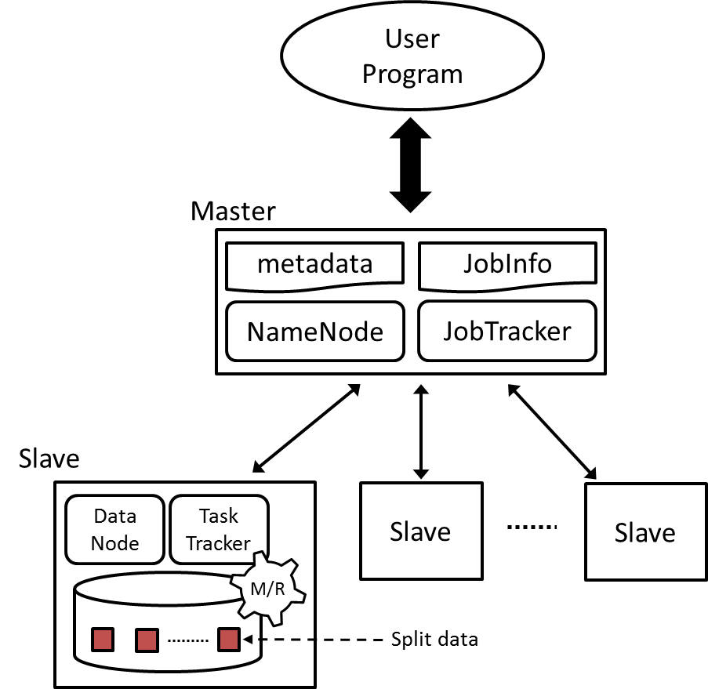
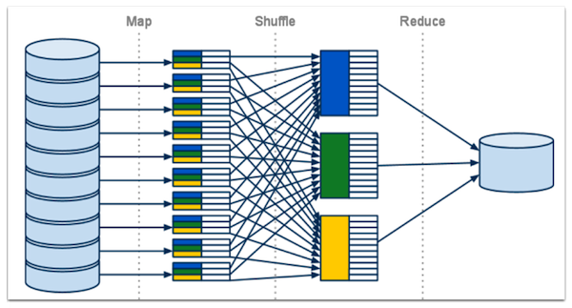
MapReduce Background
Why MapReduce
  Massive data analysis in commodity cluster
  Simple programming model
  Scalable
Why with Data Intensive applications
  Large and long computation
  Computing intensive
  Complex data needs special optimization
  E.g. Blast, Kmeans, and SWG

Slide 5
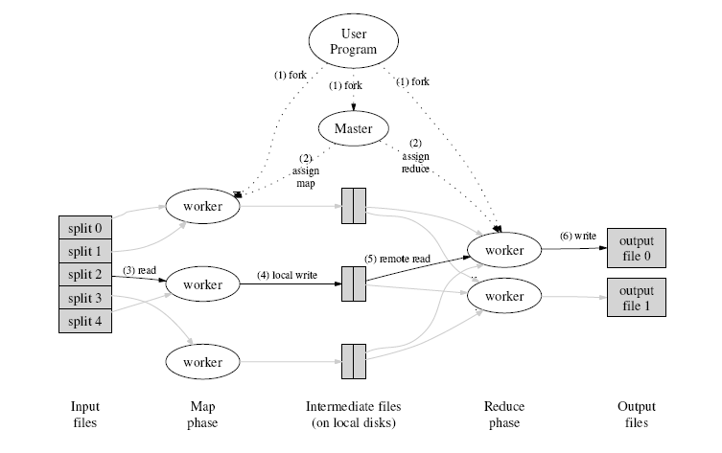
Classic MapReduce
Original model derives from functional programming
Job and tasks scheduling are based on locality information supported by High-level File System
E.g Google MapReduce, Hadoop MapReduce
Notes:
It is a programming paradigm which allows for massive scalability across hundreds or thousands machines.
Map (transform) -> reduce (combine / aggregate ) -> GFS (data locality) -> task scheduling
In general, it’s good for some algorithm but not all.

Slide 6
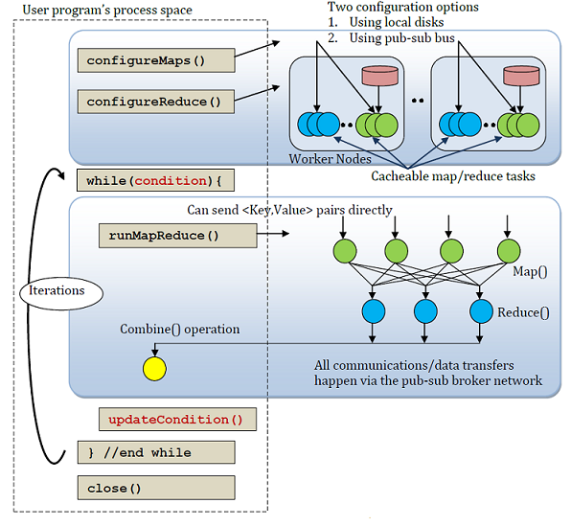
Twister
Designed for algorithms need multiple rounds of MapReduce
  Machine learning, Graph processing, and others
Support broadcasting and messaging communication for data sync and framework control
In-memory caching for static data (loop-invariant)
Data are directly stored on local disk (can be integrated with HDFS)
Twister4Azure is an alternative implementation on Windows Azure
  Merge tasks
  cache-aware scheduling
Notes:
Machine learning, AI, mentioned their performance,

Slide 7
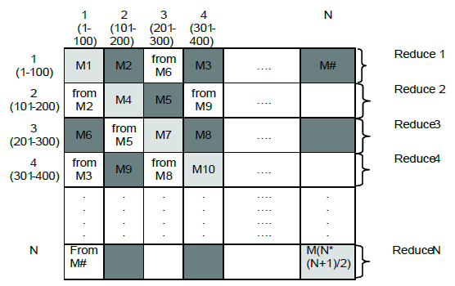
Challenges
Address large scale data analytic problems
  Sequence alignment, Clustering, etc.
Implement apps. on top of MapReduce
  Decomposing data independently
Advanced optimization
  Caching
  Intermediate data size
  Database support
Notes:
Processing/ algorithm/application pattern
Addressing large scale data analysis problems

Slide 8
Application Types
(a) Map-only
(b) Classic MapReduce
(c) Data Intensive Iterative Computations
(d) Loosely Synchronous
Input
Input
Iterations
Input
map
map
map
P_{ij}
reduce
reduce
Output
BLAST Analysis
Cap3 Analysis
Distributed search
Distributed sorting
Information retrieval
Expectation maximization clustering e.g. Kmeans
Linear Algebra
Smith-Waterman
Page Rank
Many MPI scientific applications such as solving differential equations and particle dynamics
Slide from Geoffrey Fox Advances in Clouds and their application to Data Intensive problems University of Southern California Seminar February 24 2012
8
Notes:
Communication and fault tolerance
Data model

Slide 9
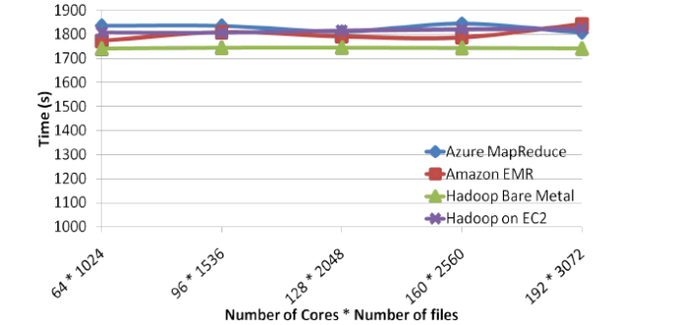
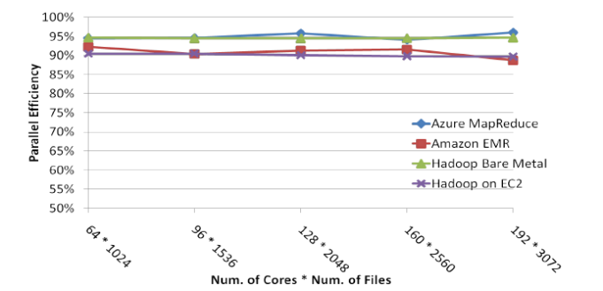
Application Types - Map-Only
Cap3 sequence assembly
  Input FASTA file are spilt into files and stored on HDFS
  Cap3 binary is called as an external java process
  Need a new FileInputFileFormat
  Addition step for collecting the output result
  Near linear scaling
FASTA
files
Execute
Cap3
map
map
map
HDFS / Local Disk
Notes:
Cap3 – describe more
Linear scale up with adding more computation power

Slide 10
Application Types – Classic MapReduce
Smith Waterman Gotoh (SWG) Pairwise dissimilarity
  Input FASTA file are spilt into blocks stored on HDFS
  <block index, content>
  Calculate upper/lower blocks
FASTA data blocks
SWG pairwise distance
map
map
map
Shuffling
Aggregate
Row results
reduce
reduce
HDFS / Local Disk
Notes:
The output matrix can be spilt the ij

Slide 11
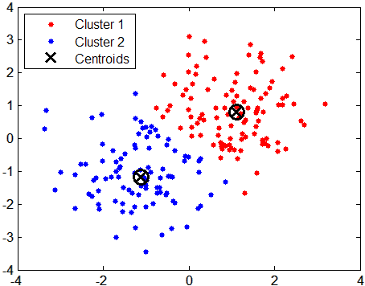
Application Types – Iterative MapReduce
Kmeans clustering
  Data points are cached into memory (Twister)
  User-defined break conditions
Split data
points
Distance
calculation
map
map
map
Shuffling
Update
New
centroids
reduce
reduce
end?
HDFS / Local Disk

Slide 12
Summary
Need special customization
  split Data into appropriate <key, value>
  A new InputFormat for a entire file
Large Intermediate data
  Local combiner / merge task
  Compression
  Communication Optimization

Slide 13
MapReduce Research
Scheduling
  Optimize Data locality
Runtime Optimization
  Break the shuffling stage
Higher-level abstraction
  Cross-domains/Hierarchical MapReduce

Slide 14
Scheduling optimization for data locality
Problem: given a set of tasks and a set of idle slots, assign tasks to idle slots
Hadoop schedules tasks one by one
  Consider one idle slot each time
  Given an idle slot, schedule the task that yields the “best” data locality
  Favor data locality
  Achieve local optimum; global optimum is not guaranteed
    Each task is scheduled without considering its impact on other tasks
Solution: use lsap-sched scheduling to reorganize the task assignment
Zhenhua Guo, Geoffrey Fox, Mo Zhou Investigation of Data Locality and Fairness in MapReduce Presented at the Third International Workshop on MapReduce and its Applications (MAPREDUCE'12) of ACM HPDC 2012 conference at Delft the Netherlands
Notes:
Reference: Zhenhua Guo, Geoffrey Fox, Mo Zhou Investigation of Data Locality and Fairness in MapReduce Presented at the Third International Workshop on MapReduce and its Applications (MAPREDUCE'12) of ACM HPDC 2012 conference at Delft the Netherlands

Slide 15
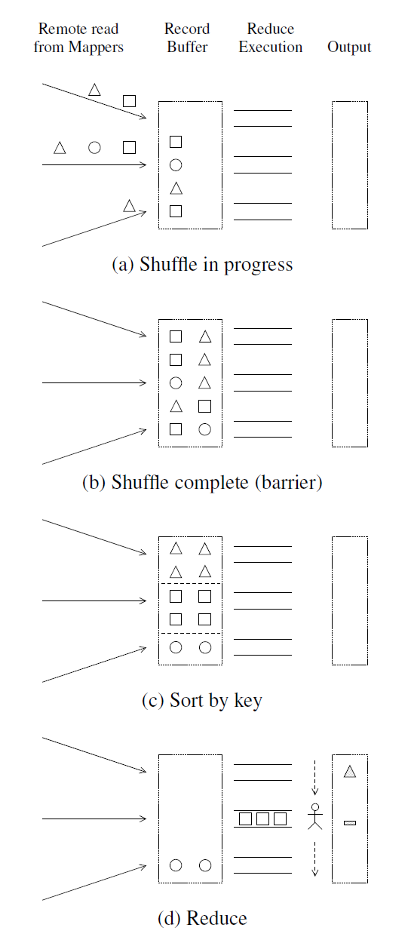
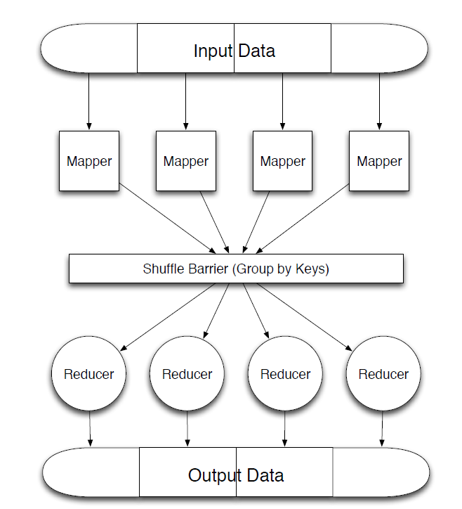
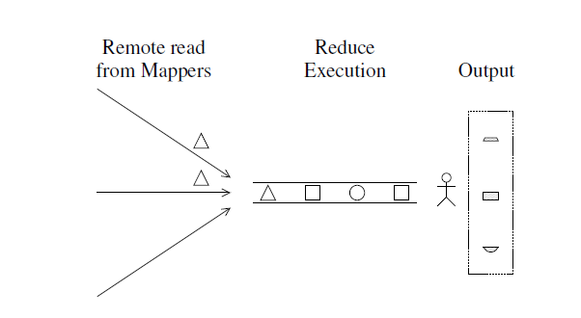
Breaking the shuffling barrier
Invoke reducer computation ahead
Maintain partial reducer outputs with extra disk/memory storage
Reducer partials’ output need to be combined with some additional steps
A. Verma, N. Zea, B. Cho, I. Gupta, and R. H. Campbell. Breaking the MapReduce Stage Barrier. in Cluster Computing (CLUSTER), 2010 IEEE International Conference on. 2010.
Notes:
Reference: A. Verma, N. Zea, B. Cho, I. Gupta, and R. H. Campbell. Breaking the MapReduce Stage Barrier. in Cluster Computing (CLUSTER), 2010 IEEE International Conference on. 2010.

Slide 16
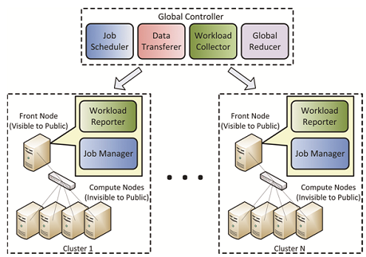
Hierarchical MapReduce
Motivation
  Single user may have access to multiple clusters (e.g. FutureGrid + TeraGrid + Campus clusters)
  They are under the control of different domains
  Need to unify them
  to build MapReduce
  cluster
Extend MapReduce to
Map-Reduce-GlobalReduce
Components
  Global job scheduler
  Data transferer
  Workload reporter/
  collector
  Job manager
Local cluster 1
Local cluster 2
Yuan Luo, Zhenhua Guo, Yiming Sun, Beth Plale, Judy Qiu, and Wilfred W. Li, A hierarchical framework for cross-domain MapReduce execution, in Proceedings of the second international workshop on Emerging computational methods for the life sciences. 2011, ACM: San Jose, California, USA. p. 15-22.
Notes:
Reference: Zhenhua Guo High Performance Integration of Data Parallel File Systems and Computing: Improving MapReduce PhD Thesis presentation August 31 2012

Slide 17
Outline
MapReduce
  Challenges with large scale data analytic applications
  Researches
NoSQL
  Typical Types of solutions
  Practical Use Cases
salsaDPI (salsa Dynamic Provisioning Interface)
  System design and architecture
  Future Directions

Slide 18
NoSQL
Why NoSQL?
  Scalable
  Flexible data schema
  Fast write
  Cost less (commodity hardware)
  Support MapReduce analysis
Design challenges
  CAP Theorem
Notes:
ACID,
Atomicity: all or nothing transication
Consistency: immediate consistency
Isolation: event happens one after the other.
Durability: once a transaction has been committed, it will remain so, even in the event of power loss
http://en.wikipedia.org/wiki/ACID
BASE http://stackoverflow.com/questions/3342497/explanation-of-base-terminology
Basically available indicates that the system does guarantee availability, in terms of the CAP theorem.
Soft state: indicates that the state of the system may change over time, even without input. This is because of the eventual consistency model.
Eventual consistency indicates that the system will become consistent over time, given that the system doesn't receive input during that time.
CAP
Consistency (all nodes see the same data at the same time)
Availability (a guarantee that every request receives a response about whether it was successful or failed)
Partition tolerance (the system continues to operate despite arbitrary message loss or failure of part of the system)

Slide 19



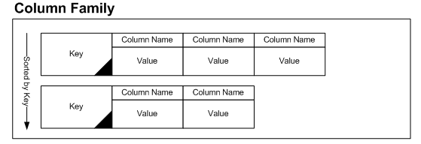
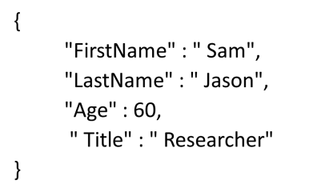

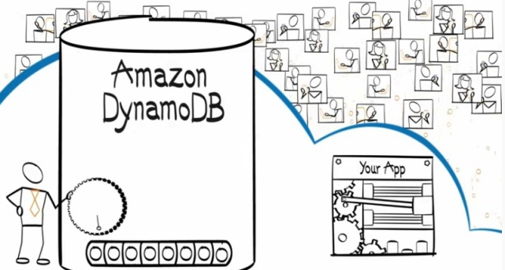

Data Model / Data Structure
Column Family based
(BobFirstName, James)
(BobLastName, Bob)
(BobImage, AF456C123…….)
Image in binary
Key-value based
Document based

Slide 20
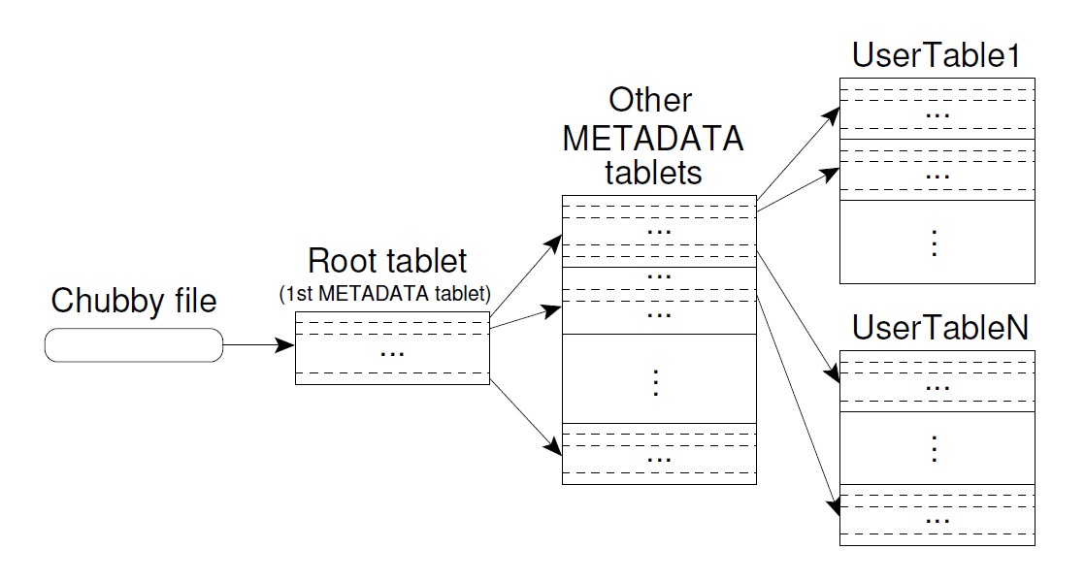
Master-slaves Architecture – Google BigTable (1/3)
Three-level B+ tree to store tablet metadata
Use Chubby files to lookup tablet server location
Metadata contains SSTables’ locations info.
Slaves
Master
Fay Chang, Jeffrey Dean, Sanjay Ghemawat, Wilson C. Hsieh, Deborah A. Wallach, Mike Burrows, Tushar Chandra, Andrew Fikes, and Robert E. Gruber, Bigtable: A Distributed Storage System for Structured Data. ACM Trans. Comput. Syst., 2008. 26(2): p. 1-26. DOI:10.1145/1365815.1365816
Notes:
HOW THEY DO DATA REPLICAITON - AVALIBLITY
SYNC - CONSISTENCY
COMMUNICATION WHEN QUERY A DATA – DATAFLOW
Root tablet is the first tablet contains locations of all tablets, Each METADATA tablet contains the location of a set of user tablets. Each tablet is assigned to one tablet server at a time.
Bigtable uses Chubby to keep track of tablet servers. Like zookeeper. It creates a uniquely-named le in a specific Chubby directory
To store the bootstrap location of Bigtable data (see Section 5.1);
to discover tablet servers and finalize tablet server deaths (see Section 5.2);
to store Bigtable schema information (the column family information for each table);
to store access control lists.
If Chubby becomes unavailable for an extended period of time, Bigtable becomes unavailable.

Slide 21
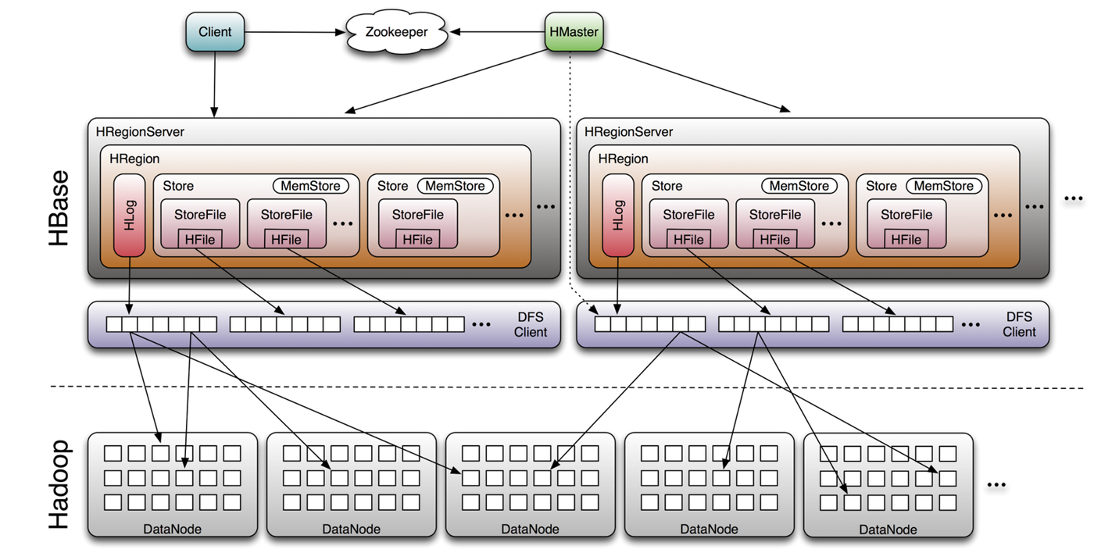
Master-slaves Architecture – HBase (2/3)
Tablet server
Chubby
memtable
SSTables
  Open source implementation of Google BigTable
  Based on HDFS
  Tables split into regions and served by region servers
  Reliable data storage and efficient access to TBs or PBs of data, successful applications in Facebook and Twitter
  Good for real-time data operations and batch analysis using Hadoop MapReduce
Image Source: http://www.larsgeorge.com/2009/10/hbase-architecture-101-storage.html
Notes:
FIND OR MAKE A GOOGLE BIGTABLE ARCHITECTURE
Add hbase
Hlog

Slide 22
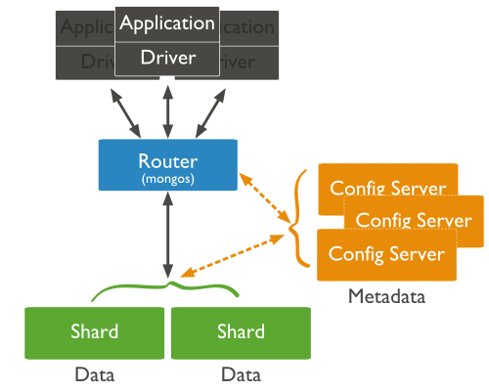
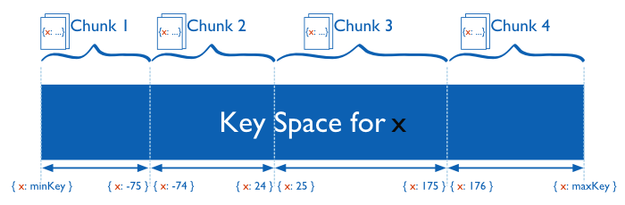
Master-slaves Architecture – MongoDB (3/3)
Determine records’ location by Shard keys
Discover data location by mongos router, which caches the metadata from config server
Master
Provide metadata
to mongos router
Slaves
Image Source: http://docs.mongodb.org/manual/
Notes:
From http://docs.mongodb.org/manual/, http://docs.mongodb.org/manual/core/sharded-cluster-components/
The set of nodes comprising a sharded MongoDB deployment. A sharded cluster consists of three config processes, one or more replica sets, and one or more mongos routing processes.
MongoDB partitions data in the collection using ranges of shard key values. Each range, or chunk, defines a non-overlapping range of shard key values. MongoDB distributes the chunks, and their documents, among the shards in the cluster.
Mongos instances route queries and writes to shards. It tracks what data is on which shard by caching the metadata from the config servers. This is like zookeeper. Config server is like hmaster or hslaves. a mongos instance behaves identically to any other MongoDB instance.
A shard is a MongoDB instance that holds a subset of a collection’s data. Each shard is either a single mongod instance or a replica set. In production, all shards are replica sets. For more information see Shard Servers.
Config Servers: Each config server is a mongod instance that holds metadata about the cluster. The metadata maps chunks to shards.
A production sharded cluster has exactly three config servers, bcoz of two-phase commit to ensure immediate consistency and reliability. http://en.wikipedia.org/wiki/Two_phase_commit
DRAW ANOTHER GRAPH OF MASTER AND SLAVES ARCH

Slide 23
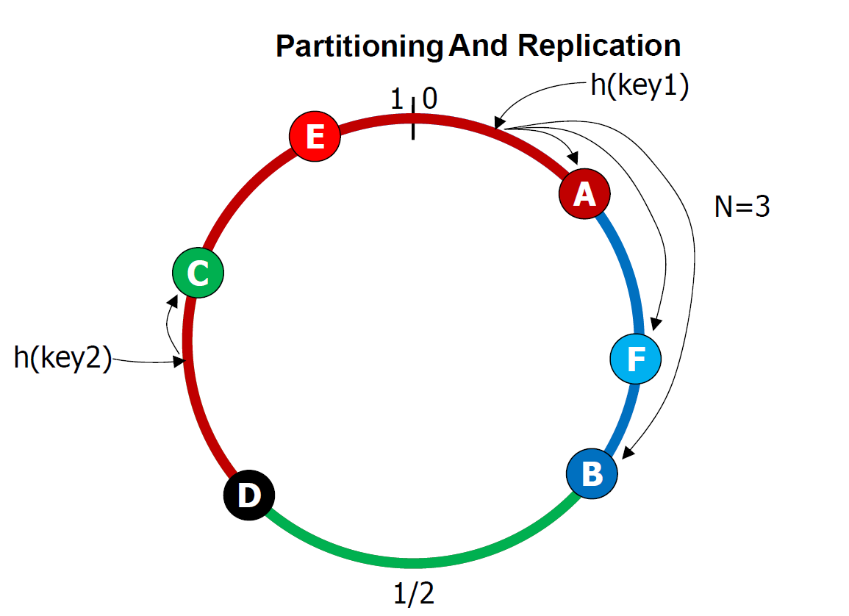
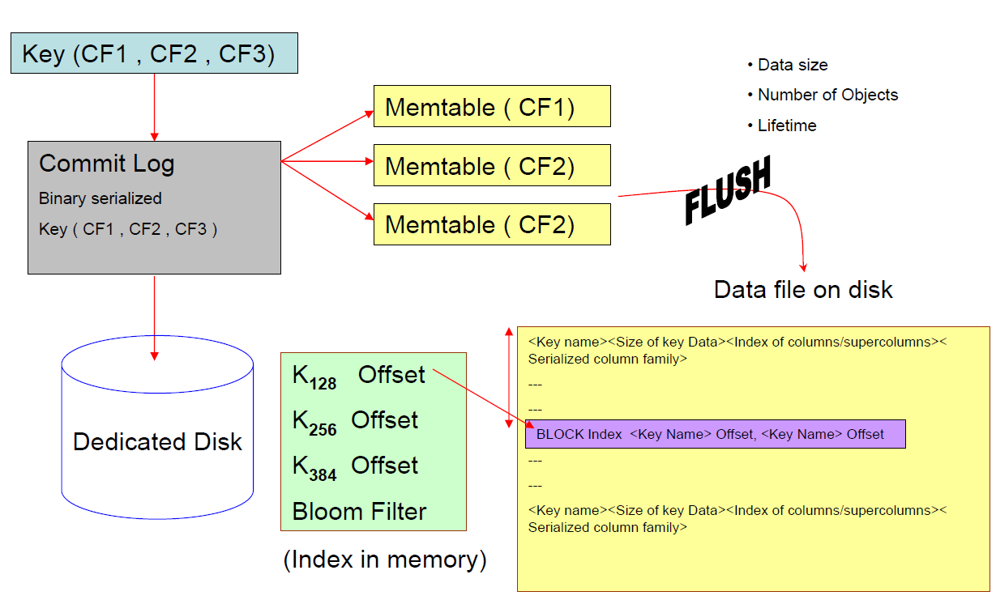
P2P Ring Topology -
Dynamo and Cassandra
Decentralized, data location determines by ordered consistent hashing (DHT)
Dynamo
  Key-value store with P2P ring topology
Cassandra
  In between key-value store and BigTable-like table
  Tables (CFs) are stored as objects with unique keys
  objects are allocated on Cassandra nodes based on their key
Graphs obtained from Avinash Lakshman, Prashant Malik, Cassandra: Structured Structured Storage System over a P2P Network http://www.slideshare.net/Eweaver/cassandra-presentation-at-nosql
Notes:
DHT Hash function
Replication : N-1 successor, rack-aware, data-center-aware
Slides from: Avinash Lakshman, Prashant Malik, Cassandra: Structured Structured Storage System over a P2P Network http://www.slideshare.net/Eweaver/cassandra-presentation-at-nosql
A coordinator node handles the read/write operations for specific key ranges, in addition, it replicates the theses key at N-1 nodes in the ring based on “Rack Unaware” (N-1 successors), “Rack Aware” (within a datacenter) and “Datacenter Aware”. “Rack Aware” (within a datacenter) and “Datacenter Aware” use zookeeper to determine N-1 nodes.
HOW TO DUPLICATE RECORDS, SUCCEEOR ? OR OTHER STRATGY

Slide 24
NoSQL solutions comparison (1/2)
NoSQL solution | Data Model | Lang. | Query Model | Sharding | Replication | Consistency | MapReduce Support | Applications
BigTable | Column-based table. | C++ | Google internal C++ lib | partition by row-keys into tablets stored in different tablet servers. | Use Google File System (GFS) to store tablets and logs on file level | Strong consistency | Support Google MapReduce | Search engines, high throughput batch data analytics, latency-sensitive database
Cassandra | Column-based table | Java | Java API | Partition with an order pre-serving consistent hashing | Replicate to N-1 successors, use Zookeeper to elect the coordinator | Eventually consistency, or per-write-operation strong consistency | Possibly integrated with Hadoop MapReduce | Search engines, log data analytics
HBase | Column-based table. | Java | Shell query. Java, REST and Thrift API | partition by row-keys into regions stored in different region servers. | Use HDFS to store replication with selectable factors | Strong consistency | Hadoop MapReduce | Search engines, high throughput batch data analytics
Notes:
cassandra vs hbase, Availability VS Consistency,
http://stackoverflow.com/questions/7237271/large-scale-data-processing-hbase-vs-cassandra
“Cassandra supports hundreds, even thousands of ColumnFamilies. "HBase currently does not do well with anything above two or three column families.”
“Cassandra allows you to choose how strong you want it to require consistency to be on a per-operation basis. Sometimes this is misunderstood as "Cassandra does not give you strong consistency," but that is incorrect.”
BigTable: each tablet can only store on one tablet server.
HBase, each record must be updated on assigned region server and replications before read.
Dynamo,
CAP
CouchDB vs mongoDB

Slide 25
NoSQL solutions comparison (2/2)
NoSQL solution | Data Model | Lang. | Query Model | Sharding | Replication | Consistency | MapReduce Support | Applications
Dynamo | Key-value based | Java | Web console, Java, C#, PHP API | Partition with an order pre-serving consistent hashing | Replicate to N-1 successors, | Eventually consistency | Amazon EMR | Search engines, log data analysis supported by Amazon EMR
CouchDB | Document-based (JSON) | Erlang | HTTP API | No built-in partitioning, but could use extenral proxy-based partitioning | built-in MVCC synchronization mechanism to replicate data | strong or eventual consistency | Internal views functions | MySQL-like Applications, dynamic queries, less data updates
MongoDB | Document-based (Binary JSON) | C++ | Shell, REST, HTTP API | partition by shard keys stored in different shard servers. | Primary master-slaves data replication | Eventual consistency | Internal views functions | MySQL-like Applications, dynamic queries, many data updates
Notes:
Bson and Json
http://en.wikipedia.org/wiki/BSON
BSON types are nominally a superset of JSON types (JSON does not have a date or a byte array type, for example^{[3]}), with one exception of not having a universal "number" type as JSON does
http://bsonspec.org/
an ad­vant­age in flex­ib­il­ity but also a slight dis­ad­vant­age in space ef­fi­ciency (BSON has over­head for field names with­in the seri­al­ized data).
MVCC : http://guide.couchdb.org/draft/consistency.html
Documents in CouchDB are versioned, create an entire new version of that document and save it over the old one. After doing this, you end up with two versions of the same document, one old and one new. append it to the database without having to wait for the read request to finish. CouchDB will point it to the new version that has just been written.

Slide 26

Facebook messaging using HBase
Need a tremendous storage space (15 Billions messages per day when 2011, 15B X 1024 = 14TB )
Messages data
  message metadata and indices
  Search index
  Small message bodies
  Most recent read
HBase solutions
  Large Table, Storge TB-Level data
  Efficient random access
  High write throughput
  Support structured
  and semi-structured data
  Support Hadoop
Dhruba Borthakur, Joydeep SenSarma, and Jonathan Gray, Apache Hadoop Goes Realtime at Facebook, in SIGMOD. 2011, ACM: Athens, Greece. p. 4503-0661.
Notes:
Reference:
Dhruba Borthakur, Joydeep SenSarma, and Jonathan Gray, Apache Hadoop Goes Realtime at Facebook, in SIGMOD. 2011, ACM: Athens, Greece. p. 4503-0661.
HBase @ Facebook - QCon London, http://qconlondon.com/dl/qcon-london-2011/slides/KannanMuthukkaruppan_HBaseFacebook.pdf

Slide 27
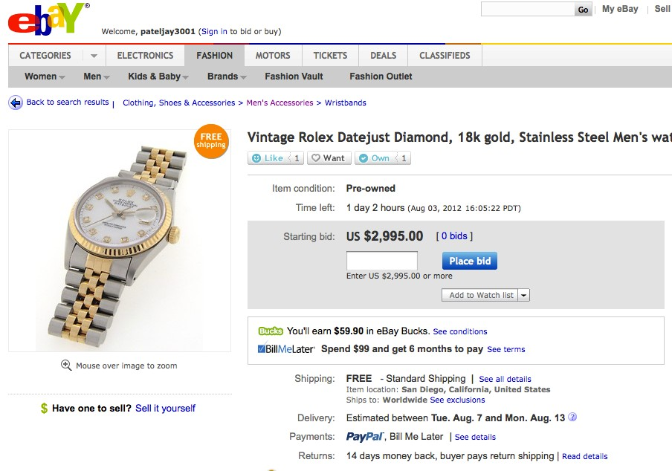
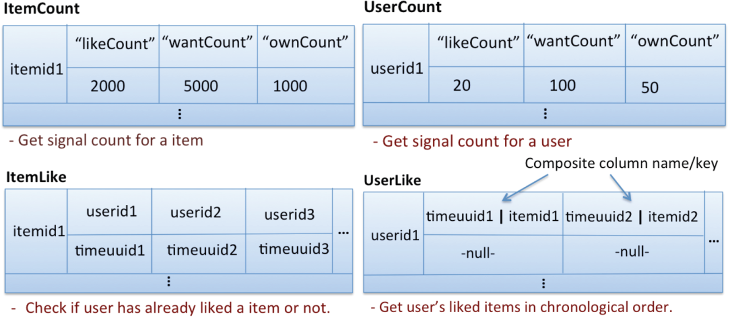
eBay social signals with Cassandra
Data stored across data center
Time stamp and scalable counters
Real (or near) time analytics on collected social data
Good write performance
Duplicates – tuning eventual consistency
Served by Cassandra
They also use HBase and MongoDB for other product !
Slides from Jay Patel. Buy It Now! Cassandra at eBay, 2012; Available from: http://www.datastax.com/wp-content/uploads/2012/08/C2012-BuyItNow-JayPatel.pdf
Notes:
Reference: Jay Patel. Buy It Now! Cassandra at eBay, 2012; Available from: http://www.datastax.com/wp-content/uploads/2012/08/C2012-BuyItNow-JayPatel.pdf

Slide 28

Architecture for Search Engine
Data Layer
Apache Lucene
crawler
Inverted Indexing System
Business Logic Layer
mapreduce
Web UI
PHP script
HBase Tables
1. inverted index table
2. page rank table
ClueWeb’09 Data
Hive/Pig script
Apache Server on Salsa Portal
HBase
Presentation Layer
Thrift client
Thrift Server
Hadoop Cluster
on FutureGrid
Ranking System
Pig script
Xiaoming Gao, Hui Li, Thilina Gunarathne Apache Hbase Presentation at Science Cloud Summer School organized by VSCSE July 31 2012

Slide 29
Summary
Data and its structure
Scale
Read/Write performance
Consistency level
Real time analytics support

Slide 30
Outline
MapReduce
  Challenges with large scale data analytic applications
  Researches
NoSQL
  Typical Types of solutions
  Practical Use Cases
salsaDPI (salsa Dynamic Provisioning Interface)
  System design and architecture
  Future Directions

Slide 31

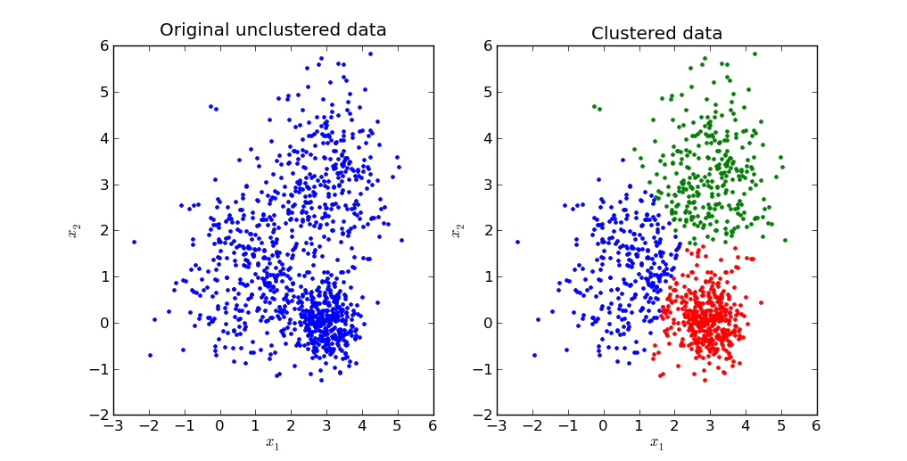





Motivations
Background knowledge
  Environment setting
  Different cloud infrastructure tools
  Software dependencies
  Long learning path
Automatic these complicated steps?
Solution: Salsa Dynamic Provisioning Interface (SalsaDPI).
  batch-like program

Slide 32

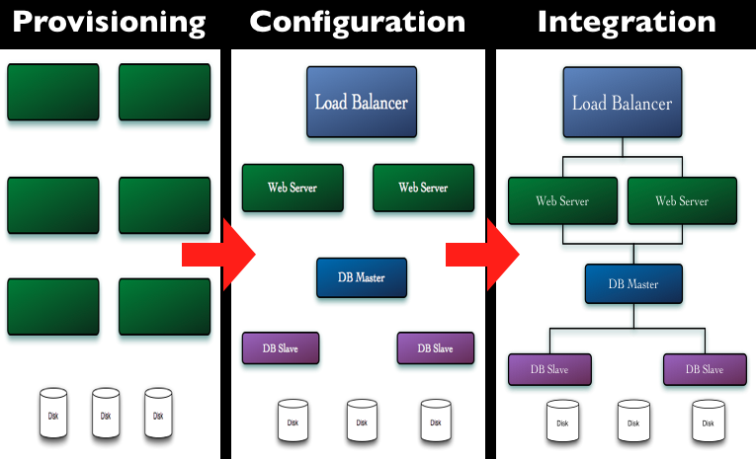
Key component - Chef
open source system
traditional client-server software
Provisioning, configuration management and System integration
contributor programming interface
Change their core language from Ruby to Erlang started from version 11
Graph source: http://wiki.opscode.com/display/chef/Home

Slide 33
Bootstrap compute nodes
Fog Cloud API (Start VMs)
Knife Bootstrap installation
Compute nodes registration
Chef Client
(knife-euca/knife-openstack)
Chef Server
Bootstrap templates
FOG
NET::SSH
3
2
1
Compute Node
Compute Node
Compute Node

Slide 34




What is SalsaDPI? (High-Level)
SalsaDPI Jar
Chef Client
Chef Server
OS
User
Conf.
2. Retrieve conf. Info. and request Authentication and Authorization
3. Authenticated and Authorized to execute software run-list
5. Submit application
commands
Bootstrap VMs
with a conf. file
6. Obtain Result
4. VM(s) Information
Apps
Apps
Apps
S/W
S/W
S/W
Chef
Chef
Chef
OS
OS
OS
VM
VM
VM
* Chef architecture http://wiki.opscode.com/display/chef/Architecture+Introduction

Slide 35
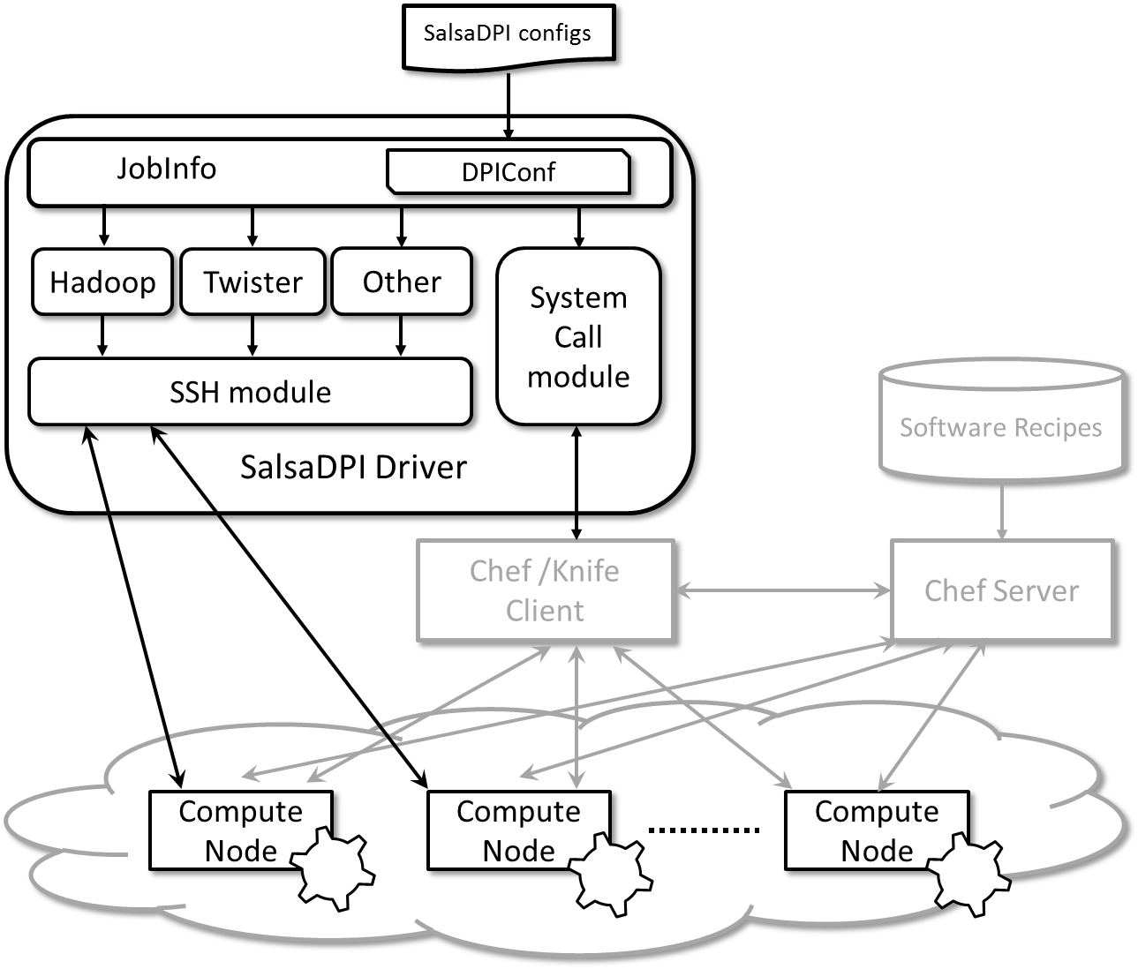
Architecture

Slide 36

What is SalsaDPI? (Cont.)
Chef Features
  On-demand install software when starting VMs
  Monitor software installation progress
  Scalable
SalsaDPI features
  Software stack abstraction
  Automate Hadoop/Twister/general application
  Online submission portal
  Support persistent storage, e.g. Walrus
  Inter-Cloud support
*Chef Official website: http://www.opscode.com/chef/

Slide 37
Use Cases
Hadoop/Twister WordCount
Hadoop/Twister Kmeans
General graph algorithms from VT
  CCDistance
  Likelihood
  BetweennessNX

Slide 38
Initial results (1/4)

Slide 39
Initial results (2/4)

Slide 40
Initial results (3/4)

Slide 41
Initial results (4/4)

Slide 42
Conclusion
Big Data is a practical problem for large-scale computation, storage, and data modeling.
Challenges in terms of scalability, throughput performance, interoperability, etc.

Slide 43
Reference
https://developers.google.com/appengine/docs/python/dataprocessing/
J Dean and S. Ghemawat, MapReduce: Simplified Data Processing on Large Clusters. Sixth Symposium on Operating Systems Design and Implementation, 2004: p. 137-150.
J.Ekanayake, H.Li, B.Zhang, T.Gunarathne, S.Bae, J.Qiu, and G.Fox, Twister: A Runtime for iterative MapReduce, in Proceedings of the First International Workshop on MapReduce and its Applications of ACM HPDC 2010 conference June 20-25, 2010. 2010, ACM: Chicago, Illinois.
Geoffrey Fox Advances in Clouds and their application to Data Intensive problems University of Southern California Seminar February 24 2012
http://kavyamuthanna.wordpress.com/2013/01/07/big-data-why-enterprises-need-to-start-paying-attention-to-their-data-sooner/
Zhenhua Guo, Geoffrey Fox, Mo Zhou?Investigation of Data Locality and Fairness in MapReduce?Presented at the Third International?Workshop?on MapReduce and its Applications (MAPREDUCE'12) of ACM?HPDC?2012 conference at Delft the Netherlands
A. Verma, N. Zea, B. Cho, I. Gupta, and R. H. Campbell. Breaking the MapReduce Stage Barrier. in Cluster Computing (CLUSTER), 2010 IEEE International Conference on. 2010.
Yuan Luo, Zhenhua Guo, Yiming Sun, Beth Plale, Judy Qiu, and Wilfred W. Li, A hierarchical framework for cross-domain MapReduce execution, in Proceedings of the second international workshop on Emerging computational methods for the life sciences. 2011, ACM: San Jose, California, USA. p. 15-22.
Fay Chang, Jeffrey Dean, Sanjay Ghemawat, Wilson C. Hsieh, Deborah A. Wallach, Mike Burrows, Tushar Chandra, Andrew Fikes, and Robert E. Gruber, Bigtable: A Distributed Storage System for Structured Data. ACM Trans. Comput. Syst., 2008. 26(2): p. 1-26. DOI:10.1145/1365815.1365816
Image Source: http://www.larsgeorge.com/2009/10/hbase-architecture-101-storage.html
Image Source: http://docs.mongodb.org/manual/
Avinash Lakshman, Prashant Malik, Cassandra: Structured Structured Storage System over a P2P Network http://www.slideshare.net/Eweaver/cassandra-presentation-at-nosql
Jay Patel. Buy It Now! Cassandra at eBay, 2012; Available from: http://www.datastax.com/wp-content/uploads/2012/08/C2012-BuyItNow-JayPatel.pdf
Dhruba Borthakur, Joydeep SenSarma, and Jonathan Gray, Apache Hadoop Goes Realtime at Facebook, in SIGMOD. 2011, ACM: Athens, Greece. p. 4503-0661.
Xiaoming Gao, Hui Li, Thilina Gunarathne?Apache Hbase?Presentation at Science Cloud?Summer School?organized by?VSCSE?July 31 2012
http://wiki.opscode.com/display/chef/Home
Chef architecture http://wiki.opscode.com/display/chef/Architecture+Introduction
Chef Official website: http://www.opscode.com/chef/

Slide 44
Spark
RDDs are in memory for fast I/O, loop-invariant data caching, and fault tolerance.
  Large data can be stored partially on the disk
Data can be stored to HDFS
Spark
Hadoop
MPI
Apache Mesos
Node
Node
Node
Matei Zaharia, Mosharaf Chowdhury, Michael J. Franklin, Scott Shenker, and Ion Stoica. Spark: cluster computing with working sets. in HotCloud'10 Proceedings of the 2nd USENIX conference on Hot topics in cloud computing. 2010. Berkeley, CA, USA: ACM.

Slide 45
Twister4Azure
In-Memory/Disk caching of static data
Decentralized based on Azure queue service
Caching data on disk and loop-invariant data in-memory
  Direct in-memory
  Memory mapped files
Cache-aware hybrid scheduling
Thilina Gunarathne Twister4Azure: Iterative MapReduce for Windows Azure Cloud Presentation at Science Cloud Summer School organized by VSCSE August 1 2012
Notes:
In-Memory Caching of static data
Programming model extensions to support broadcast data
Merge Step
Hybrid intermediate data transfer
Loop invariant data (static data) – traditional MR key-value pairs
Comparatively larger sized data
Cached between iterations
Avoids the data download, loading and parsing cost between iterations
support in-memory caching of static loop-invariant data between iterations. We achieved this by having cacheable input formats, requiring no changes to the map reduce programming model.
Often input data needs to be uploaded to cloud. Which is not valuable if it’s for a single pass..
We can optimize workflows, where the outputs of the previous Jobs can be cached and used in the next. But we do not focus on such optimizations as they are obvious.

Slide 46
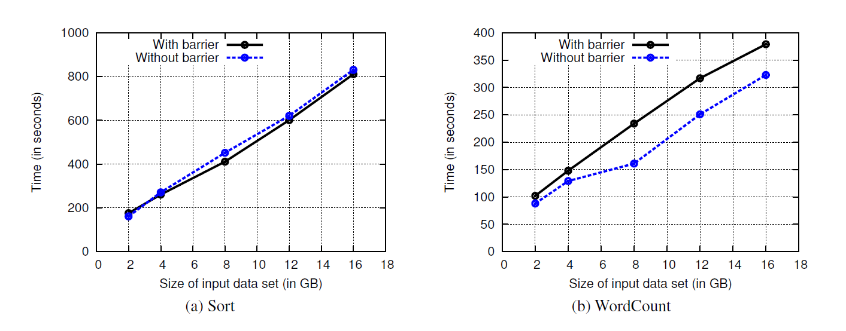
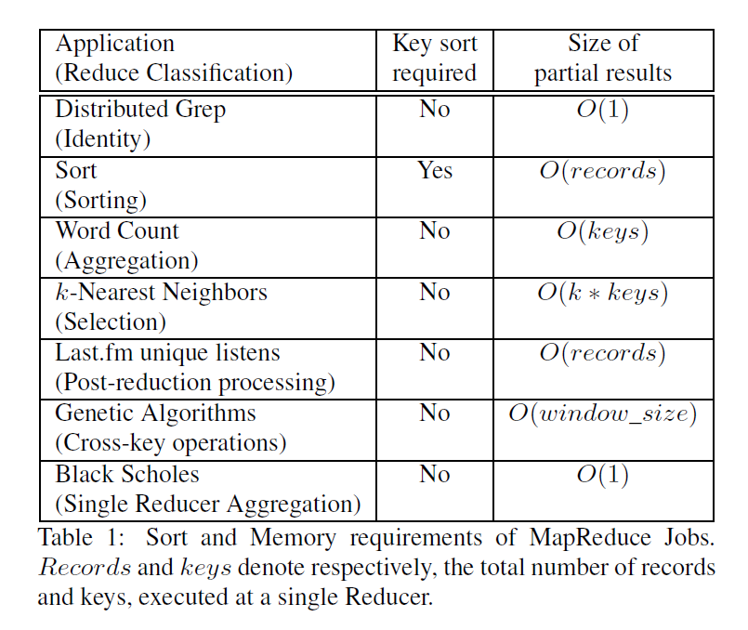
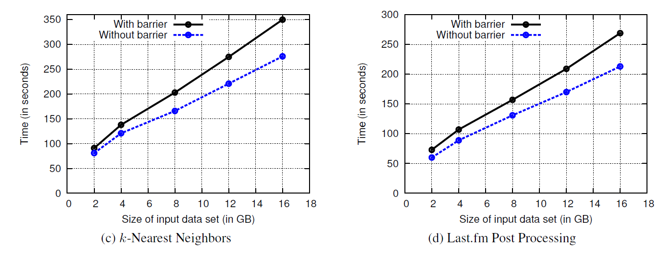
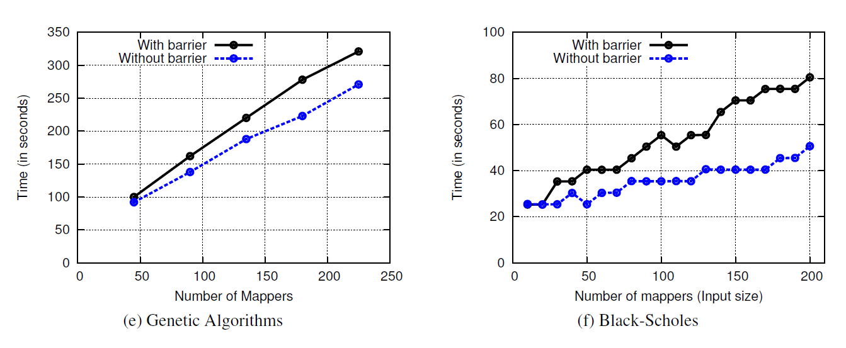
Breaking the shuffling barrier (Cont.)
Run on 16 nodes, 4 mappers and 4 reducers on each node
Reduce job completion times 25% on avg. and 87% in the best case.

Slide 47
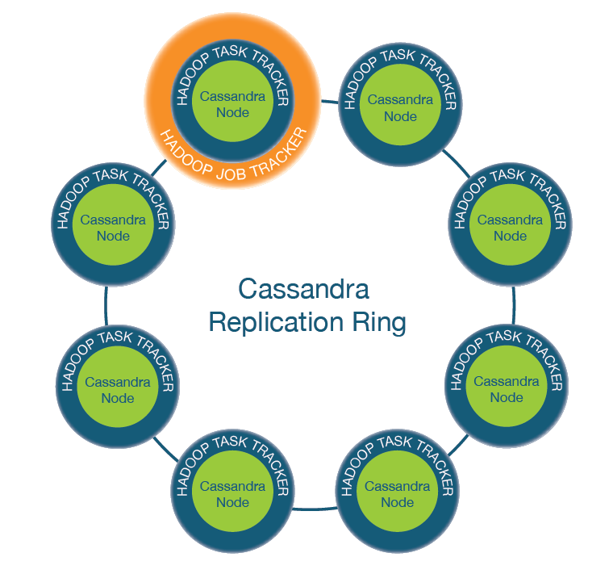
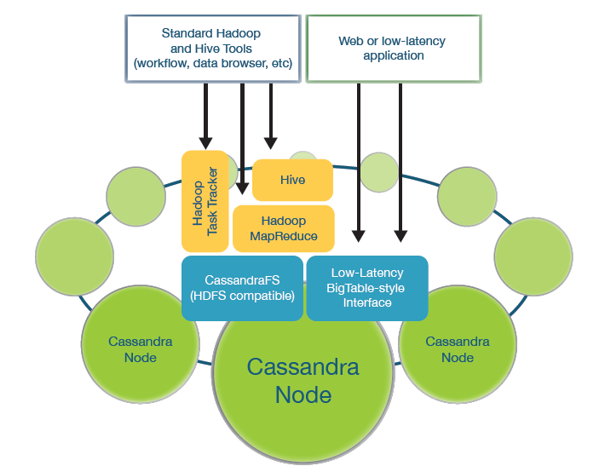
Datastax Brisk MapReduce
Cassandra serve Hadoop as a File System
Provide data locality information from Cassandra CF table
Reference: Evolving Hadoop into a Low-Latency Data Infrastructure - DataStax
Notes:
Reference: Evolving Hadoop into a Low-Latency Data Infrastructure - DataStax

Slide 48
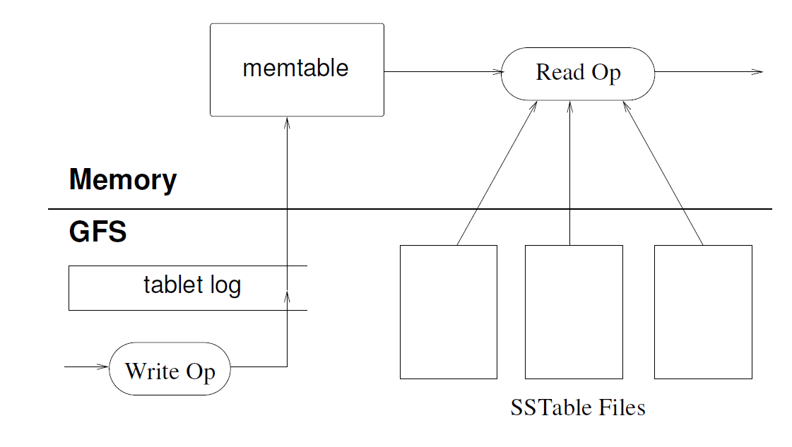
BigTable read/write operations
Updates are committed to commit log in GFS
Most recent commit logs are stored in a memory
Read operation combined the result from memory and stored SSTables
Fay Chang, Jeffrey Dean, Sanjay Ghemawat, Wilson C. Hsieh, Deborah A. Wallach, Mike Burrows, Tushar Chandra, Andrew Fikes, and Robert E. Gruber, Bigtable: A Distributed Storage System for Structured Data. ACM Trans. Comput. Syst., 2008. 26(2): p. 1-26. DOI:10.1145/1365815.1365816

Slide 49
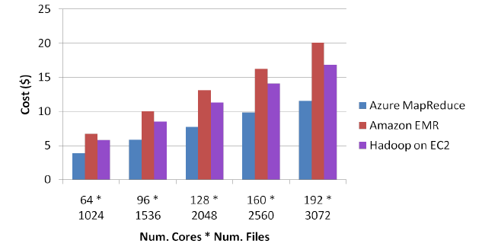
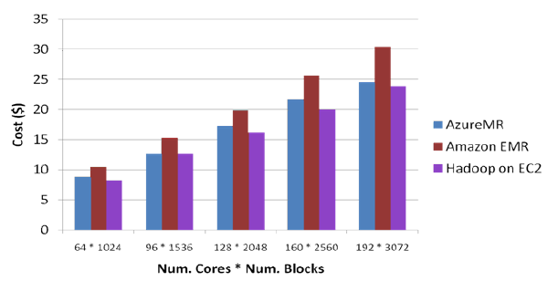
Cost on commercial clouds
Instance Type (as of 04/20/2013) | Mem. (GB) | Compute units / Virtual cores | Storage (GB) | $ per hours (Linux/Unix) | $ per hours (Windows)
EC2 Small | 1.7 | 1/1 | 160 | 0.06 | 0.091
EC2 Medium | 3.75 | 1/2 | 410 | 0.12 | 0.182
EC2 Large | 7.5 | 4/2 | 850 | 0.24 | 0.364
EC2 Extra Large | 15 | 8/4 | 1690 | 0.48 | 0.728
EC2 High-CPU Extra Large | 7 | 20/2.5 | 1690 | 0.58 | 0.9
EC2 High-Memory Extra Large | 68.4 | 26/3.25 | 1690 | 1.64 | 2.04
Azure Small | 1.75 | X/1 | 224+70 | 0.06 | 0.09
Azure Medium | 3.5 | X/2 | 489+135 | 0.12 | 0.18
Azure Large | 7 | X/4 | 999+285 | 0.24 | 0.36
Azure Extra Large | 14 | X/8 | 2039+605 | 0.48 | 0.72
Notes:
See if this should be a note instead

