Slide 1
Future Grid Software Architecture

Slide 2
What is the FutureGrid?
Provides rich and flexible test-bed
Enable rigorous scientific experiments in grid and cloud computing
Extends existing software as well as new software development
Follow standard best practices for maintenance and operations to ensure high availability and predictability for the resource.

Slide 3
Software to support Infrastructure

Slide 4
Future Grid Users
Application/Scientific users
System administrators
Software developers
Testbed users
Performance modelers
Educators
Students
Supported by
FutureGrid
Infrastructure & Software offerings

Slide 5
Software: Impact on Organization

Slide 6
Impact
Impact on Software and tools from each committee
Examples:
Hardware - > scripts
Training -> convenient tools to conduct training
Performance -> monitoring tools
User support -> portal, knowledgebase
Take existing tools to minimize new developments
Adapt to our own needs
Example: use xcat for deployment
This impact motivated the organization
Role of the software architect is to integrate between the different groups and coordinate software related activities
Role of the software committee is to support the adaptation, reuse and development of software to support the activities of the other committees
Members in other groups may support can contribute to the overall software activities

Slide 7
Software: Impact on Organization

Slide 8
Objectives: Software
significant extensions to existing software
software developed
existing open-source software
open-source, integrated suite of software to
instantiate and execute grid and cloud experiments.
perform an experiment
collect the results
tools for instantiating a test environment,
Torque, MOAB, xCAT, bcfg, and Pegasus, Inca, ViNE, a number of other tools from our partners and the open source community
Portal to interact
Benchmarking

Slide 9
Software Architecture

Slide 10
Tasks for the near term
We have identified a working model for deploying FutureGrid
We need to put the components together and identify possible opportunities to improve these components while providing significant capabilities to the users
We need to work as an integrated team which we have clearly demonstrated in the past through multiple collaborations
All of us work on one or the other aspect of software for FutureGrid Software Architecture
We will together refine the diagram and develop missing components and deploy them with the teams
A spiral software development is used following the program execution plan

Slide 11
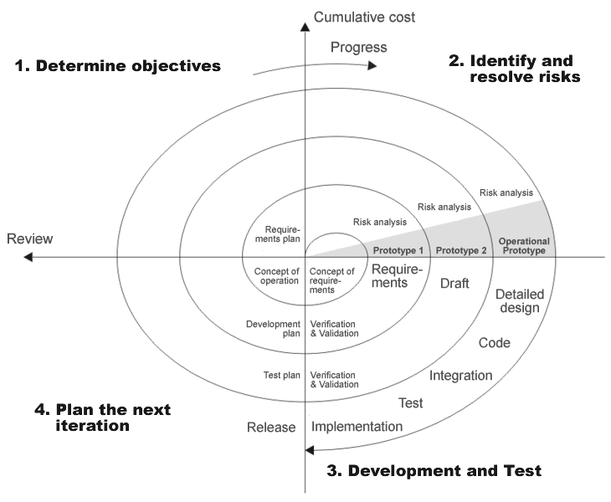
Spiral Development
Objectives
Risks
Development
Plan next step
Iterate

Slide 12
Software Architecture

Slide 13
Security
Objective
Our Hardware and network must be secure
Provide single sign on
Make security easy on the user
Leverage Teragrid security framework
Risks
Software is new/novel and could have bugs that lead to security vulnerabilities

Slide 14
Security
Isolation
Virtual machines
Single Sign-on
Provide the Software services to enable single sign on
Integrate with TeraGrid Single Sign-on
Use MyProxy, PKI, …
Enable integration of new security frameworks based on other technologies, e.g. OpenID

Slide 15
Networking & Security
Global NOC
SNAPP. High speed data collection and visualization
Visible Backbone. An XML Network data collection and analysis tool which presents a system-wide view of the network
Animated Traffic Map. Geographical view of network usage data
IU Router Proxy. Allows access to a limited set of router commands through a web interface
Multicast Tools. Custom tools to monitor and debug multicast
Nagios. Network state monitoring software with custom plugins and user interface
Alertmon. Nagios front-end with links to ticketing and documentation
Syslog Scripts. Analysis of syslog entries
MRTG. Gathers and graphs time series data
Iperf. Network bandwidth measurement tool
OWAMP. One-way latency measurement
Ixia IxTraffic. BGP and Netflow analysis and reporting
RANCID. Network device configuration version control
Ganglia Cluster Toolkit. Distributed monitoring and execution system
Arbor Peakflow. Network anomaly detection

Slide 16
Software Architecture

Slide 17
FG Interfaces
Objective
Make access simple
Support various users favorite interface
Risks
Interface development may cost a lot of time
Only partial software solution exist, integration is needed
Provide a
Portal
Command line Interface
API (if feasible)

Slide 18
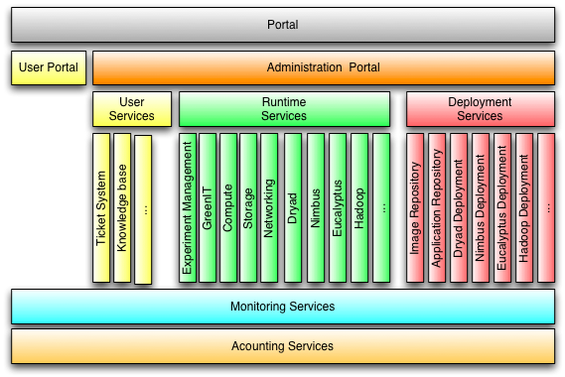
Portal (Dynamic Provisioning)

Slide 19
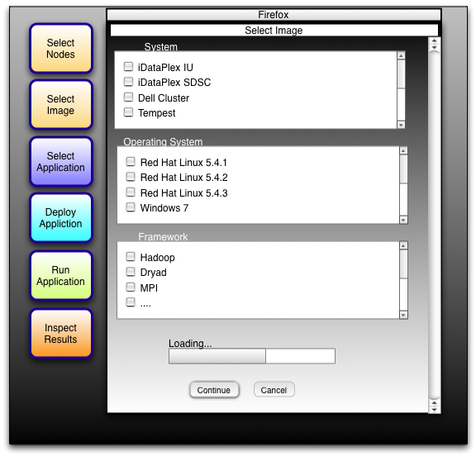
Future Grid Testbed (Dynamic Provisioning)
Text

Slide 20
Command line
fg-deploy-image
host name
image name
start time
end time
label name
fg-add
label name
framework hadoop
version 1.0
Deploys an image on a host
Adds a feature to a deployed image

Slide 21
Software Architecture

Slide 22
FG Stratosphere
Objective
Higher than a particular cloud
Provides all mechanisms to provision a cloud on a given FG hardware
Allows the management of reproducible experiments
Allows monitoring of the environment and the results
Risks
Lots of software
Possible multiple path to do the same thing
Good news
We worked in a team, know about different solutions and have identified a very good plan
We can componentize Stratosphere

Slide 23
Rain Runtime Adaptable InsertioN Service
Objective
Provide dynamic provisioning
Allow bare metal
Cloud neutral
Nimbus, Eucalyptus, …
Future oriented
Dryad
…
Risks
Multiple pathways exist to implement RAIN
Some frameworks (e.g. MS are more complex to provision)

Slide 24
Rain Runtime Adaptable InsertioN Service
A:
Use a cloud to do provisioning
B:
Create image
Use xcat to provision
Use the provisioned environment
C: (not available at time of writing the proposal)
Set up specialized queues with same image
Submit jobs to the appropriate queue
Important: be general & support also bare metal mode!

Slide 25
RAIN: Dynamic Provisioning
Change underlying system to support current user demands
Linux, Windows, Xen, Nimbus, Eucalyptus
Stateless images
Shorter boot times
Easier to maintain
Stateful installs
Windows
Use moab to trigger changes and xCAT to manage installs

Slide 26
Current Configurations (a subset)
Arch | Install Type | OS | Virtualization | Frontend
X86_64 | stateful | Linux
X86_64 | stateful | Linux | Xen
X86_64 | stateful | Linux | Xen | Nimbus
X86_64 | stateful | Linux | Xen | Eucalyptus
X86_64 | stateless | Linux
X86_64 | stateless | Linux | Xen
X86_64 | stateless | Linux | Xen | Nimbus
X86_64 | stateless | Linux | Xen | Eucalyptus

Slide 27
xCAT and Moab
xCAT
uses installation infrastructure to perform installs
creates stateless Linux images
changes the boot configuration of the nodes
remote power control and console (IPMI)
Moab
meta-schedules over resource managers
TORQUE and Windows HPC
control nodes through xCAT
changing the OS
remote power control

Slide 28
Metascheduler
Objective
Provide matching of hardware to minimize optimization criteria
Utilization
Turnaround time
Carbon emission
Risk
Information is inaccurate
Not all experiments will be deterministic and prediction is difficult
Integration of provisioning in metaschedulers is not yet done to optimize use

Slide 29
Experiment Manager
Objective
Manage the provisioning for reproducible experiments
Coordinate workflow of experiments
Share workflow and experiment images
Minimize space through reuse
Risk
Images are large
Users have different requirements and need different images

Slide 30
Monitoring & Performance Engineering
Objective
Monitor the state of FG
Support metascheduling
Support users to design efficient programs in the testbed that can be run elsewhere
Model the use of external resources
Risks
Some VM do not expose all monitoring information (due to security)
Monitoring can produce lots of data and stress on hardware and networking

Slide 31
Software Architecture

Slide 32
End

Slide 33
Timeline: Hardware
Result: Hardware Deployed by Apr 2010

