Slide 1

Architecture and Performance of Runtime Environments for Data Intensive Scalable Computing
Thesis Defense, 12/20/2010
Student: Jaliya Ekanayake
Advisor: Prof. Geoffrey Fox
School of Informatics and Computing

Slide 2
Outline
The big data & its outcome
MapReduce and high level programming models
Composable applications
Motivation
Programming model for iterative MapReduce
Twister architecture
Applications and their performances
Conclusions

Slide 3
Big Data in Many Domains
According to one estimate, mankind created 150 exabytes (billion gigabytes) of data in 2005. This year, it will create 1,200 exabytes
~108 million sequence records in GenBank in 2009, doubling in every 18 months
Most scientific task shows CPU:IO ratio of 10000:1 – Dr. Jim Gray
The Fourth Paradigm: Data-Intensive Scientific Discovery
Size of the web ~ 3 billion web pages
During 2009, American drone aircraft flying over Iraq and Afghanistan sent back around 24 years’ worth of video footage
~20 million purchases at Wal-Mart a day
90 million Tweets a day
Astronomy, Particle Physics, Medical Records …
Notes:
For each category, give examples, e.g. Astronomy solon 20 TB night,
http://www.datacenterknowledge.com/archives/2009/12/22/the-data-crunching-powerhouse-behind-avatar/

Slide 4
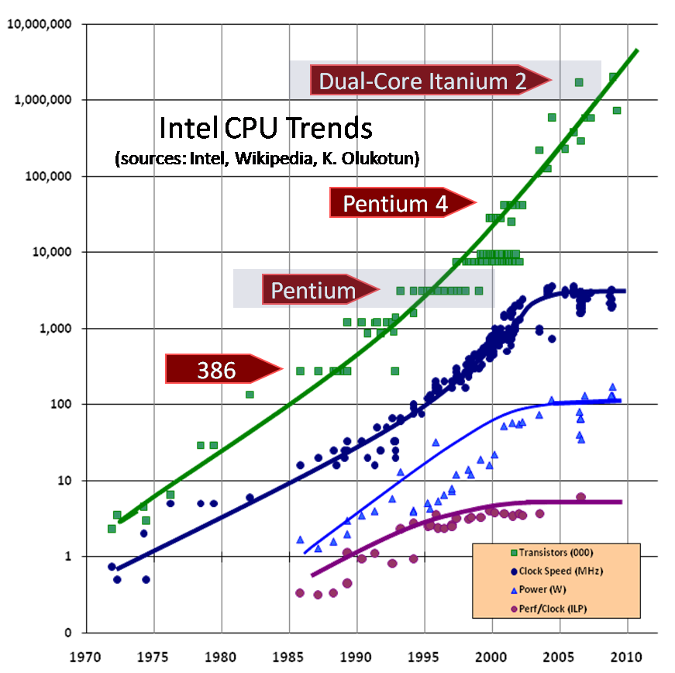

Data Deluge => Large Processing Capabilities
Converting raw data to knowledge
Requires large
processing capabilities
> O (n)
CPUs stop getting faster
Multi /Many core architectures
  Thousand cores in clusters and millions in data centers
Parallelism is a must to process data in a meaningful time
Image Source: The Economist

Slide 5
Programming Runtimes
PIG Latin, Sawzall
Workflows, Swift, Falkon
MapReduce,
DryadLINQ, Pregel
PaaS:
Worker Roles
Classic Cloud: Queues, Workers
MPI, PVM, HPF
DAGMan, BOINC
Chapel, X10
Achieve Higher Throughput
Perform Computations Efficiently
High level programming models such as MapReduce:
  Adopts a data centered design
    Computations starts from data
  Support Moving computation to data
  Show promising results for data intensive computing
    Google, Yahoo, Elastic MapReduce from Amazon …
Notes:
Draw a picture covering the technologies. Bottom layers hardware virtualization, next cores, and then the technologies that can use cores like PLINQ, Tasks, threads, OpenMP etc. Then the distributed runtimes, list them and show the HPC class and the new trend, Moving computing to data. MapReduce, DryadLINQ

Slide 6
MapReduce Programming Model & Architecture
Google, Apache Hadoop, Sector/Sphere, Dryad/DryadLINQ (DAG based)
Master Node
Worker Nodes
Data Partitions
Record readers
Read records from
data partitions
map(Key , Value)
Distributed
File System
Intermediate <Key, Value> space partitioned using a key partition function
Inform
Master
Local disks
Sort input <key,value> pairs to groups
Sort
Download data
reduce(Key , List<Value>)
Schedule Reducers
Output
Distributed
File System
Map(), Reduce(), and the intermediate key partitioning strategy determine the algorithm
Input and Output => Distributed file system
Intermediate data => Disk -> Network -> Disk
Scheduling =>Dynamic
Fault tolerance (Assumption: Master failures are rare)
Notes:
How elaborate this should be?

Slide 7
Features of Existing Architectures (1)
  Google, Apache Hadoop, Sphere/Sector, Dryad/DryadLINQ
MapReduce or similar programming models
Input and Output Handling
  Distributed data access
  Moving computation to data
Intermediate data
  Persisted to some form of file system
  Typically (Disk -> Wire ->Disk) transfer path
Scheduling
  Dynamic scheduling – Google , Hadoop, Sphere
  Dynamic/Static scheduling – DryadLINQ
Support fault tolerance
Notes:
Cascading is there, but that is for multiple MapReduce computations.

Slide 8
Features of Existing Architectures (2)
Feature | Hadoop | Dryad/DryadLINQ | Sphere/Sector | MPI
Programming Model | MapReduce and its variations such as “map-only” | DAG based execution flows (MapReduce is a specific DAG) | User defined functions (UDF) executed in stages. MapReduce can be simulated using UDFs | Message Passing (Variety of topologies constructed using the rich set of parallel constructs)
Input/Output data access | HDFS | Partitioned File (Shared directories across compute nodes) | Sector file system | Shared file systems
Intermediate Data Communication | Local disks and Point-to-point via HTTP | Files/TCP pipes/ Shared memory FIFO | Via Sector file system | Low latency communication channels
Scheduling | Supports data locality and rack aware scheduling | Supports data locality and network topology based run time graph optimizations | Data locality aware scheduling | Based on the availability of the computation resources
Failure Handling | Persistence via HDFS Re-execution of failed or slow map and reduce tasks | Re-execution of failed vertices, data duplication | Re-execution of failed tasks, data duplication in Sector file system | Program level Check pointing ( OpenMPI, FT-MPI)
Monitoring | Provides monitoring for HDFS and MapReduce | Monitoring support for execution graphs | Monitoring support for Sector file system | XMPI , Real Time Monitoring MPI
Language Support | Implemented using Java. Other languages are supported via Hadoop Streaming | Programmable via C# DryadLINQ provides LINQ programming API for Dryad | C++ | C, C++, Fortran, Java, C#
Notes:
Simple programming model in high level runtimes. Easier to support fault tolerance. Data centered.

Slide 9
Classes of Applications
No | Application Class | Description
1 | Synchronous | The problem can be implemented with instruction level Lockstep Operation as in SIMD architectures.
2 | Loosely Synchronous | These problems exhibit iterative Compute-Communication stages with independent compute (map) operations for each CPU that are synchronized with a communication step. This problem class covers many successful MPI applications including partial differential equation solution and particle dynamics applications.
3 | Asynchronous | Compute Chess and Integer Programming; Combinatorial Search often supported by dynamic threads. This is rarely important in scientific computing but it stands at the heart of operating systems and concurrency in consumer applications such as Microsoft Word.
4 | Pleasingly Parallel | Each component is independent. In 1988, Fox estimated this at 20% of the total number of applications but that percentage has grown with the use of Grids and data analysis applications as seen here. For example, this phenomenon can be seen in the LHC analysis for particle physics [62].
5 | Metaproblems | These are coarse grain (asynchronous or dataflow) combinations of classes 1)-4). This area has also grown in importance and is well supported by Grids and is described by workflow.
Source: G. C. Fox, R. D. Williams, and P. C. Messina, Parallel Computing Works! : Morgan Kaufmann 1994

Slide 10
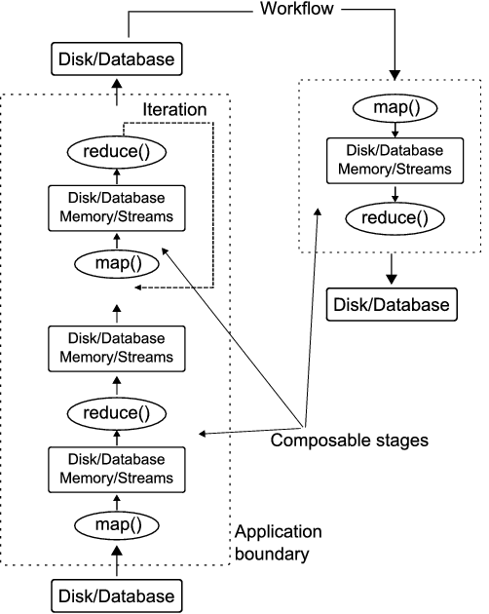
Composable Applications
Composed of individually parallelizable stages/filters
Parallel runtimes such as MapReduce, and Dryad can be used to parallelize most such stages with “pleasingly parallel” operations
contain features from classes 2, 4, and 5 discussed before
MapReduce extensions enable more types of filters to be supported
  Especially, the Iterative MapReduce computations
Iterative MapReduce
More Extensions
Map-Only
MapReduce
iterations
Input
Input
Input
map
map
map
Pij
reduce
reduce
Output
Notes:
For simple embarrassingly parallel filters such as format conversions, the distinction between MapReduce and simple job scheduling mechanisms diminishes

Slide 11
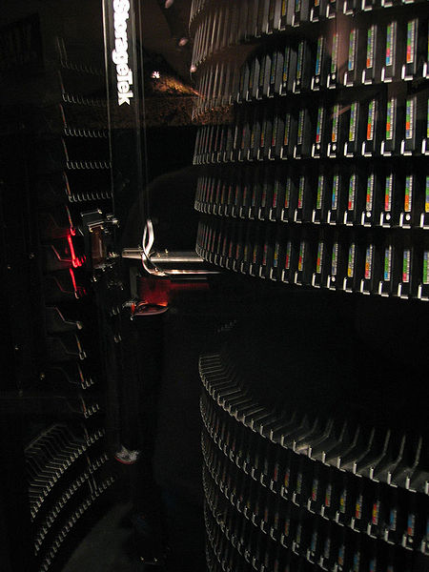
Motivation
Increase in data volumes experiencing in many domains
MapReduce
Classic Parallel Runtimes (MPI)
Data Centered, QoS
Efficient and Proven techniques
Expand the Applicability of MapReduce to more classes of Applications
Iterative MapReduce
Map-Only
MapReduce
More Extensions
iterations
Input
Input
Input
map
map
map
Pij
reduce
reduce
Output
Notes:
Data deluge
Moving Computation to Data
MapReduce
Dryad/DryadLINQ
Sector/Sphere
Simple Programming Models
MapReduce
Directed Acyclic Graphs (DAG)s
Distributed File Systems
Fault Tolerance
Benefits for Iterative Applications

Slide 12
Contributions
Architecture and the programming model of an efficient and scalable MapReduce runtime
A prototype implementation (Twister)
Classification of problems and mapping their algorithms to MapReduce
A detailed performance analysis

Slide 13

Iterative MapReduce Computations
K-Means Clustering
Variable Data
Static Data
Compute the distance to each data point from each cluster center and assign points to cluster centers
map
map
Map(Key, Value)
Main Program
Reduce (Key, List<Value>)
Iterate
reduce
Compute new cluster
centers
User program
Compute new cluster centers
Iterative invocation of a MapReduce computation
Many Applications, especially in Machine Learning and Data Mining areas
  Paper: Map-Reduce for Machine Learning on Multicore
Typically consume two types of data products
Convergence is checked by a main program
Runs for many iterations (typically hundreds of iterations)

Slide 14
Iterative MapReduce using Existing Runtimes
Variable Data – e.g. Hadoop distributed cache
Static Data
Loaded in Every Iteration
Main Program
Map(Key, Value)
New map/reduce tasks in every iteration
while(..)
{
runMapReduce(..)
}
disk -> wire-> disk
Reduce (Key, List<Value>)
Reduce outputs are saved into multiple files
Focuses mainly on single stage map->reduce computations
Considerable overheads from:
  Reinitializing tasks
  Reloading static data
  Communication & data transfers
Notes:
Cheng Tao et al. Proposed MapReduce for Machine Learning on Multicore

Slide 15
Programming Model for Iterative MapReduce
Static Data
Loaded only once
Configure()
Long running map/reduce tasks (cached)
Main Program
while(..)
{
runMapReduce(..)
}
Map(Key, Value)
Faster data transfer mechanism
Reduce (Key, List<Value>)
Combiner operation to collect all reduce outputs
Combine (Map<Key,Value>)
Distinction on static data and variable data (data flow vs. δ flow)
Cacheable map/reduce tasks (long running tasks)
Combine operation
Twister Constraints for Side Effect Free map/reduce tasks
Computation Complexity >> Complexity of Size of the Mutant Data (State)
Notes:
Cheng Tao et al. Proposed MapReduce for Machine Learning on Multicore

Slide 16
Twister Programming Model
Main program’s process space
Worker Nodes
configureMaps(..)
Local Disk
configureReduce(..)
Cacheable map/reduce tasks
while(condition){
runMapReduce(..)
May send <Key,Value> pairs directly
Map()
Iterations
Reduce()
Combine() operation
Communications/data transfers via the pub-sub broker network & direct TCP
updateCondition()
Main program may contain many MapReduce invocations or iterative MapReduce invocations
} //end while
close()

Slide 17
Outline
The big data & its outcome
MapReduce and high level programming models
Composable applications
Motivation
Programming model for iterative MapReduce
Twister architecture
Applications and their performances
Conclusions

Slide 18
Twister Architecture
Master Node
B
Pub/sub
Broker Network
Twister
Driver
B
B
B
Main Program
One broker serves several Twister daemons
Twister Daemon
Twister Daemon
map
reduce
Cacheable tasks
Worker Pool
Worker Pool
Scripts perform:
Data distribution, data collection, and partition file creation
Local Disk
Local Disk
Worker Node
Worker Node

Slide 19
Twister Architecture - Features
Use distributed storage for input & output data
Intermediate <key,value> space is handled in distributed memory of the worker nodes
  The first pattern (1) is the most common in many iterative applications
  Memory is reasonably cheap
  May impose a limit on certain applications
  Extensible to use storage instead of memory
Main program acts as the composer of MapReduce computations
Reduce output can be stored in local disks or transfer directly to the main program
Three MapReduce Patterns
Input to the map()
A significant reduction occurs after map()
1
Input to the reduce()
Input to the map()
Data volume remains almost constant
e.g. Sort
2
Input to the reduce()
Input to the map()
Data volume increases
e.g. Pairwise calculation
3
Input to the reduce()
Notes:
Quadruple Extra Large - 68.4 GB of RAM, and 26 ECU (8 virtual cores with 3.25 ECU each), 64-bit platform, costs $2.40 per hour

Slide 20
Input/Output Handling (1)
Node 0
Node 1
Node n
Data Manipulation Tool
A common directory in local disks of individual nodes
e.g. /tmp/twister_data
Partition File
Data Manipulation Tool:
Provides basic functionality to manipulate data across the local disks of the compute nodes
Data partitions are assumed to be files (Compared to fixed sized blocks in Hadoop)
Supported commands:
  mkdir, rmdir, put, putall, get, ls, Copy resources, Create Partition File
Issues with block based file system
  Block size is fixed during the format time
  Many scientific and legacy applications expect data to be presented as files

Slide 21
Input/Output Handling (2)
Sample Partition File
File No | Node IP | Daemon No | File partition path
4 | 156.56.104.96 | 2 | /home/jaliya/data/mds/GD-4D-23.bin
5 | 156.56.104.96 | 2 | /home/jaliya/data/mds/GD-4D-0.bin
6 | 156.56.104.97 | 4 | /home/jaliya/data/mds/GD-4D-23.bin
7 | 156.56.104.97 | 4 | /home/jaliya/data/mds/GD-4D-25.bin
A computation can start with a partition file
Partition files allow duplicates
Reduce outputs can be saved to local disks
The same data manipulation tool or the programming API can be used to manage reduce outputs
  E.g. A new partition file can be created if the reduce outputs needs to be used as the input for another MapReduce task
Notes:
A concept we borrowed from DryadLINQ

Slide 22
Communication and Data Transfer (1)
Communication is based on publish/susbcribe (pubsub) messaging
Each worker subscribes to two topics
  A unique topic per worker (For targeted messages)
  A common topic for the deployment (For global messages)
Currently supports two message brokers
  Naradabrokering
  Apache ActiveMQ
For data transfers we tried the following two approaches
Node X
Node X
A notification is sent via the brokers
Data is pushed from X to Y via broker network
Data is pulled from X by Y via a direct TCP connection
B
B
B
B
B
B
B
B
Pub/sub
Broker Network
Pub/sub
Broker Network
Node Y
Node Y

Slide 23
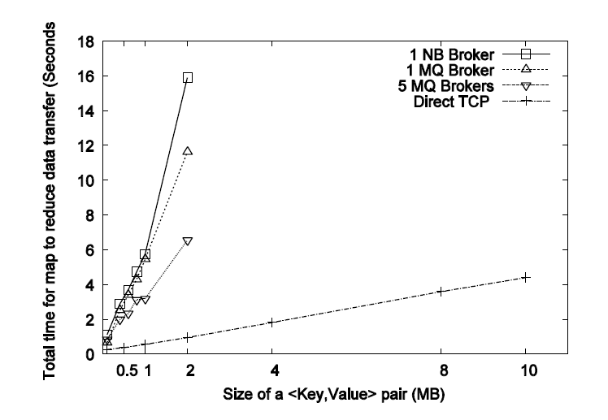
Communication and Data Transfer (2)
Map to reduce data transfer characteristics: Using 256 maps, 8 reducers, running on 256 CPU core cluster
More brokers reduces the transfer delay, but more and more brokers are needed to keep up with large data transfers
Setting up broker networks is not straightforward
The pull based mechanism (2nd approach) scales well

Slide 24
Scheduling
Master schedules map/reduce tasks statically
  Supports long running map/reduce tasks
  Avoids re-initialization of tasks in every iteration
In a worker node, tasks are scheduled to a threadpool via a queue
In an event of a failure, tasks are re-scheduled to different nodes
Skewed input data may produce suboptimal resource usages
  E.g. Set of gene sequences with different lengths
Prior data organization and better chunk sizes minimizes the skew

Slide 25
Fault Tolerance
Supports Iterative Computations
  Recover at iteration boundaries (A natural barrier)
  Does not handle individual task failures (as in typical MapReduce)
Failure Model
  Broker network is reliable [NaradaBrokering][ActiveMQ]
  Main program & Twister Driver has no failures
Any failures (hardware/daemons) result the following fault handling sequence
  Terminate currently running tasks (remove from memory)
  Poll for currently available worker nodes (& daemons)
  Configure map/reduce using static data (re-assign data partitions to tasks depending on the data locality)
    Assume replications of input partitions
  Re-execute the failed iteration

Slide 26
Twister API
configureMaps(PartitionFile partitionFile)
configureMaps(Value[] values)
configureReduce(Value[] values)
runMapReduce()
runMapReduce(KeyValue[] keyValues)
runMapReduceBCast(Value value)
map(MapOutputCollector collector, Key key, Value val)
reduce(ReduceOutputCollector collector, Key key,List<Value> values)
combine(Map<Key, Value> keyValues)
JobConfiguration
Provides a familiar MapReduce API with extensions
runMapReduceBCast(Value)
runMapreduce(KeyValue[])
Simplifies certain applications

Slide 27
Outline
The big data & its outcome
Existing solutions
Composable applications
Motivation
Programming model for iterative MapReduce
Twister architecture
Applications and their performances
Conclusions

Slide 28
Applications & Different Interconnection Patterns
Map Only (Embarrassingly Parallel) | Classic MapReduce | Iterative Reductions | Loosely Synchronous
CAP3 Gene Analysis Document conversion (PDF -> HTML) Brute force searches in cryptography Parametric sweeps PolarGrid Matlab data analysis | High Energy Physics (HEP) Histograms Distributed search Distributed sorting Information retrieval Calculation of Pairwise Distances for genes | Expectation maximization algorithms Clustering - K-means Deterministic Annealing Clustering - Multidimensional Scaling MDS Linear Algebra | Many MPI scientific applications utilizing wide variety of communication constructs including local interactions - Solving Differential Equations and - particle dynamics with short range forces
Input
iterations
Input
Input
map
map
map
Pij
reduce
Output
reduce
Domain of MapReduce and Iterative Extensions
MPI

Slide 29
Hardware Configurations
Cluster ID | Cluster-I | Cluster-II | Cluster-III | Cluster-IV
# nodes | 32 | 230 | 32 | 32
# CPUs in each node | 6 | 2 | 2 | 2
# Cores in each CPU | 8 | 4 | 4 | 4
Total CPU cores | 768 | 1840 | 256 | 256
CPU | Intel(R) Xeon(R) E7450 2.40GHz | Intel(R) Xeon(R) E5410 2.33GHz | Intel(R) Xeon(R) L5420 2.50GHz | Intel(R) Xeon(R) L5420 2.50GHz
Memory Per Node | 48GB | 16GB | 32GB | 16GB
Network | Gigabit Infiniband | Gigabit | Gigabit | Gigabit
Operating Systems | Red Hat Enterprise Linux Server release 5.4 -64 bit Windows Server 2008 Enterprise - 64 bit | Red Hat Enterprise Linux Server release 5.4 -64 bit | Red Hat Enterprise Linux Server release 5.3 -64 bit | Windows Server 2008 Enterprise (Service Pack 1) - 64 bit
We use the academic release of DryadLINQ, Apache Hadoop version 0.20.2, and Twister for our performance comparisons.
Both Twister and Hadoop use JDK (64 bit) version 1.6.0_18, while DryadLINQ and MPI uses Microsoft .NET version 3.5.

Slide 30
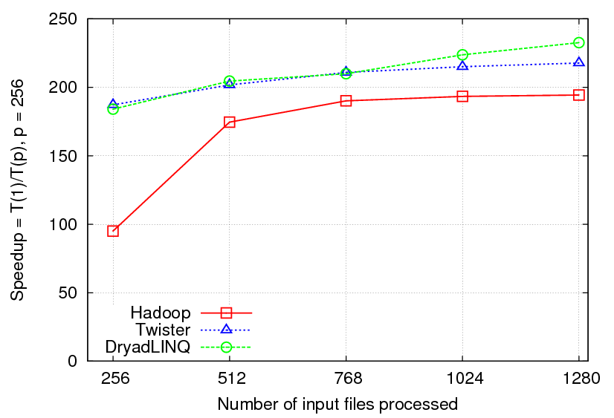

CAP3[1] - DNA Sequence Assembly Program
EST (Expressed Sequence Tag) corresponds to messenger RNAs (mRNAs) transcribed from the genes residing on chromosomes. Each individual EST sequence represents a fragment of mRNA, and the EST assembly aims to re-construct full-length mRNA sequences for each expressed gene.
Input files (FASTA)
map
map
Output files
Speedups of different implementations of CAP3 application measured using 256 CPU cores of Cluster-III (Hadoop and Twister) and Cluster-IV (DryadLINQ).
Many embarrassingly parallel applications can be implemented using MapOnly semantic of MapReduce
We expect all runtimes to perform in a similar manner for such applications
[1] X. Huang, A. Madan, “CAP3: A DNA Sequence Assembly Program,” Genome Research, vol. 9, no. 9, pp. 868-877, 1999.
Notes:
Very generic pattern. Any application of this nature can be implemented this way.

Slide 31
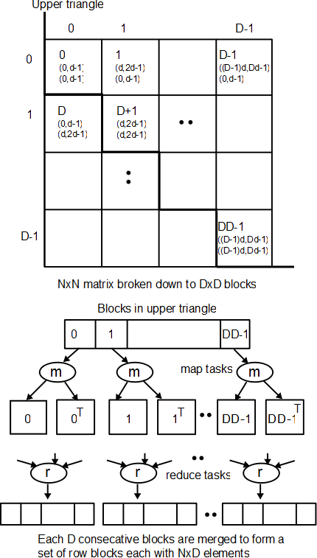
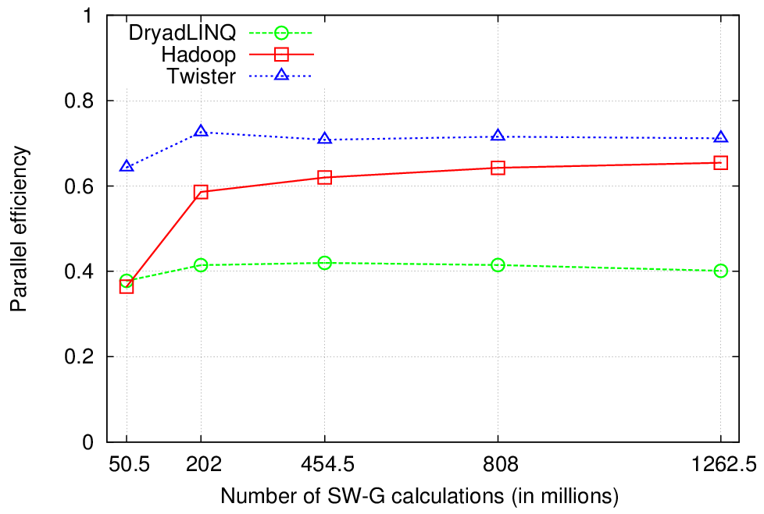

Pair wise Sequence Comparison
Using 744 CPU cores in Cluster-I
Compares a collection of sequences with each other using Smith Waterman Gotoh
Any pair wise computation can be implemented using the same approach
All-Pairs by Christopher Moretti et al.
DryadLINQ’s lower efficiency is due to a scheduling error in the first release (now fixed)
Twister performs the best

Slide 32
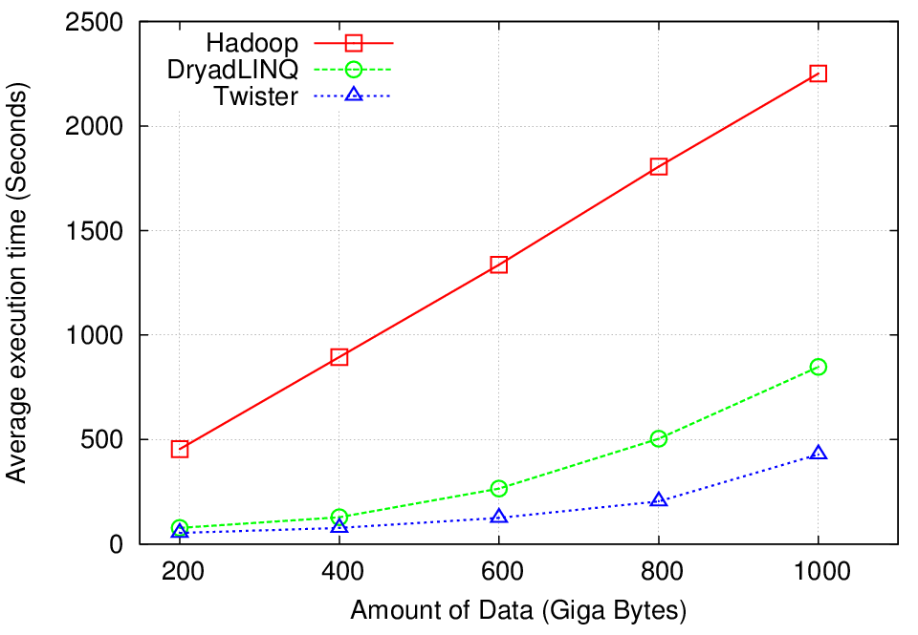
High Energy Physics Data Analysis
HEP data (binary)
256 CPU cores of Cluster-III (Hadoop and Twister) and Cluster-IV (DryadLINQ).
map
map
ROOT[1] interpreted
function
Histograms (binary)
reduce
ROOT interpreted
Function – merge
histograms
combine
Final merge operation
Histogramming of events from large HEP data sets
Data analysis requires ROOT framework (ROOT Interpreted Scripts)
Performance mainly depends on the IO bandwidth
Hadoop implementation uses a shared parallel file system (Lustre)
  ROOT scripts cannot access data from HDFS (block based file system)
  On demand data movement has significant overhead
DryadLINQ and Twister access data from local disks
  Better performance
[1] ROOT Analysis Framework, http://root.cern.ch/drupal/

Slide 33
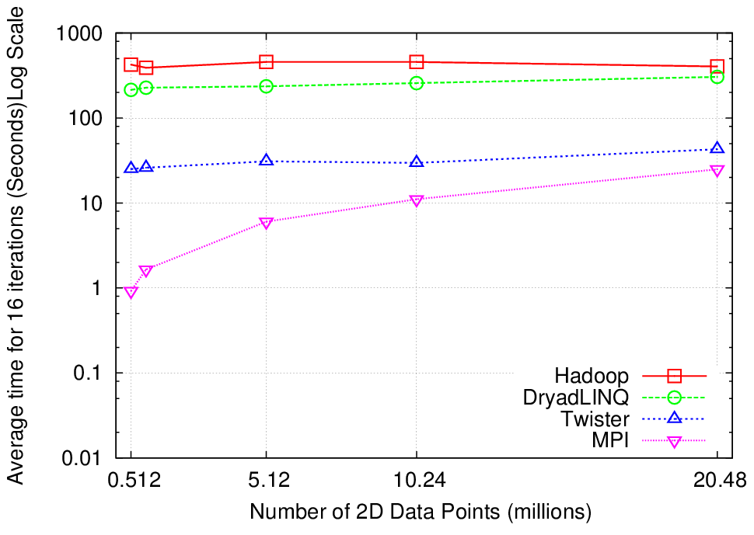
K-Means Clustering
Compute the distance to each data point from each cluster center and assign points to cluster centers
map
map
reduce
Compute new cluster
centers
Time for 20 iterations
User program
Compute new cluster centers
Identifies a set of cluster centers for a data distribution
Iteratively refining operation
Typical MapReduce runtimes incur extremely high overheads
  New maps/reducers/vertices in every iteration
  File system based communication
Long running tasks and faster communication in Twister enables it to perform closely with MPI

Slide 34
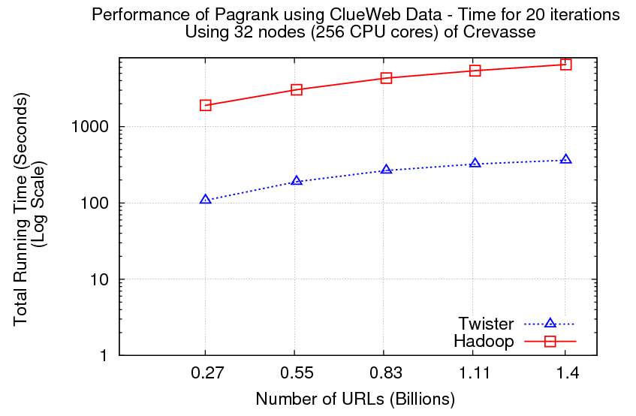
Pagerank
Partial Adjacency Matrix
Current
Page ranks (Compressed)
M
Partial
Updates
R
Iterations
C
Partially merged
Updates
Well-known pagerank algorithm [1]
Used ClueWeb09 [2] (1TB in size) from CMU
Hadoop loads the web graph in every iteration
Twister keeps the graph in memory
Pregel approach seems more natural to graph based problems
[1] Pagerank Algorithm, http://en.wikipedia.org/wiki/PageRank
[2] ClueWeb09 Data Set, http://boston.lti.cs.cmu.edu/Data/clueweb09/

Slide 35
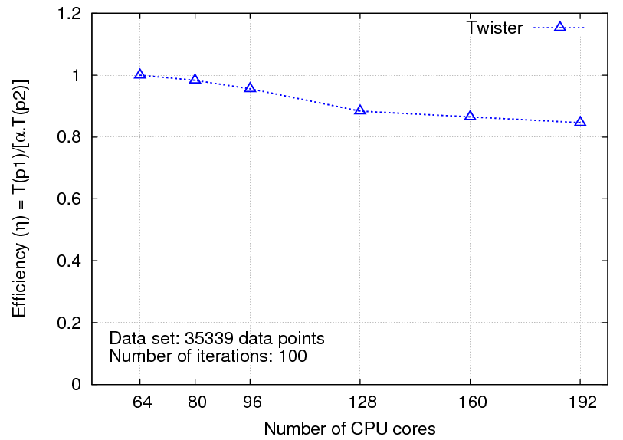
Multi-dimensional Scaling
While(condition)
{
<X> = [A] [B] <C>
C = CalcStress(<X>)
}
While(condition)
{
<T> = MapReduce1([B],<C>)
<X> = MapReduce2([A],<T>)
C = MapReduce3(<X>)
}
Maps high dimensional data to lower dimensions (typically 2D or 3D)
SMACOF (Scaling by Majorizing of COmplicated Function)[1] Algorithm
Performs an iterative computation with 3 MapReduce stages inside
[1] J. de Leeuw, "Applications of convex analysis to multidimensional scaling," Recent Developments in Statistics, pp. 133-145, 1977.

Slide 36
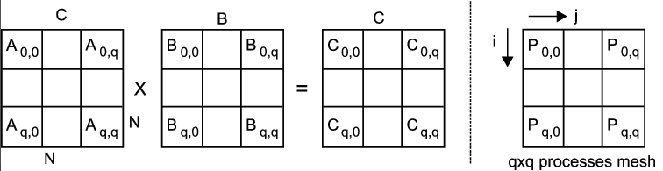
MapReduce with Stateful Tasks
Fox Matrix Multiplication Algorithm
Typically implemented using a 2d processor mesh in MPI
Communication Complexity = O(Nq) where
  N = dimension of a matrix
  q = dimension of processes mesh.
Pij

Slide 37
MapReduce Algorithm for Fox Matrix Multiplication
Consider the a virtual topology of map and reduce tasks arranged as a mesh (qxq)
Same communication complexity O(Nq)
Reduce tasks accumulate state

Slide 38
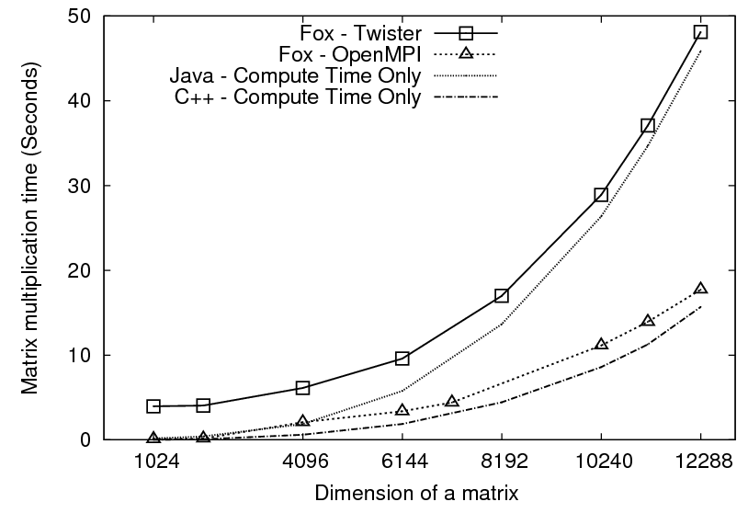
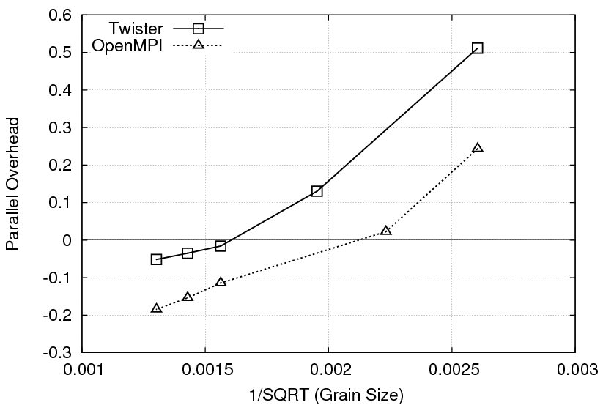
Performance of Matrix Multiplication
Matrix multiplication time against size of a matrix
Overhead against the 1/SQRT(Grain Size)
Considerable performance gap between Java and C++ (Note the estimated computation times)
For larger matrices both implementations show negative overheads
Stateful tasks enables these algorithms to be implemented using MapReduce
Exploring more algorithms of this nature would be an interesting future work

Slide 39
Related Work (1)
Input/Output Handling
  Block based file systems that support MapReduce
    GFS, HDFS, KFS, GPFS
  Sector file system - use standard files, no splitting, faster data transfer
  MapReduce with structured data
    BigTable, Hbase, Hypertable
    Greenplum uses relational databases with MapReduce
Communication
  Use a custom communication layer with direct connections
    Currently a student project at IU
  Communication based on MPI [1][2]
  Use of a distributed key-value store as the communication medium
    Currently a student project at IU
[1] -Torsten Hoefler, Andrew Lumsdaine, Jack Dongarra: Towards Efficient MapReduce Using MPI. PVM/MPI 2009: 240-249
[2] - MapReduce-MPI Library

Slide 40
Related Work (2)
Scheduling
  Dynamic scheduling
  Many optimizations, especially focusing on scheduling many MapReduce jobs on large clusters
Fault Tolerance
  Re-execution of failed task + store every piece of data in disks
  Save data at reduce (MapReduce Online)
API
  Microsoft Dryad (DAG based)
  DryadLINQ extends LINQ to distributed computing
  Google Sawzall - Higher level language for MapReduce, mainly focused on text processing
  PigLatin and Hive – Query languages for semi structured and structured data
Haloop
  Modify Hadoop scheduling to support iterative computations
Spark
  Use resilient distributed dataset with Scala
  Shared variables
  Many similarities in features as in Twister
Pregel
  Stateful vertices
  Message passing between edges
Both reference Twister

Slide 41

Conclusions
MapReduce can be used for many big data problems
  We discussed how various applications can be mapped to the MapReduce model without incurring considerable overheads
The programming extensions and the efficient architecture we proposed expand MapReduce to iterative applications and beyond
Distributed file systems with file based partitions seems natural to many scientific applications
MapReduce with stateful tasks allows more complex algorithms to be implemented in MapReduce
Some achievements
Twister open source release
Showcasing @ SC09 doctoral symposium
Twister tutorial in Big Data For Science Workshop
http://www.iterativemapreduce.org/

Slide 42
Future Improvements
Incorporating a distributed file system with Twister and evaluate performance
Supporting a better fault tolerance mechanism
  Write checkpoints in every n^{th} iteration, with the possibility of n=1 for typical MapReduce computations
Using a better communication layer
Explore MapReduce with stateful tasks further

Slide 43
Related Publications
Jaliya Ekanayake, Hui Li, Bingjing Zhang, Thilina Gunarathne, Seung-Hee Bae, Judy Qiu, Geoffrey Fox, Twister: A Runtime for Iterative MapReduce," The First International Workshop on MapReduce and its Applications (MAPREDUCE'10) - HPDC2010
Jaliya Ekanayake, (Advisor: Geoffrey Fox) Architecture and Performance of Runtime Environments for Data Intensive Scalable Computing, Doctoral Showcase, SuperComputing2009. (Presentation)
Jaliya Ekanayake, Atilla Soner Balkir, Thilina Gunarathne, Geoffrey Fox, Christophe Poulain, Nelson Araujo, Roger Barga, DryadLINQ for Scientific Analyses, Fifth IEEE International Conference on e-Science (eScience2009), Oxford, UK.
Jaliya Ekanayake, Thilina Gunarathne, Judy Qiu, Cloud Technologies for Bioinformatics Applications, IEEE Transactions on Parallel and Distributed Systems, TPDSSI-2010.
Jaliya Ekanayake and Geoffrey Fox, High Performance Parallel Computing with Clouds and Cloud Technologies, First International Conference on Cloud Computing (CloudComp2009), Munich, Germany. – An extended version of this paper goes to a book chapter.
Geoffrey Fox, Seung-Hee Bae, Jaliya Ekanayake, Xiaohong Qiu, and Huapeng Yuan, Parallel Data Mining from Multicore to Cloudy Grids, High Performance Computing and Grids workshop, 2008. – An extended version of this paper goes to a book chapter.
Jaliya Ekanayake, Shrideep Pallickara, Geoffrey Fox, MapReduce for Data Intensive Scientific Analyses, Fourth IEEE International Conference on eScience, 2008, pp.277-284.

Slide 44
Acknowledgements
My Advisors
  Prof. Geoffrey Fox
  Prof. Dennis Gannon
  Prof. David Leake
  Prof. Andrew Lumsdaine
Dr. Judy Qiu
SALSA Team @ IU
  Hui Li, Binging Zhang, Seung-Hee Bae, Jong Choi, Thilina Gunarathne, Saliya Ekanayake, Stephan Tak-lon-wu
Dr. Shrideep Pallickara
Dr. Marlon Pierce
XCG & Cloud Computing Futures Group @ Microsoft Research

Slide 45
Questions?
Thank you!

Slide 46
Backup Slides

Slide 47
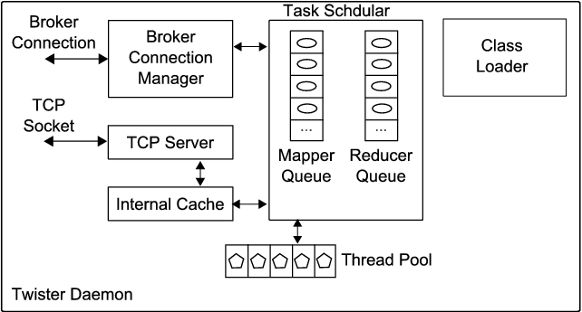
Components of Twister Daemon

Slide 48

Communication in Patterns

Slide 49
The use of pub/sub messaging
Intermediate data transferred via the broker network
Network of brokers used for load balancing
  Different broker topologies
Interspersed computation and data transfer minimizes large message load at the brokers
Currently supports
  NaradaBrokering
  ActiveMQ
map task queues
Map workers
E.g.
100 map tasks, 10 workers in 10 nodes
Broker network
~ 10 tasks are producing outputs at once
Reduce()

Slide 50
Features of Existing Architectures(1)
  Google, Apache Hadoop, Sector/Sphere,
  Dryad/DryadLINQ (DAG based)
Programming Model
  MapReduce (Optionally “map-only”)
  Focus on Single Step MapReduce computations (DryadLINQ supports more than one stage)
Input and Output Handling
  Distributed data access (HDFS in Hadoop, Sector in Sphere, and shared directories in Dryad)
  Outputs normally goes to the distributed file systems
Intermediate data
  Transferred via file systems (Local disk-> HTTP -> local disk in Hadoop)
  Easy to support fault tolerance
  Considerably high latencies
Notes:
Cascading is there, but that is for multiple MapReduce computations.

Slide 51
Features of Existing Architectures(2)
Scheduling
  A master schedules tasks to slaves depending on the availability
  Dynamic Scheduling in Hadoop, static scheduling in Dryad/DryadLINQ
  Naturally load balancing
Fault Tolerance
  Data flows through disks->channels->disks
  A master keeps track of the data products
  Re-execution of failed or slow tasks
  Overheads are justifiable for large single step MapReduce computations
  Iterative MapReduce

Slide 52
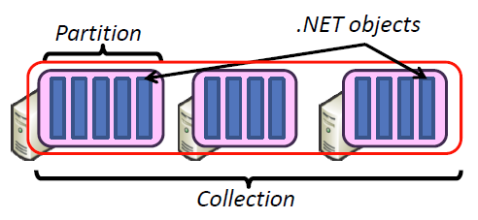
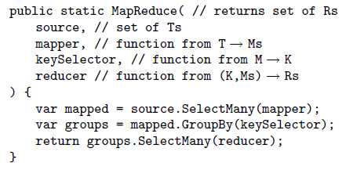
Microsoft Dryad & DryadLINQ
Implementation supports:
  Execution of DAG on Dryad
  Managing data across vertices
  Quality of services
Standard LINQ operations
DryadLINQ operations
DryadLINQ Compiler
Vertex :
execution task
Directed Acyclic Graph (DAG) based execution flows
Edge :
communication path
Dryad Execution Engine

Slide 53
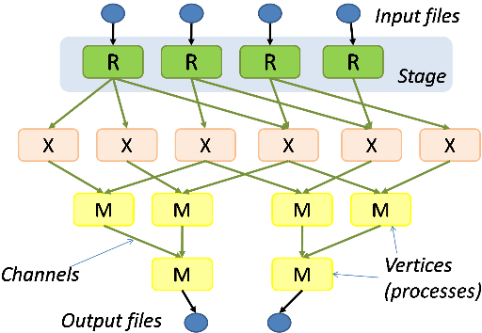
Dryad
The computation is structured as a directed graph
A Dryad job is a graph generator which can synthesize any directed acyclic graph
These graphs can even change during execution, in response to important events in the computation
Dryad handles job creation and management, resource management, job monitoring and visualization, fault tolerance, re-execution, scheduling, and accounting

Slide 54
Security
Not a focus area in this research
Twister uses pub/sub messaging to communicate
Topics are always appended with UUIDs
  So guessing them would be hard
The broker’s ports are customizable by the user
A malicious program can attack a broker but cannot execute any code on the Twister daemon nodes
  Executables are only shared via ssh from a single user account

Slide 55
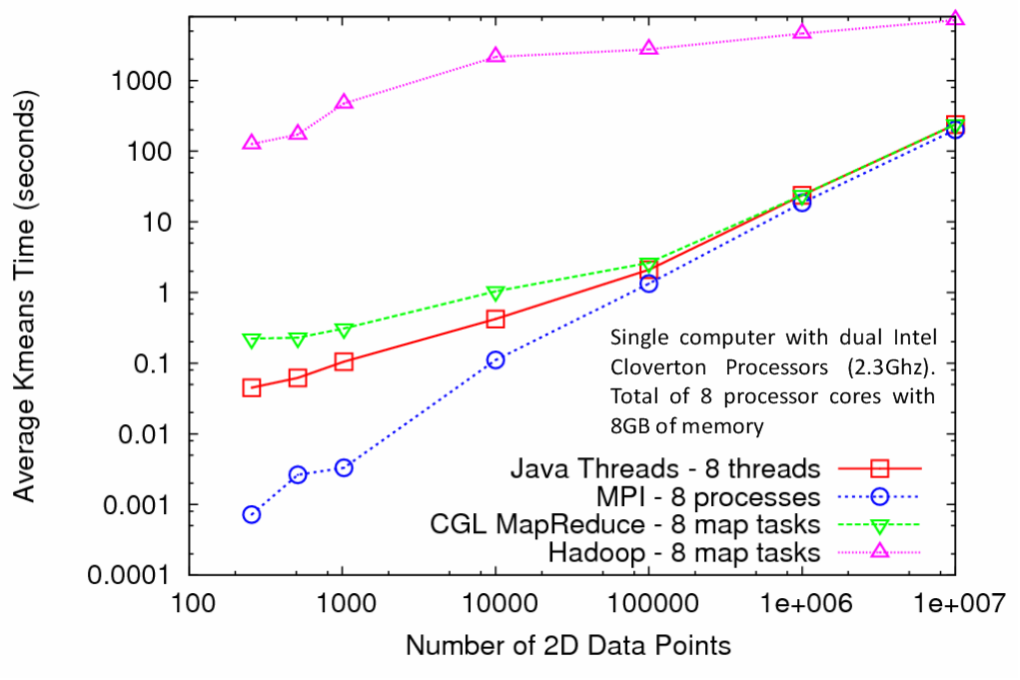
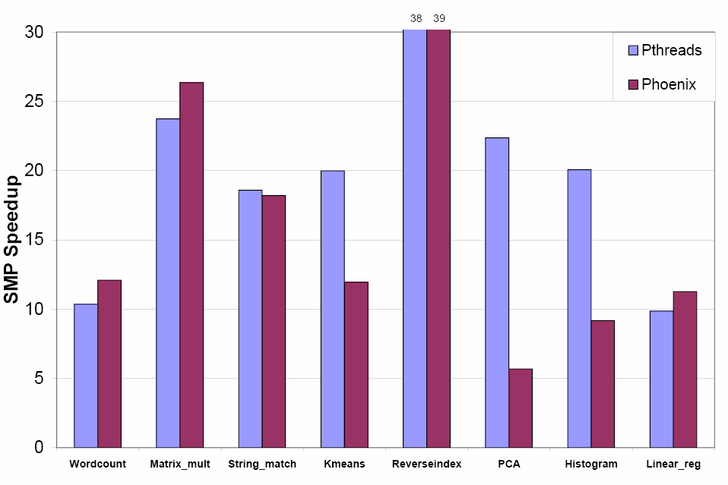
Multicore and the Runtimes
The papers [1] and [2] evaluate the performance of MapReduce using Multicore computers
Our results show the converging results for different runtimes
The right hand side graph could be a snapshot of this convergence path
Easiness to program could be a consideration
Still, threads are faster in shared memory systems
[1] Evaluating MapReduce for Multi-core and Multiprocessor Systems. By C. Ranger et al.
[2] Map-Reduce for Machine Learning on Multicore by C. Chu et al.

Slide 56
MapReduce Algorithm for Fox Matrix Multiplication
Consider the following virtual topology of map and reduce tasks arranged as a mesh (qxq)
Main program sends the iteration number k to all map tasks
The map tasks that meet the following condition send its A block (say Ab)to a set of reduce tasks
  Condition for map => (( mapNo div q) + k ) mod q == mapNo mod q
  Selected reduce tasks => (( mapNo div q) * q) to (( mapNo div q) * q +q)
Each map task sends its B block (say Bb) to a reduce task that satisfy the following condition
  Reduce key => ((q-k)*q + mapNo) mod (q*q)
Each reduce task performs the following computation
  Ci = Ci + Ab x Bi (0<i<n)
  If (last iteration) send Ci to the main program
An Iterative MapReduce Algorithm:

