Slide 1

Scalable Parallel Computing on Clouds :
Efficient and scalable architectures to perform pleasingly parallel, MapReduce and iterative data intensive computations on cloud environments
Thilina Gunarathne (tgunarat@indiana.edu)
Advisor : Prof.Geoffrey Fox (gcf@indiana.edu)
Committee : Prof.Beth Plale, Prof.David Leake, Prof.Judy Qiu
Notes:
Scalable parallel computing landscape has been traditionally dominated by the HPC. More specifically super computers and MPI. They were and they are hugely successful and well matured for the type of use cases, which were in the fields of Particle physics, thermodynamic simulations, etc.
But recently we saw 3 major disruptions happen to this landscape, mainly driven by the growing needs of the software industry.

Slide 2
Big Data
Notes:
First disruption is the Big Data or in other words, Data intensive computing.
The emergence data intensive computing is driven by the massive amount of data we generate and collect these days.
These massive data sets include the
results of massive experiments such as the Large Hadron Collider (LHC),
the rapid data produced by equipment such as new generation of sequencing machines,
the data generated by all the sensors,
the ever increasing data set of the World Wide Web and many more.
Scientists as well as those in the technology industry are heavily reliant on large scale data analysis to uncover valuable information and observations.
This has given rise to “new types of computations” where Data is dominant than the computations.

Slide 3
Cloud Computing
Notes:
Second disruption is the Cloud Computing, which introduces a utility computing model combined with a rich set of cloud infrastructure services.
Cloud computing offerings by major commercial players such as Amazon and Microsoft provide on-demand computational services over the Web, which can be purchased within a matter of minutes, with no upfront infrastructure cost.
The utility computing model of these cloud computing offerings opens up exciting new opportunities. An interesting feature of Cloud computing is the ability to increase the throughput of the computations by horizontally scaling computing resources without incurring any additional overhead costs.

Slide 4
MapReduce et al.
Notes:
The third disruption is the MapReduce and other next generation frameworks.
MapReduce consists of a storage framework, a programming model and an associated execution framework for distributed processing of very large data sets.
include framework managed fault tolerance, the ability to run on commodity hardware, the ability to process very large amounts of data and horizontal scalability of compute resources.

Slide 5
Cloud Computing
Big Data
MapReduce
Notes:
As we can see, we have new computational paradigms, new type of problems, and new type of infrastructure.. Our focus lies in the opportunities generated by the intersection of these 3 things.

Slide 6
feasibility of
Cloud Computing environments to perform large scale data intensive computations using next generation programming and execution frameworks
Notes:
Or more specifically, to evaluate the …….
This includes, to identify what’s best suited for clouds, to identify limits, etc.

Slide 7
Research Statement
Cloud computing environments can be used to perform large-scale data intensive parallel computations efficiently with good scalability, fault-tolerance and ease-of-use.

Slide 8
Outline
Research Challenges
Contributions
  Pleasingly parallel computations on Clouds
  MapReduce type applications on Clouds
  Data intensive iterative computations on Clouds
  Performance implications on clouds
  Collective communication primitives for iterative MapReduce
Summary and Conclusions

Slide 9
Why focus on computing frameworks for Clouds?
Clouds are very interesting
  No upfront cost, horizontal scalability, zero maintenance
  Cloud infrastructure services
Non-trivial to use clouds efficiently for computations
  Loose service guarantees
  Unique reliability and sustained performance challenges
  Performance and communication models are different
“Need for specialized distributed parallel computing frameworks build specifically for cloud characteristics to harness the power of clouds both easily and effectively“
Notes:
Clouds are very interesting for scalable parallel computing.
No upfront cost.
Horizontally scalable, where you pay the same for 10 instances for 100 hours or 1000 instances for 1 hour.
Zero maintenance, no need to worry about the failed disk..
How ever, Cloud native development is not easy, neither straight forward
Loose service guarantees – eventual consistency.
virtualization,
multi-tenancy,
non-dedicated commodity connectivity and etc..
This makes it necessary to have specialized distributed parallel computing frameworks build specifically for cloud characteristics to harness the power of clouds both easily and effectively.
We believe there is a need for scalable parallel programming frameworks specifically designed for cloud environments to support efficient, reliable and user friendly execution of data intensive iterative computations.

Slide 10
Research Challenges in Clouds
Programming model
Data Storage
Task Scheduling
Data Communication
Fault Tolerance
Scalability
Efficiency
Monitoring, logging and metadata storage
Cost Effective
Ease of Use

Slide 11
Data Storage
Challenge
  Bandwidth and latency limitations of cloud storage
  Choosing the right storage option for the particular data product
    Where to store, when to store, whether to store
Solution
  Multi-level caching of data
  Hybrid Storage of intermediate data on different cloud storages
  Configurable check-pointing granularity
Notes:
How do we overcome the bandwidth and latency limitations, when accessing large data products from cloud and other storages.
Where we should store, when we should to store, or whether to store at all.
Clouds offer a variety of storage options. We need to choose the storage option best-suited for the particular data product and the particular use case.
SOLUTIONS
========
We introduce multi-level data caching to overcome the latencies and bandwidth issues of Cloud Storages.
Hybrid Storage of intermediate data on different cloud storages based on the size and access patterns of data and the performance of different cloud storages
Configurable check-pointing granularity which allows coarser grained check pointing resulting in smaller amount of data to store. this allows users to select a tradeoff between a finer grained fault tolerance vs the performance of the computations.

Slide 12
Task Scheduling
Challenge
  Scheduling tasks efficiently with an awareness of data availability and locality
  Minimal overhead
  Enable dynamic load balancing of computations
  Facilitate dynamic scaling of the compute resources
  Cannot rely on single centralized controller
Solutions
  Decentralized scheduling using cloud services
  Global queue based dynamic scheduling
  Cache aware execution history based scheduling
  Map-collectives based scheduling
  Speculative scheduling of iterations
Notes:
How can we schedule 10s of thousands of tasks, with an awareness of the data availability and locality, and with very low overhead? How can we enable dynamic load balancing and facilitate dynamic scaling of compute resources.? And we cannot rely on a single centralized controller due to the unreliability in cloud instances.
use a global queue based dynamic scheduling approach to schedule the tasks, ensuring natural load balancing and dynamic scalability of the system. As presented in section 5.1.3, we introduced a data cache aware task scheduling algorithm to improve the aggregate data bandwidth by eliminating the data transfer overheads. Further, as mentioned in section 7.3.2.3, the Map-Collectives facilitates communication primitive based task scheduling to remove some of the overheads of the task scheduling.

Slide 13
Data Communication
  Challenge
    Overcoming the inter-node I/O performance fluctuations in clouds
  Solution
  Hybrid data transfers
  Data reuse across applications
    Reducing the amount of data transfers
  Overlap communication with computations
  Map-Collectives
    All-to-All group communication patterns
    Reduce the size, overlap communication with computations
    Possibilities for platform specific implementations
Notes:
How to overcome the inter-node I/O performance fluctuations in clouds to perform inter-node communications for the computations. These fluctuations are due to the shared and virtualized nature of clouds.
Solution
Hybrid data transfers
Data reuse across applications
Reducing the amount of data transfers
Overlap communication with computations through multiple waves of computations.
Map-Collectives
Map-Collectives improve the communication and computation performance of iterative MapReduce applications by utilizing all-to-all group communications and hierarchical reductions. Map-Collectives also reduce the size of data communication, overlap the communication with computation and enable the possibility of platform specific Map-Collectives implementations suited for the particular cloud environment.

Slide 14
Programming model
Challenge
  Need to express a sufficiently large and useful subset of large-scale data intensive computations
  Simple, easy-to-use and familiar
  Suitable for efficient execution in cloud environments
Solutions
  MapReduce programming model extended to support iterative applications
    Supports pleasingly parallel, MapReduce and iterative MapReduce type applications - a large and a useful subset of large-scale data intensive computations
    Simple and easy-to-use
    Suitable for efficient execution in cloud environments
      Loop variant & loop invariant data properties
      Easy to parallelize individual iterations
  Map-Collectives
    Improve the usability of the iterative MapReduce model.
Notes:
We need to find a programming abstraction that can express a sufficiently large and useful subset of large-scale data intensive computations. It should be easy-to-use and familiar to the users. Also above all, it should be suitable for efficient execution in clouds.
Solution
=====
The iterative MapReduce model supports pleasingly parallel, MapReduce and iterative MapReduce type applications; this gives us the ability to express a large and a useful subset of large-scale data intensive computations. Iterative MapReduce is simple and easy-to-use by the end user developers who are already familiar with the MapReduce model. As mentioned in section 2.3, the loop variant & loop invariant data properties and the ability to easily parallelize individual iterations make data intensive iterative computations suitable for efficient execution in cloud environments.

Slide 15
Fault-Tolerance
Challenge
  Ensuring the eventual completion of the computations efficiently
  Stragglers
  Single point of failures
Notes:
How to ensure the eventual completion of the computations through framework managed fault tolerance. It should be efficient as well. We also need to deal with stragglers and get rid of single point of failures as well. In clouds, virtual instances are running on top of non-dedicated hardware
Related Works
Google MapReduce, Hadoop, Dryad
Twister

Slide 16
Fault Tolerance
Solutions
  Framework managed fault tolerance
  Multiple granularities
    Finer grained task level fault tolerance
    Coarser grained iteration level fault tolerance
  Check-pointing of the computations in the background
  Decentralized architectures.
  Straggler (tail of slow tasks) handling through duplicated task execution
Notes:
Frameworks presented in this thesis support framework managed fault tolerance by ensuring the ability to recover from failure of the parts or tasks of a large scale computation without having to re-run the whole computation.
Also they supports finer grained task level fault tolerance as well as coarser grained iteration level fault tolerance.
Also, we proposed the usage of hybrid data communication mechanisms by utilizing a combination of faster non-persistent mediums and slower persistent mediums, a combination which can enable check-pointing of the computations in the background.
The architectures introduced in this thesis avoid single point of failures through the use of decentralized architectures. This ensures that a single cloud instance failure won’t cause a total computation failure.
Further, the frameworks handle the stragglers (tail of slow tasks) by scheduling duplicate executions of the slow tasks.

Slide 17
Scalability
Challenge
  Increasing amount of compute resources.
    Scalability of inter-process communication and coordination overheads
  Different input data sizes
Solutions
  Inherit and maintain the scalability properties of MapReduce
  Decentralized architecture facilitates dynamic scalability and avoids single point bottlenecks.
  Primitives optimize the inter-process data communication and coordination
  Hybrid data transfers to overcome cloud service scalability issues
  Hybrid scheduling to reduce scheduling overhead
Notes:
We need to make sure computations scale well with increasing amount of compute resources. This includes the scaling of Inter-process communication and coordination as well. Also the computations should scale well with different input data sizes as well.
extend the MapReduce programming model and inherit most of the scalability properties of MapReduce.
The decentralized architectures presented in this thesis facilitate dynamic scalability and avoid single point bottlenecks.
They also support hybrid data transfers to overcome cloud service scalability issues by utilizing multiple services that act in parallel to transfer the data.
The hybrid scheduling, utilizing a combination of cloud queue storage and cloud table storage, reduces the scheduling overhead even with the increase of the amount of tasks and compute resources of the computations.

Slide 18
Efficiency
Challenge
  To achieve good parallel efficiencies
  Overheads needs to be minimized relative to the compute time
    Scheduling, data staging, and intermediate data transfer
  Maximize the utilization of compute resources (Load balancing)
  Handling stragglers
Solution
  Execution history based scheduling and speculative scheduling to reduce scheduling overheads
  Multi-level data caching to reduce the data staging overheads
  Direct TCP data transfers to increase data transfer performance
  Support for multiple waves of map tasks
    Improve load balancing
    Allows the overlapping communication with computation.
Notes:
How to achieve good parallel efficiencies for most of the commonly used application patterns.
Framework overheads needs to be minimized relative to the compute time. These overheads include, scheduling, data staging, and intermediate data transfer
Maximum utilization of compute resources through Load balancing.
Handling slow tasks
The iterative MapReduce architecture proposed in this thesis uses multi-level data caching to improve efficiency by reducing the data transfer and staging overheads. Also, it uses direct TCP data transfers to increase data transfer performance, and performs execution history based scheduling to reduce the scheduling overheads. The frameworks proposed in this thesis support multiple waves of map tasks per computation and iteration, which improves the load balancing and the utilizations of the cluster. Frameworks also improve performance and efficiency by overlapping the intermediate data communication with computations, and by performing duplicate executions of straggling tasks.

Slide 19
Other Challenges
Monitoring, Logging and Metadata storage
  Capabilities to monitor the progress/errors of the computations
  Where to log?
    Instance storage not persistent after the instance termination
    Off-instance storages are bandwidth limited and costly
  Metadata is needed to manage and coordinate the jobs / infrastructure.
    Needs to store reliably while ensuring good scalability and the accessibility to avoid single point of failures and performance bottlenecks.
Cost effective
  Minimizing the cost for cloud services.
  Choosing suitable instance types
  Opportunistic environments (eg: Amazon EC2 spot instances)
Ease of usage
  Ablity to develop, debug and deploy programs with ease without the need for extensive upfront system specific knowledge.
* We are not focusing on these research issues in the current proposed research. However, the frameworks we develop provide industry standard solutions for each issue.
Notes:
Main focus is on the previous once…

Slide 20
Other - Solutions
Monitoring, Logging and Metadata storage
  Web based monitoring console for task and job monitoring,
  Cloud tables for persistent meta-data and log storage.
Cost effective
  Ensure near optimum utilization of the cloud instances
  Allows users to choose the appropriate instances for their use case
  Can also be used with opportunistic environments, such as Amazon EC2 spot instances.
Ease of usage
  Extend the easy-to-use familiar MapRduce programming model
  Provide framework-managed fault-tolerance
  Support local debugging and testing of applications through the Azure local development fabric.
  Map-Collective
    Allow users to more naturally translate applications to the iterative MapReduce
    Free the users from the burden of implementing these operations manually.
Notes:
Note: In this thesis, we do not focus on the research issues involving monitoring, logging and metadata storage*(9), cost effectiveness*(10) and the ease of usage*(11). However, the solutions and frameworks we have developed as part of this thesis research provide and, in some cases, improve the industry standard solutions for each of these issues.

Slide 21
Outcomes
Understood the challenges and bottlenecks to perform scalable parallel computing on cloud environments
Proposed solutions to those challenges and bottlenecks
Developed scalable parallel programming frameworks specifically designed for cloud environments to support efficient, reliable and user friendly execution of data intensive computations on cloud environments.
Developed data intensive scientific applications using those frameworks and demonstrate that these applications can be executed on cloud environments in an efficient scalable manner.

Slide 22
Pleasingly Parallel Computing On Cloud Environments
Goal : Design, build, evaluate and compare Cloud native decentralized frameworks for pleasingly parallel computations
Published in
  T. Gunarathne, T.-L. Wu, J. Y. Choi, S.-H. Bae, and J. Qiu, "Cloud computing paradigms for pleasingly parallel biomedical applications," Concurrency and Computation: Practice and Experience, 23: 2338–2354. doi: 10.1002/cpe.1780. (2011)
  T. Gunarathne, T.-L. Wu, J. Qiu, and G. Fox, "Cloud Computing Paradigms for Pleasingly Parallel Biomedical Applications," In Proceedings of the 19th ACM International Symposium on High Performance Distributed Computing (HPDC '10)- ECMLS workshop. Chicago, IL., pp 460-469. DOI=10.1145/1851476.1851544 (2010)
Notes:
In this section we’ll be presenting scalable architectures to perform pleasingly parallel computations on clouds.

Slide 23
Pleasingly Parallel Frameworks
Cap3 Sequence Assembly
Classic Cloud Frameworks
Notes:
The left hand figure presents the pleasingly computing framework architecture for cloud environments to process embarrassingly parallel applications.
This uses queues for scheduling and monitoring, Blob storage for input/output data storage and cloud instances for parallel processing. We implemented this architecture for EC2 and Azure clouds.. We implemented similar framework using Hadoop and DraydLing on traditional local clusters.
We implemented several applications including Cap3 sequence assembly, Blast sequence search and couple of dimensional scaling interpolation algorithms. Cloud frameworks were able to achieve comparable performance. We also performed studies to identify the best instance types as well.

Slide 24
MapReduce Type Applications On Cloud Environments
Goal : Design, build, evaluate and compare Cloud native decentralized MapReduce framework
Published in
  T. Gunarathne, T. L. Wu, J. Qiu, and G. C. Fox, "MapReduce in the Clouds for Science," Proceedings of 2nd International Conference on Cloud Computing, Indianapolis, Dec 2010. pp.565,572, Nov. 30 2010-Dec. 3 2010. doi: 10.1109/CloudCom.2010.107
Notes:
Next we’ll look in to the scalable decentralized architecture and implementation to perform MapReduce type computations on cloud environments.

Slide 25
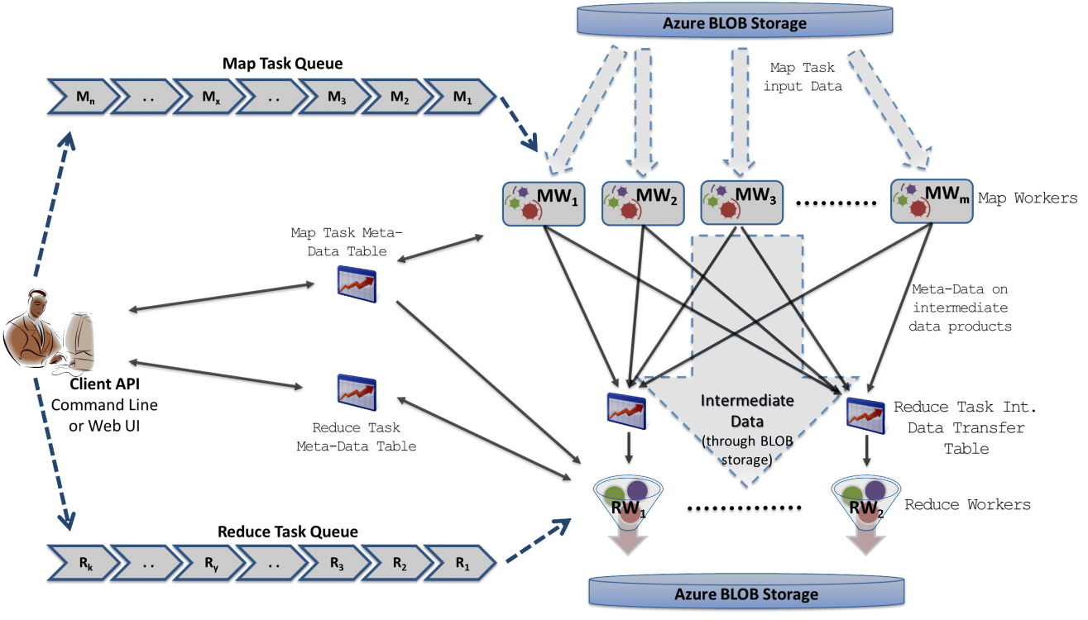
Decentralized MapReduce Architecture on Cloud services
Cloud Queues for scheduling, Tables to store meta-data and monitoring data, Blobs for input/output/intermediate data storage.
Notes:
This is a decentralized scalable architecture to implement MapReduce frameworks on cloud environments using cloud infrastructure services.
This architecture had the ability to dynamically scale up/down even in middle of an computation and provides typical MapReduce Fault Tolerance features.
Avoids Single Point of Failure through the decentralized architecture.
Users a global queue based dynamic scheduling achieving natural load balancing.
Main challenge was dealing with eventual consistency nature of the cloud services and implementing barriers using those..

Slide 26
MRRoles4Azure
Azure Cloud Services
Highly-available and scalable
Decentralized
Avoids Single Point of Failure
Utilize eventually-consistent , high-latency cloud services effectively
Minimal maintenance and management overhead
Dynamically scale up/down
Global queue based dynamic scheduling
MapReduce
First pure MapReduce for Azure
Typical MapReduce fault tolerance
Notes:
We implemented MRR4Azure for Microsoft windows Azure cloud using the above architecture.
MRRoles4Azure uses the highly available and scalable Azure cloud services as the building block and utilize eventually-consistent , high-latency cloud services effectively to build a scalable decentralized MapReduce framework.
This is the first pure MapReduce implementation for Azure.
Minimal maintenance and management overhead
Easy testing and deployment
Combiner step
Web based monitoring console

Slide 27
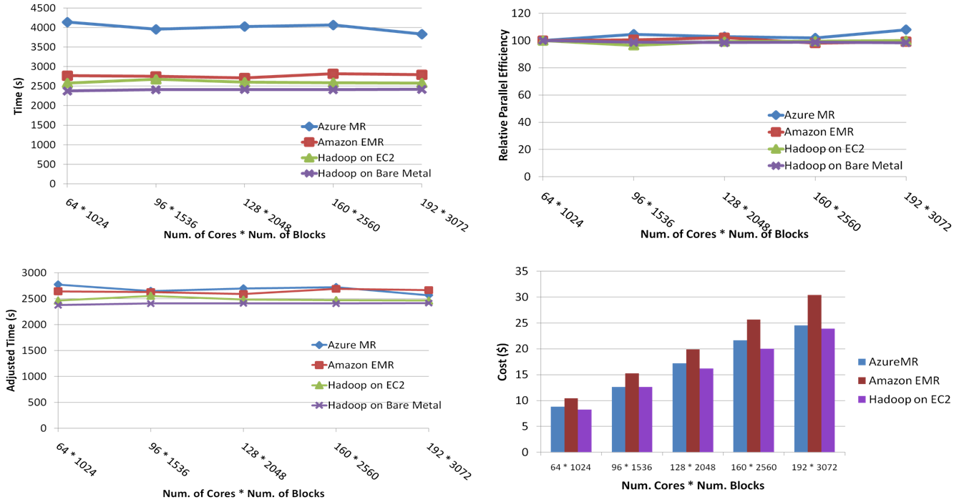
SWG Sequence Alignment
Smith-Waterman-GOTOH to calculate all-pairs dissimilarity
Notes:
We implemented and benchmarked several applications using MRRoles4Azure and noticed performance and scalability comparable to the MapReduce frameworks running on local clusters.. SWG is one of them.
Top left – weak scaling.. MRRoles4Azure is slower than others, but scales similarly. The slowness is due to the performance difference between Naligner and JAligner., which we use as the kernel for SWG.
Bottom left: Naligner vs Jaligner performance adjusted..
Top left : parellel efficiency relative to the 64 instance test case..
Bottem right: amortized computing cost.. Costs less than EMR, even when the computations takes more time than Jaligner.
~123 million sequence alignments, for under 30$ with zero up front hardware cost,

Slide 28
Data Intensive Iterative Computations On Cloud Environments
Goal : Design, build, evaluate and compare Cloud native frameworks to perform data intensive iterative computations
Published in
  T. Gunarathne, B. Zhang, T.-L. Wu, and J. Qiu, "Scalable parallel computing on clouds using Twister4Azure iterative MapReduce," Future Generation Computer Systems, vol. 29, pp. 1035-1048, Jun 2013.
  T. Gunarathne, B. Zhang, T.L. Wu, and J. Qiu, "Portable Parallel Programming on Cloud and HPC: Scientific Applications of Twister4Azure," Proc. Fourth IEEE International Conference on Utility and Cloud Computing (UCC), Melbourne, pp 97-104, 5-8 Dec. 2011, doi: 10.1109/UCC.2011.23.
Notes:
Next we’ll look in to the scalable and decentralized architecture and implementation to perform data intesive iterative MapReduce type computations on cloud environments.
18 MINS

Slide 29
Data Intensive Iterative Applications
Growing class of applications
  Clustering, data mining, machine learning & dimension reduction applications
  Driven by data deluge & emerging computation fields
  Lots of scientific applications
k ← 0;
MAX ← maximum iterations
δ^{[0]} ← initial delta value
while ( k< MAX_ITER || f(δ^{[k]}, δ^{[k-1]}) )
foreach datum in data
β[datum] ← process (datum, δ^{[k]})
end foreach
δ^{[k+1]} ← combine(β[])
k ← k+1
end while
Notes:
Iterative computations are at the core of the vast majority of data intensive scientific computations, such as …
The application types are gaining even more popularity due to the data deluge and due to the emergence of data intensive computational fields, such as bioinformatics, chemical informatics and web mining.
These computations often has a structure like this, where inside an iteration, the individual data items would get processed independently and then the result of those would be combined to generate the iteration result. This result would often be used in the computations of the next iteration.

Slide 30
Data Intensive Iterative Applications
Smaller Loop-Variant Data
Broadcast
Compute
Communication
Reduce/ barrier
New Iteration
Larger Loop-Invariant Data
Notes:
We can specify this type applications structures as set of computation and communication steps where single iterations can easily be specified as MapReduce computations.
These would typically have large input data sizes which are loop-invariant and can be reused across iterations.
We call the iteration result as the loop-variant data.. This is Orders of magnitude smaller…
While these can be performed using traditional MapReduce frameworks, Traditional is not efficient for these types of computations. MR leaves lot of room for improvements in terms of iterative applications.

Slide 31
Iterative MapReduce
MapReduceMergeBroadcast
Extensions to support additional broadcast (+other) input data
      Map(<key>, <value>, list_of <key,value>)
      Reduce(<key>, list_of <value>, list_of <key,value>)
      Merge(list_of <key,list_of<value>>,list_of <key,value>)
Map
Combine
Shuffle
Sort
Reduce
Merge
Broadcast
Notes:
We extend the MR to support IMR. The goal is to support more patterns efficiently , while keeping the desirable features of MapReduce such as scalability, ease of use and fault tolerance of map reduce.
Add two steps..
Extend the programming model adding an extra dynamic input parameter to Map and Reduce functions.
Loop invariant data (static data) would be the traditional MR key-value pairs
Comparatively larger sized data
Cached between iterations
Loop variant data (dynamic data) – broadcast to all the map tasks in beginning of the iteration

Slide 32
Merge Step
Map -> Combine -> Shuffle -> Sort -> Reduce -> Merge
Receives all the Reduce outputs and the broadcast data for the current iteration
User can add a new iteration or schedule a new MR job from the Merge task.
  Serve as the “loop-test” in the decentralized architecture
    Number of iterations
    Comparison of result from previous iteration and current iteration
  Possible to make the output of merge the broadcast data of the next iteration
Notes:
Merge phase adds a new step to the MapReduce computation flow. Merge recieves…

Slide 33
Broadcast Data
Loop variant data (dynamic data) – broadcast to all the map tasks in beginning of the iteration
  Comparatively smaller sized data
  Map(Key, Value, List of KeyValue-Pairs(broadcast data) ,…)
Can be specified even for non-iterative MR jobs
Notes:
Broadcast data is the loop variant data or the iteration result of an iteration.

Slide 34
Multi-Level Caching
In-Memory/Disk caching of static data
Caching BLOB data on disk
Caching loop-invariant data in-memory
Notes:
Loop invariant data (static data), that are reused between iterations, gets cached between the iterations.
This avoids the data download, loading and parsing cost between iterations. Data download cost can be pretty significant when getting data from off-instance cloud blob storages. Bandwidth variations
Which gives significant speedups for data-intensive iterative MapReduce applications
Cached data can be reused by any MR application within the job

Slide 35
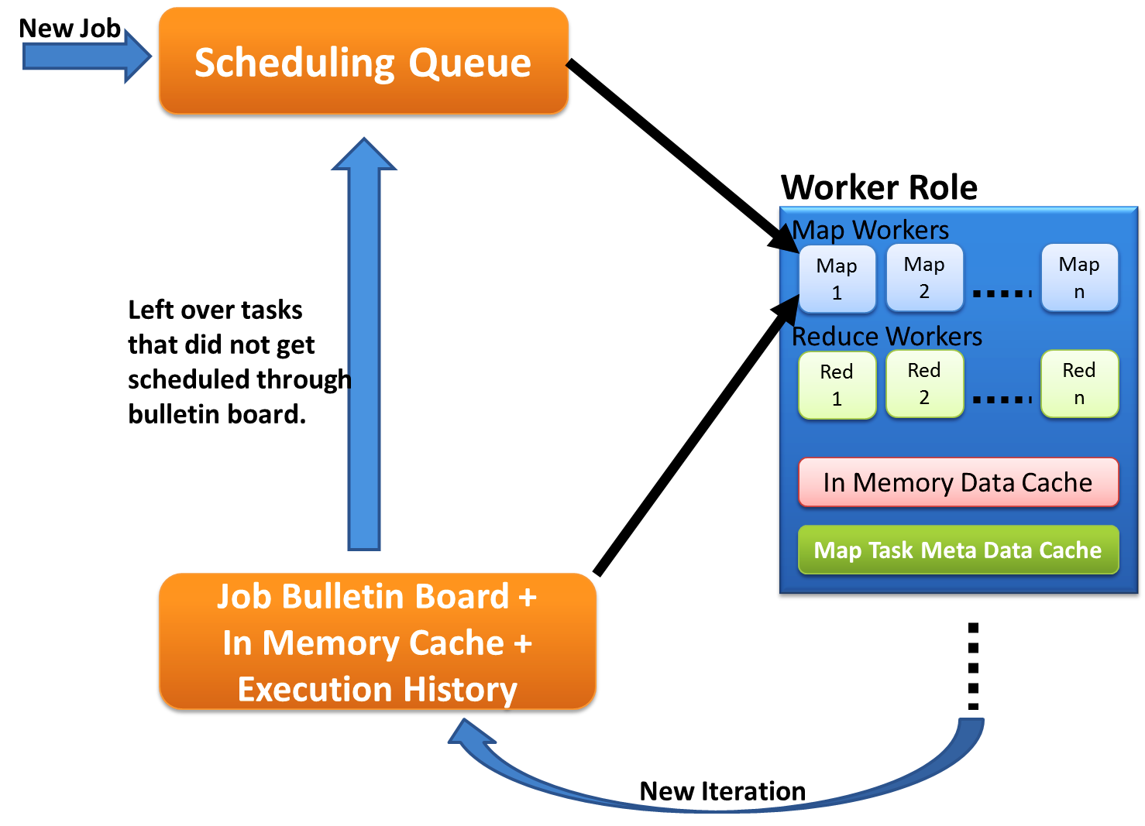
Cache Aware Task Scheduling
First iteration through queues
Cache aware hybrid scheduling
Decentralized
Fault tolerant
Multiple MapReduce applications within an iteration
Load balancing
Multiple waves
Left over tasks
Data in cache + Task meta data history
New iteration in Job Bulleting Board
Notes:
Map tasks need to be scheduled with cache awareness
Nobody has global view of the data products cached in workers.. No single entity has the knowledge that instance X has this data product in cache..
Decentralized architecture
Impossible to do cache aware assigning of tasks to workers
However, we came up with a Solution: workers pick tasks based on the data they have in the cache and the execution histories
Job Bulletin Board : advertise the new iterations
First iteration load balanced. Rest is a challenge.
Multiple MapReduce applications within an iteration supporting much richer application patterns..
Supports multiple waves..

Slide 36
Intermediate Data Transfer
In most of the iterative computations,
  Tasks are finer grained
  Intermediate data are relatively smaller
Hybrid Data Transfer based on the use case
  Blob storage based transport
  Table based transport
  Direct TCP Transport
    Push data from Map to Reduce
Optimized data broadcasting
Notes:
The tasks of iterative computations are much finer grained and the intermediate data are relatively smaller than typical map reduce computations. We added support for hydrid transfer of intermediate data.
Optimized n-ary tree based data broadcasting algorithms..

Slide 37
Fault Tolerance For Iterative MapReduce
Iteration Level
  Role back iterations
Task Level
  Re-execute the failed tasks
Hybrid data communication utilizing a combination of faster non-persistent and slower persistent mediums
  Direct TCP (non persistent), blob uploading in the background.
Decentralized control avoiding single point of failures
Duplicate-execution of slow tasks
Notes:
Duplicate execution can be slow as data needs to be downloaded.. Cache sharing?

Slide 38
Twister4Azure – Iterative MapReduce
Decentralized iterative MR architecture for clouds
  Utilize highly available and scalable Cloud services
Extends the MR programming model
Multi-level data caching
  Cache aware hybrid scheduling
Multiple MR applications per job
Collective communication primitives
Outperforms Hadoop in local cluster by 2 to 4 times
Sustain features of MRRoles4Azure
  dynamic scheduling, load balancing, fault tolerance, monitoring, local testing/debugging
Notes:
Collective communications increasing the performance and giving users more easy options to perform their computations.
Ability to deploy multiple Map Reduce applications in a single deployment
Possible to invoke different MR applications in a single job
Support for many application invocations in a workflow without redeployment

Slide 39

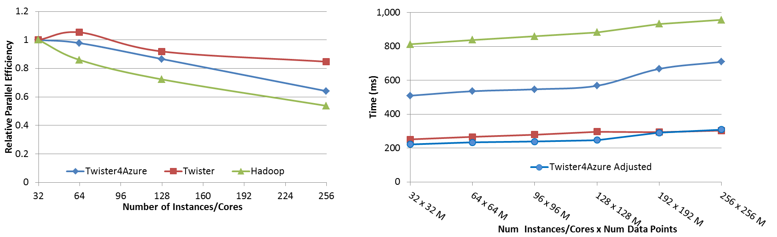




Performance – Kmeans Clustering
Overhead between iterations
First iteration performs the initial data fetch
Task Execution Time Histogram
Number of Executing Map Task Histogram
Scales better than Hadoop on bare metal
Strong Scaling with 128M Data Points
Weak Scaling
Performance with/without
data caching
Speedup gained using data cache
Scaling speedup
Increasing number of iterations
Notes:
Right(c): Twister4Azure executing Map Task histogram for 128 million data points in 128 Azure small instances
Figure 5. KMeansClustering Scalability. Left(a): Relative parallel efficiency of strong scaling using 128 million data points.
Center(b): Weak scaling. Workload per core is kept constant (ideal is a straight horizontal line).

Slide 40
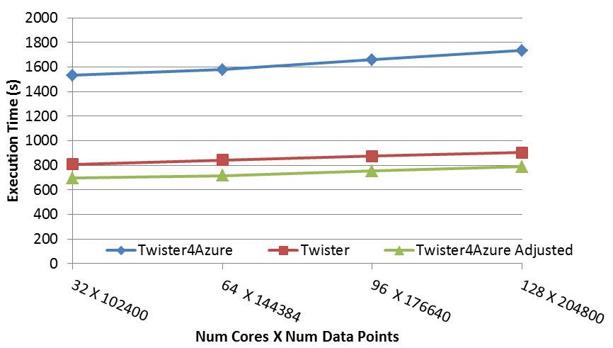
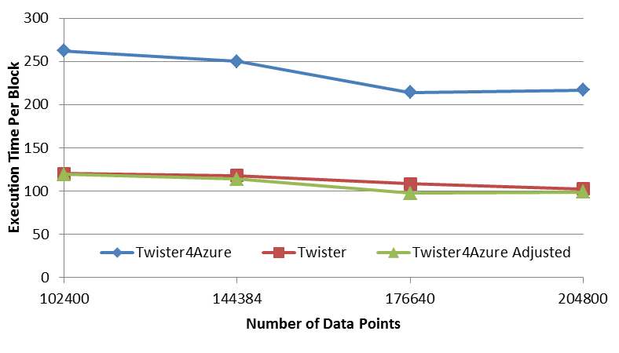
Performance – Multi Dimensional Scaling
BC: Calculate BX
X: Calculate invV (BX)
Calculate Stress
Map
Reduce
Merge
Map
Reduce
Merge
Map
Reduce
Merge
New Iteration
Performance adjusted for sequential performance difference
Weak Scaling
Data Size Scaling
Scalable Parallel Scientific Computing Using Twister4Azure. Thilina Gunarathne, BingJing Zang, Tak-Lon Wu and Judy Qiu. Submitted to Journal of Future Generation Computer Systems. (Invited as one of the best 6 papers of UCC 2011)
Notes:
The Java HPC Twister experiment was performed in a dedicated large-memory cluster of Intel(R) Xeon(R) CPU E5620 (2.4GHz) x 8 cores with 192GB memory per compute node and with Gigabit Ethernet on Linux. Java HPC Twister results do not include the initial data distribution time.
Azure large instances with 4 workers per instances is used. Memory mapped based caching and AllGather primitive are used.
Left: Weak scaling where workload per core is ~constant. Ideal is a straight horizontal line. X axis is
Right: Data size scaling with 128 Azure small instances/cores, 20 iterations.
The Twister4Azure adjusted (t_{a}) depicts the performance of Twister4Azure normalized according to the sequential MDS BC calculation and Stress calculation performance ratio between the Azure(t_{sa}) and Cluster(t_{sc}) environments used for Java HPC Twister. It is calculated using t_{a} x (t_{sc}/t_{sa}). This estimation however does not account for the overheads that remain constant irrespective of the computation time. Hence Twister4Azure seems to perform better, but in reality when the task execution times become smaller, twister4Azure overheads will become relatively larger and the performance would not be as good as shown in the adjusted curve.
Tested for other applications like Blast and SWG as well.

Slide 41
Collective Communications Primitives For Iterative Mapreduce
Goal : Improve the performance and usability of iterative MapReduce applications
  Improve communications and computations
Published in
  T. Gunarathne, J. Qiu, and D.Gannon, “Towards a Collective Layer in the Big Data Stack”, 14th IEEE/ACM International Symposium on Cluster, Cloud and Grid Computing (CCGRID 2014). Chicago, USA. May 2014. (To be published)
Notes:
32 mins

Slide 42
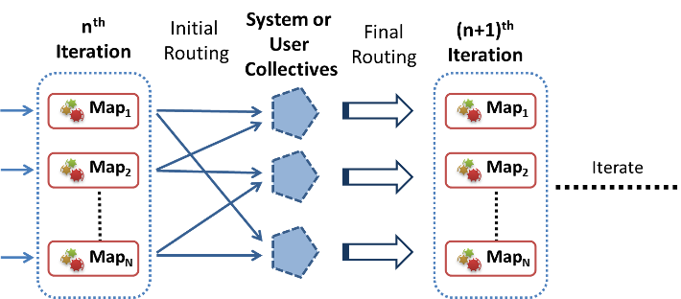
Collective Communication Primitives for Iterative MapReduce
Introducing All-All collective communications primitives to MapReduce
Supports common higher-level communication patterns

Slide 43
Collective Communication Primitives for Iterative MapReduce
Performance
  Framework can optimize these operations transparently to the users
    Poly-algorithm (polymorphic)
  Avoids unnecessary barriers and other steps in traditional MR and iterative MR
Ease of use
  Users do not have to manually implement these logic
  Preserves the Map & Reduce API’s
  Easy to port applications using more natural primitives
Notes:
Users do not have to manually implement these logic (eg: Reduce and Merge tasks)
Preserves the Map & Reduce API’s
Easy to port applications with more natural primitives

Slide 44
 | MPI | H-Collectives / Twister4Azure
All-to-One | Gather | Reduce-merge of MapReduce*
 | Reduce | Reduce of MapReduce*
One-to-All | Broadcast | MapReduce-MergeBroadcast
 | Scatter | Workaround using MapReduceMergeBroadcast
All-to-All | AllGather | Map-AllGather
 | AllReduce | Map-AllReduce
 | Reduce-Scatter | Map-ReduceScatter (future)
Synchronization | Barrier | Barrier between Map & Reduce and between iterations*
*Native support from MapReduce.
Notes:
*Native support from MapReduce.

Slide 45
Map-AllGather Collective
Traditional iterative Map Reduce
  The “reduce” step assembles the outputs of the Map Tasks together in order
  “merge” assembles the outputs of the Reduce tasks
  Broadcast the assembled output to all the workers.
Map-AllGather primitive,
  Broadcasts the Map Task outputs to all the computational nodes
  Assembles them together in the recipient nodes
  Schedules the next iteration or the application.
Eliminates the need for reduce, merge, monolithic broadcasting steps and unnecessary barriers.
  Example : MDS BCCalc, PageRank with in-links matrix (matrix-vector multiplication)

Slide 46
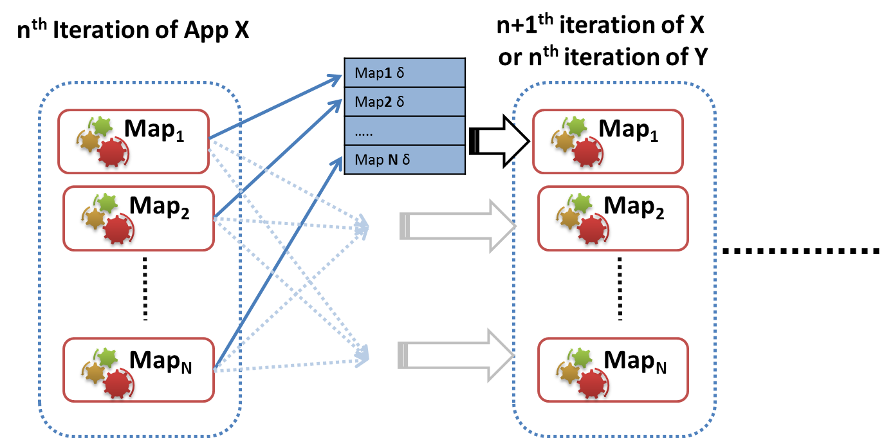
Map-AllGather Collective
Notes:
Using the Windows Communication Foundation (WCF) based Azure TCP inter-role communication mechanism
Uses the Azure table storage as a persistent backup.

Slide 47
Map-AllReduce
Map-AllReduce
  Aggregates the results of the Map Tasks
    Supports multiple keys and vector values
  Broadcast the results
  Use the result to decide the loop condition
  Schedule the next iteration if needed
Associative commutative operations
  Eg: Sum, Max, Min.
Examples : Kmeans, PageRank, MDS stress calc

Slide 48
Map-AllReduce collective
n^{th}
Iteration
(n+1)^{th}
Iteration
Map₁
Op
Map₁
Map₂
Op
Map₂
Iterate
Map_{N}
Op
Map_{N}
Notes:
Commutative associative
Uses a hierarchical reduction approach
The results are first aggregated in the local node
Final assembly performed in the destination nodes
The iteration check happens in the destination nodes
Examples : Kmeans, PageRank, MDS stress calc

Slide 49
Implementations
H-Collectives : Map-Collectives for Apache Hadoop
  Node-level data aggregations and caching
  Speculative iteration scheduling
  Hadoop Mappers with only very minimal changes
  Support dynamic scheduling of tasks, multiple map task waves, typical Hadoop fault tolerance and speculative executions.
  Netty NIO based implementation
Map-Collectives for Twister4Azure iterative MapReduce
  WCF Based implementation
  Instance level data aggregation and caching

Slide 50
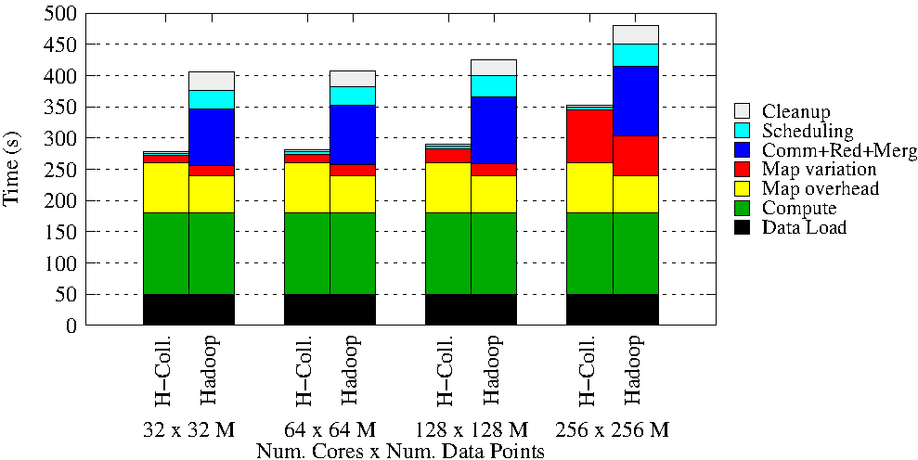
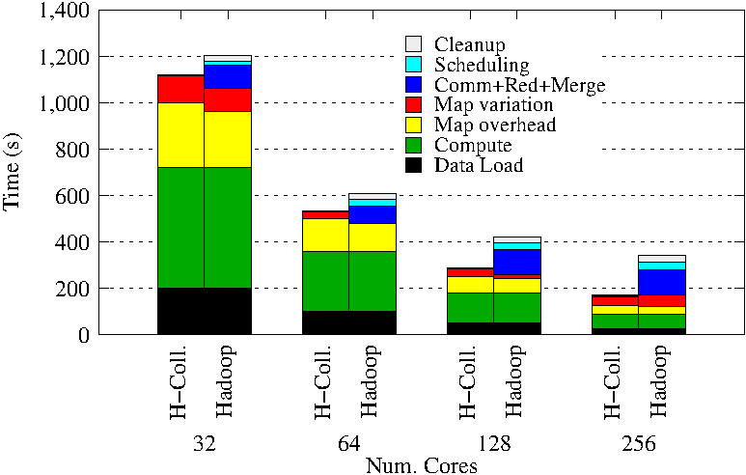
KMeansClustering
Weak scaling
Strong scaling
Hadoop vs H-Collectives Map-AllReduce.
500 Centroids (clusters). 20 Dimensions. 10 iterations.
Notes:
Hadoop K-means Clustering comparison with H-Collectives Map-AllReduce Weak scaling. 500 Centroids (clusters). 20 Dimensions. 10 iterations.
Hadoop K-means Clustering comparison with H-Collectives Map-AllReduce Strong scaling. 500 Centroids (clusters). 20 Dimensions. 10 iterations.

Slide 51
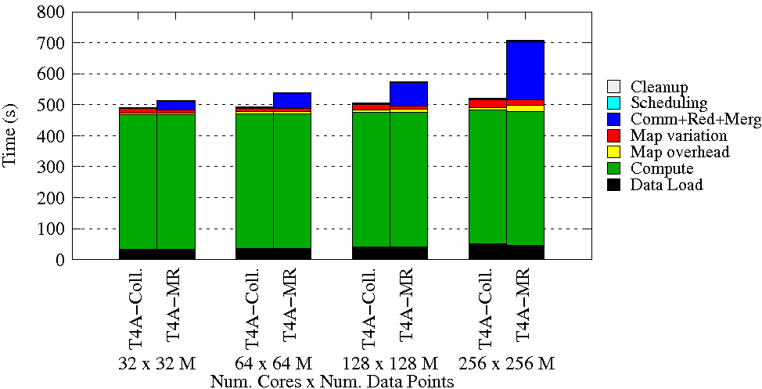
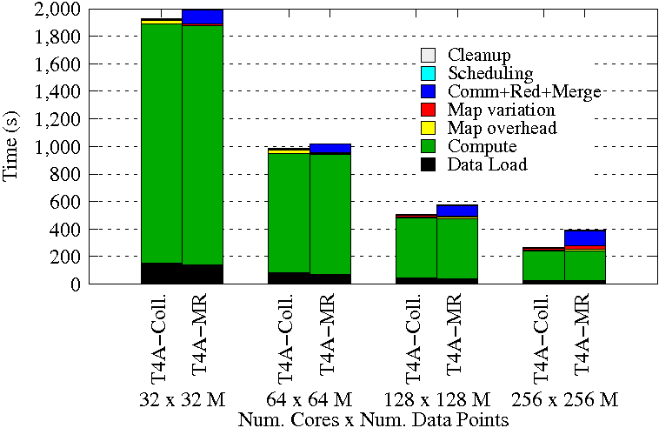
KMeansClustering
Weak scaling
Strong scaling
Twister4Azure vs T4A-Collectives Map-AllReduce.
500 Centroids (clusters). 20 Dimensions. 10 iterations.
Notes:
T4A already optimized,. Like ideal Hadoop.. Uses optimized broadcast, communications, etc..
Weak scaling - 32 to 256 Million data points.
String scaling – 128M data points

Slide 52
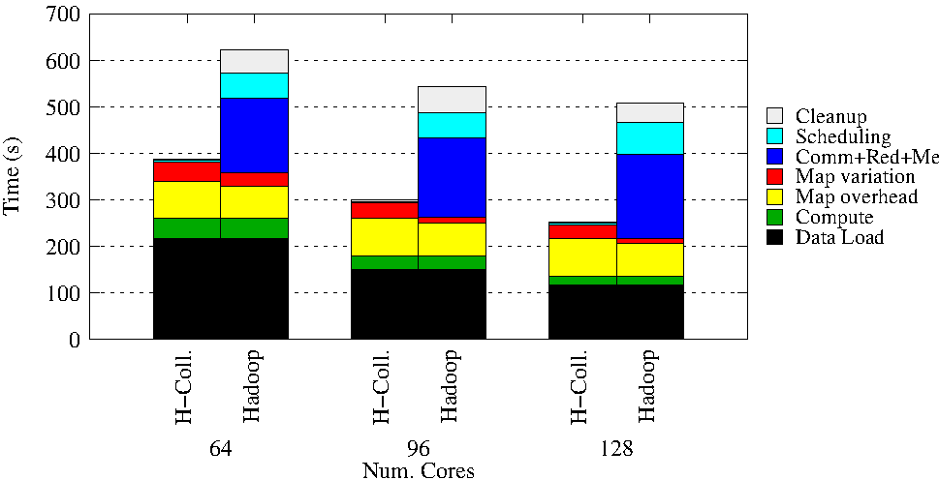
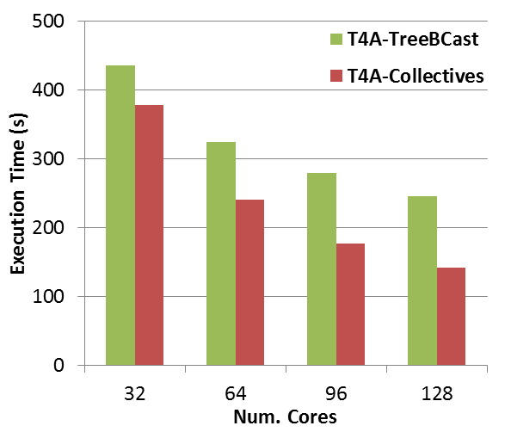
MultiDimensional Scaling
Hadoop MDS – BCCalc only
Twister4Azure MDS
Notes:
Figure 55 MDS Hadoop using only the BC Calculation MapReduce job per iteration to highlight the overhead. 20 iterations, 51200 data points
MDS application implemented using Twister4Azure. 20 iterations. 51200 data points (~5GB).

Slide 53
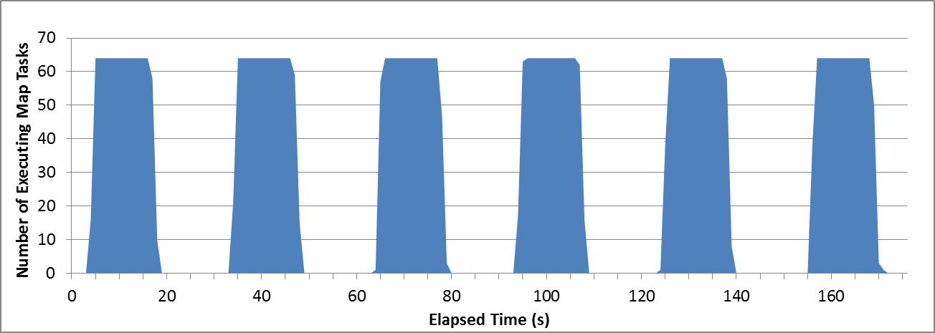
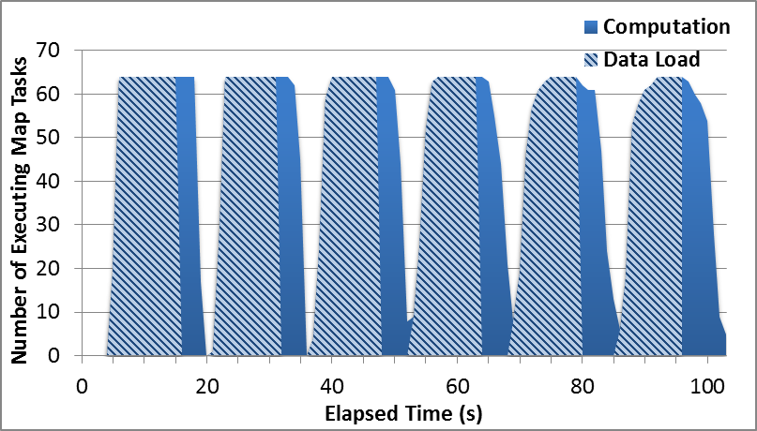
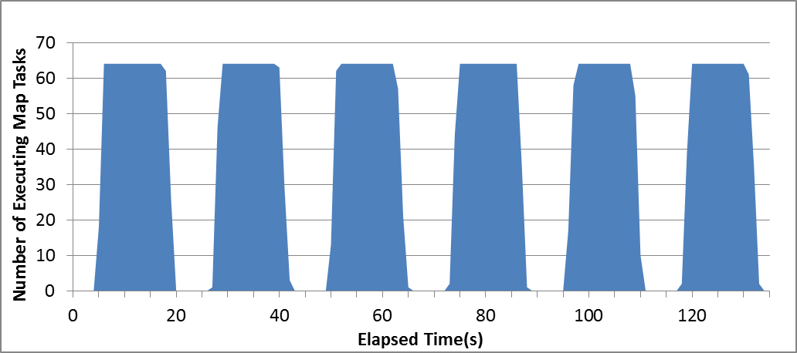
Hadoop MDS Overheads
Hadoop MapReduce MDS-BCCalc
H-Collectives AllGather MDS-BCCalc
H-Collectives AllGather MDS-BCCalc without speculative scheduling

Slide 54
Comparison with HDInsight
Notes:
KMeansClustering implementation used in section 7.2.3 on HDInsight. HDInsight currently limits the number of cores to 170, which doesn’t allow us to perform the 256 core test on it.
Input data for the HDInsight computation were stored in Azure Blob Storage and were accessed through ASV (Azure storage vault), which provides a HDFS file system interface for the Azure blob storage. Input data for the Twister4Azure computation were also stored in Azure blob storage and were cached in memory using the Twister4Azure caching feature.
The darker areas of the bars represent the approximated compute only time for the computation based on the average map task compute only time.
Rest of the area in each bars represent the overheads, which would be the time taken for task scheduling, data loading, shuffle, sort, reduce, merge and broadcast. The overheads are particularly high for HDInsight due to the data download from the Azure Blob storage for each iteration. The variation of the time to download data from the Azure Blob storage adds significant variation to the map task execution times affecting the whole iteration execution time.
Twister4Azure computation is significantly faster than HDInsight due to the data caching and other improvements such as hybrid TCP based data shuffling, cache aware scheduling etc. , even though the compute only time (darker areas) is much higher in Twister4Azure (C# vs Java) than in HDInsight.

Slide 55
Performance Implications For Distribued Parallel Applications On Cloud Environments
Goal : Identify certain bottlenecks and challenges of Clouds for parallel computations
Published in
  J. Ekanayake, T. Gunarathne, and J. Qiu, "Cloud Technologies for Bioinformatics Applications," Parallel and Distributed Systems, IEEE Transactions on, vol. 22, pp. 998-1011, 2011.
  And other papers.
Notes:
28 mins

Slide 56
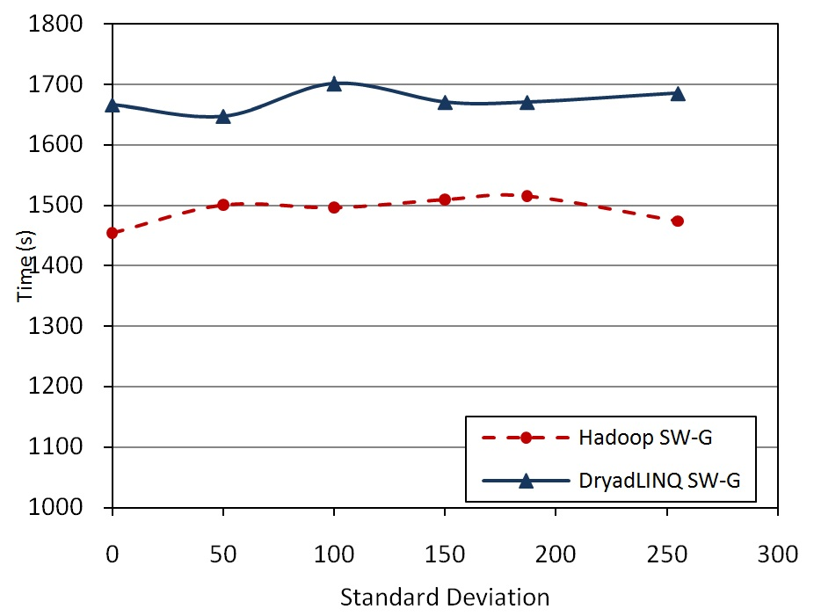
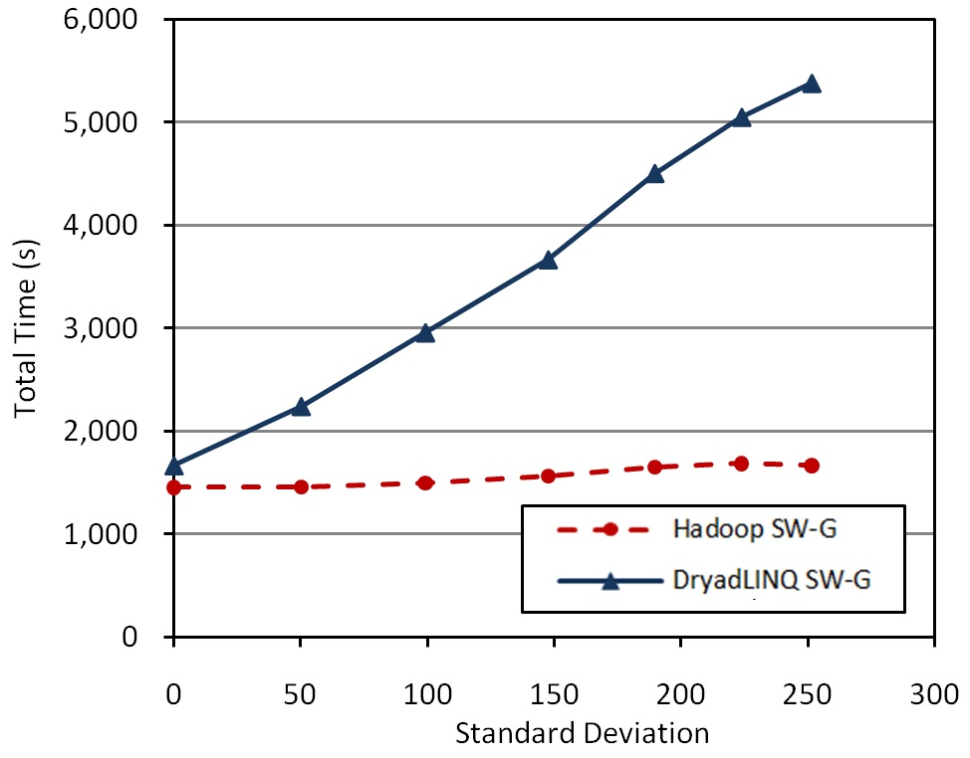
Inhomogeneous Data
Randomly Distributed
Skewed Distributed
Notes:
Performances of SW-G for skewed distributed inhomogeneous data with ‘400’ mean sequence length. Following normal distribution.
Each test contained 10000 sequences leading to 100 million pairwise distance calculations to perform.
We did the same for Cap3.
Dynamic scheduling load balances as long as there are multiple waves
Randomizing the data helps..

Slide 57
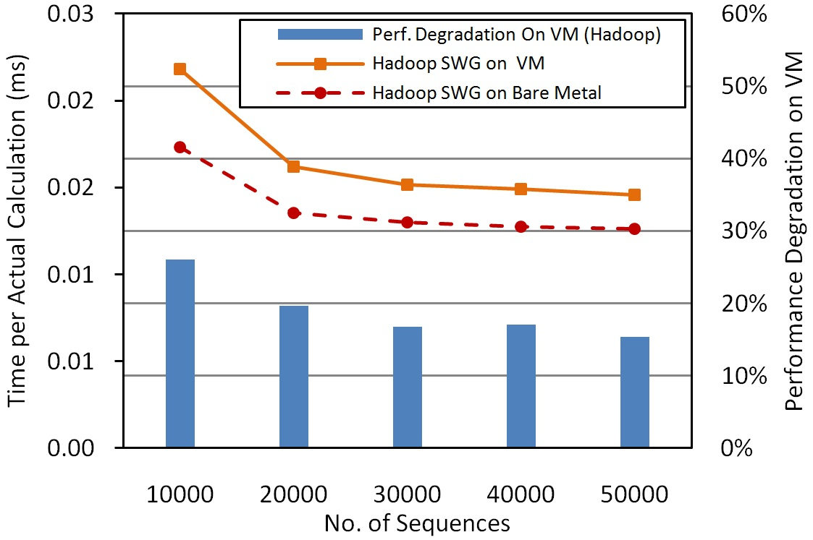
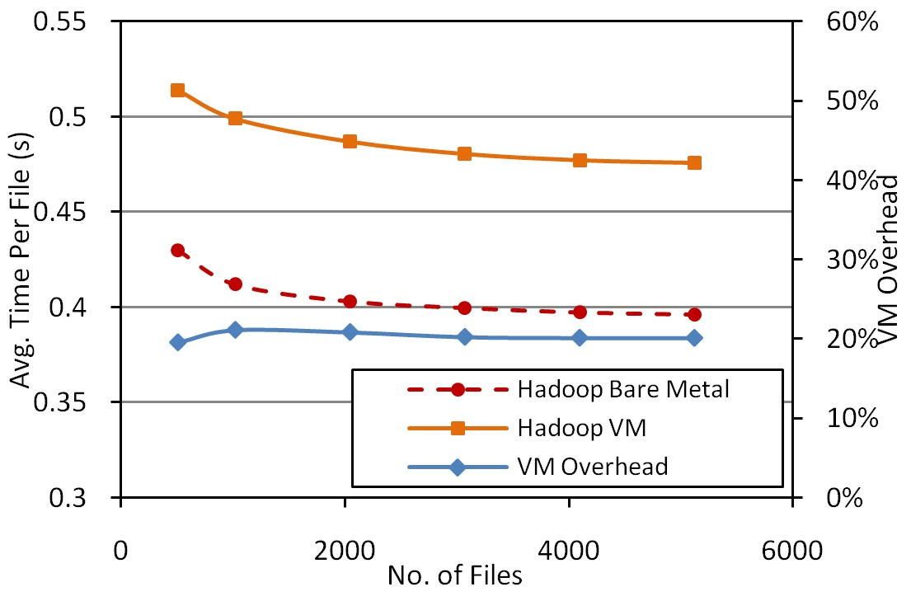
Virtualization Overhead
SWG
Cap3
Notes:
performance degradation for the Hadoop SWG application on a virtual environment ranges from 25% to 15%. Reduced with increased problem size.
number of blocks is kept constant across the test, resulting in larger blocks for larger data sets.
few coarser grained I/O and memory operations would incur relatively low overheads than doing the same work using many finer grained operations.
Cap3
Unlike in SWG, the I/O and memory behavior of the CAP3 program does not change based on the data set size, as irrespective of the data set size, the granularity of the processing (single file) remains same. Hence, the VM overheads do not get changed even with the increase of the workload.

Slide 58
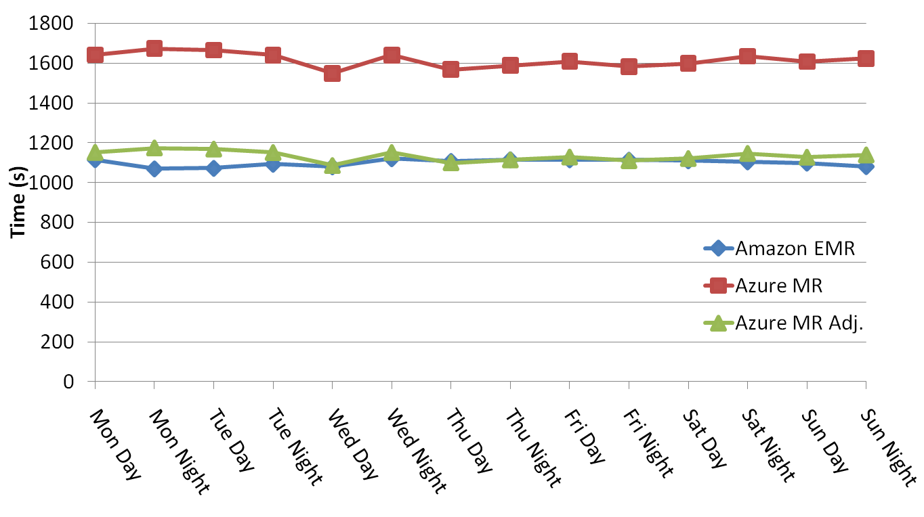
Sustained Performance of Clouds
Notes:
32 cores were used to align 4000 sequences. Each of these tests was performed at +/- 2 hours 12AM/PM. Figure 5 also includes the normalized performance for MRRoles4Azure, calculated using the EMR as the baseline. We are happy to report that the performance variations we observed were very minor, with standard deviations of 1.56% for EMR and 2.25% for MRRoles4Azure. Additionally, we did not notice any noticeable trends in performance fluctuation.

Slide 59
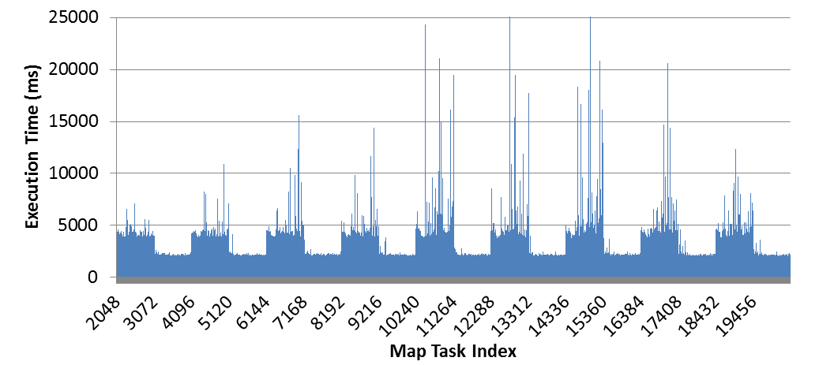
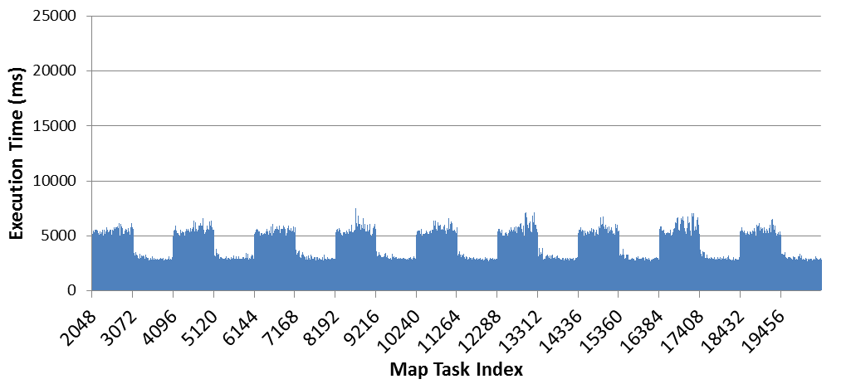
In-memory data caching on Azure instances
In-Memory Cache
Memory-Mapped File Cache
Notes:
Add description slides?
Execution traces of Twister4Azure MDS using in-memory caching on small instances. The taller bars represent the MDSBCCalc computation, while the shorter bars represent the MDSStressCalc computation, and together they represent an iteration.
Execution traces of Twister4Azure MDS using Memory-Mapped file based caching on Large instances.
(204800 * 204800 input data matrix, 128 total cores, 20 iterations. 20480 BCCalc map tasks)

Slide 60
Summary
&
Conclusions
Notes:
42 mins

Slide 61
Conclusions
Architecture, programming model and implementations to perform pleasingly parallel computations on cloud environments utilizing cloud infrastructure services.
Decentralized architecture and implementation to perform MapReduce computations on cloud environments utilizing cloud infrastructure services.
Decentralized architecture, programming model and implementation to perform iterative MapReduce computations on cloud environments utilizing cloud infrastructure services.
Map-Collectives collective communication primitives for iterative MapReduce
Notes:
In this thesis, we have investigated the applicability of cloud computing environments and related application frameworks to be able to perform large-scale data intensive parallel computations efficiently with good scalability, fault-tolerance and ease-of-use. Over the course of our work, we have acquired greater understanding about the challenges and bottlenecks involved in performing scalable data-intensive parallel computing on cloud environments; we have proposed solutions to overcome these potential obstacles. We selected pleasingly parallel computations, MapReduce type computations and iterative MapReduce type computations as the types of computations that are better suited for execution in cloud environments. We developed scalable parallel programming and computing frameworks specifically designed for cloud environments to support efficient, reliable and user friendly execution of the above three types of computations on cloud environments. Further, we developed data intensive applications using those frameworks, and demonstrated that these applications can be executed on cloud environments in an efficient scalable manner.
Use of high latency, eventually consistent cloud services together with off-instance cloud storage can cause significant overheads

Slide 62
Conclusions
Highly available, scalable decentralized iterative MapReduce architecture on eventual consistent services
More natural Iterative programming model extensions to MapReduce model
Collective communication primitives
Multi-level data caching for iterative computations
Decentralized low overhead cache aware task scheduling algorithm.
Data transfer improvements
  Hybrid with performance and fault-tolerance implications
  Broadcast, All-gather
Leveraging eventual consistent cloud services for large scale coordinated computations
Implementation of data mining and scientific applications for Azure cloud
Notes:
Performance comparison of applications in Clouds, VM environments and in bare metal.
Exploration of the effect of data inhomogeneity for different map reduce run times

Slide 63
Conclusions
Cloud infrastructure services provide users with scalable, highly-available alternatives, but without the burden of managing them
It is possible to build efficient, low overhead applications utilizing Cloud infrastructure services
The frameworks presented in this work offered good parallel efficiencies in almost all of the cases
“The cost effectiveness of cloud data centers, combined with the comparable performance reported here, suggests that large scale data intensive applications will be increasingly implemented on clouds, and that using MapReduce frameworks will offer convenient user interfaces with little overhead.”
Notes:
Use of high latency, eventually consistent cloud services together with off-instance cloud storage can cause significant overheads

Slide 64
Future Work
Extending Twister4Azure data caching capabilities to a general distributed caching framework.
  Coordination and sharing of cached data across the different instances
  Expose a general API to the data caching layer allowing utilization by other applications
Design domain specific language and workflow layers for iterative MapReduce
Map-ReduceScatter collective
  Modeled after MPI ReduceScatter
  Eg: PageRank
Explore ideal data models for the Map-Collectives model
Explore the development of cloud specific programming models to support some of the MPI type application patterns
Large scale real time stream processing in cloud environments
Large scale graph processing in cloud environments
Notes:
In this thesis, we presented Twister4Azure iterative MapReduce and Map-Collectives as solutions to perform scalable parallel computing in cloud environments. Several areas and directions exist through which we could build on f the foundation established by these frameworks.
If present, rather than downloading them from the cloud storage. Some use cases for this capability include the re-executions of failed tasks and the duplicate executions of straggling tasks. Further, we can expose a general API to the data caching layer, allowing applications other than Twister4Azure also to utilize the data caching layer. One option is to model this API as a distributed file system.
One option is to extend one of the existing MapReduce language layers such as Hive and Pig to support iterative MapReduce computations. We can also develop workflow layers on top of iterative Mapreduce to better compose the applications together; this would allow for a more richer and efficient data sharing (eg: share data stored in cache) process to occur between the applications.
There are iterative MapReduce applications where only a small subset of loop invariant data product is needed to process the subset of input data in a Map task. In such cases, it is inefficient to make all the loop invariant data available to such computations. In some of these applications, the size of the loop variant data is too large to fit into the memory and it can introduce communication and scalability bottlenecks as well. An example of such a computation is PageRank. The Map-ReduceScatter primitive can be modeled after MPI ReduceScatter to support such use cases in an optimized manner.
Given the relative novelty of the Big Data movement, cloud infrastructures and the MapReduce frameworks, there exist many more exciting topics to explore for future research work. Some of these examples include the large scale real time stream processing in cloud environments and large scale graph processing in cloud environments.

Slide 65
Thesis Related Publications
T. Gunarathne, T.-L. Wu, J. Y. Choi, S.-H. Bae, and J. Qiu, "Cloud computing paradigms for pleasingly parallel biomedical applications," Concurrency and Computation: Practice and Experience, 23: 2338–2354.
T. Gunarathne, T.-L. Wu, B. Zhang and J. Qiu, “Scalable Parallel Scientific Computing Using Twister4Azure”. Future Generation Computer Systems(FGCS), 2013 Volume 29, Issue 4, pp. 1035-1048.
J. Ekanayake, T. Gunarathne, and J. Qiu, "Cloud Technologies for Bioinformatics Applications" Parallel and Distributed Systems, IEEE Transactions on, vol. 22, pp. 998-1011, 2011.
T. Gunarathne, J. Qiu, and D.Gannon, “Towards a Collective Layer in the Big Data Stack”, 14th IEEE/ACM International Symposium on Cluster, Cloud and Grid Computing (CCGRID 2014). Chicago, USA. May 2014. (To be published)
T. Gunarathne, T.-L. Wu, B. Zhang and J. Qiu, “Portable Parallel Programming on Cloud and HPC: Scientific Applications of Twister4Azure”. 4th IEEE/ACM International Conference on Utility and Cloud Computing (UCC 2011). Melbourne, Australia. Dec 2011.
T. Gunarathne, T. L. Wu, J. Qiu, and G. C. Fox, "MapReduce in the Clouds for Science," presented at the 2nd International Conference on Cloud Computing, Indianapolis, Dec 2010.
T. Gunarathne, T.-L. Wu, J. Qiu, and G. Fox, "Cloud Computing Paradigms for Pleasingly Parallel Biomedical Applications," ECMLS workshop (HPDC 2010). ACM, 460-469. DOI=10.1145/1851476.1851544
Notes:
TODO: Fix the names

Slide 66
Other Selected Publications
T. Gunarathne (Advisor: G. C. Fox). “Scalable Parallel Computing on Clouds”. Doctoral Research Showcase at SC11. Seattle. Nov 2011
Thilina Gunarathne, Bimalee Salpitikorala, Arun Chauhan and Geoffrey Fox. Iterative Statistical Kernels on Contemporary GPUs. International Journal of Computational Science and Engineering (IJCSE).
Thilina Gunarathne, Bimalee Salpitikorala, Arun Chauhan and Geoffrey Fox. Optimizing OpenCL Kernels for Iterative Statistical Algorithms on GPUs. In Proceedings of the Second International Workshop on GPUs and Scientific Applications (GPUScA), Galveston Island, TX. Oct 2011.
Gunarathne, T., C. Herath, E. Chinthaka, and S. Marru, Experience with Adapting a WS-BPEL Runtime for eScience Workflows. The International Conference for High Performance Computing, Networking, Storage and Analysis (SC'09), Portland, OR, ACM Press, pp. 7,
J.Ekanayake, H.Li, B.Zhang, T.Gunarathne, S.Bae, J.Qiu, and G.Fox., "Twister: A Runtime for iterative MapReduce," Proceedings of the First International Workshop on MapReduce and its Applications of ACM HPDC 2010 conference June 20-25, 2010, Chicago, Illinois, 2010.
Jaiya Ekanayake, Thilina Gunarathne, Atilla S. Balkir, Geoffrey C. Fox, Christopher Poulain, Nelson Araujo, and Roger Barga, DryadLINQ for Scientific Analyses. 5th IEEE International Conference on e-Science, Oxford UK, 12/9-11/2009.
Judy Qiu, Jaliya Ekanayake, Thilina Gunarathne, et al.. Data Intensive Computing for Bioinformatics, Data Intensive Distributed Computing, Tevik Kosar, Editor. 2011, IGI Publishers.

Slide 67
Acknowledgements
My Advisors
  Prof.Geoffrey Fox
  Prof. Beth Plale
  Prof. David Leake
  Prof. Judy Qiu
Prof. Dennis Gannon, Prof. Arun Chauhan, Dr. Sanjiva Weerawarana
Microsoft for the Azure compute/storage grants
Persistent systems for the fellowship
Salsa group past and present colleagues
Suresh Marru and past colleagues of Extreme Lab
Sri Lankan community @ Bloomington
Customer Analytics Group @ KPMG (formerly Link Analytics)
My parents, Bimalee, Kaveen and the family

Slide 68
Thank You!

Slide 69
Backup Slides

Slide 70
Application Types
(a) Pleasingly Parallel
(b) Classic MapReduce
(c) Data Intensive Iterative Computations
(d) Loosely Synchronous
Input
Input
Iterations
Input
map
map
map
P_{ij}
reduce
reduce
Output
BLAST Analysis
Smith-Waterman Distances
Parametric sweeps
PolarGrid Matlab data analysis
Distributed search
Distributed sorting
Information retrieval
Expectation maximization clustering e.g. Kmeans
Linear Algebra
Multimensional Scaling
Page Rank
Many MPI scientific applications such as solving differential equations and particle dynamics
Slide from Geoffrey Fox Advances in Clouds and their application to Data Intensive problems University of Southern California Seminar February 24 2012
70
Notes:
Currently most of the cloud usage is for pleasingly parallel and MapReduce workloads..
MPI more low level interface..More flexible… but Makes things more complex.. Fault tolerance issues. More susceptible to jitter, etc…
Cloud : no guarantee things will deploy nearby..or communicaitpon time.
There are lot of applications that fall in between MR and MPI..
Iterative with map reduce is ineficient.. Programmer have to manually issue multiple MR jobs uisig drivers..
We believe there is a need to fill this gap and come up with solutions specifically designed for clouds, taking in to account the unique characteristis of clouds.

Slide 71
Feature | Programming Model | Data Storage | Communication | Scheduling & Load Balancing
Hadoop | MapReduce | HDFS | TCP | Data locality, Rack aware dynamic task scheduling through a global queue, natural load balancing
Dryad ^{[1]} | DAG based execution flows | Windows Shared directories | Shared Files/TCP pipes/ Shared memory FIFO | Data locality/ Network topology based run time graph optimizations, Static scheduling
Twister^{[2]} | Iterative MapReduce | Shared file system / Local disks | Content Distribution Network/Direct TCP | Data locality, based static scheduling
MPI | Variety of topologies | Shared file systems | Low latency communication channels | Available processing capabilities/ User controlled

Slide 72
Feature | Failure Handling | Monitoring | Language Support | Execution Environment
Hadoop | Re-execution of map and reduce tasks | Web based Monitoring UI, API | Java, Executables are supported via Hadoop Streaming, PigLatin | Linux cluster, Amazon Elastic MapReduce, Future Grid
Dryad^{[1]} | Re-execution of vertices |  | C# + LINQ (through DryadLINQ) | Windows HPCS cluster
Twister^{[2]} | Re-execution of iterations | API to monitor the progress of jobs | Java, Executable via Java wrappers | Linux Cluster, FutureGrid
MPI | Program level Check pointing | Minimal support for task level monitoring | C, C++, Fortran, Java, C# | Linux/Windows cluster

Slide 73
Iterative MapReduce Frameworks
Twister^{[1]}
  Map->Reduce->Combine->Broadcast
  Long running map tasks (data in memory)
  Centralized driver based, statically scheduled.
Daytona^{[3]}
  Iterative MapReduce on Azure using cloud services
  Architecture similar to Twister
Haloop^{[4]}
  On disk caching, Map/reduce input caching, reduce output caching
iMapReduce^{[5]}
  Async iterations, One to one map & reduce mapping, automatically joins loop-variant and invariant data
Notes:
iMapReduce, Twister -> single wave..
Iterative MapReduce: Haloop, Twister @IU, Spark
Map-Reduce-Merge: enable processing heterogeneous data sets
MapReduce online: online aggregation, and continuous queries

Slide 74
Other
Mate-EC2^{[6]}
  Local reduction object
Network Levitated Merge^{[7]}
  RDMA/infiniband based shuffle & merge
Asynchronous Algorithms in MapReduce^{[8]}
  Local & global reduce
MapReduce online^{[9]}
  online aggregation, and continuous queries
  Push data from Map to Reduce
Orchestra^{[10]}
  Data transfer improvements for MR
  Spark^{[11]}
  Distributed querying with working sets
CloudMapReduce^{[12]} & Google AppEngine MapReduce^{[13]}
  MapReduce frameworks utilizing cloud infrastructure services
Notes:
Orchestra : Broadcast and shuffle improvements…

Slide 75
Applications
Current Sample Applications
  Multidimensional Scaling
  KMeans Clustering
  PageRank
  SmithWatermann-GOTOH sequence alignment
  WordCount
  Cap3 sequence assembly
  Blast sequence search
  GTM & MDS interpolation
Under Development
  Latent Dirichlet Allocation
  Descendent Query

