Slide 1
Overview of Cloud Technologies and Parallel Programming Frameworks for Scientific Applications
Thilina Gunarathne
Indiana University

Slide 2
Trends
Massive data
Thousands to millions of cores
  Consolidated data centers
  Shift from clock rate battle to multicore to many core…
Cheap hardware
Failures are the norm
VM based systems
Making accessible (Easy to use)
  More people requiring large scale data processing
Shift from academia to industry..
Notes:
Hardware cheap – storage cost going down.

Slide 3
Moving towards..
Computing Clouds
  Cloud Infrastructure Services
  Cloud infrastructure software
Distributed File Systems
  HDFS, etc..
Distributed Key-Value stores
Data intensive parallel application frameworks
  MapReduce
  High level languages
Science in the clouds

Slide 4
Clouds & Cloud Services

Slide 5
Virtualization
Goals
  Server consolidation
  Co-located hosting & on demand provisioning
  Secure platforms (eg: sandboxing)
  Application mobility & server migration
  Multiple execution environments
  Saved images and Appliances, etc
Different virtualization techniques
  User mode Linux
  Pure virtualization (eg:Vmware)
    Hard till processor came up with virtualization extensions (hardware assisted virtualization)
  Para virtualization (eg: Xen)
    Modified guest OS’s
  Programming language virtual machines
Notes:
User mode Linuz: on top of the operating system and in the user-space.
Pure can be slow due to i86 not providing virtualization support…
Para needs to modify the geust OS to call VMM for some system calls, instead of the hardware.

Slide 6
Cloud Computing
On demand computational services over web
  Spiky compute needs of the scientists
Horizontal scaling with no additional cost
  Increased throughput
Public Clouds
  Amazon Web Services, Windows Azure, Google AppEngine, …
Private Cloud Infrastructure Software
  Eucalyptus, Nimbus, OpenNebula
Notes:
Horizontal scaling increase throughput – 100 hours in 10 nodes == 10 hours in 100 nodes
Virtually Unlimited resource availability
Amazon HPC instances – 250 in TOP500….
Cloud word == End-user neither knows or cares where exactly these VMs are phyiscally located or the configuration of the underlying hardware, so long as the they can access their bank of properly configured VM's..

Slide 7
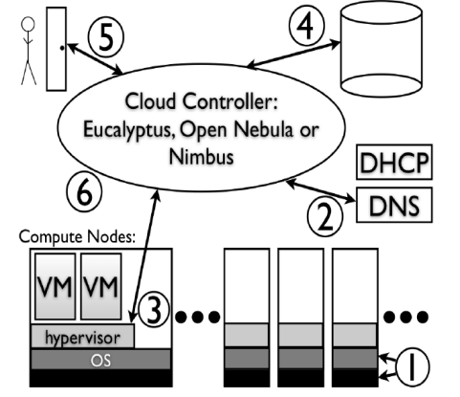
Cloud Infrastructure Software Stacks
Manage provisioning of virtual machines for a cloud providing infrastructure as a service
Coordinates many components
  Hardware and OS
  Network, DNS, DHCP
  VMM Hypervisor
  VM Image archives
  User front end, etc..
Peter Sempolinski and Douglas Thain, A Comparison and Critique of Eucalyptus, OpenNebula and Nimbus, CloudCom 2010, Indianapolis.
Notes:
* private clouds == cost effective for large organizations.
* role of the cloud control software is to coordinate all of following pieces and to provide sufficient abstraction so that user can simply request a VMs..
Hardware & OS (VM extended hardware, if not only para virtualization)
Network. DNS, DHCP.. Giving VM's virtual MAC addresses..
VMM Hypervisor... Xen, VMware, KVM,etc.. all use libvirt (facility to control start and stop of VMs)
Archive of VM Disk images.. One of the images is copied and prepared according to the hypervisor (Add swap, padding).
Front-end for users (eg: EC2 APIs)
cloud frameworks (euca, nimbus, opennebula) .. input from front-end -> retrieves disk images, signals VMM to setup VM, signals DHCP and IP briging programs to setup MAC and IP for VM..

Slide 8
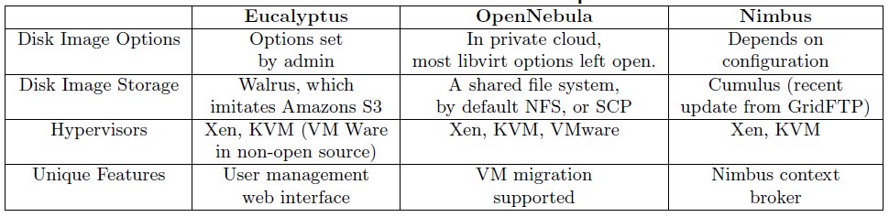
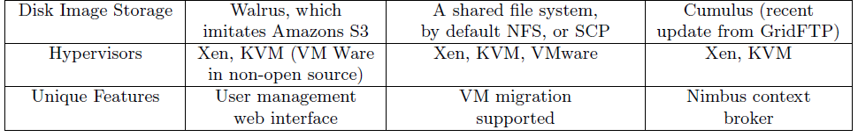
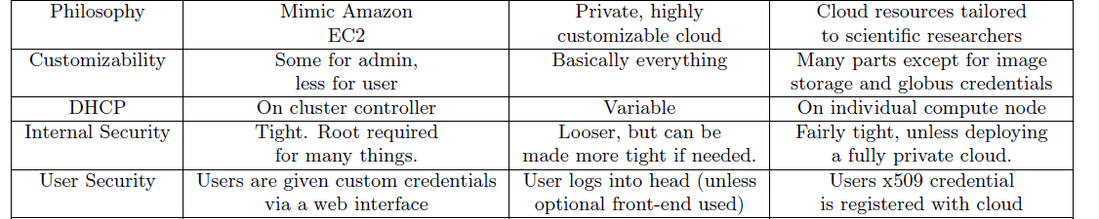
Cloud Infrastructure Software
Peter Sempolinski and Douglas Thain, A Comparison and Critique of Eucalyptus, OpenNebula and Nimbus, CloudCom 2010, Indianapolis.
Notes:
Nimbus Context broker : (one click virtual cluster)This is a service that allows clients to coordinate large virtual cluster launches automatically and repeatably.
Used to deploy "one-click" virtual clusters that function right after launch as opposed to launching a set of "unconnected" virtual machines like most VM-on-demand services give you. It also provides a facility to "personalize" VMs (seed them with secrets, access policies, and just-in-time configurations). This requires that the VMs run a lightweight script at boot time called the Context Agent.

Slide 9
Public Clouds & Services
Types of clouds
  Infrastructure as a Service (IaaS)
    Eg: Amazon EC2
  Platform as a Service (PaaS)
    Eg: Microsoft Azure, Google App Engine
  Software as a Service (SaaS)
    Eg: Salesforce
IaaS
PaaS
More Control/ Flexibility
Autonomous

Slide 10
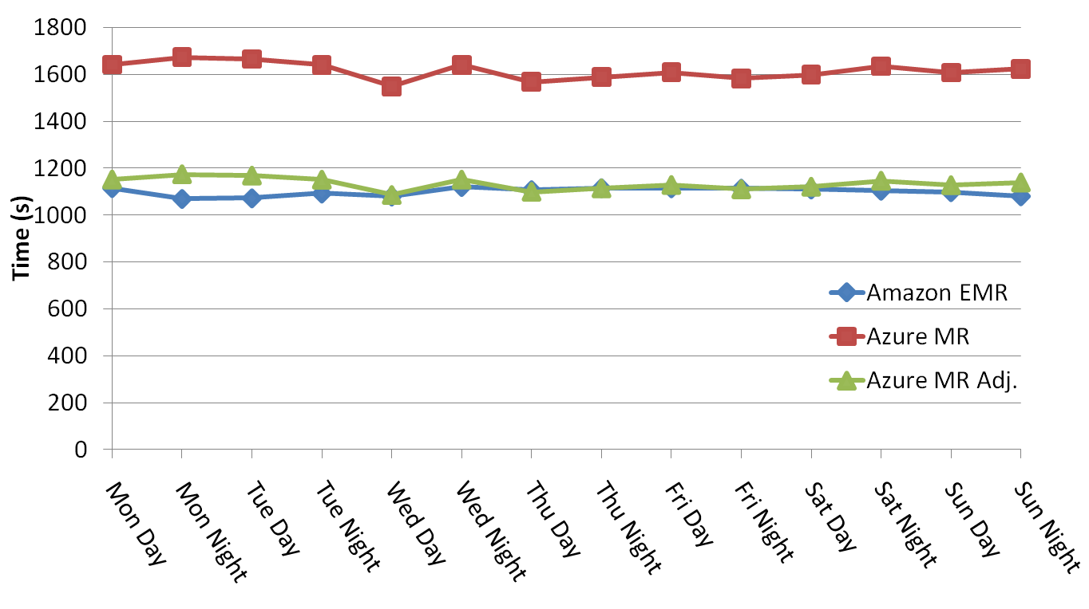
Sustained performance of clouds
Notes:
Not too much smaller communication. Less # of communiations..but large data transfer between maps & reduces.. Use storage too…
SWG - In these tests, 32 cores were used to align 4000 sequences.
Standard deviations of 1.56% for EMR and 2.25% for AzureMapReduce.

Slide 11
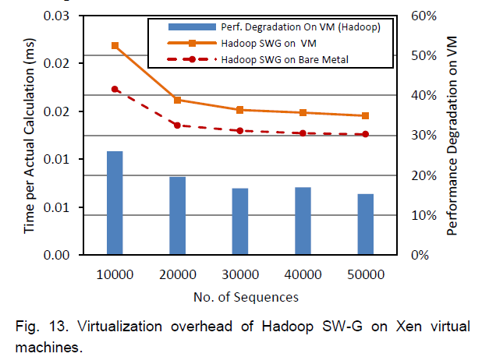
Virtualization Overhead for All Pairs Sequence Alignment
Notes:
Same machine, bare metal vs VM…

Slide 12
Cloud Infrastructure Services
Cloud infrastructure services
  Storage, messaging, tabular storage
Cloud oriented services guarantees
  Distributed, highly scalable & highly available, low latency
  Consistency tradeoff’s
Virtually unlimited scalability
Minimal management / maintenance overhead
Notes:
Distributed, highly scalable & highly available, low latency services, but eventual consistency..
Minimal management / maintenance overhead : eg: running mysql on cloud (unreliable…where to store data)
Reduced footprint

Slide 13
Amazon Web Services
Compute
  Elastic Compute Service (EC2)
  Elastic MapReduce
  Auto Scaling
Storage
  Simple Storage Service (S3)
  Elastic Block Store (EBS)
  AWS Import/Export
Messaging
  Simple Queue Service (SQS)
  Simple Notification Service (SNS)
Database
  SimpleDB
  Relational Database Service (RDS)
Content Delivery
  CloudFront
Networking
  Elastic Load Balancing
  Virtual Private Cloud
Monitoring
  CloudWatch
Workforce
  Mechanical Turk

Slide 14
Classic cloud architecture

Slide 15
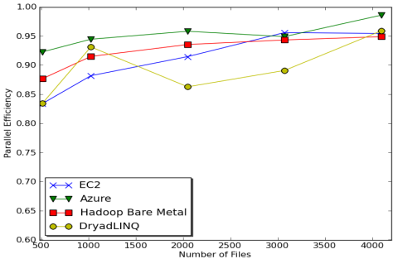
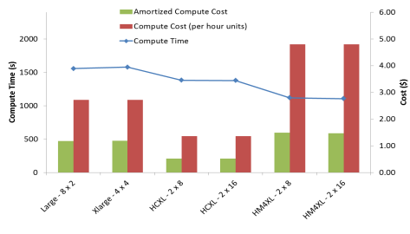
Sequence Assembly in the Clouds
Cost to assemble to process 4096 FASTA files
  Amazon AWS - 11.19$
  Azure - 15.77$
  Tempest (internal cluster) – 9.43$
    Amortized purchase price and maintenance cost, assume 70% utilization
Notes:
Amazon AWS total :11.19 $
Compute 1 hour X 16 HCXL (0.68$ * 16) = 10.88 $
10000 SQS messages = 0.01 $
Storage per 1GB per month = 0.15 $
Data transfer out per 1 GB = 0.15 $
Azure total : 15.77 $
Compute 1 hour X 128 small (0.12 $ * 128) = 15.36 $
10000 Queue messages = 0.01 $
Storage per 1GB per month = 0.15 $
Data transfer in/out per 1 GB = 0.10 $ + 0.15 $
Tempest (amortized) : 9.43 $
24 core X 32 nodes, 48 GB per node
Assumptions : 70% utilization, write

Slide 16
Distributed Data storage

Slide 17
Cloud Data Stores (NO-SQL)
Schema-less:
  No pre-defined schema.
  Records have a variable number of fields
Shared nothing architecture
  each server uses only its own local storage
  allows capacity to be increased by adding more nodes
  Cost is less (commodity hardware)
Elasticity
Sharding
Asynchronous replication
BASE instead of ACID
  Basically Available, Soft-state, Eventual consistency
http://nosqlpedia.com/wiki/Survey_distributed_databases
Notes:
Schema-less: “Tables” don’t have a pre-defined schema. Records have a variable number of fields that can vary from record to record. Record contents and semantics are enforced by applications.
Shared nothing architecture: Instead of using a common storage pool (e.g., SAN), each server uses only its own local storage. This allows storage to be accessed at local disk speeds instead of network speeds, and it allows capacity to be increased by adding more nodes. Cost is also reduced since commodity hardware can be used.
Elasticity: Both storage and server capacity can be added on-the-fly by merely adding more servers. No downtime is required. When a new node is added, the database begins giving it something to do and requests to fulfill.
Sharding: Instead of viewing the storage as a monolithic space, records are partitioned into shards. Usually, a shard is small enough to be managed by a single server, though shards are usually replicated. Sharding can be automatic (e.g., an existing shard splits when it gets too big), or applications can assist in data sharding by assigning each record a partition ID.
Asynchronous replication: Compared to RAID storage (mirroring and/or striping) or synchronous replication, NoSQL databases employ asynchronous replication. This allows writes to complete more quickly since they don’t depend on extra network traffic. One side effect of this strategy is that data is not immediately replicated and could be lost in certain windows. Also, locking is usually not available to protect all copies of a specific unit of data.
BASE instead of ACID: NoSQL databases emphasize performance and availability. This requires prioritizing the components of the CAP theorem (described elsewhere) that tends to make true ACID transactions implausible.
ACID (atomicity, consistency, isolation, durability)
MySQL > 50 GB Data
Writes Average: ~300 ms Reads Average: ~350 ms
Cassandra > 50 GB Data
Writes Average: 0.12 ms Reads Average: 15 ms
http://nosqlpedia.com/wiki/Survey_distributed_databases

Slide 18
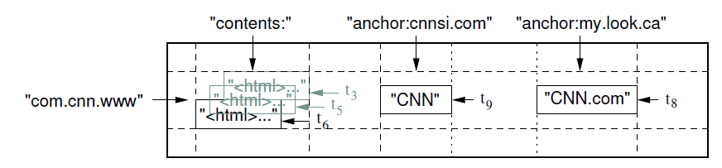
Google BigTable
Data Model
  A sparse, distributed, persistent multidimensional sorted map
  Indexed by a row key, column key, and a timestamp
  A table contains column families
  Column keys grouped in to column families
Row ranges are stored as tablets (Sharding)
Supports single row transactions
Use Chubby distributed lock service to manage masters and tablet locks
Based on GFS
Supports running Sawzal scripts and map reduce
Fay Chang, et. al. “Bigtable: A Distributed Storage System for Structured Data”.
Notes:
Linked client libraries, one master, many tablet servers
tablet server handles read and write requests to the tablets that it has loaded, and also splits tablets that have grown too large.
use GFS.. SStable file format internally. Single disk seek lookups using in-memory index.
Updates are committed to a commit log that stores redo records. Of these updates, the recently committed ones are stored in memory in a sorted buffer called a memtable;
Users tablet log and METADATA to recover tablets
Use Chubby to keep track of tablet servers and the master… Use chubby files as distributed locks… master lock and tablet locks…

Slide 19
Amazon Dynamo
Problem | Technique | Advantage
Partitioning | Consistent Hashing | Incremental Scalability
High Availability for writes | Vector clocks with reconciliation during reads | # of versions is decoupled from update rates.
Handling temporary failures | Sloppy Quorum and hinted handoff | Provides high availability and durability guarantee when some of the replicas are not available.
Recovering from permanent failures | Using Merkle trees | Synchronizes divergent replicas in the background.
Membership and failure detection | Gossip-based membership protocol and failure detection. | Preserves symmetry and avoids having a centralized registry for storing membership and node liveness information.
DeCandia, G., et al. 2007. Dynamo: Amazon's highly available key-value store. In Proceedings of Twenty-First ACM SIGOPS Symposium on Operating Systems Principles (Stevenson, Washington, USA, October 14 - 17, 2007). SOSP '07. ACM, 205-220. (pdf)
Notes:
Partitioning
Replication : virtual nodes..
Data versioning
Execution of get() & put()
Corrdinator node : who handles the read or write operation
Sloppy quorem : Minimum number of nodes for a write (W) and for a read (R)… Use first N healthy nodes to avoid delays
Hinted handoffs : when node A is down the data is sent to another node with a HINT A.. When A comes online, it’ll get to A…
Failure handling :
Handling permanent failures
When hinted handoff fails… Use Merkle trees o check inconsistencies(hash tree – leaves are hashes of values, parent of leaves are hashes of leaves…..) one tree for each virtual node…
Node addition, Admin manually adds or removes by loging in to a single node… Then it propogates info using gossip (eventual consistency)..
Failure detection : avoids if a node does not respond for some tiem… check back periodically...
Dynamo Vs BigTAble
Focus on applications that require only key/value access, with primary focus on high availability…Updates are not rejected even in the wake of network partition..
As oppose to BigTable…Sparse Multi-Dimensional sorted map…
High Speed (Dynamo) vs Large Data(Big Table)

Slide 20
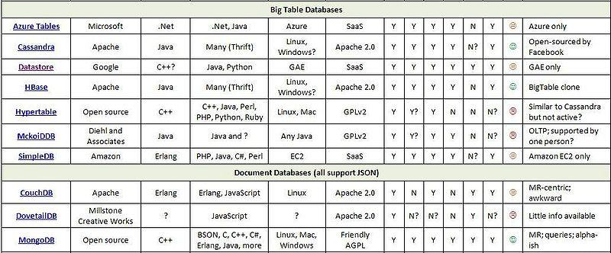
NO-Sql data stores
http://nosqlpedia.com/wiki/Survey_distributed_databases
Notes:
Document, vs key/value vs, graph data bases ??

Slide 21
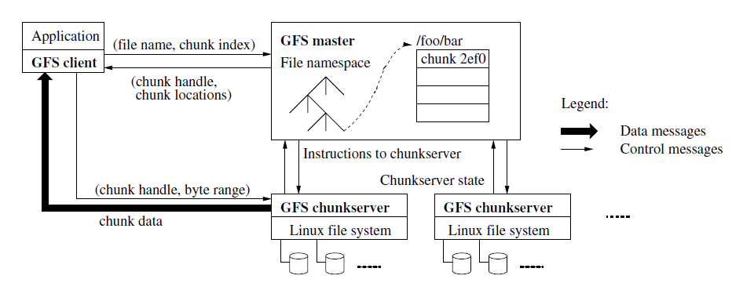
GFS
Notes:
Shadow masters : provide read only even when the master is down. Outside needs to come in to make a shadow a master.
Master: Metadata in-memory.. Refreshes each time it restarts…
Leases for mutating operations (append or a write)
Client send data to all the replicas, then send a commit message to master replica.,
Chunk version number to detect stale replicas…
Master once in a while chunkservers scans and verfies the chunks…

Slide 22
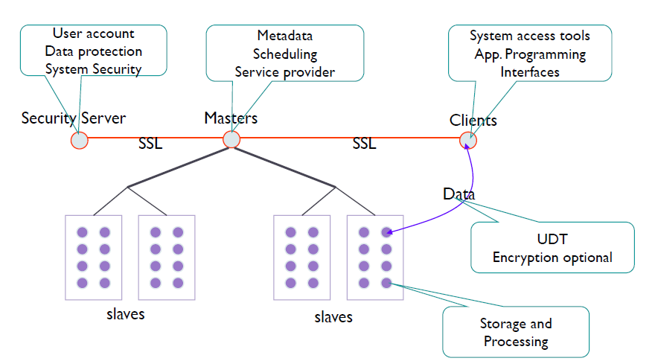
Sector

Slide 23
File System | GFS/HDFS | Lustre | Sector
Architecture | Cluster-based, asymmetric, parallel | Cluster based, Asymettric, Parallel | Cluster based, Asymettric, Parallel
Communication | RPC/TCP | Network Independence | UDT
Naming | Central metadata server | Central metadata server | Multiple Metadata Masters
Synchronization | Write-once-read-many, locks on object leases | Hybrid locking mechanism using leases, distributed lock manager | General purpose I/O
Consistency and replication | Server side replication, Async replication, checksum | Server side meta data replication, Client side caching, checksum | Server side replication
Fault Tolerance | Failure as norm | Failure as exception | Failure as norm
Security | N/A | Authentication, Authorization | Security server, based Authentication, Authorization
Notes:
Architecture : client-server (eg: NFS), cluster based distributed (GFS), Symmetric (DHT based, clients handle meta data too), Asymmetric (One or more dedicated meta data nodes), Parallel (data stripped across nodes, allow parallel apps to access files parallely)
Processes : Statefull or stateless
Commmunication : RPC using TCP or UDP, Network Independence(Luster provide network abstraction layer supporting heterogeneuous networks)
Naming: central metadata sever ( manages the files namespace), meta-data distributed in all nodes.... (aggregation of logical path name == distributed namespace)
Synchronization : Unix semantics, session semantics, immutable semantics, transactions.....
File locking systems (give locking to clients, perf by caching in clients and leases), or perform all ops in the server synchronously..... Hybrid system in Lustre, chosen depending on the resource contension
Write once- read many (most systems), many producer-single customer (eg: GFS)..
Consistency and replication : Checksum....
client-side caching, server-side replication
Meta-data replication (backup meta-data servers, snapshot with logs)
Data object replication : (luster, panasas assume data is available as long as physical device is available- consider failure as an exception, but Lustre do RAID0 too), GFS & etc consider failure as the norm
Lustre:TCP,INFINIBAND,ETC
Sector : user space (relies on local file systems to store files), file based (vs block) causing size limitations,

Slide 24
Data intensive Parallel processing frameworks

Slide 25
MapReduce
General purpose massive data analysis in brittle environments
  Commodity clusters
  Clouds
Efficiency, Scalability, Redundancy, Load Balance, Fault Tolerance
Apache Hadoop
  HDFS
Microsoft DryadLINQ
Notes:
Even thought the concept was there in PL & DB world, the use of MapReduce model for large parallel data processing was introduced by Google.
A MapReduce framework divides the input data in to parts, process them in parallel using a ‘Map’ function and then collect/combine the processed data using a ‘Reduce’ function.
Simple interface to the programmers. Use sequential Map & Reduce functions for massively parallel computations.
Fault tolerance.
Implementations support:
Splitting of data
Passing the output of map functions to reduce functions
Sorting the inputs to the reduce function based on the intermediate keys
Quality of services

Slide 26
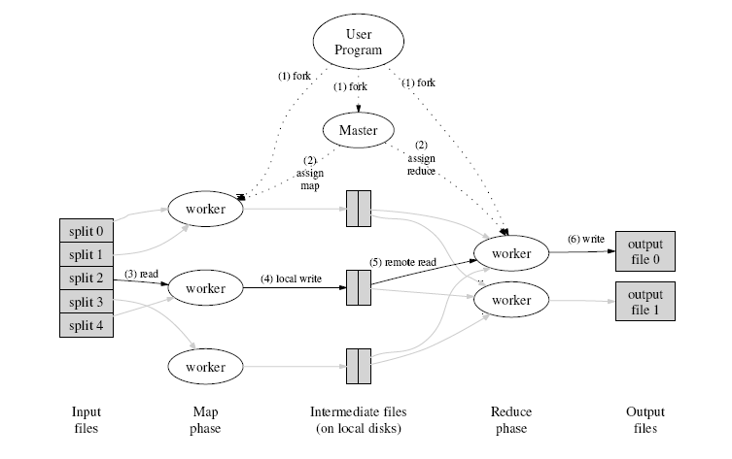
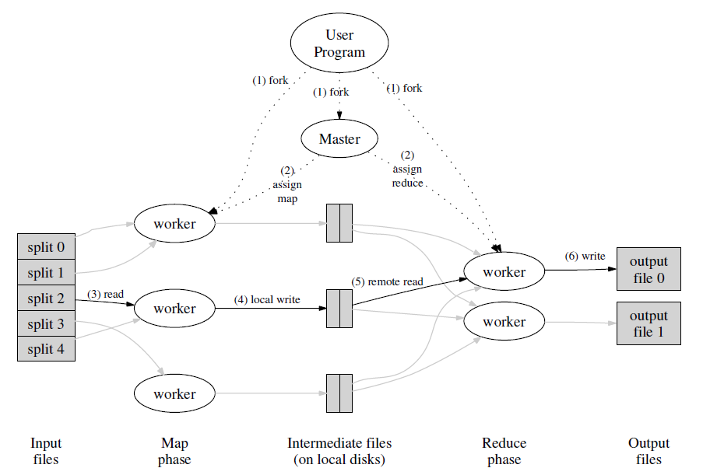
Execution Overview
Source: http://code.google.com/edu/parallel/mapreduce-tutorial.html
Notes:
The MapReduce library in the user program first shards the input files into M pieces of typically 16 megabytes to 64 megabytes (MB) per piece. It then starts up many copies of the program on a cluster of machines.
One of the copies of the program is special: the master. The rest are workers that are assigned work by the master. There are M map tasks and R reduce tasks to assign. The master picks idle workers and assigns each one a map task or a reduce task.
A worker who is assigned a map task reads the contents of the corresponding input shard. It parses key/value pairs out of the input data and passes each pair to the user-defined Map function. The intermediate key/value pairs produced by the Map function are buffered in memory.
Periodically, the buffered pairs are written to local disk, partitioned into R regions by the partitioning function. The locations of these buffered pairs on the local disk are passed back to the master, who is responsible for forwarding these locations to the reduce workers.
When a reduce worker is notified by the master about these locations, it uses remote procedure calls to read the buffered data from the local disks of the map workers. When a reduce worker has read all intermediate data, it sorts it by the intermediate keys so that all occurrences of the same key are grouped together. If the amount of intermediate data is too large to fit in memory, an external sort is used.
The reduce worker iterates over the sorted intermediate data and for each unique intermediate key encountered, it passes the key and the corresponding set of intermediate values to the user's Reduce function. The output of the Reduce function is appended to a final output file for this reduce partition.
When all map tasks and reduce tasks have been completed, the master wakes up the user program. At this point, the MapReduce call in the user program returns back to the user code.

Slide 27
Word Count
Input
Mapping
Shuffling
Reducing
foo, 1
car, 1
bar, 1
foo, 1
foo, 1
foo, 1
foo, 3
foo car bar
foo bar foo
car car car
foo, 1
bar, 1
foo, 1
bar, 1
bar, 1
bar, 2
car, 1
car, 1
car, 1
car, 1
car, 1
car, 1
car,1
car, 4
Notes:
Represent the resulting data products.

Slide 28
Word Count
Input
Mapping
Shuffling
Sorting
Reducing
foo, 1
car, 1
bar, 1
foo,1
car,1
bar, 1
foo, 1
bar, 1
foo, 1
car, 1
car, 1
car, 1
foo car bar
foo bar foo
car car car
foo, 1
bar, 1
foo, 1
bar,<1,1>
car,<1,1,1,1>
foo,<1,1,1>
bar,2
car,4
foo,3
car, 1
car, 1
car, 1

Slide 29

Hadoop & DryadLINQ
Apache Hadoop
Microsoft DryadLINQ
Master Node
Data/Compute Nodes
Standard LINQ operations
Job
Tracker
M
M
M
M
DryadLINQ operations
R
R
R
R
DryadLINQ Compiler
Name
Node
HDFS
Data
blocks
Directed Acyclic Graph (DAG) based execution flows
1
2
Vertex :
execution task
2
3
3
4
Edge :
communication path
Dryad Execution Engine
Apache Implementation of Google’s MapReduce
Hadoop Distributed File System (HDFS) manage data
Map/Reduce tasks are scheduled based on data locality in HDFS (replicated data blocks)
Dryad process the DAG executing vertices on compute clusters
LINQ provides a query interface for structured data
Provide Hash, Range, and Round-Robin partition patterns
  Job creation; Resource management; Fault tolerance& re-execution of failed taskes/vertices
Judy Qiu Cloud Technologies and Their Applications Indiana University Bloomington March 26 2010

Slide 30
Feature | Programming Model | Data Storage | Communication | Scheduling & Load Balancing
Hadoop | MapReduce | HDFS | TCP | Data locality, Rack aware dynamic task scheduling through a global queue, natural load balancing
Dryad | DAG based execution flows | Windows Shared directories (Cosmos) | Shared Files/TCP pipes/ Shared memory FIFO | Data locality/ Network topology based run time graph optimizations, Static scheduling
Twister | Iterative MapReduce | Shared file system / Local disks | Content Distribution Network/Direct TCP | Data locality, based static scheduling
MapReduceRole4Azure | MapReduce | Azure Blob Storage | TCP through Azure Blob Storage/ (Direct TCP) | Dynamic scheduling through a global queue, Good natural load balancing
MPI | Variety of topologies | Shared file systems | Low latency communication channels | Available processing capabilities/ User controlled

Slide 31
Feature | Failure Handling | Monitoring | Language Support
Hadoop | Re-execution of map and reduce tasks | Web based Monitoring UI, API | Java, Executables are supported via Hadoop Streaming, PigLatin | Linux cluster, Amazon Elastic MapReduce, Future Grid
Dryad | Re-execution of vertices | Monitoring support for execution graphs | C# + LINQ (through DryadLINQ) | Windows HPCS cluster
Twister | Re-execution of iterations | API to monitor the progress of jobs | Java, Executable via Java wrappers | Linux Cluster, FutureGrid
MapReduceRoles4Azure | Re-execution of map and reduce tasks | API, Web based monitoring UI | C# | Window Azure Compute, Windows Azure Local Development Fabric
MPI | Program level Check pointing | Minimal support for task level monitoring | C, C++, Fortran, Java, C# | Linux/Windows cluster
Adapted from Judy Qiu, Jaliya Ekanayake, Thilina Gunarathne, et al, Data Intensive Computing for Bioinformatics , to be published as a book chapter.

Slide 32
Inhomogeneous Data Performance
Inhomogeneity of data does not have a significant effect when the sequence lengths are randomly distributed
Dryad with Windows HPCS compared to Hadoop with Linux RHEL on Idataplex (32 nodes)

Slide 33
Inhomogeneous Data Performance
This shows the natural load balancing of Hadoop MR dynamic task assignment using a global pipe line in contrast to the DryadLinq static assignment
Dryad with Windows HPCS compared to Hadoop with Linux RHEL on Idataplex (32 nodes)

Slide 34
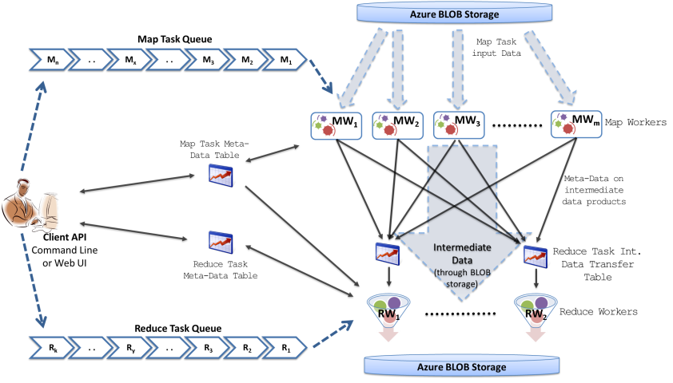
MapReduceRoles4Azure
Notes:
Dealing with eventual consitency…

Slide 35
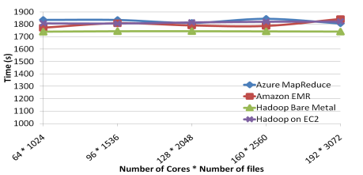
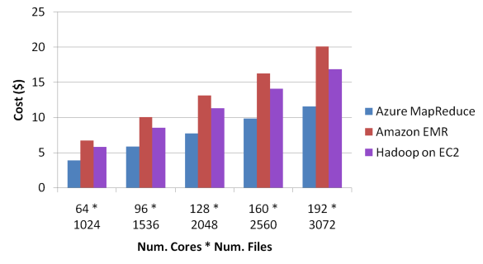
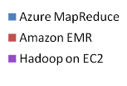
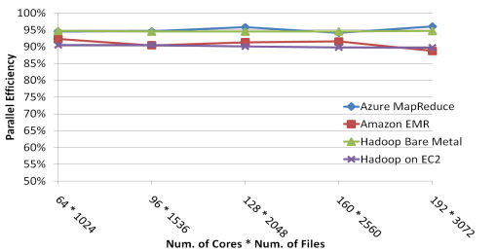
Sequence Assembly Performance

Slide 36
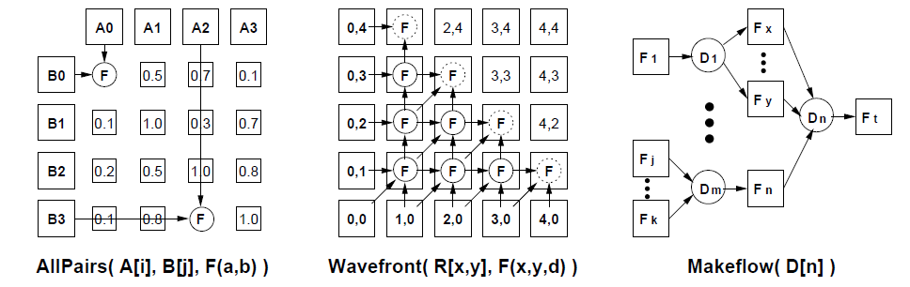
Other Abstractions
Other abstractions..
  All-pairs
  DAG
  Wavefront

Slide 37
Applications

Slide 38
Application Categories
Synchronous
  Easiest to parallelize. Eg: SIMD
Asynchronous
  Evolve dynamically in time and different evolution algorithms.
Loosely Synchronous
  Middle ground. Dynamically evolving members, synchronized now and then. Eg: IterativeMapReduce
Pleasingly Parallel
Meta problems
GC Fox, et al. Parallel Computing Works. http://www.netlib.org/utk/lsi/pcwLSI/text/node25.html#props
Notes:
synchronous systems consist of more or less identical members which evolve synchronously with identical time evolution algorithms.
Asynchronous complex systems contain, disparate members which evolve dynamically in time with changing interconnect and usually different evolution algorithms for each member. This corresponds to a general distributed-memory MIMD machine with each node typically executing distinct programs and with varying and unsynchronized internode message traffic.
Loosely synchronous complex systems are an important intermediate case between asynchronous and synchronous systems. They have generally disparate members evolving with possibly different temporal algorithms. However, they are synchronized ``every now and then''; typically at the end of an iteration or time step in a solution. The majority of large scale scientific and engineering computations are synchronous or loosely synchronous as exemplified by the contents of this book.

Slide 39
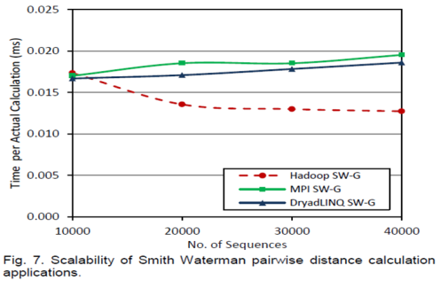
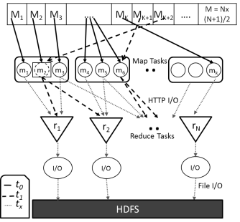
Applications
BioInformatics
  Sequence Alignment
    SmithWaterman-GOTOH All-pairs alignment
  Sequence Assembly
    Cap3
    CloudBurst
Data mining
  MDS, GTM & Interpolations

Slide 40
Workflows
Represent and manage complex distributed scientific computations
  Composition and representation
  Mapping to resources (data as well as compute)
  Execution and provenance capturing
Type of workflows
  Sequence of tasks, DAGs, cyclic graphs, hierarchical workflows (workflows of workflows)
  Data Flows vs Control flows
  Interactive workflows

Slide 41
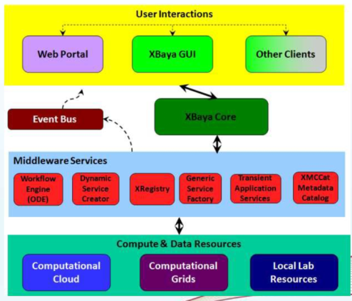
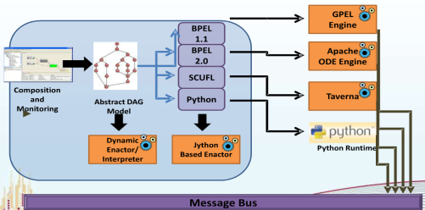
LEAD – Linked Environments for Dynamic Discovery
Based on WS-BPEL and SOA infrastructure

Slide 42
Pegasus and DAGMan
Pegasus
  Resource, data discovery
  Mapping computation to resources
  Orchestrate data transfers
  Publish results
  Graph optimizations
DAGMAN
  Submits tasks to execution resources
  Monitor the execution
  Retries in case of failure
  Maintain dependencies

Slide 43
Conclusion
Scientific analysis is moving more and more towards Clouds and related technologies
Lot of cutting-edge technologies out in the industry which we can use to facilitate data intensive computing.
Motivation
  Developing easy-to-use efficient software frameworks to facilitate data intensive computing

Slide 44
Thank You !!!

Slide 45
Backup SlIDES

Slide 46
Background
Web services – Apache Axis2, Kandula, Axiom
Workflows – BPELMora, WSO2 Mashup Server
Large scale E-Science workflows
  LEAD & LEAD in ODE
MapReduce
  Implemented Applications
  Benchmark DryadLINQ, Hadoop, Twister.
  Inhomogeneous studies.
MapReduceRoles 4 Azure
MSR internship
  Disk drive failure prediction
  Data center cooling
IBM internship
  UI integrated workflows

Slide 47
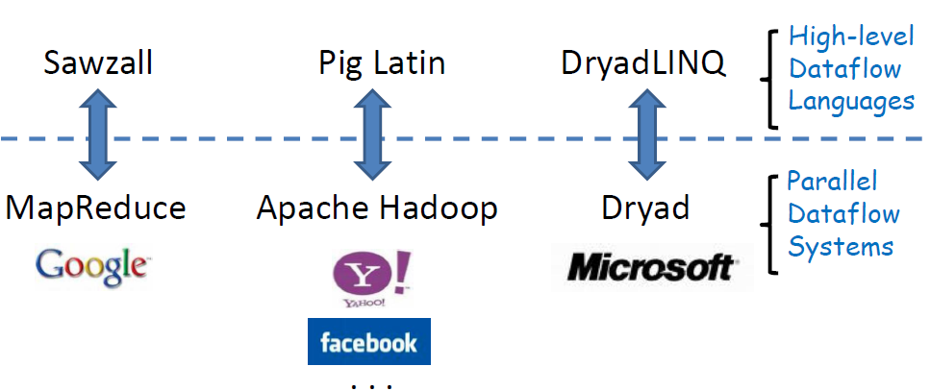
High-level parallel data processing languages
More transparent program structure
Easier development and maintenance
Automatic optimization opportunities
http://www.systems.ethz.ch/education/past-courses/hs08/map-reduce/slides/pig.pdf

Slide 48
Comparison
Language | Sawzall | Pig Latin | DryadLINQ
Programming | Imperative | Imperative | Imperative & Declarative Hybrid
Resemblance to SQL | Least | Moderate | Most
Execution Engine | Google MapReduce | Apache Hadoop | Microsoft Dryad
Implementation | Open Source (MapReduce internal) | Open Source Apache-License | Internal, inside Microsoft
Model | Operate per record Protocol Buffer | Sequence of MR Atom, Tuple, Bag, Map | DAGs .net data types
Usage | Log Analysis | + Machine Learning | + Iterative computations
http://www.cs.uiuc.edu/class/sp09/cs525/CC1.ppt
Notes:
HIVE?
Hive : Database/data ware house on Hadoop. Rich data types, Efficient implementations of SQL filters, joins, and group-by.
SQL support - Join, group-by, sampling, multi-table insert.
Structured data with rich data types.
allows embedded scripts..
Rich meta-data for discovery and optimization
Stored in SQL backend
table schema, table location in hdfs, partitioning information.
Less efficient (slow) but scalable...
Schemas using primitive types.

Slide 49
For AI
To implement and execute AI algorithms
To help automating frameworks in decision making..

Slide 50
Cloud Computing Definition
Definition of cloud computing from Cloud Computing and Grid Computing 360-Degree compared:
  A large-scale distributed computing paradigm that is driven by economies of scale, in which a pool of abstracted, virtualized, dynamically-scalable, managed computing power, storage, platforms, and services are delivered on demand to external customers over the Internet.

Slide 51
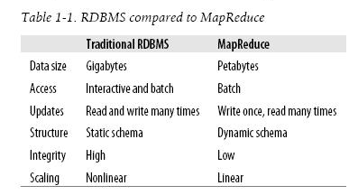
MapReduce vs RDBMS
http://fabless.livejournal.com/255308.html

Slide 52
ACID vs BASE
ACID  Strong consistency  Isolation  Focus on “commit”  Nested transactions  Availability?  Conservative (pessimistic)  Difficult evolution (e.g. schema) | BASE  Weak consistency – stale data OK  Availability first  Best effort  Approximate answers OK  Aggressive (optimistic)  Simpler!  Faster  Easier evolution
Notes:
ACID
 Strong consistency
 Isolation
 Focus on “commit”
 Nested transactions
 Availability?
 Conservative
(pessimistic)
 Difficult evolution
(e.g. schema)
BASE
 Weak consistency
– stale data OK
 Availability first
 Best effort
 Approximate answers OK
 Aggressive (optimistic)
 Simpler!
 Faster
 Easier evolution
NO-SQL - less latency and high availability at the cost of consistency. (replication)
(SimpleDB supporting consistent reads, with higher latency, lower read throughput. Also conditional put/delete)

Slide 53
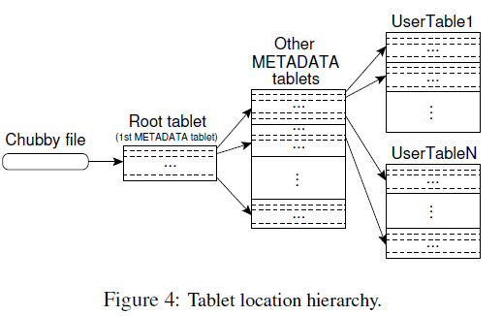
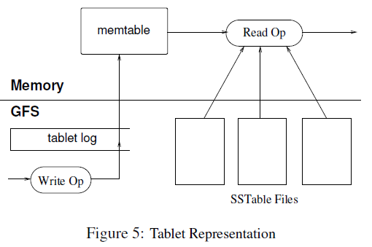
Big Table cnt.

