Slide 1
VBS-Lustre: A Distributed Block Storage System for Cloud Infrastructure
Xiaoming Gao, gao4@indiana.edu
Yu Ma, yuma@indiana.edu
Marlon Pierce, mpierce@cs.indiana.edu
Mike Lowe, jomlowe@iupui.edu
Geoffrey Fox, gcf@indiana.edu

Slide 2
Outline
Introduction to VBS and VBS-Lustre
The Lustre file system
VBS-Lustre architecture
Workflows
Security and access control
Read-only volume sharing
Preliminary performance test
Future work

Slide 3
Introduction - VBS
The Virtual Block Store (VBS) system is a block storage system that provide persistent virtual volumes to virtual machines in clouds.
Similar functionality to Amazon Elastic Block Store (EBS): volume/snapshot creation and deletion, volume attachment and detachment
VBS
Cloud environment
Snapshot s
/lost+found
/etc
/usr
…
LV1
Attachment
VM 1
VM 2
….
LV2
Attachment
….
LV: logical volume
VM: virtual machine
Snapshot: a static “copy” of a logical volume at a specific time point

Slide 4
Introduction – VBS architecture
LVM
iSCSI
Volume Server
iSCSI
LVM: Logical Volume Manager
iSCSI: internet SCSI protocol
VBD: Virtual Block Device
VM: Virtual Machine
VMM: Virtual Machine Manager
Vol 1
Vol 2
VBD
VBD
……
VM 1
VM 2
VMM1
VMM 2
Single point of failure on volume server
Not scalable
Solution: VBS-Lustre

Slide 5
Lustre file system
Developed by Oracle and Sun
Scale to petabytes of storage and hundreds of gigabytes of I/O throughput
(Picture from the Lustre white paper 2008)

Slide 6
VBS-Lustre architecture
VBS-Lustre Web Services
Virtual Machine Manager (VMM) Nodes as Lustre Clients
Lustre File System

Slide 7
VBS-Lustre architecture
Client
: Data transmission
: Invocation
Volume Metadata Database
VM: Virtual Machine
VMM: Virtual Machine Manager
VBD: Virtual Block Device
MDS: Metadata Server
OSS: Object Storage Server
VBSLustre
Service
VM
Volume Delegate
Volume Delegate
VM
VBD
VBD
……
Vol 1
VMM Delegate
Vol 2
VMM Delegate
VMM Lustre Client
VMM Lustre Client
Lustre servers
File 1
Obj 1
File 1
Obj 2
File 1
Obj n
File 2
Obj 1
……
File 2
Obj m
MDS
OSS
OSS
OSS

Slide 8
Workflows – create and describe volume
Volume Delegate
VBSLustre Service
Client
Create-volume
Check available space
Update metadata
Volume Information
Create_volume
“dd” or “cp”
Update_volume_status
Update metadata
Describe-volumes
Query Metadata
Volume Information

Slide 9
Workflows – attach volume
VMM Delegate
VBSLustre Service
Client
Attach-volume
Check metadata
Attach_volume
“xm block-attach”
Update metadata
Attachment Information

Slide 10
Security and access control
Web service accesses protected with HTTPS channels
Public key user authentication: users only allowed to access their own volumes
New accounts created by adding new users’ certificates to services’ trusted certificate store

Slide 11
Read-only volume sharing
Definition: attaching one volume to multiple VM instances in read-only mode at the same time.
Common data
results
results
results
results
VM 0
VM 1
VM 2
VM 3
…

Slide 12
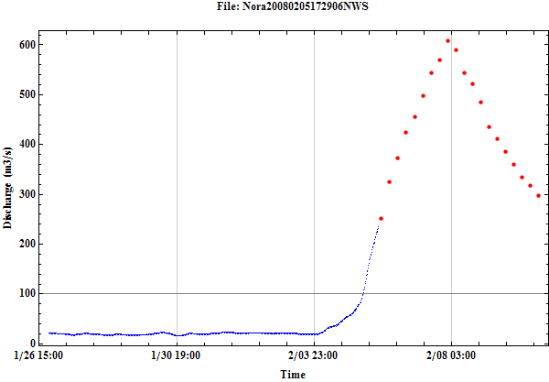
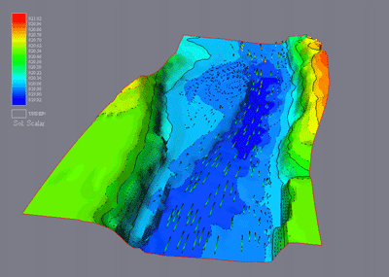
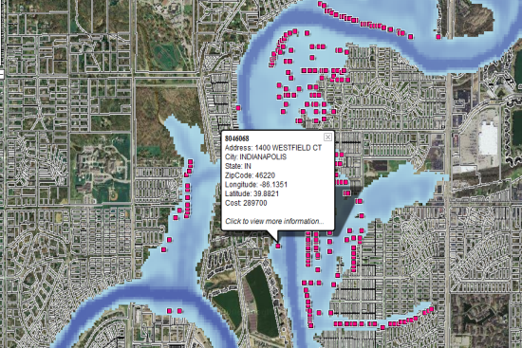
Experience with FloodGrid
FloodGrid: an integrated platform for inundation modeling, property loss estimation, and visual presentation.
Flood Monitoring
Flood Simulation Service
Flood Damage Estimation
Flood Damage Visualization
Flood Scenarios

Slide 13
Experience with FloodGrid
Shared volume
Private volumes
Simulation program,
Flood scenarios
results
results
results
results
Simulation service
Simulation service
Simulation service
Simulation service
VM1
VM2
VM3
VM4
Analysis for 10 flood scenarios takes 205 minutes; in comparison, it takes 739 minutes if only 1 VM is used.

Slide 14
Preliminary performance tests
VBS-Lustre servers
OST 1
OST 2
……
……
OST 3
OST 4
MDS
OSS 1
OSS 2
OSS 3
OSS 4
Vol 1
Vol 2
VM 1
VM 2
VMM1
VBS-Lustre test configuration
VMM 2
MDS: 4 * Intel Xeon 2.8G CPU, 512MB, and 2 * 147GB 10K RPM.
OSS and VMM: 2 * AMD Opteron 2.52G CPU, 2GB, and 1 * 73GB 10K RPM.
VM: 1 * AMD Opteron 2.52G CPU, 256MB, and a 4GB disk image.
Volume size: 5GB.
All nodes connected to a 1Gb Ethernet LAN.

Slide 15
Preliminary performance tests
Vol 1
Volume Server
Vol 2
VM 1
VM 2
VMM1
VBS test configuration
VMM 2
VM 1
VM 2
VMM1
VMM 2
Local volume test configuration

Slide 16
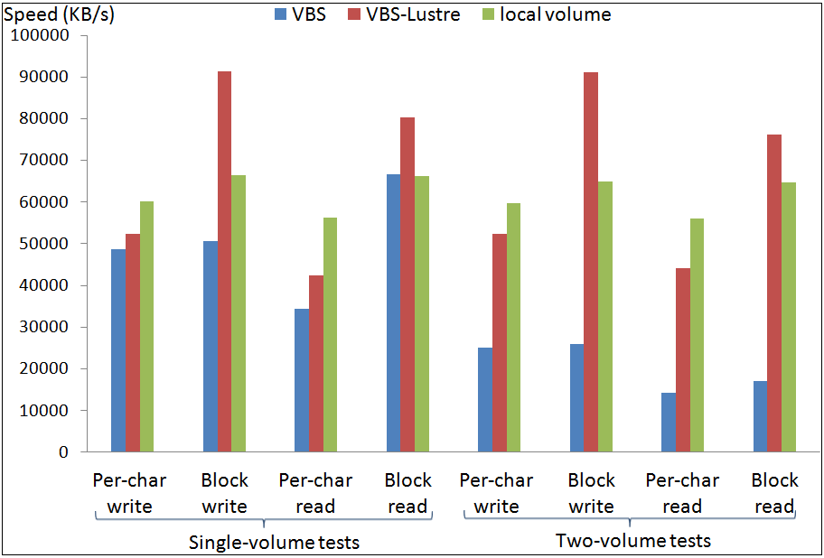
Preliminary performance test
I/O throughput tests done with Bonnie++

Slide 17
Preliminary performance test
VBS-Lustre metadata performance (files/s)
Test type | Sequential create | Random create | Random delete
single-volume | 6629 | 6654 | 23211
two-volume VM1 | 6510 | 6724 | 23312
two-volume VM2 | 6565 | 6771 | 23274
two-volume Aggregate | 13075 | 13495 | 46586

Slide 18
Future work
Larger scale tests using data capacitor
More efficient volume and snapshot creation
Accommodate commodity hardware: using Distributed Replicated Block Device (DRBD) and Hadoop Distributed File System (HDFS)?
Address issues with Lustre, such as metadata maintenance and small file access.

Slide 19
References
[1] X. Gao, M. Lowe, Y. Ma, M. Pierce, "Supporting Cloud Computing with the Virtual Block Store System", Proceedings of e-Science 2009, Oxford, UK, Dec. 2009.
[2] Amazon EBS, http://aws.amazon.com/ebs/
[3] Lustre file system white paper, Oct. 2008.
[4] Yang, R., "Flood Grid" The 2009 International Symposium on Collaborative Technologies and Systems (CTS 2009) , Baltimore, MD, 05/2009.
[5] bonnie++ http://www.coker.com.au/bonnie++/.
[6] LVM, http://tldp.org/HOWTO/LVM-HOWTO/.
[7] The iSCSI protocol, http://tools.ietf.org/html/rfc3720.
[8] The VBD technology of Xen, http://www.xen.org/.
[9] Eucalyptus, http://open.eucalyptus.com/.
[10] DRBD, http://www.drbd.org/.
[11] The Hadoop Distributed File System, http://hadoop.apache.org/hdfs/

Slide 20
Questions?

