Slide 1
Future Grid
Introduction
April 5 2010
www.futuregrid.org
MAGIC Meeting
Gregor von Laszewski
laszewski@gmail.com
Community Grids Laboratory,
Digital Science Center
Pervasive Technology Institute
Indiana University

Slide 2
FutureGrid Goals
Support the research on the future of distributed, grid, and cloud computing.
Build a robustly managed simulation environment or testbed to support the development and early use in science of new technologies at all levels of the software stack: from networking to middleware to scientific applications.
Mimic TeraGrid and/or general parallel and distributed systems – FutureGrid is part of TeraGrid and one of two experimental TeraGrid systems (the other is based on GPU)
Enable major advances in science and engineering through collaborative development of science applications and related software using FG
FutureGrid is a (small 5600 core) Science Cloud but it is more accurately a virtual machine based simulation environment

Slide 3
Add Network Fault Generator and other systems running FutureGrid Hardware

Slide 4
FutureGrid Hardware
FutureGrid has dedicated network (except to TACC) and a network fault and delay generator
Can isolate experiments on request; IU runs Network for NLR/Internet2
(Many) additional partner machines will run FutureGrid software and be supported (but allocated in specialized ways)

Slide 5
Storage Hardware
System Type | Capacity (TB) | File System | Site | Status
DDN 9550 (Data Capacitor) | 339 | Lustre | IU | Existing System
DDN 6620 | 120 | GPFS | UC | New System
SunFire x4170 | 72 | Lustre/PVFS | SDSC | New System
Dell MD3000 | 30 | NFS | TACC | New System

Slide 6
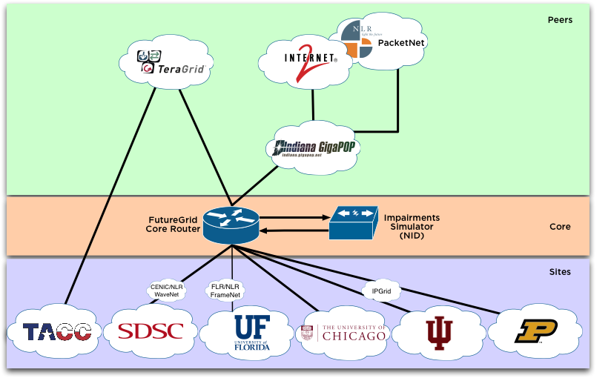
Logical Diagram

Slide 7
FutureGrid Partners
Indiana University (Architecture, core software, Support)
Purdue University (HTC Hardware)
San Diego Supercomputer Center at University of California San Diego (INCA, Monitoring)
University of Chicago/Argonne National Labs (Nimbus)
University of Florida (ViNE, Education and Outreach)
University of Southern California Information Sciences (Pegasus to manage experiments)
University of Tennessee Knoxville (Benchmarking)
University of Texas at Austin/Texas Advanced Computing Center (Portal)
University of Virginia (OGF, Advisory Board and allocation)
Center for Information Services and GWT-TUD from Technische Universtität Dresden. (VAMPIR)
Blue institutions have FutureGrid hardware

Slide 8
Other Important Collaborators
NSF
Early users from an application and computer science perspective and from both research and education
Grid5000/Aladin and D-Grid in Europe
Commercial partners such as
  Eucalyptus ….
  Microsoft (Dryad + Azure) – Note current Azure external to FutureGrid as are GPU systems
  Application partners
TeraGrid
Open Grid Forum
Open Nebula, Open Cirrus Testbed, Open Cloud Consortium, Cloud Computing Interoperability Forum. IBM-Google-NSF Cloud, UIUC Cloud

Slide 9
FutureGrid Usage Scenarios
Developers of end-user applications who want to develop new applications in cloud or grid environments, including analogs of commercial cloud environments such as Amazon or Google.
  Is a Science Cloud for me?
Developers of end-user applications who want to experiment with multiple hardware environments.
Grid/Cloud middleware developers who want to evaluate new versions of middleware or new systems.
Networking researchers who want to test and compare different networking solutions in support of grid and cloud applications and middleware. (Some types of networking research will likely best be done via through the GENI program.)
Education as well as research
Interest in performance requires close to OS support

Slide 10
Future Grid Users
Application/Scientific users
System administrators
Software developers
Testbed users
Performance modelers
Educators
Students
Supported by
FutureGrid
Infrastructure
&
Software
offerings

Slide 11
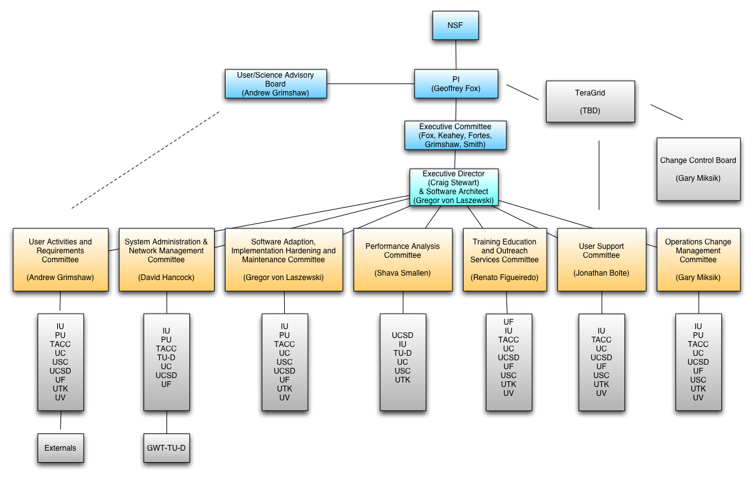
Management Structure

Slide 12
FutureGrid Working Groups
Systems Administration and Network Management Committee: This committee will be responsible for all matters related to systems administration, network management, and security. David Hancock of IU will be the inaugural chair of this committee.
Software Adaptation, Implementation, Hardening, and Maintenance Committee: This committee will be responsible for all aspects of software creation and management. It should interface with TAIS in TeraGrid. Gregor von Laszewski from IU will chair this committee.
Performance Analysis Committee: This committee will be responsible for coordination of performance analysis activities. Shava Smallen of UCSD will be the inaugural chair of this committee.
Training, Education, and Outreach Services Committee: This committee will coordinate Training, Education, and Outreach Service activities and will be chaired by Renato Figueiredo.
User Support Committee: This committee will coordinate the management of online help information, telephone support, and advanced user support. Jonathan Bolte of IU will chair this committee.
Operations and Change Management Committee (including CCB): This committee will be responsible for operational management of FutureGrid, and is the one committee that will always include at least one member from every participating institution, including those participating without funding. This is led by Craig Stewart

Slide 13
FutureGrid Architecture
Open Architecture allows to configure resources based on images
Managed images allows to create similar experiment environments
Experiment management allows reproducible activities
Through our modular design we allow different clouds and images to be “rained” upon hardware.
Note will be supported 24x7 at “TeraGrid Production Quality”
Will support deployment of “important” middleware including TeraGrid stack, Condor, BOINC, gLite, Unicore, Genesis II, MapReduce, Bigtable …..

Slide 14
FutureGrid Architecture

Slide 15
Development Phases
Phase 0: Get Hardware to run
Phase I: Get early users to use the system
Phase II: Implement Dynamic Provisioning
Phase III: Integrate with TeraGgrid

Slide 16
Objectives: Software
Extensions to existing software
Existing open-source software
Open-source, integrated suite of software to
  instantiate and execute grid and cloud experiments.
  perform an experiment
  collect the results
  tools for instantiating a test environment,
    Torque, MOAB, xCAT, bcfg, and Pegasus, Inca, ViNE, a number of other tools from our partners and the open source community
    Portal to interact
  Benchmarking

Slide 17
FG Stratosphere
Objective
  Higher than a particular cloud
  Provides all mechanisms to provision a cloud on a given FG hardware
  Allows the management of reproducible experiments
  Allows monitoring of the environment and the results
Risks
  Lots of software
  Possible multiple path to do the same thing
Good news
  We know about different solutions and have identified a very good plan with risk mitigation plans

Slide 18
Rain
Runtime Adaptable InsertioN Service
Objective
  Provide dynamic provisioning
  Running outside virtualization
  Cloud neutral
    Nimbus, Eucalyptus, …
  Future oriented
    Dryad
    …
Risks
  Some frameworks (e.g. MS) are more complex to provision

Slide 19
Dynamic Provisioning
Change underlying system to support current user demands
  Linux, Windows, Xen, Nimbus, Eucalyptus, Hadoop, Dryad
  Switching between Linux and Windows possible!
Stateless images
  Shorter boot times
  Easier to maintain
Stateful installs
  Windows
Use Moab to trigger changes and xCAT to manage installs

Slide 20
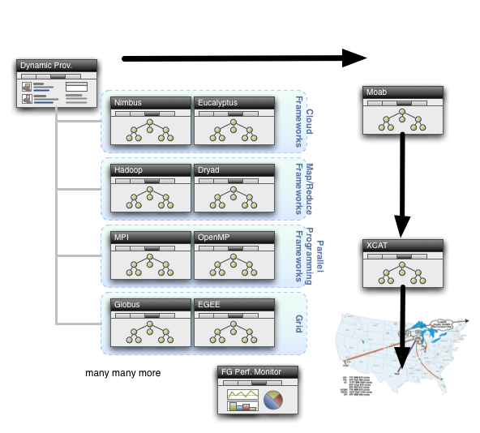
Dynamic Provisioning

Slide 21
Dynamic provisioning Examples
Give me a virtual cluster with 30 nodes
Give me a Eucalyptus environment with 10 nodes
Give me a hadoop environment with x nodes
Run my application on hadoop, dryad, … and compare the performance

Slide 22
Command line
fg-deploy-image
  host name
  image name
  start time
  end time
  label name
fg-add
  label name
  framework hadoop
  version 1.0
Deploys an image on a host
Adds a feature to a deployed image

Slide 23
xCAT and Moab
xCAT
  uses installation infrastructure to perform installs
  creates stateless Linux images
  changes the boot configuration of the nodes
  remote power control and console (IPMI)
Moab
  meta-schedules over resource managers
    TORQUE and Windows HPC
  control nodes through xCAT
    changing the OS
    remote power control

Slide 24
Experiment Manager
Objective
  Manage the provisioning for reproducible experiments
  Coordinate workflow of experiments
  Share workflow and experiment images
  Minimize space through reuse
Risk
  Images are large
  Users have different requirements and need different images

Slide 25
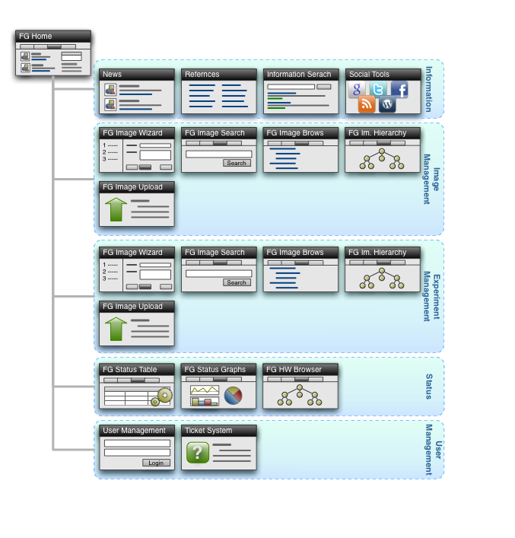
User Portal

Slide 26
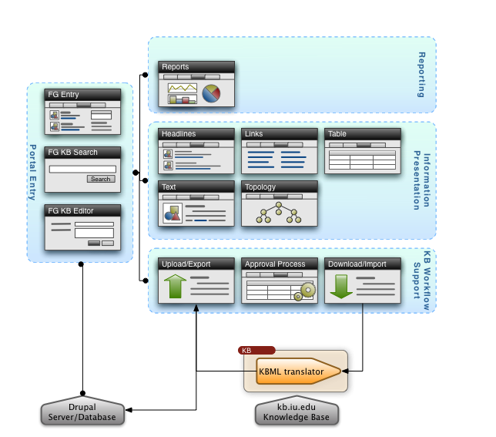
FG Information Portal

Slide 27
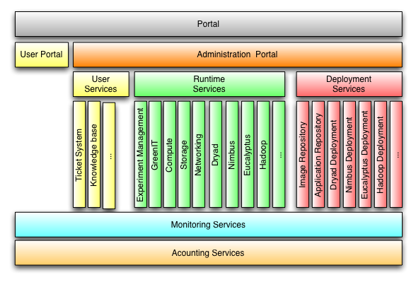
FG Administration Portal

Slide 28
Integration within TeraGrid / TeraGrid XD
Sure it’s part of TeraGrid
Allocation: separate from TG processes for two years
It is a very exciting project, it will teak effort
  TG may change, good that we can wait
We are looking for early adopters!

Slide 29
Milestones
Oct. 2009
Project Start
Nov. 2009
SC Demo
Mar. 2010
Network Completed
May 2010
Hardware available to early users
Sept. 2010
Hardware available to general users
Oct.2011
Integration into TeraGrid
Oct. 2013
Project end

Slide 30
Questions
Please contact Gregor via mail
  laszewski@gmail.com
We will update our web page soon
  http://futuregrid.org

