Slide 1
Towards Thermal Aware Workload Scheduling in a Data Center
Lizhe Wang, Gregor von Laszewski, Jai Dayal, Xi He, Andrew Younge, Thomas R. Furlani

Slide 2
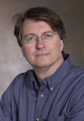
Bio
Gregor von Laszewski is conducting state-of-the-art work in Cloud computing and GreenIT at Indiana University as part of the Future Grid project. During a 2 year leave of absence from Argonne National Laboratory he was an associate Professor at Rochester Institute of Technology (RIT). He worked between 1996 and 2007 for Argonne National Laboratory and as a fellow at University of Chicago.
He is involved in Grid computing since the term was coined. Current research interests are in the areas of GreenIT, Grid & Cloud computing, and GPGPUs. He is best known for his efforts in making Grids usable and initiating the Java Commodity Grid Kit which provides a basis for many Grid related projects including the Globus toolkit (http://www.cogkits.org). His Web page is located at http://cyberaide.org
Recently worked on FutureGrid, http://futuregird.org
Masters Degree in 1990 from the University of Bonn, Germany
Ph.D. in 1996 from Syracuse University in computer science.

Slide 3


Outline
Cyberaide
A project that aims to make advanced cyberinfrastructure easier to use
GreenIT & Cyberaide
How do we use advanced cyberinfrastructure in an efficient way
Future Grid
A newly funded project to provide a testbed that integrates the ability of dynamic provisioning of resources.
(Geoffrey C. Fox is PI)
GPGPU’s
Application use of special purpose hardware as part of the cyberinfrastructure

Slide 4
Acknowledgement
Work conducted by Gregor von Laszewski is supported (in part) by NSF CMMI 0540076 and NSF SDCI NMI 0721656.
FutureGrid Is supported by NSF grant #0910812 - FutureGrid:
  An Experimental, High-Performance Grid Test-bed.

Slide 5
Outline
Background and related work
Models
Research problem definition
Scheduling algorithm
Performance study
FutureGrid
Conclusion

Slide 6
Green computing
a study and practice of using computing resources in an efficient manner such that its impact on the environment is as less hazardous as possible.
  least amount of hazardous materials are used
  computing resources are used efficiently in terms of energy and to promote recyclability

Slide 7
Green Aware Computing

Slide 8
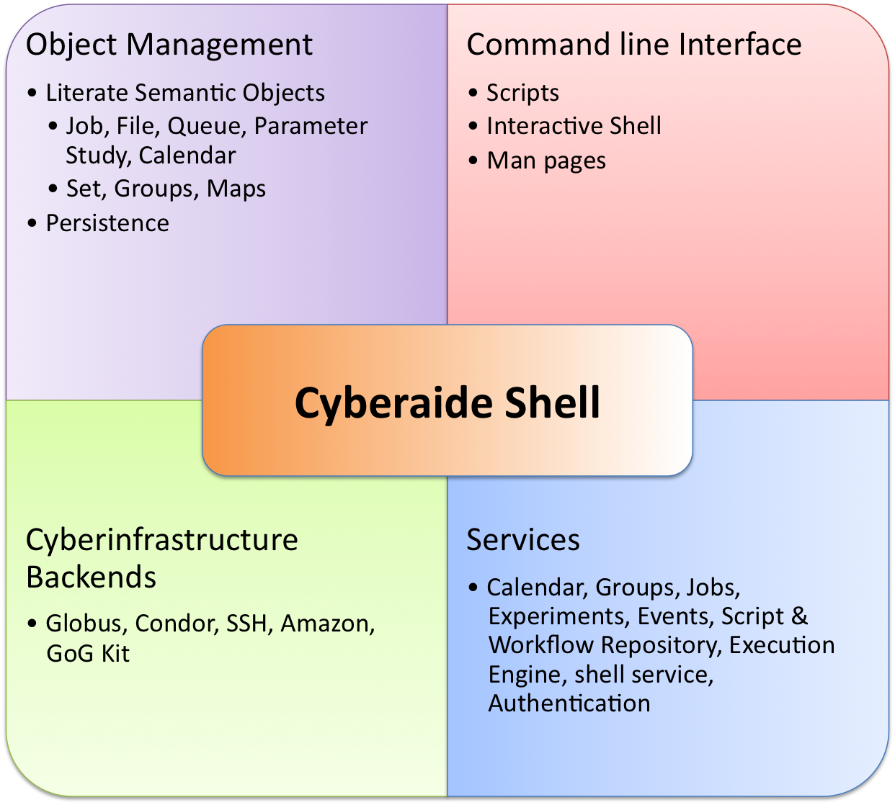
Cyberaide Project
A middleware for Clusters, Grids and Clouds
Project at IU
  Some students from RIT

Slide 9
Motivation
Cost:
  A supercomputer with 360-Tflops with conventional processors requires 20 MW to operate, which is approximately equal to the sum of 22,000 US households power consumption
  Servers consume 0.5 percent of the world’s total electricity usage
  Energy usage will quadruple by 2020
  The total estimated energy bill for data centers in 2010 is $11.5 billion
  50% data center energy is used by cooling systems
Reliability:
  Every 10 C increase of temperature leads to a doubling of the system failure rate
Environment:
  A typical desktop computer consumes 200-300W of power
  This results in emission of about 220Kg of CO2/annum
  Data Centers produce 170 million metric tons of CO2 worldwide currently per year
  670 million metric tons of CO2 are expected to be emitted by data centers worldwide annually by 2020

Slide 10
A Typical Google Search
Google spends about 0.0003 kWh per search
  1 kilo-watt-hour (kWh) of electricity = 7.12 x 10-4 metric tons CO2 = 0.712 kg or 712g of CO2
  => 213mg CO2 emitted
The number of Google searches worldwide amounts to 200-500 million per day.
  total carbon emitted per day:
  = 500 million x 0.000213 kg
  per search = 106500kg or 106.5 metric ton
Source: http://prsmruti.rediffiland.com/blogs/2009/01/19/How-much-cabondioxide-CO2-emitted.html
Notes:
ref:
http://www.globus.org/grid_software/security/voms.php – globus alliance ... basic definition
http://vdt.cs.wisc.edu/components/voms.html – virtual data toolkit (osg) – grid middleware
http://edg-wp2.web.cern.ch/edg-wp2/security/voms/voms.html – (datagrid)

Slide 11
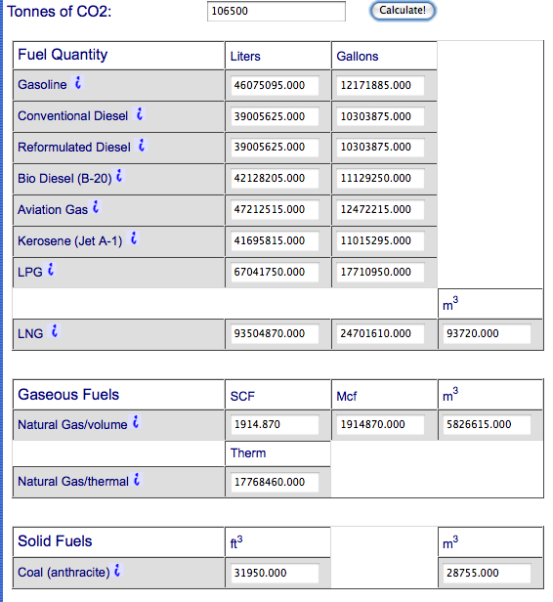
What does it mean?
10282 times around the world with a 21m/g car

Slide 12
So what can we do?
Doing less google searches ;-)
Doing meaningful things ;-)
Do more thinking ;-)
Create an infrastructure that supports use and monitoring of activities costing less environmental impact.
Seek services that advertise clearly their impact on the environment
Augment them with Service Level Agreements

Slide 13
Research topic
To reduce temperatures of computing resources in a data center, thus reduce cooling system cost and improve system reliability
Methodology: thermal aware workload distribution

Slide 14
Model
Data center
  Node: <x,y,z>, tª, Temp(t)
  TherMap: Temp(<x,y,z>,t)
Workload
  Job ={job_{j}}, job_{j}=(p,t^{arrive},t^{start},t^{req},Δtemp(t))

Slide 15
Thermal model
Node_{i}.Temp(t)
Nodei.Temp(t)
task-temperature profile
node_{i}
<x,y,z>
ambient temperature:
TherMap=Temp(Node_{i}.<x,y,z>,t)
Online task-temperature
Nodei.Temp(0)
Node_{i}.Temp(t)
RC-thermal model
P
C
R
t
PR+
Temp(Nodei.<x,y,z>,t)
Temp(Node_{i}.<x,y,z>,t)

Slide 16
Research Issue definition
Given a data center, workload, maximum temperature permitted of the data center
Minimize T^{response}
Mininimize Temperature

Slide 17
Concept framework
Data center
model
Workload
model
input
Workload placement
TASA-B
schedule
input
input
online
task-temperature
Cooling system control
TASA = Thermal Aware Scheduling Algorithm

Slide 18
Concept framework
Data center
model
Workload
model
input
Workload placement
TASA-B
schedule
input
input
RC-thermal model
calculation
online
task-temperature
Cooling system control
task-temperature profile
Thermal map

Slide 19
Concept framework
Data center
model
Workload
model
input
Workload placement
TASA-B
schedule
input
input
RC-thermal model
calculation
online
task-temperature
Cooling system control
task-temperature profile
Thermal map
Control

Slide 20
Concept framework
Data center
model
Workload
model
input
Workload placement
TASA-B
schedule
input
input
RC-thermal model
calculation
online
task-temperature
Cooling system control
task-temperature profile
Thermal map
Control
profiling
Profiling tool

Slide 21
Concept framework
Data center
model
Workload
model
input
Workload placement
TASA-B
schedule
input
input
RC-thermal model
calculation
online
task-temperature
Cooling system control
task-temperature profile
Thermal map
Control
profiling
provide information
Calculate thermal map
Profiling tool
monitoring service
CFD model

Slide 22
Scheduling framework
Jobs
Job queue
Job submission
Data center
Job scheduling
TASA-B
Rack
Update data center
Information periodically

Slide 23
Thermal Aware Scheduling Algorithm (TASA)
Sort all jobs
  with decreased order of task-temperature profile
Sort all resources
  with increased order of predicted temperature with online task-temperature profile
Hot jobs are allocated to cool resources

Slide 24
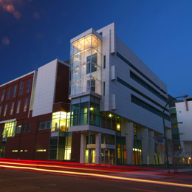


Simulation
Data center:
  Computational Center for Research at UB
  Dell x86 64 Linux cluster consisting 1056 nodes
  13 Tflop/s
Workload:
  20 Feb 2009 – 22 Mar. 2009
  22385 jobs

Slide 25
Thermal aware task scheduling with backfilling
Execute TASA
Backfill a job if
  the job will not delay the start of jobs which are already scheduled
  the job will not change the temperature profile of resources that are allocated to the jobs which are already scheduled

Slide 26
Backfilling
Time backfilling holes
node_{k}.t^{bfend} ,
end time for backfilling
Available
time
t₀
node_{max1}
node_{max2}
Node
node_{k}.t^{bfsta} , backfilling start time of node_{k}

Slide 27
Backfilling
Temperature
Temperature backfilling holes
node_{k}.Temp^{bfend}, end
temperature for backfilling
Temp^{bfmax}
node_{max2}
node_{max1}
Node
node_{k}.Temp^{bfsta}, start temperature for backfilling of node_{k}

Slide 28
Simulation
Data center:
  Computational Center for Research at UB
  Dell x86 64 Linux cluster consisting 1056 nodes
  13 Tflop/s
Workload:
  20 Feb. 2009 – 22 Mar. 2009
  22385 jobs

Slide 29
Simulation result
Metrics | TASA
Reduced average temperature | 16.1 F
Reduced maximum temperature | 6.1 F
Increase job response time | 13.9%
Saved power | 5000 kW
Reduced CO2 emission | 1900kg /hour

Slide 30
Simulation result
Metrics | TASA-B
Reduced average temperature | 14.6 F
Reduced maximum temperature | 4.1 F
Increase job response time | 11%
Saved power | 4000 kW
Reduced CO2 emission | 1600kg /hour

Slide 31
Our work on Green computing
Power aware virtual machine scheduling (cluster’09)
Power aware parallel task scheduling (submitted)
TASA (i-SPAN’09)
TASA-B (ipccc’09)
ANN based temperature prediction and task scheduling (submitted)

Slide 32
FutureGrid
The goal of FutureGrid is to support the research that will invent the future of distributed, grid, and cloud computing.
FutureGrid will build a robustly managed simulation environment or testbed to support the development and early use in science of new technologies at all levels of the software stack: from networking to middleware to scientific applications.
The environment will mimic TeraGrid and/or general parallel and distributed systems
This test-bed will enable dramatic advances in science and engineering through collaborative evolution of science applications and related software.

Slide 33
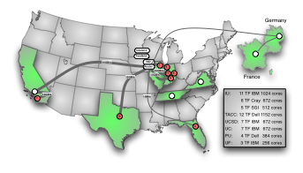
FutureGrid Partners
Indiana University
Purdue University
University of Florida
University of Virginia
University of Chicago/Argonne National Labs
University of Texas at Austin/Texas Advanced Computing Center
San Diego Supercomputer Center at University of California San Diego
University of Southern California Information Sciences Institute, University of Tennessee Knoxville
Center for Information Services and GWT-TUD from Technische Universtität Dresden.

Slide 34
FutureGrid Hardware

Slide 35
FutureGrid Architecture

Slide 36
FutureGrid Architecture
Open Architecture allows to configure resources based on images
Shared images allows to create similar experiment environments
Experiment management allows management of reproducible activities
Through our “stratosphere” design we allow different clouds and images to be “rained” upon hardware.

Slide 37
FutureGrid Usage Scenarios
Developers of end-user applications who want to develop new applications in cloud or grid environments, including analogs of commercial cloud environments such as Amazon or Google.
  Is a Science Cloud for me?
Developers of end-user applications who want to experiment with multiple hardware environments.
Grid middleware developers who want to evaluate new versions of middleware or new systems.
Networking researchers who want to test and compare different networking solutions in support of grid and cloud applications and middleware. (Some types of networking research will likely best be done via through the GENI program.)
Interest in performance requires that bare metal important

Slide 38
Selected FutureGrid Timeline
October 1 2009 Project Starts
November 16-19 SC09 Demo/F2F Committee Meetings
March 2010 FutureGrid network complete
March 2010 FutureGrid Annual Meeting
September 2010 All hardware (except Track IIC lookalike) accepted
October 1 2011 FutureGrid allocatable via TeraGrid process – first two years by user/science board led by Andrew Grimshaw

Slide 39
Final remark
Green computing
Thermal aware data center computing
TASA-B
Good results with simulation
FutureGrid promises a good testbed

