Slide 1
CSTI General Assembly 2012 Washington, D.C., USA Technical Activities Coordinating Committee (TACC) Meeting Data Management, Cloud Computing and the Long Tail of Science
Dennis Gannon
Director Cloud Research Strategy

Slide 2
Outline
The Challenge of the “long tail” of science
Is there a sustainable financial model for scientific data?
Data Centers powering commercial clouds
The Azure cloud in research
Data architectures
Massively parallel dedicated data systems
Managing parallel data analysis from your desktop
Building Communities

Slide 3
The 4th Paradigm and the Revolution in Science

Slide 4
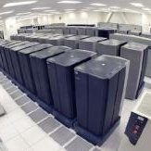
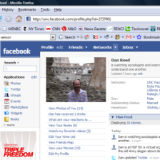
The data explosion is transforming science
Experiments
Simulations
Archives
Literature
Consumer
Petabytes Doubling & Doubling
Every area of science is now engaged in data-intensive research
Researchers need
Technology to publish and share data in the cloud
Data analytics tools to explore massive data collections
A sustainable economic model for scientific analysis, collaboration and data curation

Slide 5
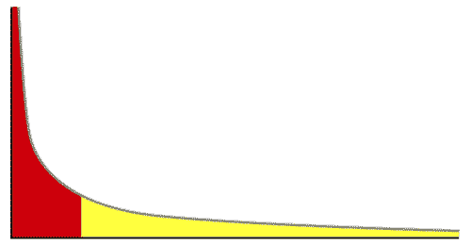
The Long Tail of Science
High energy physics, astronomy
genomics
The long tail: economics, social science, ….
Collectively “long tail” science is generating a lot of data
Estimated at over 1PB per year and it is growing fast.
US National Science Foundation requires all data be made public
US Universities are struggling with this new load
Data must be preserved
Data must be sharable, searchable, and analyzable

Slide 6
The Data for Science Sustainability Challenge
Can we create a sustainable economic model for the long tail of science?
The government will not directly support an exponentially growing data collection.
Our hypothesis
We can create an ecosystem that supports a marketplace of research tools and domain expertise
Allowing researchers to outsource special tasks to expert service providers
Funding will come from subscriptions from individual researchers, academic institutions and private sectors
Michigan’s Inter-university Consortium for Political and Social Research (ICPSR) is a great model.

Slide 7
Data Centers and the Microsoft Cloud

Slide 8
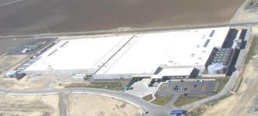
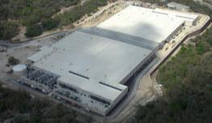
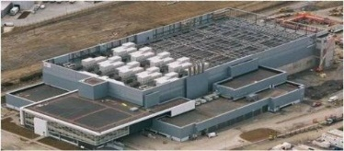
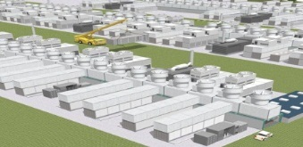
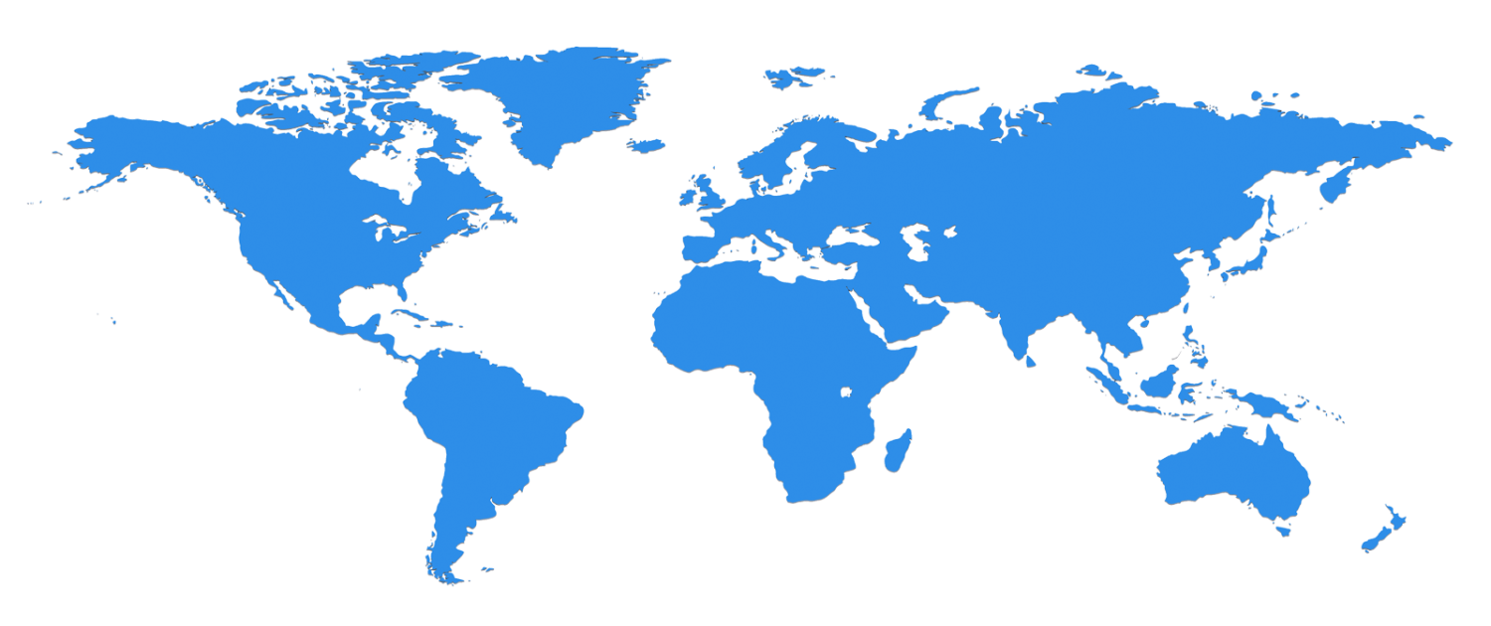
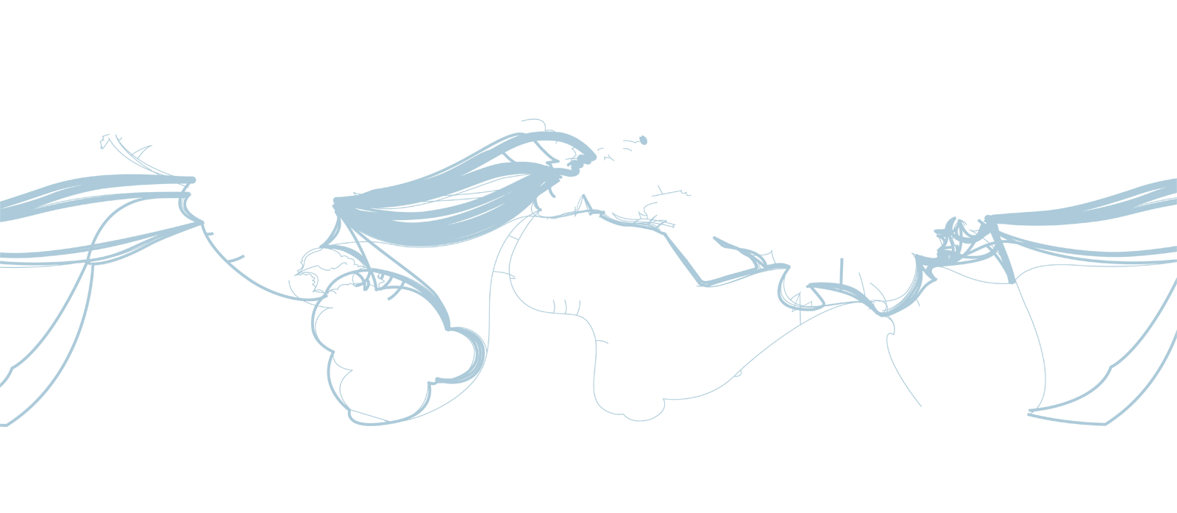
The Microsoft Cloud is Built on Data Centers
~100 Globally Distributed Data Centers
Range in size from “edge” facilities to megascale (100K to 1M servers)
Quincy, WA
Chicago, IL
San Antonio, TX
Dublin, Ireland
Generation 4 DCs

Slide 9
Cloud Properties
Designed to Provide Information and Computation to Many Users
Automatic Deployment and Management of Virtual Machine Instances
tens to thousands & dynamic scalability
Dynamic Fault Recovery of Failed Resources
Cloud Services must run 24x7
Automatic Data Replication
Geo-replication if needed
Two levels of parallelism
Thousands of concurrent users
Thousands of servers for a single task.

Slide 10
Our Experience (so far) with Science in the Cloud

Slide 11
Microsoft Cloud Research Engagement Project Work with international funding agencies to grant access to cloud resources to researchers. 90 projects world wide.
Europe
Brussels
Venus-C
England - University of Nottingham
Inria in France
Plus Italy, Spain, Greece, Denmark, Switzerland, Germany
WA DC
Japan
National Science Foundation
Florida
Georgia
Mass.
Virginia
North Carolina
Indiana
Delaware
China - Now!
InfoPlosion
Tokyo
Kyoto
Seattle
Project HQ
Penn
Louisiana
Washington
New York
New Mexico
California
Colorado
Michigan
South Carolina
Texas
Taiwan- Now!
Australia
Partners
NICTA
ANU
CSIRO

Slide 12
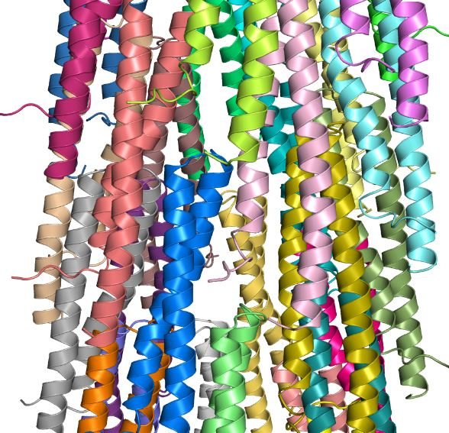
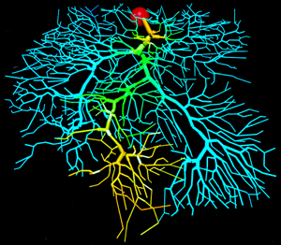
Sample Projects on Windows Azure
Protein Folding
The University of Washington is studying the ways proteins from salmonella virus inject DNA into cells. Used 2000 concurrent cores. PI: Nikolas Sgourakis, Baker Lab.
Joint Genetic and Neuroimaging Analysis
France’s premier research institute INRIA is using 1000 cores of Azure to study large cohorts of subjects to understand links between genetic patterns and brain anomalies. Pis: Radu Marius Tudoran, Gabriel Antoniu IRISA INRIA France.
Fire Risk
This app from the University of Aegean estimates the fire risk probability using meteo and geo-data sources and calculates the so-called fire risk index. A client application for the fire and forest services as well as cloud services that allow access to real-time data from sensors and on-the-ground reporting. This service has been tested and validated with fire-fighting crews in both Mytilene and Thessaloniki, Greece PI: Kostas Kalabokidis

Slide 13
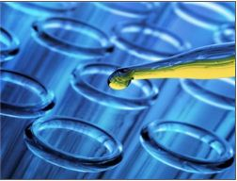
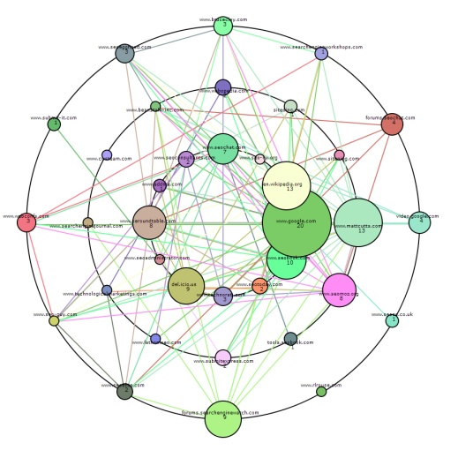
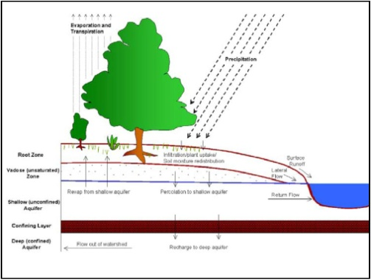
More Samples
Drug Discovery
Researchers at Newcastle University in the U.K. are using Azure to model the properties (toxicity, solubility, biological activity) of molecules for potential use as drugs. This cloud solution is primarily aimed at domain scientists who do not have advanced IT skills. PI: Paul Watson
Predicate-Argument Structure Analysis
University of Kyoto team applied a predicate-argument structure analysis to a huge Japanese corpora consisting of about 20 billion web sentences, to improve the open-search engine infrastructure TSUBAKI, which is based on deep natural language processing. To achieve this goal 10,000 core on Windows Azure were used in a massively parallel computation that took about a week.
Model and Manage Large Watershed Systems
Predict the impact of land use change and climate change on water resources. Going beyond modeling to include entire workflow from data collection to decision making. University of Virginia and South Carolina. Using HPC Scheduler on Azure to launch thousands of analysis jobs.

Slide 14
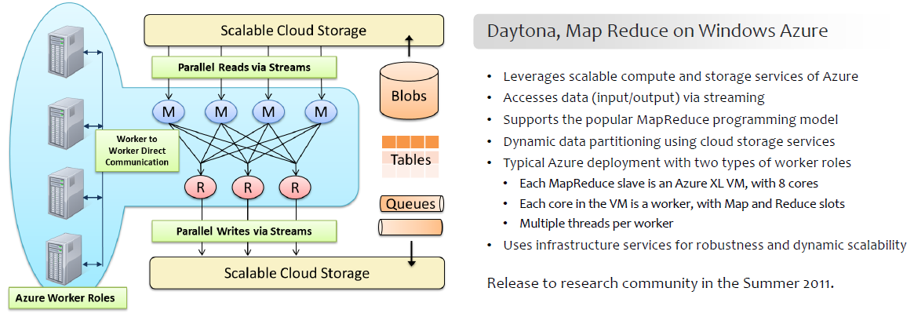
What have we learned?
Traditional communication-intensive MPI apps belong on supercomputers.
The cloud advantage
Applications that require sharing & web access
Massive “Map Reduce” data analytics on cloud resident data
Massive ensemble computations
The “scale-out as needed” model works.
Users prefer spending on pay-as-you-go cloud to buying and cluster hardware. (use 500 cores 2 days a week vs. 120 cores purchased)
Most researcher prefer to avoid maintaining cluster and data storage facilities.
Most users do not have access to supercomputers

Slide 15
Bringing Large scale data analytics to more people. Let Scientists Be Scientists…
Most scientists do not want to be system administrators
They don’t want to learn to use supercomputers
They want to focus on their science
They use standard tools: spreadsheets, statistical packages, desktop visualization
Programming = modifying a few parameters in a trusted scripting language
They want to share experiments with their collaborators

Slide 16
Cloud Science Stack
The challenge: Design a platform for scientific data management and analysis that is
Open and extensible
Provides an economic sustainability model for data preservation and use
Is easily accessed by simple desktop/web analysis apps.
Encourages scientific collaboration
Leverages the capabilities of public clouds and on-campus resources
Can we build a demonstration project to test the feasibility of this?
Build it using the tools the community wants and uses.

Slide 17
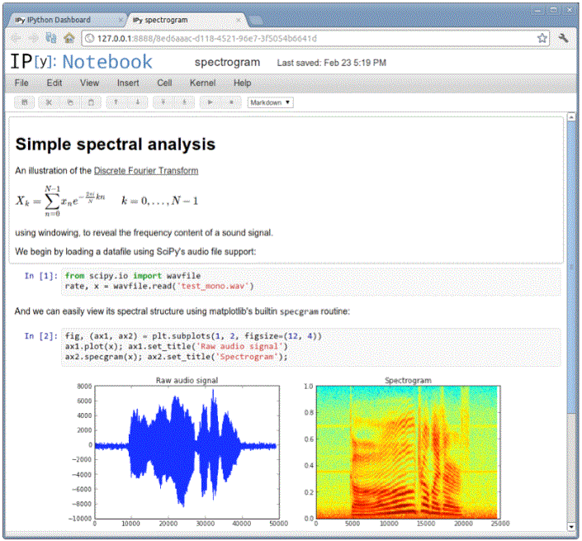
IPython Notebook on Windows Azure
Browser/OS independent
Math rendering
Azure ready
Notebooks stored in Azure Blobs
Interactive Parallel Computing & MPI
Engine on Azure via Windows or Linux VM
Support for R, LaTeX, PHP, …
Inline graphics & Video
Collaborate with colleagues

Slide 18
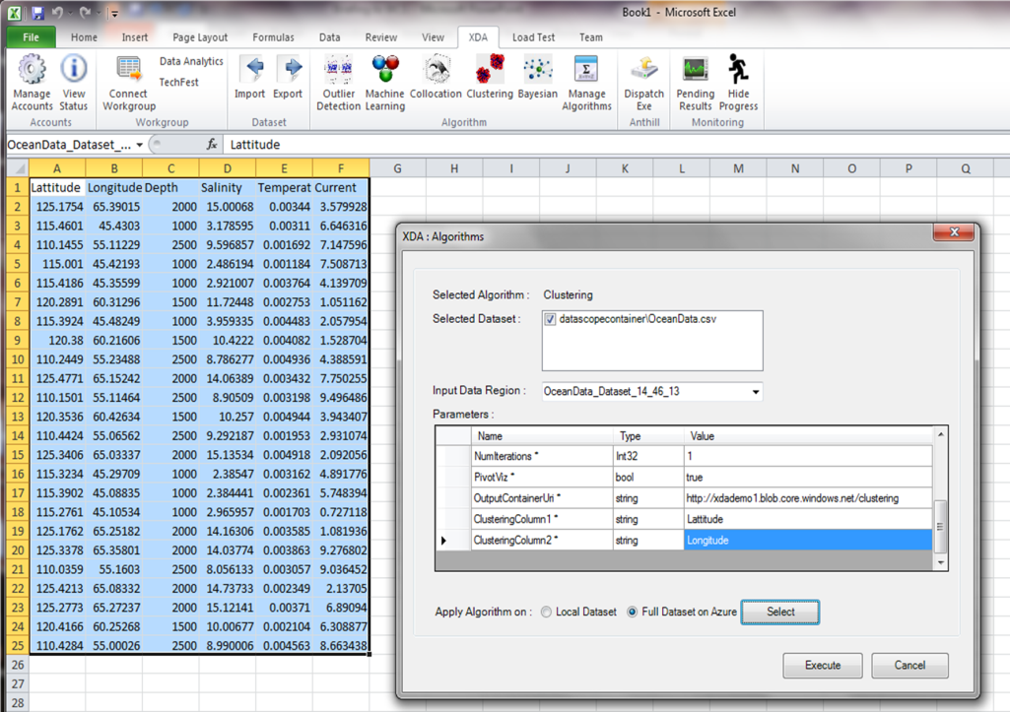
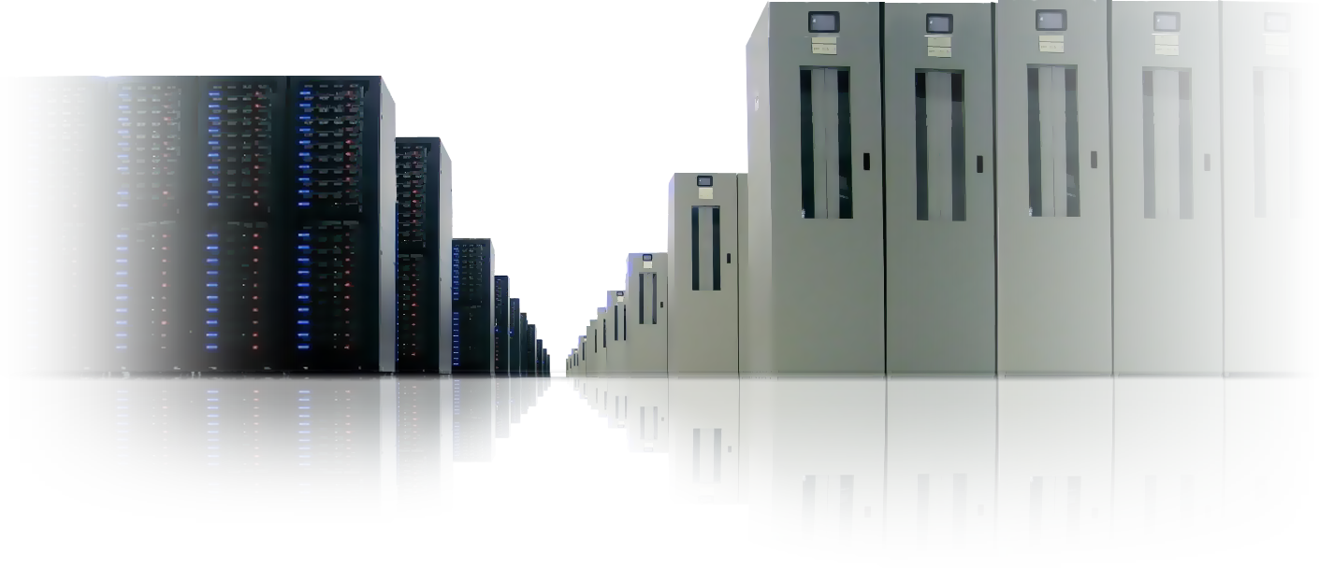
Excel DataScope Cloud Scale Data Analytics from Excel
Bringing the power of the cloud to the laptop
Data sharing in the cloud, with annotations to facilitate discovery and reuse;
Sample and manipulate extremely large data collections in the cloud;
Top 25 data analytics algorithms, through Excel ribbon running on Azure;
Invoke models, perform analytics and visualization to gain insight from data;
Machine learning over large data sets to discover correlations;
Publish data collections and visualizations to the cloud to share insights;
Researchers use familiar tools, familiar but differentiated.

Slide 19
Data Analytics Algorithms for Datascope
Parallel algorithms for massively distribute data
Clustering: K-means, fuzzy clustering, canopy clustering;
Recommendation Mining: Log-Likelihood;
Prediction: SVM; trend prediction
Frequent Item Set Mining: Collocation, Outlier Detection;
Bayesian/Regression Toolkit (linear, non-linear, logistic);
Bayesian Net, Neural Nets, other Machine learning
These algorithms are being built on top of the Daytona mapreduce engine

Slide 20
Next Steps – Bringing Communities Together

Slide 21
Internet2 and 13 University CIOs @ MS
A meeting March 1 in Bellevue
Universities need to solve some problems
An effective way to use the cloud to address them
Use standard authentication protocols
Rational data costs and pricing
The Research Genomics Challenge
A universal problem – analysis and storage of sequence data
A pilot project – follow up meeting at UC Davis.
Discussions starting.
The Rest – “The Long Tail of Science”
Many disciplines, each with unique data and analysis challenges

Slide 22
Next Steps
A “long tail” workshop at UW Oct 15-16 focused on cyberinfrastructure for social science data.
Sustainable data collections requires
A community of dedicated users,
Substantial data collections of interest to a large community,
Data Analytics tools rendered as composible services.
Goal - Build two working examples that will be self-sustaining in 3 years.
Bioinformatics with a focus on Genomics
Social/behavioral/political/economic sciences
Talk to me if you are interested.

Slide 23
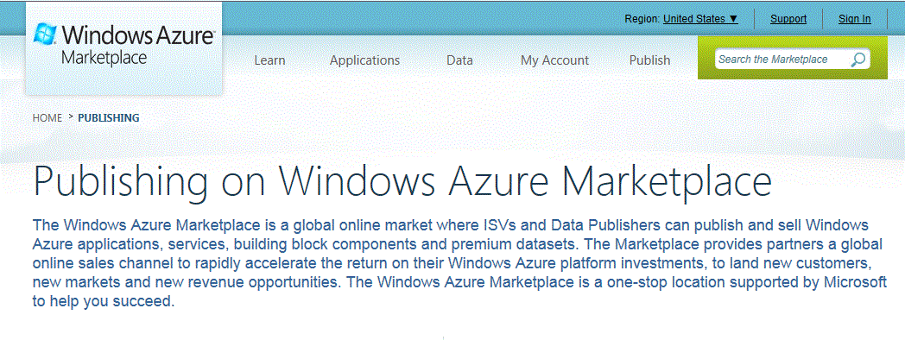
Next Goal: Build a Research Marketplace
A place to host services for
advanced data analytics and machine learning libraries
Curated data collections (via dataverse or duracloud)
Data upload, curation and visualization tool (CDL project)
A support platform for research challenge projects
such machine learning and medical image analysis
Exploit Azure Marketplace to provided limited free and paid access.

