Slide 1
Objective Function
Fixed Temperature – false minima
T3
Annealing -- correct minima
T3
T2
T2
T3 < T2 < T1
T1
T1
Configuration – Center Positions Y(k)

Slide 2
Free Energy F
Clusters Stable
Y(k)_{A} or Y(k)_{B}
Unstable Clusters Split
Y(k)_{A} + Y(k)_{B}
Y(k)_{A} - Y(k)_{B}

Slide 3
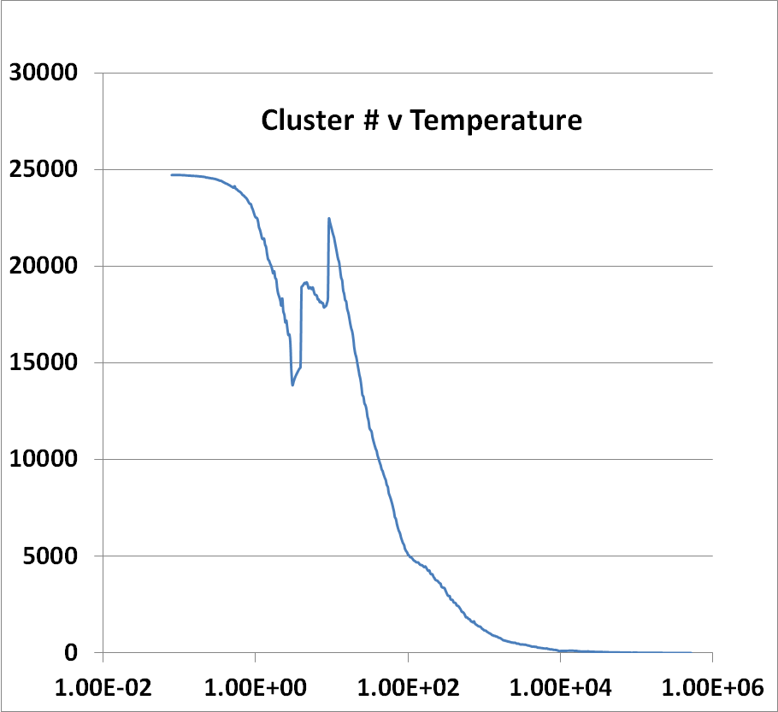
# Clusters
Low Temperature -- End
High Temperature -- Start
Temperature

