Slide 1
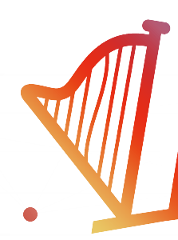
Tutorial: Harp-DAAL for
High Performance Big Data Machine Learning
Framework & Applications

Slide 2
For Developers
We introduce Harp-DAAL, a high performance machine learning framework.
Harp (Hadoop plugin) provides communication patterns and invokes Intel’s Data Analytics Acceleration Library (DAAL) that runs on Xeon/Xeon Phi hardware to achieve good performance.
Big Data
Clouds
HPC
For Users
You may use simple Python interface and run scalable machine learning applications on Google Cloud.
AI & You
This tutorial clarifies what type of hardware and software is needed for scalable machine learning.
What You Will Learn?
Big Data Machine Learning
on HPC-Cloud

Slide 3
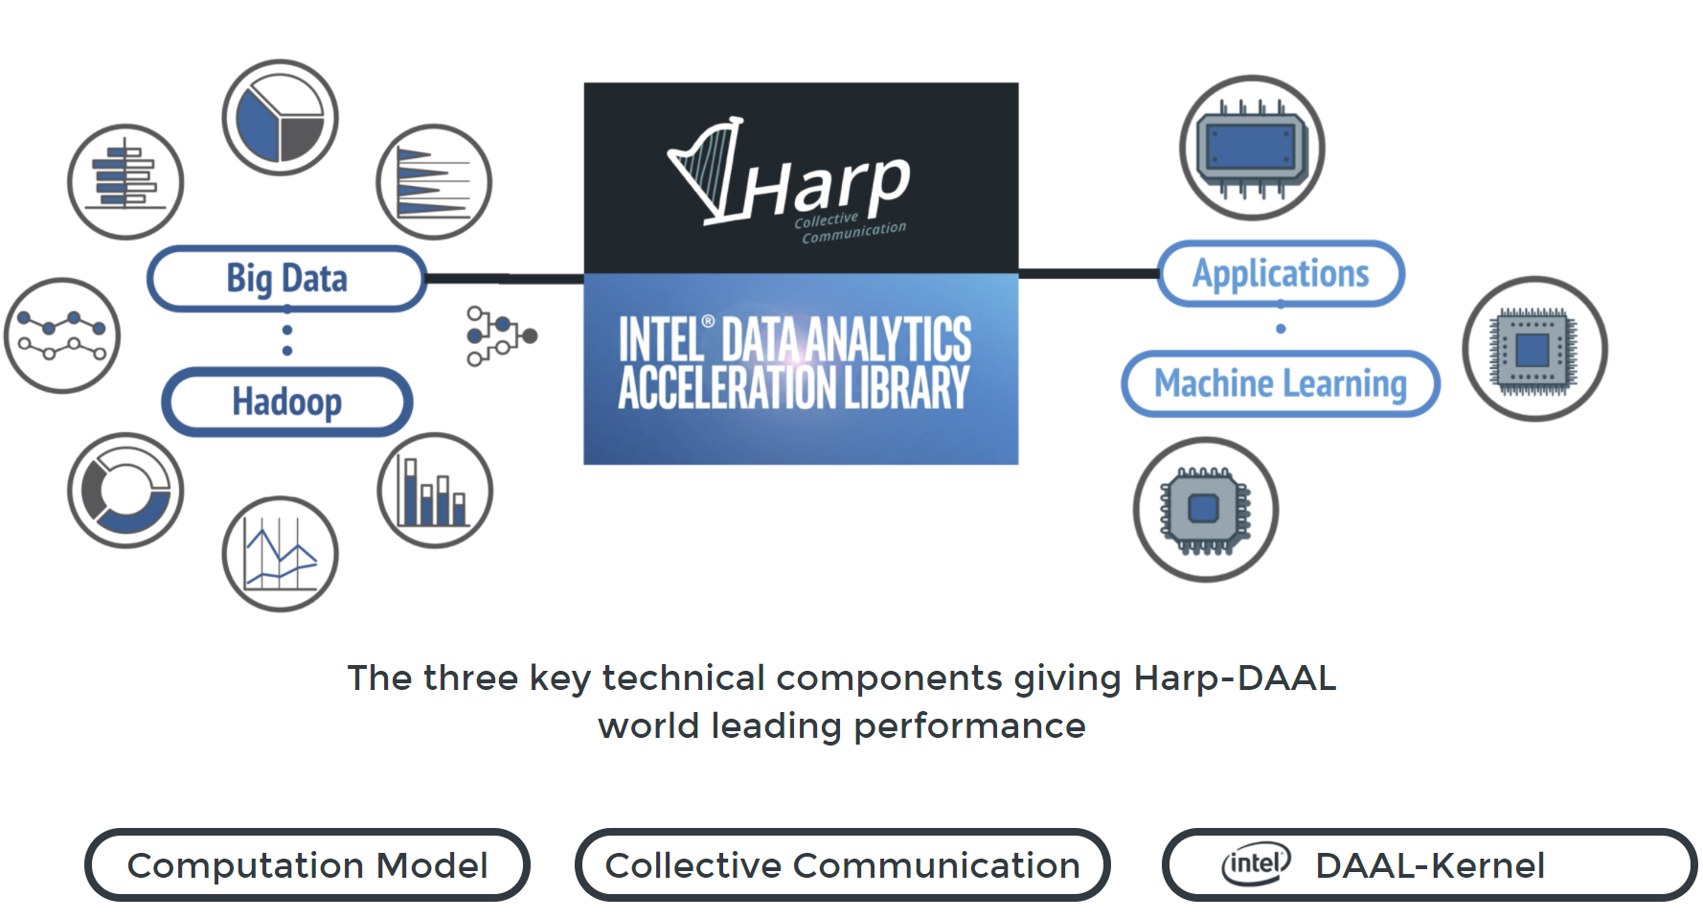

Slide 4

Harp-DAAL Framework
• Concept • Data Types • APIs

Slide 5
Large volume of training data and model parameters
Complex analysis process
For large-scale Machine Learning
Big Data tools have limitations in performance
HPC techniques can really help (e.g. MPI, BLAS)
Can we do better than simply deploy MPI or BLAS?
Status
of Big Data Tools

Slide 6
High Performance – Apache Big Data Stack
MapReduce
Classic Parallel Runtimes (MPI)
Data Centered, QoS
Efficient and Proven techniques
Expand the Applicability of MapReduce to more classes of Applications
Sequential
Map-Only
MapReduce
Iterative MapReduce
MPI and Point-to-Point
Input
Input
Input
iterations
Input
map
map
map
map
Pij
Output
Output
reduce
reduce

Slide 7
Data management
Algorithms
Intel® DAAL is an open-source project that provides:
Algorithms Kernels to Users
    Batch Mode (Single Node)
    Distributed Mode (multi nodes)
    Streaming Mode (single node)
Data Management & APIs to Developers
    Data structure, e.g., Table, Map, etc.
    HPC Kernels and Tools: MKL, TBB, etc.
    Hardware Support: Compiler
Data sources
Data dictionaries
Data model
Numeric tables and matrices
Compression
Analysis
Training
Prediction
Services
Memory allocation
Error handling
Collections
Shared pointers

Slide 8
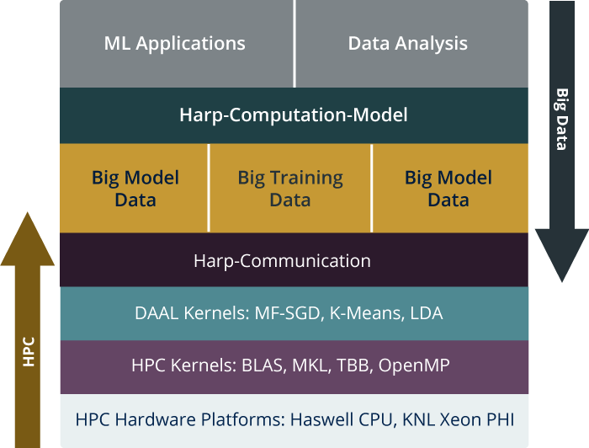
HPC-ABDS is Cloud-HPC interoperable software with the performance of HPC (High Performance Computing) and the rich functionality of the commodity Apache Big Data Stack. This concept is illustrated by Harp-DAAL.
High Level Usability: Python Interface, well documented and packaged modules
Middle Level Data-Centric Abstractions: Computation Model and optimized communication patterns
Low Level optimized for Performance: HPC kernels Intel® DAAL and advanced hardware platforms such as Xeon and Xeon Phi
Harp-DAAL

Slide 9
Parallelism Model
Architecture
MapReduce Model
MapCollective Model
MapReduce Applications
MapCollective Applications
Application
M
M
M
M
M
M
M
M
MapReduce V2
Harp
Shuffle
Framework
Collective Communication
R
R
Resource Manager
YARN
Harp is an open-source project developed at Indiana University, it has:
MPI-like collective communication operations that are highly optimized for big data problems.
Harp has efficient and innovative computation models for different machine learning problems.
The Concept of Harp Plug-in
Harp project. Available at https://dsc-spidal.github.io/harp

Slide 10
  Why Collective Communications for Big Data Processing?
Collective Communication and Data Abstractions
  Optimization of global model synchronization
    ML algorithms: convergence vs. consistency
    Model updates can be out of order
  Hierarchical data abstractions and operations
Map-Collective Programming Model
  Extended from MapReduce model to support collective communications
  BSP parallelism at Inter-node vs. Intra-node levels
Harp Implementation
  A plug-in to Hadoop

Slide 11
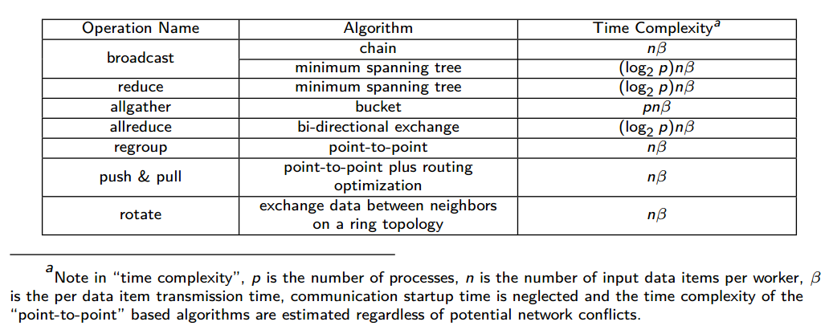
Collective Communication Operations

Slide 12
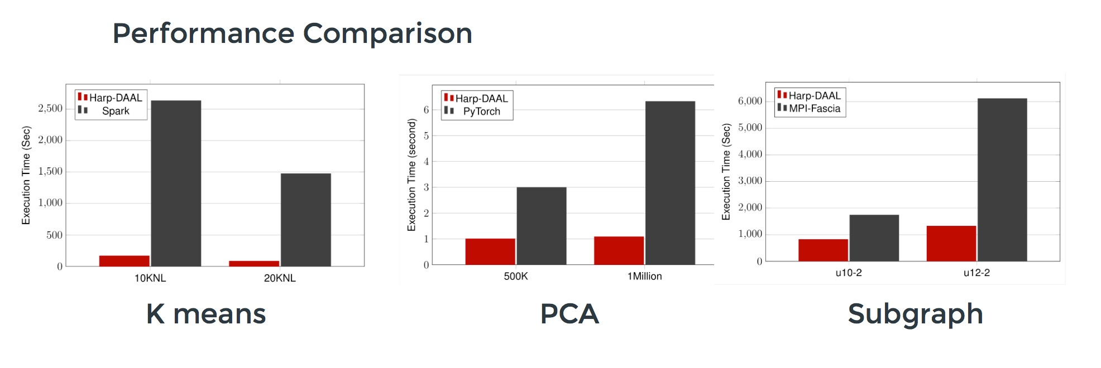
Datasets: 5 million points, 10 thousand centroids, 10 feature dimensions
10 to 20 nodes of Intel KNL7250 processors
Harp-DAAL has 15x speedups over Spark MLlib
Datasets: 500K or 1 million data points of feature dimension 300
Running on single KNL 7250 (Harp-DAAL) vs. single K80 GPU (PyTorch)
Harp-DAAL achieves 3x to 6x speedups
Datasets: Twitter with 44 million vertices, 2 billion edges, subgraph templates of 10 to 12 vertices
25 nodes of Intel Xeon E5 2670
Harp-DAAL has 2x to 5x speedups over state-of-the-art MPI-Fascia solution

Slide 13
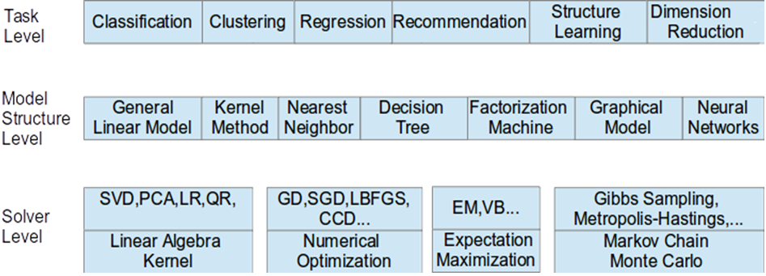
Taxonomy for Machine Learning Algorithms
Optimization and related issues
  Task level only can't capture the traits of computation
  Model is the key for iterative algorithms. The structure (e.g. vectors, matrix, tree, matrices) and size are critical for performance
  Solver has specific computation and communication pattern
We investigate different computation and communication patterns of important ml algorithms

Slide 14
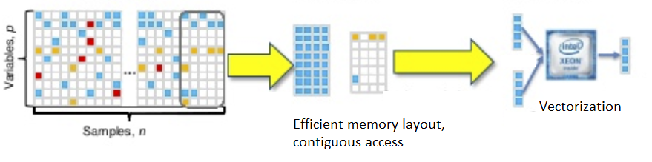
  Challenges Behind Big Data Machine Learning
Optimization and related issues
  Big Data machine learning has irregular computation, non-homogeneous data and random memory access
  Easier manageable for traditional HPC, much more challenging for Big Data
  Big model with high dimensional data or model parameters is a unique computational feature
  Iterative computation is sensitive to the speed of global model update and synchronization for high accuracy and convergence.

Slide 15
Machine Learning Application
Machine Learning Algorithm
Programming Interface
Computation Model
Implementation
Parallelization of
Machine Learning Applications

Slide 16
(A) Locking
(B) Rotation
Model
Model1
Model2
Model3
Process
Process
Process
Process
Process
Process
Synchronized algorithm
The latest model
Synchronized algorithm
The latest model
(C) AllReduce
(D) Asynchronous
Model
Model
Process
Process
Process
Process
Process
Process
Synchronized algorithm
The stale model
Asynchronous algorithm
The stale model
Harp Computation Models
Inter-node & Intra-node

Slide 17
(A) Locking
Once a process trains a data item, it locks the related model parameters and prevents other processes from accessing them. When the related model parameters are updated, the process unlocks the parameters. Thus the model parameters used in local computation is always the latest.
(C) AllReduce
Each process first fetches all the model parameters required by local computation. When the local computation is completed, modifications of the local model from all processes are gathered to update the model.
(B) Rotation
Each process first takes a part of the shared model and performs training. Afterwards, the model is shifted between processes. Through model rotation, each model parameters are updated by one process at a time so that the model is consistent.
(D) Asynchronous
Each process independently fetches related model parameters, performs local computation, and returns model modifications. Unlike A, workers are allowed to fetch or update the same model parameters in parallel. In contrast to B and C, there is no synchronization barrier.
Harp Computing Models
Inter-node (Process)

Slide 18
(A) Dynamic Scheduler
All computation models can use this scheduler.
All the inputs are submitted to one queue.
Threads dynamically fetch inputs from the queue.
The main thread can retrieve the outputs from the output queue.
(B) Static Scheduler
All computation models can use this scheduler.
Each thread has its own input queue and output queue.
Each thread can submit inputs to another thread .
The main thread can retrieve outputs from each task’s output queue.
Intra-node
Schedulers (Thread)

Slide 19
Schedule Training Data Partitions to Threads
(only Data Partitions in Computation Model A, C, D; Data and/or Model Partitions in B)
(A) Dynamic Scheduler
(B) Static Scheduler
I
I
I
I
I
I
Thread
Thread
Thread
Thread
Thread
Thread
O
O
O
O
O
O

Slide 20
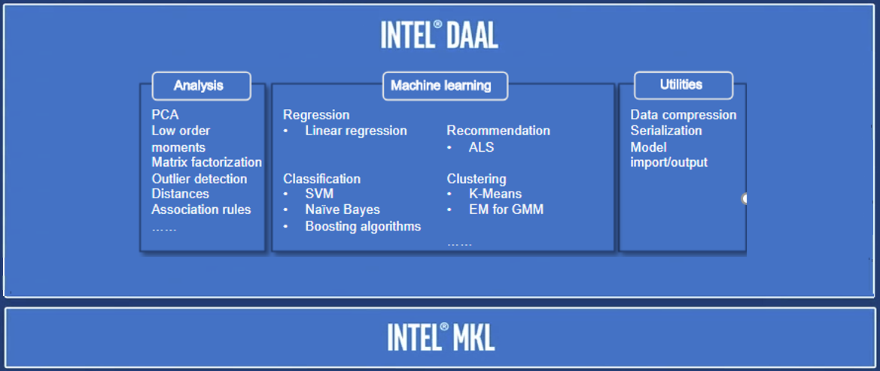
Intra-node
Schedulers (Thread)

Slide 21



Data Conversion
Interface Harp with Intel® DAAL
Harp Data
Intel® DAAL Kernel
DAAL Java API
Table<Obj>
Data on JVM Heap
NumericTable
Data on JVM heap
Data on Native Memory
MicroTable
Data on Native Memory
A single DirectByteBuffer
has a size limits of 2 GB
Two ways to store data using Intel® DAAL Java API
Keep Data on JVM heap
  no contiguous memory access requirement
  Small size DirectByteBuffer and parallel copy (OpenMP)
Keep Data on Native Memory
  contiguous memory access requirement
  Large size DirectByteBuffer and bulk copy

Slide 22
Data Structures of Harp and Intel® DAAL
Table<Obj> in Harp has a three-level data
Hierarchy
Table: consists of partitions
Partition: partition id, container
Data container: wrap up Java objs, primitive arrays
Data in different partitions, non-contiguous
in memory
Harp Table consists of Partitions
NumericTable in DAAL stores data either in
Contiguous memory space (native side)
or non-contiguous arrays (Java heap side)
Data in contiguous memory space favors matrix
operations with regular memory accesses.
DAAL Table has different types of Data storage

Slide 23
Two Types of Data Conversion
JavaBulkCopy:
Dataflow: Harp Table<Obj> -----
Java primitive array ---- DiretByteBuffer ----
NumericTable (DAAL)
Pros: Simplicity in implementation
Cons: high demand of DirectByteBuffer size
NativeDiscreteCopy:
Dataflow: Harp Table<Obj> ----
DAAL Java API (SOANumericTable)
---- DirectByteBuffer ---- DAAL native memory
Pros: Efficiency in parallel data copy
Cons: Hard to implement at low-level kernels

Slide 24
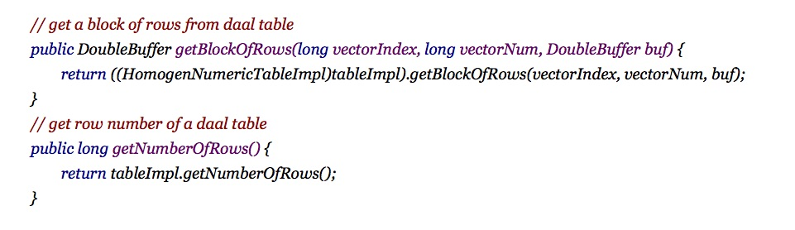
HomogenNumericT
able
SOANumericT
able
Data
Storage
at
Native
side
Data
Storage
at
Java
side
Member
Data
Data
Data
Member
Functions
Data
Data
Data
Functions
getRow
Data
Data
Data
jvm
pointer
setRow
Data
Data
Data
Accessor
getColumn
Data
Data
Data
mutator
Various Table type: Homogeneous, Structure of Array (SOA), etc.
Data store at C++ Side or Java Side
Easy-to-use function to retrieve table data or meta-data
setColumn
Data
Data
Data
others
others
Native
Contiguous
JVM
heap
Mem
JVM
Memory
Space
Non-contiguous
NumericTable
(Intel® DAAL)

Slide 25
Harp-DAAL Framework
• Concept • Data Types • APIs

Slide 26
Abstraction
Distributed computing
Management
Data
Computation
Collective
Dynamic scheduler
Arrays & Objects
Pool-based
Event-driven
Multi-threading
Partitions & Tables
Hadoop 2.6.0 Plugin
Static scheduler
Schedulers
Harp Features

Slide 27
Arrays & Objects
Primitive Arrays
ByteArray, ShortArray, IntArray, FloatArray, LongArray, DoubleArray
Serializable Objects
Writable
Partitions & Tables
Partition
An array/object with partition ID
Table
The container to organize partitions
Key-value Table
Automatic partitioning based on keys
Data Types

Slide 28
Table<DoubleArray> table = new Table<>(0, new DoubleArrPlus());
for (int i = 0; i < numPartitions; i++) {
DoubleArray array = DoubleArray.create(size, false);
table.addPartition(new Partition<>(i, array));
}
To create a table, an ID and a combiner is required.
Combiner can combine partitions with the same ID in the table.
A partition contains a partition ID and an object <? extends Simple>.
Table ID is user defined. Default ID is allowed.
Partition & Table

Slide 29
Array
ByteArray, ShortArray, IntArray, FloatArray, LongArray and DoubleArray
Writable
Users are required to implement getNumWriteBytes, write & read methods to direct the serialization / deserialization.
public static DoubleArray create(int size, boolean approximate)
create method utilizes the pool based management to fetch an cached allocation. After using, the array/object can be released back to the pool or freed to GC.
The boolean flag is used to indicate if the allocation size can be padded to a size in order to increase the chance for reuse.
Array & Writable

Slide 30
protected void setup(Context context)
protected void mapCollective(KeyValReader reader, Context context)
The main interface to process key-value pairs
KeyValReader is used to read all the key-value pairs to the task
The interface invoked before running the task, used for fetching job configurations to the Map task.
mapCollective
interface

Slide 31
Harp-DAAL Framework
• Concept • Data Types • APIs

Slide 32
Scheduler
Collective
broadcast
Event Drive
reduce
allgather
allreduce
regroup
pull
push
rotate
getEvent
waitEvent
sendEvent
DynamicScheduler
StaticScheduler
Algorithm
Data converter
TrainingBatch
Input
Parameter
PartialResult
Result
HomogenTableHarpMap
HomogenTableHarpTable
TrainingDistributed
Prediction
PredictionDistributed
Harp APIs

Slide 33
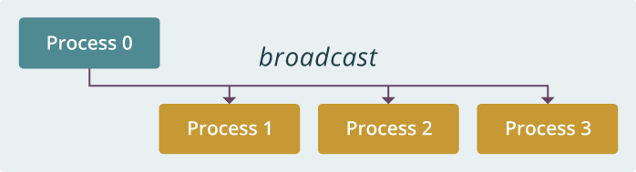
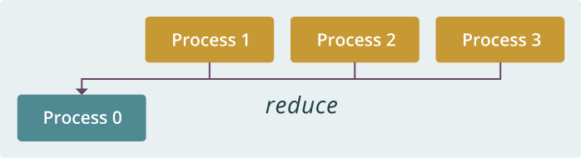
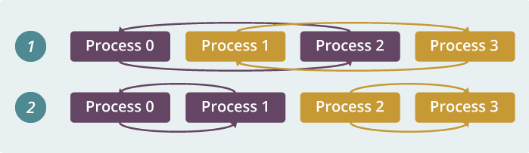
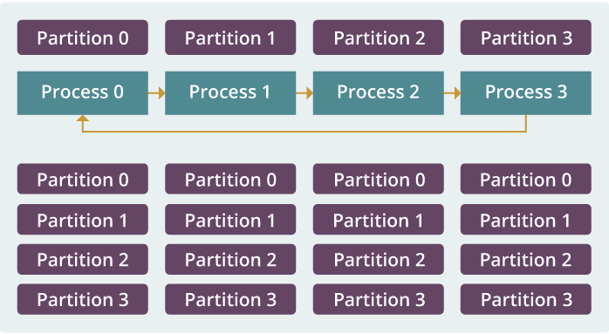
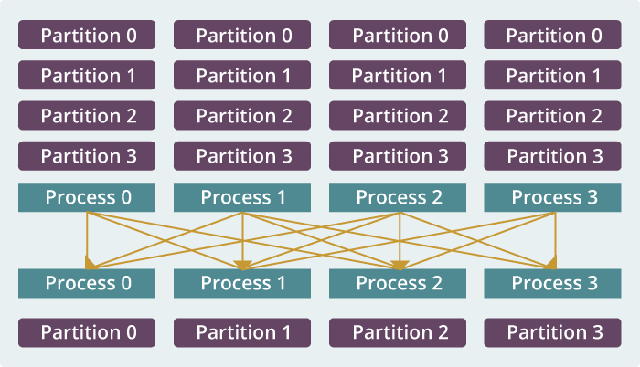
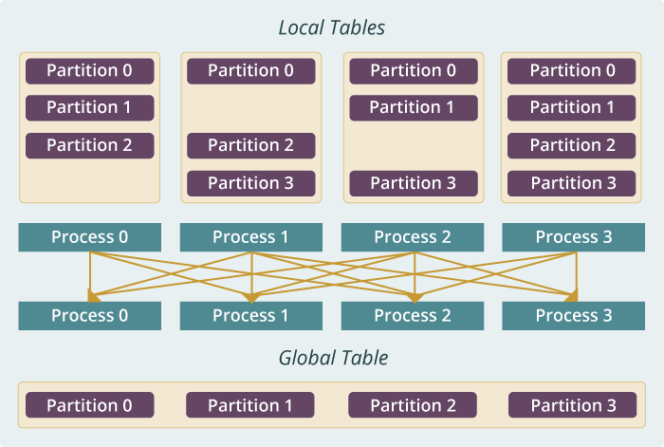
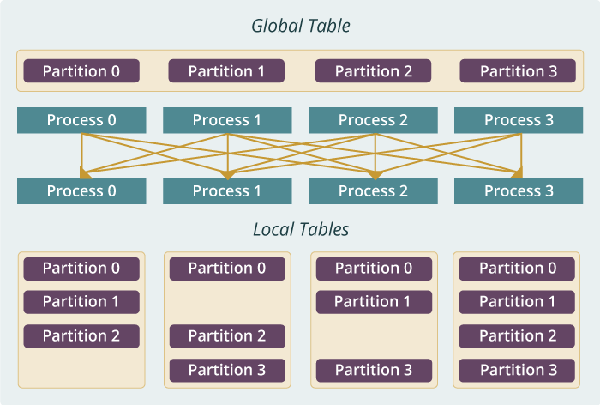
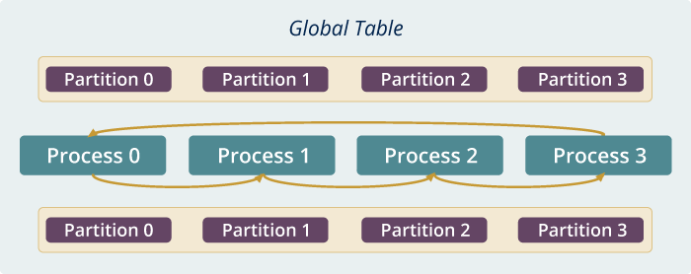
broadcast
reduce
allreduce
allgather
regroup
push & pull
rotate
Collective

Slide 34
public <P extends Simple> boolean broadcast(String contextName, String operationName, Table<P> table, int bcastWorkerID, boolean useMSTBcast)
Simple – the interface for ByteArray, ShortArray, IntArray, FloatArray, LongArray and DoubleArray and Writable
contextName – user defined name to separate operations indifferent groups
operationName – user defined name to separate operations
Table<P> table – the data structure to broadcast/receive data
bcastWorkerID – the worker to broadcast data
useMSTBcast – default broadcast algorithm is pipelining, set this option to true to enable minimum spanning tree algorithm
Broadcast

Slide 35
public <P extends Simple> boolean reduce(String contextName, String operationName, Table<P> table, int reduceWorkerID)
reduceWorkerID - the worker ID to receive the reduced data
contextName -user defined name to separate operations indifferent groups
operationName -user defined name to separate operations
table -the data structure to broadcast/receive data
Reduce

Slide 36
public <P extends Simple> boolean allgather(String contextName, String operationName, Table<P> table)
contextName – user defined name to separate operations indifferent groups
operationName –user defined name to separate operations
table -the data structure to broadcast/receive data
Allgather

Slide 37
public <P extends Simple> boolean allreduce(String contextName, String operationName, Table<P> table)
regroup("main", "regroup", table, new Partitioner(getNumWorkers()));
An Alternative Way (if the dataset is large…)
Normally…
allgather("main", "allgather", table);
Allreduce

Slide 38
public <P extends Simple, PT extends Partitioner> boolean regroup(String contextName, String operationName, Table<P> table, PT partitioner)
contextName –user defined name to separate operations indifferent groups
operationName –user defined name to separate operations
table –the data structure to broadcast/receive data
partitioner – tells which partition to go to which worker for regrouping, e.g. new Partitioner(numWorkers)
Regroup

Slide 39
public <P extends Simple, PT extends Partitioner> boolean push(String contextName, String operationName, Table<P> localTable, Table<P> globalTable, PT partitioner)
Retrieve the partitions from globalTable to localTable based on partition ID matching
Send the partitions from localTable to globalTable based on the partition ID matching
public <P extends Simple> boolean pull(String contextName, String operationName, Table<P> localTable, Table<P> globalTable, boolean useBcast)
useBcast – if broadcasting is used when a partition is required to send to all the processes.
partitioner – if some local partitions is not shown in the globalTable, a partitioner can be used to decide where partitions with this partition ID go
localTable - contains temporary local partitions
globalTable - is viewed as a distributed dataset where each partition ID is unique across processes
Push & Pull

Slide 40
rotate(String contextName, String operationName, Table<P> globalTable, Int2IntMap rotateMap)
rotateMap – the mapping between source worker and target worker
contextName -user defined name to separate operations indifferent groups
operationName -user defined name to separate operations
globalTable -- a distributed dataset where each partition ID is unique across processes
Rotate

Slide 41
Harp-DAAL Applications
• Demo • Hands-on

Slide 42
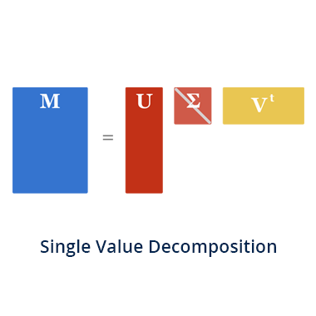
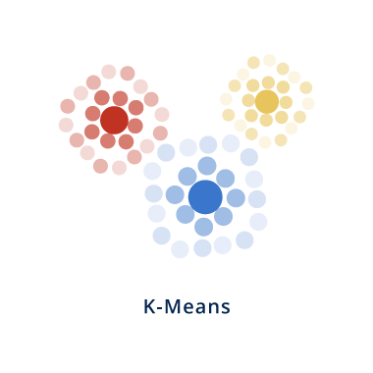
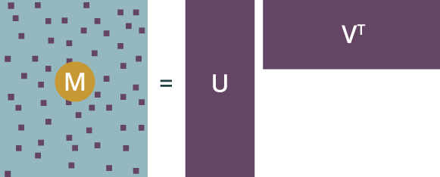
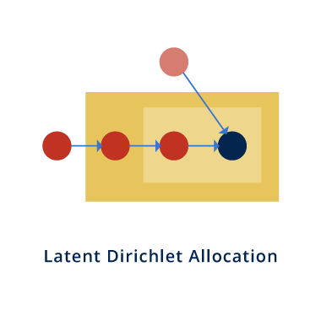
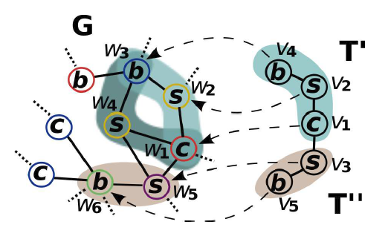
Explore Algorithms
PCA
Alternating least squares (ALS)
MatrixFactorization-SGD
SubGraph Counting

Slide 43
Harp-DAAL
Algorithms
Learning Tasks | Algorithms | Notes
Classification | Naive Bayes, Neural Network | Naive Bayes is not iterative Iterative algorithm
Regression | Linear Regression, Ridge Regression | All solved by normal equation, not iterative algorithms
Clustering | K-means | Iterative algorithm
Recommender System | Matrix Factorization(SGD), ALS | Iterative algorithm
Dimension Deduction | SVD, PCA, QR | Linear algebra kernel
Statistics | Moments, Covariance | Statistics

Slide 44
Distributed Memory
Computation Models
Model-Centric Synchronization Paradigm
broadcast
regroup
sendEvent
reduce
push & pull
getEvent
Computation Models
allgather
rotate
waitEvent
allreduce
Communication Operations
Locking
Rotation
Shared Memory
Schedulers
Intel® DAAL, MKL
High Performance Library
Allreduce
Asynchronous
Dynamic Scheduler
Static Scheduler
Solutions to Big Data Problems

Slide 45
Example: K-means Clustering
The Allreduce Computation Model
Model
Worker
Worker
Worker
When the model size cannot be held in each machine’s memory
When the model size is small
When the model size is large but can still be held in each machine’s memory
broadcast
regroup
push & pull
allreduce
reduce
allgather
rotate

Slide 46
Harp-DAAL-Kmeans workflow
Load Data from
HDFS in parallel
Load Training data to DAAL before iteration
Convert Model data
to DAAL in each iteration
Local computation offloaded to native DAAL kernel
Harp collective communication among mappers

Slide 47
Step 1 & 2: Load Training and Model Data
Training Data distributed among mappers, loaded from HDFS
Centroids are model data, mapper works at a local copy, synchronized globally
Centroids loaded by Master Mapper and broadcasted to all the mappers
Harp-DAAL has an efficient data loading module implemented by Java multi-threading

Slide 48
Step 3: Convert Data From Harp to DAAL
DAAL NumericTable has the memory allocated at Native side, with a given feature dim and table row number
Bulk copy Data from harp to DAAL by using API releaseBlockOfRows

Slide 49
Step 4: Create and setup DAAL K-means kernel
DAAL provides Java API to its native kernels
DAAL has K-means kernel for local computation of training data: Distance, partialSum, observations of clustering
A cenTable at DAAL side to
receive partialsum and observations from native kernel

Slide 50
Step 5: Convert Centroids data from Harp to DAAL ( for each iteration )
Convert non-continuous harp side centroids data to DAAL NumericTable by a multi-threaded converter

Slide 51
Step 6: Local Computation by DAAL kernel ( for each iteration)
Refresh the centroids data at each iteration by reset the input object of DAAL kernel
DAAL kernel update model by local training points.

Slide 52
Step 7: Inter-Mapper Communication ( for each iteration)
Four harp collective operations to suite different communication data size
Regroup operation combines partial results of the same centroid ID from all mappers, combined results re-assigned to different mappers
Allgather aggregate and broadcast averaged centroids data to each mapper

Slide 53
Step 8: Release Memory and Record
Release the memory allocation at DAAL side after the whole iterations
Write centroids (model back) back to HDFS

Slide 54
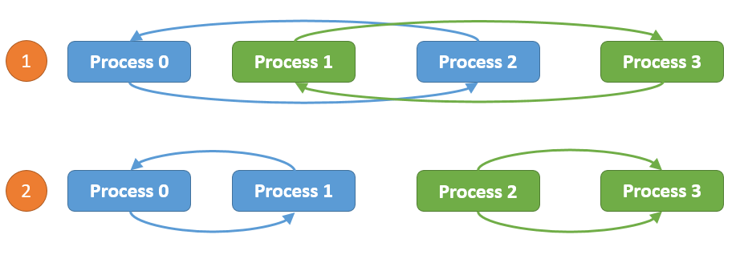
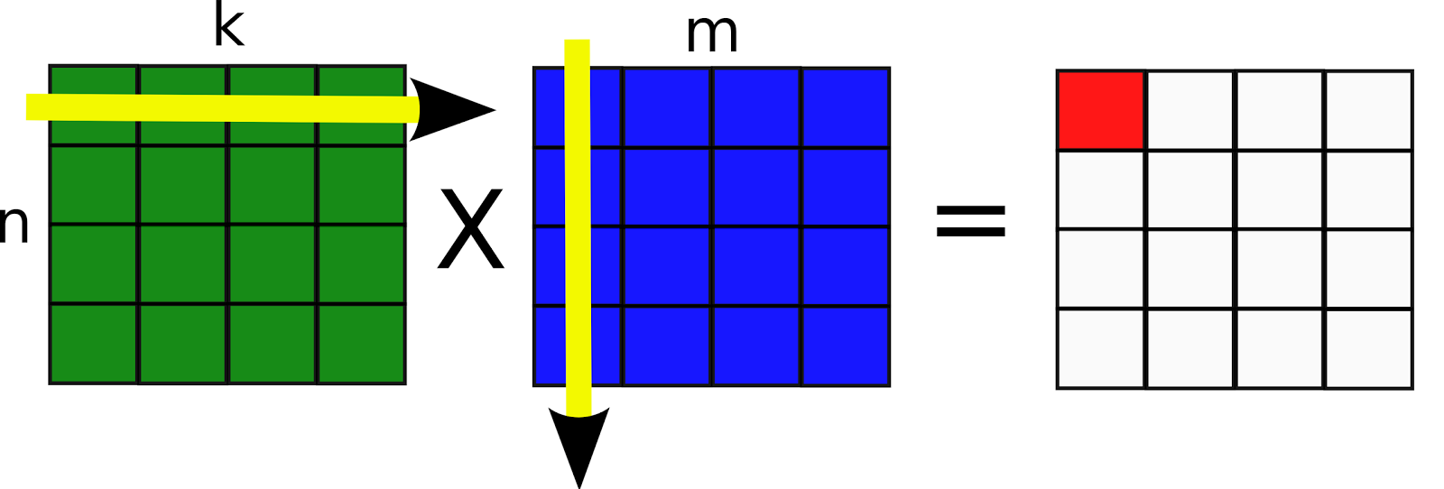
Computation models for K-means
Harp-DAAL-Kmeans
Inter-node: Allreduce, Easy to implement, efficient when model data is not large
Intra-node: Shared Memory, matrix-matrix operations, xGemm: aggregate vector-vector distance computation into matrix-matrix multiplication, higher computation intensity (BLAS-3)

Slide 55
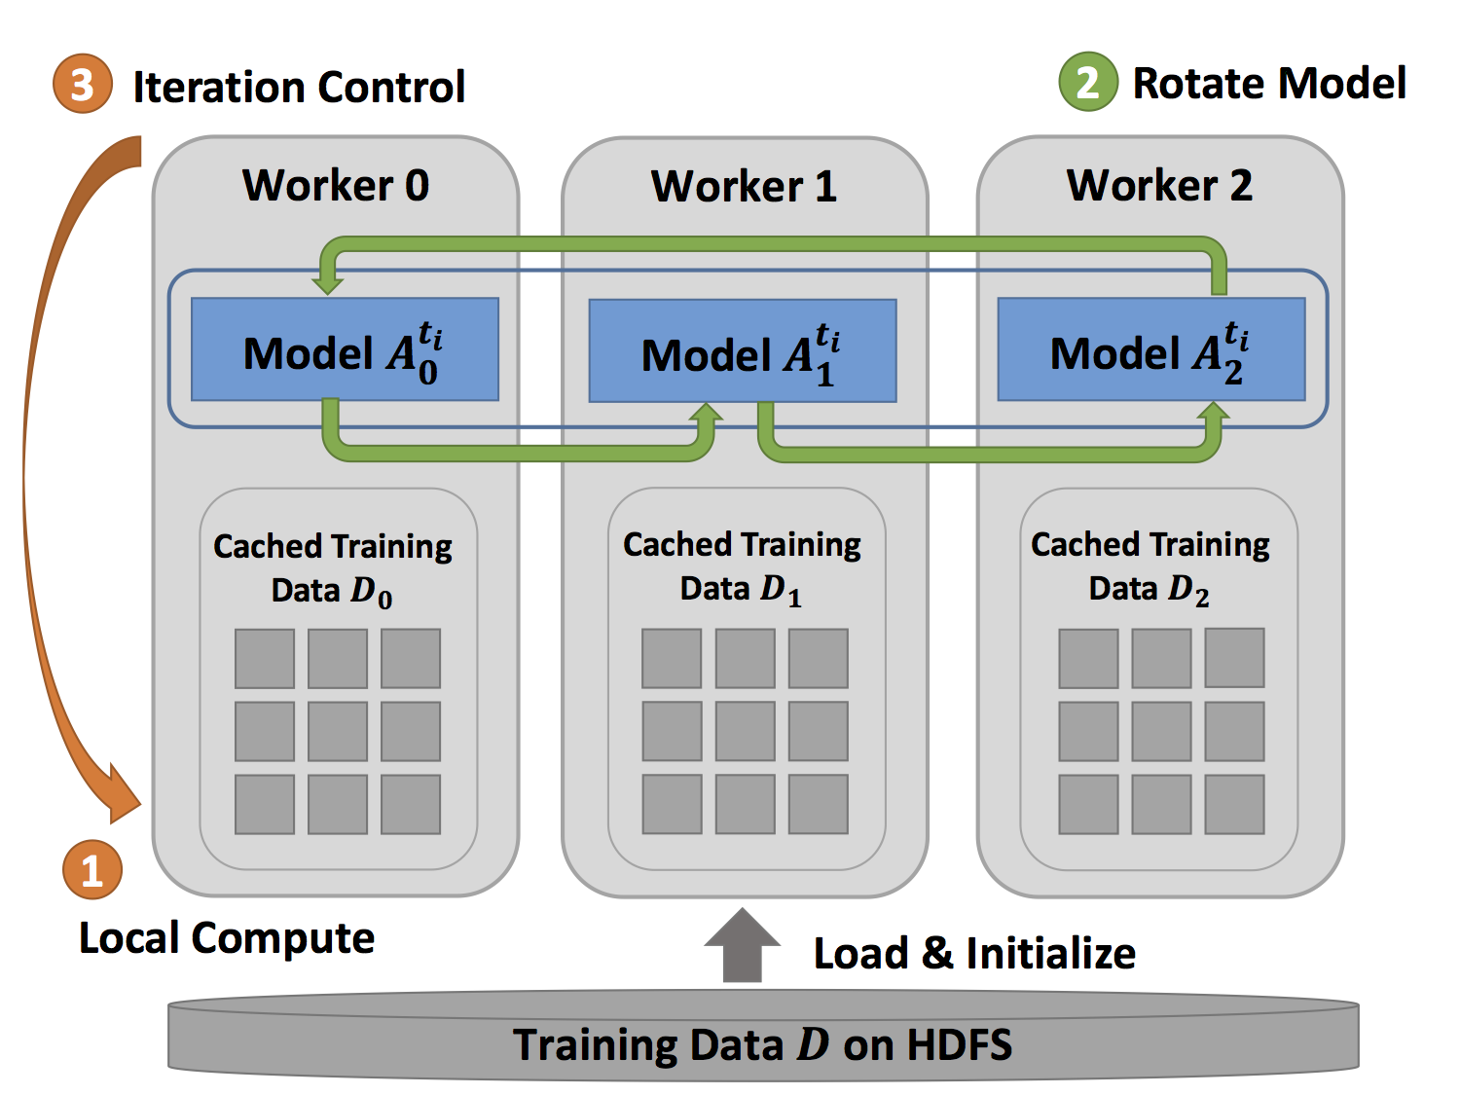
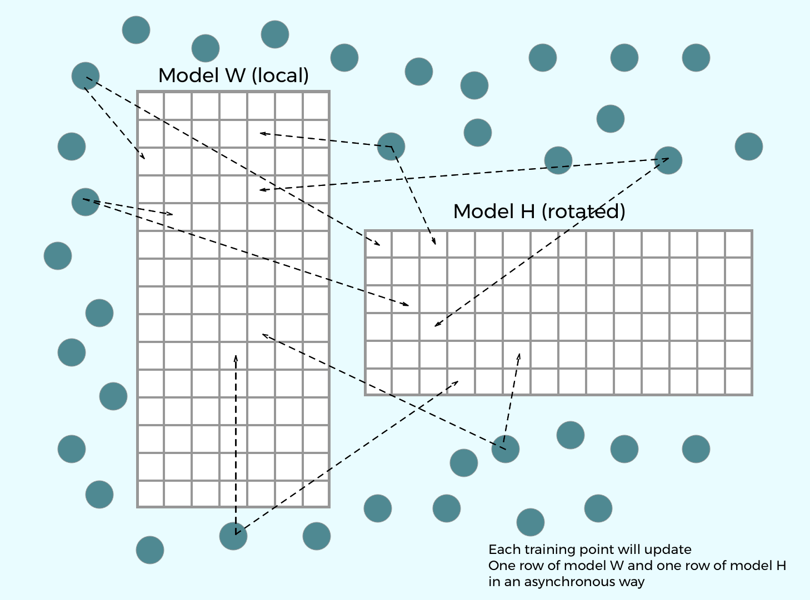
Computation models for MF-SGD
Inter-node: Rotation
Intra-node: Asynchronous
Rotation: Efficient when the mode data
Is large, good scalability
Asynchronous: Random access to model data
Good for thread-level workload balance.

Slide 56


Computation Models for ALS
Inter-node: Allreduce
Intra-node: Shared Memory, Matrix operations
xSyrk: symmetric rank-k update

Slide 57
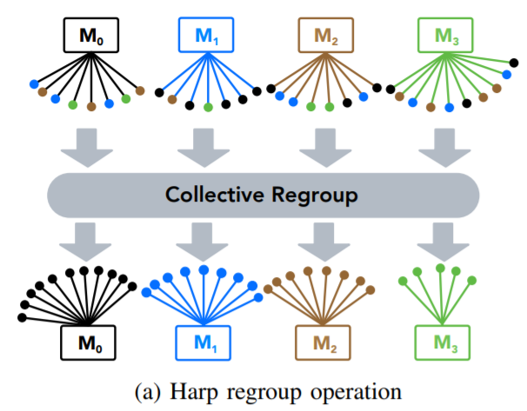
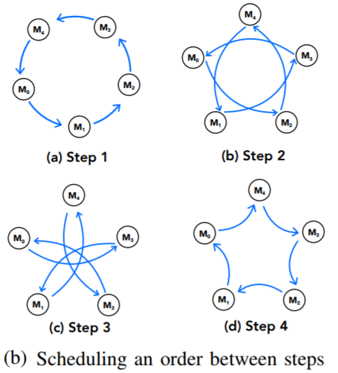

Computation models for Subgraph Counting
On-demand decoupled steps
Pipelined by computation
Each step partial collective communication within group
Com-Friendster
65 million nodes
5 billion edges
SNAP network repository
Count number of template u12-2
4.358118772743884$×{10}^{37}$
Count time of template u12-2
15 minutes

Slide 58
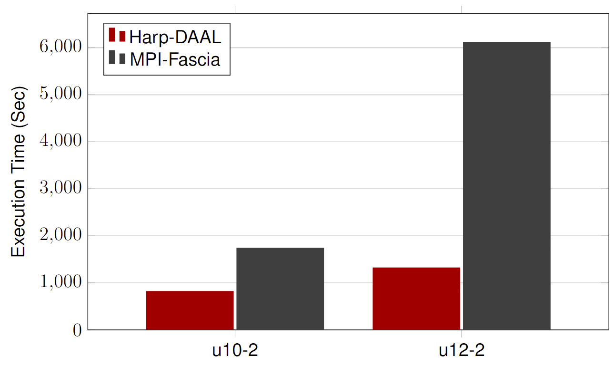
Datasets: Twitter with 44 million vertices, 2 billion edges, subgraph template size of 10 to 12 vertices
25 nodes of Intel® Xeon E5 2670
Harp-DAAL has 2x to 5x speedups over state-of-the-art MPI-Fascia solution
Performance

Slide 59
Harp-DAAL Applications
• Demo • Hands-on

Slide 60
Learning Tasks | Algorithms | Dataset | Notes
Clustering | K-means | 15scene | Fifteen Scene Categories
Classification | Naive Bayes | 20news | 20 newsgroups
Recommender System | Matrix Factorization(SGD) | movielens | Rating data sets from the MovieLens web site
Applications
for Hands-on

Slide 61
Data
Extract Features
Train Model
Evaluate
Deploy
Training
1 | 2 | 3 | 4 | 5
Define the problem, (binary or multiclass, classification or regression, evaluation metric...) | Dataset preparation, (data collection, data munging, cleaning, split, normalization, ...) | Feature engineering, (feature selection, dimension reduction, ...) | Training: select model and hyper-parameter tuning | Output the best models with optimized hyper-parameters
General Machine Learning
Pipeline

Slide 62
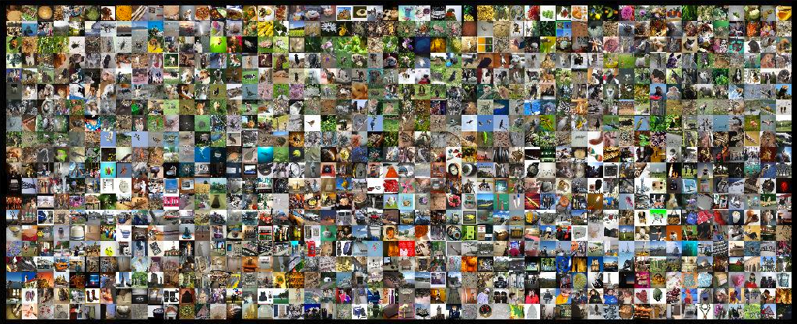
It's non-trivial to investigate the large scale image collections which contain billions of images.
Image clustering algorithms,such as K-Means,face performance and scalability issues when running on large datasets.
ImageNet
Problem

Slide 63
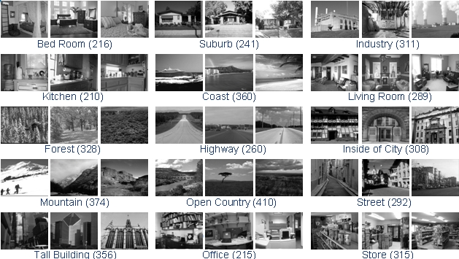
This is a dataset that consists of fifteen
natural scene
categories that expands on the thirteen category dataset released by
Fei Fei Li. The two
New categories are industrial and store.
Use the label as ground truth to evaluate the performance of K-Means.
Notes:
http://www.cs.ucf.edu/~liujg/co_clustering.html

Slide 64
Data
Extract Features
Train Model
Evaluate
1 | 2 | 3 | 4
Data 15Scene,4485 images,15 categroies | Features extract 1000 sbow features with the imagenet feature extraction tool ILSVRC2010_devkit-1.0. | Train K-Means, euclidean distance on sbow features, K=15 | Evaluate cluster quality metrics, such as homo(homogeneity score), ARI(adjusted Rand index) etc.
Solution
Kmeans

Slide 65
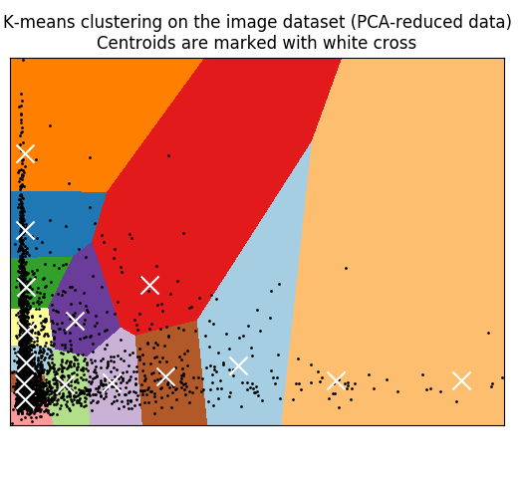
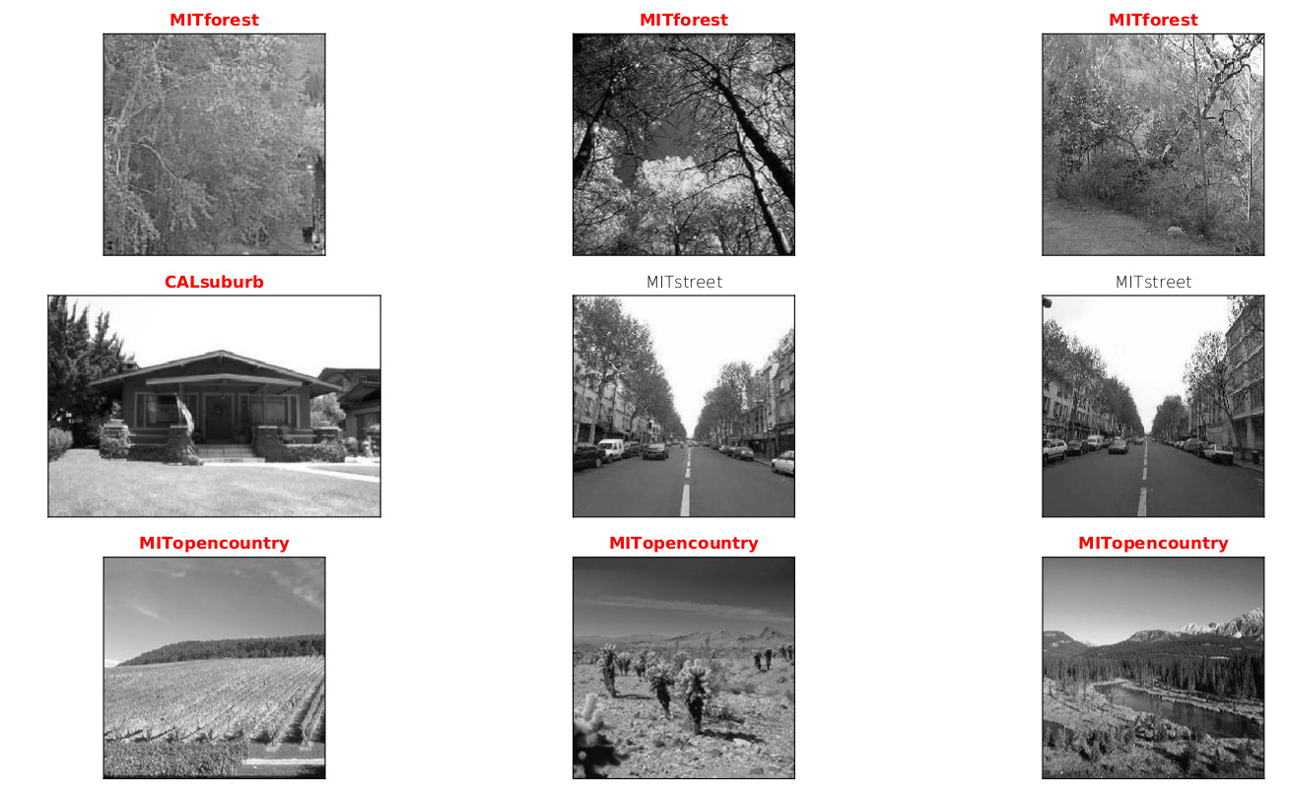
result: sample images of the result clusters,
one row for each cluster
Result

Slide 66
Summary
A bold ideas developed behind Harp-DAAL is HPC-ABDS , ­­ Apache Big Data Software Stack integration with High Performance Computing Stack
    ABDS (Many Big Data applications or algorithms need HPC for performance)
    HPC (needs software model productivity and sustainability)
High performance Hadoop (with Harp collective communication and high performance Intel® DAAL kernel library enhancement) on Intel® Xeon™ and Xeon architectures can give fast solutions for machine learning and graph applications.

Slide 67
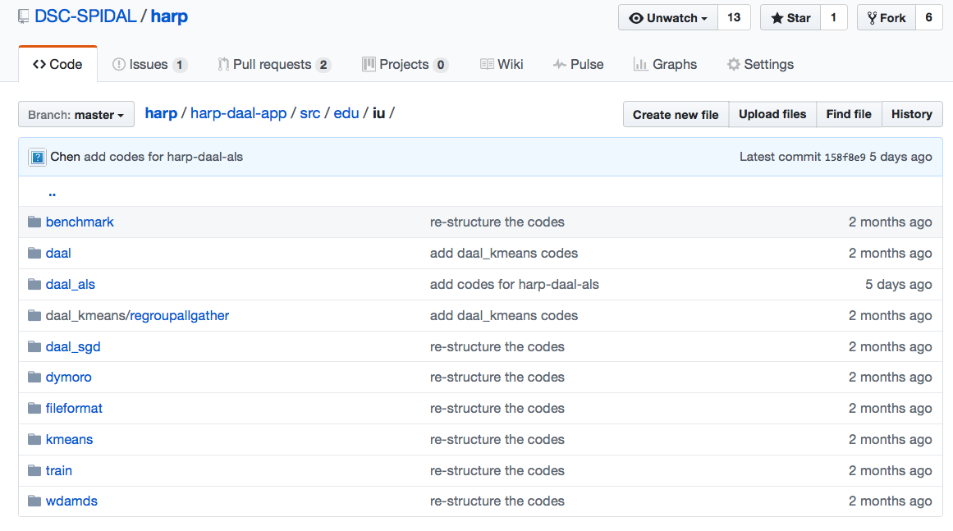
Harp-DAAL: Prototype and Production Code
Available at https://dsc-spidal.github.io/harp
Source codes became available on Github in February, 2017.
Harp-DAAL follows the same standard of DAAL’s original codes
Twelve Applications
  Harp-DAAL Kmeans
  Harp-DAAL MF-SGD
  Harp-DAAL MF-ALS
  Harp-DAAL SVD
  Harp-DAAL PCA
  Harp-DAAL Neural Networks
  Harp-DAAL Naïve Bayes
  Harp-DAAL Linear Regression
  Harp-DAAL Ridge Regression
  Harp-DAAL QR Decomposition
  Harp-DAAL Low Order Moments
  Harp-DAAL Covariance

Slide 68

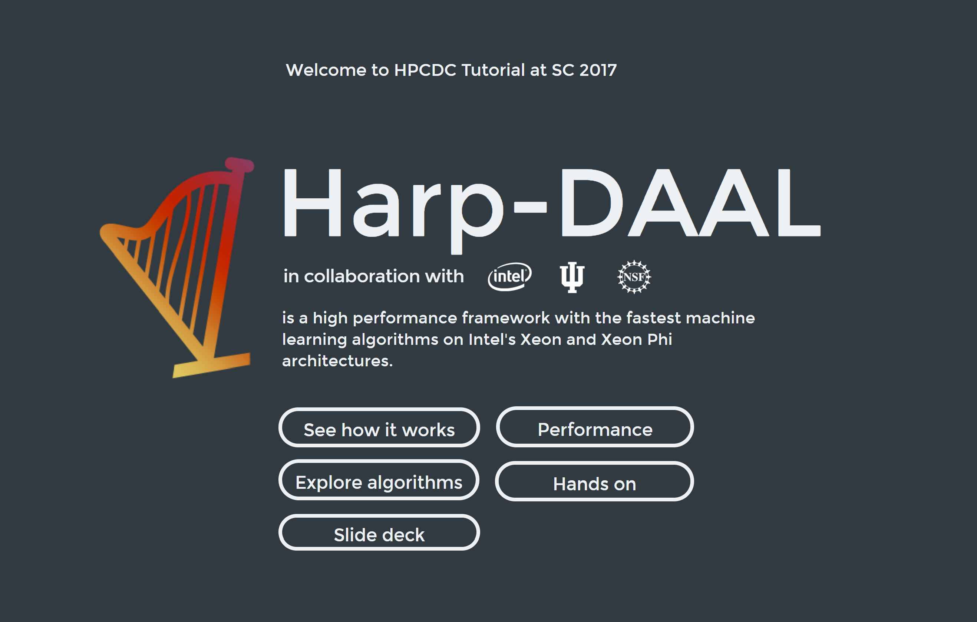
Interactive Website (https://dexterrules.github.io/SC-Demo-17/SC-Demo.html)

