Slide 1

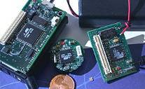

Extreme Data-Intensive Computing
Alex Szalay
The Johns Hopkins University

Slide 2
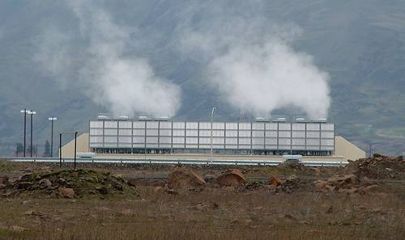
Living in an Exponential World
Scientific data doubles every year
  caused by successive generations
  of inexpensive sensors +
  exponentially faster computing
Changes the nature of scientific computing
Cuts across disciplines (eScience)
It becomes increasingly harder to extract knowledge
20% of the world’s servers go into huge data centers by the “Big 5”
  Google, Microsoft, Yahoo, Amazon, eBay

Slide 3
Collecting Data
Very extended distribution of data sets:
data on all scales!
Most datasets are small, and manually maintained (Excel spreadsheets)
Total amount of data dominated by the other end
(large multi-TB archive facilities)
Most bytes today are collected
via electronic sensors
size

Slide 4
Scientific Data Analysis
Data is everywhere, never will be at a single location
Architectures increasingly CPU-heavy, IO-poor
Data-intensive scalable architectures needed
Need randomized, incremental algorithms
  Best result in 1 min, 1 hour, 1 day, 1 week
Most scientific data analysis done on small to midsize BeoWulf clusters, from faculty startup
Universities hitting the “power wall”
Not scalable, not maintainable…

Slide 5
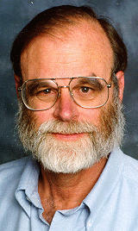
Gray’s Laws of Data Engineering
Jim Gray:
Scientific computing is revolving around data
Need scale-out solution for analysis
Take the analysis to the data!
Start with “20 queries”
Go from “working to working”
DISC: Data Intensive Scientific Computing
The Fourth Paradigm of Science

Slide 6
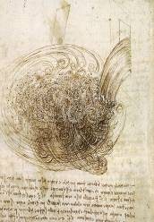
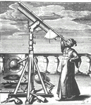
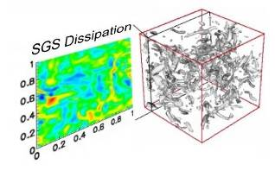
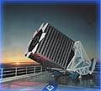
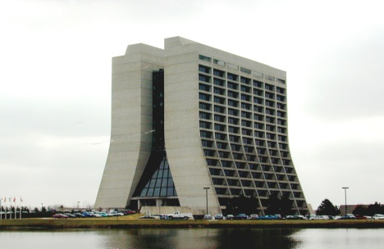
Evolving Science
Thousand years ago:
science was empirical
  describing natural phenomena
Last few hundred years:
theoretical branch
  using models, generalizations
Last few decades:
a computational branch
  simulating complex phenomena
Today:
data exploration (eScience)
  synthesizing theory, experiment and
  computation with advanced data
  management and statistics
  → new algorithms!

Slide 7
Building Scientific Databases
10 years ago we set out to explore how to cope with the data explosion (with Jim Gray)
Started in astronomy, with the Sloan Digital Sky Survey
Expanded into other areas, while exploring what can be transferred
During this time data sets grew from 100GB to 100TB
Interactions with every step of the scientific process
  Data collection, data cleaning, data archiving, data organization, data publishing, mirroring, data distribution, data curation…

Slide 8
Reference Applicatons
Some key projects at JHU
  SDSS: 100TB total, 35TB in DB, in use for 8 years
  NVO : ~5TB, few billion rows, in use for 4 years
  PanStarrs: 80TB by 2011, 300+ TB by 2012
  Immersive Turbulence: 30TB now, 100TB by Dec 2010
  Sensor Networks: 200M measurements now, forming complex relationships
Key Questions:
What are the reasonable tradeoffs for DISC?
How do we build a ‘scalable’ architecture?
How do we interact with petabytes of data?

Slide 9

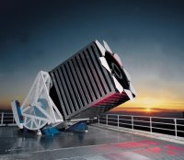
Sloan Digital Sky Survey
The University of Chicago
Princeton University
The Johns Hopkins University
The University of Washington
New Mexico State University
Fermi National Accelerator Laboratory
US Naval Observatory
The Japanese Participation Group
The Institute for Advanced Study
Max Planck Inst, Heidelberg
Sloan Foundation, NSF, DOE, NASA
“The Cosmic Genome Project”
Two surveys in one
  Photometric survey in 5 bands
  Spectroscopic redshift survey
Data is public
  40 TB of raw data
  5 TB processed catalogs
  2.5 Terapixels of images
Started in 1992, finishing in 2008
Database and spectrograph
built at JHU (SkyServer)

Slide 10
SDSS Now Finished!
As of May 15, 2008 SDSS is officially complete
Final data release (DR7.2) later this year
Final archiving of the data in progress
  Paper archive at U. Chicago Library
  Digital Archive at JHU Library
Archive will contain >150TB
  All raw data
  All processed/calibrated data
  All version of the database
  Full email archive and technical drawings
  Full software code repository

Slide 11
Database Challenges
Loading (and scrubbing) the Data
Organizing the Data (20 queries, self-documenting)
Accessing the Data (small and large queries, visual)
Delivering the Data (workbench, versions: DRx)
Analyzing the Data (spatial, scaling…)

Slide 12
MyDB: Workbench
Need to register ‘power users’, with their own DB
Query output goes to ‘MyDB’
Can be joined with source database
Results are materialized from MyDB upon request
Users can do:
  Insert, Drop, Create, Select Into, Functions, Procedures
  Publish their tables to a group area
Data delivery via the CASJobs (C# WS)
=> Sending analysis to the data!

Slide 13
Spatial Search Capabilities
SDSS has lots of complex boundaries
  60,000+ regions
  6M masks, represented as spherical polygons
Need fast, multidimensional spatial searches!
A GIS-like library built in C++ and SQL
Now converted to C# for direct plugin into
SQLServer 2008 (17 times faster than C++)
Precompute arcs and store in database for rendering
Functions for point in polygon, intersecting polygons, polygons covering points, all points in polygon
Using spherical quadtrees (HTM)

Slide 14
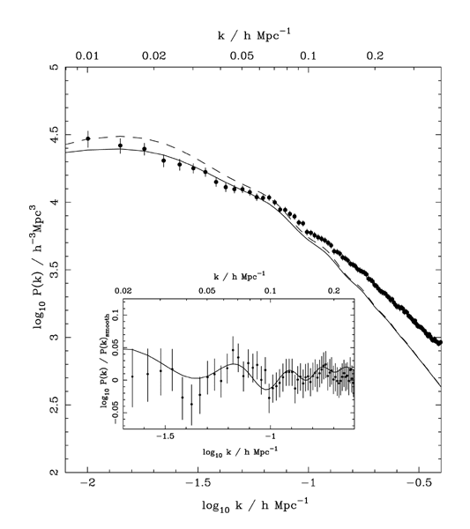
Primordial Sound Waves in SDSS
800K galaxies
Power Spectrum
(Percival et al 2006, 2007)
SDSS DR5
SDSS DR6+2dF

Slide 15
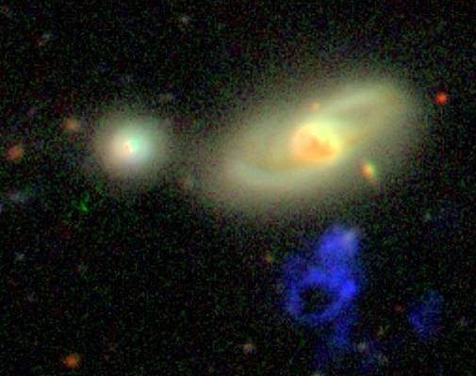
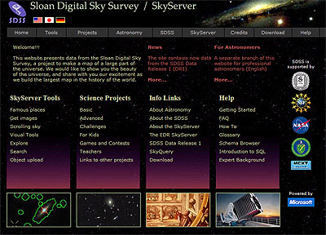
Public Use of the SkyServer
Prototype in 21st Century data access
  400 million web hits in 6 years
  930,000 distinct users
  vs 10,000 astronomers
  Delivered 50,000 hours
  of lectures to high schools
  Delivered 100B rows of data
  Everything is a power law
GalaxyZoo
  40 million visual galaxy classifications by the public
  Enormous publicity (CNN, Times, Washington Post, BBC)
  100,000 people participating, blogs, poems, ….
  Now truly amazing original discovery by a schoolteacher

Slide 16
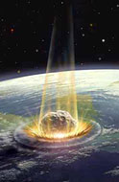
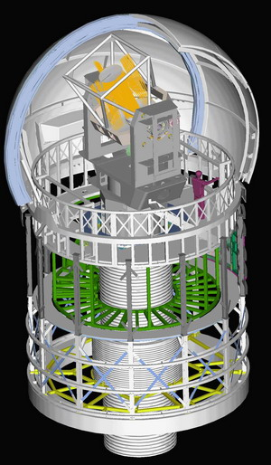
Pan-STARRS
Detect ‘killer asteroids’
  PS1: starting in May 1, 2010
  Hawaii + JHU + Harvard/CfA +
  Edinburgh/Durham/Belfast +
  Max Planck Society
Data Volume
  >1 Petabytes/year raw data
  Camera with 1.4Gigapixels
  Over 3B celestial objects
  plus 250B detections in database
  80TB SQLServer database built at JHU,
  3 copies for redundancy

Slide 17


Virtual Observatory
NSF ITR project, “Building the Framework for the National Virtual Observatory” collaboration of 20 groups
  Astronomy data centers
  National observatories
  Supercomputer centers
  University departments
  Computer science/information technology specialists
Similar projects now in 15 countries world-wide
International Virtual Observatory Alliance
NSF+NASA=> VAO!

Slide 18
Common VO Challenges
Most challenges are sociological, not technical !!!!!!!!!!
Hard to find data (yellow pages/repository)
Threshold for publishing data is currently too high
Scientists want calibrated data with occasional access to low-level raw data
High level data models take a long time…
Robust applications are hard to build (factor of 3…)
Geospatial everywhere, but GIS is not good enough
Archives on all scales, all over the world
VOSpace – distributed user repository services

Slide 19
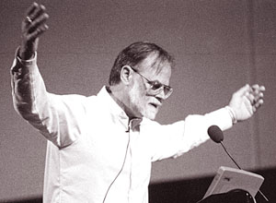
Why Is Astronomy Special?
Especially attractive for the wide public
Community is not very large
It has no commercial value
  No privacy concerns, freely share results with others
  Great for experimenting with algorithms
It is real and well documented
  High-dimensional (with confidence intervals)
  Spatial, temporal
Diverse and distributed
  Many different instruments from many
  different places and times
The questions are interesting
There is a lot of it (soon petabytes)
WORTHLESS!

Slide 20
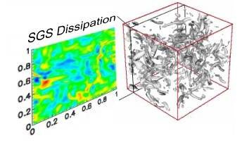
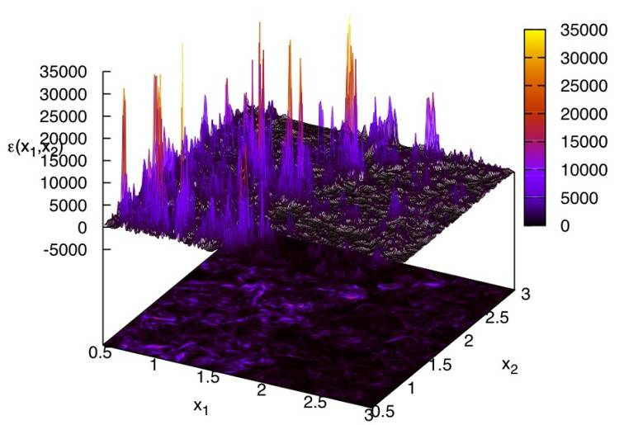
Immersive Turbulence
Understand the nature of turbulence
  Consecutive snapshots of a
  1,024³ simulation of turbulence:
  now 30 Terabytes
  Treat it as an experiment, observe
  the database!
  Throw test particles (sensors) in from
  your laptop, immerse into the simulation,
  like in the movie Twister
New paradigm for analyzing
HPC simulations!
with C. Meneveau, S. Chen (Mech. E), G. Eyink (Applied Math), R. Burns (CS)

Slide 21

The JHU public turbulence database
TDB group @ JHU
Eric Perlman², Minping Wan¹, Yi Li¹, Yunke Yang¹, Huidan Yu¹, Jason Graham¹
Randal Burns², Alex Szalay³, Shiyi Chen¹, Gregory Eyink⁴, Charles Meneveau¹
(1) Mechanical Engineering, (2) Computer Science, (3) Physics and Astronomy, (4) Applied Mathematics & Statistics.
Significant help and support: Jan Vandenberg³, Alainna White³, Támás Budávari³
Funding: National Science Foundation ITR, MRI, CDI-II, W.M. Keck Foundation

Slide 22
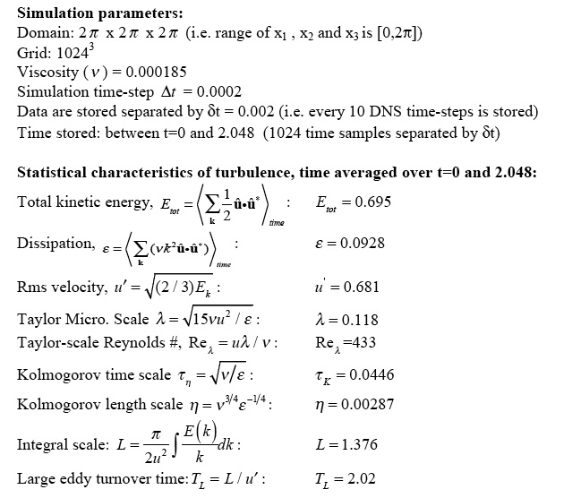
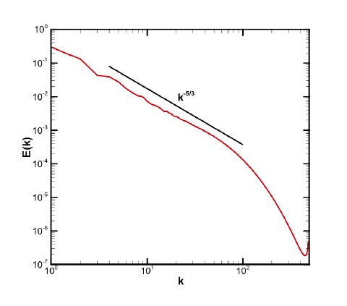
DNS of forced isotropic turbulence
(standard pseudo-spectral):
1024⁴ space-time history
16 -> 27 TBytes
Re_{λ}~ 430

Slide 23
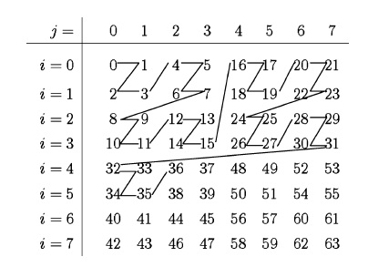
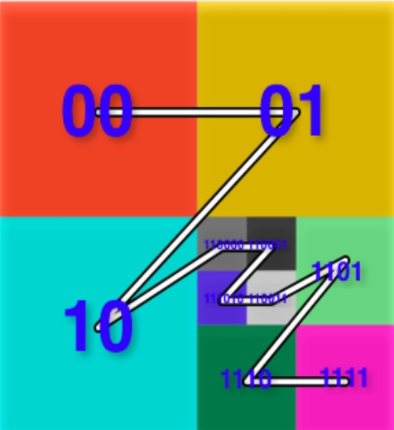
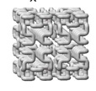
Database design philosophies
“Move operations as close as possible to the data”:
Most elementary operations in analysis of CFD data (constrained on locality):
    Differentiation (high-order finite-differencing)
    Interpolation (Lagrange polynomial interpolation)
“Storage schema must facilitate rapid searches”
    Most basic search: given x,y,z,t position, find field variables (u,v,w,p).
    Define elementary data-cube (optimize size relative to typical queries)
    and arrange along Z curve and indexing using oct-tree:

Slide 24
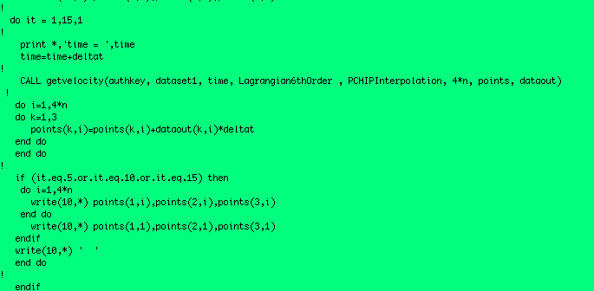
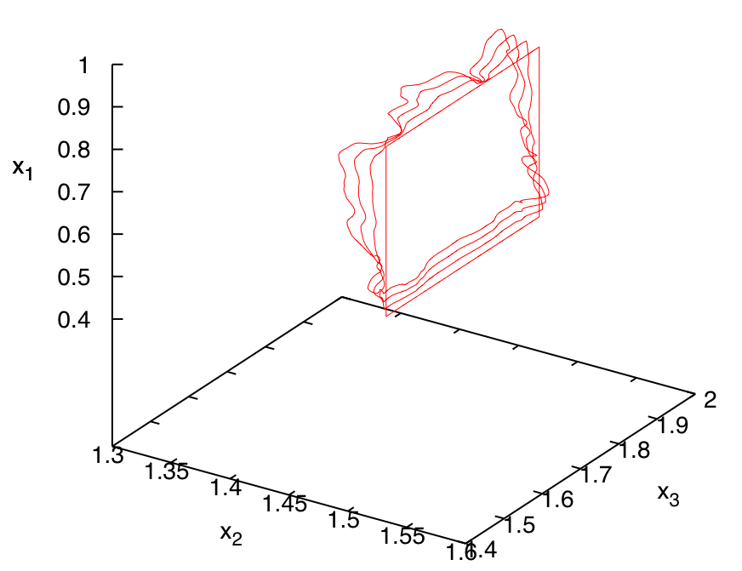
Sample code (fortran 90)
minus
-
-
-
advect backwards in time !
Not possible during DNS

Slide 25
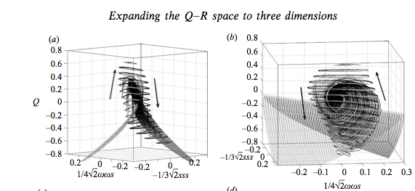
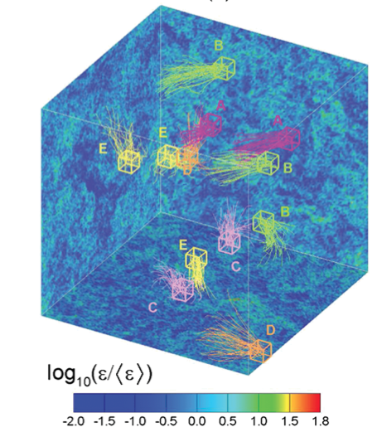
Sample Applications
Experimentalists testing PIV-based pressure-gradient measurement
(X. Liu & Katz, 61 APS-DFD meeting, November 2008)
Measuring velocity gradient using a new set of 3 invariants
Luethi, Holzner & Tsinober,
J. Fluid Mechanics 641, pp. 497-507 (2010)
Lagrangian time correlation in turbulence
Yu & Meneveau
Phys. Rev. Lett. 104, 084502 (2010)

Slide 26
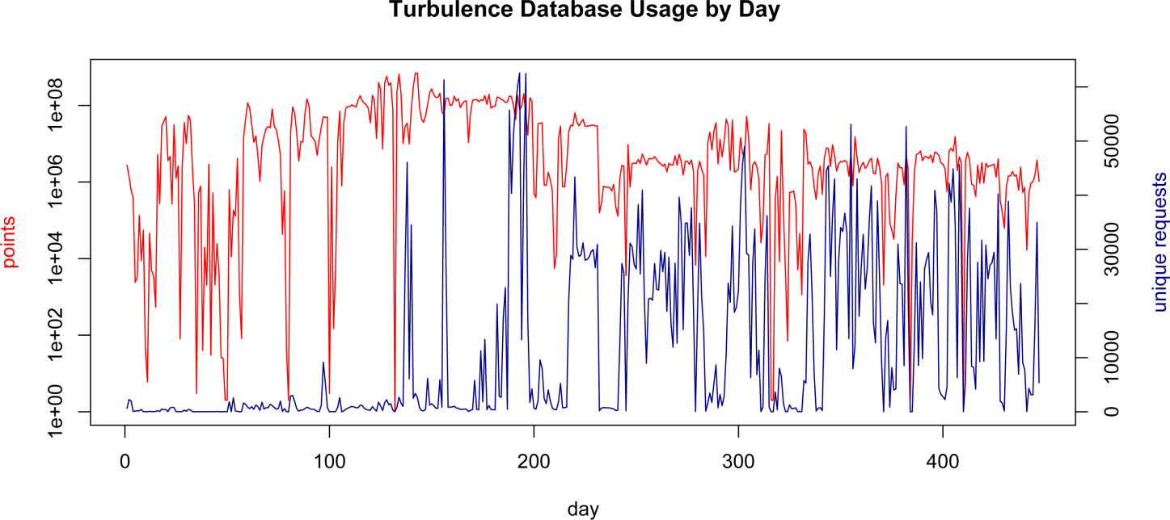
Daily Usage

Slide 27
Cosmological Simulations
Cosmological simulations have 10⁹ particles and
produce over 30TB of data (Millennium)
Build up dark matter halos
Track merging history of halos
Use it to assign star formation history
Combination with spectral synthesis
Realistic distribution of galaxy types
Hard to analyze the data afterwards -> need DB
What is the best way to compare to real data?
Next generation of simulations with 10¹² particles
and 500TB of output are already happening

Slide 28
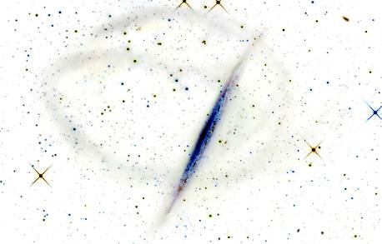
The Milky Way Laboratory
Pending NSF Proposal to use cosmology simulations as an immersive laboratory for general users
Use Via Lactea-II (20TB) as prototype, then Silver River (500TB+) as production (15M CPU hours)
Output 10K+ hi-rez snapshots (200x of previous)
Users insert test particles (dwarf galaxies) into
system and follow trajectories in
precomputed simulation
Realistic “streams” from tidal
disruption
Users interact remotely with
0.5PB in ‘real time’

Slide 29
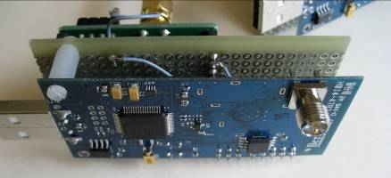
Life Under Your Feet
Role of the soil in Global Change
  Soil CO₂ emission thought to be
  >15 times of anthropogenic
  Using sensors we can measure it
  directly, in situ, over a large area
Wireless sensor network
  Use 100+ wireless computers (motes),
  with 10 sensors each, monitoring
    Air +soil temperature, soil moisture, …
    Few sensors measure CO₂ concentration
  Long-term continuous data, 180K sensor days, 30M samples
  Complex database of sensor data, built from the SkyServer
  End-to-end data system, with inventory and calibration databases
with K.Szlavecz (Earth and Planetary), A. Terzis (CS)
http://lifeunderyourfeet.org/

Slide 30
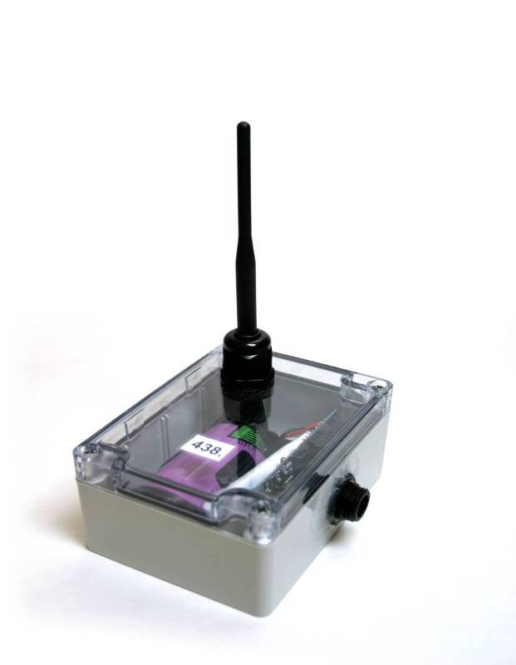
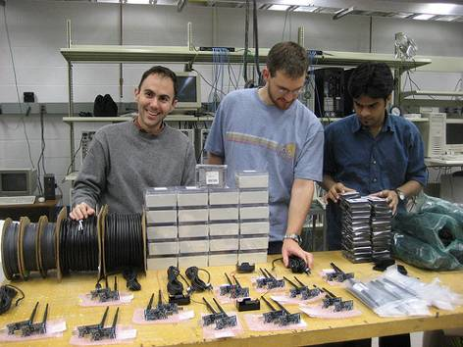
Current Status
Designed and built 2nd generation mote platform
  Telos SkyMote + own DAQ board
Hierarchical network architecture (Koala)
Improved mote software
  Support for large-scale deployments
  Over-the-air reprogramming
  Daily log file written
  Increased power efficiency
  (2 years on a single battery)

Slide 31
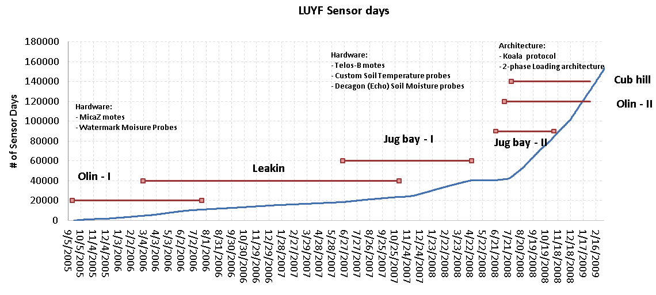
Cumulative Sensor Days

Slide 32
Commonalities
Huge amounts of data, aggregates needed
  But also need to keep raw data
  Need for parallelism
Use patterns enormously benefit from indexing
  Rapidly extract small subsets of large data sets
  Geospatial everywhere
  Compute aggregates
  Fast sequential read performance is critical!!!
  But, in the end everything goes…. search for the unknown!!
Data will never be in one place
  Newest (and biggest) data are live, changing daily
Fits DB quite well, but no need for transactions
Design pattern: class libraries wrapped in SQL UDF
  Take analysis to the data!!

Slide 33
Continuing Growth
How long does the data growth continue?
High end always linear
Exponential comes from technology + economics
⬄ rapidly changing generations
  like CCD’s replacing plates, and become ever cheaper
How many new generations of instruments do we have left?
Are there new growth areas emerging?
Software is becoming a new kind instrument
  Value added federated data sets
  Simulations
  Hierarchical data replication

Slide 34
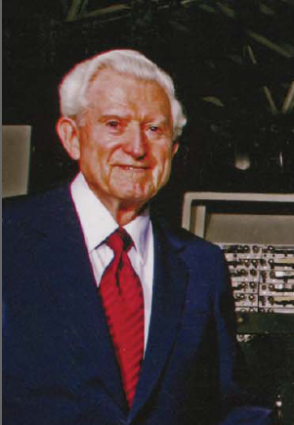
Amdahl’s Laws
Gene Amdahl (1965): Laws for a balanced system
Parallelism: max speedup is S/(S+P)
One bit of IO/sec per instruction/sec (BW)
One byte of memory per one instruction/sec (MEM)
Modern multi-core systems move farther
away from Amdahl’s Laws
(Bell, Gray and Szalay 2006)

Slide 35
Typical Amdahl Numbers

Slide 36
Amdahl Numbers for Data Sets
Data Analysis

Slide 37
The Data Sizes Involved

Slide 38
DISC Needs Today
Disk space, disk space, disk space!!!!
Current problems not on Google scale yet:
  10-30TB easy, 100TB doable, 300TB really hard
  For detailed analysis we need to park data for several mo
Sequential IO bandwidth
  If not sequential for large data set, we cannot do it
How do can move 100TB within a University?
  1Gbps 10 days
  10 Gbps 1 day (but need to share backbone)
  100 lbs box few hours
From outside?
  Dedicated 10Gbps or FedEx

Slide 39
Tradeoffs Today
Stu Feldman: Extreme computing is about tradeoffs
Ordered priorities for data-intensive science
  Total storage (-> low redundancy)
  Cost (-> total cost vs price of raw disks)
  Sequential IO (-> locally attached disks, fast ctrl)
  Fast stream processing (->GPUs inside server)
  Low power (-> slow normal CPUs, lots of disks/mobo)
The order will be different in a few years...and scalability may appear as well

Slide 40
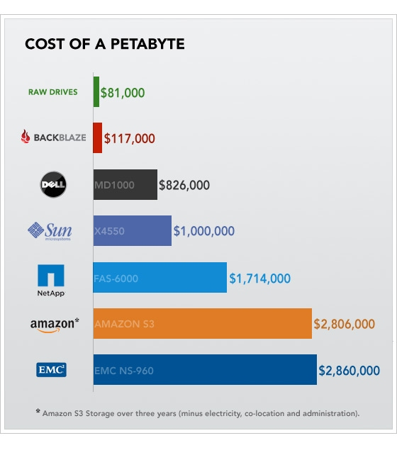
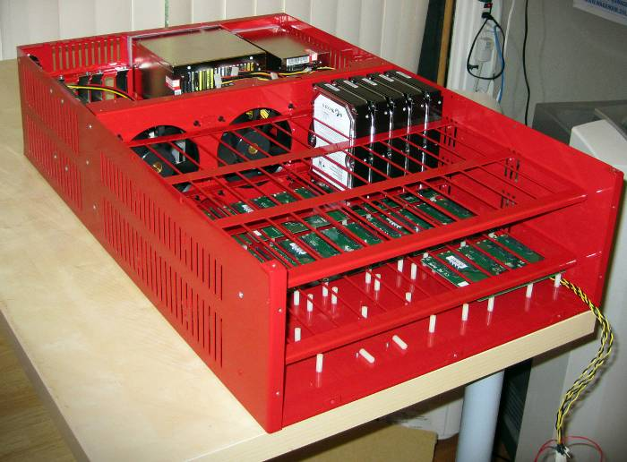
Cost of a Petabyte
From backblaze.com

Slide 41
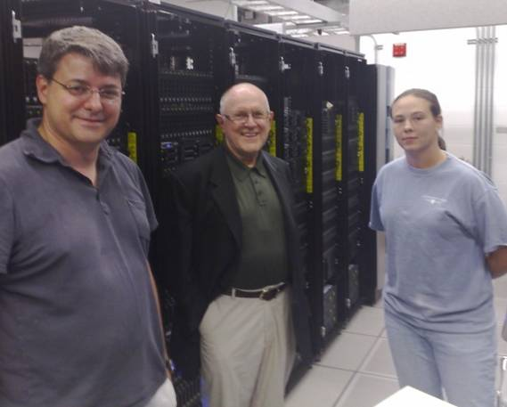

Petascale Computing at JHU
Distributed SQL Server cluster/cloud w.
50 Dell servers, 1PB disk, 500 CPU
Connected with 20 Gbit/sec Infiniband
10Gbit lambda uplink to UIC
Funded by Moore Foundation,
Microsoft and Pan-STARRS
Dedicated to eScience, provide
public access through services
Linked to 1000 core compute cluster
Room contains >100 of wireless temperature sensors

Slide 42
GrayWulf Performance
Demonstrated large scale scientific computations involving ~200TB of DB data
DB speeds close to “speed of light” (72%)
Scale-out over SQL Server cluster
Aggregate I/O over 12 nodes
  17GB/s for raw IO, 12.5GB/s with SQL
Scales to over 70GB/s for 46 nodes from $700K
Cost efficient: $10K/(GB/s)
Excellent Amdahl number : 0.50
But: we are already running out of space…..

Slide 43
Data-Scope
Proposal to NSF MRI to build a new ‘instrument’ to look at data
102 servers for $1M + about $200K switches+racks
Two-tier: performance (P) and storage (S)
Large (5PB) + cheap + fast (460GBps), but …
. ..a special purpose instrument
 | 1P | 1S | 90P | 12S | Full
servers | 1 | 1 | 90 | 12 | 102
rack units | 4 | 12 | 360 | 144 | 504
capacity | 24 | 252 | 2160 | 3024 | 5184 | TB
price | 8.5 | 22.8 | 766 | 274 | 1040 | $K
power | 1 | 1.9 | 94 | 23 | 116 | kW
GPU | 6 | 0 | 540 | 0 | 540 | TF
seq IO | 4.6 | 3.8 | 414 | 45 | 459 | GBps
netwk bw | 10 | 20 | 900 | 240 | 1140 | Gbps

Slide 44
Proposed Projects at JHU
Discipline | data [TB]
Astrophysics | 930
HEP/Material Sci. | 394
CFD | 425
BioInformatics | 414
Environmental | 660
Total | 2823
19 projects total, data lifetimes between 3 mo and 3 yrs

Slide 45
Short Term Trends
Large data sets are here, solutions are not
  100TB is the current practical limit
National Infrastructure does not match power law
No real data-intensive computing facilities available
  Some are becoming a “little less CPU heavy”
Even HPC projects choking on IO
Cloud hosting currently very expensive
Cloud computing tradeoffs different from science needs
Scientists are “cheap”, also pushing the limit
  We are still building our own…
  We will see campus level aggregation
  May become the gateways to future cloud hubs

Slide 46
5 Year Trend
Sociology:
  Data collection in ever larger collaborations (VO)
  Analysis decoupled, off archived data by smaller groups
  Data sets cross over to multi-PB
Some form of a scalable Cloud solution inevitable
  Who will operate it, what business model, what scale?
  How does the on/off ramp work?
  Science needs different tradeoffs than eCommerce
Scientific data will never be fully co-located
  Geographic origin tied to experimental facilities
  Streaming algorithms, data pipes for distributed workflows
  “Data diffusion”?
  Containernet (Church, Hamilton, Greenberg 2010)

Slide 47
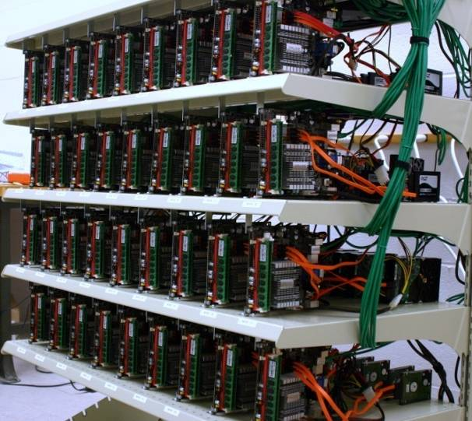
Future: Cyberbricks?
36-node Amdahl cluster using 1200W total
Zotac Atom/ION motherboards
  4GB of memory, N330 dual core Atom, 16 GPU cores
Aggregate disk space 43.6TB
  63 x 120GB SSD = 7.7 TB
  27x 1TB Samsung F1 = 27.0 TB
  18x.5TB Samsung M1= 9.0 TB
Blazing I/O Performance: 18GB/s
Amdahl number = 1!
Cost is less than $30K
Using the GPUs for data mining:
  6.4B multidimensional regressions
  in 5 minutes over 1.2TB

Slide 48
Summary
Science community starving for storage and IO
  Data-intensive computations as close to data as possible
Real multi-PB solutions are needed NOW!
  We have to build it ourselves
Current architectures cannot scale much further
  Need to get off the curve leading to power wall
  Multicores/GPGPUs + SSDs are a disruptive change!
Need an objective metrics for DISC systems
  Amdahl number appears to be good match to apps
Future in low-power, fault-tolerant architectures
  We propose scaled-out “Amdahl Data Clouds”
A new, Fourth Paradigm of science is emerging
  Many common patterns across all scientific disciplines

Slide 49
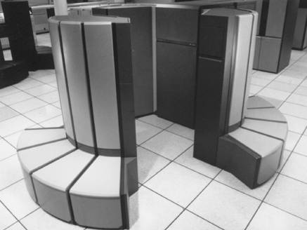
Yesterday: CPU cycles

Slide 50
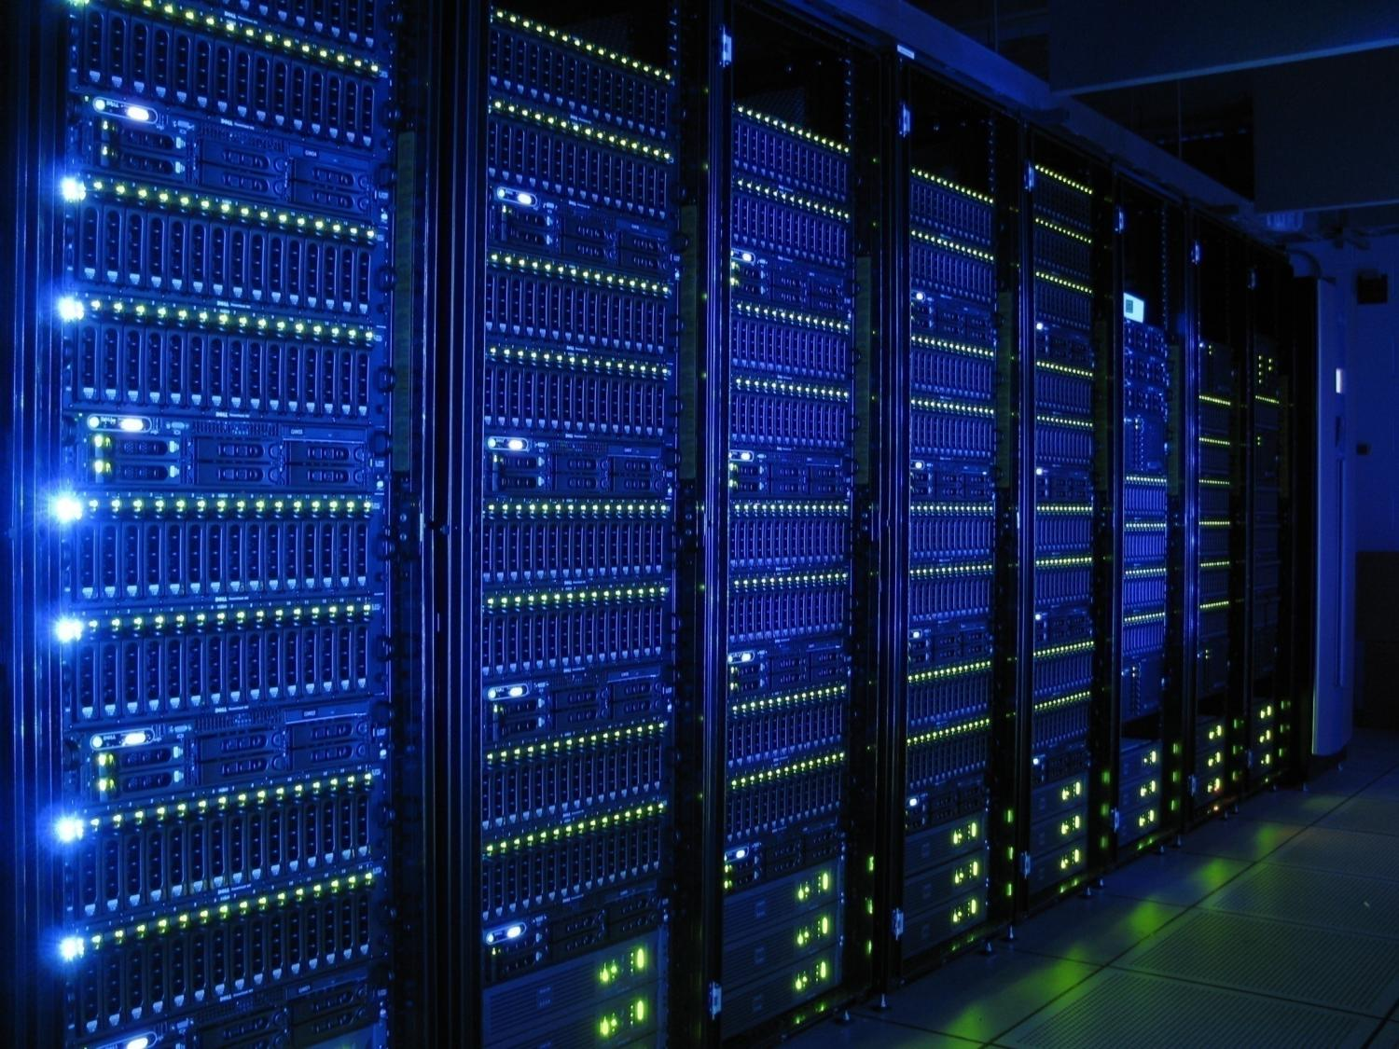
Today: Data Access

Slide 51
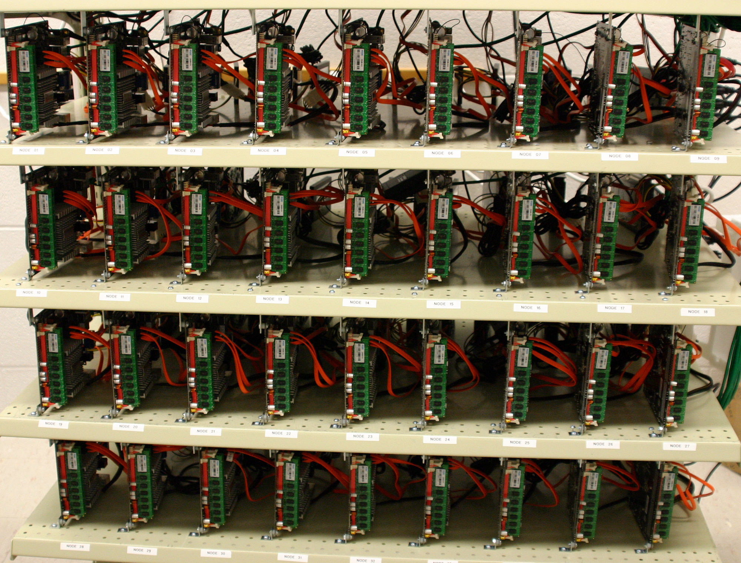
Tomorrow: Power
(and scalability)

