Slide 1
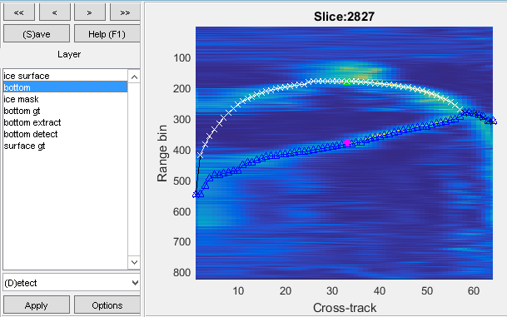
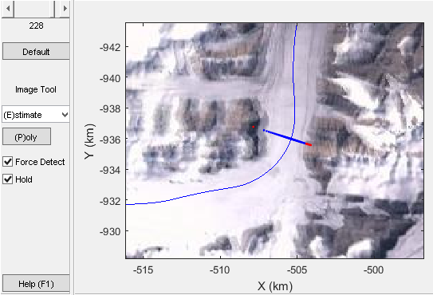
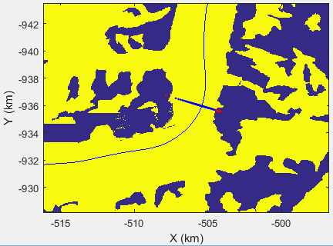
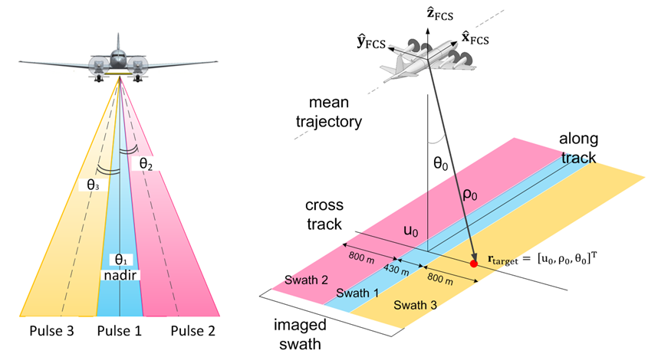
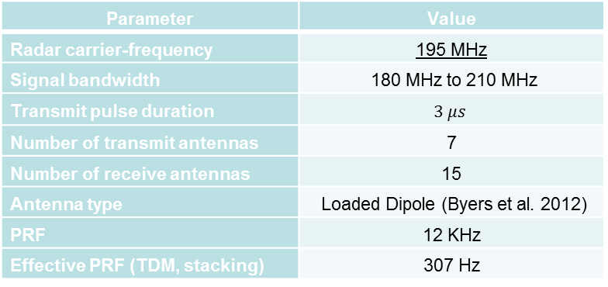
C13C-0846: 3D Imaging and Automated Ice Bottom Tracking of Canadian Arctic Archipelago Ice Sounding Data
John Paden¹ (paden@ku.edu), Mingze Xu², Jordan Sprick¹, Sravya Athinarapu¹, Mohanad Il-Ibadi¹, T. Stumpf¹, David Crandall², David Burgess³, Martin Sharp⁴, Luke Copland⁵, Wesley Van Wychen⁵, Geoffrey Fox², Carl Leuschen¹
1. Center for Remote Sensing of Ice-Sheets, University of Kansas, USA. 2. School of Computing and Informatics, Indiana University, USA.
3. Geological Survey of Canada, Canada. 4. Department of Earth and Atmospheric Sciences, University of Alberta, Canada. 5. Dept. of Geography, Environment and Geomatics, University of Ottawa, Canada.
Abstract
The basal topography of the Canadian Arctic Archipelago ice caps is unknown for a number of the glaciers which drain the ice caps. The basal topography is needed for calculating present sea level contribution using the surface mass balance and discharge method and to understand future sea level contributions using ice flow model studies. During the NASA Operation IceBridge (OIB) 2014 arctic campaign, the Multichannel Coherent Radar Depth Sounder (MCoRDS) used a three transmit beam setting (left beam, nadir beam, right beam) to illuminate a wide swath across the ice glacier in a single pass during three flights over the archipelago. In post processing we have used a combination of 3D imaging methods to produce images for each of the three beams which are then merged to produce a single digitally formed wide swath beam. Because of the high volume of data produced by 3D imaging, manual tracking of the ice bottom is impractical on a large scale. To solve this problem, we propose an automated technique for extracting ice bottom surfaces by viewing the task as an inference problem on a probabilistic graphical model. We first estimate layer boundaries to generate a seed surface, and then incorporate additional sources of evidence, such as ice masks, surface digital elevation models, and feedback from human users, to refine the surface in a discrete energy minimization formulation. We investigate the performance of the imaging and tracking algorithms using flight crossovers since crossing lines should produce consistent maps of the terrain beneath the ice surface and compare manually tracked “ground truth” to the automated tracking algorithms. We found the swath width at the nominal flight altitude of 1000 m to be approximately 3 km. Since many of the glaciers in the archipelago are narrower than this, the radar imaging, in these instances, was able to measure the full glacier cavity in a single pass.
3D Image Processing Steps
Ice sheet bed mapping with airborne synthetic aperture radar (SAR) is similar to side looking radar mapping except that the imaging swath is near or at the surface normal as shown in the “3D Image Processing Steps” figure below. An example target is indicated with a red dot. The target’s along track position, u₀ is resolved with SAR processing. Its range, ρ₀, is resolved with range bandwidth and pulse compression. A cross-track antenna array mounted on the aircraft resolves the angle of arrival θ₀. We seek optimal methods for estimating the angle of arrival since the angular resolution using the same matched filter methods that are used to resolve targets in the other dimensions is usually an order of magnitude or more worse than the resolution in the other dimensions. The direction of arrival estimation method that we use is based on Paden et al. 2010 which describes a Multiple Signal Classification (MUSIC) based algorithm to produce a 3D image of the scene.
Since there are usually errors in the individual antenna patterns and phase centers that make up the cross-track antenna array, we introduced a calibration method to correct for these errors. Using fine resolution surface DEMs from SPOT-5 imagery, we calibrated our algorithms so that the surface in the radar image showed up at the same location as indicated by the SPOT-5 DEM. The image above shows the SPOT-5 DEMs projected into radar coordinates and overlaid on the radar image. There is generally good agreement between the radar images and the SPOT-5 DEM which are indicated by the curve of black ‘x’ markers.
The images above show the left, nadir, and right beams. Each beam best resolves targets in the direction of transmission. For the current ice bottom tracking results, a single synthetic beam was created by fusing these three images into one using a normalized weighting method that emphasized the beam for targets in that beam’s direction of transmission.
Ice Bottom Tracking
We have implemented an automated technique for extracting ice-bottom surfaces by viewing the task as an inference problem on a probabilistic graphical model. We first generate a seed surface subject to a set of constraints which account for both the mismatch between the radar data and the model parameters as well as the smoothness of the estimated surface, formulated as a Markov Random Field. Additional sources of evidence are then incorporated to refine the surface in a discrete energy minimization formulation, using the Sequential Tree Reweighted Message Passing (TRW) algorithm (Koller 2009, Kolmogorov 2006). We used 7 topographical sequences (results for each shown along the bottom of the poster), each with over 3000 radar images which corresponds to about 50km of flight line data. For these images, we also have the air-ice surfaces, which come from digital elevation models produced using photogrammetry applied to electro-optical (EO) satellite images, as ground truth. Since the air-ice surface and the ice-bottom surface usually share the same pattern, we learned the parameters of the template model from the air-ice surfaces in the topographical sequences. We then ran the inference on each of the topographical sequences and measured the accuracy by comparing our estimated surfaces to human-labeled ground truth. But these labels are not always accurate at the pixel-level since the radar images are often noisy and material boundaries are difficult to track precisely by human annotators. To decouple from the ground truth errors, we consider two labels as the same when their difference is within a few pixels. Additional evidence can be easily incorporated into our energy minimization formulation. For instance, actual ground truth data (e.g. ice masks) may be available for some particular slices, and human operators can also provide feedback by marking true surface boundaries for a set of pixels.
After the automated routine is run, we use a 3D image browser that we developed for this problem to quality control the results. The primary browsing windows are shown above. The windows from left to right are: a cross-track view of a single vertical slice from the 3D image, a map view showing the location of this slice, and the ice mask associated with the map view. Using this tool, where necessary, we added additional ground truth for the ice surface and ice bottom and corrected the ice mask. The tool also provided a convenient GUI for rerunning the automated algorithms on subsets of the data with the new and corrected ground truth. This process is iterated until the tracking algorithm had no noticeable tracking errors.
Data Set
NASA OIB flew three flights for the Canadian Space Agency (CSA) to collect 3D glacier imaging data over the Canadian Artic Archipelagos (Ellesmere, Axel Heiberg, and Devon Islands). The data segments from these missions are shown in the table below and in the figure to the right over a Landsat-7 mosaic. Data frame locations with corresponding frame IDs are shown for the ice bottom images shown along the bottom of the poster.
To maximize coverage, MCoRDS (Fernando et al. 2014) was configured to transmit 3 beams. The beams were time multiplexed so that data were recorded from the left beam, then the nadir beam, then the right beam. The tables and plots below show the waveform-beam configuration, radar parameters, and the geometry of the imaged swath using the three beams.
Segment | Mission Name | Frames
20140325_05 | CSA: Axel Heiberg-Eureka/Thule | 2
20140325_06 | CSA: Axel Heiberg-Eureka/Thule | 1
20140325_07 | CSA: Axel Heiberg-Eureka/Thule | 5
20140401_03 | CSA: North Canada Glaciers | 48
20140506_01 | CSA: South Canada Glaciers | 35
Parameter | Value
Radar carrier-frequency | 195 MHz
Signal bandwidth | 180 MHz to 210 MHz
Transmit pulse duration | $$3 μs$$
Number of transmit antennas | 7
Number of receive antennas | 15
Antenna type | Loaded Dipole (Byers et al. 2012)
PRF | 12 KHz
Effective PRF (TDM, stacking) | 307 Hz
Waveform | Look Angle | Attenuation | Weights | Direction
1 | Left | 15 dB | Hanning | 30 deg
2 | Nadir | 20 dB | Hanning | 0 deg
3 | Right | 15 dB | Hanning | -30 deg
References
Kyle J. Byers, A. R. Harish, Sarah A. Seguin, Carlton Leuschen, Fernando Rodriguez-Morales, John Paden, Emily Arnold, and Richard Hale, “A Modified Wideband Dipole Antenna for an Airborne VHF Ice Penetrating Radar”, IEEE Transactions on Instrumentation and Measurement, vol.61, no.5, pp.1435-1444, doi: 10.1109/TIM.2011.2181780, May 2012.
Daphne Koller and Nir Friedman, Probabilistic graphical models: principles and techniques, 2009.
Vladimir Kolmogorov, “Convergent tree-reweighted message passing for energy minimization,” IEEE Transactions on Pattern Analysis and Machine Intelligence, vol. 28, no. 10, pp. 1568–1583, 2006.
J. Paden, T. Akins, D. Dunson, C. Allen. P. Gogineni, (2010) Ice-sheet bed 3-D tomography. Journal of Glaciology, 56(195).
F. Rodriguez-Morales, S. Gogineni, C. Leuschen, John Paden, J. Li, C. Lewis, B. Panzer, D. Gomez-Garcia, A. Patel, K. Byers, R. Crowe, K. Player, R. Hale, E. Arnold, L. Smith, C. Gifford, D. Braaten, and C. Panton, Advanced Multi-Frequency Radar Instrumentation for Polar Research, IEEE T. Geoscience and Remote Sensing, vol. 52, no. 5, May 2014, pp. 2824-2842.
Acknowledgements
The data were collected as a part of NASA Operation IceBridge. NSERC and the Canadian Space Agency provided funding to support data analysis and collection. The radar system and SAR processing software were developed with support from the University of Kansas, NSF grant ANT-0424589, and NASA Operation IceBridge grant NNX16AH54G. The 3D imaging and layer tracking work was supported on NSF DIBBs grant 1443054. We also acknowledge the contributions of many CReSIS faculty, staff, and students who contributed to the radar system development and to NASA aircraft and instrument teams, especially ATM who provided GPS data, for flying and supporting the mission.

