Slide 1
Massive Open Online Course MOOC
Judy Qiu
Indiana University Bloomington

Slide 2
What is a MOOC?
Massive
Open
Large number of students
Anyone can register
Online
Course
Access anywhere,
anytime, any device
Video Lectures, Assignments,
Communication

Slide 3
Why Use a MOOC?
Requires only an internet connection
No physical boundaries
Mostly free
Access to the latest knowledge

Slide 4
Why Create a MOOC?
Share knowledge
Universities are pushing for online education
Improve the real world courses at universities

Slide 5
MOOC Platforms

Slide 6
Google Course Builder
Open Source | Personalizable |Cloud Application

Slide 7
Google Course Builder Tehcnologies

Slide 8
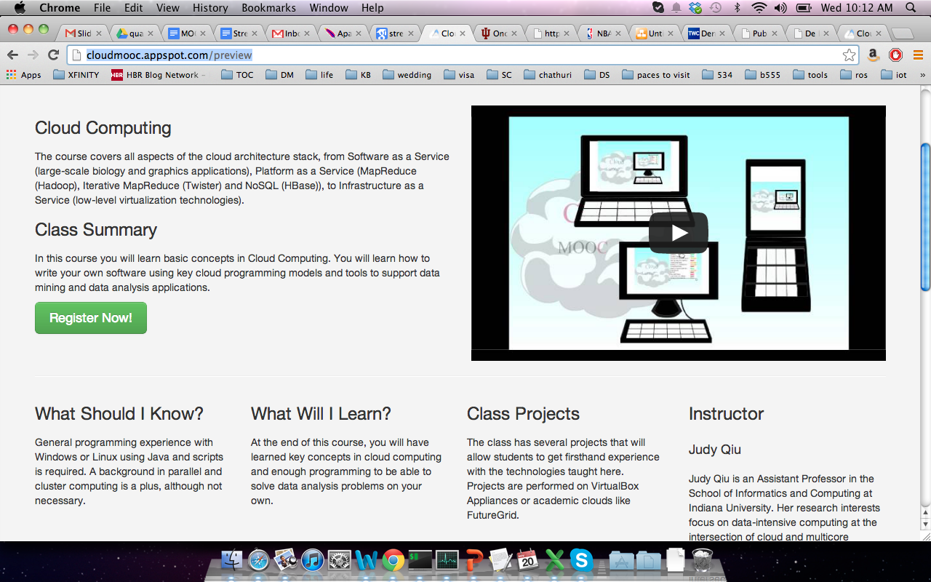
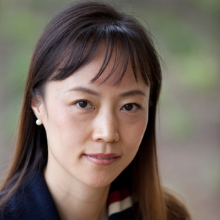
Cloud Computing MOOC

Slide 9
Big Data Applications & Analysis MOOC

Slide 10
Information Visualization MOOC

Slide 11
Challenges
Homework & Assessments
Communication
Motivate students to finish

Slide 12
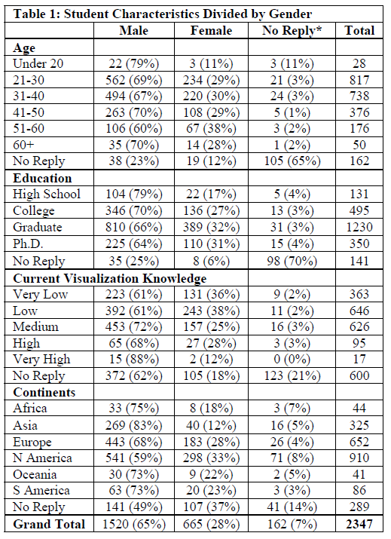
(Courtesy of Katy Börner)

Slide 13
