Slide 1
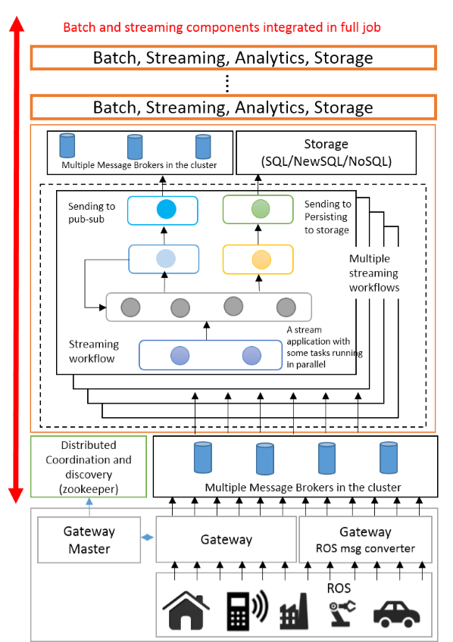
IoTCloud Architecture

Slide 2
Storm Topology
1. Laser Scan
LaserScan Spout
2. Laser Scan
Dispatcher Bolt
11. Ready for Next Laser Scan
3. Send Laser Scan
to all parallel instances
Parallel Instances
of ScanMatch Bolt
7. ScanMatch bolts distribute the maps
among themselves according to assignments
ScanMatcher Bolt
RabbitMQ
8. Send the best particle
4. Current Particle
State without Map
8. Send the best particle
Particle
Queues
Map
Queues
MapBuilding Bolt
Best Particle Send Bolt
Resamplig Bolt
5. New assignments of
particles after resampling
Map Send Bolt
6.Updated particle values
10. Send the new Map
9. Send the best particle

Slide 3
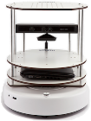
Turtlebot Application
OpenStack VMs
Apache Storm DSPF
Parallel SLAM Topology
Message
Brokers
Connected via network
Gateway running
in Workstation
Gateway Application with ROS Connection
Connect to Robot
via Wireless

Slide 4
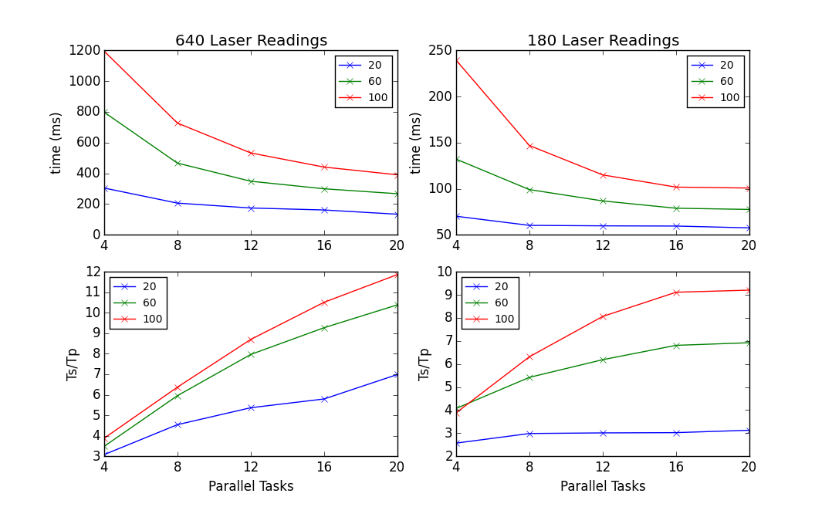
Speedup for 640 and 180 distance measurements per reading
Speedup
Overhead because of different
computation times

Slide 5
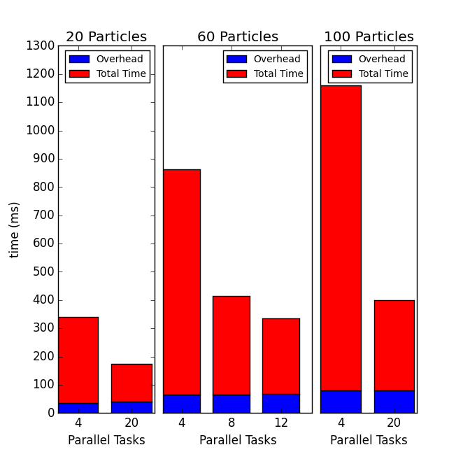
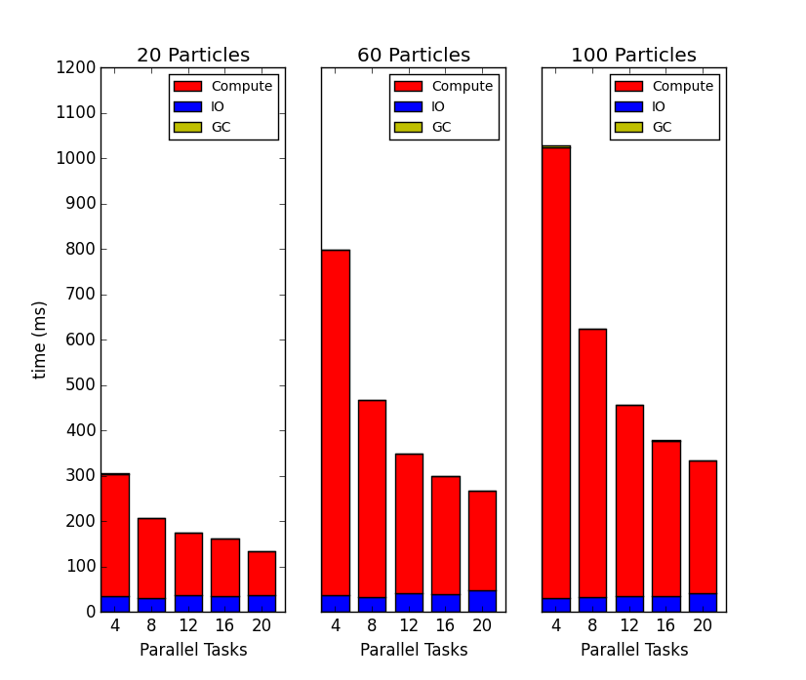
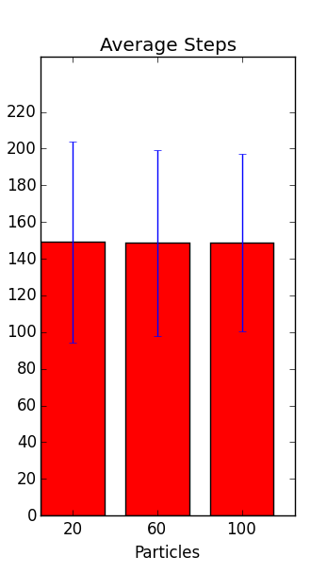
Overhead
IO, GC and Compute Times
Parallel Overhead, because of
time differences in parallel tasks
Average Steps per
one ScanMatching
operation with STD

Slide 6
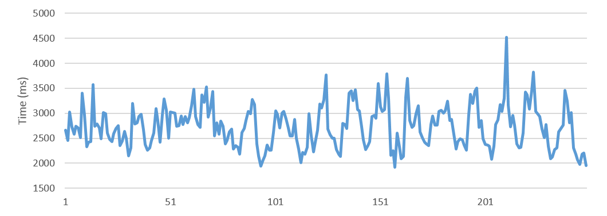
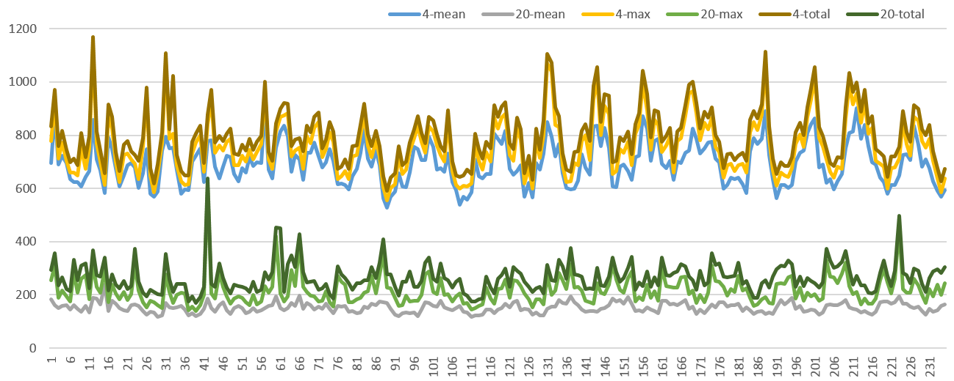
Individual Time variations
Serial Time Variations
Parallel Time Variations,
includes total time,
maximum parallel task time and
mean parallel task time

Slide 7
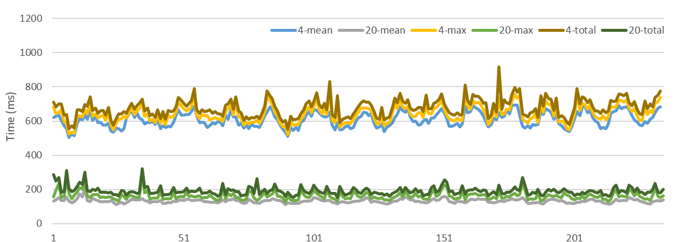
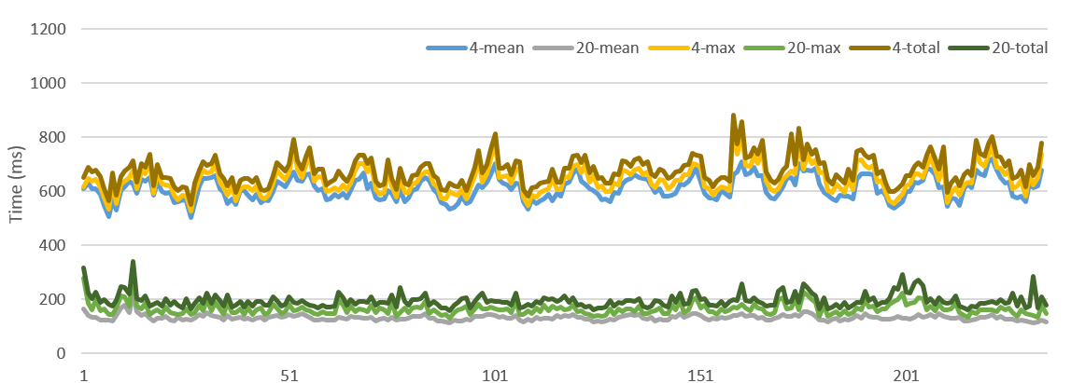
Individual Time variation after Cutoff at 140 steps for two runs

Slide 8
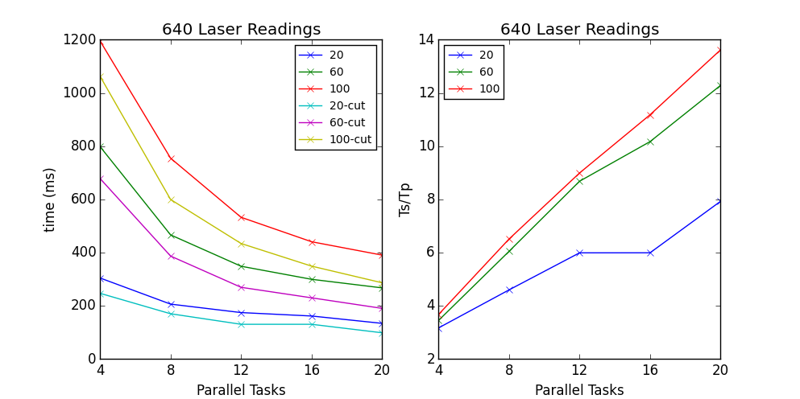
Speedup After Cutoff at 140 steps
No gains from 12 to 16 because
max number of parallel tasks are equal

Slide 9
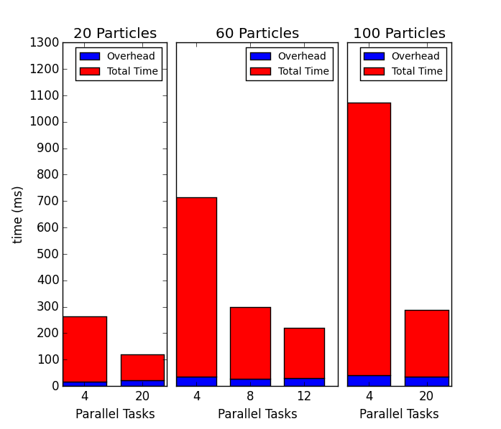
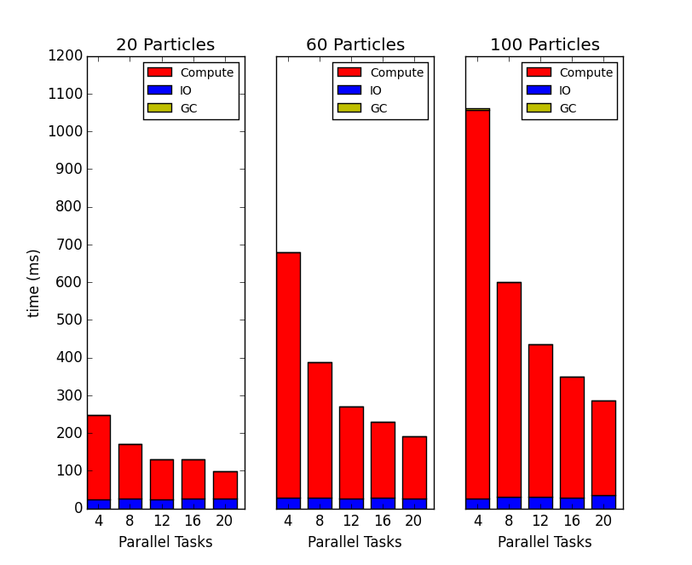
Overhead After Cutoff
Parallel Overhead, because of
time differences in parallel tasks
IO, GC and Compute Times

Slide 10
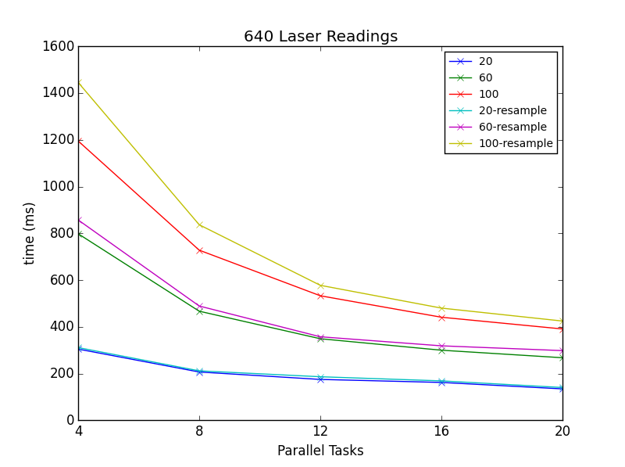
Resampling Overhead

